Slide 1
PRECOS – June 2011
Results obtained with laser pulse heating facility
M.Brykin, E.Pakhomov, M.Sheindlin, A. Vasin
Joint Institute for High Temperatures, Moscow
sheindlin@yandex.ru

Slide 2
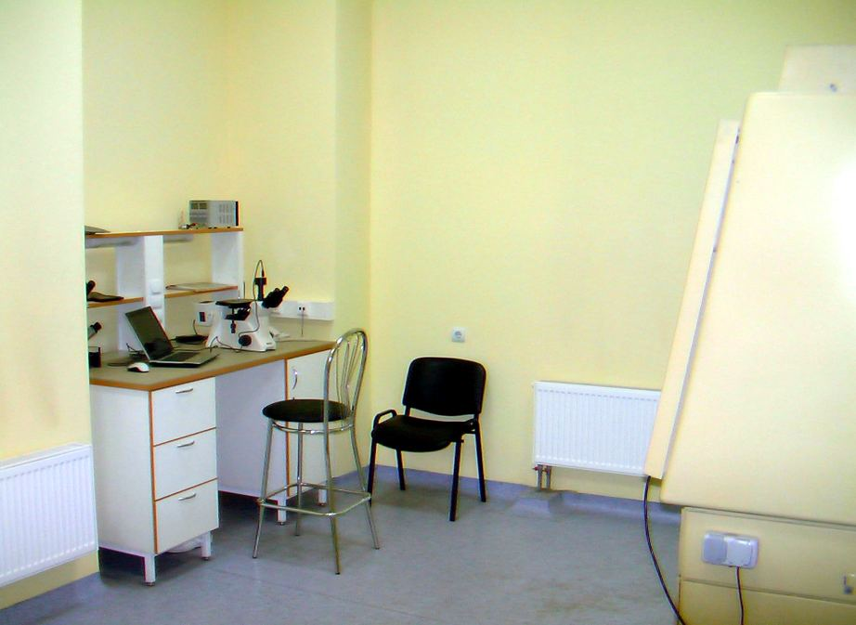
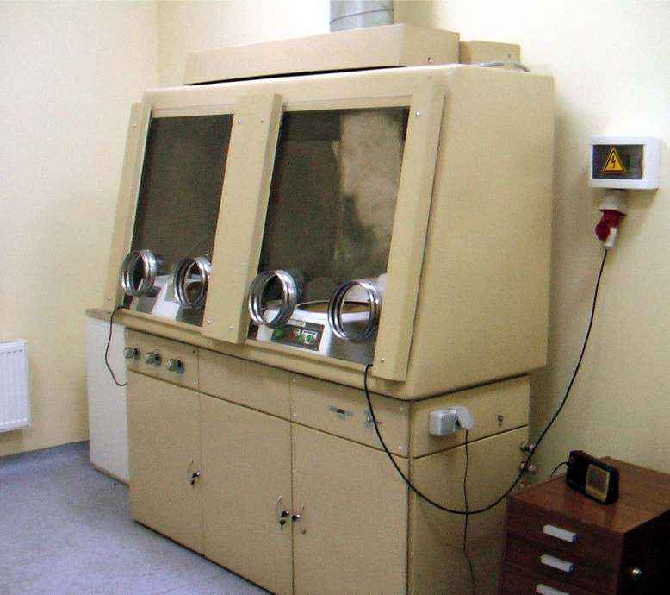
The work done so far for licensing:
1) Definition of main requirements for the laboratory room (contract work is paid by IVTAN)
2) The preliminary choice of suitable laboratory room is done
3) The specification requirements for the special laboratory are issued
4) The necessary agreement of Presidium of the Russian Academy of Sciences is received
5) The proper choice of a room for the special laboratory is officially confirmed by an authorized company (contract work is paid by IVTAN)
6) Training of laboratory personnel (contract work is paid by IVTAN)
7) Medical examination of personnel is completed
8) The project of the special laboratory is executed by an authorized company (contract work is paid by IVTAN)
9) Special additional maintenance work in the laboratory room according to recommendations of the licensing authorities is almost completed. The room is equipped with special power supplies, separate water supply and drain, ventilation with a special filtering. It has a metal door with two locks and alarm system, etc…. The separate room for storage of a radioactive waste is equipped
10) Necessary means for the individual control of contamination are leased
11) An authorized company having the right to perform an expertise of the project is defined
12) An expertise of the project of the lab is concluded
13) Decision about suitability of the laboratory to perform work with natural uranium is received
14) Remaining set of technical documentation is obtained
15) Certificate of compliance to the requirements for alfa-labs is received from Hygienic service authorities
16) The overall document package is sent for expertise on the request of Russian licensing authorities.
Laboratory Room Dedicated for Handling of Natural Uranium Samples

Slide 3
ZrO₂-FeO system
Main tasks:
Testing of applicability of the mixed oxide samples prepared by blending followed just by pressing without any heat treatment
Definition of number of the laser-melting cycles for complete homogenization of initially inhomogeneous low density samples
Slight modification of the setup for experiments with low density samples
Prepared samples:
Cylindrical samples (dia 12x3 mm) of various compositions are prepared at IVTAN by blending followed by pressing. The samples have low density (ca. 70% of the theoretical density). The latter means that test samples have to be prepared by the self-crucible melting using several consecutive laser shots;
Samples cut from ingots formed in course of CORD-10 and CORD-15 tests. The samples are very dense and even the first laser shot can be informative. However the further control of the composition is required.

Slide 4
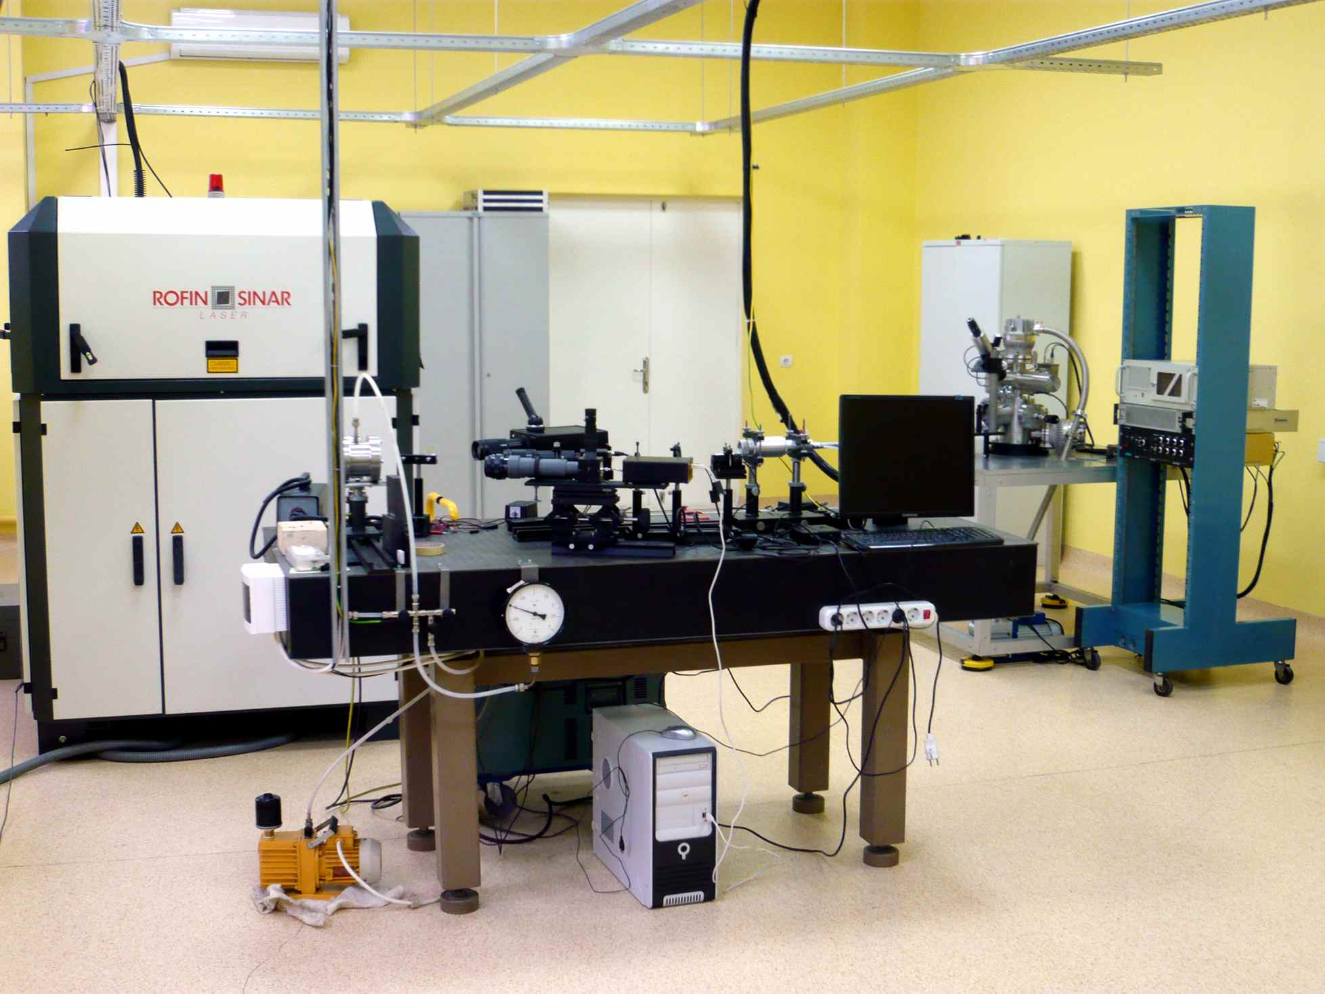
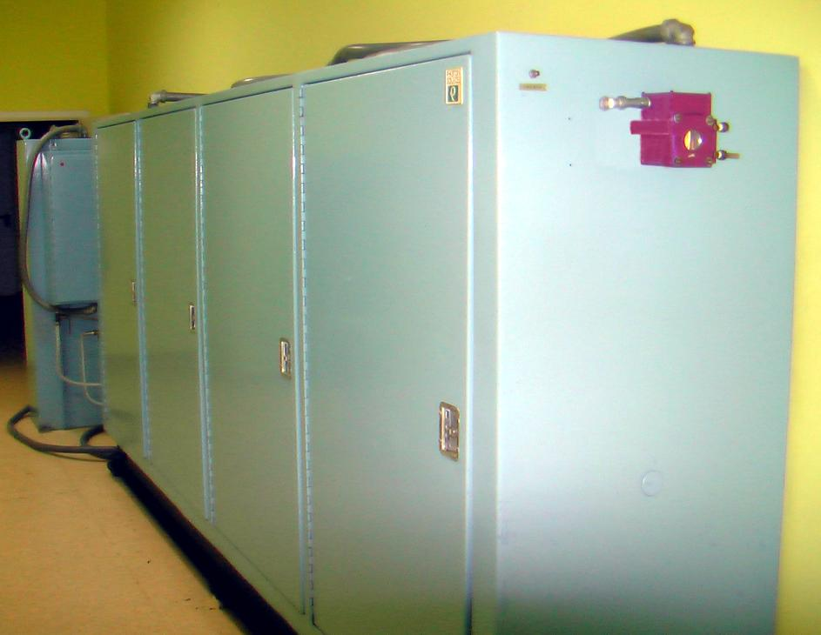
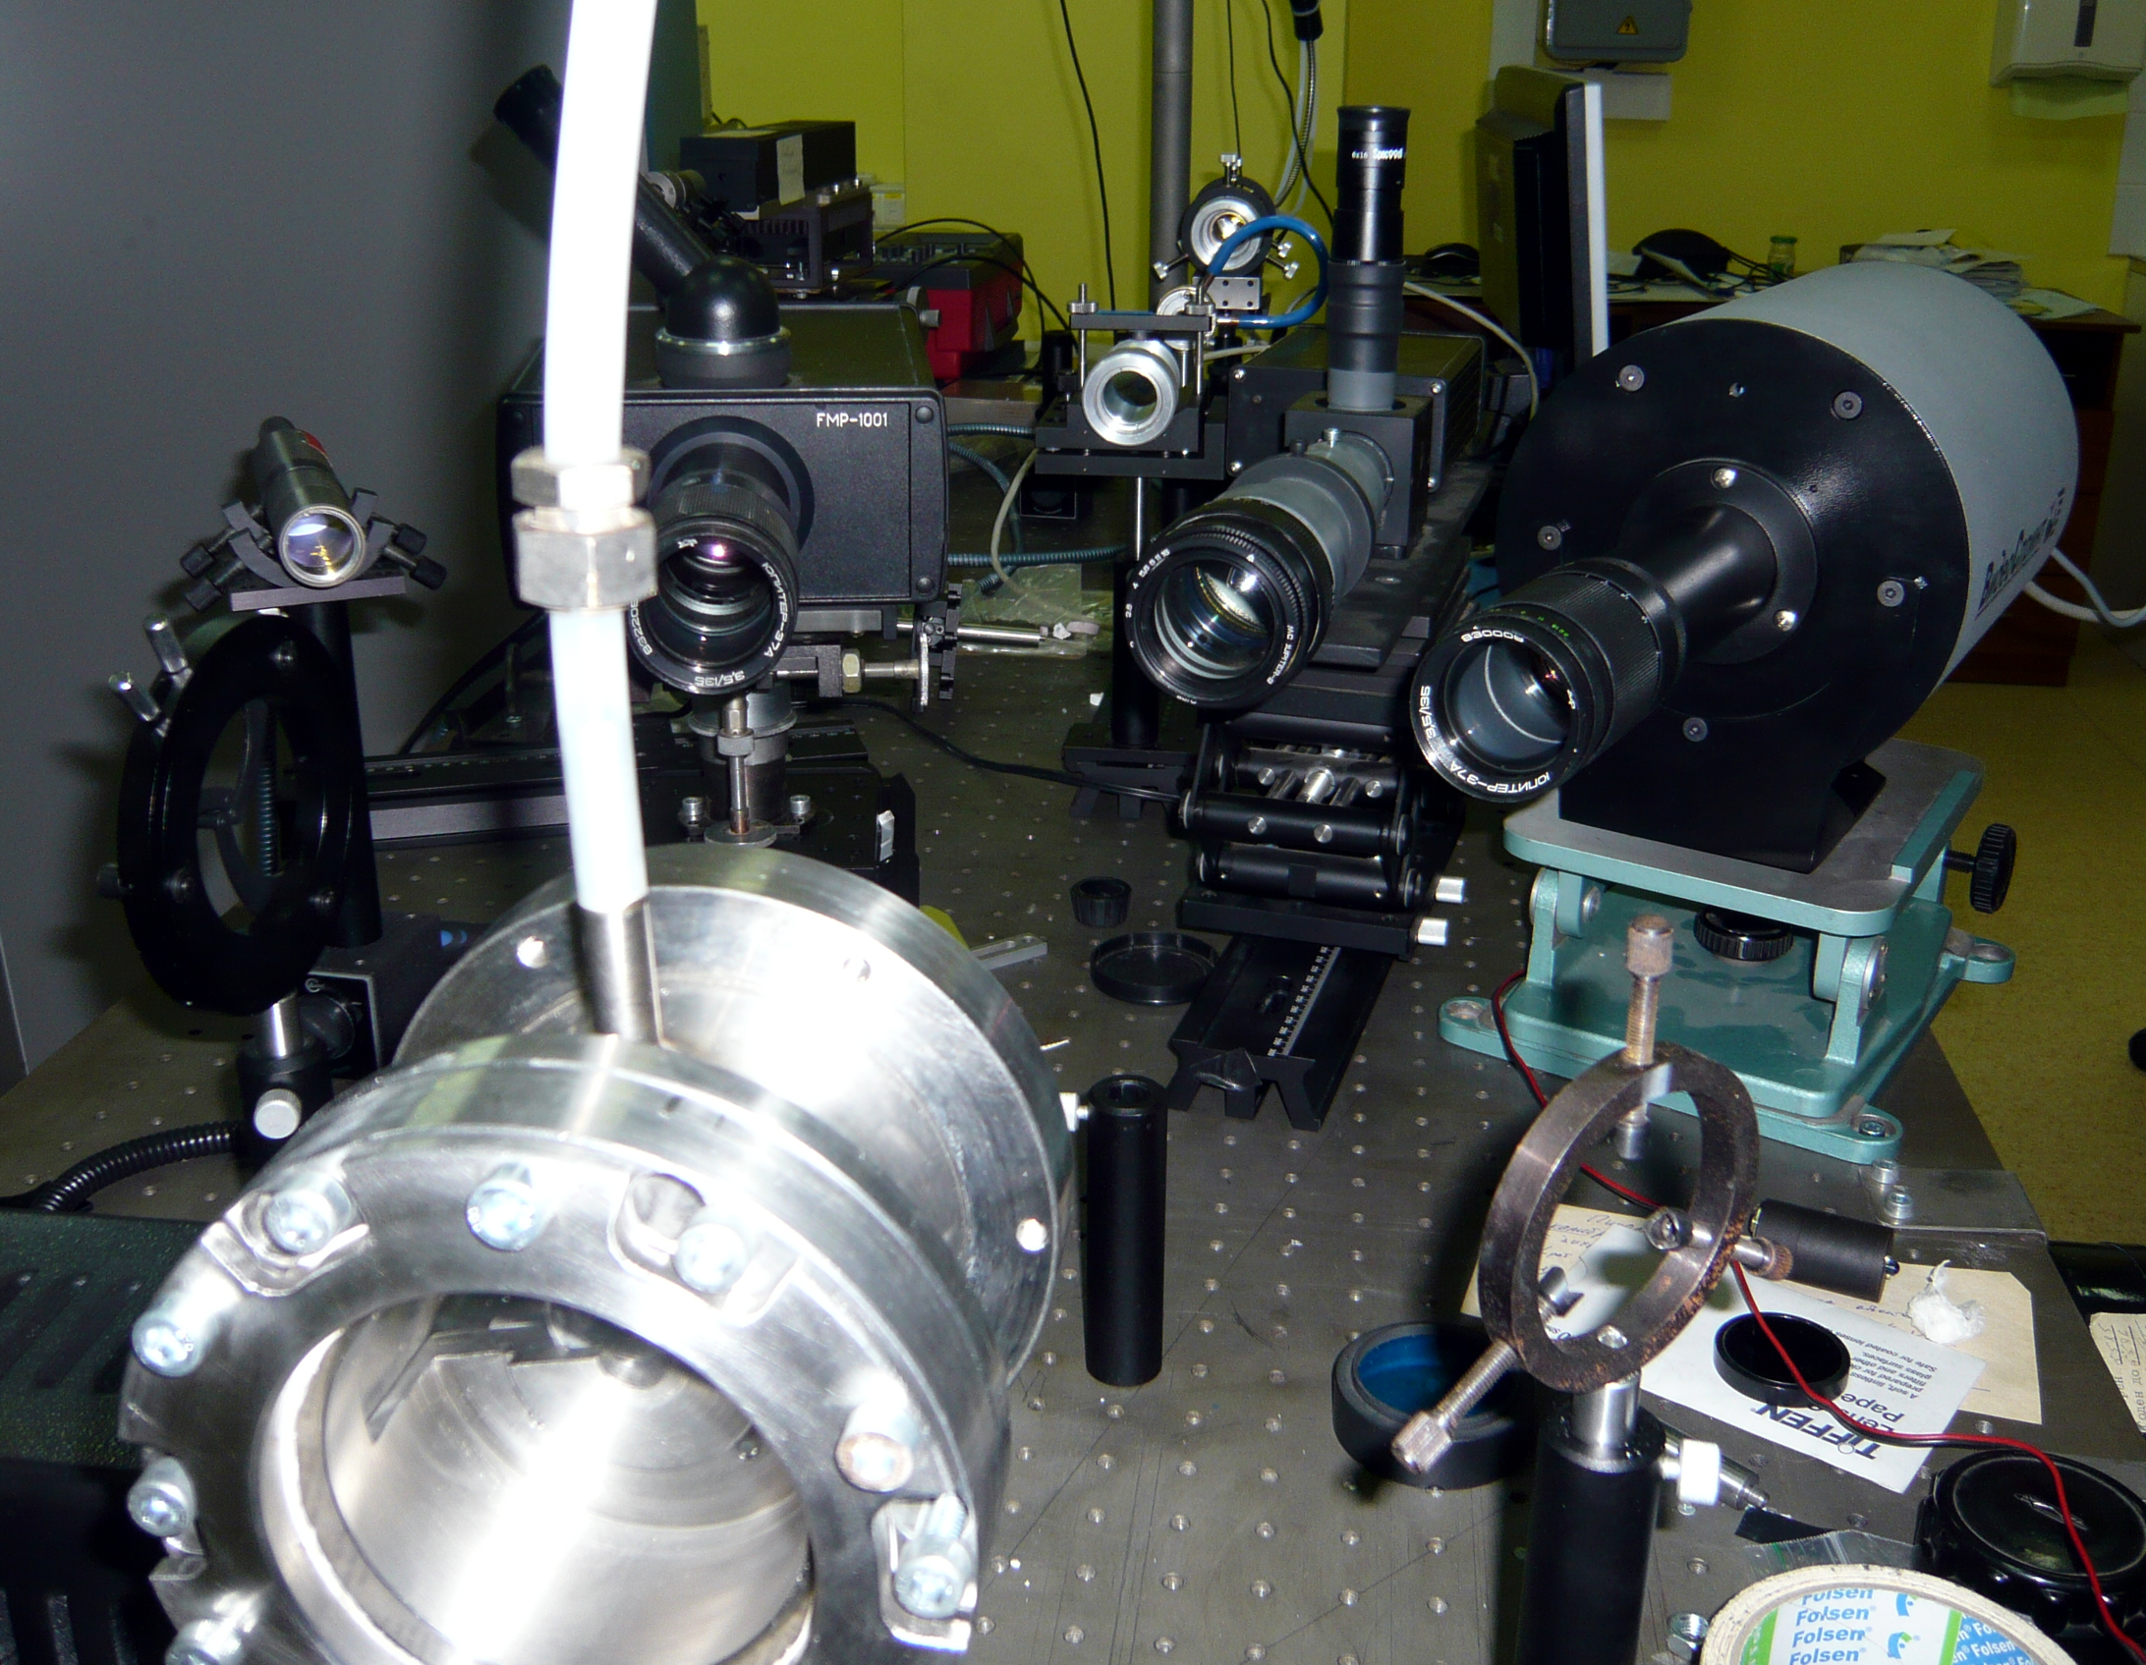
Present View of the Experimental Set-Up
Laser power regulation according to arbitrary function (time response of ca 1 ms)
Multichannel pyrometer, 1000 sp/s, wavelength range 450-900 nm
2 channel pyrometer, response time: 10 us
High-speed CMOS-camera: 1000 frames/s, max. resolution 1000x1000 pix.
Power CO₂-laser in the laboratory

Slide 5
Schematic of the Set-Up
Modification of laser-heating unit for low power experiments

Slide 6
Main problems with ZrO₂-FeO system:
Large difference between the melting temperatures of ZrO₂ and FeO
Very high vapor pressure of FeO

Slide 7
ZrO₂-FeO System
Verification of the laser-heating technique on relatively well studied binary system
Testing of applicability of the mixed oxide samples prepared by blending followed just by pressing without any heat treatment
Definition of number of the laser-melting cycles for complete homogenization of initially inhomogeneous low density samples
Example of the thermogram on IVTAN samples

Slide 8
Laser-melting of CORD-15 sample
Only the first shot is successful
Eutectic point is clearly seen both on ascending and descending flanks of the thermogram
Both variation of the reflection signal and the thermogram are used for identification of the solidus and liquidus points

Slide 9
Laser-melting of CORD-10 sample
One can see reproducibility of eutectic temperature and suggested liquids temperature. Their positions are independent on laser power density and intense vaporisation (in case of shot 3)

Slide 10
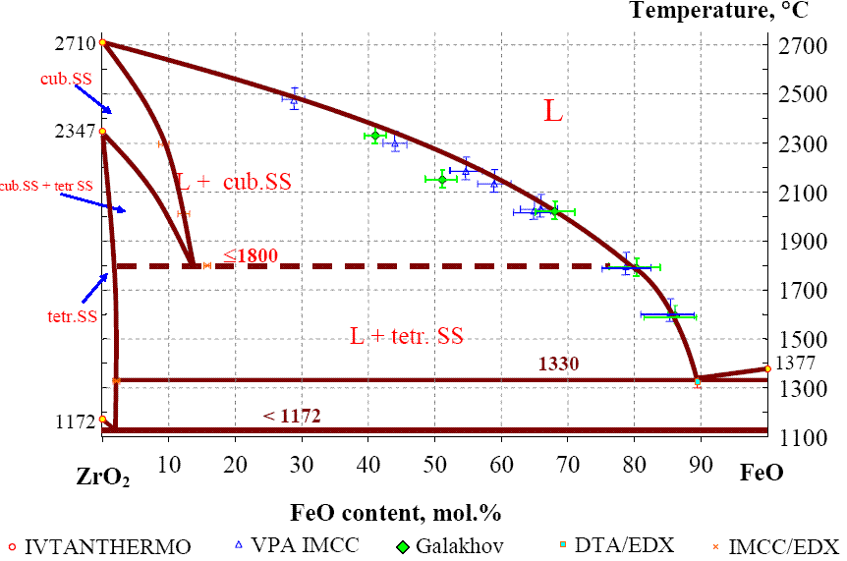
ZrO₂-FeO System: Laser-Heating Results
?
- IVTAN (2010), laser-heating
- IVTAN (2010), laser-heating
-March 2011
-May 2011, CORD samples

Slide 11
Proposed tasks for the project extension period
Measurements on suboxidized Zr-Fe-O system to verify the existence and parameters of immiscibility cupola
Further experiments with ZrO₂-FeO system on IVTAN samples and CORD samples. Possible use of the IVTAN high pressure setup can be considered
Study of possible immiscibility in Zr-U-O system on samples prepared at NPO “Lutch” (waiting for license)
Any other suggestions are welcome.

Slide 12
Conclusion
The licensing problem is still topical however all the documents are accepted by “Gosatomnadzor” and the bureaucratic process there is expected to be finalized at the end of the month
The great number of laser-melting experiments are performed on ZrO2 –FeO system. It is observed that liqudus values for both IVTAN and CORD samples are remarkably lower than previously obtained by conventional methods (Galakhov microfurnace, etc).

