Slide 1



Problems and perspectives of SEM/EDX, XRF and chemical analyses of corium samples
A.P. Alexandrov Research Institute of Technology
International Science and Technology Center
SPbSIT
(TU)
ETU
Saint-Petersburg
Presented by S. A.Vitol
3rd PRECOS Project Meeting
June 2, 2010, St. Petersburg

Slide 2
Contents
Analysis methods
Samples preparation for XRF and chemical analysis
X-ray fluorescence analysis (XRF)
Chemical analysis
SEM/EDX and Chemical analyses: comparison of results.
UO₂-SiO₂ system
SEM/EDX, XRF and Chemical analyses: comparison of
results. UO₂-CaO system
Conclusions

Slide 3
Elemental Analysis methods
Elemental analysis
X-ray fluorescence analysis (XRF)
Chemical analysis (ChА)
Energy-dispersive X-ray spectrometry (EDX)
Objectives of the presentation
– compare the results of the UO₂-SiO₂ and UO₂-CaO systems
analysis applying alternative methods
– elucidate the reasons of differences and select the most
representative results
– highlight the perspectives of analytical methods
development

Slide 4
Samples preparation for XRF and chemical analyses
Operations in samples preparation for both XRF and Chemical analyses:
Preliminary crushing of corium samples down to particles smaller than 0.5 mm in the Abikh mortar
quartering for obtaining an average sample
the further grinding of the average sample down into particles with a size less than 50 µm on a vibrating mill in protective atmosphere
2 ways of samples preparation for chemical analysis
By diluting a sample weight in a mixture of concentrated orthophosphoric and sulfuric acids in the 1:2 ratio, in flowing argon
By mixing a 0.1 g sample in the platinum crucible with 4 – 5 g of flux composed of sodium carbonate, borax and potassium carbonate, fusing the mixture in the muffle furnace at 900±25 °С within 20–25 min., and dissolving the crucible with flux in hot hydrochloric acid
Selection of a technique of sample dissolution depends on properties of a system, e.g., the incomplete dissolution of the UO₂ – SiO₂ system samples in acids requires flux application

Slide 5
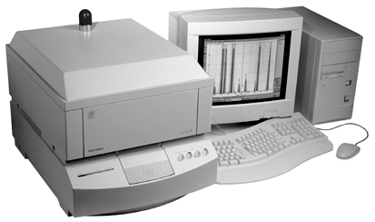
X-ray fluorescence analysis (XRF):
X-ray spectrometer SPECTROSCAN MAX-GV

Slide 6
X-ray fluorescence analysis (2):
Software of SPECTROSCAN MAX–GV spectrometers
QUALITATIVE ANALYSIS
Determination of element inventories in the specimens using their characteristic lines
QUANTITAVE ANALYSIS
Ci – element mass fraction
Fj - is chosen from: Ij, Ii×Ij, Ii ⁄ Ij series
Ii, Ij - intensities of measured lines
aij - empirical coefficients
Kij – theoretical coefficients of influence
- mass fraction of elements in a standard sample
METHOD OF FUNDAMENTAL PARAMETERS
Ci х F(C,C_{ue},P) = Ai х Ii,
C –evaluated concentrations
C_{ue} - concentrations of undetermined elements
P – function of fundamental parameters
Ii - measured intensity
Ai - instrument factor

Slide 7
X-ray fluorescence analysis (3): Problems
Main problems that reduce the element measurement accuracy:
- transient composition of samples due to
oxygen (aliovalent oxides, metal-oxidic systems)
- different matrices, in which elements are determined
(light, heavy, ceramics, glass, metal-like)
- absence of metrologically attested standards for
corium systems

Slide 8
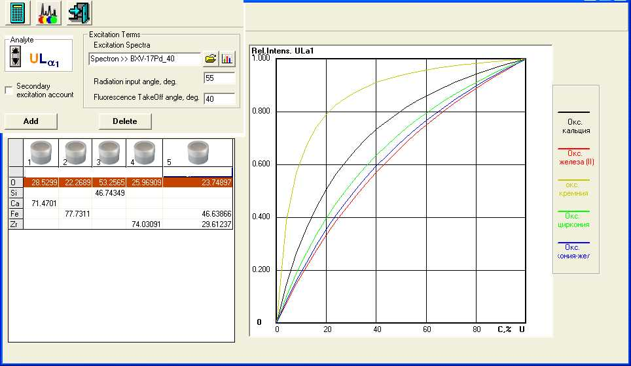
X-ray fluorescence analysis (4):
Uranium calibration lines for different fillers
CaO
FeO
CaO
FeO
SiO₂
ZrO₂
ZrO₂-FeO
SiO₂
ZrO₂
ZrO₂-FeO

Slide 9
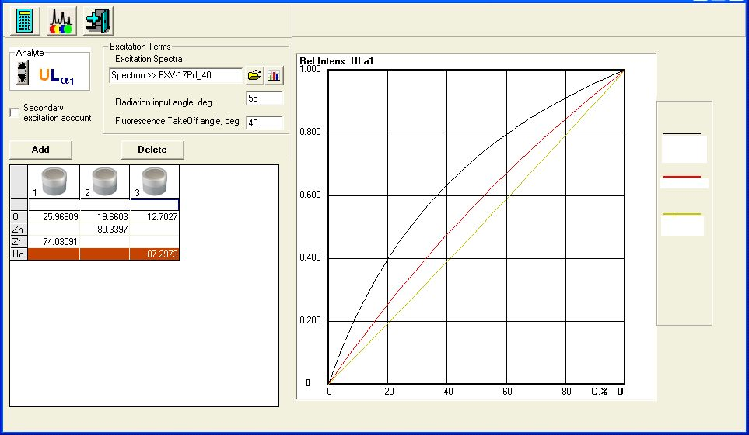
X-ray fluorescence analysis (5):
Improvement of uranium calibration characteristics by its dilution with zinc oxide and holmium oxide
ZrO₂
ZnO
ZrO₂
ZnO
Ho₂O₃
Ho₂O₃

Slide 10
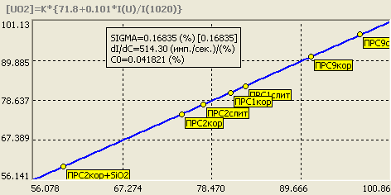
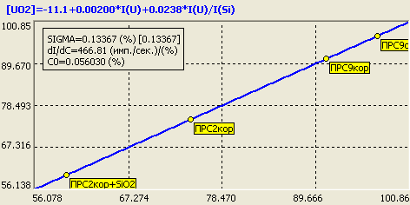
X-ray fluorescence analysis (6):
Calibration diagrams for the UO₂-SiO₂ system
The method of theoretical coefficients The method of multiple regression
The diagrams have been plotted using the calibration samples prepared by diluting a mixture of molten uranium and silicon oxides with zinc oxide (ZnO) in the ratio of 1:1.5

Slide 11
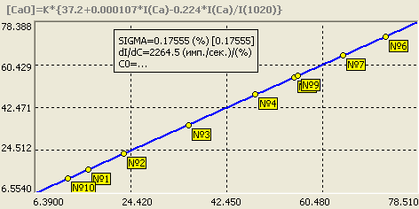
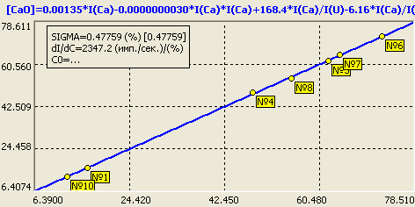
X-ray fluorescence analysis (7):
Calibration diagrams for the UO₂-СаO system
The method of theoretical coefficients The method of multiple regression
The diagrams were plotted using fused specimens with the composition determined by chemical analysis

Slide 12
Chemical analysis of dissolved samples
Spectrophotometric analysis
SF 2000 spectrophotometer characteristics:
Wavelength range 200 – 1100 nm
Wavelengths accuracy ±1.6 nm
Range of measured spectral
transmittance, % 1 – 100
Limit of admissible absolute
instrumental error, % 1.0
Determination of iron oxides (Fe²⁺, Fe³⁺)
Determination of uranium oxides (U⁴⁺, U⁶⁺)
Measurement error is less than 5%, relative

Slide 13
Chemical analysis:
Problems and Solutions
Solutions to some problems
Techniques of dissolving samples in a mixture of concentrated acids and preparing for the analysis by fusing with flux have been worked out
A technique of SiO₂ determination has been worked out. It is based on the interaction of silicic acid with ammonium molybdate
A standard technique of samples preparation for XRF and chemical analysis has been worked out. It envisages grinding of the quartered average samples on the vibtrating mill into particles sized below 50 µm
Advantages of chemical analysis
No influence of the light or heavy matrix (as in XRF); a possibility of determining the ionic form of an element (e.g., U^{+4,6}, Fe^{+2,3})
Problems
Corium samples are hard to dissolve in even in strong acids.
The multielement analysis is difficult or impossible for some elements because of their mutual influence.
High labour intensity per each element.

Slide 14
Chemical analysis:
UO₂-SiO₂ system
Initially, samples for analysis were prepared by dissolving the powdered sample in a mixture of acids, however, an incomplete dissolution required application of a technique that was more appropriate for the system in question, that is, fusing with a flux composed of sodium carbonate, water-free borax and potassium carbonate in the ratio of 1:1:1
Determination of SiO₂ by spectrophotometry based on measuring intensity of the colour of the reduced silicon-molybdenum complex. The error is no higher than 5% rel. %.
Determination of UO₂ by spectrophotometry based on measuring intensity of the colour of a compound of the 4-valent uranium and arsenazo III in the medium of 4 N HCl. The error is no higher than 5% rel. %.
Correctness of the analysis is checked by composing the elemental mass balance based on the results of analysis of all the collected products from the performed test, and by comparing these results with those obtained by other methods
The XRF analysis is at the stage of working out a technique of measured samples dilution with zinc oxide

Slide 15
SEM/EDX and Chemical analysis:
comparison of results
The results of UO₂ SEM/EDX analysis in PRS1-3 tests are close to those of
chemical analysis. The results of PRS9 test analyses differ significantly
The results of SiO₂ determination differ greatly (up to 50 rel. %)

Slide 16
Chemical analysis: correctness control in PRS9 test
Debalance for UO₂ is below 0.6 %

Slide 17
SEM/EDX and Chemical analysis:
comparison of results. PRS9 test
After templates repolishing, the results of UO₂ SEM/EDX analysis
corresponded to those of chemical analysis
The results of SiO₂ determination differ greatly (up to 33 rel. %)

Slide 18
XRF and Chemical analysis:
comparicon of results. UO₂-CaO system
Only U can be determined by chemical analysis, CaO is calculated from the residue
The deviation of results of UO₂ determination is within the limits of the analysis
method error. At low contents, the relative error in CaO determination reaches
20 rel. %

Slide 19
SEM/EDX, XRF and Chemical analysis:
comparison of results. UO₂-CaO system
Deviations in the results of UO₂ determination by XRF and Chemical analysis is
minimal and falls within the limits of the analysis method error.
The results of UO₂ determination by chemical analysis and SEM/EDX differ
significantly (up to 20%)

Slide 20
Conclusions
The application of chemical analysis allows a sufficiently precise determination of the elemental and cationic composition of corium samples. However, there exist limitations concerning the number of determined elements and analysis duration
When constructing the liquidus line in the UO₂-SiO₂ phase diagram, the ChA data were used as the most reliable ones. The SEM/EDX data from the tests in the Galakhov microfurnace were used for plotting tie-lines
When constructing the UO₂-СаO phase diagram, both the XRF, ChA and SEM/EDX data were used
A criterion for checking correctness of the XRF and ChA results has been chosen in the form of material balance of all the fused products
The use of the theoretical corrections method as an alternative to the method of multiple regressions when composing calibration equations in the samples quantitative analysis makes it possible to simplify equations and reduce errors
There is no alternative to SEM/EDX as a method for analyzing phases microstructure and composition, and for determining the limits of components solubility
Accuracy of different methods depends on the quality of samples preparation, it is especially true for the SEM/EDX analysis

