Slide 1
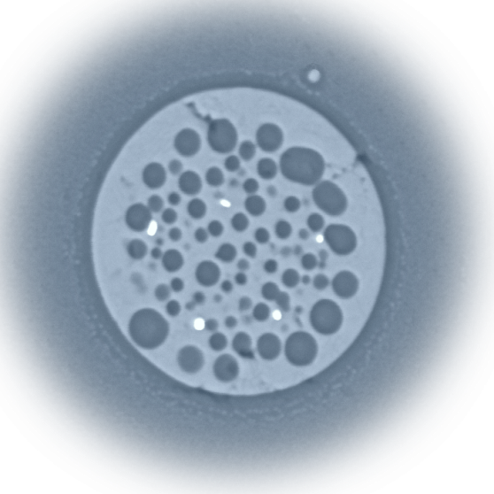

New results in the SiO₂-FeO_{x} system
A.P. Alexandrov
Research Institute of Technology
ISTC PRECOS
Project #3813
Presented by Svetlana Kirillova
4rd PRECOS Meeting
ETU
Saint-Petersburg

Slide 2
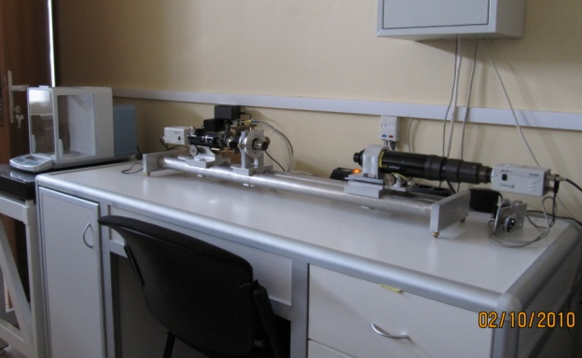
Research objectives
  Miscibility gap boundaries and eutectic determination
Experimental technique
  High temperature microscope
  (annealing, melting, quenching)
2

Slide 3
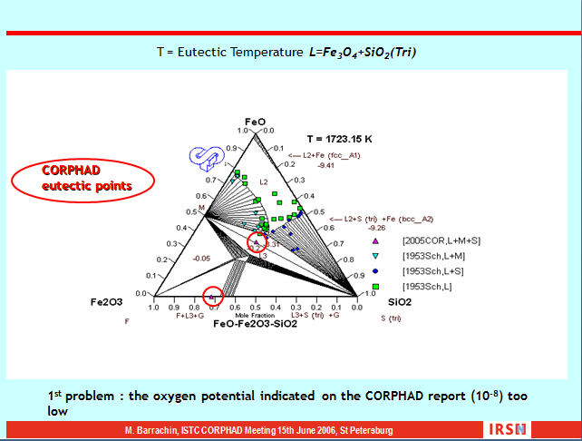
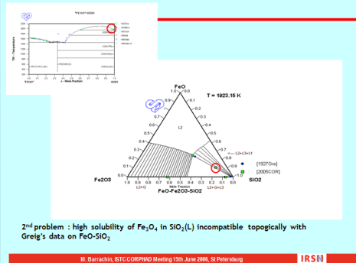
FeO_{x}-SiO₂ system results problems
T, °С
1800
In Air
L
SiO₂ + L
1723
1700
Fe₃O₄ + L
SiO₂
1600
L₁+L₂
1535
1500
SiO₂ +L
1473
20
80
L₁+L₂
Fe₃O₄ + SiO₂
1388
1400
Fe₂O₃ + SiO₂
40
60
FeO_{x} 20 40 60 80 SiO₂
mol.%
Crystob.
Mezentseva L.P. et al (2006)
60
40
2 FeO⋅SiO₂
F
1300
80
1400
20
M
1500
H
Iron
W
FeO
20
40
60
80
FeO_{1.5}
mol. %
FeO⋅Fe₂O₃
Mark`s questions
Muan A. (1955)
3

Slide 4
Initial composition
 | By synthesis | By analysis (EDX data)
SiO₂ content, mol. % | 60.0 | 67.1
T, °С
1800
In Air
L
1723
1700
SiO₂ + L
Fe₃O₄ + L
1600
L₁+L₂
1535
1500
SiO₂ +L
1473
1400
Fe₃O₄ + SiO₂
1388
Fe₂O₃ + SiO₂
FeO_{x} 20 40 60 80 SiO₂
mol.%
4

Slide 5
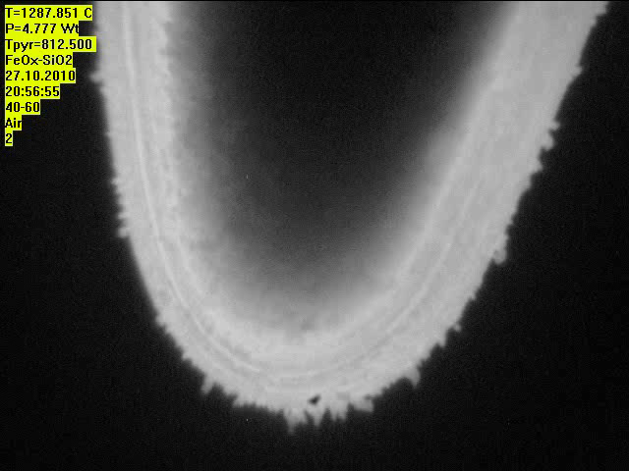
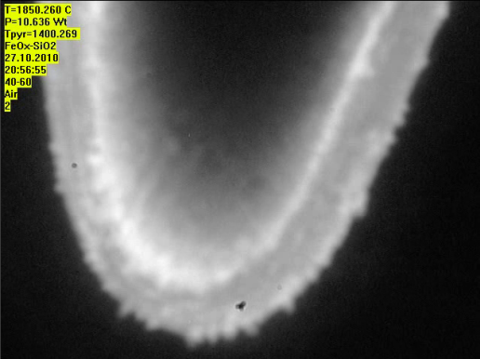
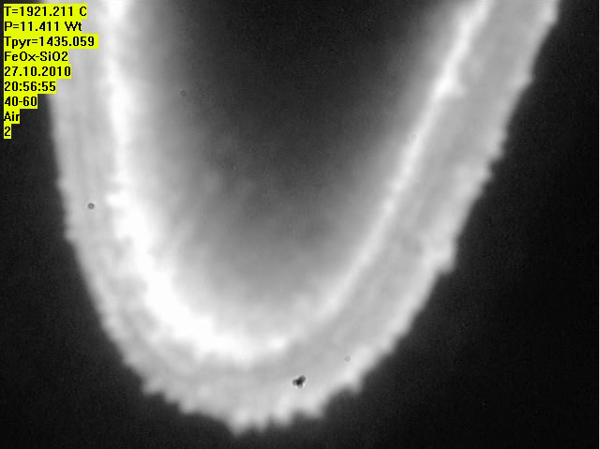
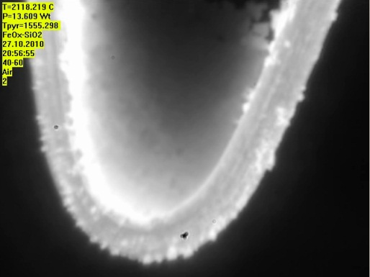
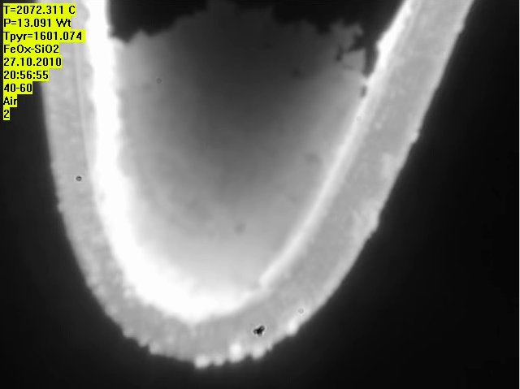
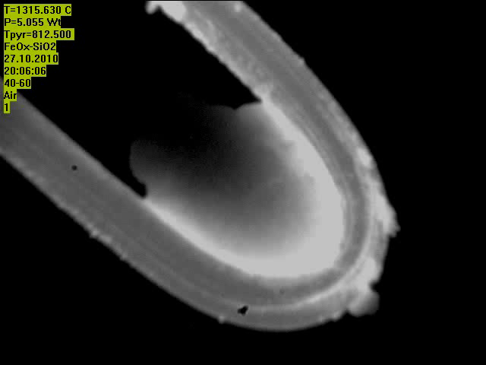
HTM investigations
1400 °С
1435 °С – start of sample motion
1550 °С – start of sample melting
1600 °С – begin of intensive melting
5

Slide 6
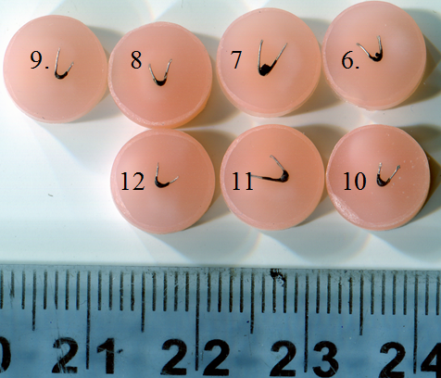
Test matrix
Peculiarities: 10 °C/min. exposure, quenching
Test | T, °C | Exp. time, min | Note
1 | 2105 | 5 | Annealing
 | 2163 | - | Quenching
2 | 1530 | 5 | Annealing
 | 1604 | - | Quenching
3 | 1600 | 5 | Annealing
 | 1603 | - | Quenching
4 | 1586 | - | Quenching
5 | - | - | Uncontrolled overheating
6 | 1650 | 5 | Annealing
 | 1692 | - | Quenching
7 | 1700 | 5 | Annealing
 | 1750 | - | Quenching
Test | T, °C | Exp. time, min | Note
8 | 1800 | 5 | Annealing
 | 1868 | - | Quenching
9 | 1900 | 5 | Annealing
 | 1878 | - | Quenching
10 | 1950 | 5 | Annealing
 | 1924 | - | Quenching
11 | 1888 | - | Quenching
12 | 2000 | 5 | Annealing
 | 2000 | - | Quenching
6

Slide 7
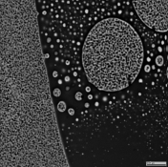
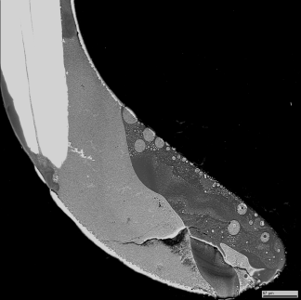
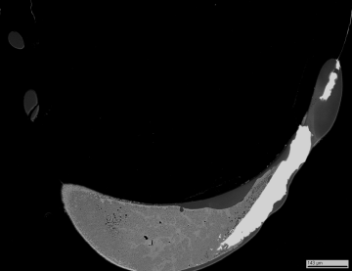
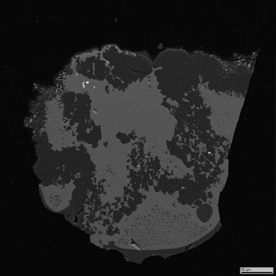
Preliminary results
T, °С
2000
1900
?
?
1800
L₁+L₂
L
1700
SiO₂ + L
1650
Fe₃O₄ + L
1600
?
SiO₂ +Ж
1550
1500
Fe₃O₄ + SiO₂
1435
1400
Fe₂O₃ + SiO₂
FeO_{x} 20 40 60 80 SiO₂
mol.%
7

Slide 8
Conclusions
The miscibility gap in the FeO_{x}-SiO₂ system was observed
Monotectic and eutectic temperatures is outlined
Tie lines was estimated
Twelve experiments have been made
There is very many differences with previous works
A research strategy modifications and step by step calculation adjustment is needed
8

