Slide 1
FSUE SRI SIA “LUCH”
IBRAE RAS
OKB “Gidropress”
Fuel assembly tests under severe accident conditions
(Project status # 3194 )
Podolsk, Russia, September 15, 2005

Slide 2
Objective:
Investigation of behaviour of WWER-1000 fuel assembly simulators, completed with standard structural materials (fuel rod claddings and spacing grids of alloy Zr+1%Nb, fuel pellets of uranium dioxide), under the simulated conditions of severe accident including the Phase of low-rate cooling (quench) with top flooding and high-rate cooling (quench) with simultaneous top and bottom flooding.
Implementation:
FSUE SRI SIA “LUCH” – assembling the FA simulators and the system of top and bottom flooding, preparing and performing the tests.
IBRAE RAS – calculational analysis of the tests.
OKB “Gidropress” – choosing and justifying the test scenario, calculational analysis.

Slide 3
Task 1 ( I – IV quarters)
Preparing and performing the 1-st test at the test bench PARAMETER under simulated conditions of severe accident including the Phase of top low-rate flooding the model assembly.
Main tasks of the 1-st stage (1 quarter)
Choosing and justifying the 1-st test scenario.
Development of the main tasks of the 1-st test.
Completing the FA simulator and preparing the process systems of the test bench for performing the 1-st test.

Slide 4
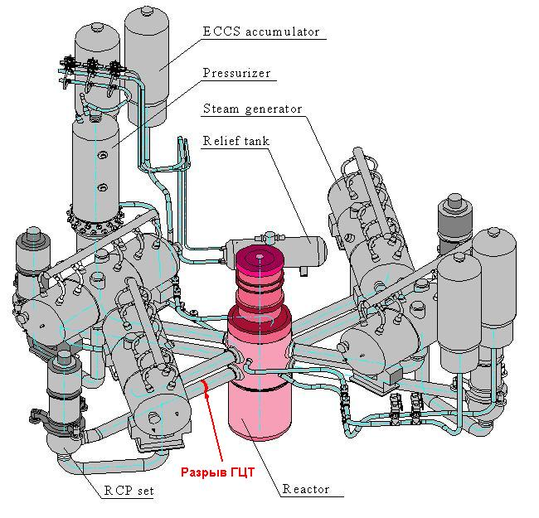
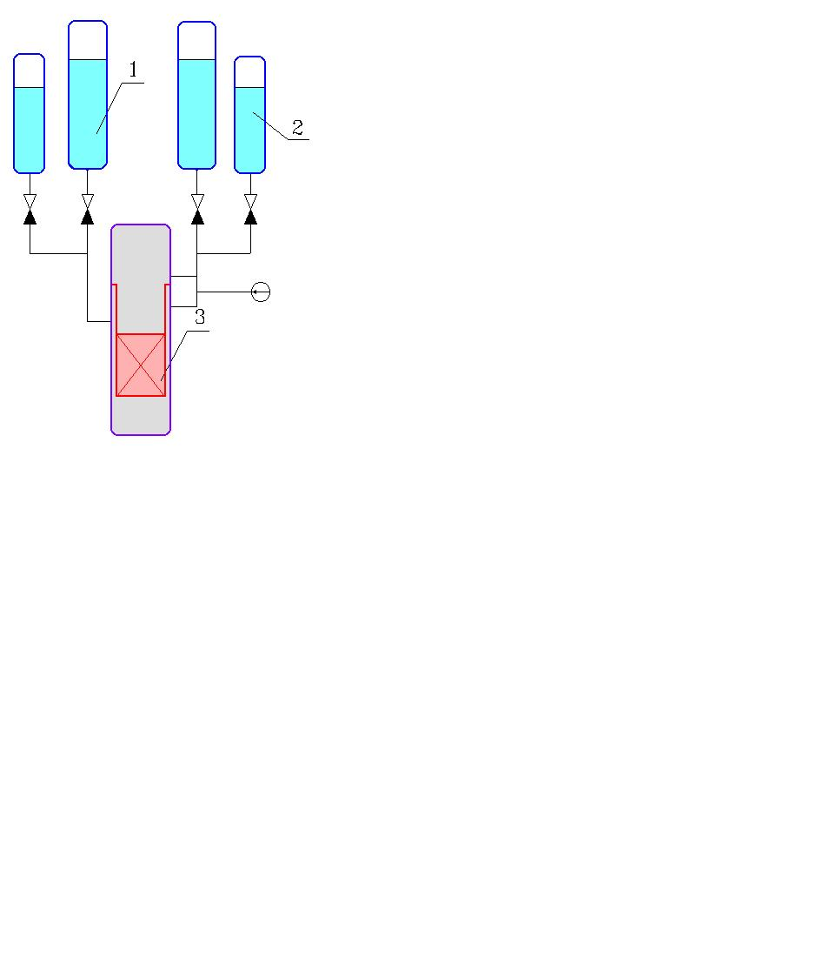
1. Justification of the test scenario
1.1. WWER-1000 ECCS
WWER-1000 (outline)
Scheme of implementation of
simultaneous top and bottom flooding
the core
1, 2 – ECCS high- and low pressure hydroaccumulators
3 – reactor

Slide 5
1.2. Probable scenario of accident at WWER-1000
Main coolant piping break with simultaneous ECCS failure
Restoring one ECCS channel at the stage of severe accident at Tclad>2250 K
The core water flooding from top and bottom with total flow rate of 200 kg/s
Temperature of fuel rod claddings over the core height in the most-powered radial region
Flooding in 1950 second from accident onset
Flooding in 1990 second from accident onset

Slide 6
1.3. Main conclusions of the calculational analysis of severe accident scenario
Design of WWER-1000 emergency cooling system provides for simultaneous top and bottom flooding the overheated core
  Overheating stage:
    rate of cladding heating – 1…2 K/s;
    steam flow rate – 0.2 g/s per a fuel rod (4 g/s for 19 rods FA);
  Flooding stage:
    top flooding – to 2 g/s per a fuel rod (40 g/s for 19 rods FA);
    bottom flooding – to 5 g/s per a fuel rod (100 g/s for 19 rods FA).

Slide 7
2. Main tasks of the 1-st test
Development of the scenario of the 1-st test considering the results of the test QUENCH-06
Experimental development of the model fuel assembly top flooding system
Study of behaviour and state of WWER-1000 model fuel assembly under simulated conditions of severe accident including the Phase of low-rate (quench) top flooding the model assembly

Slide 8
2.1. Proposed parameters for the 1-st test
Model assembly WWER-1000 (PARAMETER) QUENCH-06
Coolant steam/argon steam/argon
Flow rate of coolant, g/s 3/3 3/3
Temperature of coolant, К 773 873
Rate of cladding heating, К/s 0.5 0.3
Temperature of claddings
at the pre-oxidation stage, К 1473 1473
Time of pre-oxidation, sс 3000 4000
Maximum cladding temperature, К 2273 1973
Mode of quenching top flooding bottom flooding
Coolant at quench stage water water
Flow rate of water, g/s to 20 (from top) 40 (from bottom)
Temperature of water, К 323

Slide 9
2.2. Test assembly
(analog of model assembly in the test QUENCH-06)
Main technical characteristics
Bundle PARAMETER QUENCH-06
number of fuel rods 19 21
- heated 18 20
- passive 1 1
Grid type triangle square
Grid pitch, mm 12.75 14.3
Spacing grid Zr1%Nb Zry/Inconel
- height, mm 20 42/38
- spacing, mm 255 500
Shroud Zr1%Nb Zry
- shape hexahedron cylinder
- height, mm 1550 1600
Thermal insulation ZrO2 ZYFB-3 ZrO2 ZYFB-3
- thickness, mm 25 36.77
- height, mm 1550 1324

Slide 10
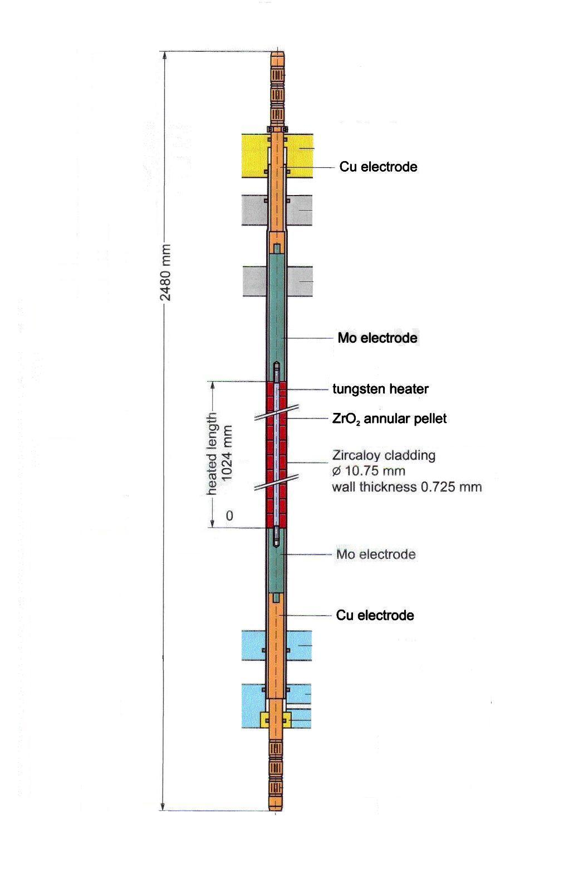
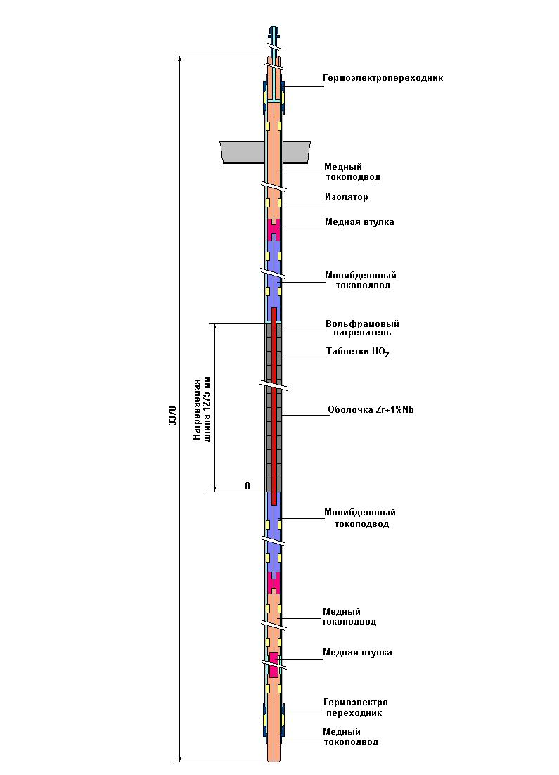
2.3. Fuel rod simulators
QUENCH-06
PARAMETER
Main technical characteristics
Model assembly PARAMETER QUENCH-06
Cladding Zr1%Nb Zry-4
- diameter, mm 9.13x0.7 10.75x0.725
- length, mm 3370 2480
Heater W W
- length, mm 1275 1024
- diameter, mm 4 6
Pellets UO2 ZrO2
- diameter, mm 7 9
Heating rod Heating fuel rod

Slide 11
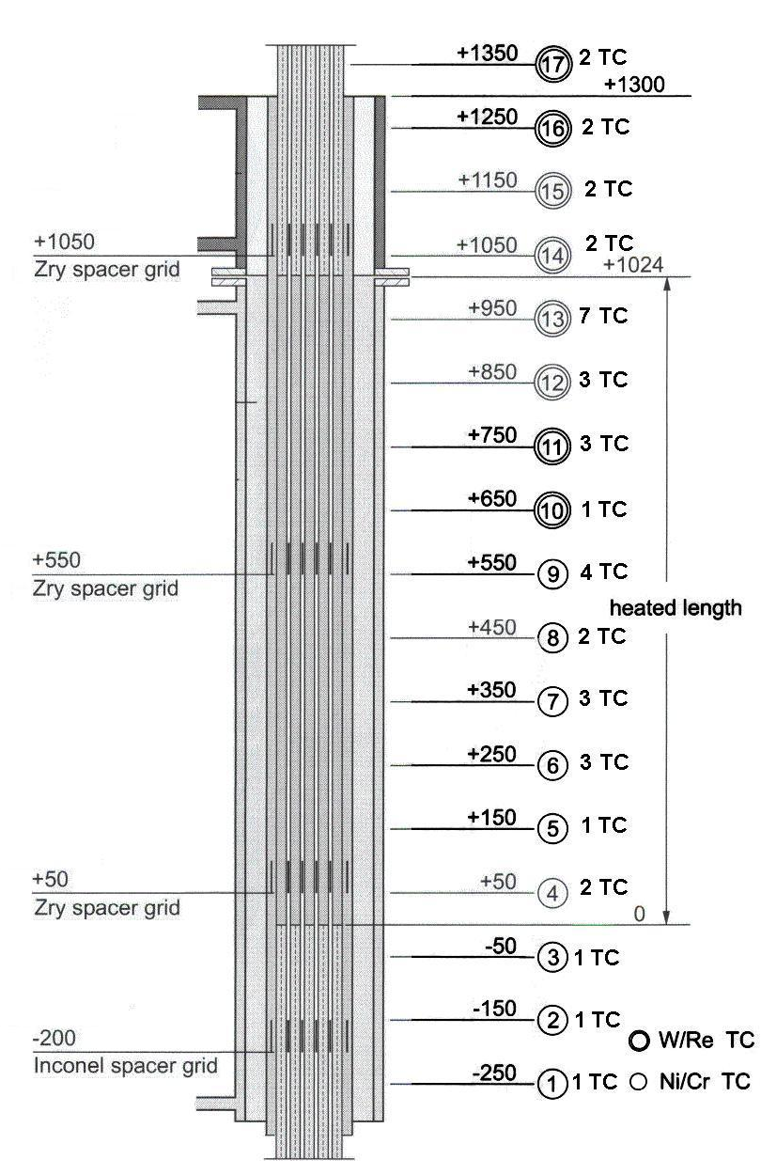
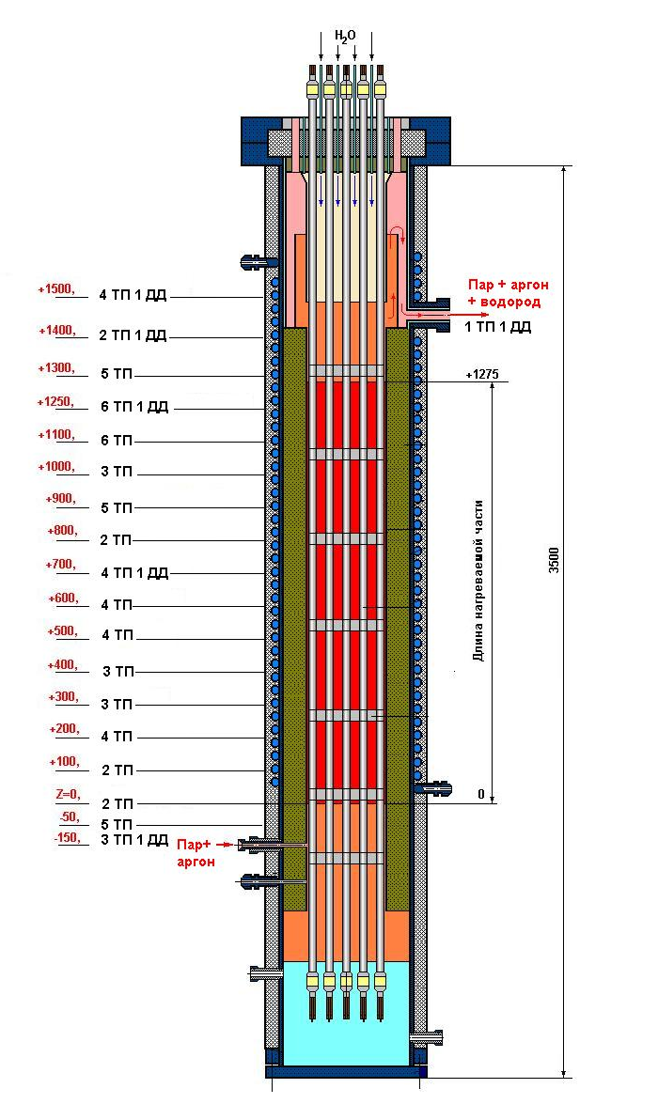
2.4. Arrangement of model assembly temperature measurements
QUENCH-06
PARAMETER
40 thermocouples in the assembly
in total, including;
22 - WRe, 18 - NiCr
47 thermocouples in the assembly
in total, including :
28 - WRe, 19 - XA,
pressure control in fuel rods and assembly -
24 pressure pick-ups

Slide 12
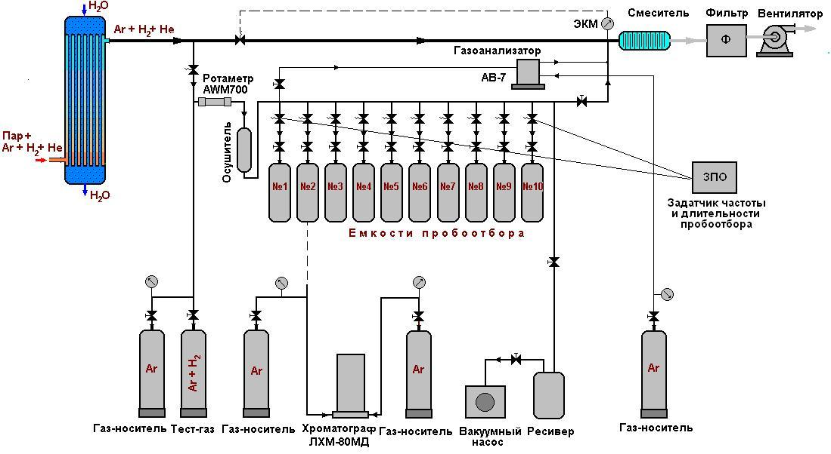
2.5. Gas analysis system
Monitoring the hydrogen
concentration change – gas analyzer АВ-7:
concentration measurement range - 0-50%vol.
absolute permissible
error limit - to 0.5%.
Discrete monitoring – sampling system
+ gas chromatograph ЛХМ-80МД:
sampling interval - 1 - 10 s,
sampling tanks - 1 - 2 L ,
sampling time - ∼ 0.3 s.

Slide 13
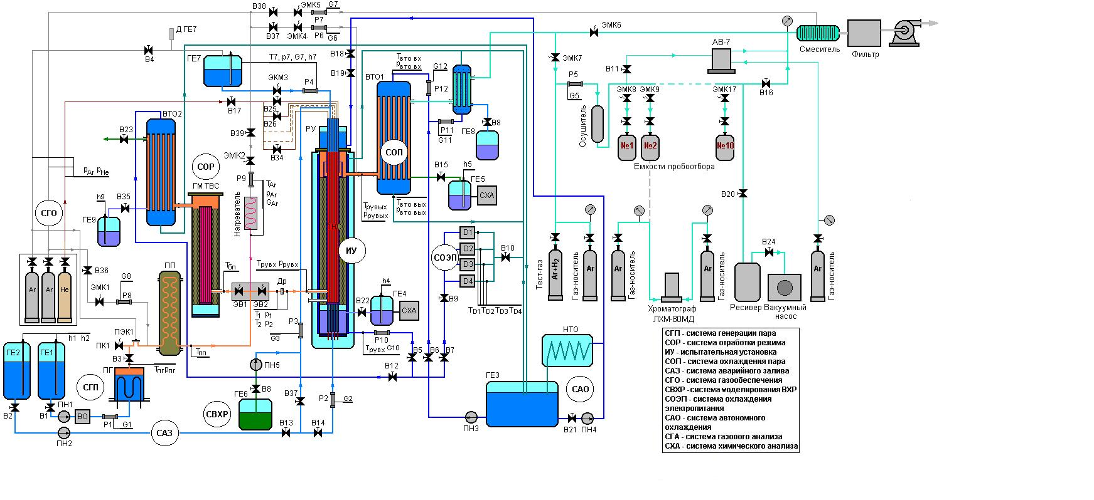
2.6. Test facility
Functional diagram
Monitoring the steam path water balance: flow meters - Р1, ДР,
level gauges – h1, h4, h5.
Monitoring the water balance of the top and bottom flooding system: flow meters Р2, Р3, P4,
level gauges – h2, h7.
Monitoring the gas flow rate: flow meters – Р5, Р9.

Slide 14
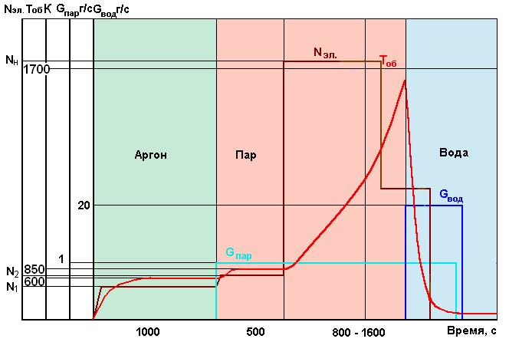
3. Development of the top flooding system
4.1. Object of tests
System of top flooding the WWER-1000 19-rod model FA with 18 heating fuel rods
Testing parameters
Sequence diagram of tests
medium - steam
temperature of medium - 773 К
flow rate of medium - 1 г/с
assembly initial
temperature - 773 К
rate of temperature
rise - to 1 К/s
maximum
temperature - 1573-1675 К
top flooding system
water flow rate - 20 g/s

Slide 15
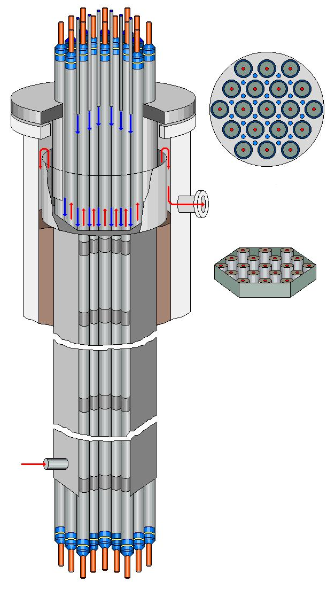
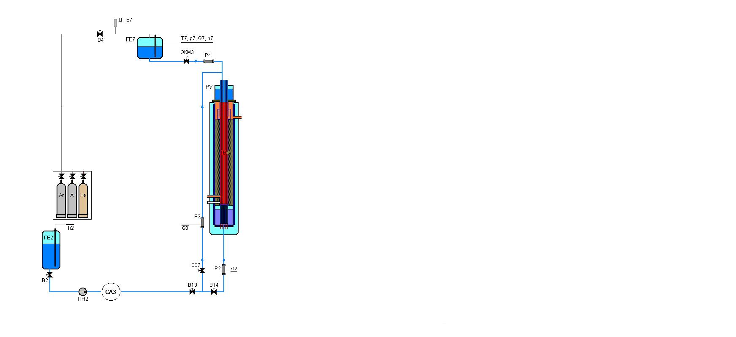
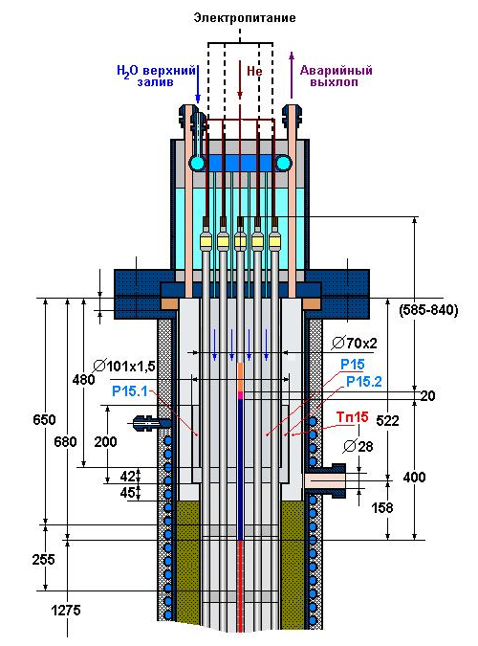
General view of top flooding system
Flow diagram of the top and bottom
flooding system
Main technical data
Top flooding:
- buffer vessel capacity - to 10 L
- back pressure - to 8 atm (g)
- temperature of medium - to 353 К
- number of injectors - 24
- flooding water flow rate - to 40 g/s
Bottom flooding:
- temperature of medium - to 353 К
- flooding water flow rate - to 200 g/s

Slide 16
Test parameters realized
- steam flow rate at temperature ∼ 760 К ∼ 1 g/s;
- maximum total electric power of model FA ∼ 8 kW;
- water flow rate of top flooding system at argon pressure in the buffer vessel of ∼ 8 atm (g) ∼ 20 g/s;
- maximum temperature of fuel rod cladding ∼ 1670 К;
- zone of FA maximum temperature
(1550÷1674 К) 900÷1250 mm;
- heat-up rate of the heating fuel rods
at the level of Z=(900÷1250) ∼ 1 К/s

Slide 17
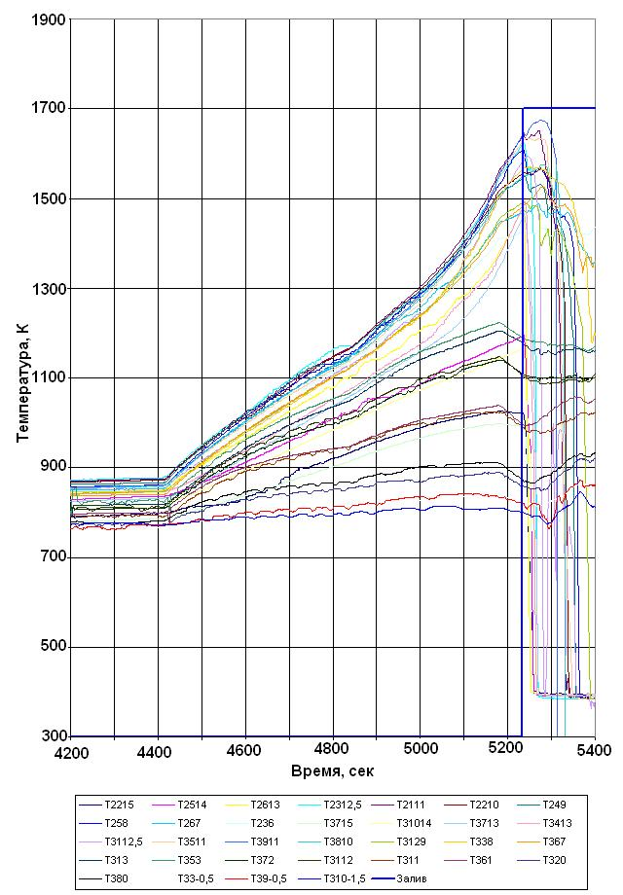
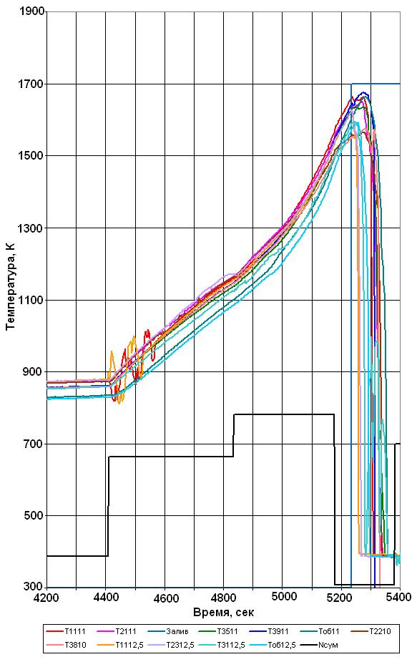
Test results
Change of the main test parameters
Temperature of fuel rod claddings
over FA height
Temperature of fuel rod claddings
In sections Z=1000-1250

Slide 18
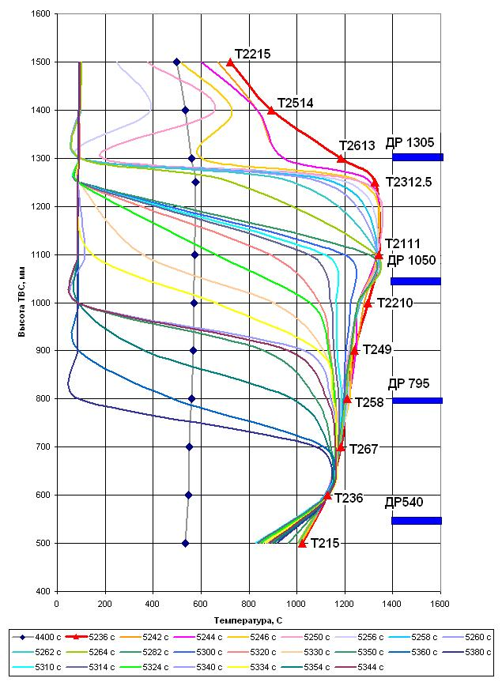
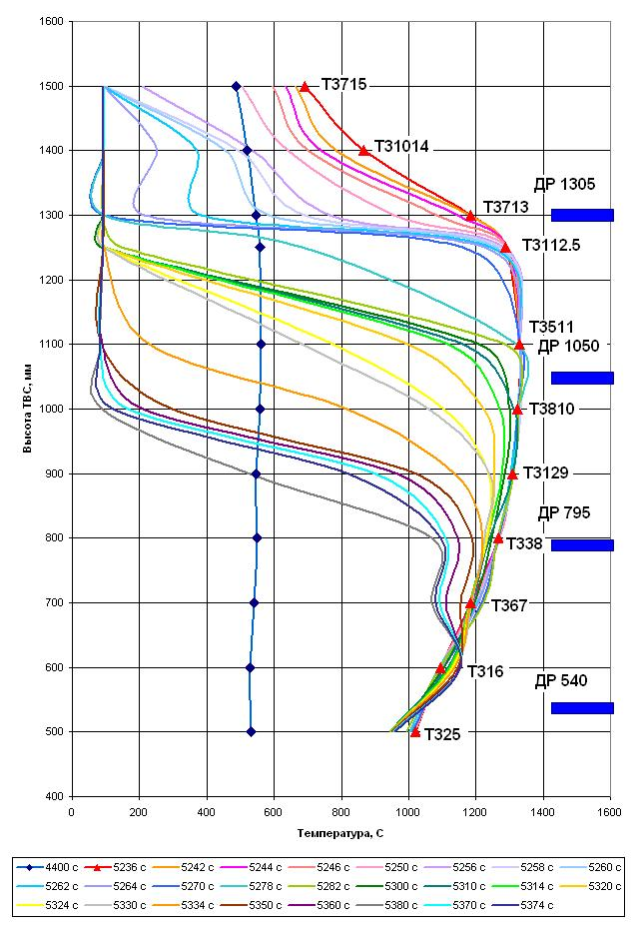
Time history of the model FA top flooding
Top flooding time history of the 2-nd row
Top flooding time history of the 3-rd row
(the first grid cooling time is 24 s)
(the first grid cooling time is 34 s)

Slide 19
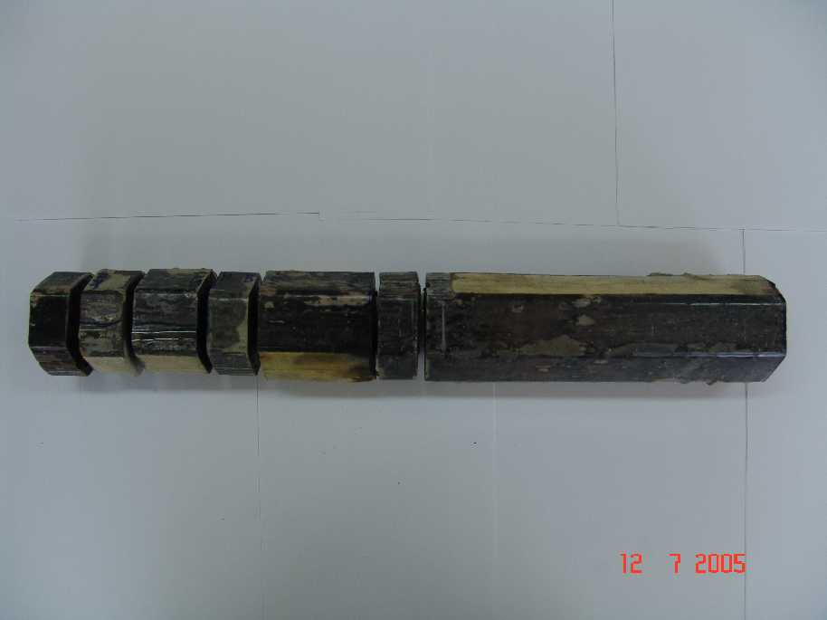
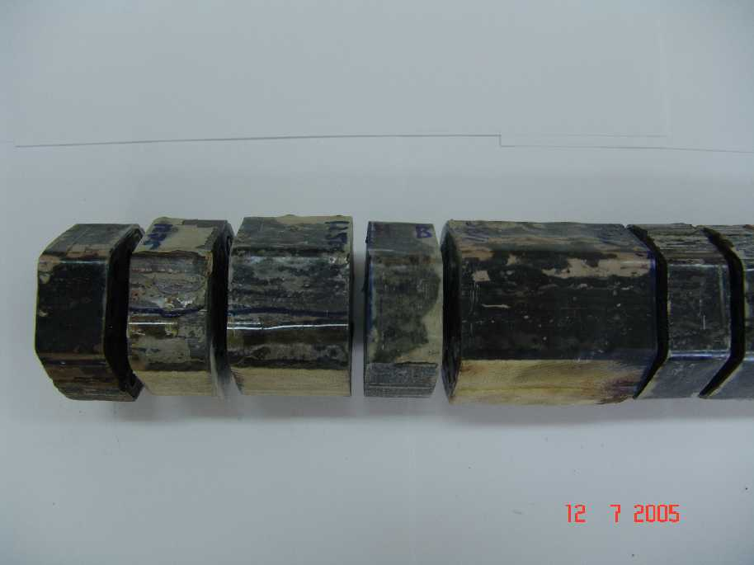
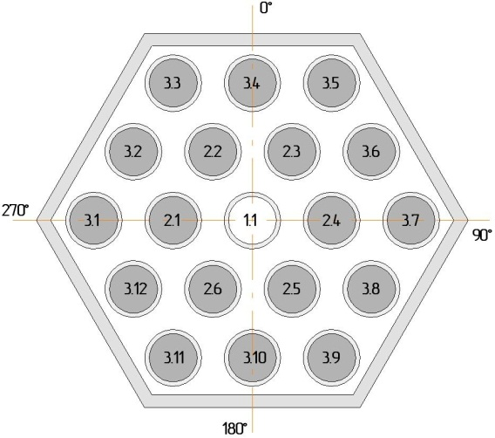
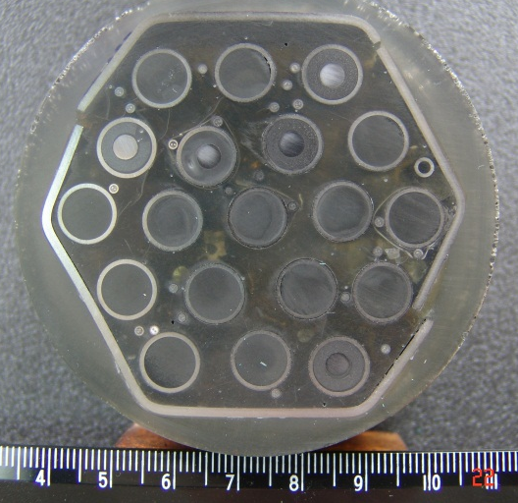
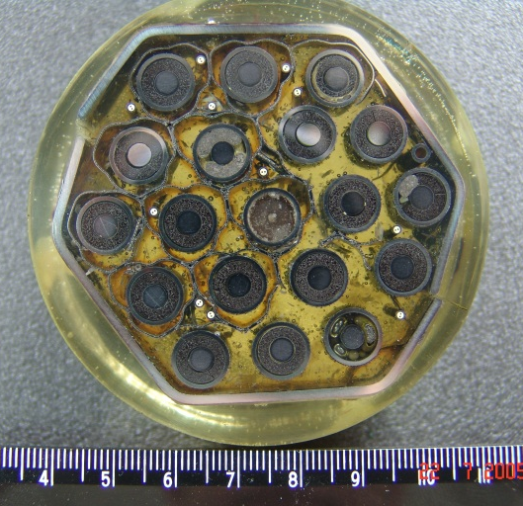
Development of the procedure for the FA post-test preserving and disassembling
Appearance of templets over FA height following preserving,
disassembling and grinding
Scheme
Cross section

Slide 20
Conclusions
On the basis of the calculational analysis of probable scenario of
WWER-1000 severe accident the scenario of the 1-st test has been
chosen and justified.
2. The system of the model fuel assembly top emergency flooding has
been developed using calculations and experiments under the simulated
conditions of beyond design basis accident at WWER-1000 RP
(Тclad <1670 К).
3. The effect of spacing grids on the model assembly cooling
time history under top flooding has been established.
4. The procedure for the model FA post-test preserving and
disassembling has been developed for performing the subsequent
material study.

