Slide 1
JSC СKTI R&D and
Production Association
SOME WORDS ABOUT OUR TUBE

Slide 2
JSC СKTI R&D and
Production Association
Study of Fluid Dynamics and Heat Transfer in Russian Fissile Material Storage Facility Cooling Pipes (extract)

Slide 3
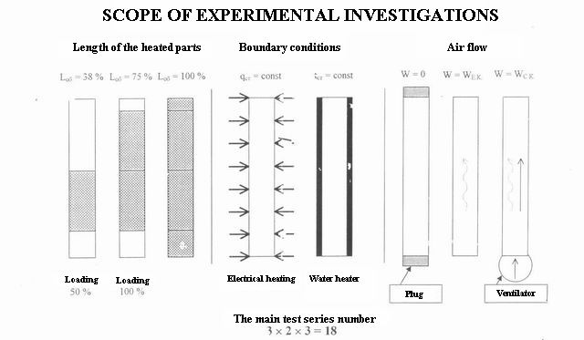

Slide 5
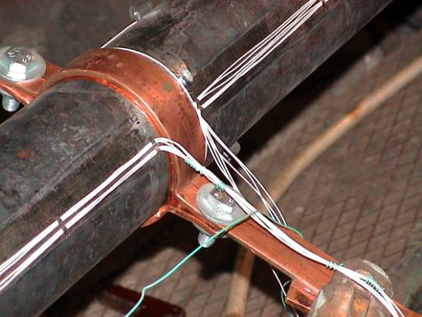
Current-Leading Straps.
Braids of wires used to measure voltage profile along the pipe height are shown.

Slide 6
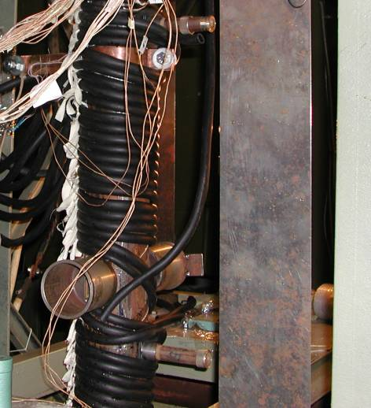
Installation of water-heating coils

Slide 7
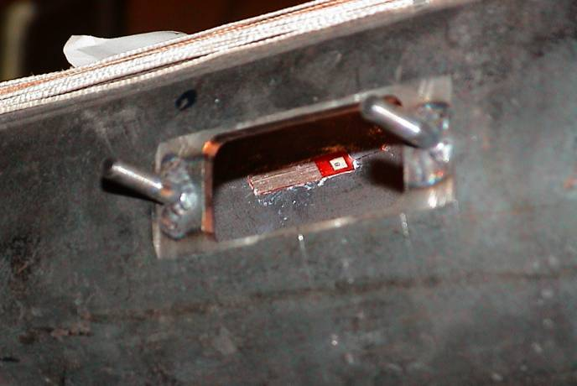
LDV System Window with Rods used to Install Securing Fixtures.
Heat flux sensor installed over the pipe inner surface is shown.

Slide 8
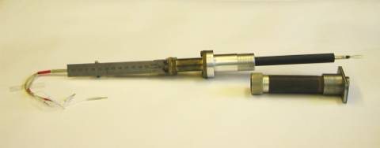
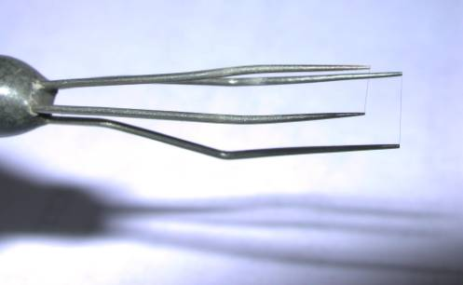
a) General View of Travel Device with Probe. Detail for securing travel device to the pipe is shown (below).
b) Probe Sensor. Two gold-plated . 3- to 5-mm long tungsten wires with the diameter of 5 μm welded to holders are shown.
Probe for Carrying out Air Temperature Measurements

Slide 9
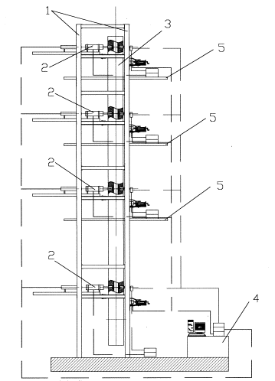
Hardware system for recording the velocity fields
1 – Steel structure; 2 – measurement set; 3 – working portion;
4 – control panel; 5 – service platform.

Slide 10
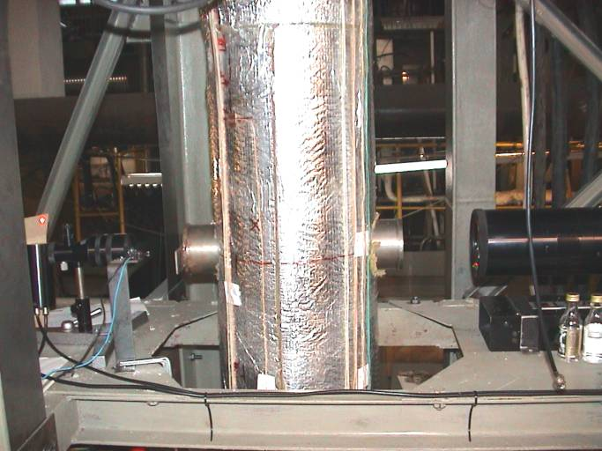
LDA measurement set
The photo shows the movable platform (on the bottom), one of the leaf springs (on the left), working portion (center) having optical system windows, laser (on the right), and light detector (on the left).

Slide 11
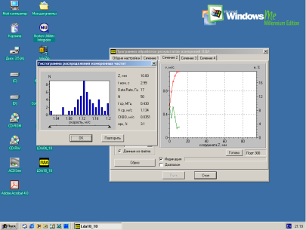
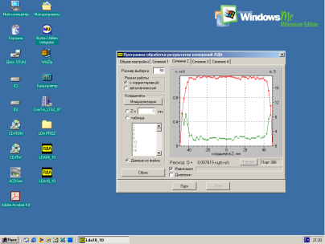
a). Snapshot of the velocity profile measurement; b) The result of the velocity profile measurement.
Desktop of the LD measurement hardware system

Slide 12
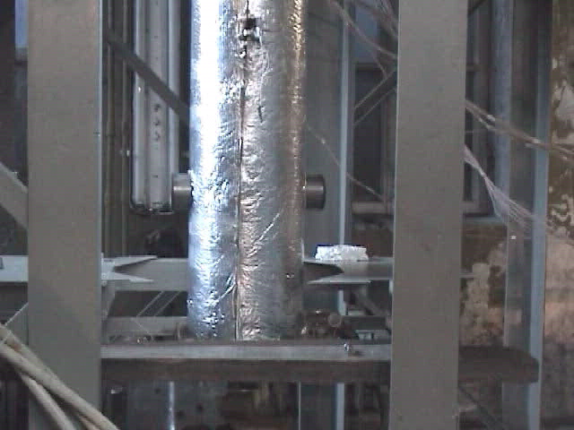

Slide 13
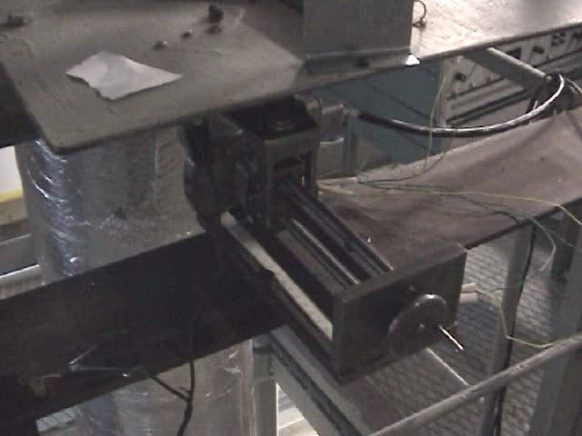

Slide 14
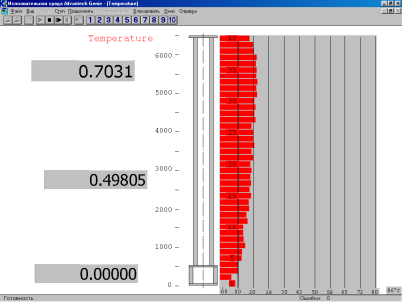
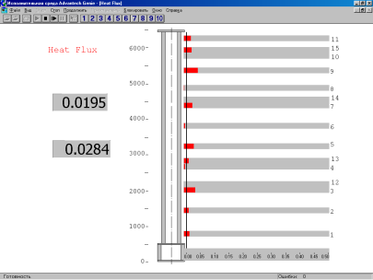
a) b)
General view of the Display Format Editor with the indication of the pipe wall temperature level (a) and thermal flux densities (b)

Slide 15
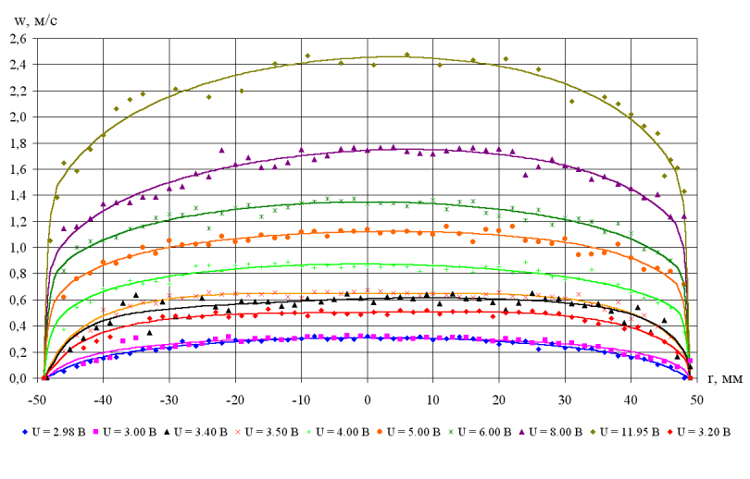
Legend: м/с - m/s; B - V, мм - mm
Velocity profiles for tests W0,0F1 through W0,0F10.

Slide 17
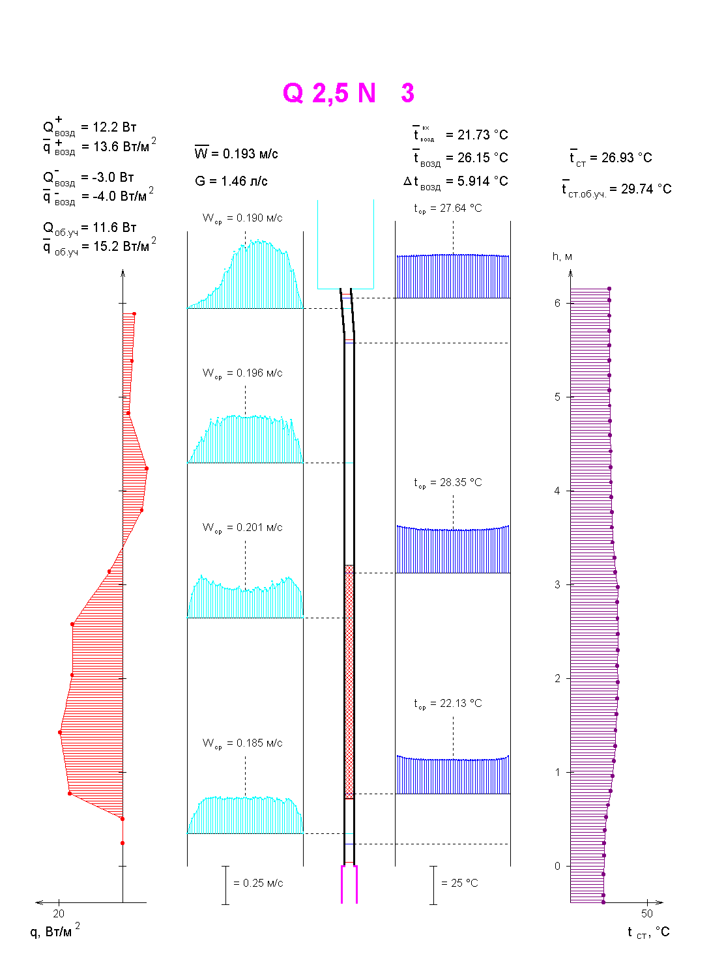
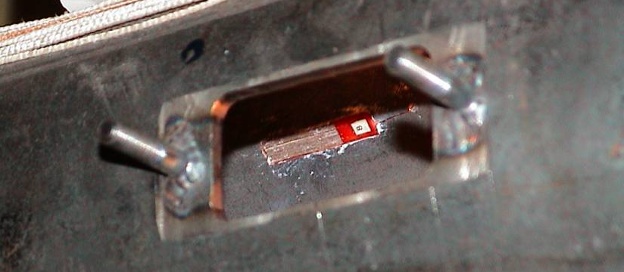
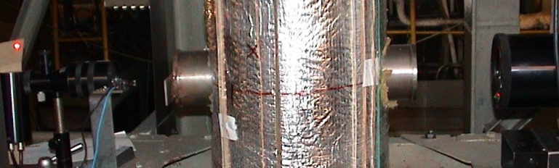

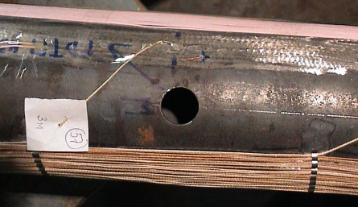
Sample protocol of the test performed with the cooling channel
1
Heat flux density profile
Measured by gradient heat flux sensor
Air velocity profile
Measured by Doppler anemometer
2
3
Air temperature profile
Measured by resistor- thermometer probes
4
Wall temperature profile
Measured by thermocouples
1
2
3
4

Slide 18
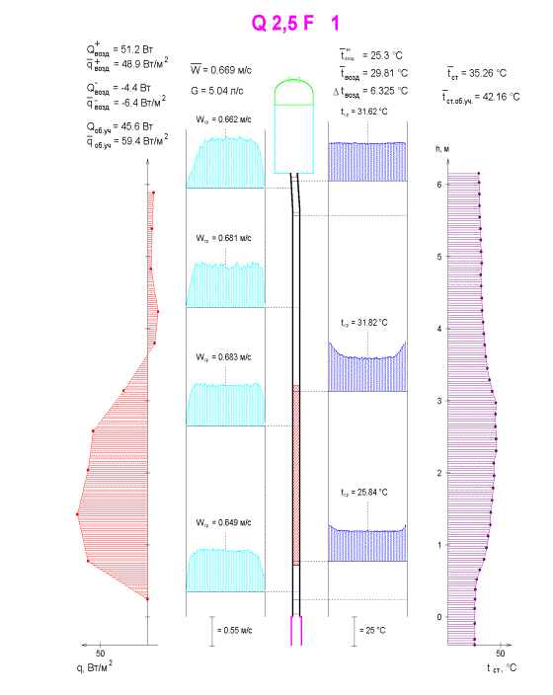
Legend:
Вт - W;
Вт/м² - W/m²;
м/с - m/s;
л/с - l/s;
Index:
возд - air;
об. уч. - heated section;
вх - inlet;
ср - average;
ст. - wall;
ст об. уч. - heated section wall

Slide 19
Fig. 7.6. Velocity profile for working section outlet obtained in Test Q2,5N3
Key: horizontal axis – r, mm; vertical axis – w, m/s

Slide 21
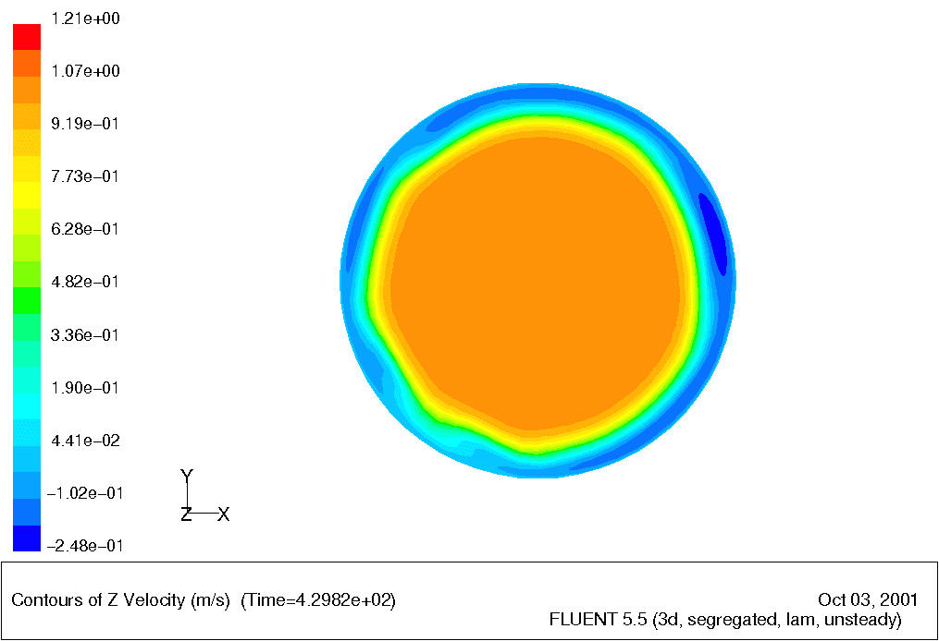

Slide 22
