Slide 1
Background and Target of the planned ISTC Partner experiment
EPICOR
Manfred Fischer, NEPA-G
St Petersburg – June 1, 2010

Slide 2
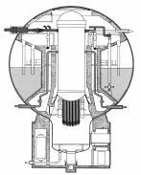
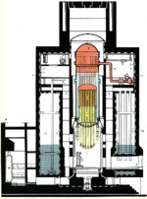
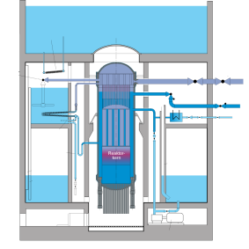
BWR Development in Germany
15 – 350 MWe
640 – 1350 MWe
1290 MWe
1250+ MWe
Kahl (‘61)
Gundremmingen
A (‘66)
Lingen (‘68)
Würgassen (‘71)
Brunsbüttel (‘77)
Isar 1 (‘77)
Philippsburg 1 (‘79)
Krümmel (‘83)
Gundremmingen B
Gundremmingen C
(‘84 & ‘85)

Slide 3
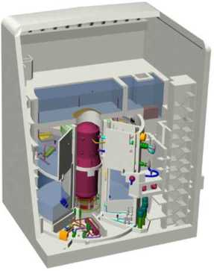
KERENA™ Main Technical Data
Thermal power 3,370 MWth
Net power 1,250 MWe
RPV height 23.81 m
RPV inside diameter 7.12 m

Slide 4
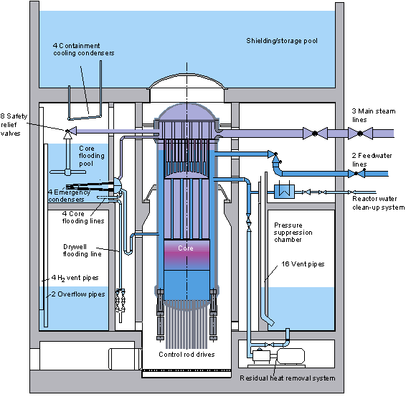
Safety systems of the KERENA™ BWR
Safety systems simplified by including passive safety features.
All active systems have passive safety related backups.
Accident control possible with only passive safety systems, without core heat up.
Passive systems function either without activation system or with passive activation systems
Core-melting only after postulated failure of all active and passive injection systems
Large water volumes inside RPV, and inside/outside containment.
Core melt mitigation by in-vessel retention (IVR) and passive heat removal from the containment.

Slide 5
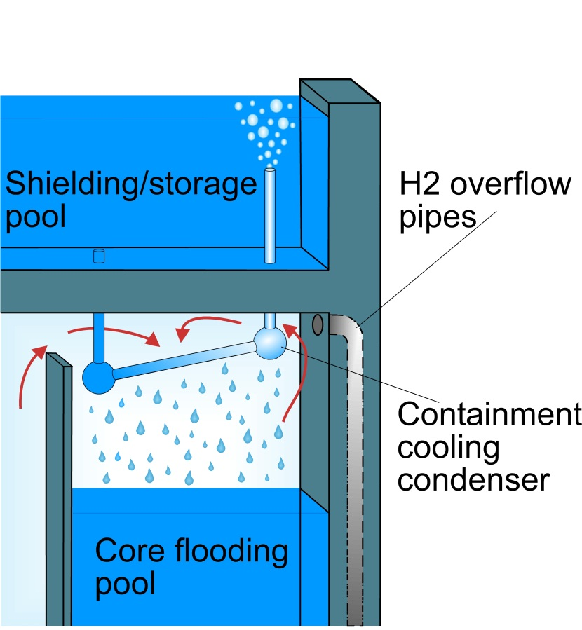
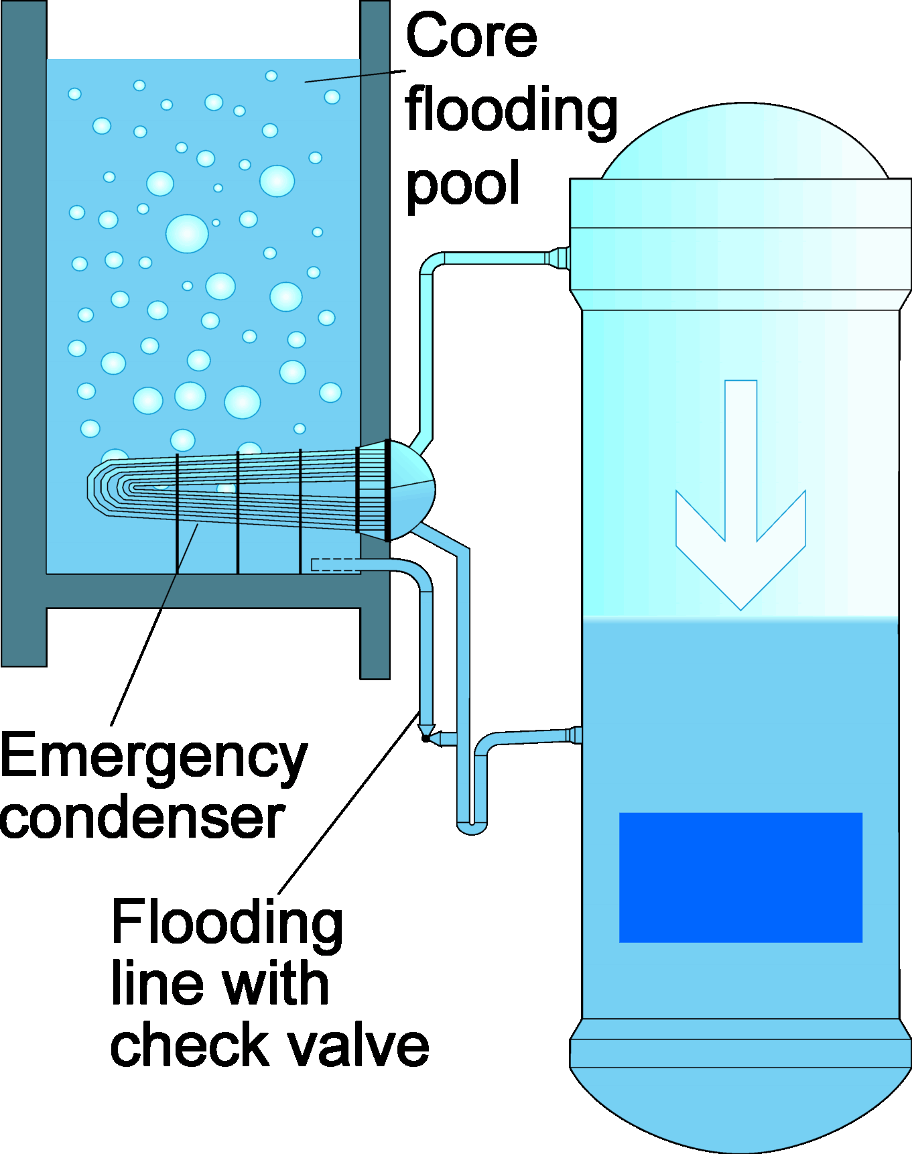
Passive heat removal systems of the KERENA™ BWR

Slide 6
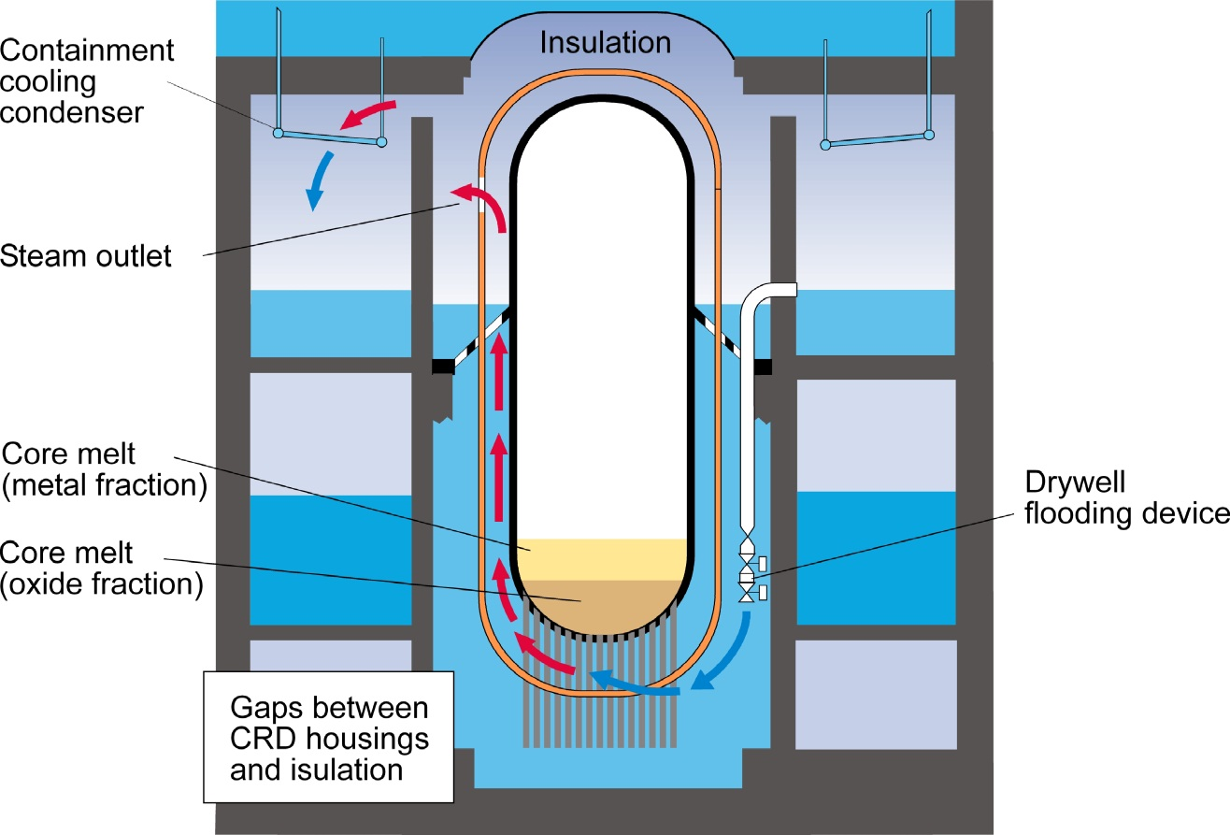
Ultimate Flooding of the Drywell with IVR KERENA™ BWR
Actuation of drywell flooding means water loss from the core flooding pools (CFPs) into the cavity
  Accordingly the preventive systems that use the CFP water inventory become weakened or deactivated
        Emergency condensers
        Passive core flooding
  Flooding when thresholds are reached which indicate that these systems are no longer capable of preventing the core melt
  Actual PSA results predict core melt frequencies in the order of 10⁻⁸ per reactor year

Slide 7
Analysis Methodology to validate IVR
Masses of core materials
Time scales (decay power)
Transient heat fluxes
Core melt progression
Melcor 1.8.6
Best estimate
Thermo-chemistry of corium (oxide/metal) incl. their densities
Melt pool stratification
Thermo-
chemistry tools
RPV wall temperature
CHF not exceeded
RPV wall ablation
Heat transfer to the RPV
Own code (heat eq. Solver)
Material behavior under thermo-mechanical loads
Mechanical stability analyses
FEM
Reference cases
Judgement

Slide 8
Internal heat fluxes and RPV melting
Thermal-hydraulic correlations for oxidic (internally heated) pool
Heat transfer correlations between oxide and metal
Thermal-hydraulic correlations for metallic layer
Radiation from the top
Boiling heat transfer to the water

Slide 9
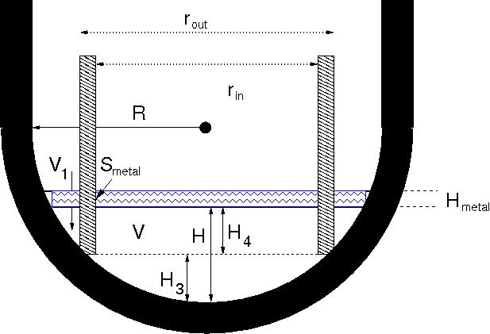

Focusing Effect
During Melt-Down Progression
Cylindrical
internal structure
Assess whether a local high heat flux can occur during melt down of steel internals due to the focusing effect
Make a qualitative best-estimate when and how internal structures are molten
UO₂ | Zr / ZrO₂ | B₄C | Steel
About 154 tons (Full inventory) | About 65 tons zirconium with About 35 % oxidation | max. 2.8 tons from control rods | min 200 tons, up to ~500 t

Slide 10
Assessment of thermochemical phenomena with potential impact on IVR
MASCA
RASPLAV
METCOR/-P
AREVA-NP
  Formation of a dense metallic phase
  Miscibility gap(s) in the oxide system
  Interactions with B₄C and B₂O₃
  Decay heat distribution between oxide and metal
  Interaction of oxidic melt with vessel steel
  Formation of an oxidic crust on the upper metal layer
  Uncertainties related with the formation of a dense metallic and surface crusts have the highest potential impact on the validation of IVR for KERENA™

Slide 11
Formation and behavior of a dense metallic phase
MASCA Matrix-1: Experimental findings

Slide 12
Formation and behavior of a dense metallic phase
Impact of experimental findings on IVR
MASCA finding:
  Zr,U,Fe and O migration between (U,Zr)O_{2-x}- and steel melt under near thermodynamic-equilibrium conditions can lead to the formation of a dense metallic (Fe-U-Zr)O_{x} phase
  In this process the density of the residual oxide phase is correspondingly reduced
  Oxide/metal densities and layering depend on :
    degree of preceding Zr-oxidation
    U/Zr-ratio in the oxide
    steel to oxide ratio
  Oxidizing atmosphere can cause a re-inversion
Impact on IVR:
  Reduction of the thickness of the upper light metal layer, aggravated focussing effect
  Transient thermal pulse of superheated metal rising to the top
Photo caption - © Copyright

Slide 13
Target of planned EPICOR test
Provide information on thermochemical equilibrium conditions and densities for a BWR-specific U/Zr-ratio (high Zr content)
Check the predictions of analytical tools, improve confidence
Test procedure:
Creation of an substochiometric oxidic melt
Subsequent addition of steel, wait to establish equilibrium with the oxide at predefined temperature, sporadic sample taking
Detect the moment at which metal rises to the top, final sample taking (metal plus oxide), density estimation from pool volume
Additional investigations (dependence on temperature)
Post test analyses

Slide 14


Any reproduction, alteration or transmission of this document or its content to any third party or its publication, in whole or in part, are specifically prohibited, unless AREVA NP has provided its prior written consent.
This document and any information it contains shall not be used for any other purpose than the one for which they were provided.
Legal action may be taken against any infringer and/or any person breaching the aforementioned obligations.

Slide 15
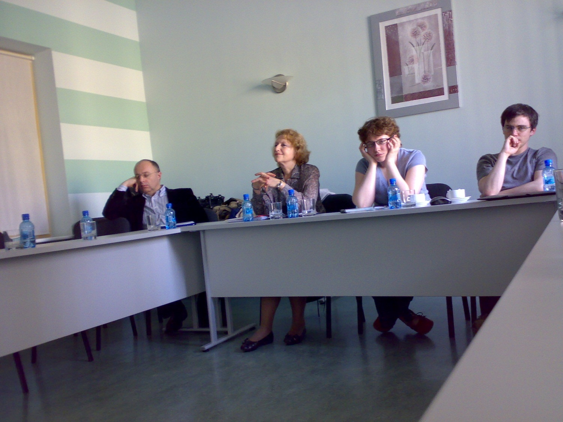
Fascinating meetings

Slide 16
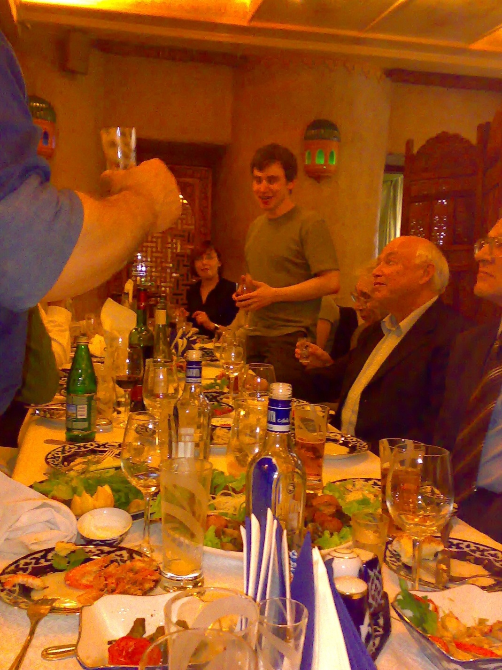
Food and drinks in abundance

Slide 17
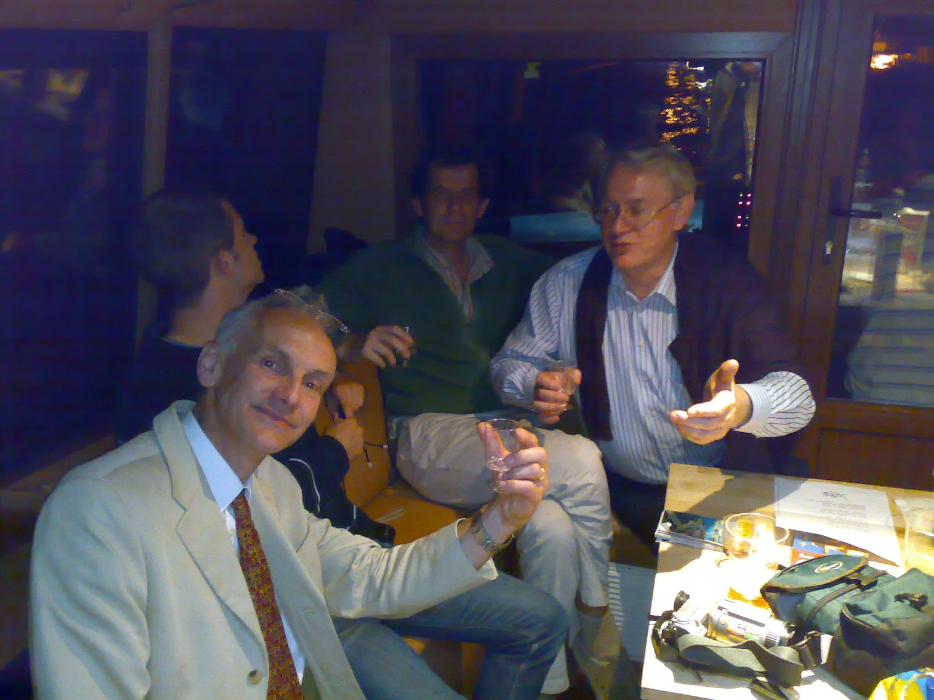
Thrilling discussions

Slide 18

Deep insights

Slide 19
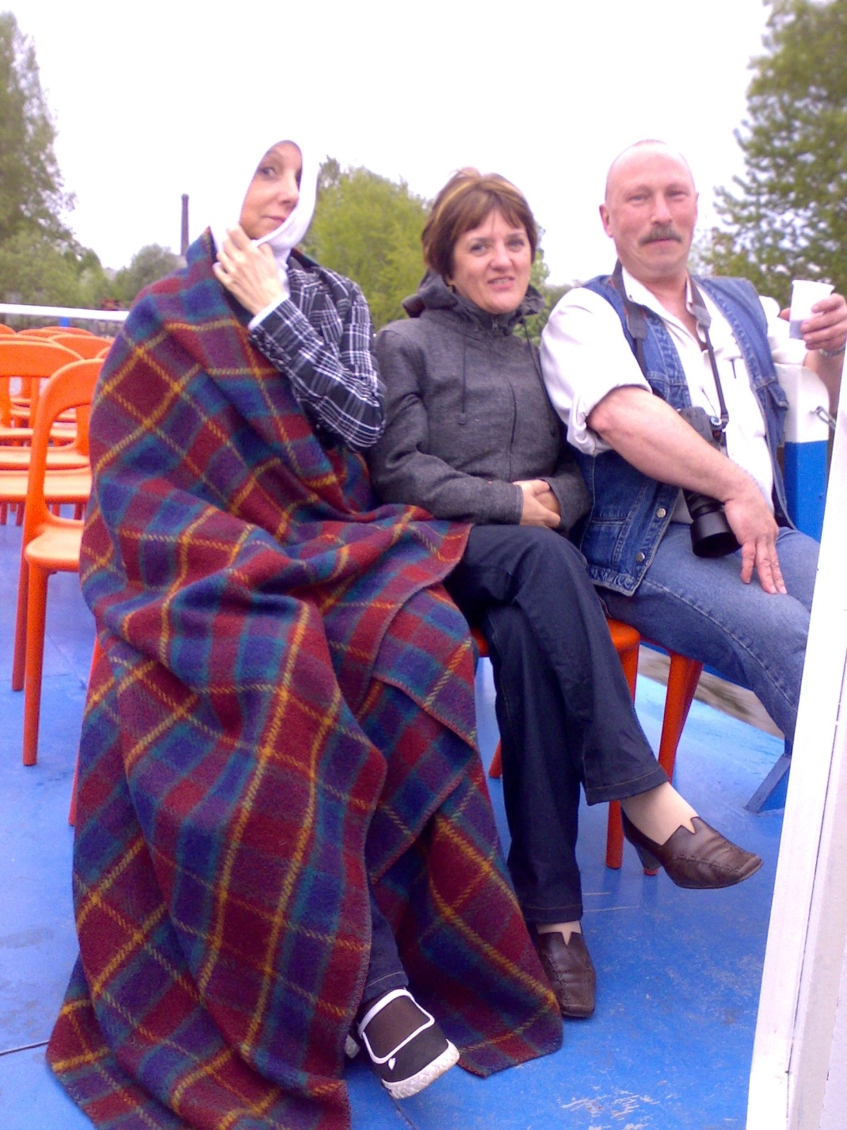
a warm atmosphere

Slide 20
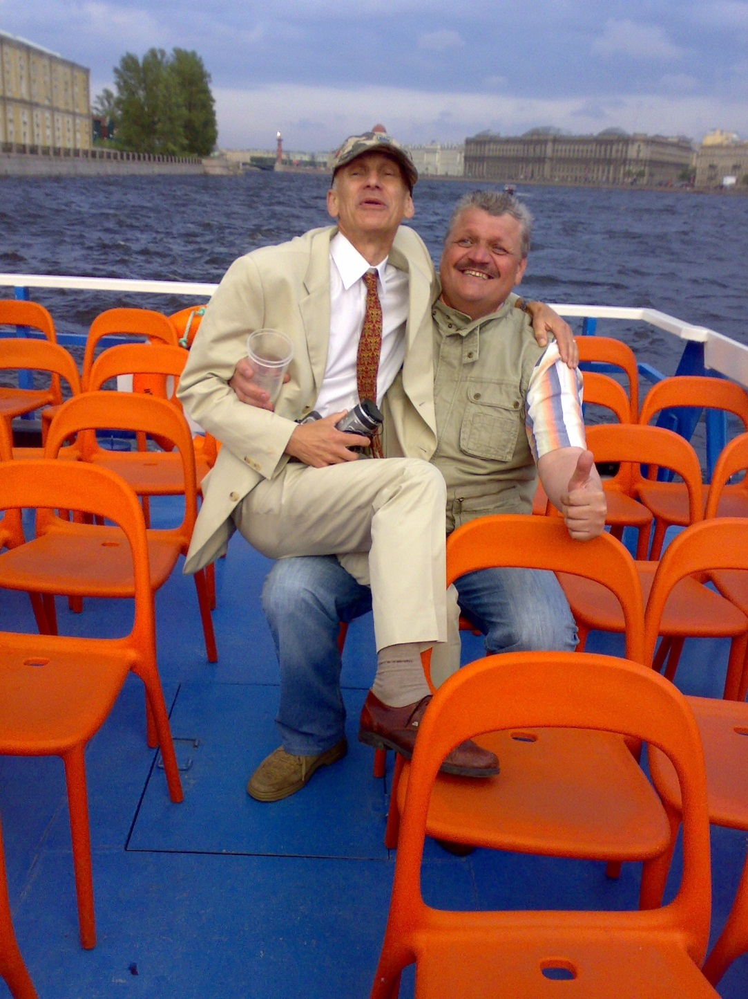
excellent support by our Russian colleagues

Slide 21
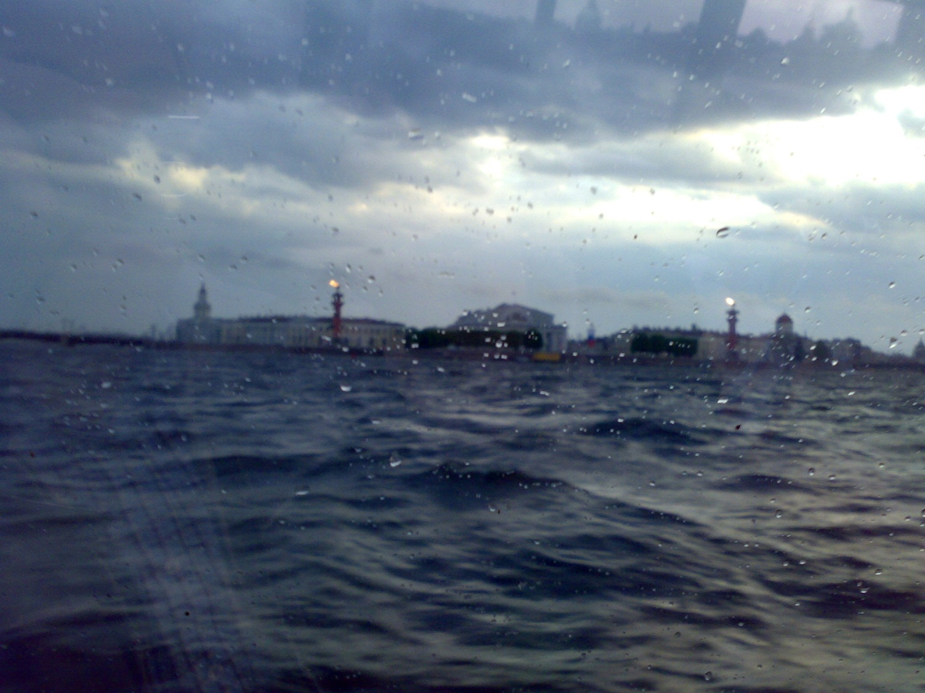
but nevertheless ... an unclear perspective

