Slide 1

Plans for further and their experimental realization
A.P. Alexandrov Research Institute of Technology
International Science and Technology Center
Presented by S. Bechta
3rd METCOR-P project meeting
May 27, 2009, St. Petersburg

Slide 2
METCOR-P experimental matrix
5 remaining tests

Slide 3
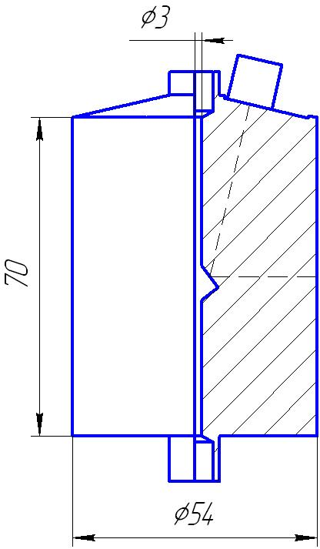
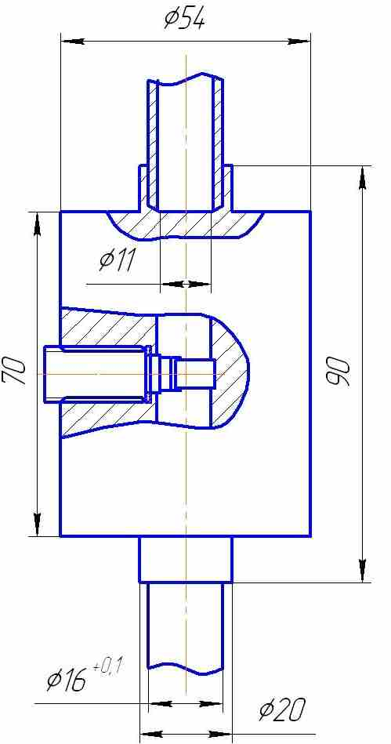
Interaction at the vertically positioned interface (1)
US measurement scheme
Test 1.2
USS with mirror
Radial location of USS
U-Zr- Fe(Cr, Ni)-O; atmosphere: Ar
The composition corresponds
to that of the metallic melt, e,g, С-30+40% SS,
T_{s} =1400ºC →MC6
(in accordance with
the matrix)

Slide 4
An alternative: horizontal orientation of the interface
Interaction at the vertically positioned interface (2)
Test 1.2
No indication of significant influence of orientation on the final corrosion state from MCP-1 test results
But corrosion kinetics was not measured due to technical difficulties of ultrasonic diagnostic application
Guaranteed measurement of the interaction kinetics and better accuracy of the IZ temperature boundary determination for horizontally oriented interface

Slide 5
Molten corium oxidation transients (1)
Test 2.2
Melt: UO₂ + ZrO₂ + Zr (С-30)
Oxidizer: Ar + O₂ instead of steam (in contrast to the matrix)
A considerable more accurate determination of the oxidation rate
A possibility of the pool surface temperature measurement
Objective: determination of influence of the oxide pool surface crust on the oxidation rate (oxygen diffusion coefficient)
3 steady-state temperature regimes; the final oxidation index is С-50
An option: replacement of the atmosphere with Ar after every oxidation transient, exposure and steady-state measurements for posttest crust thickness modeling
Posttest calculations of oxygen diffusion coefficient

Slide 6
Molten corium oxidation transients (2)
Test 2.3
Objective: determination of influence of the metal pool surface crust on the oxidation rate (oxygen diffusion coefficient)
Variant 1
Variant 2
Oxidation of solid U-Zr- Fe(Cr, Ni)-O specimens in air at Т = 900 and 1000ºC with different exposure time (analogous to METCOR)
Two-liquid pool: C-30 + 40% SS
(molten metal at the top)
Oxidizer: Ar + O₂
Option 1
Vertical water-cooled tube (permitting measurement of water temperature at different heights) along the pool axis
Option 2
Determination of the crust crystallization peculiarities under thermogradient conditions (primary crystallization zones)

Slide 7
Molten corium oxidation transients (3)
Alternatives to the tests 2.2 and 2.3
Variant 1
Melt: С-30 in Ar
Objective: determination influence of the crust formation conditions on its composition and properties
Option 1
Option 2
Rapid melt crystallization on the water-cooled rod (e.g. annular tube) dipped into the melt
The same, with slow (8 mm/hour) submerging of rod into the melt
Heat fluxes to the rod are measured during the tests
Posttest analysis of the crust
Variant 2
Melt: С-30+Boron
Objective: determination of the influence of В on the interaction of the suboxidized molten corium with vessel steel
2 tests with different melt composition, e.g. B concentration

Slide 8
Interaction of molten corium with European vessel steel
Test 3.1
Melt: UO₂+ZrO₂+Zr, C-30, in Ar, T_{s}=1400°C (MC6) in accordance with the matrix
Test 3.2
UO_{2+x}+ZrO₂, air instead of steam
Option 1
2-3 steady-state temperature regimes, T_{s}=900…1200°C
Option 2
Addition of Fe into the melt, its oxidation and formation of the UO_{2+x}+ZrO₂-FeO_{y} melt
Option 3
3 – 4 steady-state temperature regimes, T_{s}=1200…900°C
Europe steel blanks have arrived thanks to AREVA good offices, custom clearance is done by ISTC, transportation from Moscow is in progress

Slide 9
Conclusions
Collaborator comments and recommendations to the proposed tests are welcomed
Next tests on the corium interaction with European vessel steel should be coordinated ASAP (during this meeting if possible)

