Slide 1
Preparation of МСР-8 experiment on the interaction of metallic melt with vertical specimen
A.P. Alexandrov Research Institute of Technology (Russia)
ISTC METCOR-P Project
#3592
Presented by A. Sulatsky
4th METCOR-P Meeting
St. Petersburg, Russia,
June 1, 2010

Slide 2
Content
State of the art
Objectives of MCP-8 test
Objectives of Pr1-MCP-8 pretest
Principle of US monitoring
Specimen schematics
Furnace schematics
Modeling of specimen cooling
Specimen view during the pretest
Pr1-MCP-8 results
Alternative specimen design
Comparison of two designs
Conclusions

Slide 3
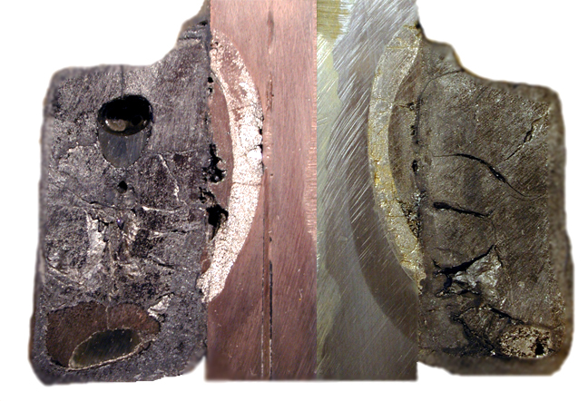
State of the art
Test MCP-1 (2007): Study of vessel steel corrosion at its interaction with molten suboxidized corium
Main MCP-1 differences from the tests with horizontal interaction interface (prototype test of MC6):
Considerably shorter incubation period (or completely absent)
Different structure and composition of the interaction zone
Unaffected steel
Thermal impact zone
Interaction zone I
Interaction zone II
Metallic inclusion in the ingot - ring
Main problem during MCP-1 and posttest processing of its results: No data on steel corrosion kinetics during the test

Slide 4
Objectives of test MCP-8
Determine corrosion kinetics of vertically positioned vessel steel specimen at its interaction with Fe-Zr-U melt
Method for determining kinetics:
On-line US monitoring of steel corrosion

Slide 5
Objectives of pretest Pr1-MCP-8
Check the efficiency of the vertical specimen cooling systems and US monitoring
Controlled conditions and parameters:
no DNB water cooling in the central channel of the
specimen
depth of ablation/melting of the outer specimen surface

Slide 6
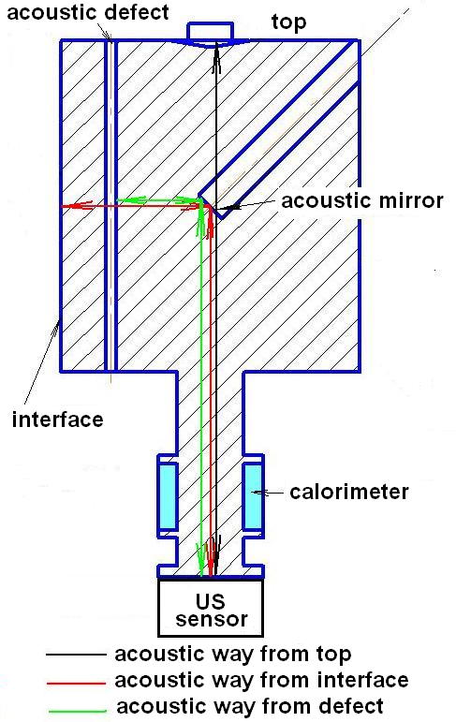
Principle of US monitoring

Slide 7
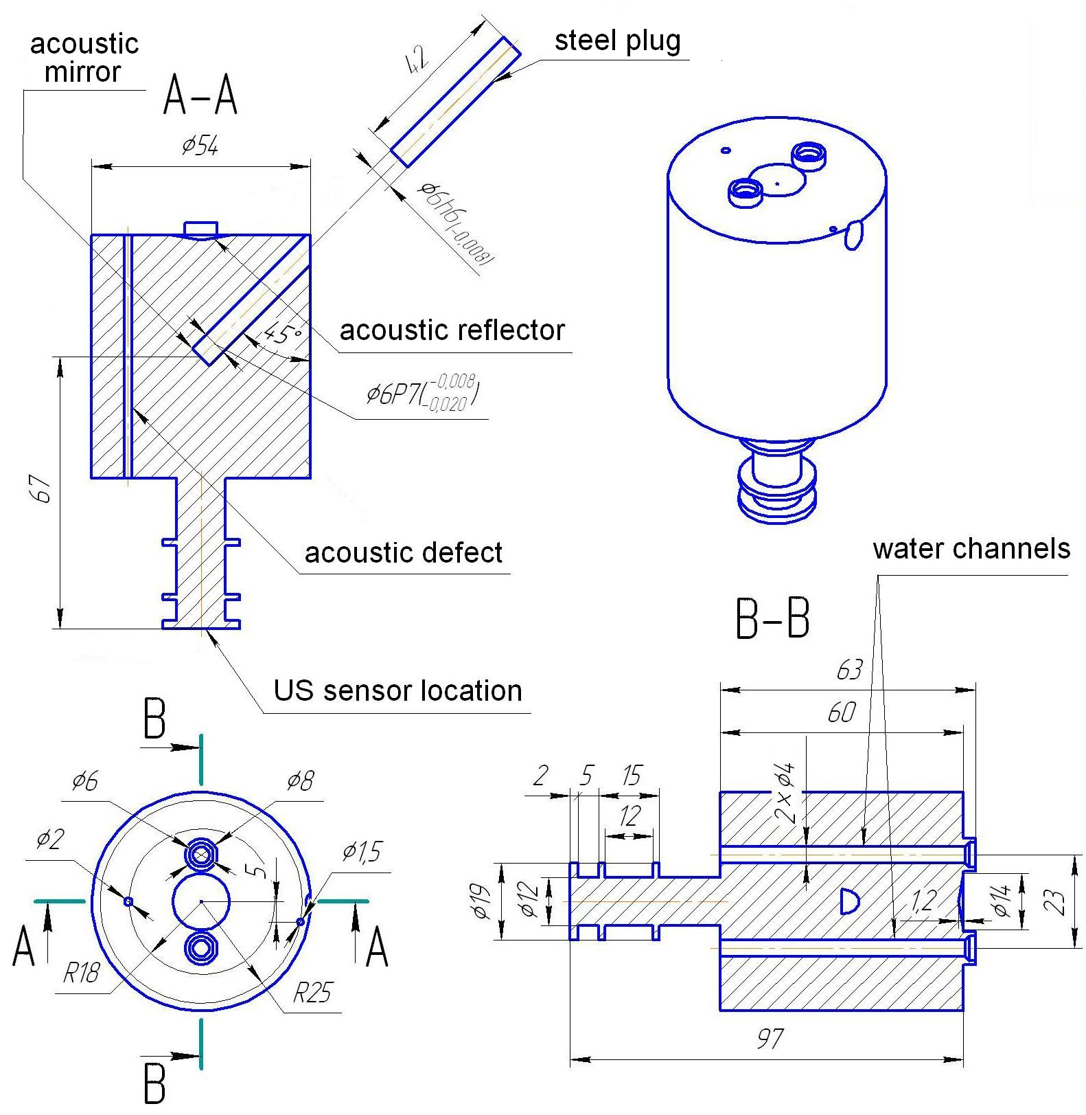
Specimen schematics

Slide 8
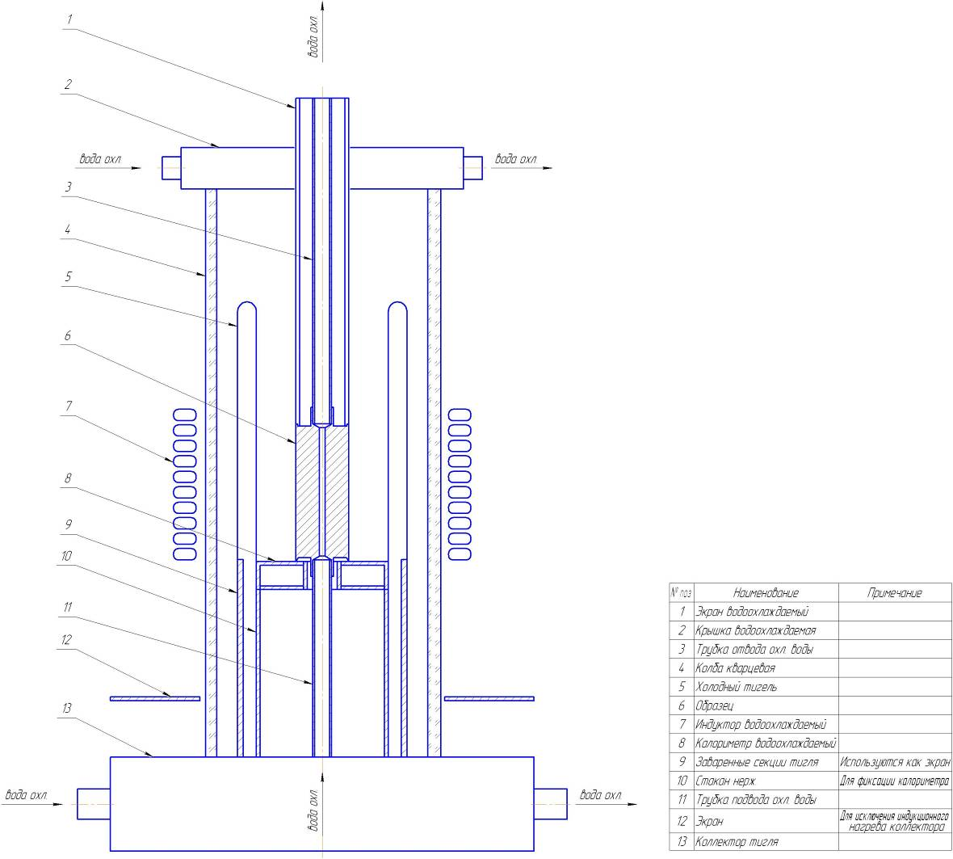
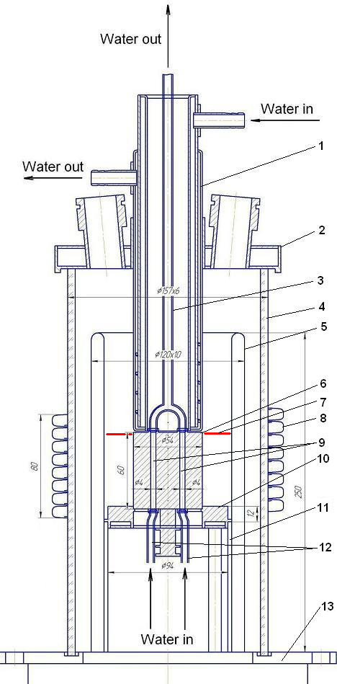
Furnace schematics
water
1 – water cooled
screen
2 – water cooled cover
3 – water-off pipe
4 – quartz tube
5 – crucible sections
6 – specimen
7 – melt surface position
8 – inductor
9 – two cooling channels
10 – bottom calorimeter
11 – CC holder
12 – water supply pipes
13 – furnace basis
water
water
water
water
water

Slide 9
Modeling of specimen cooling
Approximations:
stationary conditions
2D geometry (radius and azimuth angle) with uniform
distribution of heat flux on specimen surface
temperature dependence of vessel steel heat conductivity
CHF Lookup Table of Groeneveld & Kirillov (1997)
Evaluated parameters:
specimen diameter – 54 mm
diameter of water channels – 4 mm
length of specimen – 60 mm
water volumetric rate – 2.8 m³/hr (velocity ≈ 31 m/s)
outlet water pressure – 1 bar
inlet water temperature – 20°C
maximum surface temperature – 1400°C
temperature of surface of water channels – 100°C

Slide 10
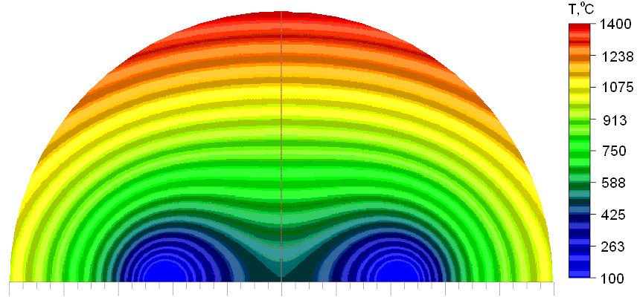
Modeling of Specimen Cooling (2)
Calculation results:
outlet water temperature – 23°C
power extracted from the specimen – 9.9 kW
heat flux on external surface of specimen opposite acoustic mirror
– 0.97 MW/m²
maximum heat flux at the surfaces of water channels – 7.4 MW/m²
DNB margin > 1.6
N.b.!
Uneven temperature field explained by the peculiarities of the cooling system provokes faster ablation right across the acoustic mirror

Slide 11
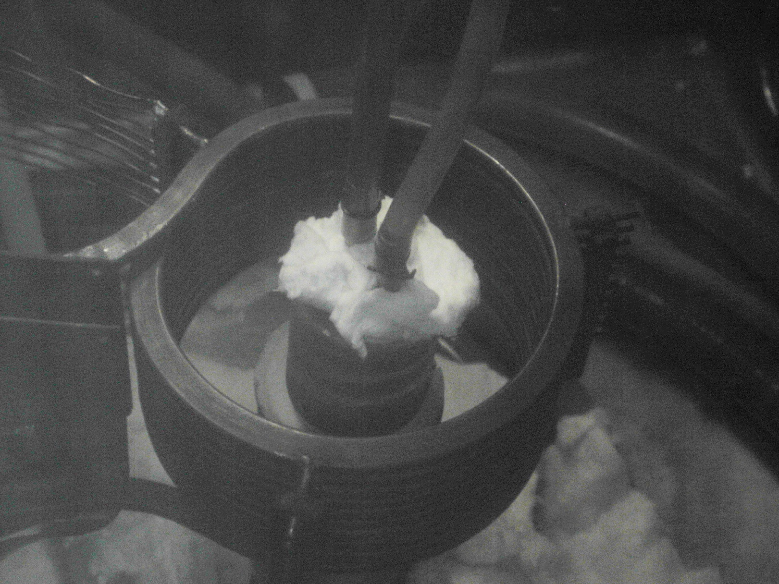
Specimen view during the pretest
Water removal pipes
Inductor
Specimen
Specimen basis

Slide 12
Pr1-MCP-8 results
Power extracted from the specimen
Start of specimen ablation in accordance with post-test processing of the US monitoring data
Beginning of distinctly observed specimen melting
Heating disconnection
Maximum power into
the specimen:
12.2 kW
Average heat flux:
1.20 MW/m²
No DNB indications

Slide 13
Pr1-MCP-8 results (2)
TC readings
Specimen ablation start in accordance with post-test processing of US monitoring data
Observed beginning of specimen melting
Heating disconnection

Slide 14
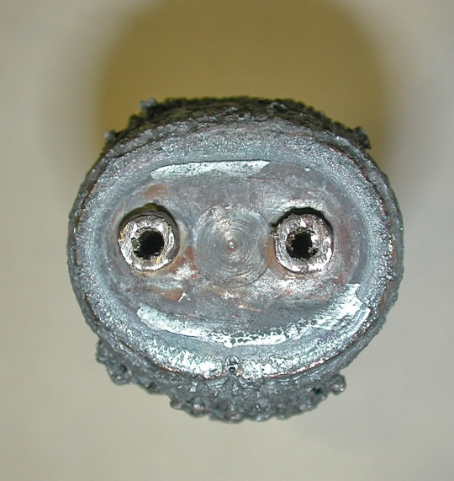
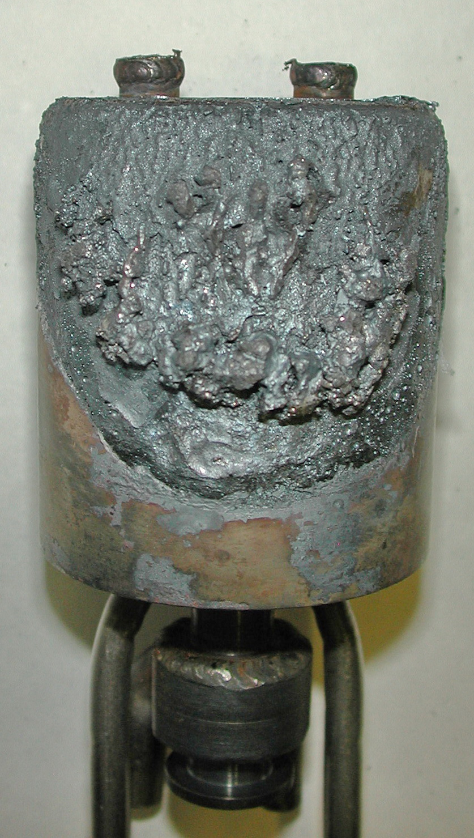
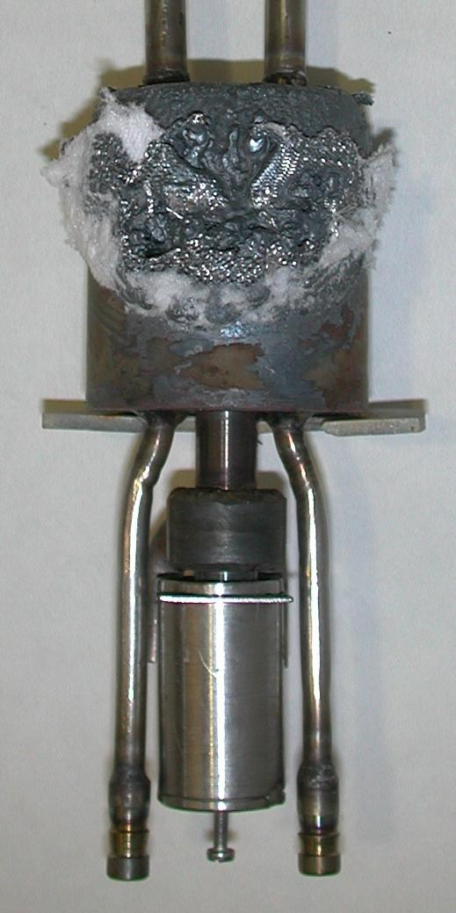
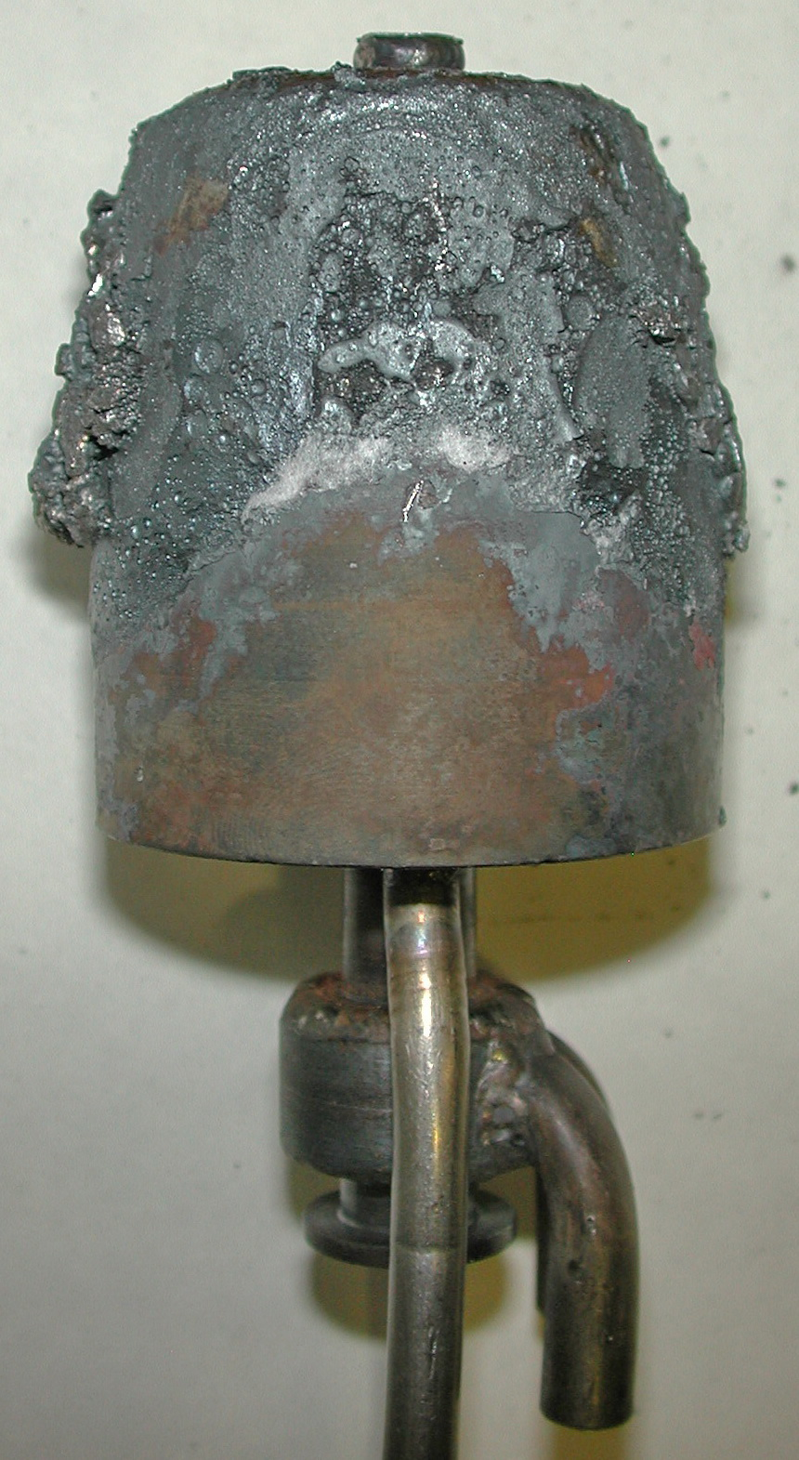
Pr1-MCP-8 results (3)
Specimen view after the pretest
Acoustic defect
Zone of US monitoring
Water supply pipes
US sensor

Slide 15
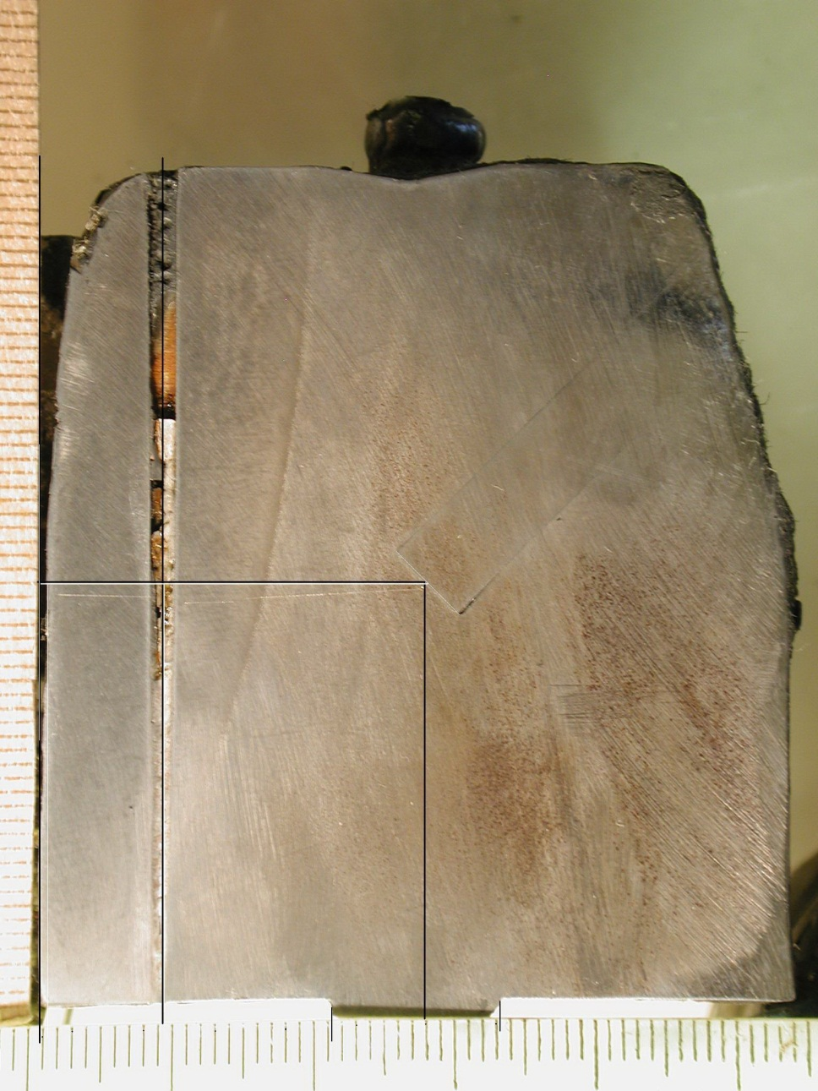
Pr1-MCP-8 results (4)
View of specimen axial section
Acoustic defect
Acoustic mirror
Boundary of thermal influence (≈730°C)
Molten layer is removed!
Acoustic way
≈ 0.9 mm

Slide 16
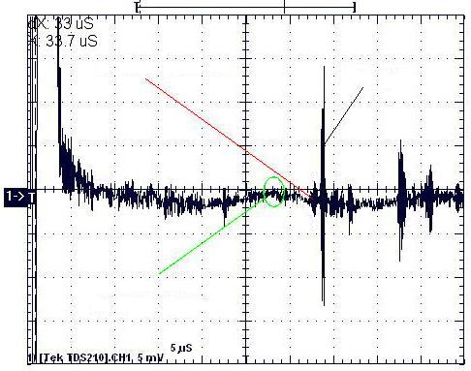
Pr1-MCP-8 results (5)
US monitoring of ablation
Signal from
interface
Signal from
top edge
Signal from
defect
Wanted signal reflected from the interface surface is several times weaker than the signal reflected from the specimen top edge
Signal from the defect is barely detectable above the level of noise
Explanation: double sound transfer through the small acoustic mirror

Slide 17
Pr1-MCP-8 results (6)
Ablation depth
Specimen ablation start in accordance with post-test processing of US monitoring data
Inleakage of molten metal from the specimen top
Ablation:
0.9…1.0 mm
In the post-test
processing of the US data
only the signal from
the interaction interface
was used. Signal from
acoustic defect was not
used due to its
weakness
Start of the distinctly observed specimen melting
Heating disconnection

Slide 18
Pr1-MCP-8 results (7)
DNB margin and efficiency of specimen cooling are experimentally confirmed
Maximum corrosion in the experiment is expected in the US monitoring zone
The US monitoring system efficiency is demonstrated, though its sensitivity is lower than for specimens with horizontal orientation of the interface. This is explained by the double sound transfer through the small acoustic mirror

Slide 19
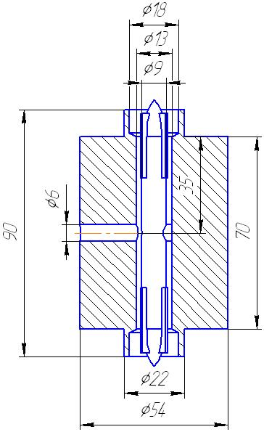
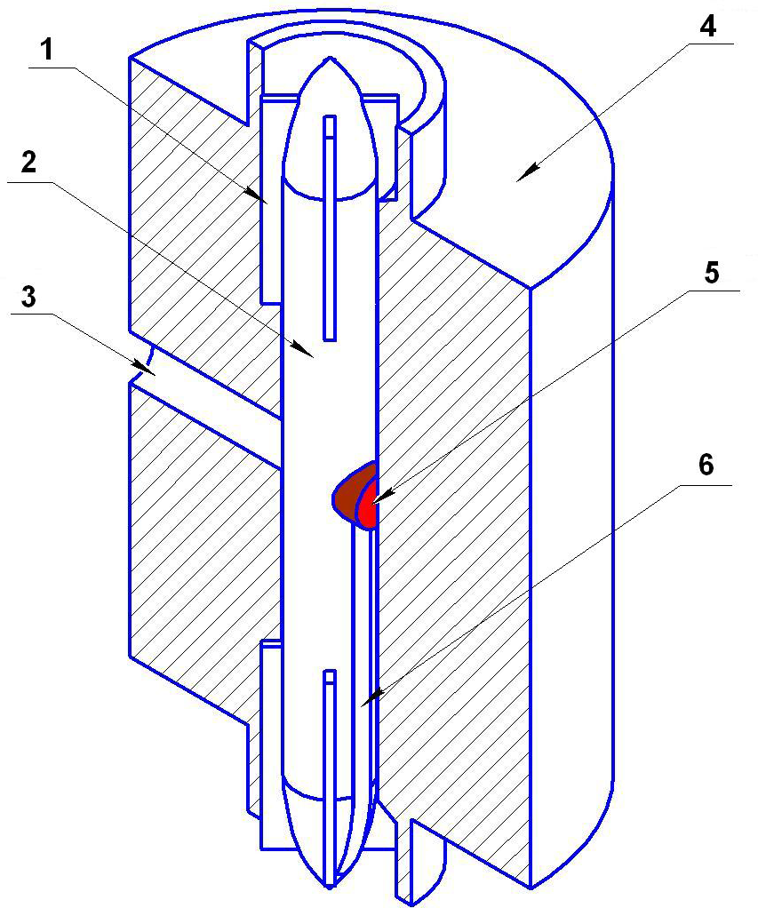
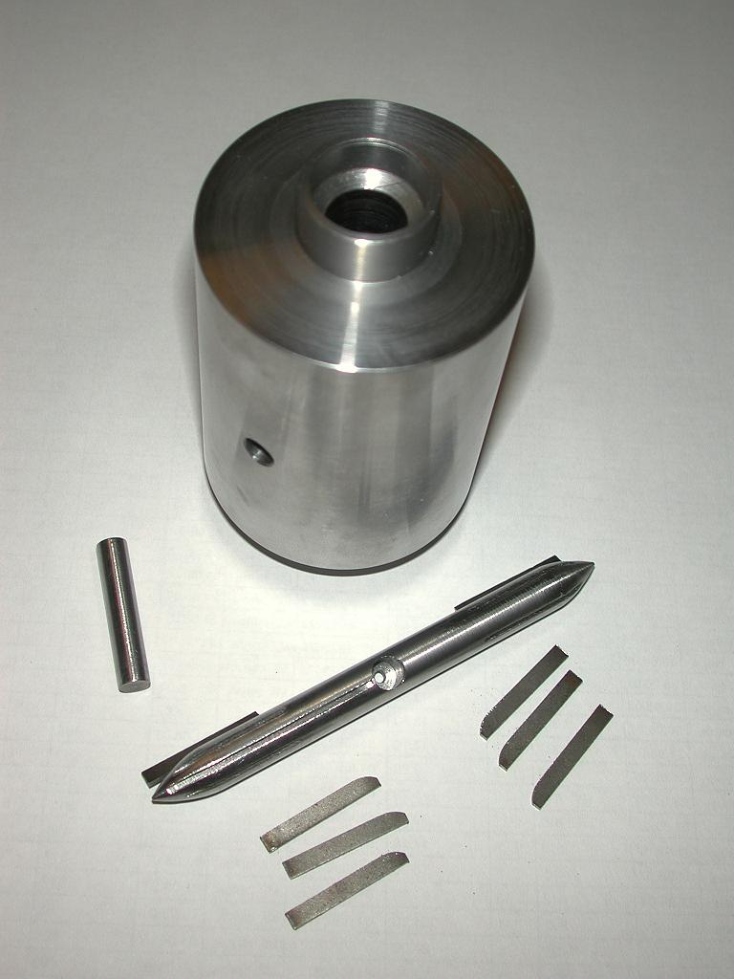
Alternative specimen design
Specimen schematics
1 – spacers
2 – displacer-holder of US sensor
3 – technological channel (in the test it will
be stopped by the steel plug 7)
4 – specimen
5 – US sensor
6 – slot in displacer for US sensor wires
7 – steel plug
4
3
7
2
heat flux on external surface ≈1 MW/m²
heat flux on internal surface of
channel ≈4 MW/m²
margin of heat flux ≈2
6
1
1

Slide 20
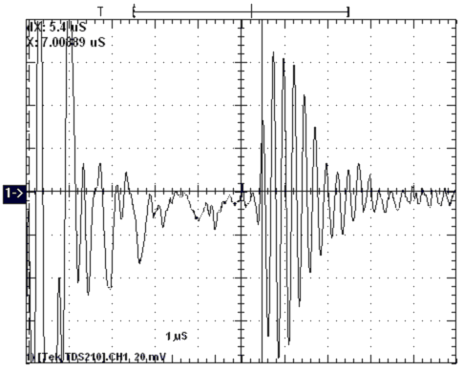
Alternative specimen design (2)
US monitoring (ambient condition, without water in central channel)
Reflected signal
US sensor proportion:
diameter – 6 mm
length – 8 mm
Frequency: 5 (±0.2) MHz
Working distance: 15(±7) mm
Temperature: <200°C
A drawback of US sensor – small damping decrement of own oscillations. It is not very important because the interface position is determined from the signal front

Slide 21
Comparison of two designs
Specimen type |  | two-channel | single-channel
Cooling system |  | Efficiency checked in the pretest at high temperatures | Not tested
US monitoring system | efficiency | Checked in the pretest with heating | Checked in ambient conditions without water supply to the channel
 | sensitivity | Sufficient for the US monitoring, though it is lower due to the double sound transfer through the small acoustic mirror | Acceptable. Small damping decrement of own US sensor oscillations
 | peculiarities | The zone of highest ablation rate – right across the acoustic mirror | The zone of highest ablation rate has a random position versus the US sensor

Slide 22
Conclusions
Two designs for steel specimens with a vertical interface orientation are proposed: two- and single-channel
The efficiency of cooling system and US monitoring for the two-channel specimen is experimentally proven
The US monitoring system for single-channel specimen has been tested in ambient conditions without water in the central channel
Proposal: use the two-channel specimen for MCP-8 studies, because it has successfully passed “hot” pretests and its systems have been found to meet essential functionality requirements

