Slide 1
SAFETY ANALYSES OF NUCLEAR INSTALLATIONS AT THE CHERNOBYL SHELTER SITE
Gunter G. Pretzsch
Gesellschaft für Anlagen- und Reaktorsicherheit (GRS) mbH
Kurfürstendamm 200, 10719 Berlin, Germany
Gunter.Pretzsch@grs.de

Slide 3
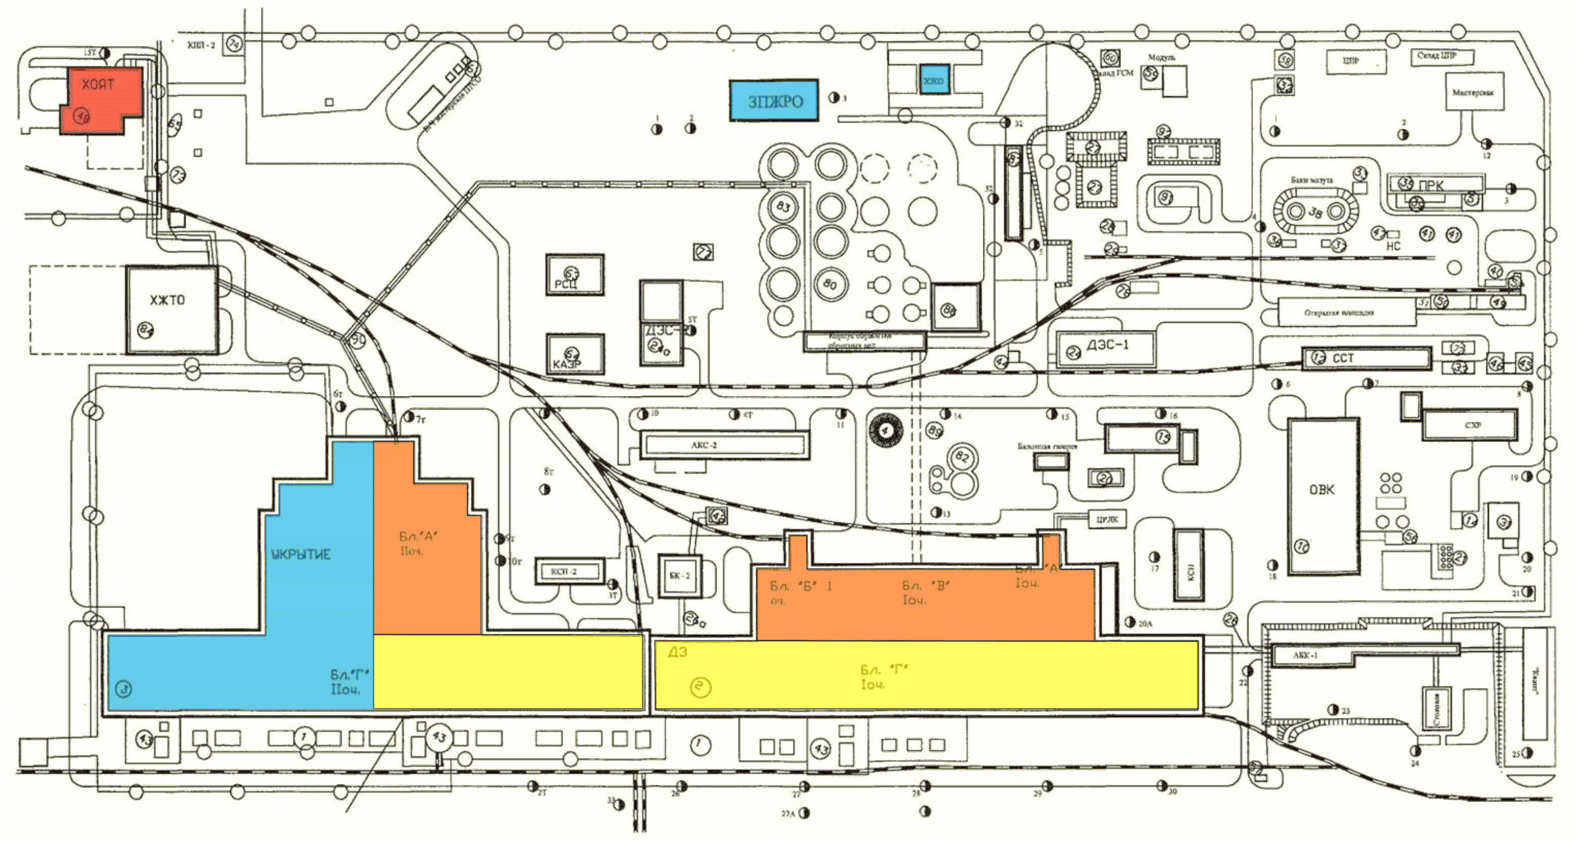
Chernobyl NPP Site - Schematic View

Slide 4
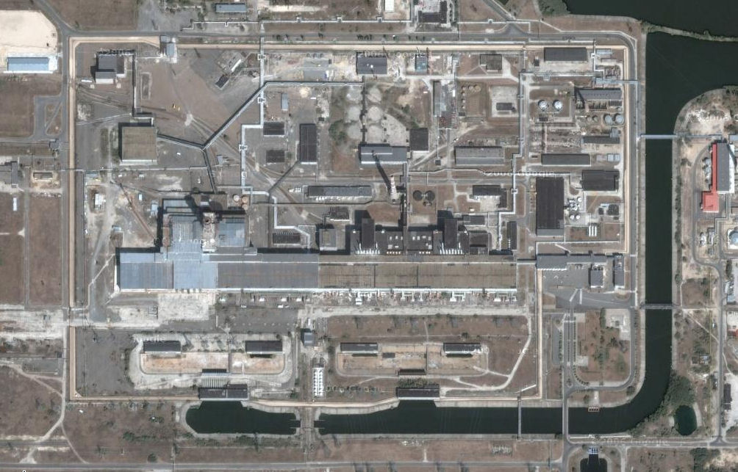
Chernobyl NPP Site - View form Satellite

Slide 6
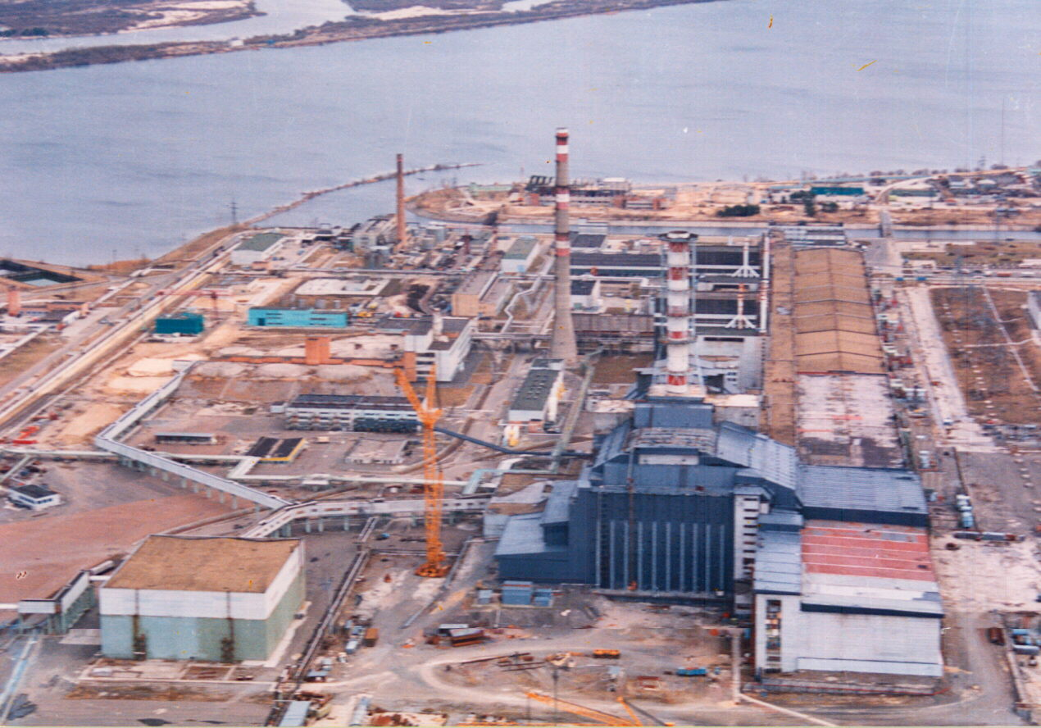
The Chernobyl Shelter Site

Slide 8
The Chernobyl Shelter
Fuel fragments
and dust in the
central hall
Fuel lava and
radioactive
water in the
lower rooms

Slide 9
    Remaining fuel inside the Chernobyl Shelter
Modification | Location | Estimated Mass
Fuel Dust | Central Hall + Upper Rooms | 30 t
Fragments of Reactor Core | Central Hall | > 21 t
Fragments of Reactor Core | Southern Cooling Pool | 14,8 t
Fragments + Lava + Dust | Upper Rooms + Room 305/2 | 85 ± 25 t
Lava | Rooms Level 3 + Room 304/3 | 10,5 ± 4,5 t
Lava | Rooms Level 2 | 12,4 ± 6,2 t
Lava | Lower Rooms | 10,5 ± 6 t
Water Solutes | Lower Rooms | 4 kg in Water

Slide 10
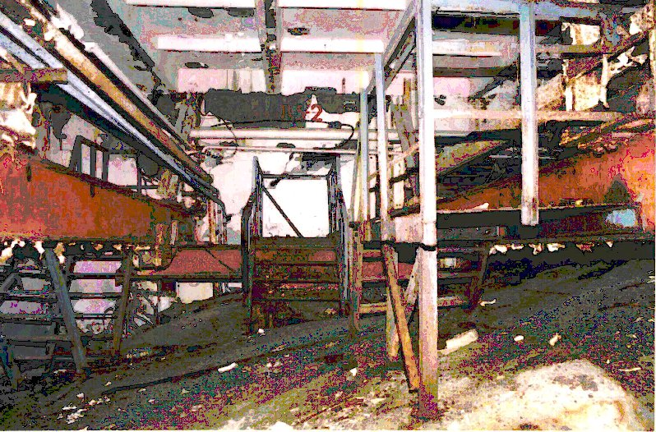
    Chernobyl Shelter, Room 401/2, fresh Concrete 4 m high

Slide 11
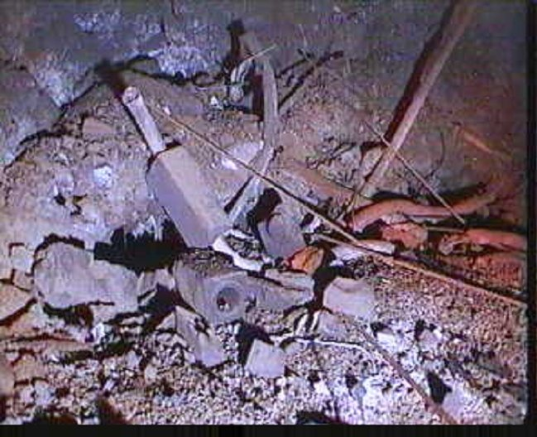
Fuel element fragments, graphite and fuel lava in the Chernobyl Shelter

Slide 12
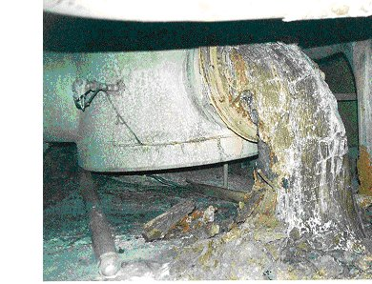
    Fuel lava in the Chernobyl Shelter, Bubble Condenser

Slide 14
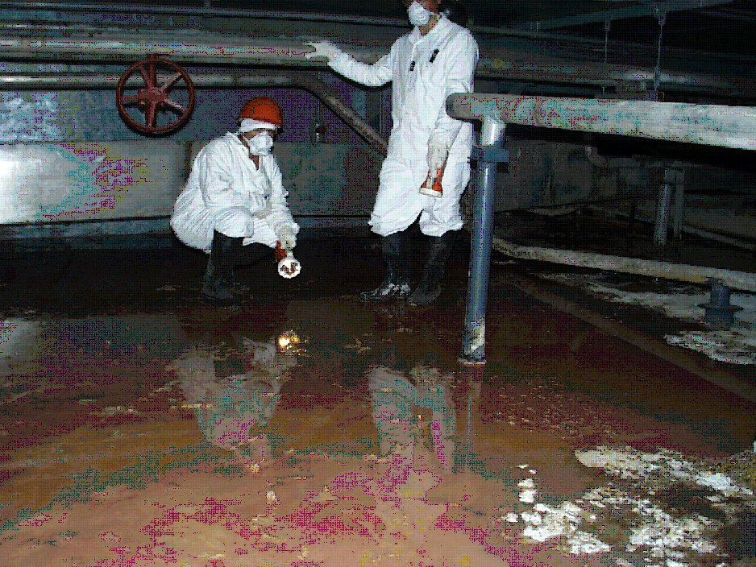
    Uranium- and Plutonium salts dissoluted in water, lower rooms

Slide 16
d₅₀ = 6...9 µm
Cumulative activity distribution of fuel dust particles versus AED

Slide 17
1,0E+01
C, no rain, u = 1,0 m/s
C, no rain, u = 2,5 m/s
C, rain 1 mm/h, u = 1.0 m/s
A, no rain, u = 1,0 m/s
F, no rain, u = 1,0 m/s
1,0E+00
Dose limit 20 mSv
Dose / Sv
1,0E-01
1,0E-02
10
100
Distance / m
1000
10000
Effective dose by inhalation versus distance

Slide 18
Neutron multiplication factor for fuel lava in room 304/3 versus water contents

Slide 19
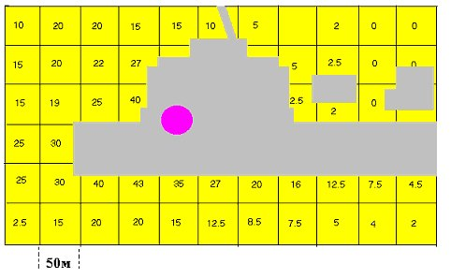
Distribution of spent fuel fallout at the Shelter site
(kg per 50 x 50 m2, June 1986, total ~ 600 kg)

Slide 20
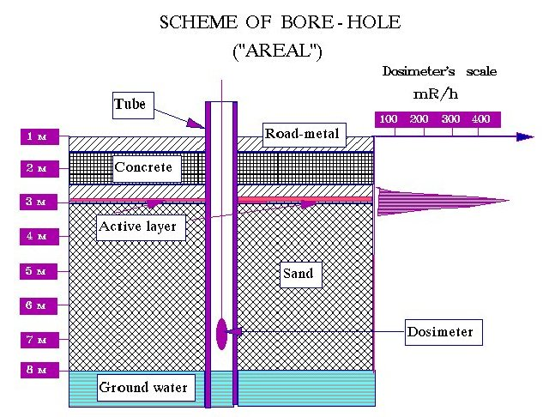
    Schemes of the groundwater observation wells at the Chernobyl Shelter site

Slide 21
    Annual groundwater concentrations of Sr 90 and Cs 137 at the Chernobyl Shelter site
    (red line - limit for Cs 137, blue line - limit for Sr 90 drinking water in Ukraine)

Slide 23
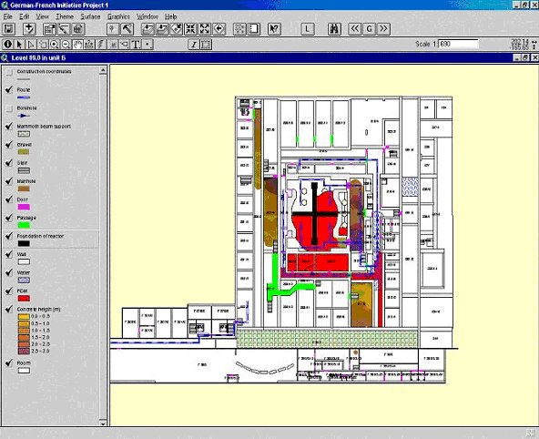
Cross section of the Chernobyl Shelter at height level 9.00 m with fuel lava (red)

Slide 24
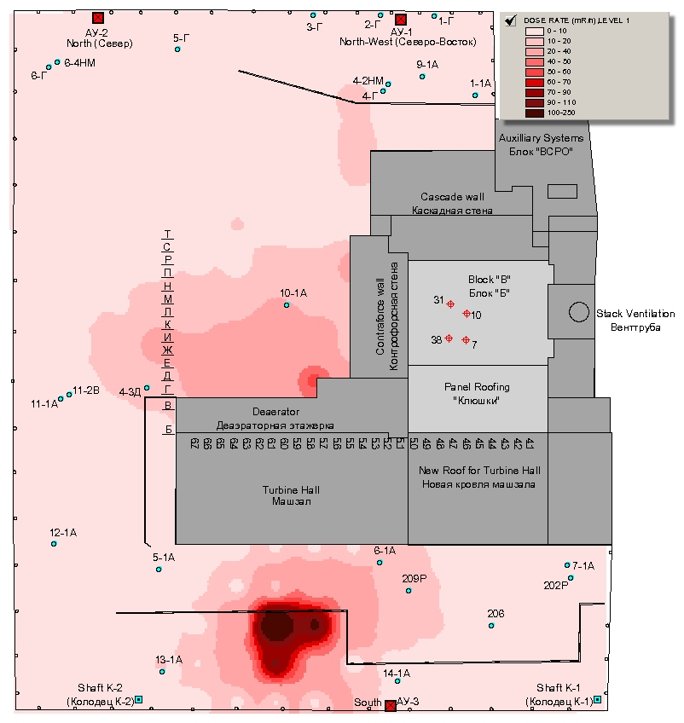
Dose rate at 1 m height above
ground at the Chernobyl Shelter Site

Slide 25
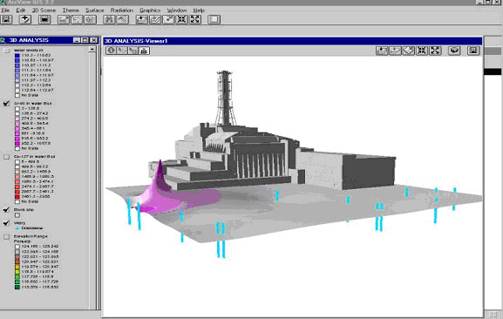
Sr 90 concentration in the groundwater at the Chernobyl Shelter site

Slide 26
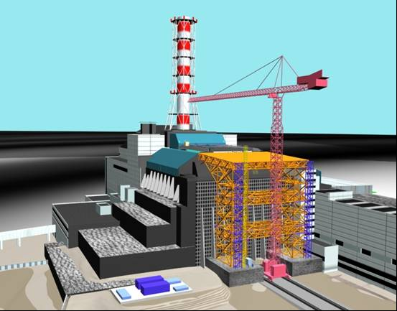
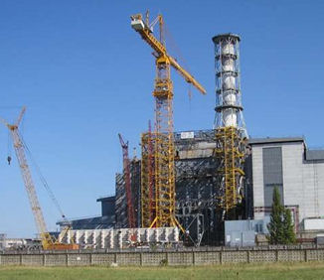
Shelter Implementation Plan, Stabilization Measures - Western Wall

Slide 27
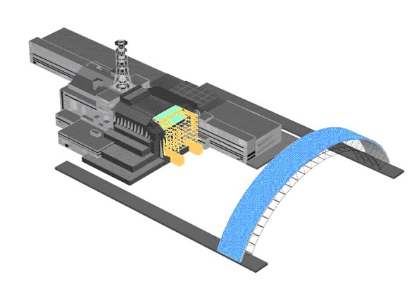
Shelter Implementation Plan, New Safe Confinement (NSC)

Slide 28
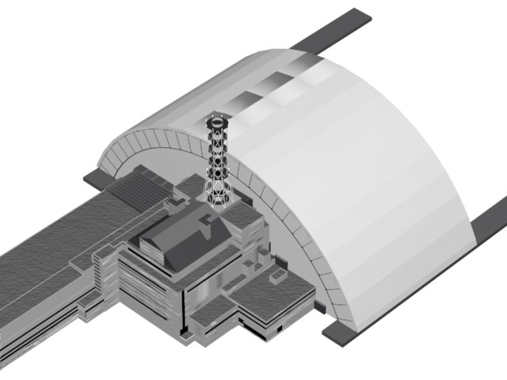
Scheme of the New Safe Confinement (NSC) - Shelter 2

Slide 29
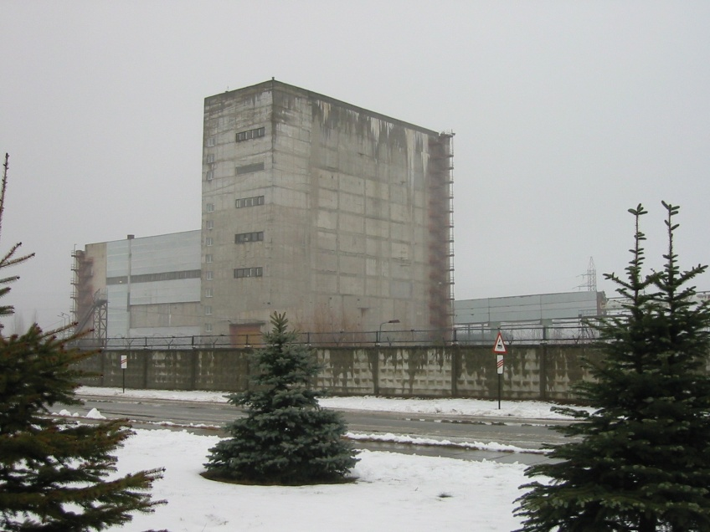
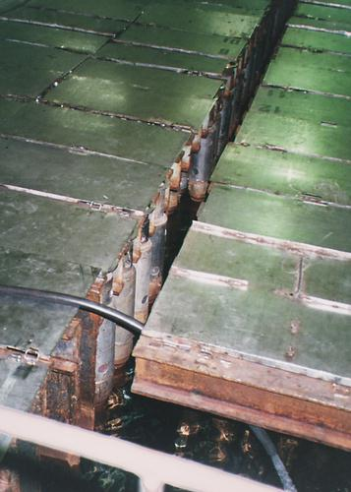
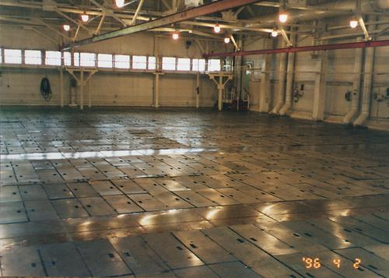
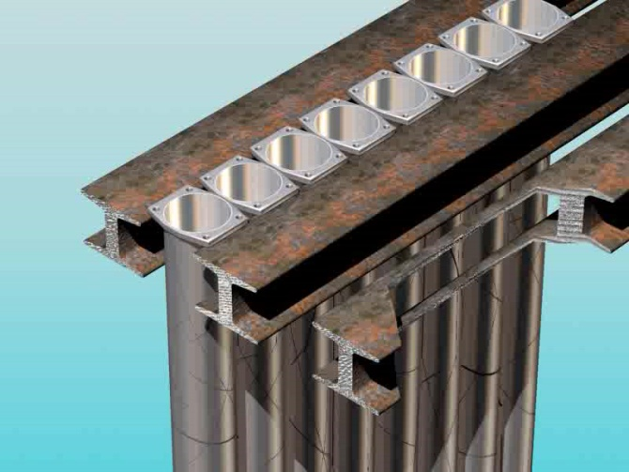
Safety Assessment - Spent Fuel storage Facility (SFSF-1)

Slide 30
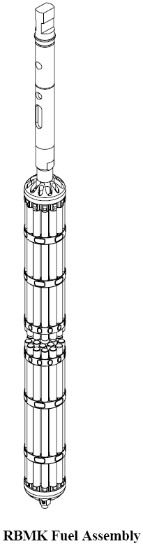
Spent Fuel storage Facility (SFSF-1) - Wet Storage of Fuel Assemblies

Slide 31
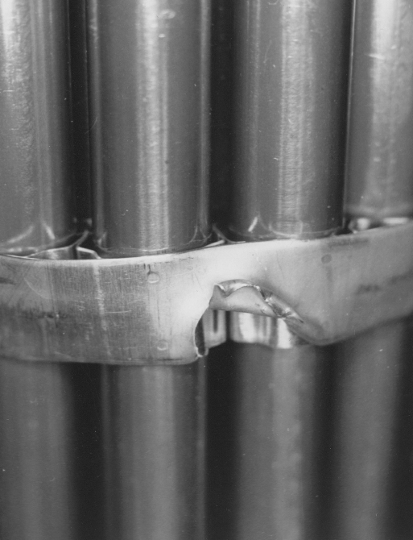
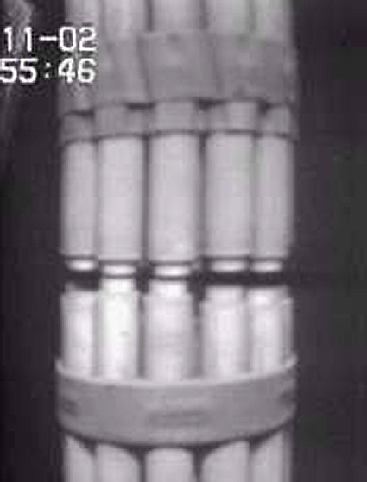
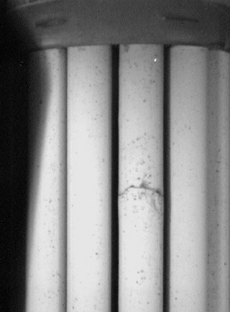
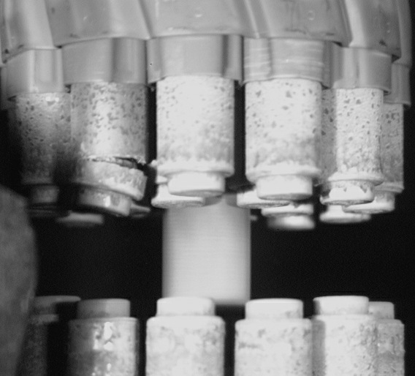
Safety Assessment SFSF-1
Destroyed Fuel Assemblies

Slide 32
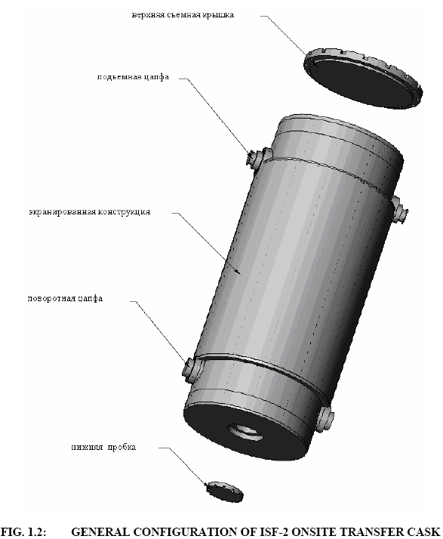
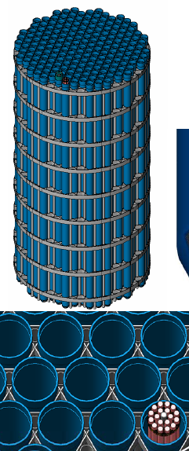
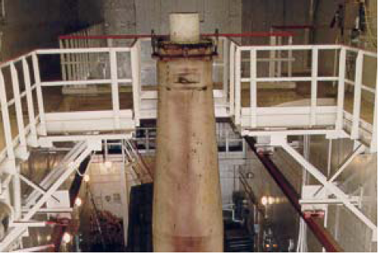
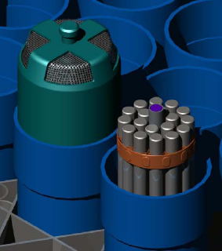
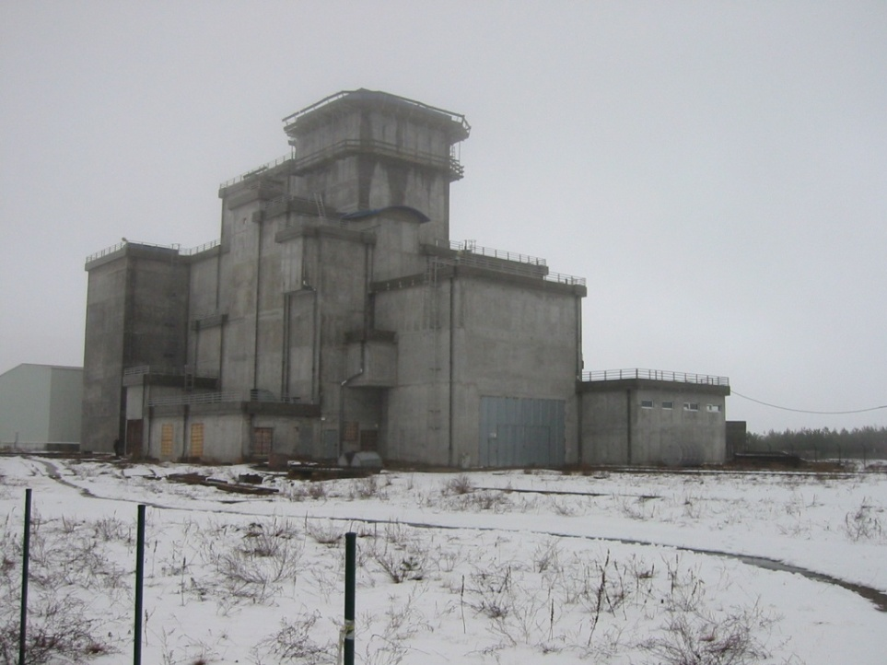
Interim Storage Facility ISF-2

Slide 33
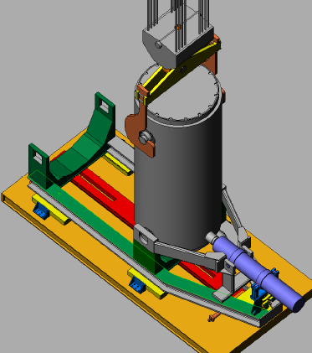
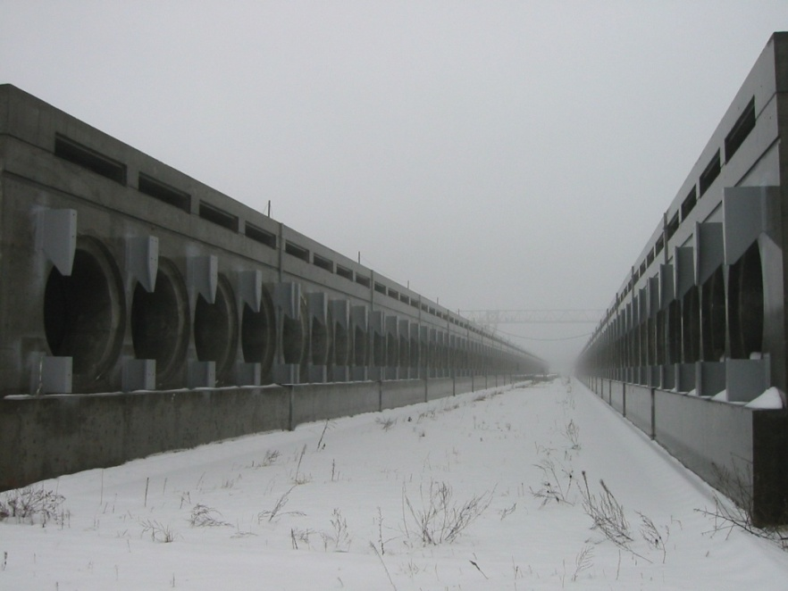
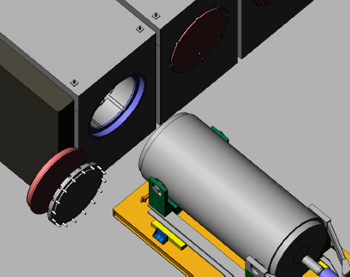
Interim Storage Facility ISF-2

Slide 35
Thank You for Attention!

