Slide 1

Interaction at molten corium oxidation transients
Proposals on МСР-7 test
A.P. Alexandrov Research Institute of Technology
ISTC METCOR-P Project
#3592
Presented by E. Krushinov
4th METCOR-P Meeting
St. Petersburg, Russia,
June 1, 2010

Slide 2
Contents
Objectives
Furnace schematics
Gas-aerosol sampling system
Experimental procedure
Posttest analysis
Conclusions

Slide 3
Objective
Study oxygen diffusion through oxidic crust on the surface of suboxidized corium melt when neutral atmosphere is replaced by steam

Slide 4
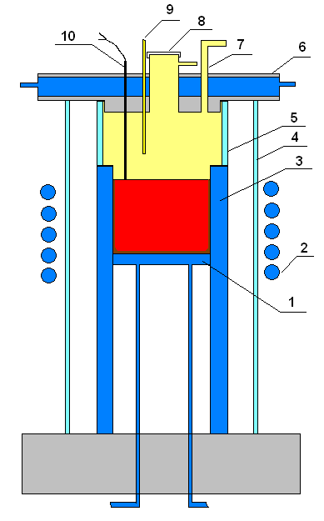
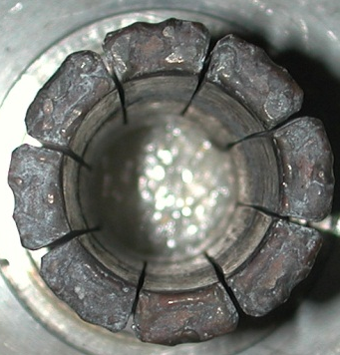
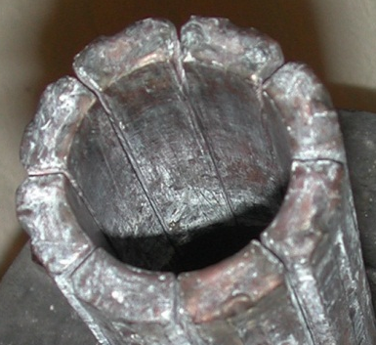
Furnace schematics
The crucible has milled sections and flat
extended 0.5 mm gaps between them. The
crucible cross-section is round, with 38 mm
diameter. To prevent steam escape to the outside
surface of the crucible the gaps will be filled with
ZrO₂ silica-alumina enamel
The outside surface of the crucible cold sections
is separated from the steam atmosphere by
quartz ring (5)
Steam condensation on the furnace cover will be
prevented by water-cooled lid (6) having hot
downward surface
Molten pool surface is raised to the maximum
level
The crucible in charged with C-32 corium, which
is molten well in advance
Furnace atmosphere is Ar/steam
1 – water-cooled bottom calorimeter; 2 – inductor; 3 – crucible sections; 4 – quartz tube;
5 – quartz ring; 6 – water-cooled furnace lid having hot downward surface;
7 – gas-aerosol mixture out; 8 – monitoring window; 9 – stainless pipe for steam supply;
10 – WRe thermocouple

Slide 5
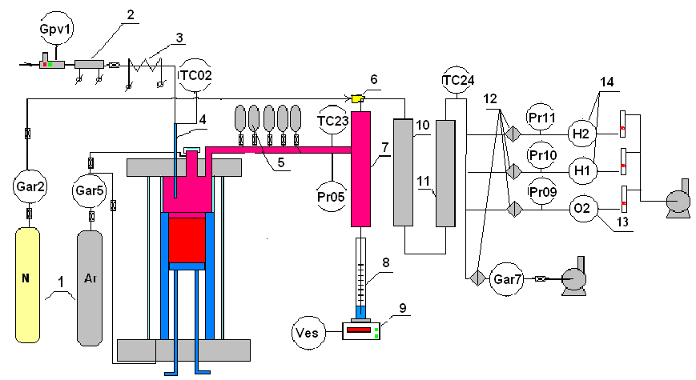
Gas-aerosol sampling system
1 – Ar, N tanks; 2 – direct-flow steam generator; 3 – heated steam supply line;
4 – stainless steam supply pipe; 5 – evacuated burettes; 6 – ejector; 7 – steam condenser;
8 – condensate collector; 9 – tensiometric weight sensor; 10 – large-area filter (LAF);
11 – silica-gel drier; 12 – Petrianov filter (AFA); 13 – electrochemical oxygen sensor;
14 – electrochemical hydrogen sensors; Gpv1, Gar – Bronhorst flow-rate regulators;
TC02 – K-thermocouple; TC23,24 – L- thermocouples; Pr05-11 – absolute pressure gauges (Honeywell)

Slide 6
Experimental procedure
Furnace is sparged with Ar
Startup heating, molten pool is produced and homogenized in the Ar atmosphere
Melt sample is taken
Molten pool surface is raised above the upper inductor coil ring to suppress the meniscus and form initial crust
At each manipulation with the molten pool its electrical and thermal parameters as well as surface crust temperature are registered
Crucible is moved to the height, which provides the minimum temperature level on the top of the formed crust
WRe thermocouple is installed on top
Ar is disconnected, steam is supplied to the furnace at a 60 g.H₂O/h flow-rate; simultaneously nitrogen is supplied to the ejector
Melt oxidation takes place
At the initial melt oxidation stage the steam-gas mixture is sampled by vacuum burettes for the chromatographic analysis
Steam is disconnected at the hydrogen content drop to the lowest sensitivity level of hydrogen sensor
Furnace is sparged with Ar; HF heating is disconnected
Ingot is crystallized in the Ar atmosphere until complete freezing

Slide 7
Posttest analysis
Posttest analysis will include the following:
Experimental file processing to determine:
Hydrogen release during oxidation
Steam spent on oxidation
Crust temperature condition at oxidation
Physicochemical analysis to determine :
Final degree of melt oxidation (integral amount of spent Zr)
Final crust thickness
Melt crust composition
Posttest analysis will be followed by:
- Direct numerical modeling of the molten pool temperature conditions
and modeling of oxidic crust growth on the pool surface

Slide 8
Conclusions
Experimental procedure has been developed
Gas-aerosol system has been assembled
New furnace design has minimum-possible
surface for uncontrolled steam condensation

