Slide 1
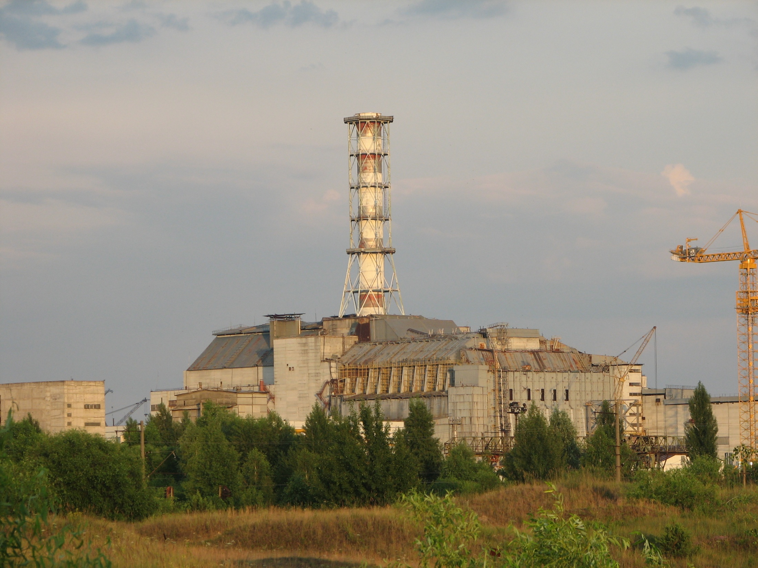
Status of STCU Project # 4207
Long-term prognosis of behavior of
the fuel dust in Chernobyl Shelter
Presented by V.Protsak
15th CEG-SAM Meeting
15th CEG-SAM meeting by PSI, Villigen, March 10-12, 2009

Slide 2
CONTENT
General information
Significance of the project
Aims and Tasks of the project
Expected results
15th CEG-SAM meeting by PSI, Villigen, March 10-12, 2009

Slide 3
Participating Institutions
Ukrainian Institute of Agricultural Radiology of National University of Life and Environmental Sciences of Ukraine.
Institute of Safety Problems of Nuclear Power Plants
of National Academy of Sciences of Ukraine
Project duration | 30 months
Participating personnel | 19 (13 “weapon” scientists)
Funding | 300,000 USD
Funding party | Canada
Project status | Initial stage (will start after the final approval by the funding party)
Foreign Partners
Krause Matt | Canada, Thermalhydraulics Branch, AECL Chalk River Laboratories
Bottomley Paul | Germany, European Commission, DG Joint Research Centre, Institute for Transuranium Elements (ITU)
Journeau Christophe | France, CEA
15th CEG-SAM meeting by PSI, Villigen, March 10-12, 2009

Slide 4
Significance of the project
Various authors estimate the fuel dust inventory in Shelter as 500 to 2000 kg. Approx 98 % of the irradiated nuclear fuel of the ChNPP unit 4 is presented by various FCMs
Analysis of the available technologies shows that removal of FCMs from Shelter can take 50-100 years
FCMs are subjected to destruction because of the external and internal factors. As a result, the new compounds and radioactive dust are formed
Dust resuspension and transport in Shelter can be caused not only by the accidents, but by any actions implying the personnel translocations (even inspections of the rooms etc)
Dispersion of 1 g of the fuel dust in 1 million m³ of air will result in two orders of magnitude exceeding the permissible levels for alpha-emitting radionuclides
15th CEG-SAM meeting by PSI, Villigen, March 10-12, 2009

Slide 5
The project aim
The main aim of the project is to create a prognosis of the long-term (50-100 years) behaviour of the radioactive dust in Shelter. It will describe both transformation of the existing fuel dust and the processes of the dust formation from the main types of FCM under the current & future Shelter conditions.
Year 1 |  |  |  | Year 2 |  |  |  | Year 3
Task 1. Mechanisms of formation and classification of the Chernobyl FP, updating the DB
Task 2. Characteristics and behavior of RA and water in Shelter
 | Task 3. Experimental study of the FP destruction
 |  |  |  | Task 4. Creation of the model of the FP transformation
 |  |  |  |  | Task 5. Long-term prognosis of the fuel dust behavior in Shelter
Quarter 1 | Quarter 2 | Quarter 3 | Quarter 4 | Quarter 5 | Quarter 6 | Quarter 7 | Quarter 8 | Quarter 9 | Quarter10
15th CEG-SAM meeting by PSI, Villigen, March 10-12, 2009

Slide 6
Main research methods:
Radiochemical methods
γ-spectrometry
α-spectrometry
β-radiometry
Optical microscopy
Micro- X-ray-spectra method
Electronic microscopy
Autoradiography
Method of the dielectric track detectors
Statistical analysis
15th CEG-SAM meeting by PSI, Villigen, March 10-12, 2009

Slide 7
1st task
The first task of the project is classification and generalization of available data on fuel particles
To update the review of particles data by the recently obtained data and to identify gaps in knowledge about their formation.
Examination of formation mechanisms of the Chernobyl FP, physical-chemical characteristics & CFP classification.
This will include analysis of the samples of fuel, CFP, FCMs and sediments collected from the basement of the Shelter
15th CEG-SAM meeting by PSI, Villigen, March 10-12, 2009

Slide 8
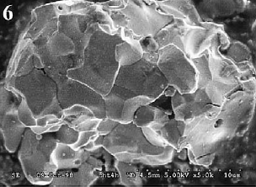
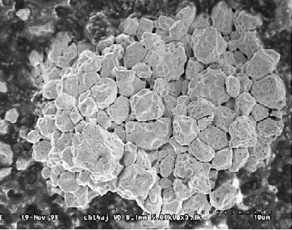
3 types of FP according to their dissolution rates under natural conditions:
chemically extra-stable particles (U-Zr-O). These particles were formed at the first moment of the accident on 04/26/86 and were deposited within the narrow western trace;
U-Zr-O
Super stable
non-oxidized chemically stable fuel particles (UO₂) of the first release (04/26/86), formed as a result of the mechanical destruction of nuclear fuel. These particles also were deposited along the narrow western trace of fallout;
UO₂
Stable
chemically low stable particles (UO_{2+x}), formed as a result of oxidization of the nuclear fuel in the period 04/26/86-05/05/86. These particles were predominantly deposited in the northern and southern traces of fuel fallout.
UO_{2+x}
Non-stable
15th CEG-SAM meeting by PSI, Villigen, March 10-12, 2009

Slide 9
For better understanding of the processes in the accidental unit and for estimation of the dispersal composition of the released fuel particles, the experiments have been performed which simulated the FP formation during the accident
Parameters of FPs dispersal composition were obtained. Median diameter of FPs does not depend on the temperature of annealing and decreases to the fuel grain (crystallite) size (∼6 μm) with prolongation of the annealing period. Taking into account the dispersal and matrix composition of the real Chernobyl FPs, one can infer that oxidization of the nuclear fuel was one of the principal processes leading to formation of FPs during the Chernobyl accident
15th CEG-SAM meeting by PSI, Villigen, March 10-12, 2009

Slide 10
Results of model experiments on dissolution of nuclear fuel particles (UO₂ and UO_{2+x}, obtained by annealing in air of UO₂) and of waste material from the trench T-22 at pH=3 and pH=4
10
UO2
UO2+x (1h)
UO2+x (3h)
k, year-1
UO2+x (5h)
1
UO2+x (7h)
UO
2+x
UO2+x (13h)
UO2+x (21h)
0,1
T-22
UO
2
0,01
2
4
6
8
10
pH
dA/dt= −(k+λ)⋅A,
ΔFP=A(t)/A₀⋅exp(-λt)=exp(-kt),
A₀ and A(t) – radionuclide initial activity in FP and activity remaining at the moment t after the beginning of dissolution, respectively;
k – FP transformation constant, year⁻¹;
λ - radioactive decay constant, year⁻¹
15th CEG-SAM meeting by PSI, Villigen, March 10-12, 2009

Slide 11
The FP dissolution processes
in the temporary storages of radioactive waste (TSRW)
It was found that in TSRW Red Forest (2.5 kilometers South-West of the ChNPP) ⁹⁰Sr in initial radioactive contamination of the trench (at t=0) was presented in four different physical-chemical forms:
U-Zr-O particles: ΔFP₁(0)=0,20±0,10 of ⁹⁰Sr total activity (k₁≈0)
UO₂ particles: ΔFP₂(0)=0,57±0,15 of ⁹⁰Sr total activity (k₂=0,018±0,001 year⁻¹ for pH=5)
UO_{2+x} particles: ΔFP₃(0)=0,21±0,15 of ⁹⁰Sr total activity (k₃=0,28±0,05 year⁻¹ for pH=5)
Condensed form of ⁹⁰Sr outside particles: A_{k}(0)=0,02±0,01 of ⁹⁰Sr total activity (k₄=∞).
15th CEG-SAM meeting by PSI, Villigen, March 10-12, 2009

Slide 12
Relative dynamics of the ⁹⁰Sr inventories in the mobile forms in the trench (without release due the migrations from the trench)
1
U-Zr-O
0,8
1-ΔFP
0,6
(1-ΔFP)*exp(-λt)
0,4
0,2
0
1
10
100
t, years
1000
15th CEG-SAM meeting by PSI, Villigen, March 10-12, 2009

Slide 13
2nd task
Characteristics and behavior of RA and water in Shelter
The main aim is identification of the “origination signs” of RA and radionuclides in water in Shelter.
Investigation of the Shelter RA and water will include:
Classification of the places of localization of the LFCM to be controlled.
Balance study of the water and air fluxes in the places of localization of
the controlled LFCM.
Study of the phase and dispersal distribution of the radionuclides on
the solid particles in water and RA in Shelter, identification of the
radionuclides activity correlations (U, Pu, Am, Sr, Cs) for evaluation
of the level and rate of destruction of the fuel and LFCM.
15th CEG-SAM meeting by PSI, Villigen, March 10-12, 2009

Slide 14
Aerosols in Shelter
The recent studies report an increase of the airborne concentration
of the sub-micron aerosol fraction (AMAD < 0.6 μm) In Shelter.
The average monthly increments in 207/4 and 318/2 rooms are 5%
and 10%, respectively (measurements of 2006-2008).
In 318/2 room the α-activity of the sub-micron aerosols is about
5·10⁻⁴ Bq/m³, and its 10% increase can be caused by formation of
1000 fine FP per 1 m³ of the room volume (assuming that the α-
activity of each particle is 5·10⁻⁸ Bq).
However, the actual generation rate of the fuel aerosol sub-micron
fraction can be determined only if we perform the aerosols
sampling directly in the rooms that contain fuel.
15th CEG-SAM meeting by PSI, Villigen, March 10-12, 2009

Slide 15
Water in Shelter
Nonhermeticity of Shelter results in the permanent flowing the waters through it.
Annual water fluxes in Shelter are formed by 2000 m³ of the precipitations, 600 m³
of the fluid condensed at the walls, and 200 m³ sprayed by the dust-suppression system.
⁹⁰Sr, Bq/m³
Sr-90
Pu
Pu,Bq/m³
1E+10
1,0E+08
Dynamics of the ⁹⁰Sr and ²³⁸⁺²³⁹⁺²⁴⁰Pu concentrations in the liquid radioactive waste (LRW) in 001/3 room
1E+9
1,0E+06
1E+8
1,0E+04
1996
1998
2000
2002
2004
2006
2008
²³⁸⁺²³⁹⁺²⁴⁰Pu, Bq/m³
6,0E+06
5,0E+06
Dynamics of the Pu concentration in the LRW in 001/3 room
4,0E+06
3,0E+06
2,0E+06
1,0E+06
III
VI
IX
XII
III
VI
IX
XII
2007
2008
15th CEG-SAM meeting by PSI, Villigen, March 10-12, 2009

Slide 16






1,0E+10
⁹⁰Sr, Bq/m³
Dynamics of the annual average concentration of ⁹⁰Sr in the LRW in the steam chamber
1,0E+9
1,0E+8
96
97
98
99
00
01
02
03
04
05
06
07
08
60
U, gr/m³
40
Dynamics of the annual average
concentration of uranium in the LRW in
the steam chamber
20
0
96
97
98
99
00
01
02
03
04
05
06
07
08
1,0E+8
²³⁸⁺²³⁹⁺²⁴⁰Pu, Bq/m³
Dynamics of the annual average
concentration of plutonium in the
LRW in the steam chamber
1,0E+7
1,0E+6
1,0E+5
1,0E+4
96
97
98
99
00
01
02
03
04
05
06
07
08
15th CEG-SAM meeting by PSI, Villigen, March 10-12, 2009

Slide 17
Dynamics of the ⁹⁰Sr and ¹³⁷Cs specific activities and рН in the groundwater
in the Shelter’s local zone (well 4-G)
Bq/L
рН
800
14.0
Sr-90
Cs-137
рН
700
12.0
600
10.0
500
8.0
400
6.0
300
200
4.0
100
2.0
0.0
01.01
05.01
09.01
01.02
05.02
09.02
01.03
05.03
09.03
01.04
05.04
09.04
01.05
02.05
06.05
10.05
04.06
08.06
09.07
15th CEG-SAM meeting by PSI, Villigen, March 10-12, 2009

Slide 18
3rd task
Experimental study of the FP destruction
Fragments of the active zone
Condensed
UO2
UO2+X
U-Zr-O
LFCM
Shelter conditions
destruction
dispersion
transformation
Radionuclides transfer into the mobile forms
Formation of the secondary HP
15th CEG-SAM meeting by PSI, Villigen, March 10-12, 2009

Slide 19
Experimental studies of destruction of FP and main types of the LFCM in the model media
Experimental studies of CFP destruction rate as a function of particle
characteristics: matrix composition, oxidation level, and as a function
of the medium: humidity, temperature, pH.
The medium pH will be alkaline (water in Shelter is in contact with
concrete of the basement), with either acid (groundwater) or neutral
(control) water for comparison.
Experimental studies of destruction rate of the samples of the main
types of LFCM as a function of the cycling temperature (heating and
cooling) and pH.
The fate of the key radionuclides such as ⁹⁰Sr (as SrCO₃) and the
leaching rates of ¹³⁷Cs, U, ²⁴¹Am and Pu from the particles will be
some of the essential information expected from this work.
15th CEG-SAM meeting by PSI, Villigen, March 10-12, 2009

Slide 20
4rd task
Creation of the model of the FP transformation
UO2
UO2+X
U-Zr-O
The model will describe transformation of the
main FP types in the Shelter conditions.
To create the model we will use the results of
both the previous studies and the experimental
studies within the frameworks of the project.
The main parameters to be predicted:
- destruction rate;
- changing the dispersal composition;
- the radionuclides leaching rates from the FP
matrix.
Shelter conditions
destruction
Radionuclides transfer into the mobile forms
15th CEG-SAM meeting by PSI, Villigen, March 10-12, 2009

Slide 21
5th task
Long-term prognosis of the fuel dust behavior in Shelter
The long-term prognosis of the fuel dust behavior in Shelter will be based on the
analysis and generalization of all available information including the results of
modeling of the fuel particles transformation.
The aim of the prognosis is to answer the main questions: what will be the amount
of the fuel dust in Shelter in the future? What will be the parameters of the dust
(dispersal composition, radionuclide composition, bulk density, aerodynamical
properties, solubility etc)?
Prognosis will take into account both the present conditions in Shelter and their
evolution after the NSC creation.
15th CEG-SAM meeting by PSI, Villigen, March 10-12, 2009

Slide 22
Expected results
Classification of FP in Shelter according to their physical-chemical properties
(mechanism of formation, matrix, radionuclides fractionation coefficients, burn-
up, types of admixtures, chemical stability).
Modernization and update of “Chernobyl HP” database.
Quantitative identification of the structural changes of the LFCM aggregate state
using the data on the radionuclide activities in the samples of RA and water from
Shelter.
Experimental values of the destruction parameters of the actual FP and samples
of the main types of LFCM in the media simulating those in Shelter.
The model describing the FP transformation parameters in the Shelter
conditions.
The long-term prognosis of the fuel dust behavior in Shelter.
15th CEG-SAM meeting by PSI, Villigen, March 10-12, 2009

Slide 23
The results of the project can be utilized for:
Optimization of the project solutions while planning the works in Shelter.
Optimization of the necessary level of the radiation safety during
realization of the works in Shelter.
Calculation of the costs (including the expenses for the radiation
protection and management the radioactive waste).
Evaluation of the radiological risk to the personnel.
Evaluation of the risk caused by the worsening working conditions during
the maintenance activity, building the NSC and removal of the FCM.
15th CEG-SAM meeting by PSI, Villigen, March 10-12, 2009

Slide 24
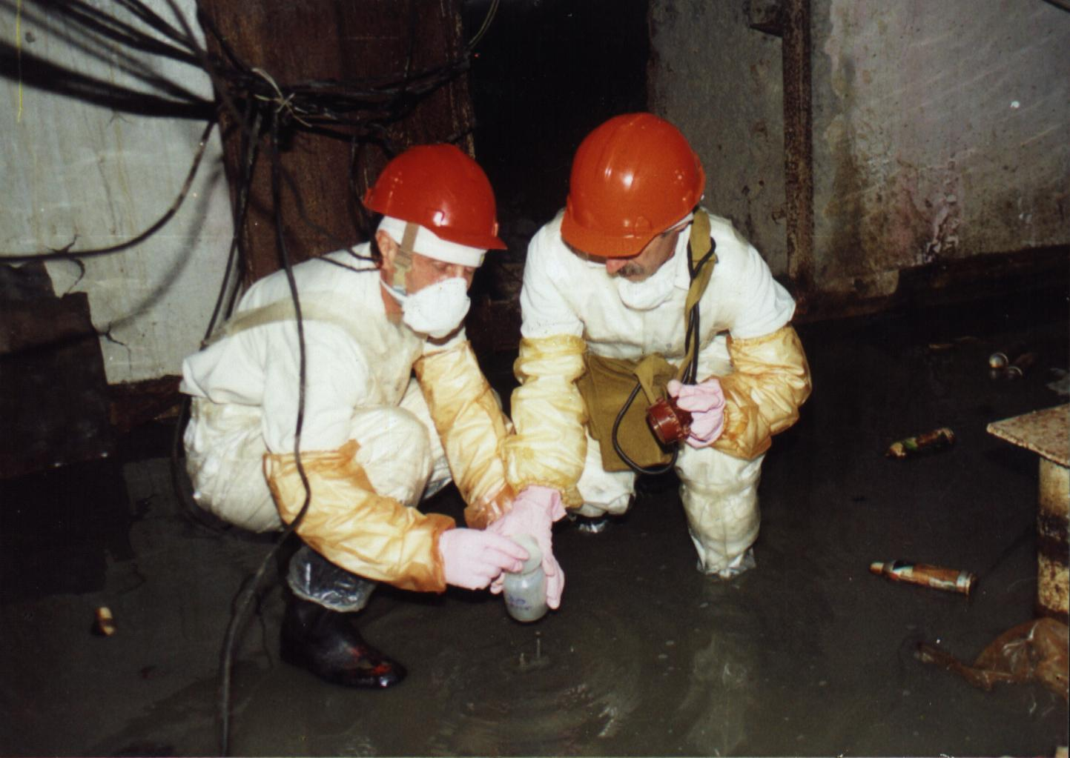
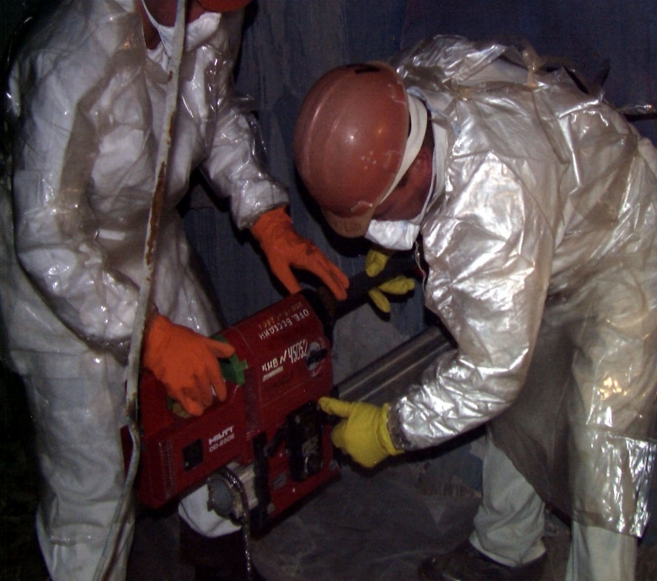
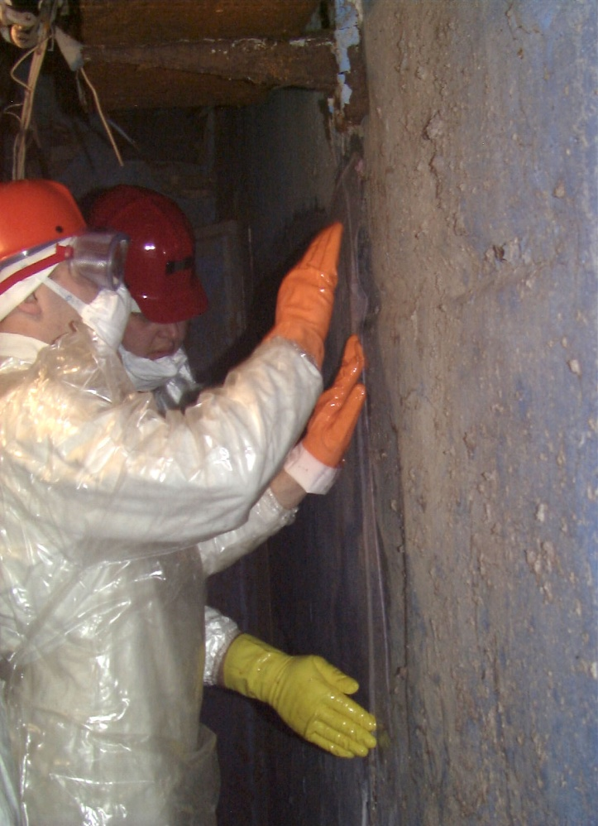
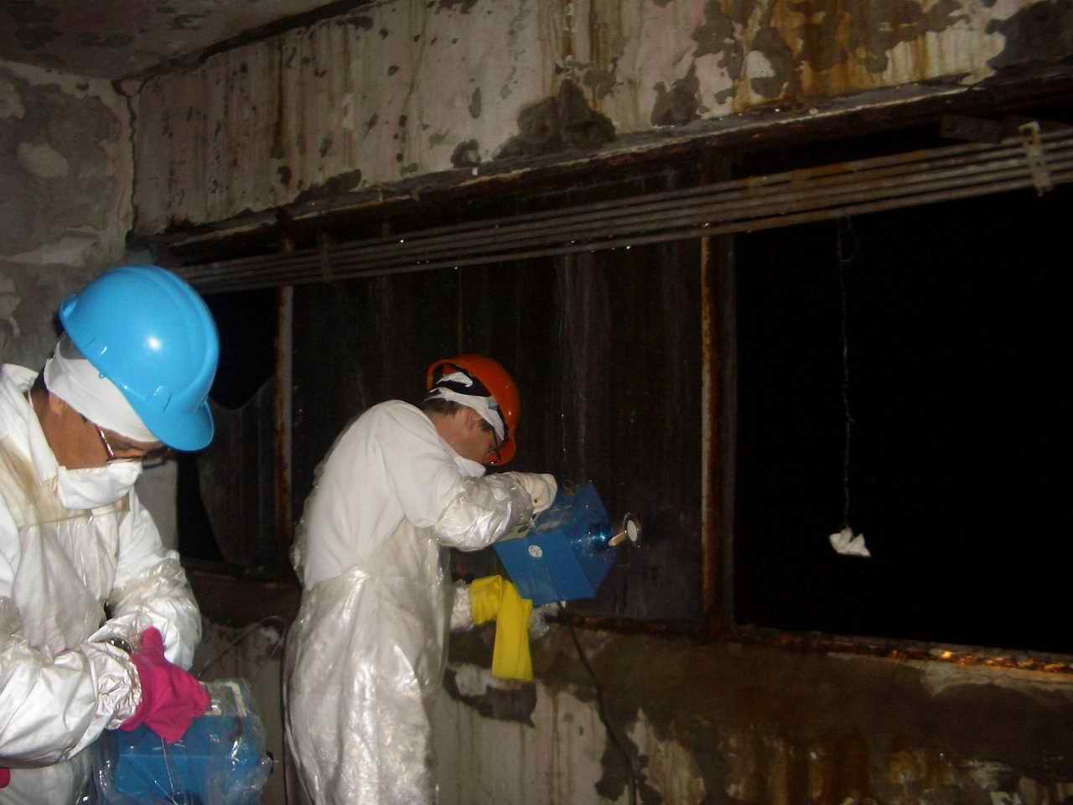
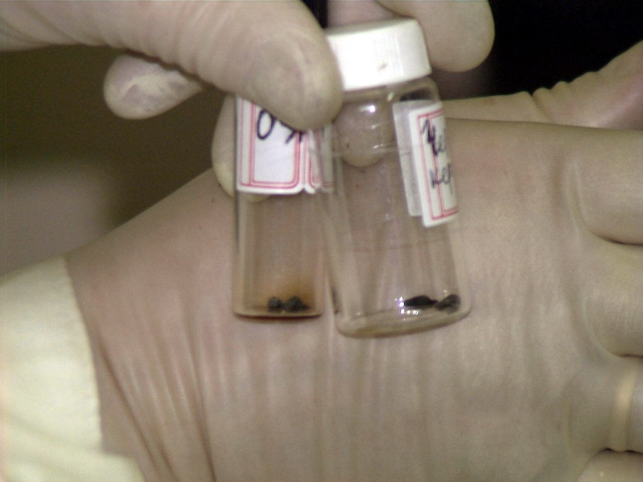
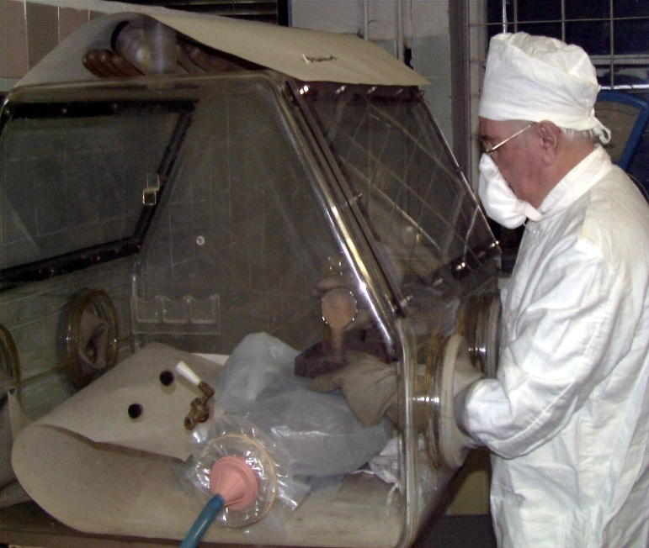
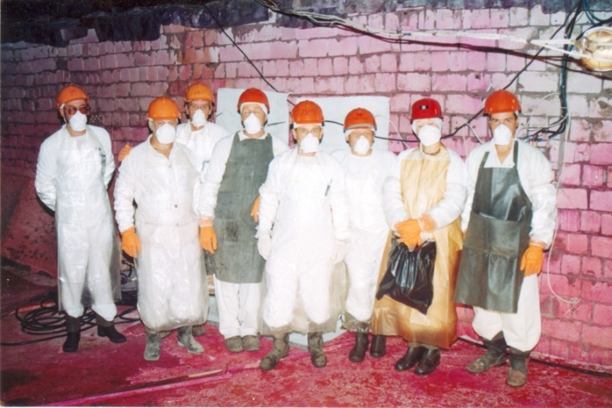
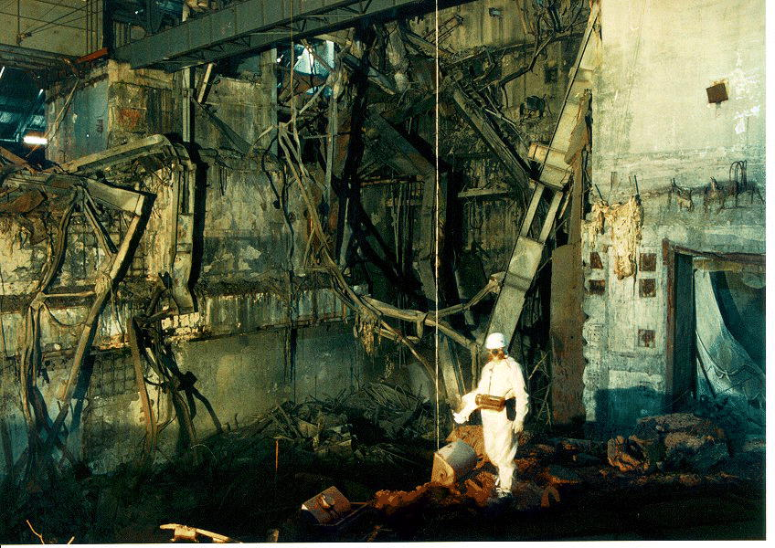
Thank you very much for attention!

