Slide 1
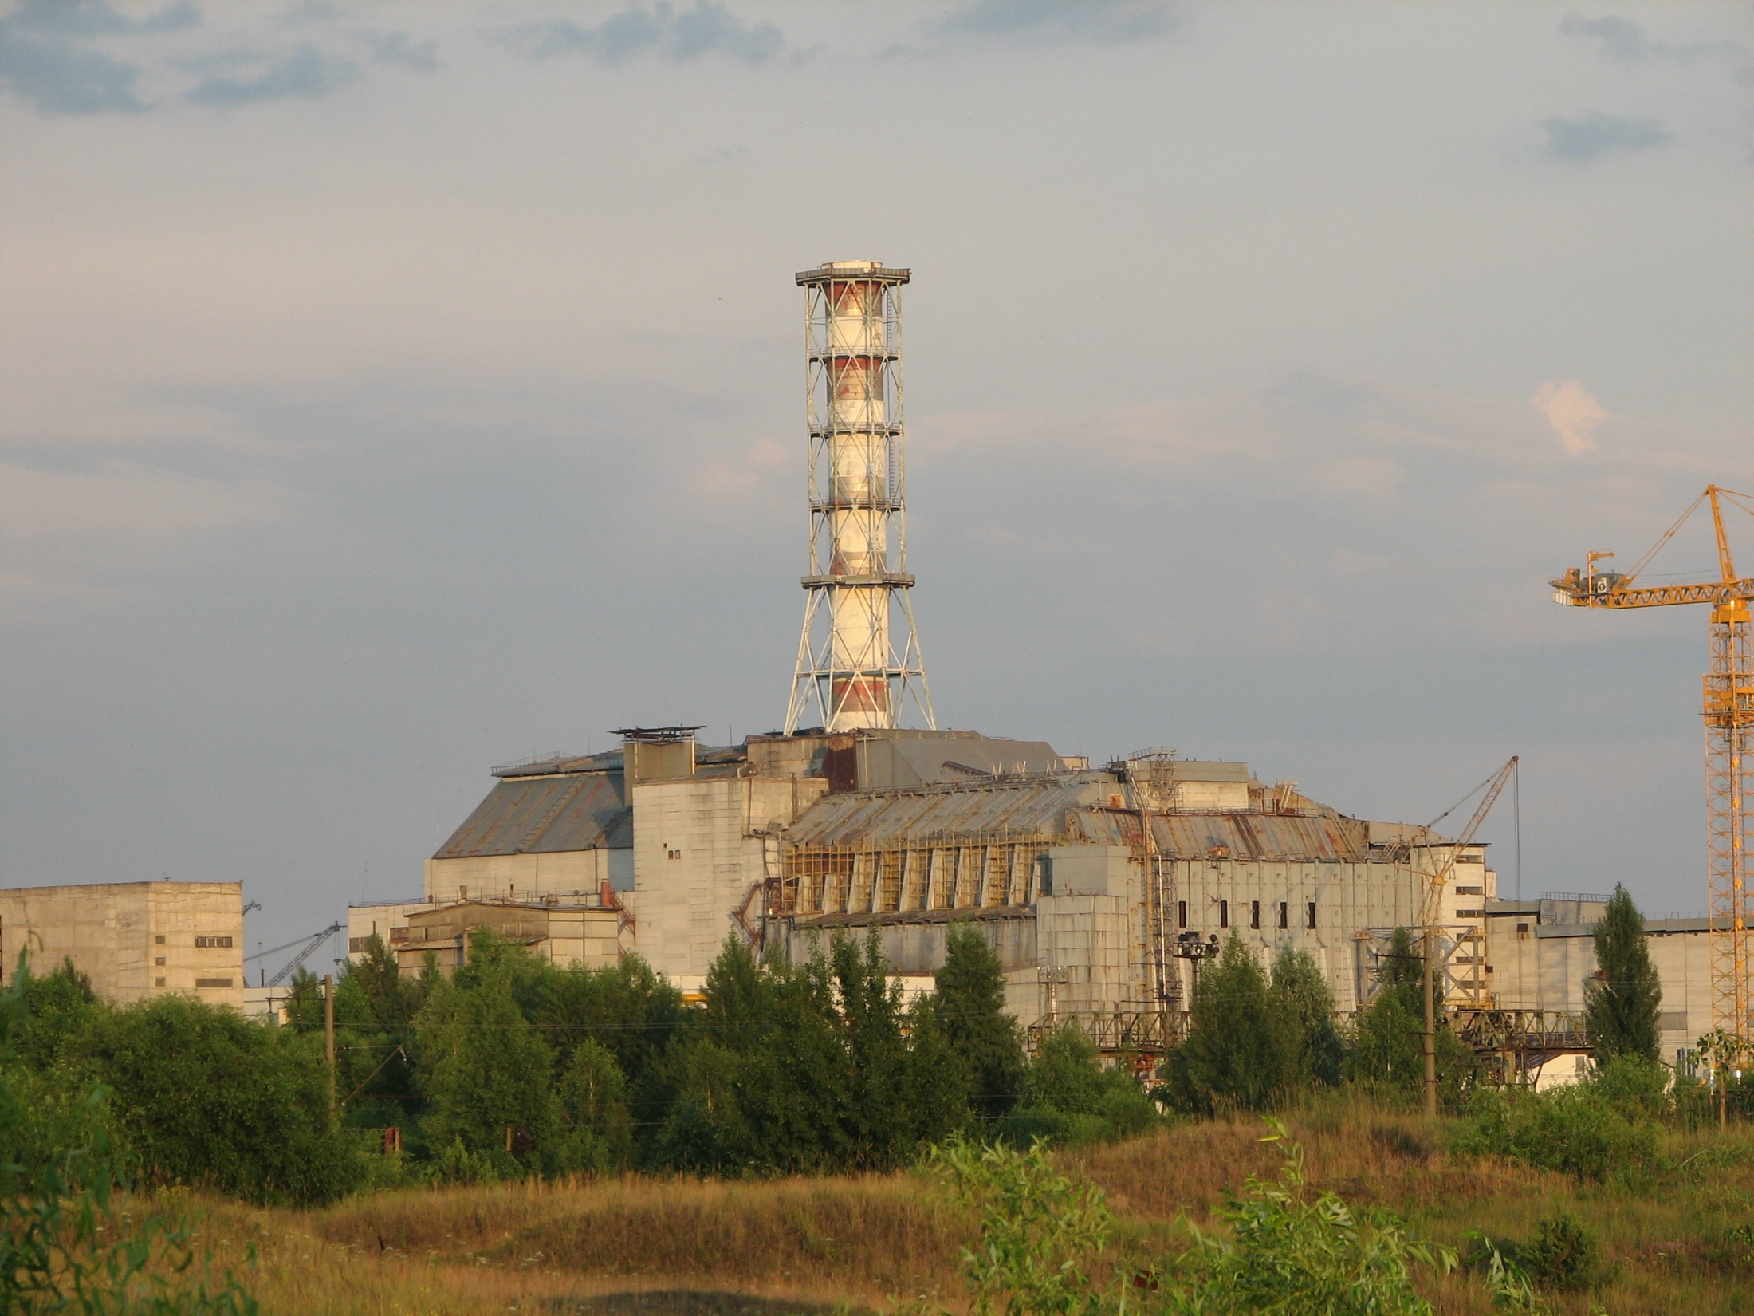
Progress report STCU Project # 4207
Long-term prognosis of behavior of the fuel dust in Chernobyl Shelter
Presented by V.Protsak
18th CEG-SAM Meeting
18th CEG-SAM meeting
St. Petersburg, September 27-30, 2010

Slide 2
CONTENT
General information
Significance of the project
Objectives & Stages
Results obtained

Slide 3
Participating Institutions
Ukrainian Institute of Agricultural Radiology of National University of Life and Environmental Sciences of Ukraine
Institute of Safety Problems of Nuclear Power Plants
of National Academy of Sciences of Ukraine
Collaborator – Dr. M. Krause, AECL, Chalk River, ON, Canada
Project duration | 30 months
Participating personnel | 19 (13 “weapon” scientists)
Funding | 300,000 USD
Funding party | Canada
Project status | 6th Quarter

Slide 4
Significance of the project
Various authors estimate the fuel dust inventory in Shelter as 500 to 2000 kg. Approx 98 % of the irradiated nuclear fuel of the ChNPP unit 4 is presented by various FCMs
Analysis of the available technologies shows that removal of FCMs from Shelter can take 50-100 years
FCMs are subjected to destruction because of the external and internal factors. As a result, the new compounds and radioactive dust are formed
Dust resuspension and transport in Shelter can be caused not only by the accidents, but by any actions implying the personnel translocations (even inspections of the rooms etc)
Inhalation of the fuel dust is very dangerous because it results in the internal irradiation

Slide 5
The project objectives & stages
The main aim of the project is to create a prognosis of the long-term (50-100 years) behaviour of the radioactive dust in Shelter. It will describe both transformation of the existing fuel dust and the processes of the dust formation from the main types of FCM under the current & future Shelter conditions.
Year 1 |  |  |  | Year 2 |  |  |  | Year 3
Stage1. Mechanisms of formation and classification of the Chernobyl FP, updating the DB
Stage 2. Characteristics and behavior of RA and water in Shelter
 | Stage 3. Experimental study of the FP destruction
 |  |  |  | Stage 4. Creation of the model of the FP transformation
 |  |  |  |  | Stage 5. Long-term prognosis of the fuel dust behavior in Shelter
Quarter 1 | Quarter 2 | Quarter 3 | Quarter 4 | Quarter 5 | Quarter 6 | Quarter 7 | Quarter 8 | Quarter 9 | Quarter10

Slide 6
Main research methods:
Radiochemical methods
γ-spectrometry
α-spectrometry
β-radiometry
Optical microscopy
Micro- X-ray-spectra method
Electronic microscopy
Autoradiography
Method of the dielectric track detectors
Statistical analysis

Slide 7
Stage 1
Mechanisms of formation and classification of the Chernobyl FP, updating the DB
Within the frameworks of the 1st stage we have analyzed the array of the available information related to the problem of the fuel dust and FCM in Shelter. The main attention was paid to:
- the data concerning the distribution and inventories of the FCM in the Shelter rooms;
- the FCM physical-chemical characteristics and their classification;
- the data characterizing the destruction processes in the existing FCM types and the models describing the FCM destruction;
- the data concerning the water flows and the characteristics of the water volumes in Shelter;
- the characteristics of the radioactive aerosols in Shelter.

Slide 8
Stage 1
At present the obtained information is processed and stored in the specially developed Database.
The main fields of the DB are:
the premise code,
characteristics of the premise,
presence and types of the FCM in the premise,
the FCM parameters, presence of the fuel dust according to the observations,
presence of the water flow through the premise and its parameters,
presence of the air flow,
the models of destruction of the present types of the FCM.

Slide 9
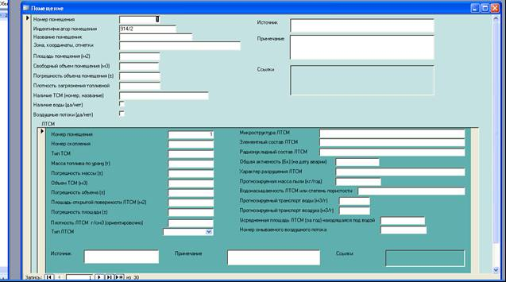

Slide 10
Stage 2 Characteristics and behavior of RA and water in Shelter
During this stage the water samples for analysis of uranium concentration and specific activity of the radionuclide (90Sr, 137Cs, 238Pu, 239+240Pu, 241Am, 244Cm) in aggregations of the LRW were collected at the lower marks of Shelter, namely in the rooms 001/3 VSRW, bubbler pool and in the south-east part of the block B. The radionuclide activities in the water samples collected were measured. The 90Sr activity was determined by means of β-radiometry, 137Cs – γ-spectrometry, U – spectrophotometer, TUE – radiochemical extraction and α-spectrometry. Uncertainty of all measurements did not exceed 10-15 %.
The number of water samples and air samples exceed 100.

Slide 11
Stage 3 Experimental study of the FP destruction
During the stage we have continued the experimental works for determination of the dynamics of the radionuclide leaching from the LFCM samples in the simulated Shelter waters. The experiments are in progress now.
Also during the stage the samples of the three LFCM types (brown, polychrome and black ceramics) were prepared for study of 90Sr, 137Cs, 238Pu, 239+240Pu and 241Am leaching in the distilled water.

Slide 12
Stage 4 Creation of the model of the FP transformation
During this stage we started the works for creation of a model of the fuel particles transformation in the Shelter conditions. The model will describe the FP destruction, change of their dispersal composition and the radionuclide leaching rates. We have analyzed the information characterizing the physical-chemical properties of the Shelter environment and the chemical stability of uranium dioxide and its higher oxides. Also we reviewed the results of studies of the fuel particles destruction both in natural conditions and in the simulated media. The preliminary analysis shows that the fuel particles dissolution kinetics is satisfactory described by the first order differential equation. Since the dissolution rate of the particles will increase with time because of the increase of their surface/mass ratio, it is planned to apply either the concept of the dissolution rate normalized to the particle surface area (g/cm2·day) or the concept of linear dissolution rate (μm/yr).

Slide 13
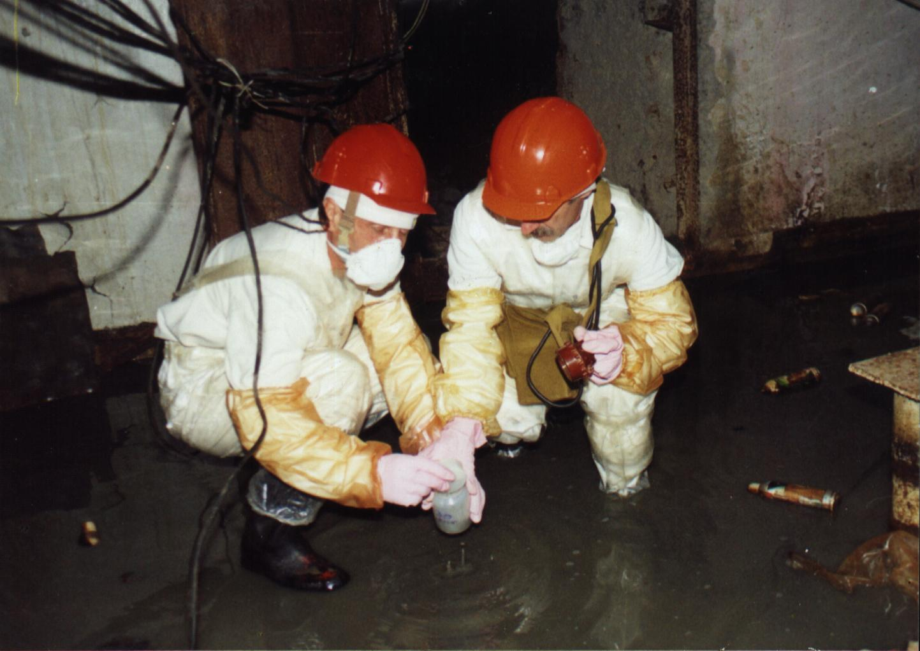
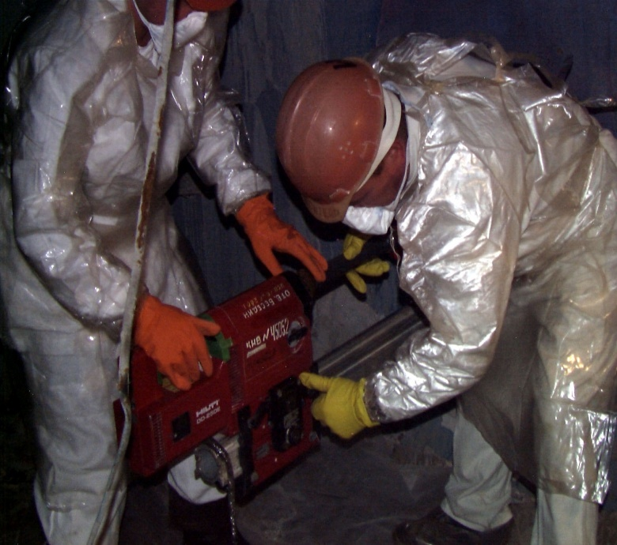
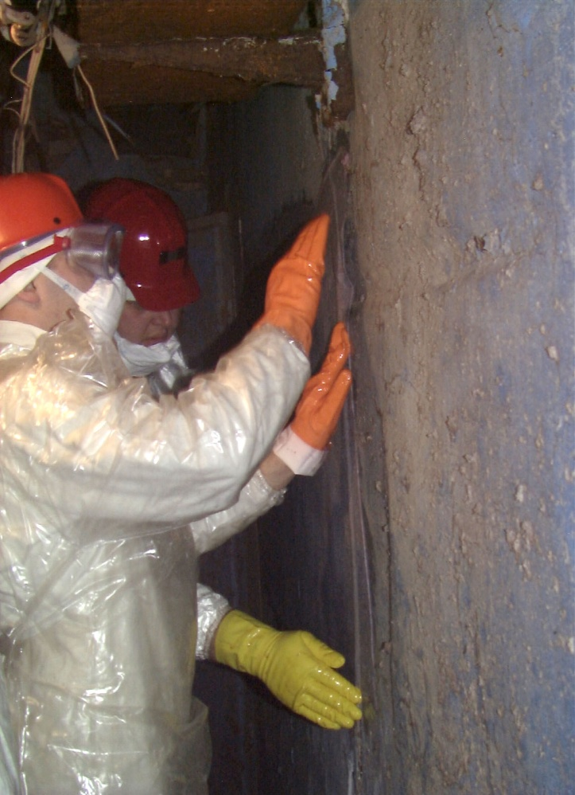
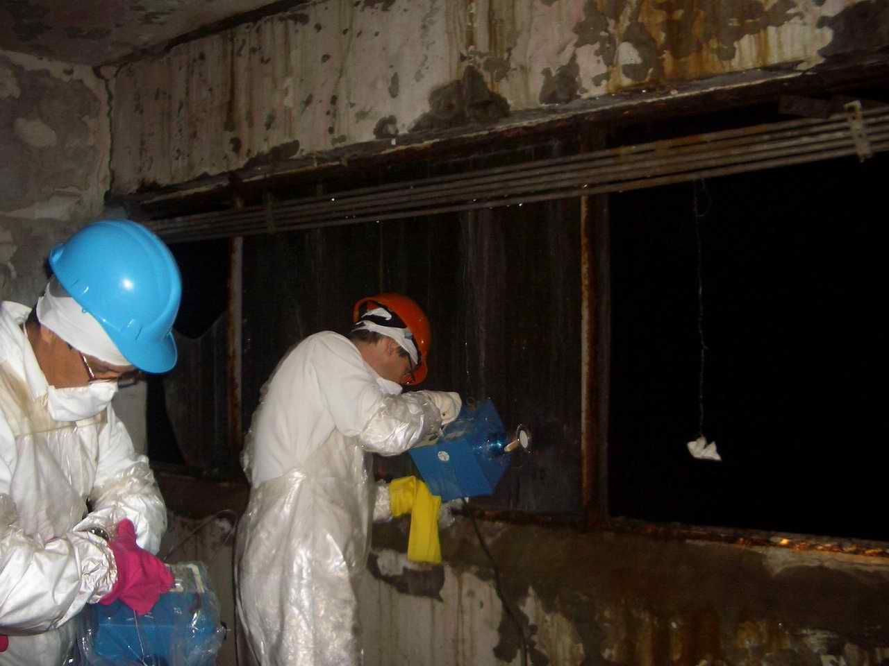
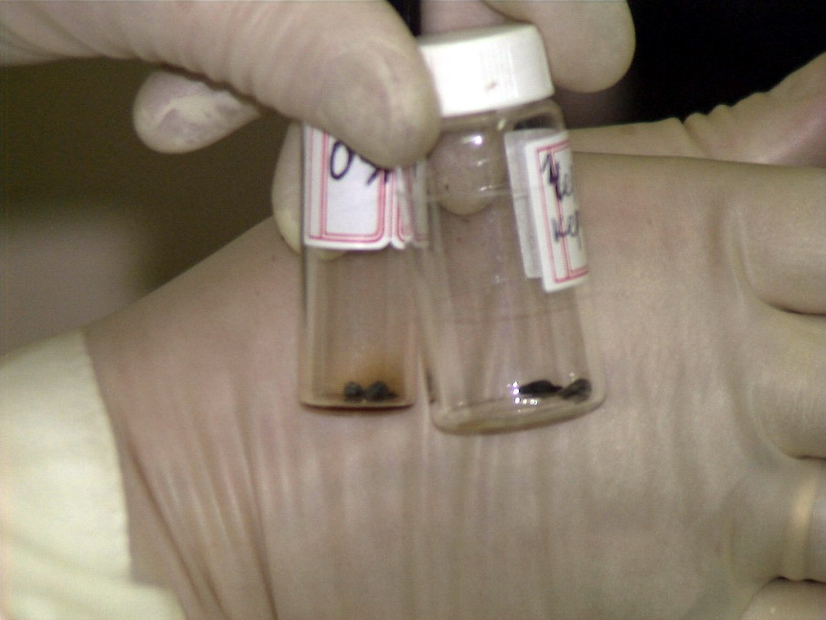
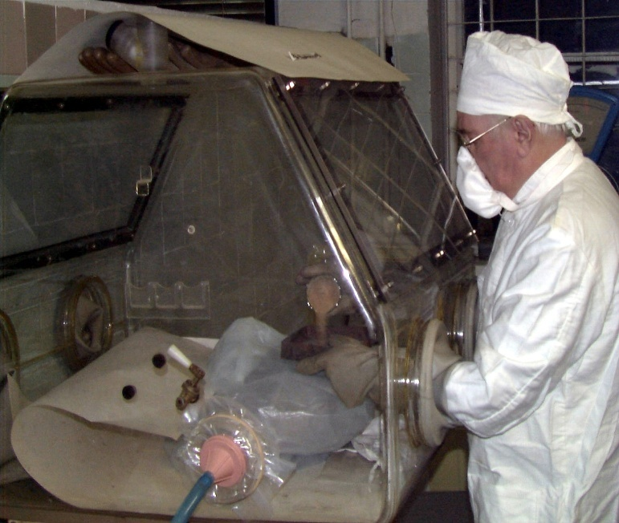
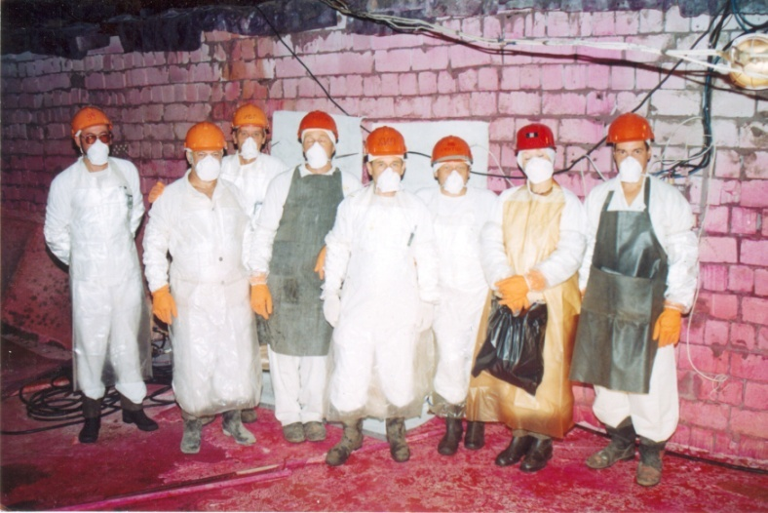
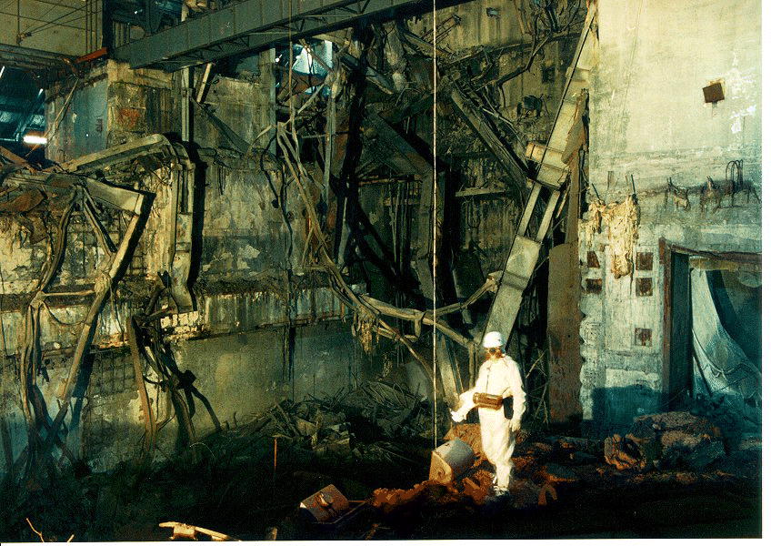
Thank you very much for attention!

