Slide 1

Status of CORPHAD and PRECOS publications
A.P. Alexandrov
Research Institute of Technology
ISTC PRECOS
Project #3813
Presented by Vyacheslav Almjashev
2nd PRECOS Meeting
ETU
Saint-Petersburg

Slide 2
Recent publications
1. Bechta S.V., Granovsky V.S., Khabensky V.B., Gusarov V.V., Almjashev V.I., Mezentseva L.P., Krushinov E.V., Kotova S.Yu., Kosarevsky R.A., Barrachin M., Bottomley D., Fichot F., Fischer M.
Corium phase equilibria based on MASCA, METCOR and CORPHAD results
// NED. 2008. V 238. N 10. P. 2761–2771.
Almjashev V.I., Barrachin M., Bechta S.V., Bottomley D., Defoort F., Fischer M., Gusarov V.V., Hellmann S., Khabensky V.B., Krushinov E.V., Lopukh D.B., Mezentseva L.P., Miassoedov A., Petrov Yu.B., Vitol S.A.
Eutectic crystallization in the FeO_{1.5}–UO_{2+x}–ZrO₂ system
// JNM. 2009. V. 389. N. 1. P. 52–56.

Slide 3
Accepted for publication
Almjashev V.I., Barrachin M., Bechta S.V., Bottomley D., Defoort F., Fischer M., Gusarov V.V., Hellmann S., Khabensky V.B., Krushinov E.V., Lopukh D.B., Mezentseva L.P., Miassoedov A., Petrov Yu.B., Vitol S.A.
Phase equilibria in the FeO_{1+X}–UO₂–ZrO₂ system in the FeO_{1+X}-enriched domain
// JNM. 2009. In Press
Minor revision of paper was recommended
Reviewer #1: At the beginning of this part, the authors mention some thermodynamic calculations using MULTICOM Code. For the understanding of the phase equilibria in this complex system, it would be very helpful to show some results of thermodynamic calculations.
Reviewer #2: "The selection of the melt ... thermodynamic calculations by MULTICOM code using the CALPHAD method. Parameters of the thermodynamic model for these calculations were determined from the data of the phase diagrams of the corresponding binary systems [6,10,16]" The references give the access to experimental points but it is not really clear if an optimization of these data was made with the Calphad technics, and what and where are the results of that work.
+
NUCLEA/GEMINI-2 calculations?

Slide 4
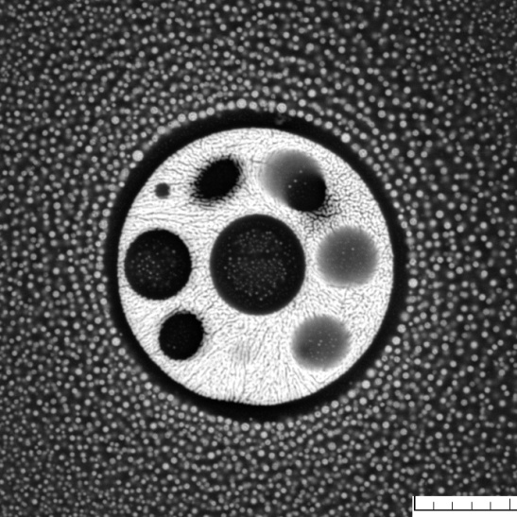
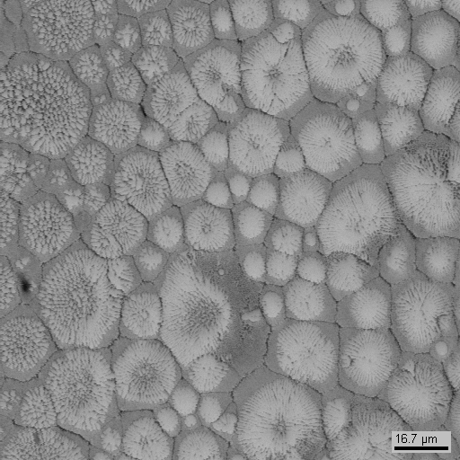
Near Future
Phase diagram of the UO₂–SiO₂ system // JNM

