Slide 1
Work plan and status on the project # 1648.2
“Examination of VVER fuel behaviour
under severe accident conditions, Quench state”
Presented by A.V. Goryachev, FSUE “SSC RF RIAR”

Slide 2
STAGE A. Spent ROD-QUENCH: Study of the spent fuel rod segments behavior under reflood conditions. At this stage the experimental data on spent fuel rod characteristics after reflood will be obtained. Heated up to different temperatures pre-oxidized spent fuel rod simulators will be cooled down by water.
STAGE B. Fresh FA-QUENCH: Integral experiment of QUENCH type using model bundle with 31 fuel rod simulators under QUENCH conditions. The result of the work will be the database for VVER bundle behavior under quench conditions, in comparison with available database for PWR bundles.
STAGE C. FA Quench Model: Development of models and codes to describe VVER core behavior under severe accident conditions (“quench” stage).
The obtained results will allow to make a conclusion on the behavior of VVER fuel under severe accident conditions during the core reflood and modification and/or adaptation of codes and physical models for PWR fuel behavior to VVER reactor.

Slide 3
Technical Schedule for first year

Slide 4
Sample
1 - cladding; 2 - fuel pellets; 3 - TC; 4 - fuel plug; 5 - diminishing socket;
6 - ceramic shield tube; 7 - suspension bracket

Slide 5
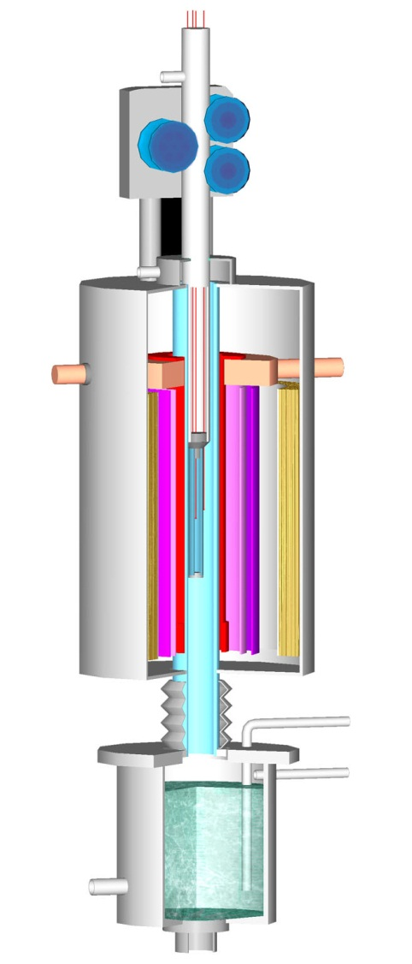
Heating module
5
4
6
7
3
2
8
1
9
10
11
15
12
14
13

Slide 6
Experimental stand

Slide 7
Test conduct

Slide 8
Measured and controlled parameters:
    temperature on the cladding and in the central
    hole at the middle plane of sample;
    ⁸⁵Kr activity in argon;
    ¹³⁴Xe concentration in argon;
    H₂ concentration in argon;
    argon flow through the working canal ;
    argon flow through the inner volume of the sample;
    temperature steam-argon mixture in the steam generator;
    water flow, incoming in the flooding tank;
    water temperature in the flooding tank;
    pressure in the working canal.

Slide 9
Pre- and posttest examination
gamma-spectrometry of the fuel before and after tests
pre- and posttest fission gas inventory in the fuel
ECR measurements
metallography
measurements of the H₂ content in the cladding

Slide 10
Current status of the 1648.2 Project
1. The program of the single rod test is worked out.
2. Designing of the test facility for the single rod tests is completed.
Facility is in manufacturing stage.
3. The preparatory work on irradiated fuel rod samples are in progress.
4. Parts of the bundle for the QUENCH test are manufactured.
5. Input data base for the code SVECHA is revised
with reference to E-110 alloy

