Slide 1
“Examination of VVER
fuel behaviour under
severe accident conditions”
Progress report on the project # 1648.2
Presented by A.Goryachev, RIAR

Slide 2
1648.2 Project ISTC structure
Study of the spent fuel rod segments behavior under reflood conditions.
Integral experiment of QUENCH type using model bundle with 31 VVER fuel rod simulators.
Development of models and codes to describe VVER core behavior under severe accident conditions (“quench” stage).
Involved Institutions: RIAR, IBRAE, JSC MSZ, FZK, IRSN, JRC-ITU, CEA/DEN/DSNI

Slide 3
Study of the spent fuel rod segments behavior under reflood conditions.

Slide 4
Study of the spent fuel rod segments behavior
under reflood conditions.
Stages of work

Slide 5
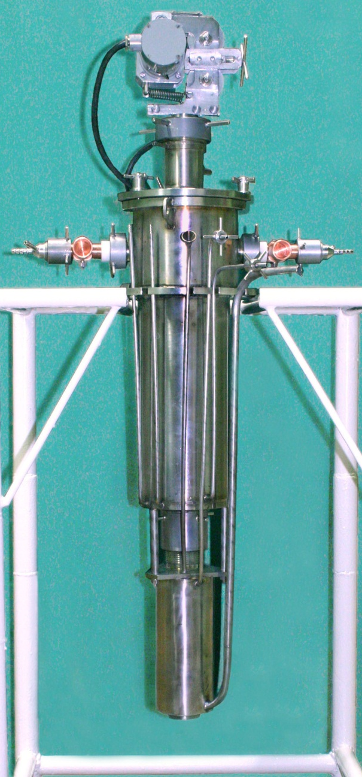
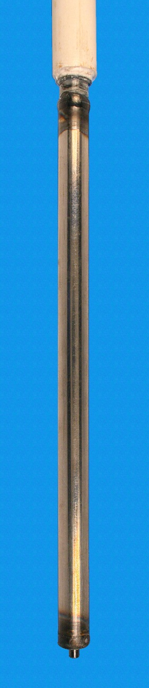
Unirradiated Simulator
Test rig furnace

Slide 6
Design test regime

Slide 7
Preoxidation stage

Slide 8
Heating stage
Ar
Ar+ steam
Ar

Slide 9
Quench stage
Ar
Ar+ steam
Ar

Slide 11
Temperature gradient along the sample
0 50 100 150

Slide 12
Unirradiated sample test diagram
Steam
Water injection
Pre-oxidation position
Water level touch
Full immersion

Slide 13
New test regime

Slide 15
Quench bundle test

Slide 16
FA Quench Model
Development of models and codes to describe VVER core behavior under SA conditions
Development of the requirements to models and codes
The requirements to the SVECHA code models (mainly concerning the material properties) were elaborated in order to be able to describe VVER reactor behavior under severe accident conditions.
Preparation and adaptation of models and codes
The preliminary stage of the adaptation of the models of high temperature oxidation and mechanical behavior of VVER cladding tubes was performed with respect to:
Comparison of the results obtained during examination of "fresh" and spent claddings;
Development of physical model of time-dependent high temperature cladding oxidation based on the PWR Zry-4 cladding oxidation model developed in IBRAE;
Further development of cladding mechanical behaviour model developed in IBRAE for PWR Zry-4 claddings and application of modified model to describe examined VVER fuel rods.
8th CEG-SAM Meeting Podolsk September 14-16, 2005

Slide 17
Cladding Oxidation Model
Adaptation to VVER Materials (1)
Simulation of the α-Zr and ZrO₂ layers growth kinetics in the RIAR isothermal tests on Zr-1%Nb cladding oxidation in steam at 1000 and 1100ºC
8th CEG-SAM Meeting Podolsk September 14-16, 2005

Slide 18
Cladding Oxidation Model
Adaptation to VVER Materials (2)
Simulation of the α-Zr and ZrO₂ layers growth and weight gain kinetics in the RIAR isothermal tests on Zr-1%Nb cladding oxidation in steam at 1200ºC
8th CEG-SAM Meeting Podolsk September 14-16, 2005

Slide 19
Cladding Oxidation Model
Adaptation to VVER Materials (3)
Calculated oxygen diffusion coefficients in α-Zr and ZrO₂ phases of Zr-1%Nb and Zry cladding materials
8th CEG-SAM Meeting Podolsk September 14-16, 2005

Slide 20
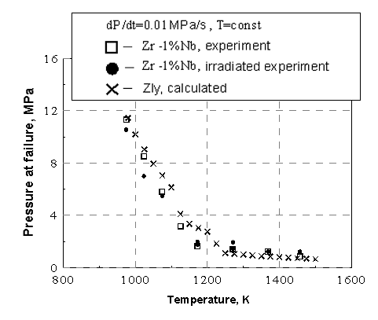
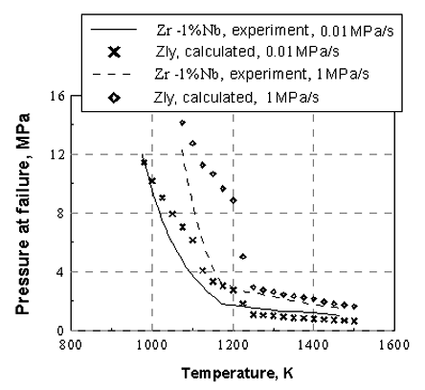
Cladding Deformation Model
Adaptation to VVER Materials
RIAR Tests on Zr-1%Nb Cladding Ballooning
8th CEG-SAM Meeting Podolsk September 14-16, 2005

