Slide 1

“Examination of the VVER fuel behavior under the severe accident conditions. Quench stage”
ISTC 1648.2 Project Progress Report
10th CEG-SAM Meeting
Kurchatov-City, Republic of Kazakhstan
IAE NNC, September 5-8, 2006

Slide 2
Tests with unirradiated simulators
Objectives:
Checking the test rig
Test regimes determining
Revealing the possible simulators post-test state and sources of additional H₂ generation at quench
Obtaining the data base for comparison with the irradiated simulators and previous results (FZKA)

Slide 3
Test rig furnace

Slide 4
Tests with unirradiated simulators quench at 1400 ºC
Main feature:
Preliminary oxidation in the Ar-O₂ mixture
Objectives:
Checking the rig parameters
Estimation of possible features of non-gas tight simulator design
Comparison with previous (FZKA) results

Slide 5
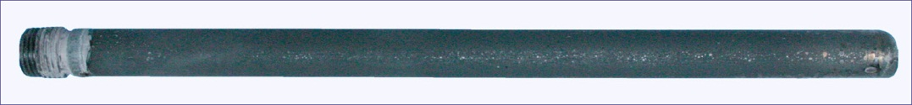
Tested simulators appearance
Simulator 21
Simulator 22
Simulator 23
Simulator 24
Test regime and H₂ generation rate
Simulator 22

Slide 6
Unirradiated simulator
(in-hot-cell test, steam oxidation)
Simulator 35

Slide 7
Structure of oxide films formed during oxidation in Ar-O₂ mixture and steam
simulator 24 (Ar-O)
simulator 35 (steam)
Results of unirradiated simulator tests at quench
temperature of 1400 °С

Slide 8
Hydrogen generation vs oxide film thickness in quench tests at 1400 °С.
Comparison with FZKA results

Slide 9
Main results of unirradiated simulator tests at quench temperature of 1400 ºC
No any cladding damage has appear. Crack formation and oxidation have no influence on the H₂ generation at quench
Due to Ar protection there is no internal cladding surface oxidation
Good coincidence of out-of hot cell (Ar+O₂ preliminary oxidation) and
in-hot-cell (oxidation in steam) test results
Good coincidence with previous (FZK) results

Slide 10
Tests with unirradiated simulators at quench temperature of 1700 ºC
Features:
Preliminary oxidation in the steam-argon flow
Quench at the reversed flow
Objectives:
Checking the rig workability at the maximal test temperature
Estimation of the H₂ generation rate vs oxide film thickness

Slide 11
Simulator25
Quench in the upward directed Ar-steam flow

Slide 12
Problems aroused:
The central tube of the furnace was cracked (Main possible reason for the central tube damage is water droplets injection during simulator quench)
Hydrogen peak at quench appeared on the background of hydrogen generated at preliminary oxidation.
Shooting the problems:
The test mode has been changed: during the simulator heating after preliminary oxidation the steam-gas mixture flowing from the bottom to top of the simulator was replaced with the inert gas flow directed from the top to bottom that was kept until the termination of the quenching

Slide 13
Gas lines system layout
GPU – gas purification unit; P1, P3, P5 – pressure-gauges; P2, P4 , P6 – pressure- sensors; G1 – G7 – gas flow meters; V1 – V8 – electromagnetic valves; MFC 1, MFC 2 – gas mass flow controllers; MFМ - gas mass flow meter; PC – pressure controller; GA – gas analyzer; GPS 1, GPS 2 – gas pressure stabilizers; GFS – gas flow stabilizer; MS - mass-spectrometer; C1, C2 – condensers; γ - gamma spectrometer.

Slide 14
Simulator 26
Test with the gas flow reversing

Slide 15
Simulators 27, 28
Features:
Simulators without UO₂ pellets
Steam quenching
Objectives:
Revealing the difference in hydrogen generation rate at change of quenching environment (simulator 27).
Revealing the state of oxide film before the quench

Slide 16
Test rig furnace

Slide 17
Simulator 27 (Steam quench)
Simulator 28 (Steam starvation condition cooling)

Slide 18
Simulator 31
Simulator 32

Slide 19
Structure of the simulator claddings quenched at 1700 ºC
simulator 25 (direct steam flow)
simulator 28 (Steam starvation
condition cooling)
simulator 26 (gas flow reversing)
simulator 31 (gas flow reversing)
simulator 27 (Steam quench)
simulator 32 (gas flow reversing)

Slide 20
Test results at quench temperature of 1700 °
Thermal shock at quench lead to simulator collapse
H₂ generation at quench seems to be dependent on final simulator state
Slow cooling in steam lead to oxide film spallation and increase of hydrogen generation at quench

Slide 21
Irradiated Simulators Test
Simulators 36, 39:
Irradiated simulators, refabricated from VVER fuel rod with burnup
of 54 MW·d/kg U and 65 MW·d/kg U;
Quench tests at 1400 ºC in the regime
similar to simulator 35 (comparison of the unirradiated and irradiated simulator tests).
Simulators 37:
Irradiated simulator, refabricated from VVER fuel rod with burnup of 54 MW·d/kg U ;
Quench tests at 1700 ºC without preliminary oxidation (maximal hydrogen peak at quench is expected).

Slide 22
Simulator 36 (54 MW·d/kg U )
Simulator 39 (65 MW·d/kg U )

Slide 23
Simulator 37 (54 MW·d/kg U )

Slide 24
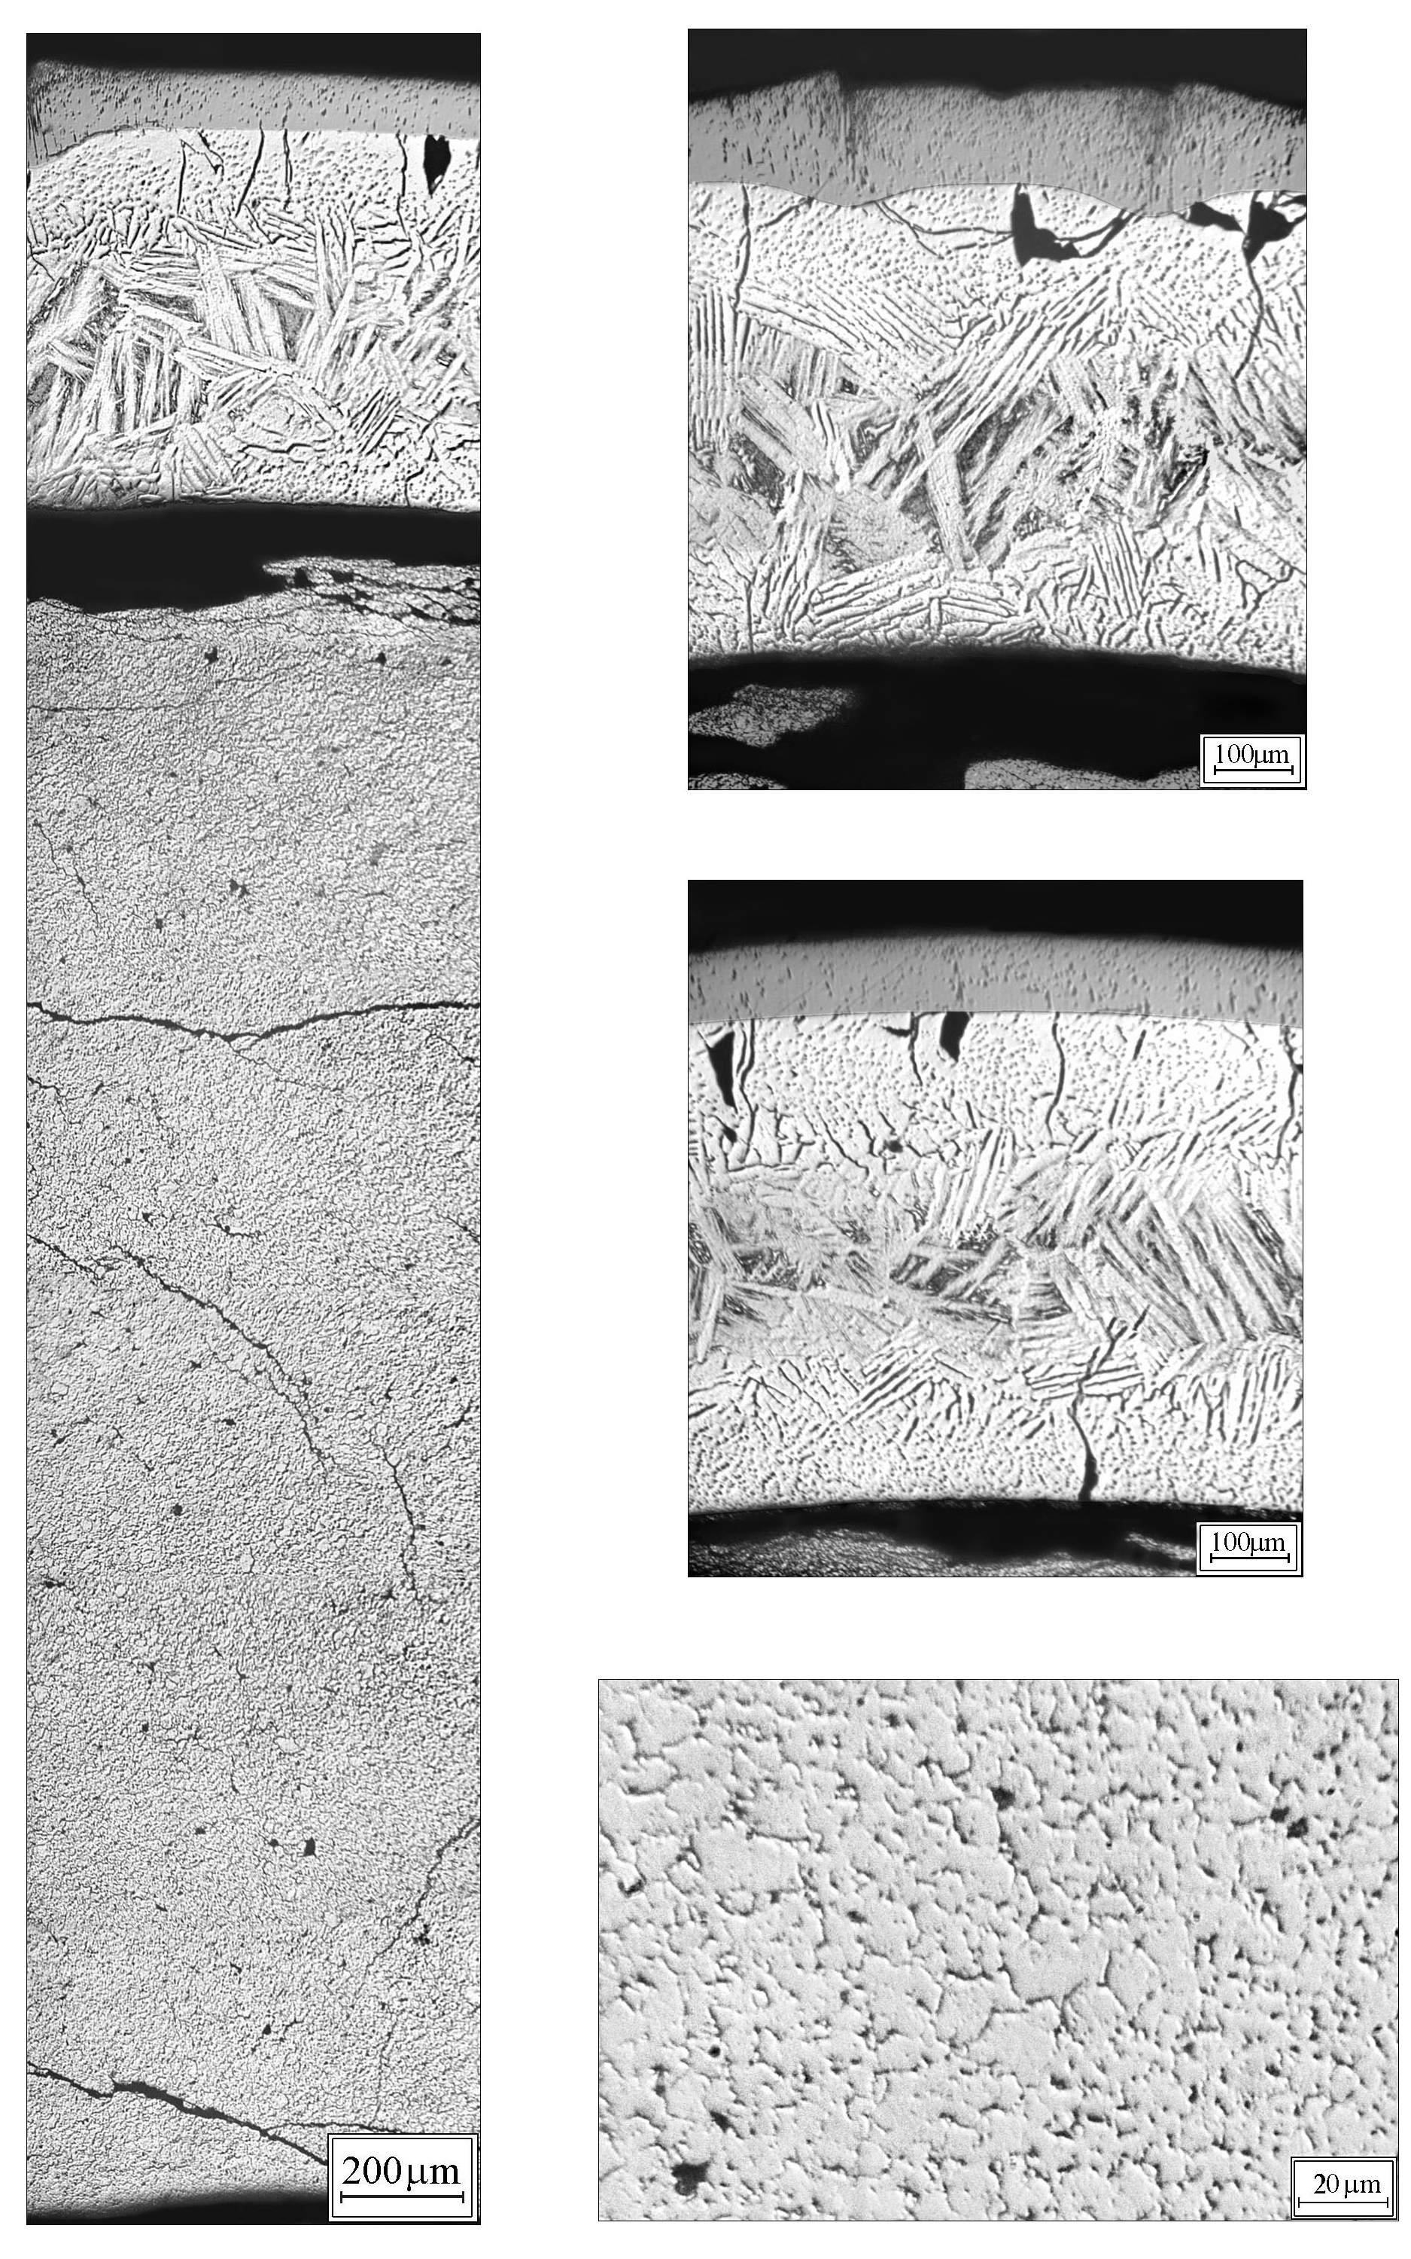
Fuel and cladding microstructure
Simulator 36

Slide 25
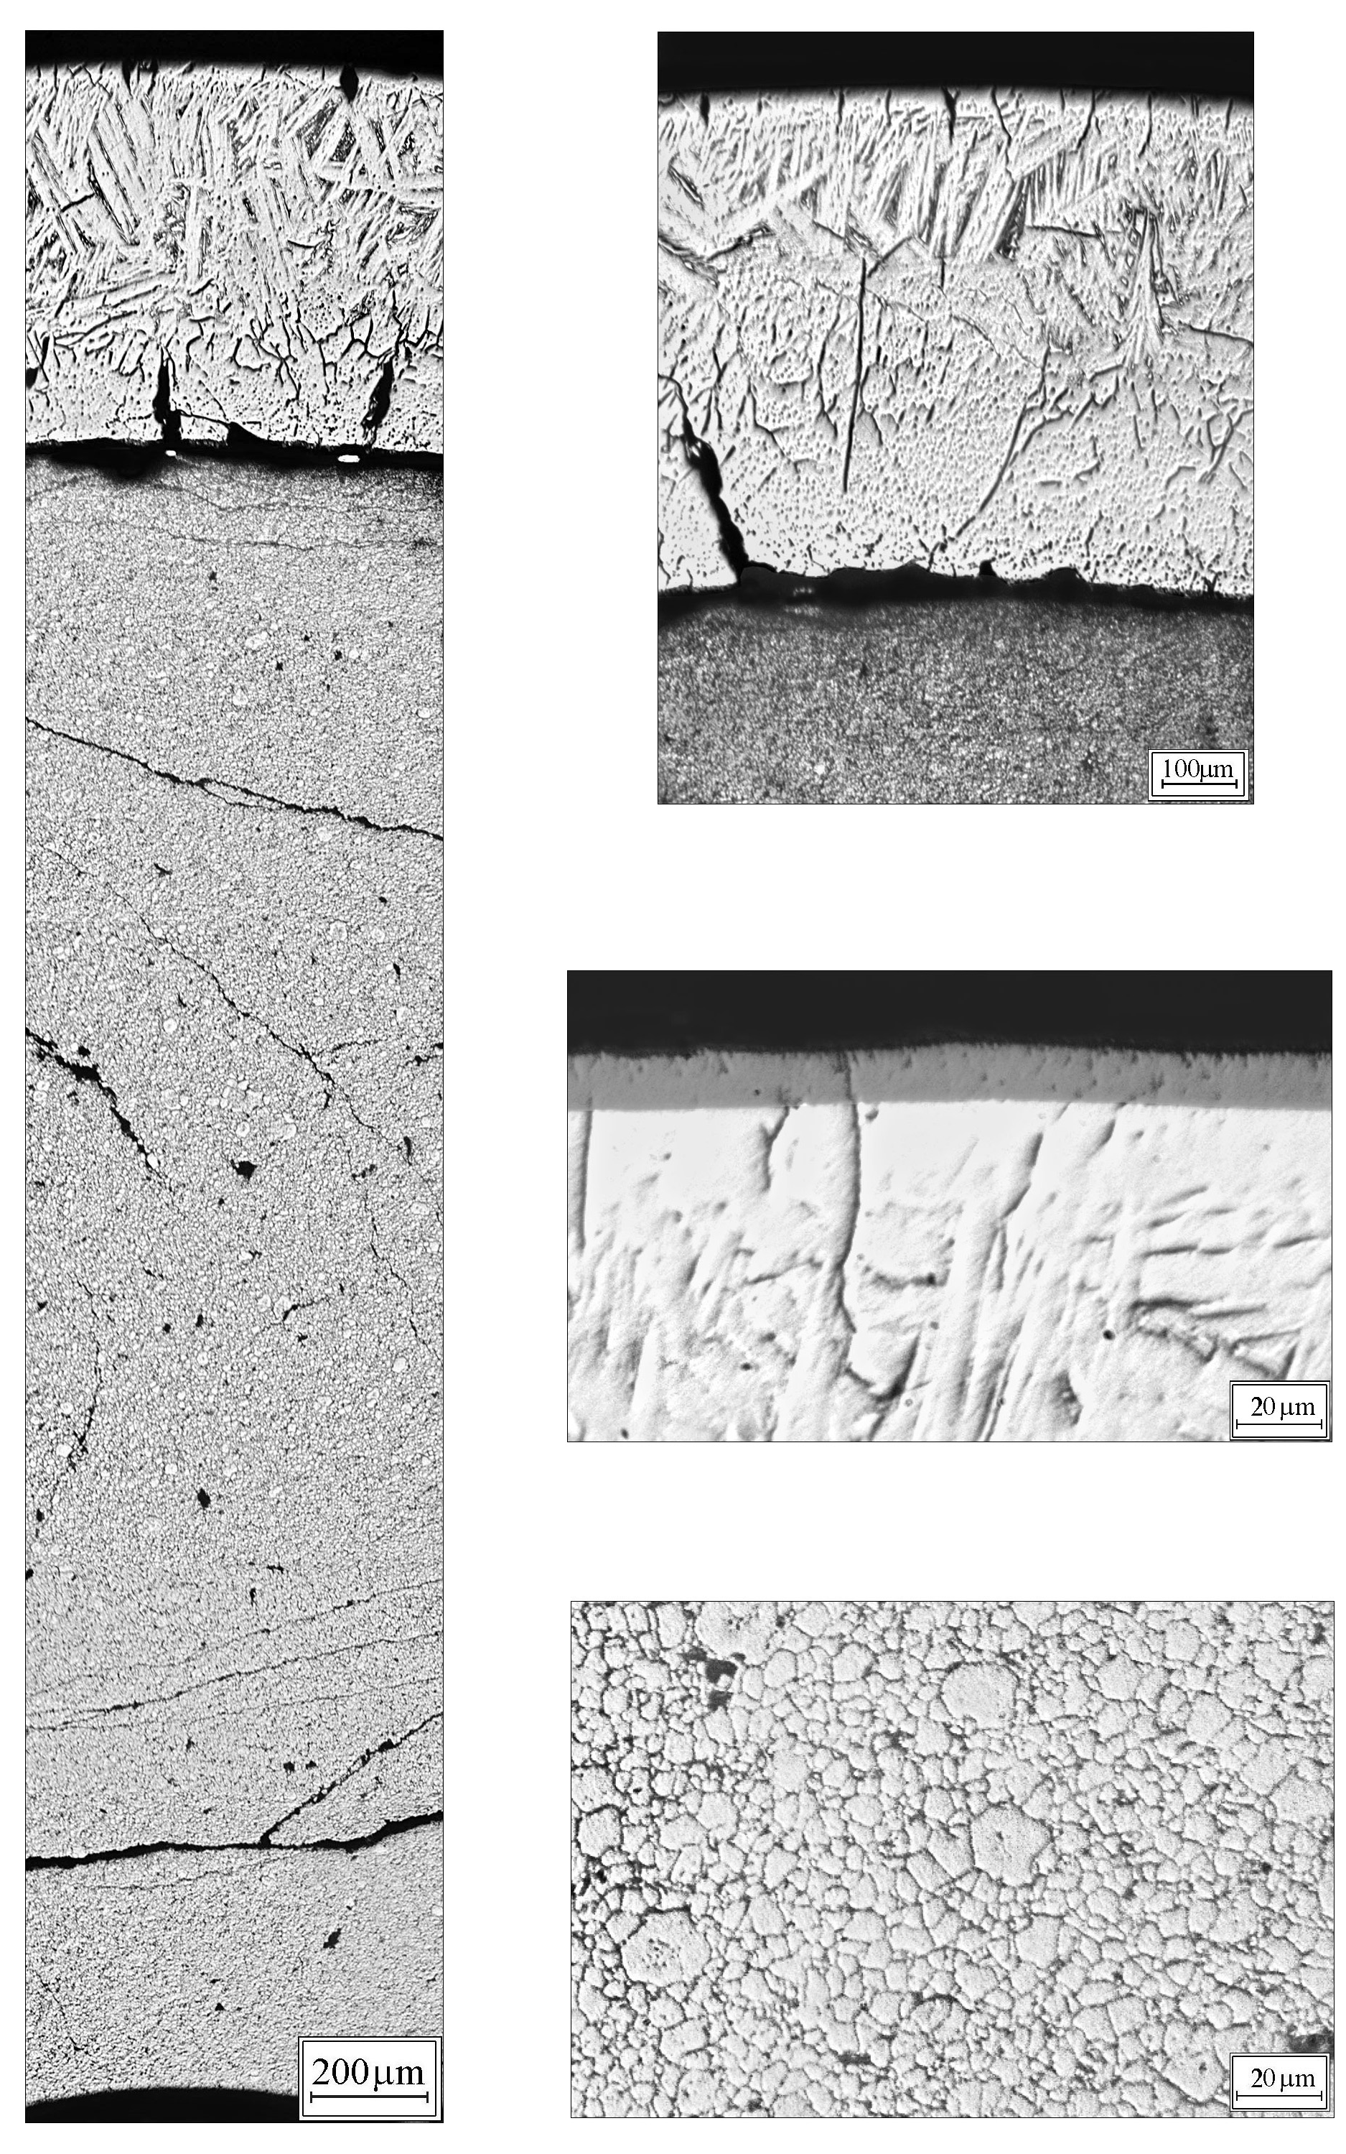
Fuel and cladding microstructure
Simulator 37

Slide 26

Fission gas release
Simulator 36
(54 MW·d/kg U )
Simulator 39
(65 MW·d/kg U )
Simulator 37
(54 MW·d/kg U )

Slide 27
Results of the irradiated simulator tests:
Raising the quench temperature leads to noticeable FGR release.
Simulator with burnup of 65 MWt d/kg U shows lower relative FGR but enhanced fraction of FG released at quench.

Slide 28
Cesium release
Cs-137 distribution along the fuel stack of simulator 36
before and after the test.
Results of gamma spectrometric analysis of water samples
from quenching tank

Slide 29
Conclusions
As a result of the series of calibrating tests the test rig workability in conditions modelling the reflood stage was checked.
Data acquisition system is checked up.
The condition of tests providing reliable workability of the rig in conditions of a hot sell is determined.
The hydrogen release at all stages of planned tests is measured and conditions of its reliable measurement are determined.
The base of comparison with results of planned experiments with the irradiated fuel is created.
The tests with irradiated simulators are in progress

