Slide 1



TACIS R2.03/97,Part B: Development of a Code System for Severe Accident Analysis in RBMK.
EUROPEAN COMMISSION
&
UNIVERSITY OF PISA
S.Soloviev
CEG-SAM Meeting
Paris,8-9 March

Slide 2

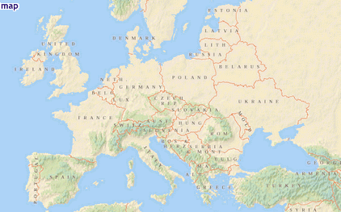

ORGANIZATIONAL MANAGEMENT
Westinghouse
Vasteras
Stockholm
Moscow
Minatom EREC IPPE NITI
Nikiet Gidropress
Kurchatov
REA
GAN
Ignalina NPP
LEI
Smolensk NPP
Vilnius
Kursk NPP
NSC
Balakovo NPP
Amsterdam
SEI
Bruxelles
FZJ
FZR
Warsaw
Kjev
EC
FZK
Dresden
Univ. of Kiev
AVN
Frankfurt
Rovno NPP
Paris
Wien
IAEA
KFKI
PSU
AECL
CEA
Budapest
USA
Canada
Milan
Ljubljana
1000 km
SIET
IJS
Piacenza
Pisa
UNIPI
Sofia
Rome
Barcellona
ENEA
ITER
UVA
Valencia

Slide 3
Regulatory Body (former GAN) requirements
Analysis of SA and BDBA must be included in SAR

Slide 4
Project history
TACIS R2.13/93 «Safety of design choice and exploitation of NPP with RBMK»;
TACIS R2.30/94 «Analysis of severe transient behavior in RBMK»;
TACIS R2.30/96 «Estimation of RBMK Residual service-life».

Slide 5
Purposes of project are reached
(possibilities of created codes)
Thermal, mechanical and neutron-physical behavior of damaged fuel and degradation mechanisms of channel pipe
Mechanical return reaction of graphite stack and core under multiple channel rupture
Тhermal-hydraulic characteristics in reactor space under severe conditions
Chemical reactions and other physical phenomena, occurring in reactor space under pipe breakup
Calculation of the hydrogen distribution after accident
Programs for calculation of mechanical transport and confinement of fission products

Slide 6
Key results
Model development and conjugation of all phenomena, caused by core accident
  Thermal-hydraulic code
  3D dynamic neutron-physical code: «…can process great amount of technological channels under deterioration of the conditions in core»
  Thermal-mechanical modeling of damages

Slide 7
Key results
Composition of safety analysis description for RBMK
    «the most important result of given project must become an extensive analysis, executed by means of new complex of programs, available to this moment of safety studies in respect of all emergency scenarios, which threaten wholeness of canal pipes»
Presence of base of numeric and experimental initial data

Slide 8
Future Activities and Problems of Project
Stage 1: Preparation for codes certification
Stage 2: Adaptation of the codes to existing components and upgrading
T/h code: «Applicability of program for specific form of core RBMK (more than 1660 parallel channels) must be proved»
  3D neutron-kinetic code:
  «It is necessary to produce recalculation of power density distribution under any significant changes of steam quality in core or under significant displacement of control rods by means of given program ».

Slide 9
Activities and Problems of Project
  With its help neutron flow must also be recalculated, if a significant moving a fuel occurs. Validation of the given program of 3D kinetics should show by means of comparison with one of the western programs
  Code for calculation of mechanical characteristics of fuel rods and fuel channel pipes
  Estimation of aeration productivity of reactor space
  Modeling of formation – transporting– accumulations-distribution of fission products
  Stage 3: Data base of accidents
  Stage 4: Code application to analysis of complex RBMK problems: ICM, Water hammer, RIA, Venting capacity, Radioactivity consequences, MPTR

Slide 10
Neutron-physical code BARS
Based on improved heterogeneous Galanin-Feinberg method
Allows to model 80000 cells in plan, 40 axial harmonics and 6 power groups
GAN certification: problem of coupled codes verification

Slide 11
Verification of code BARS
PGR – Pulse graphite reactor (Semipalatinsk)
highly enriched uranium fuel
Experiment: 1.8β

Slide 12
Verification of code BARS

Slide 13
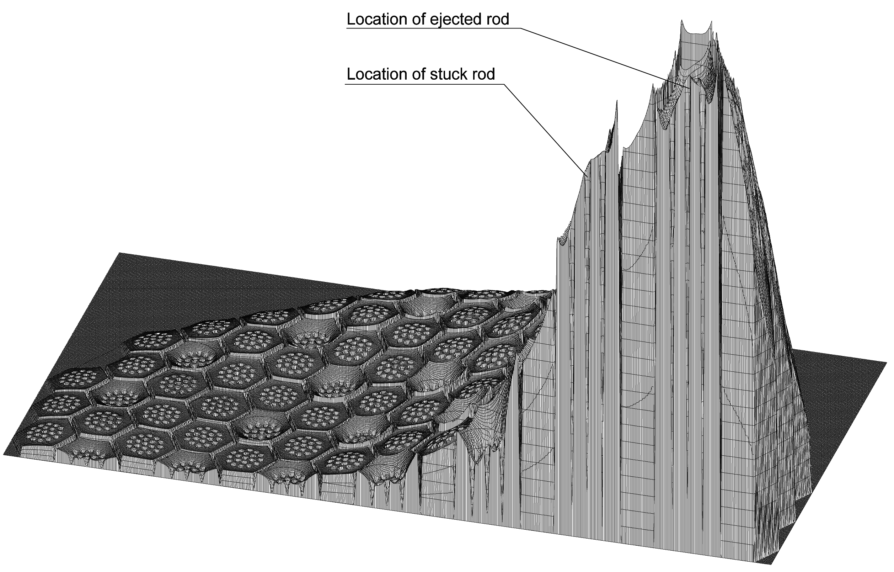
Verification of code BARS
Pin-by-Pin Power Distribution After Rod Ejection

Slide 14
Code U_STACK&KATRAN
Thermal-mechanical code
TKR facility data has been used
GAN certification for U_STACK&KATRAN started: problem of coupled codes verification

Slide 15
U_STACK: Mechanics, interaction of elements
Possible contact interactions
Interaction with 18 nearby blocks
Schemes of interaction of pipe with graphite block

Slide 16
U_STACK: Thermal-Hydraulics
Stack nodalisation Central part – breakup region of the fuel channel
Partition of a stack on calculation sector

Slide 17
U_STACK: Experience of application
Cartogram of reactor
(crosses are chosen for marking of analyzed emergency positions of fuel channel )
13

Slide 18
U_STACK: Experience of application
RBMK-1000. Breakup of fuel channel 52-16 in upper part, fuel assembly is ejected from fuel channel
Stack deformation after 24 sec after fuel channel breakup(in breakup section)
Pressure distribution along the height in gap between accident and neighbor columns of fuel channel

Slide 19
U_STACK: Experience of application
RBMK-1000. Breakup of fuel channel 52-16 in upper part, fuel assembly is ejected from fuel channel
Track record of sagging in nearby pipe of fuel channel
Distribution of a sagging in a fuel channel pipe after 23 sec from breakup of fuel channel
Distribution of axial crook stress after 23 sec from breakup of fuel channel

Slide 20
U_STACK: Results of calculation analysis
*) Criterion of entity on fracture failure is not overcome

Slide 21
Stack model of KuNPP-5 based on a U_STACK code
Interactions of elements
Full kit of desksides of mutual location four nearby blocks in horizontal section of stack
Schemes of interaction of pipe with graphite block

Slide 22
U_STACK: results comparison
LNPP-3
(after 60 sec)
KuNPP-5
(after 53 sec)

Slide 23
U_STACK: results comparison
5
Offset of blocks in section of breakup
LNPP-3 (measurement)
LNPP-3 (calculation)
KuNPP-5 (calculation)
Pressure in gap between columns of fuel channel after 25 sec from breakup
19

Slide 24
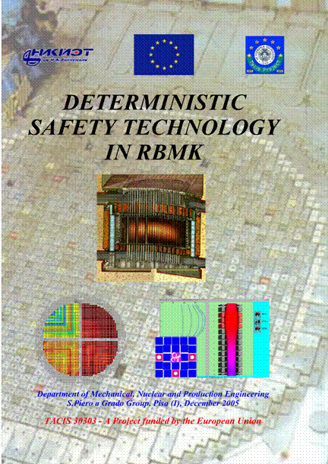
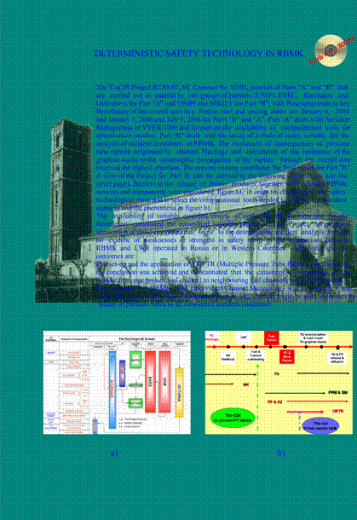
COVER PAGES
TOP
BOTTOM

Slide 25
OBJECTIVE
To present the Final Report Part B
The document consists of:
838 Pages
1.9e6 Characters
~1000 Figures
~ 300 Tables
13 Chapters
15 Annexes
~ 50 Input deck developed
1 CD Rom

Slide 26
CONTENTS OF THE FINAL REPORT PART B
FRAMEWORK AND OBJECTIVES
ACKNOWLEDGEMENTS…………………………………………… 19
FOREWORD………………………………………………………….. 21
NOMENCLATURE…………………………………………………… 24
LIST OF FIGURES………………………………………………........ 29
LIST OF TABLES……………………………………………………. 46
ABSTRACT………………………………………………………........ 51
EXECUTIVE SUMMARY…………………………………………… 53
1. INTRODUCTION…………………………………………………. 58
2. THE ROAD-MAP OF THE PROJECT FOR PART B…………. 62
3. THE DESCRIPTION OF THE RBMK………………………....... 72

Slide 27
CONTENTS OF THE FINAL REPORT PART B
THE MAIN BODY
4. THE BACKGROUND FOR RBMK ACCIDENT ANALYSIS………….. …...91
5. THE TRANSIENT THERMALHYDRAULICS…………………………… .114
6. THE THREE-DIMENSIONAL NEUTRON KINETICS…………………… 228
7. THE FUEL PERFORMANCE…………………………………………………284
8. THE PERFORMANCE OF THE PRESSURE TUBE AND OF THE NEIGHBORING GRAPHITE BRICKS………………………………………338
9. THE SOURCE TERM INSIDE THE FUEL CHANNEL…………………….403
10. THE TRANSPORT OF H2 AND OF FISSION PRODUCTS AND THE ALS SOURCE TERM…………………………………………………………….….418
11. THE RBMK INDIVIDUAL CHANNEL MONITORING………….….........477

Slide 28
CONTENTS OF THE FINAL REPORT PART B
THE CONCLUSIONS AND THE ACHIEVEMENTS
12. THE KEY ACHIEVEMENTS……………………………………….....502
13. CONCLUSIONS ……………………………………………………..….571
REFERENCES………………………………………………………………578
BIBLIOGRAPHY (taken from reports issued within the Project)………586

Slide 29
CONTENTS OF THE FINAL REPORT PART B
THE SUPPORT DOCUMENTATION 1 of 2
ANNEX 0: Summary records from selected Project Meetings (Moscow Jan. 2004, Pisa Jan. 2005, Pisa July 2005)
ANNEX 1: The correspondence between the TOR, the Project commitment, the Project achievements and the subjects of the Final Report
ANNEX 2: The description of the individual Project codes
ANNEX 3: The database of issued reports
ANNEX 4: Overview of (additional) MCC analysis results obtained in relation to Ignalina NPP 1
ANNEX 5: Overview of (additional) MCC analysis results obtained in relation to Smolensk 3 by NIKIET
ANNEX 6: Overview of (additional) MCC analysis results obtained in relation to Smolensk 3 by UNIPI
ANNEX 7: Overview of (additional) confinement analysis results obtained in relation to Smolensk 3 by NIKIET & UNIPI

Slide 30
CONTENTS OF THE FINAL REPORT PART B
THE SUPPORT DOCUMENTATION 2 of 2
ANNEX 8: Overview of (additional) coupled 3D NK TH analysis results obtained in relation to Smolensk 3 by UNIPI
ANNEX 9: Overview of (additional) results from the analysis of partial flow blockage of one individual RBMK FC
ANNEX 10: Overview from the application of the CFD code Star-cd to the analysis of the FC flow blockage transient
ANNEX 11: Overview of results related to the evaluation of CHF in the RBMK fuel bundle
ANNEX 12: Recommendations for additional researches in the area of RBMK safety technology
ANNEX 13: The qualification of computational tools adopted within the Project
ANNEX 14: The training organized within the Project
ANNEX 15: List of the references of the annexes
CD (attached to copies of the report available to Project Partners): Database of input decks adopted within the Project

Slide 31
CONTENTS OF THE FINAL REPORT PART B
EXAMPLE FOR LEVEL OF DETAIL FOR CHAPTER 6 1 of 2

Slide 32
CONTENTS OF THE FINAL REPORT PART B
EXAMPLE FOR LEVEL OF DETAIL FOR CHAPTER 6 2 of 2

Slide 33
SETTING UP THE ROAD MAP FOR THE PROJECT: RUSSIAN CODES

Slide 34
SETTING UP THE ROAD MAP FOR THE PROJECT: WESTERN CODES

Slide 35
THE ROAD-MAP OF THE PROJECT
Five types of logical components constitute the road map
the starting point and the framework (top rectangular block)
the objective or the achievements (main ellipse blocks)
the activities (rectangular blocks)
the connections among the various blocks (full lines and arrows)
the key logical paths (dotted lines and small ellipse blocks <Y and NO>)

Slide 36
MAIN ACHIEVEMENTS
LIST OF SCENARIOS

Slide 37
MAIN ACHIEVEMENTS
PROGRESSION OF REFERENCE SCENARIO
+ CFD

Slide 38
MAIN ACHIEVEMENTS
TH 1 of 2
Containment

Slide 39
MAIN ACHIEVEMENTS
TH 2 of 2
Ignalina-1
Smolensk-3, (UNIPI)
Smolensk-3, (NIKIET)

Slide 40
Comparison KORSAR vs Relap5/mod3.2
DS Level
Max. Power FC

Slide 41
MAIN ACHIEVEMENTS
COUPLED TH 3D-NK 1 of 2
Relap5/Nestle
Korsar-Bars
Associated presentation

Slide 42
MAIN ACHIEVEMENTS
COUPLED TH 3D NK 2 of 2
cross section view
three-dimensional view

Slide 43
MAIN ACHIEVEMENTS
FPM
Ballooning FC LOCA
Collapse FC Blockage
A fuel bundle damage map related to the collapse and hydraulic loads

Slide 44
MAIN ACHIEVEMENTS
APPLICATION OF CFD
To support and to qualify the application of Korsar code and to understand and to characterize phenomena expected following the PT rupture CFD codes have been adopted (outside the Project commitments from the TOR)
Modelling by Star-cd of flow through a closed valve in the RBMK GDH line
Fluent nodalisation and meshes of the RBMK fuel channel in case of PT break following FC-BLOCKAGE
Associated presentation

Slide 45
STAR-CD application
ICV
DS WC, DC
MCP, check valve
Core cavity venting capacity

Slide 46
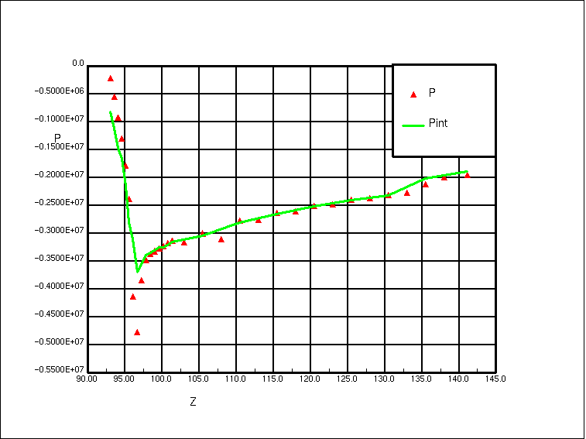
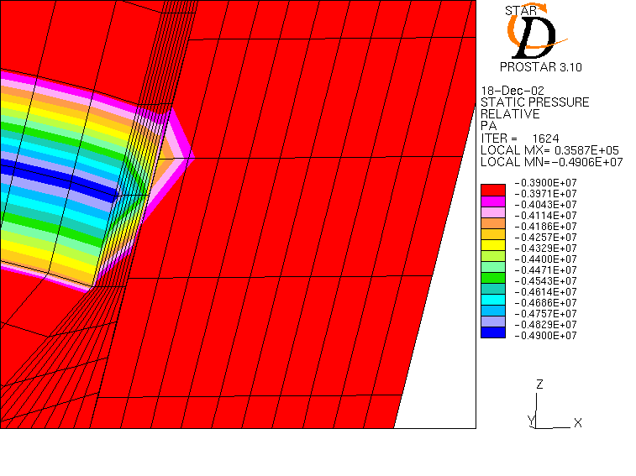
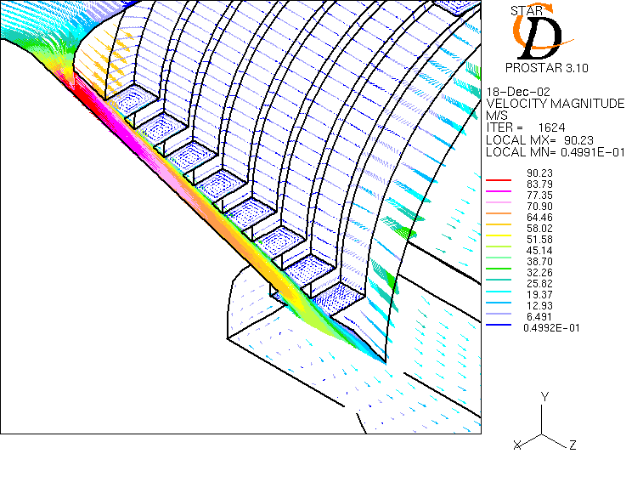
ICV
(h = 8 мм; Р_{in} = 7,0 MPa; Т_{in} = 235 ^{о}С) Рs =3,0 MPa
Saturation
Length

Slide 47
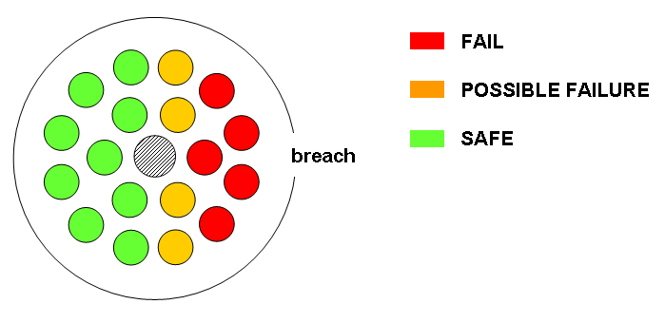
UNIPI CFD CALCULATIONS
Structural mechanics study on RBMK fuel pin following PT rupture, plastic limit analysis assuming a ‘large’ PT break: graphical presentation of the results.

Slide 48
MAIN ACHIEVEMENTS
APPLICATION OF FE
Ansys nodalisation adopted for sensitivity studies: 2D plain model without ring
Ansys nodalisation for structural analysis of the PT-graphite interaction: maximum principal stresses
Associated presentation

Slide 49
RBMK

Slide 50
CONFINEMENT
ENVIRONMENT
9
Reactor
Building
Turbine
Hall
Fuel loading machine hall
ALS
Top core plate
6
High energy pipeline or component
4
1
8
Reactor Cavity
RC
Pool

Slide 51
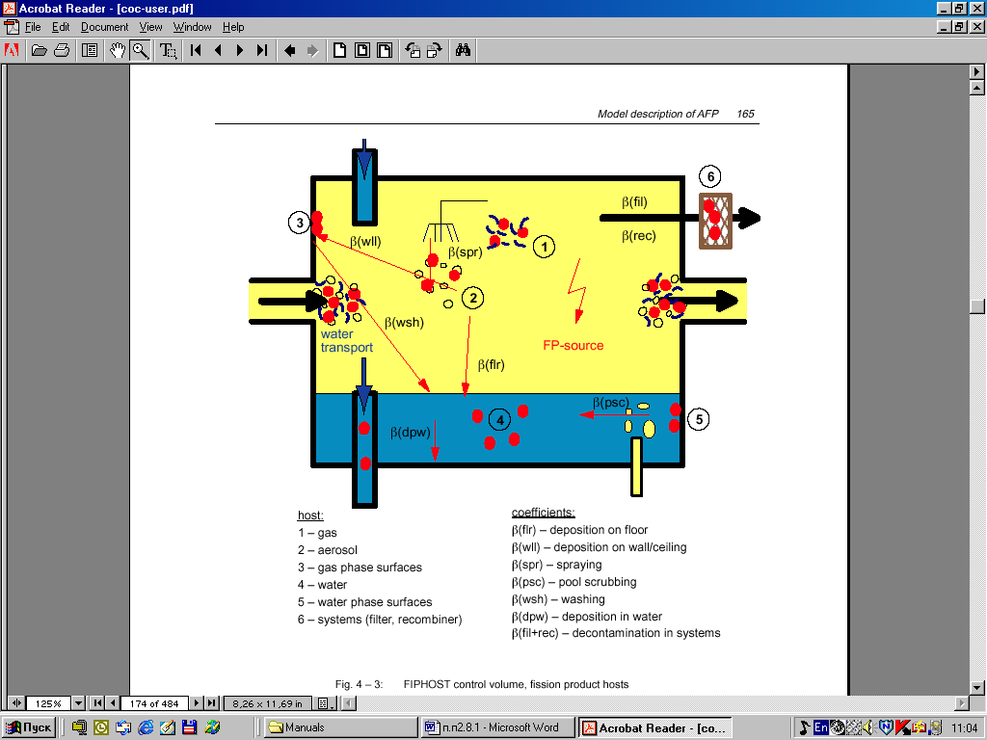
FP transport in
RBMK confinement
Cocosys application to the evaluation of FP transport in
RBMK confinement: sketch of code modeled processes.

Slide 52
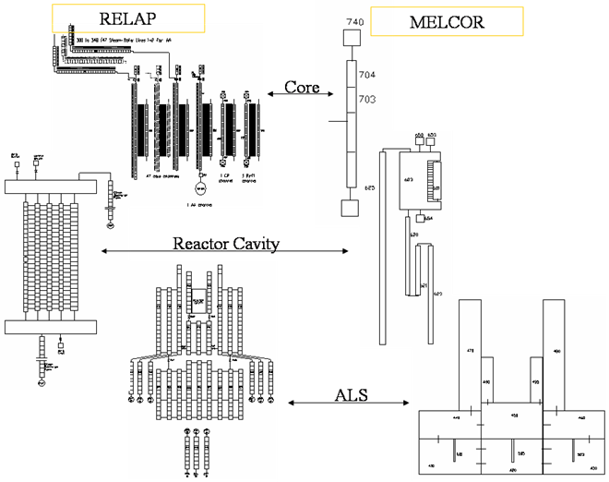
MAIN ACHIEVEMENTS
H2 AND FP SOURCE TERM AND TRANSPORT 1 of 6
Refp and Melcor code used to determinate the FP and H2 source term inside the FC
Cocosys and Melcor codes used for the transport of FP and H2
Relap5/ MELCOR model
Cocosys model
Associated presentation

Slide 53
MAIN ACHIEVEMENTS
THE VENTING CAPACITY OF THE RC 2 of 6
Top cavity lifting limit
SD actuation
Cocosys Analysis
Relap5 Analysis

Slide 54
H2 POSSIBLE FLOW PATH 3 of 6
MAIN ACHIEVEMENTS
to environment
SDV
RC
ALS

Slide 55
FP POSSIBLE FLOW PATH 4 of 6
MAIN ACHIEVEMENTS
to environment
SDV
RC
ALS

Slide 56
TOTAL AMOUNT OF H2 AND FP RELEASE 5 of 6
MAIN ACHIEVEMENTS
FC-BLOCKAGE scenario
MCC
ALS
RC
H2 release in the ALS (total atmosphere and pool), the RC and the primary system.
FP releases in the ALS (total atmosphere and pool), the RC, the primary system (PT and MCC) and the environment

Slide 57
FP DISTRIBUTION FC-BLOCKAGE SCENARIO 6 of 6
MAIN ACHIEVEMENTS
Melcor application to the prediction of consequences of fuel bundle melt
Temperature of the debris accumulated at the bottom of the FC in thermal contact with the RC bottom plate.
FC configuration after the relocation.

Slide 58
MAIN ACHIEVEMENTS
THE CHAINS OF CODES
NIKIET
= SIGNIFICANT OUTCOME FROM THE ANALYSIS
UNIPI

Slide 59
MAIN ACHIEVEMENTS
THE MPTR
The objective of the Project is demonstrating the capabilities of computational tools to identify the conditions for the occurrence of the MPTR and to calculate its consequences.
MPTR procedure proposed by UNIPI: assumptions related to the stack deformation.
Map of admissible loads with and without the consideration of the tank
Application of coupled U_Stack and Katran code
Associated presentation

Slide 60
MAIN ACHIEVEMENTS
ICM PROPOSAL 1 of 2
The ICM system has to prevent the PT rupture following the FC blockage.
It depends upon the devoted scram signal of simultaneous occurrences of low flow and high coolant temperature at FC inlet and outlet
It requires the introduction of thermocouples (TC) at each FC outlet and the combined use of signals from TC and flow-rate or pressure drop instruments at the FC inlet (in order to prevent or minimize the risk of spurious scram signals).
Associated presentation

Slide 61
MAIN ACHIEVEMENTS
ICM PROPOSAL 2 of 2
Setting the reactor scram when:
G > G_{nom} - 30%
T_{steam} > T_{sat,} _{70bar} + 10 K
Scram delay time = 2.2 sec
Start of the F.B. accident
Results obtained from a thermal-hydraulic study show the validity of the ICM proposal.

Slide 62
MAIN ACHIEVEMENTS
THE TRAINING 1 of 2
Two training-workshops have been organized within the framework of the Project, according to the requests of Partners: Cocosys and 3D Suncop training
TRAINING COURSE | No of PARTICIPANTS | INSTITUTION
COCOSYS | 1 | Becker Technologies, Germany
 | 4 | NIKIET, Russia
 | 1 | ENPRO Consult, Bulgaria
 | 2 | UNIPI, Italy
3D SUNCOP | 5 | EREC, Russia
 | 2 | Gidropress, Russia
 | 2 | NIKIET, Russia
 | 2 | Kurchatov Institute, Russia
 | 2 | ENPRO Consult, Bulgaria
 | 1 | PAKS NPP Ltd, Hungary
 | 1 | Turkey Atomic Energy Commission, Turkey
 | 1 | Kiev University, Ukraine
 | 1 | Et&D, Ukraine
 | 2 | Pakistan Atomic Energy Commission, Pakistan
 | 2 | Lithuanian Energy Institute, Lithuania
 | 1 | Lithuanian Regulatory Commission (VATESI), Lithuania
 | 2 | FER, Croatia
 | 2 | UNIPI, Italy

Slide 63
MAIN ACHIEVEMENTS
THE TRAINING 2 of 2

Slide 64
CONCLUSIONS 1 of 3
The demonstration of capabilities and suitability of computational tools for deterministic RBMK safety analyses constitutes the subject of the activity.
The thermal-hydraulics is the central (pivot) discipline
CHF in fuel bundle
MCC and ECCS performance
Confinement
PT failure
Fuel failure mechanisms (ballooning and collapse) are investigated
PT and neighboring graphite block failure are investigated
Pioneering effort made for the coupled Korsar-Bars application to RBMK safety technology (3D NK – TH).
The FP and the H2 source term, transport and release are evaluated.
A dozen codes (Russian and Western origin) have been used creating chains of codes to achieve the Project objectives.

Slide 65
CONCLUSIONS 2 of 3
Key words and acronyms for the conclusion:
MPTR (proposed solution of the issue)
CIAU Uncertainty (application)
ICM (proposal)
Database (creation)

Slide 66
CONCLUSIONS 3 of 3
The safety evaluation of the RBMK was not a purpose for the activity. The single FC rupture is part of the DBA of a RBMK, owing to its probability to happen. Consequent, severe local fuel damages including extended melting are allowed within the RBMK DBA and constitute the major difference in safety technology between RBMK and other water cooled nuclear reactors.
The ICM system has the capability to prevent the PT rupture following the FC blockage and to remove this difference

Slide 67
MAIN CONCLUSIONS
Unique chain of codes for RBMK analyses has been created and brought to practice
These codes allow for rather precise modeling of complicated RBMK issues which were treated with great conservatism before
The Project gave essential impact for further code development and applications

Slide 68
RECOMMENDATIONS FOR THE FUTURE
ICM
Qualification of the chain of codes
Use of the chain of codes

Slide 69
Reviewer Comments
KEY REMARKS FROM THE ‘INDEPENDENT’ PEER REVIEW 1 of 3
E. Hicken
a) The chain of codes “The key objective of the Project successfully accomplished. Congratulation.”
b) The MPTR “These calculations and the related results are very valuable (they demonstrate also the capabilities of current codes). It is recommended to continue this study because it is an important licensing question.”
c) The ICM “It has to be emphasized that progressive ideas should be studied, especially if the potential for an improvement is expected to be high. The proposed improvement has the potential to reduce the risk of RBMK, mainly a reduction in a pressure channel failure and thus less repair and cleaning activities and less interruption of electricity production. A follow-up of these activities is highly recommended.”
d) The qualification methodology “It is highly supported that the University of Pisa developed a methodology to qualify the computational tools including sensitivity and uncertainty analyses.”
e) The training (Cocosys and SUNCOP) “Training courses are also useful and should be further supported”.
f) Overall report “It has to be pointed out that the whole report is well structured, contains all necessary information, is homogeneous and is well written; in general, the report impresses.”

Slide 70
Reviewer Comments
KEY REMARKS FROM THE “INDEPENDENT” PEER REVIEW 2 of 3
R. B. Duffey
a) The list of accident scenarios discussed in Chapter 4 “This is an excellent list, covering a wide range of problems that should be supplemented by uncertainty and sensitivity analyses.” (licensing studies to be performed by tools available from the Project should require uncertainty and sensitivity analyses).
b) RBMK safety In the report it is stated (section 12.11). <The lack of a comprehensive qualification, as already mentioned, constitutes the reason why the results obtained from the Project activities shall not be directly applied to the evaluation of safety of the RBMK>. “This is precisely why all the comments made directly and indirectly on generic RBMK safety and safety margins should be deleted from this report.” (there is agreement on this matter between the reviewer and the authors: however, it has been preferred to keep those ‘comments’ in the final Project document).

Slide 71
Reviewer Comments
KEY REMARKS FROM THE “INDEPENDENT” PEER REVIEW 3 of 3
c) The ICM “The analytical approach looks very reasonable, although I have not had time to digest all the calculations. However, the ICM to be an effective and useful detection safety system, it will have to be <safety grade>. This means having multiple redundant sensors/detectors and significant qualification. In addition, if temperatures and pressures rise quickly, as it appears, then the sampling time for each channel must be considered. None of these issues are apparently mentioned, and the implementation of an ICM would hinge on how to use the results of all this valuable analysis.” (ICM was not part of the Project commitment and the reviewer recommendations shall be considered in possible follow-up activities).
d) The stability of parallel channels and the related Project findings “This is a key remark and accomplishment (section 13.13). Much work has been done on stability in the past, and instability methods are known to exist in Russia for both boilers and steam generating equipment. Can these be adopted or adapted to RBMK? The integral TH codes may have a problem with refining the channel representation sufficiently while retaining computational feasibility. Should a separate channel instability code be derived/validated that is linked to Korsar?” (the questions are considered in the recommendations for future R & D).
e) Overall report “Overall this is an impressive and thorough report, with a great deal of important and relevant information on RBMK safety analysis methods and approaches.”

