Slide 1
ISTC Project «Scale experimental investigation of the thermal and structural integrity of the VVER pressure vessel Lower Head in severe accident» (#3635)
Participating Institutions:
- «Moscow Power Engineering Institute» (MPEI): Leading Institution
- Federal State Unitary Enterprise «Experimental and Design Organization “GIDROPRESS” (EDO «GP»)
- Lavrentyev Institute of Hydrodynamics of the Siberian Branch of the Russian Academy of Sciences (IGiL)
Moscow, 14-16 July, Loktionov V.D.

Slide 11
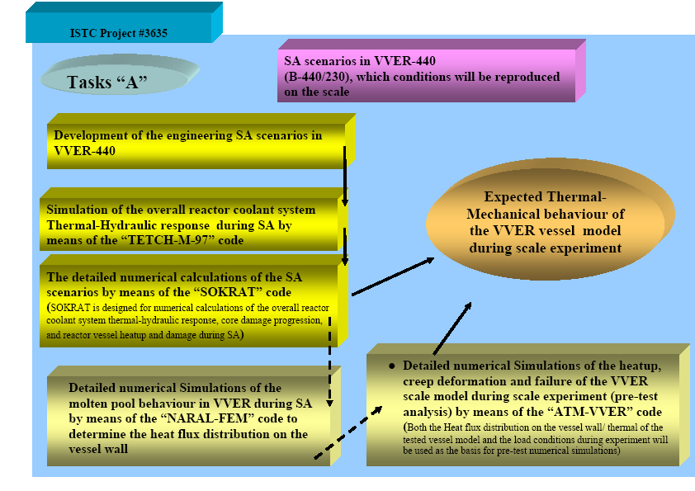

Slide 21
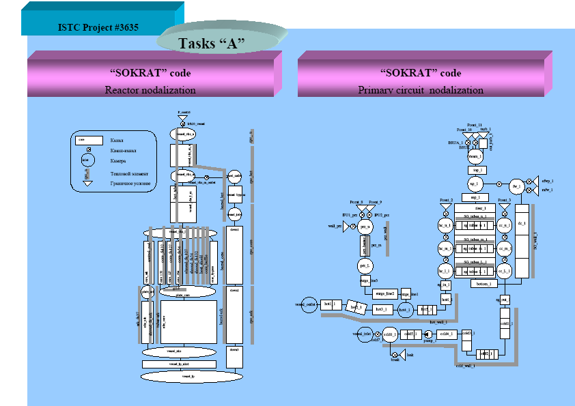

Slide 23
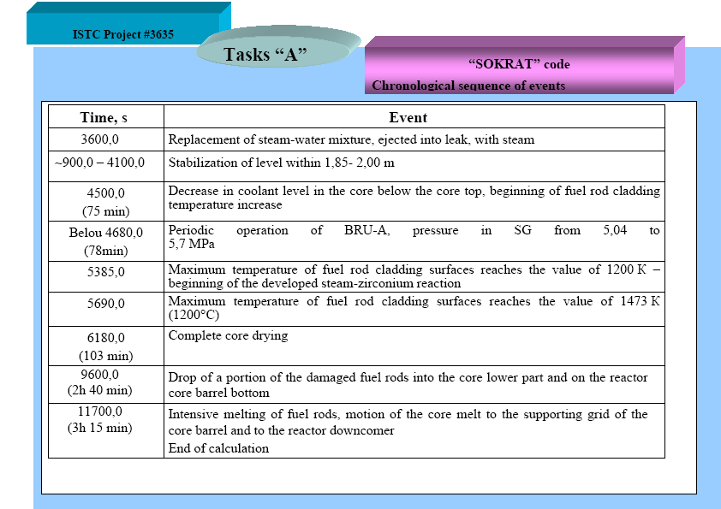

Slide 24
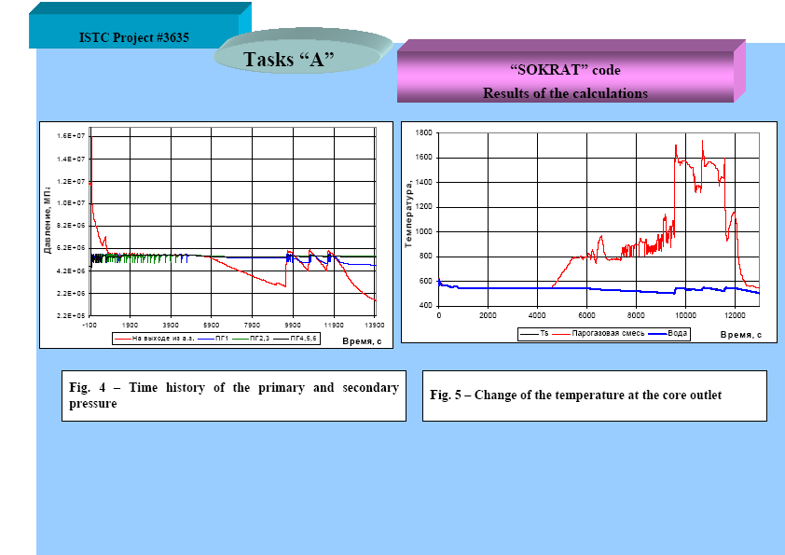

Slide 33
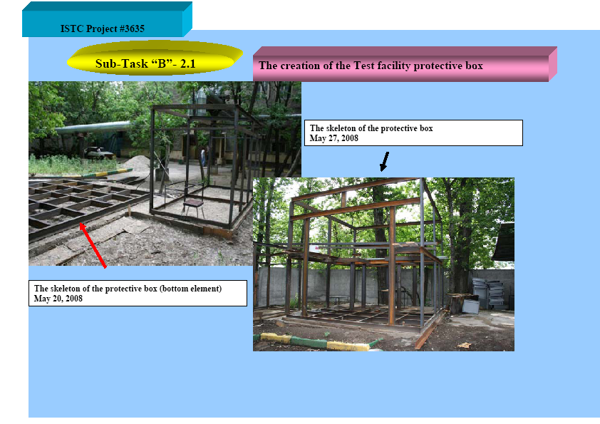

Slide 35
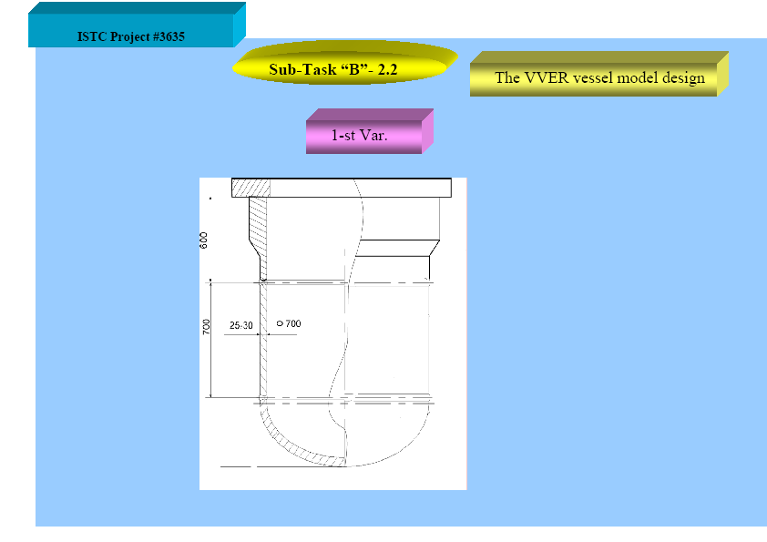

Slide 36
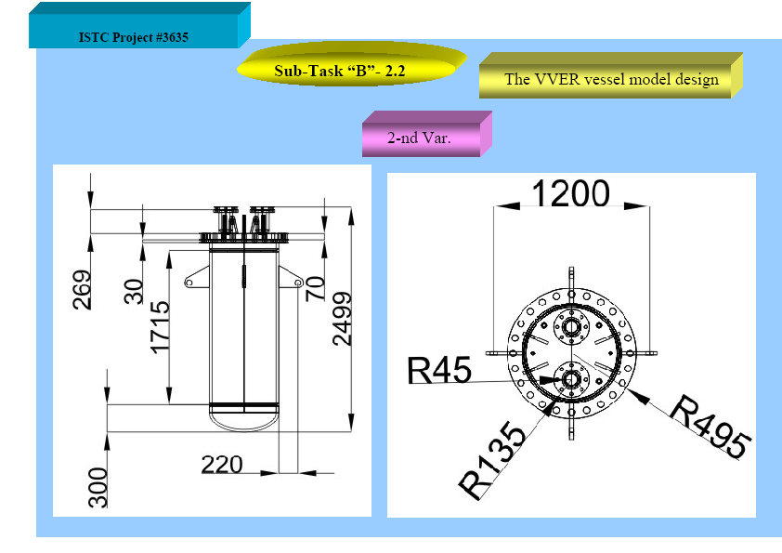

Slide 38
More than the 30 thermocouples on the outer and more than 6 thermocouples on the inner vessel wall surfaces will be used to measure the wall temperature during testing.
The monitoring of the vessel model deformation in course of the testing will be carried out by linear displacement transducers (at the 10 locations). There are two displacement gauges at each location (one for horizontal displacement and one for vertical displacement).
The arrangement of the thermocouples and displacement transducers will be determined after choosing the SA scenarios and test conditions within the Task “A” framework.

Slide 40
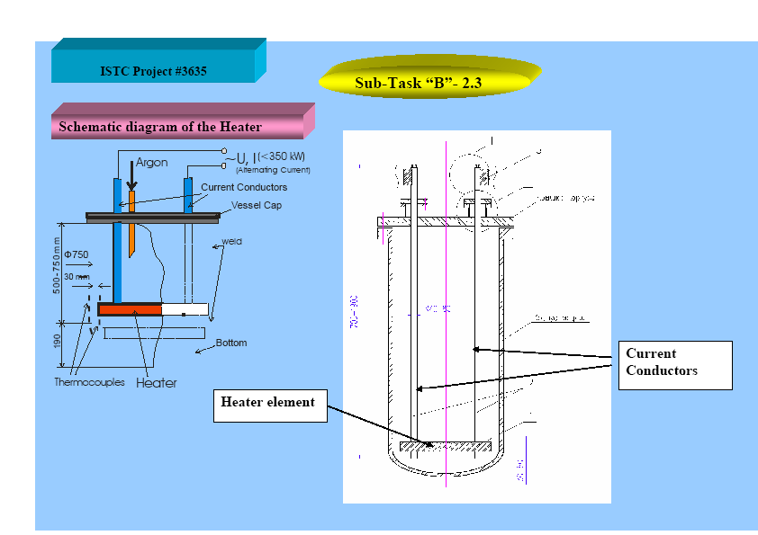

Slide 48
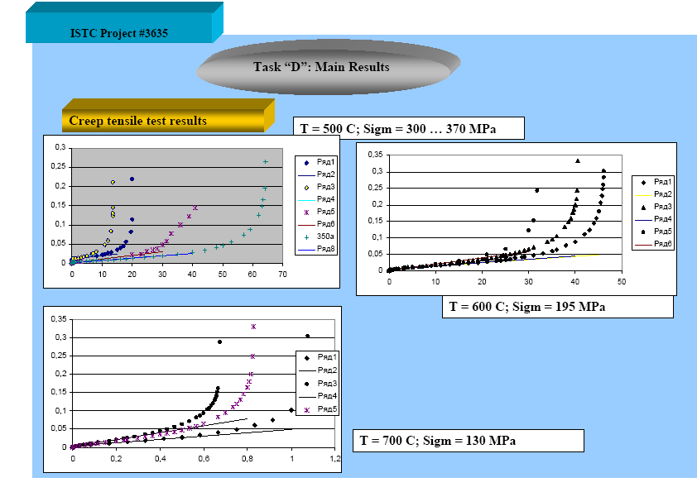

Slide 49
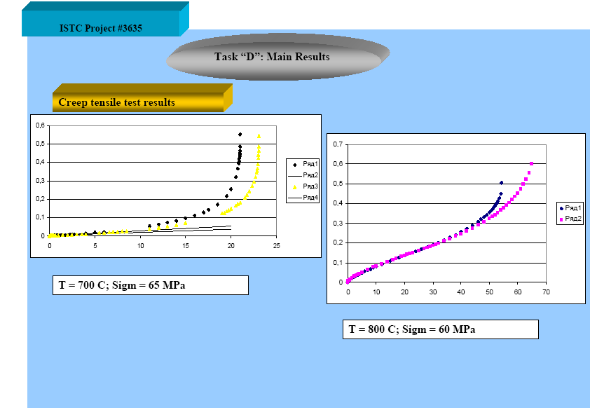

Slide 50
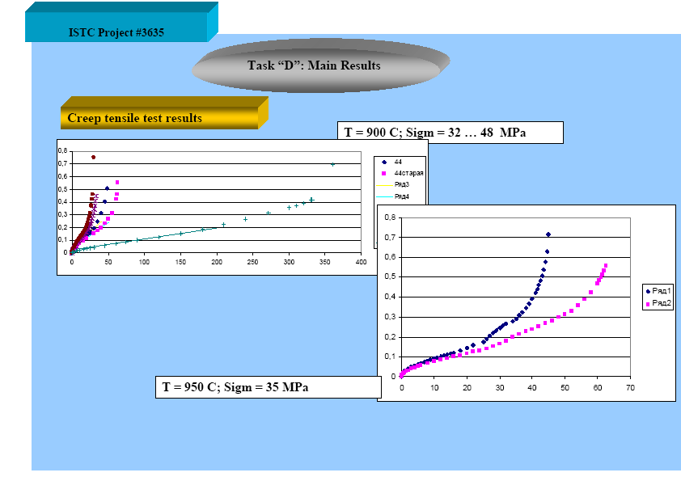

Slide 53
Thank You! End

