Slide 1
Update on SARNET2
Presented by B. Clément (IRSN)

Slide 2




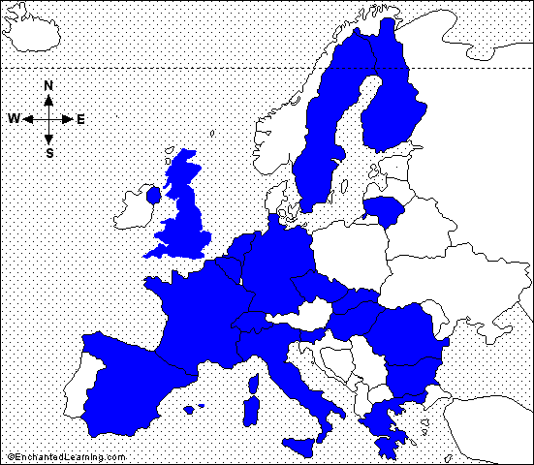
Add Title by Clicking
General features
Severe
Accident
Research
NETwork of excellence
Add Text by Clicking
  New SARNET2 project in 7th EC Framework Programme (follow-up of SARNET 1st phase 2004-2008)
  21 countries (European Union, plus Switzerland, Canada, USA and South-Korea)
  42 organizations (new entry: KINS from Korea)
    24 Research organizations
    7 Universities
    5 Industry/Utilities
    6 Safety authorities or Technical supports
  ≈ 200 researchers (+ PhD)
Starts April 1st, 2009 for 4 years
≈ work of 40 persons-year per year
≈ 8,5M€ effort per year
≈ 1,5M€ per year funded by EC

Slide 3
Research priorities
6 issues remain open with high priority:
  Core coolability during reflooding and debris cooling,
  Ex-vessel melt pool configuration during MCCI (Molten Core Concrete Interaction) & ex-vessel corium coolability by top flooding,
  Melt relocation into water & ex-vessel FCI (Fuel Coolant Interaction),
  Hydrogen mixing and combustion in containment (flame acceleration),
  Oxidising impact on source term (Ru oxidising conditions or air ingress for HBU and MOX fuel elements),
  Iodine chemistry in RCS and in containment.

Slide 4
Work-Packages
WP1: NoE Management, incl. updates of the research priorities,
WP2: Spreading of Excellence (courses, ERMSAR conferences, mobility of researchers)
WP3: Information Systems (web, ACT, DATANET)
WP4: ASTEC (capitalisation of knowledge, assessment, extension to BWR and CANDU)
WP5: corium and debris coolability (core reflooding..)
WP6: MCCI
WP7: steam explosion and hydrogen combustion in containment
WP8: oxidising impact on source term (Ru, HBU and MOX fuel), iodine chemistry in circuit and containment
R&D
The WP5 to 8 cover the 6 high-priority issues defined by SARP in SARNET.

Slide 5
Main progress in the last 6 months
Sept.09: elaboration of the report on detailed description of 1st year work (until March 2010).
Sept.09: release of the SARNET2 newsletter N°1.
Oct.09 (Petten): WP8 technical progress meeting.
Oct.12-14, 2009 (Paris): joint workshop OECD/CSNI/WGAMA and WP5 on in-vessel coolability ⇨ good success with 66 participants.
Jan.2010 (Cadarache): WP5 and 7 technical progress meetings.
Good preliminary results of the PRELUDE tests (IRSN), preparing the future PEARL tests on debris bed reflooding.
March 25, 2010 (Petten): WP8 technical progress meeting (in conjunction with the Phebus.FP–ISTP meetings).
March 2010: opening of the public web site ww/sar-net.eu.

Slide 6
Main next milestones
Preparation of the 1st year progress reports and of the report on detailed description of 2nd period content (April 2010 – Nov. 2011, 18 months long): to be released in April-May 2010.
End of March 2010: release of the SARNET2 newsletter N°2.
1st General Assembly (gathering one representative from each partner + M.Hugon, EC Corresponding Officer) on May 10, 2010 in Bologna (Italy).
4th ERMSAR conference on 11-12 May 2010 in Bologna (Italy), hosted by ENEA (yearly events: next one around May 2011..).
SARNET Book on SA: currently under review; planned publication end of 2010.
1st Education & Training course: planned In January 2011 on Gen.III NPP SA phenomenology, jointly organised by Univ. of Pisa and CEA in Pisa (Italy).

