Slide 1

PARAMETER SF3 first post-test calculation
Jon Birchley, PSI
PARAMETER Meeting
29th July 2009
Podolsk, Russia

Slide 2
  Outline
  ● PARAMETER SF3 experiment
  ● Modelling
  ● Boundary conditions
  ● Results
  - overall
  - reflood
  ● Summary

Slide 3
  PARAMETER SF3 experiment
  ● Initial power ramp and thermal escalation
  ● Approximate temperature plateau for pre-oxidation
  ● Second power ramp and thermal escalation to ca. 1600 °C
  ● Top injection at ca. 40 g/s
  - primary aim to address top-down quenching

Slide 4
  Modelling
  ● PSI version(s) of SCDAP/RELAP5/irs
  - properties for Ta, Mo and brass
  - oxidation models
  - standard SCDAP (Cathcart-Pawel/Urbanic-Heidrick)
  - Sokolov correlation implemented but not used in this calculation
  - separate correlations for weight gain and thickness
  ● Input model
  - single hydraulic channel for test section
  - cooling circuits; dummy volumes for lab temperature
  - 5 core components (central, 2*heater, peripheral rods, shroud)
  - problems in modelling upper section of shroud
  - 28 axial nodes for heaters (14 Ta, 2x6 Mo, 2x1 brass)
  - external resistance 8.5 mohm/rod
  - interphase drag with and without CCFL model

Slide 5
  Boundary conditions
  ● Inlet flows
  - steam: 3.5 g/s (start at 2300 s); 0 g/s during water injection
  - Ar: 2 g/s
  - reflood: top injection at ca. 40 g/s
  ● Power
  - total DC power follows experimental evolution
  - tripped off at start of injection

Slide 6
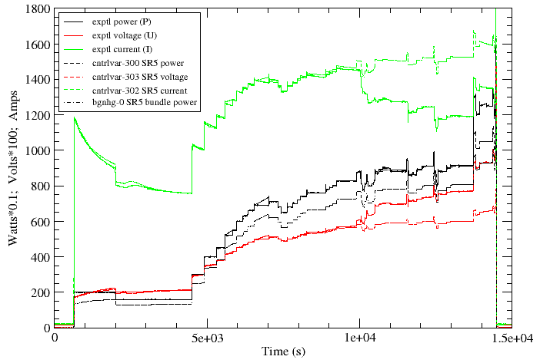
  SF3 electrical power

Slide 7
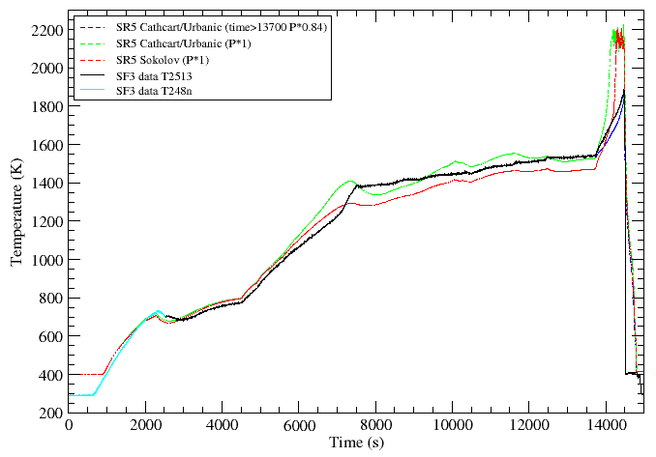
  SF3 maximum temperature

Slide 8
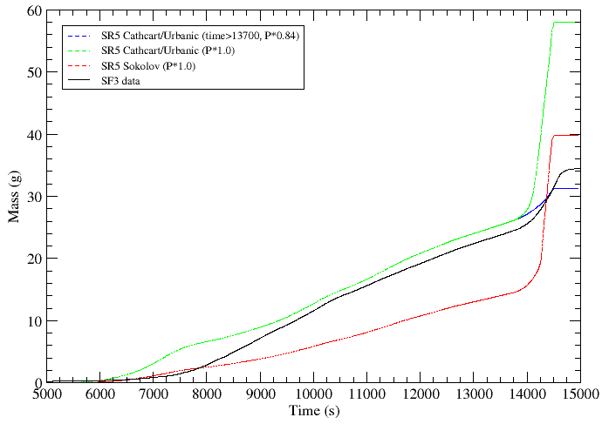
  SF3 hydrogen generation

Slide 9
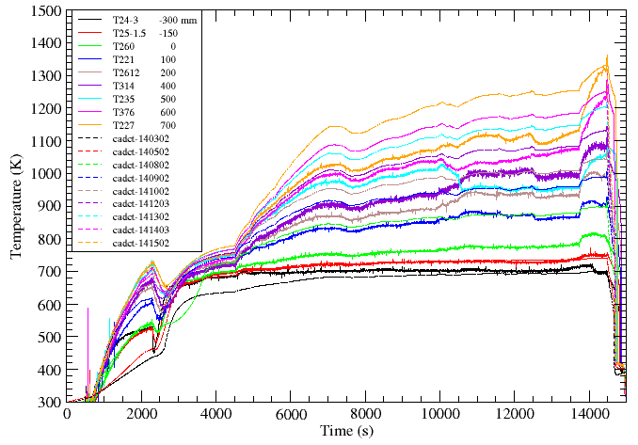
  SF3 bundle temperatures - lower

Slide 10
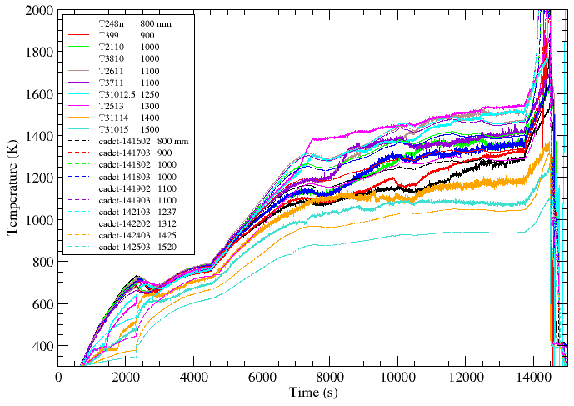
  SF3 bundle temperatures - upper

Slide 11
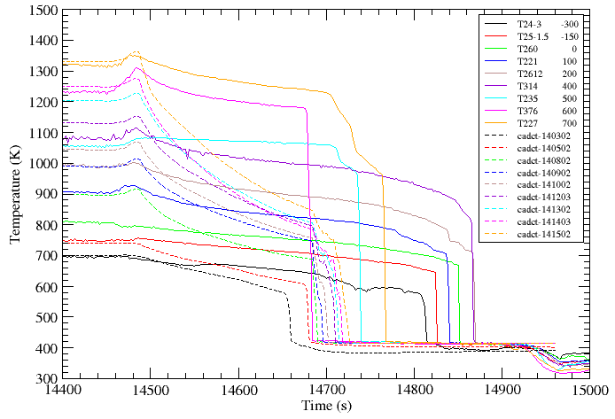
  SF3 reflood – lower (no CCFL model)

Slide 12
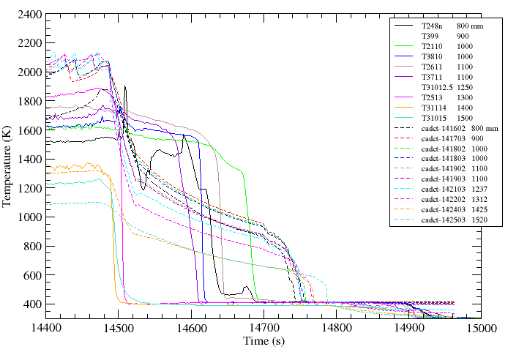
  SF3 reflood – upper (no CCFL model)

Slide 13
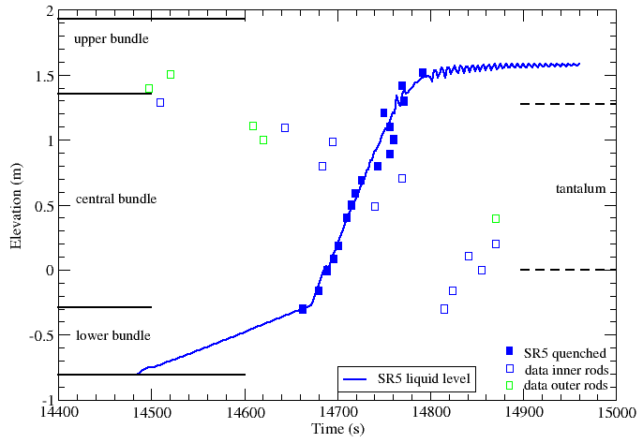
  SF3 quench (no CCFL model)

Slide 14
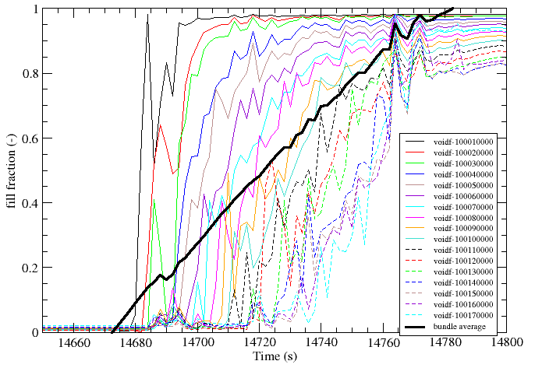
  SF3 bundle refill (no CCFL model)

Slide 15
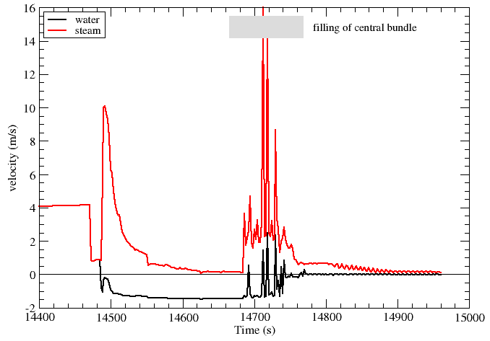
  SF3 bundle exit velocities (no CCFL)
CCFL model needed?

Slide 16
  Counter-current flow limitation
  ● Baseline case used “standard” RELAP5 interphase drag
  - annular-mist model allows liquid penetration during injection
  - bundle refills and quenches bottom-up, contrary to experiment
  ● G. B. Wallis says “no way water could penetrate so easily through the bundle with all that steam flowing”
  ● Introduce Wallis CCFL correlations
  - No, Lee, Song (Nucl. Engrg. Tech. 37 (6) 557-564, (2005))
  - aimed at top injection; CCFL at upper core support plate
  j_{g}^{*1/2} + 1.22 j_{l}^{*1/2} = 0.88 (A)
  - Wallis, One-dimensional two-phase flow, McGraw-Hill (1969)
  - Original modelling; CCFL in single tube
  j_{g}^{*1/2} + j_{l}^{*1/2} = 0.725 (B)

Slide 17
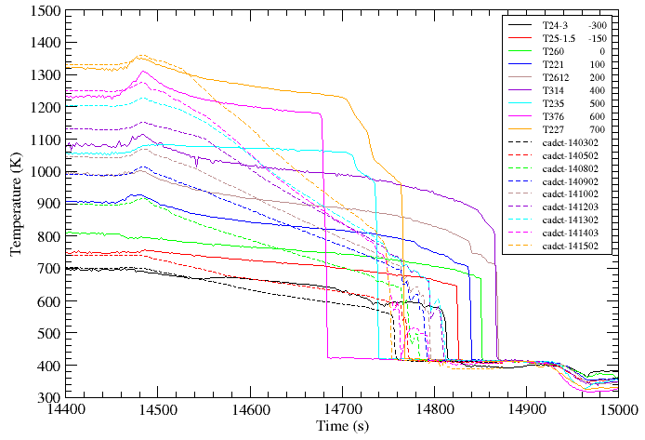
  SF3 quench – lower (CCFL model A)

Slide 18
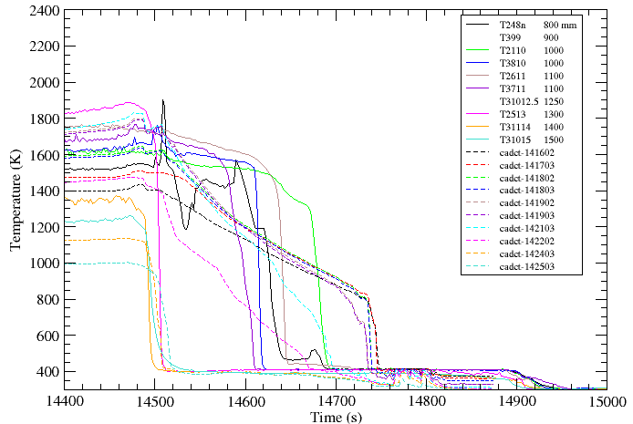
  SF3 quench – upper (CCFL model A)

Slide 19
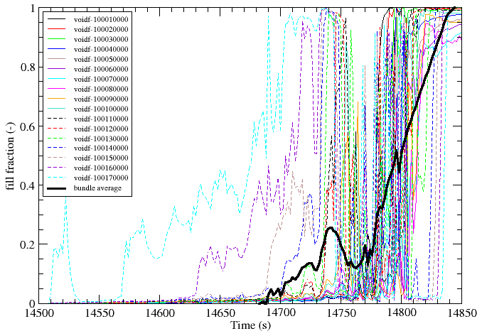
  SF3 bundle refilling (CCFL model A)

Slide 20
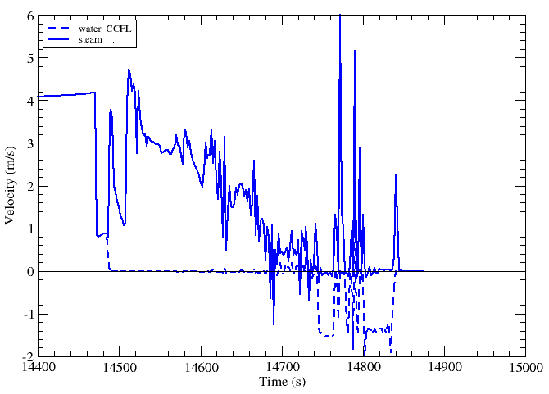
  SF3 bundle exit velocities (CCFL model A)
filling of central bundle
CCFL model needed?
not enough steam for CCFL

Slide 21
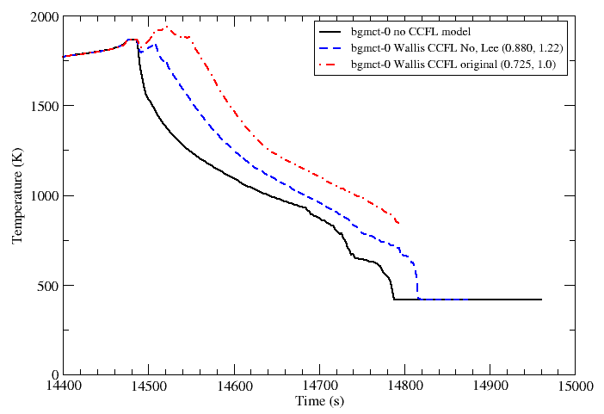
  SF3 T,max (CCFL models: none A, B)

Slide 22
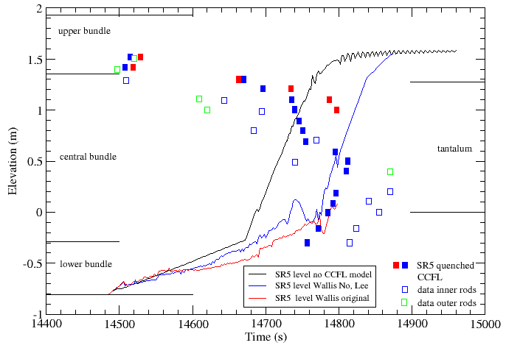
  SF3 reflood (CCFL models: none A, B)

Slide 23
  Summary
  ● First SF3 post-test calculations performed
  ● Difficulties encountered in two areas
  - limitations in modelling upper part of bundle
  - representation of power history and distribution
  ● Power reduced during final heat-up
  - sought to simulate actual conditions at start of injection
  ● RELAP5 interphase drag model fails to capture CCFL
  - water penetrated directly through bundle, quenched from bottom up
  ● CCFL successfully captured with Wallis-type correlation
  - water collected first in upper bundle before filling bundle
  - quench initially top-middle, then bottom-middle
  - recent correlation aimed at top injection works better than original
  ● Analyses will continue with new code version just available

Slide 24
  Acknowledgments
  The work is supported by Swissnuclear and by the European Commission in the frame of SARNET and SARNET-2
  Thank you for your attention
  ☺

