Slide 1
PARAMETER-SF4 pre-test calculation with MAAP4.07
Emilie BEUZET, Jean-Sylvestre LAMY

Slide 2
Content
PARAMETER-SF4 test section
Specification of PARAMETER-SF4 test
Model parameters used in MAAP4.07
Results of SF4 pre-test obtained with MAAP4.07
➔ Temperatures
➔ O₂ flow rates
➔ Oxide layer thickness
Conclusion

Slide 3
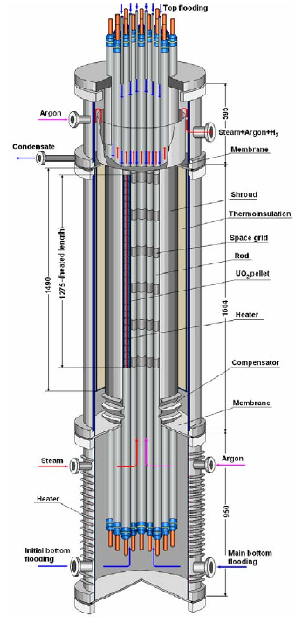
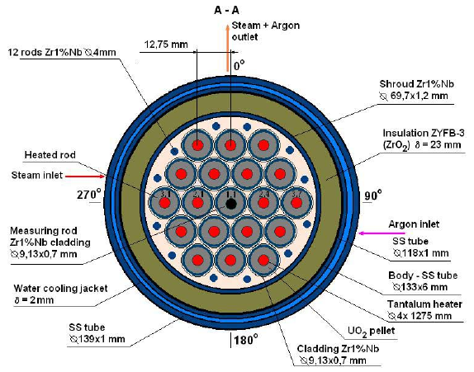
PARAMETER-SF4 test section
PARAMETER cross section PARAMETER test facility

Slide 4
Specification of PARAMETER-SF4 test
Pre-test calculation for PARAMETER SF4 has been carried out with a local version of MAAP4.07, containing extensions developed by EDF, specifically :
- Zr oxidation by air, - introduction of material properties of the heater element materials (tantalum, molybdenum and brass) used in PARAMETER.
The simulation covers :
- the initial power ramp and heat up, - establishment of a stable pre-oxidation plateau, - power reduction, - air ingress phase, - bottom reflood.

Slide 5
Specification of PARAMETER-SF4 test
~1873 k
Argon 2g/s
Air 0.5g/s
Steam 3.5g/s
~1473 k
~300 µm
~873 k
Bottom reflood 80g/s
1500 s
16000 s
16875 s

Slide 6
Model parameters used in MAAP4.07
Steam pre-oxidation = Cathcart + Urbanic correlation
Air oxidation = NUREG correlation
External resistance : 8.5mΩ / rod
Distribution in : - 3 rows : 1 unheated rod / 6 rods / 12 rods + 12 ‘little’ rods , - 58 axial meshes : 5 for the lower plenum, 48 for the core and 5 for the upper plenum.
58 meshes
3 rows

Slide 7
Results of SF4 pre-test obtained with MAAP4.07
Temperatures all simulation long :

Slide 8
Results of SF4 pre-test obtained with MAAP4.07
Temperatures during air ingress :

Slide 9
Results of SF4 pre-test obtained with MAAP4.07
O₂ flow rates :

Slide 10
Results of SF4 pre-test obtained with MAAP4.07
Oxide layer thickness :

Slide 11
Conclusion
Confidence in our simulation ➔ until start of air ingress phase :
- good agreement in steam oxidation between MAAP modelling and QUENCH experiments,
- during air ingress, in case of O₂ starvation : nitriding phenomenon = not taken into account ➔ may attenuate the temperature escalation at the hot spot.
EDF is very interested in getting experimental data from SF4 :
- to improve the understanding of air oxidation phenomenon,
- to know how well our model reproduces the experiment,
- to indicate areas of weakness of our model and to improve it.

Slide 12
Thanks for your attention …

