Slide 1

PARAMETER SF4 final pre-test calculation
Jon Birchley, PSI
PARAMETER Meeting
29th July 2009
Podolsk, Russia

Slide 2
  Outline
  ● Background
  ● SF4 objectives and target conditions
  ● Modelling
  ● Boundary conditions
  ● Results
  ● Summary

Slide 3
  SF4 objectives
  ● Conduct an air ingress experiment with a significant period of total oxygen consumption
  ● Recover the bundle with bottom injection so as to avoid a major excursion during reflood and degradation

Slide 4
  SF4 target conditions
  ● Conditions defined following discussions and planning analyses by IBRAE, GRS, EDF, KI and PSI
  ● Moderate pre-oxidation in steam
  - maximum temperature ca. 1200 °C
  - oxide thickness ≤ 300 mu
  - reduce temperature to ca. 900 °C before air phase
  ● Air ingress
  - thermal escalation driven by reduced heat transfer and increased oxidation heat
  - air flow low enough to exhaust all the oxygen
  ● Initiate reflood at temperature 1750 °C
  - bottom injection at 80 g/s

Slide 5
  Modelling
  ● PSI version(s) of SCDAP/RELAP5/irs
  - properties for Ta, Mo and brass and alternative oxidation models
  - steam: standard SCDAP (Cathcart-Pawel/Urbanic-Heidrick); separate correlations for weight gain and thickness
  - Sokolov correlation implemented but not used in this calculation
  - air: oxidation heat release; kinetic correlation from MELCOR
  ● Input model
  - based on SF2, SF3 simulations; modified for SF4 configuration
  - single hydraulic channel
  - cooling circuits; dummy volumes for lab temperature
  - 5 core components (central rod, 2 rings of heater rods, peripheral rods, composite shroud)
  - problems in modelling and upper section of shroud
  - 28 axial nodes for heaters (14 Ta, 2x6 Mo, 2x1 brass)
  - external resistance 8.5 mohm/rod

Slide 6
  Boundary conditions
  ● Pre-oxidation (0 - 16000 s)
  - steam: 3.5 g/s (start at 1500 s)
  - Ar: 2 g/s
  - power
  - ramp to 8.4 kW at 8000 s
  - gradually increase to 9.2 kW at 14000 s
  - reduce to 5.5 kW from 14000 - 16000 s
  ● Air ingress (16000 - 17375 s)
  - switch from steam to 0.5 g/s air (sensitivity: 0.333 g/s)
  - simulated by Ar + steam; preserve oxygen atoms and molar flow
  - maintain Ar flow 2 g/s and power at 5.5 kW
  ● Reflood (17375 - 18000 s)
  - bottom injection: 80 g/s water (sensitivities: 40, 150 g/s)
  - switch Ar injection to upper volume; trip power off

Slide 7
  Results
  ● Overview of full transient
  - inlet flow rates
  - energy sources
  - heater rod temperatures
  - oxidation
  ● Air ingress phase
  - heater rod temperatures
  - oxygen consumption
  ● Reflood
  - heater rod temperatures
  - water and quench levels

Slide 8
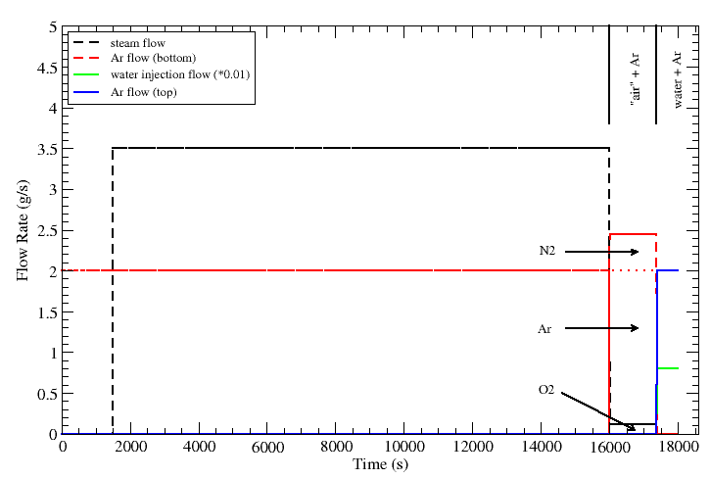
  Inlet flow rates

Slide 9
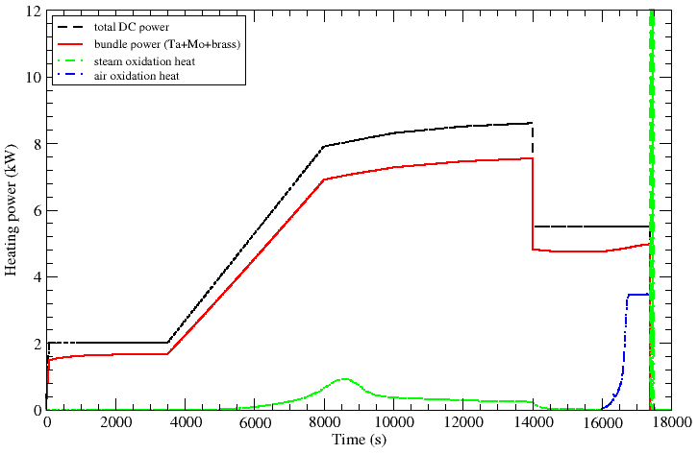
  Heat sources
peak at ca. 50 kW

Slide 10
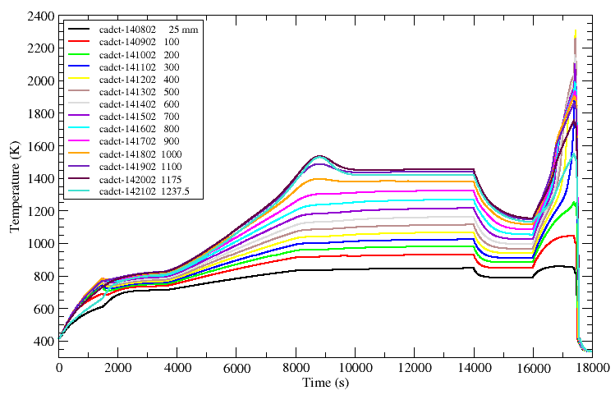
  Heater rod temperatures
end first power ramp reduce power
steam air

Slide 11
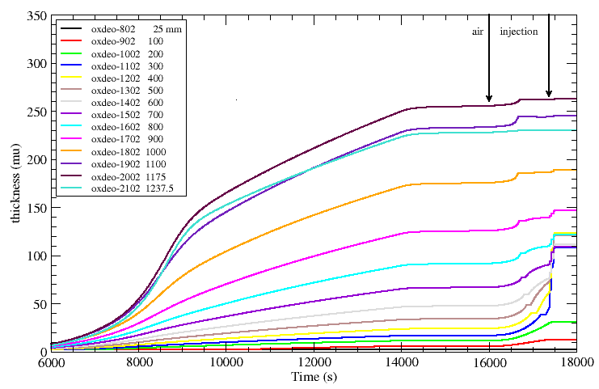
  Cladding oxide thickness
correlation may underestimate thickness
end first power ramp reduce power
steam air

Slide 12
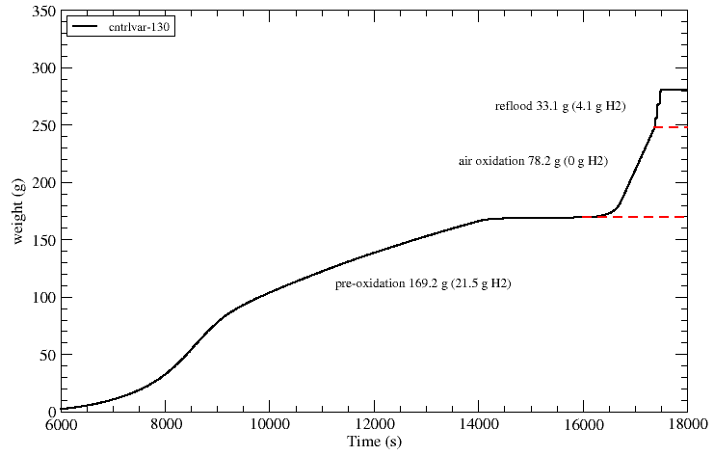
  Oxidation weight gain
correlation may underestimate thickness
end first power ramp reduce power
air injection
steam air

Slide 13
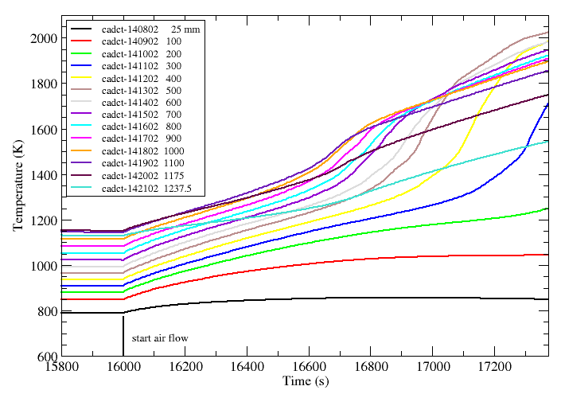
  Heater rod temperatures (air phase)

Slide 14
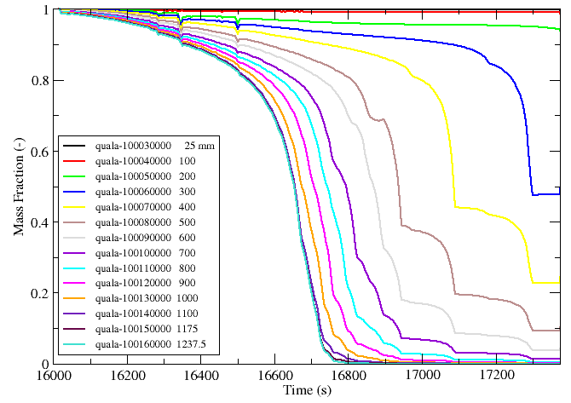
  Starvation: downward propagation

Slide 15
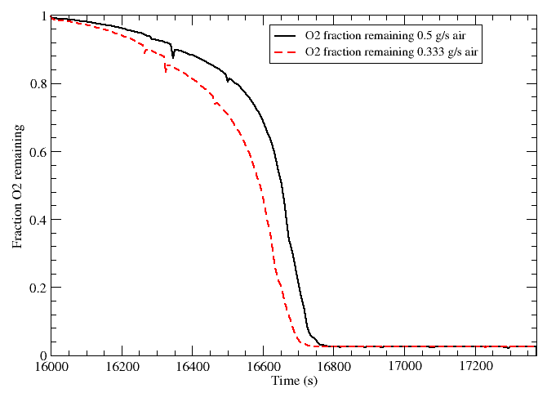
  Starvation: effect of air flow rate

Slide 16
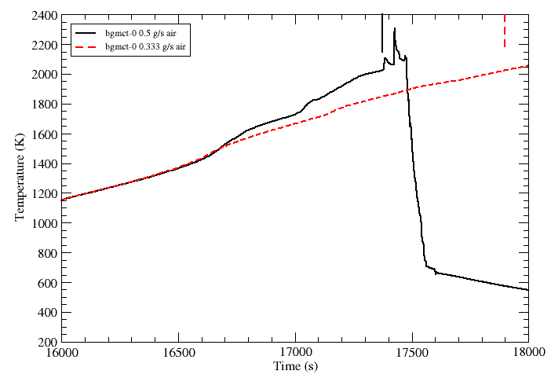
  Thermal response: effect of air flow

Slide 17
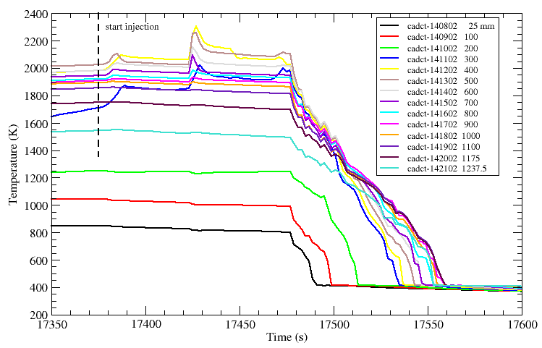
  Heater rod temperatures (reflood)

Slide 18
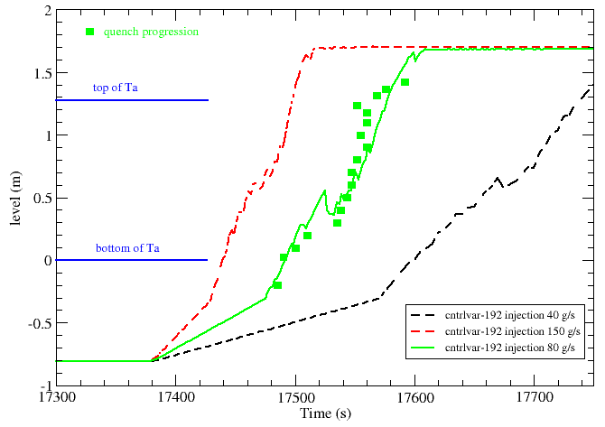
  Reflood: effect of injection rate

Slide 19
  Summary
  ● Final calculation performed with agreed boundary conditions
  - liaison and discussion with European and Russian partners
  ● Pre-oxidation at ca. 1200 C and ca. 250 mu oxide layer
  - slightly more oxidation with Cathcart-Pawel than Sokolov
  - power transient needs to be managed carefully to avoid escalation
  ● Air flow 0.5 g/s indicates ca. 600 s starvation period
  - starvation front propagates to bundle mid-elevation
  - 0.333 g/s gives longer starvation; possibly deeper propagation - result only qualitative due to error in diffusion limit model
  ● Reflood with 80 g/s injection
  - commences after ca. 100 s filling of lower volume; short escalation
  - slight metallic melting but intact geometry maintained
  - faster/slower reflood with 160/40 g/s injection

Slide 20
  Acknowledgments
  The coordination has been supported during 2008 by the European Commission in the frame of SARNET
  PSI efforts have been funded by Swissnuclear
  Thank you for your attention
  ☺

