Slide 1
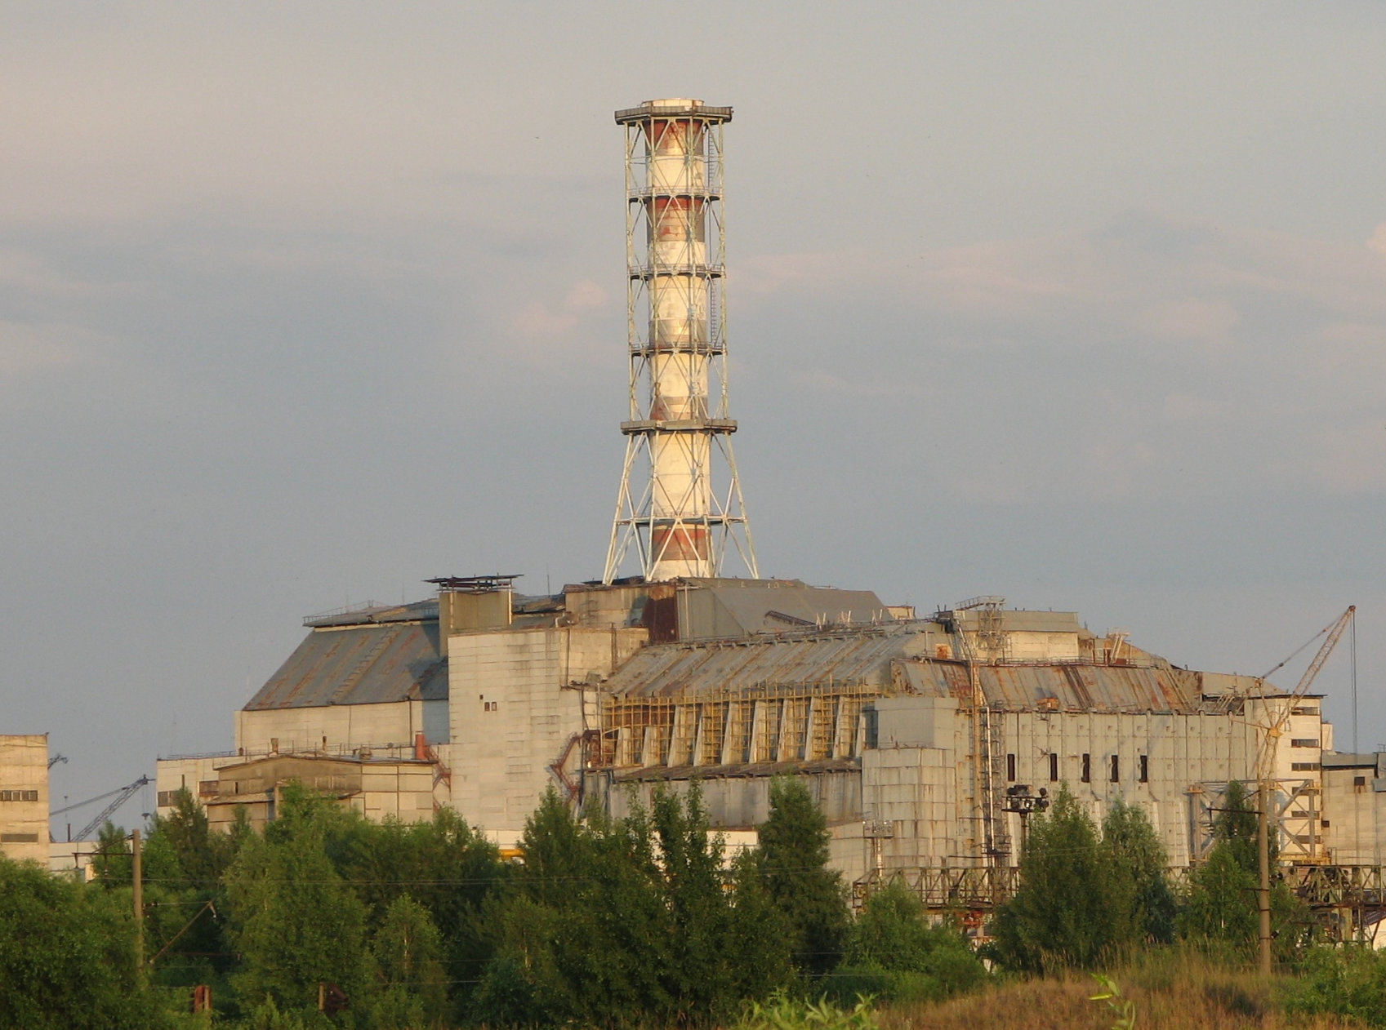
Status of STCU Project # 4207
Long-term prognosis of behavior of
the fuel dust in Chernobyl Shelter
Presented by V.Protsak
17th CEG-SAM Meeting
17th CEG-SAM Meeting by CIEMAT, Madrid, 29-31 March, 2010

Slide 2
CONTENT
General information
Current status of the project
- Analysis of information concerning the FCM in Shelter
- Creation of the draft version of the database
- Assessment of the RN parameters in the water volumes and aerosols of Shelter
- Assay of the experimental works carried out within the project frameworks
Conclusions
17th CEG-SAM Meeting by CIEMAT, Madrid, 29-31 March, 2010

Slide 3
Participating Institutions
Ukrainian Institute of Agricultural Radiology of National University of Life and Environmental Sciences of Ukraine.
Institute of Safety Problems of Nuclear Power Plants
of National Academy of Sciences of Ukraine
Project duration | 30 months
Participating personnel | 19 (13 “weapon” scientists)
Funding | 300,000 USD
Funding party | Canada
Project status | Finish the fourth quarter
Foreign Partners
Matt Krause | Canada, Thermalhydraulics Branch, AECL Chalk River Laboratories
Paul Bottomley | Germany, European Commission, DG Joint Research Centre, Institute for Transuranium Elements (ITU)
Christophe Journeau | France, CEA
17th CEG-SAM Meeting by CIEMAT, Madrid, 29-31 March, 2010

Slide 4
The project aim
The main aim of the project is to create a prognosis of the long-term (50-100 years) behaviour of the radioactive dust in Shelter. It will describe both transformation of the existing fuel dust and the processes of the dust formation from the main types of FCM under the current & future Shelter conditions.
Year 1 |  |  |  | Year 2 |  |  |  | Year 3
Task 1. Mechanisms of formation and classification of the Chernobyl FCM, updating the DB
Task 2. Characteristics and behavior of RA and water in Shelter
 | Task 3. Experimental study of the FCM destruction
 |  |  |  | Task 4. Creation of the models of the FCM transformation
 |  |  |  |  | Task 5. Long-term prognosis of the fuel dust behavior in Shelter
Quarter 1 | Quarter 2 | Quarter 3 | Quarter 4 | Quarter 5 | Quarter 6 | Quarter 7 | Quarter 8 | Quarter 9 | Quarter 10
17th CEG-SAM Meeting by CIEMAT, Madrid, 29-31 March, 2010

Slide 5
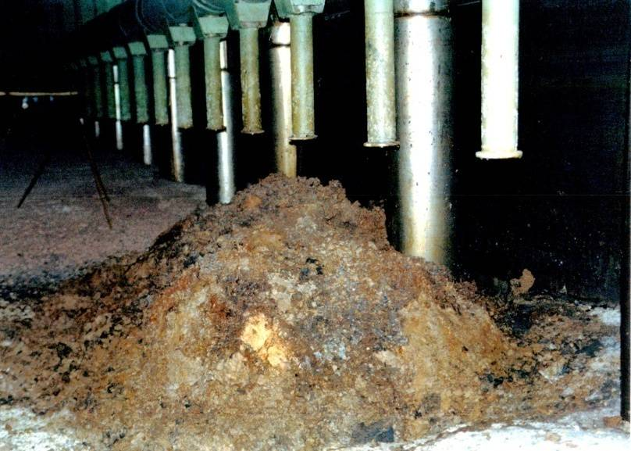
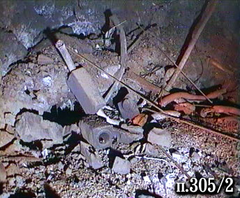
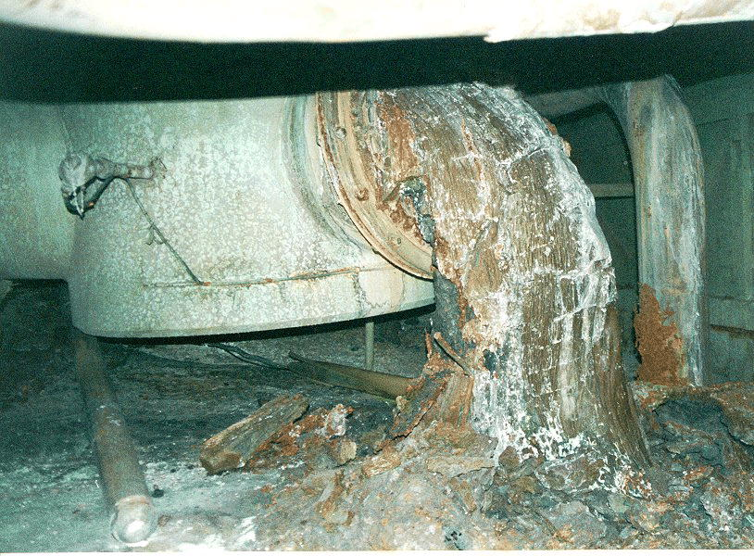
1st stage of the project. Analysis of the available information.
Main attention was paid to:
Data concerning the FCM distribution and inventories in the Shelter rooms
Physical-chemical characteristics of the FCM and their classification
Data characterizing the FCM destruction processes and the available models describing
the FCM destruction
Data concerning the water flows and water volumes in Shelter
Characteristics of the radioactive aerosol in Shelter
17th CEG-SAM Meeting by CIEMAT, Madrid, 29-31 March, 2010

Slide 6
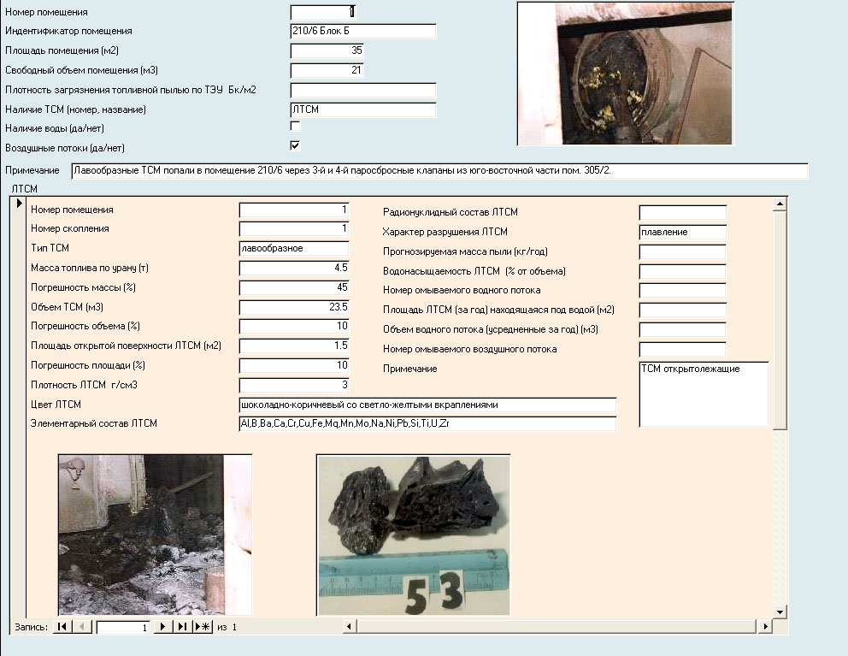
Creation of the database
Main fields of the DB:
the room’s number,
description of the room,
presence of the fuel dust,
- presence and type of the FCM,
parameters of the FCM,
presence of the water flow and its parameters,
presence of the air flow,
- the FCM destruction model.
The final version of the database will be organized in the manner enabling not only the information storage and update, but also the assessment of the FCM destruction using the relevant models and, therefore, calculation of the quantity and characteristics of the fuel dust in Shelter.
17th CEG-SAM Meeting by CIEMAT, Madrid, 29-31 March, 2010

Slide 7
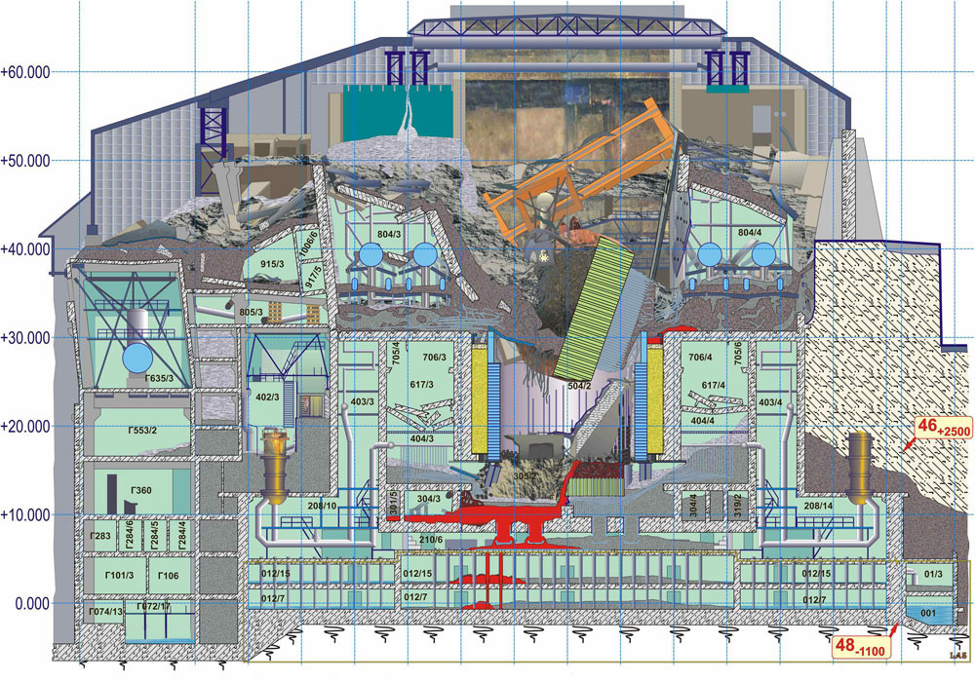
Current state of Shelter
17th CEG-SAM Meeting by CIEMAT, Madrid, 29-31 March, 2010

Slide 8
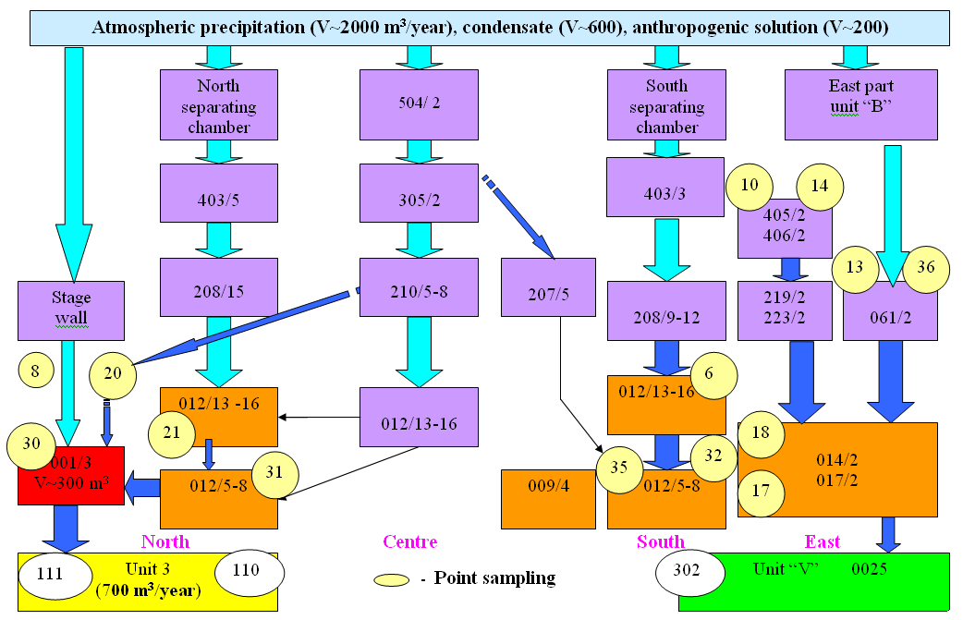
Main water fluxes in the Shelter rooms
17th CEG-SAM Meeting by CIEMAT, Madrid, 29-31 March, 2010

Slide 9
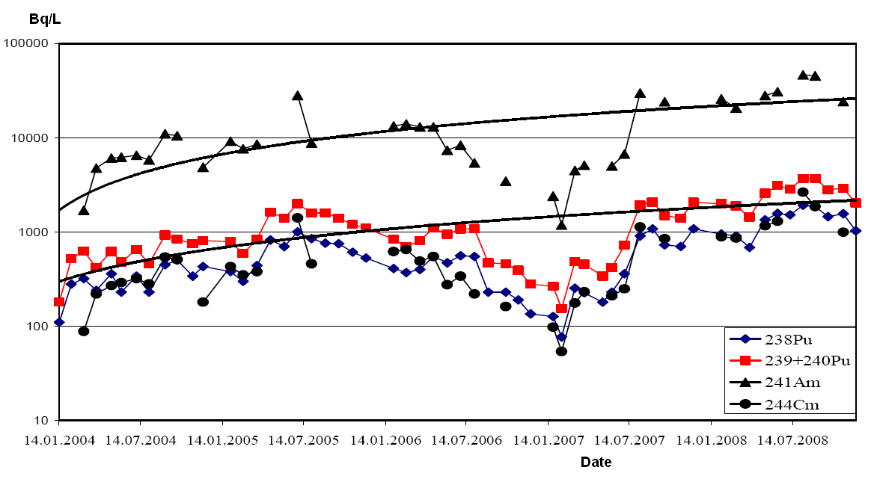
Dynamics of the RN concentration in the water volume in the room 001/3
Volume of the sediments – 96 m³ (two layers: lower is mainly sand, upper – silty fraction).
Volume of water – 300 m³.
Water level: permanent, mark -0.9 m (building coordinates)
Average annual water flow from the room to the third unit is 700 m³.
17th CEG-SAM Meeting by CIEMAT, Madrid, 29-31 March, 2010

Slide 10
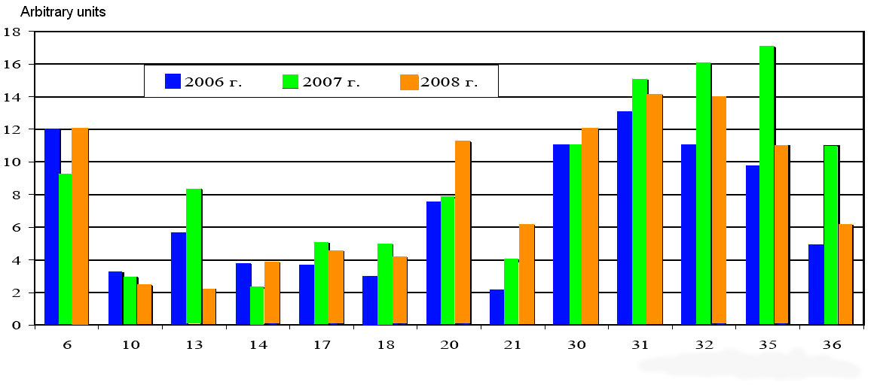
RN activity ratios in the water flows of Shelter
²³⁸Pu/²³⁹⁺²⁴⁰Pu
²⁴¹Am/²³⁹⁺²⁴⁰P
East
Southeast
North
South
Points sampling and direction water stream
Almost each water volume in Shelter is characterized by the specific radionuclide activity ratios.
In the Shelter’s waters the ²⁴⁴Сm and ²⁴¹Am fractions of the total TUE activity are 5-10 times higher than in the FCM.
17th CEG-SAM Meeting by CIEMAT, Madrid, 29-31 March, 2010

Slide 11
RN transportation forms in the Shelter waters
RN | At the particles, μm (%) |  |  | Water-soluble forms (%)
 | > 1 | 0.1-1 | 0.01-0.1
¹³⁷Cs | 0.01 - 0.94 | 0.9 - 0.38 | 0.31 - 1.35 | 97.6 - 99.5
⁹⁰Sr | 2.4 - 9.2 | 0.9 - 10.8 | 0.4 - 6.9 | 74 - 95
U isotopes | 0.5 - 4.1 | 1.6 - 4.9 | 0.8 - 5.9 | 91 - 95
Pu, Am, Cm isotopes | 11 - 73 | 15 - 67 | 0.6 - 28 | 0.4 - 24
рН=8.8-9.8
The main idea of the radionuclides measurements in the water volumes of Shelter is to establish the links between these volumes and certain aggregations of the FCM for estimation of the radionuclides fluxes from the FCM.
The destruction rates of the main types of the FCM in water are estimated as
Black LFCM – (1÷7)•10⁻⁴ g/(m²•day)
Brown LFCM - (5÷10) •10⁻⁴ g/(m²•day)
Fuel fragments - 5 •10⁻³ g/(m²•day).
17th CEG-SAM Meeting by CIEMAT, Madrid, 29-31 March, 2010

Slide 12
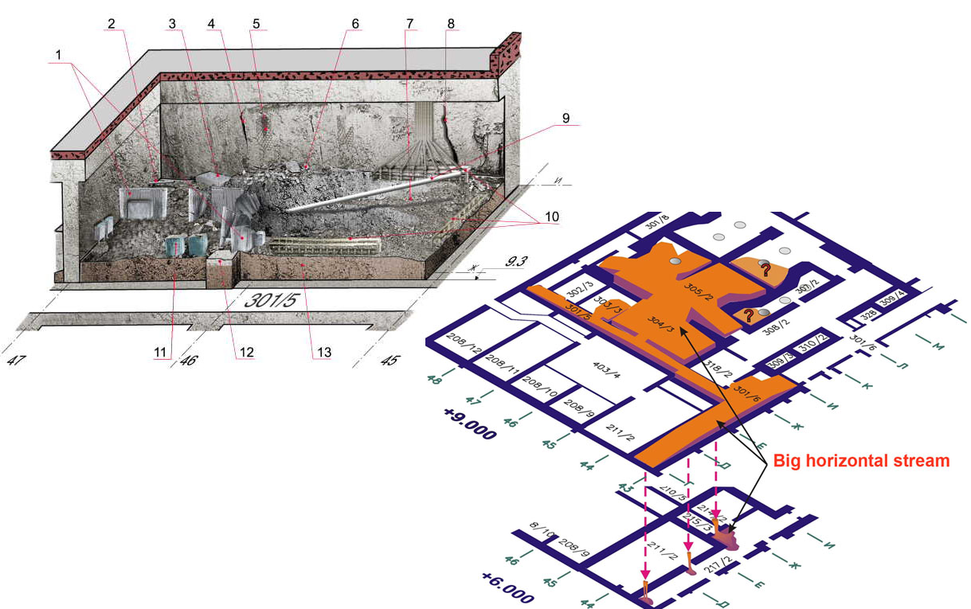
Assessment of the FCM aggregation surfaces in Shelter
Room 304/3
For estimation of the FCM open surface we analyze the video and photo documents and apply the mathematical methods of the image processing.
17th CEG-SAM Meeting by CIEMAT, Madrid, 29-31 March, 2010

Slide 13
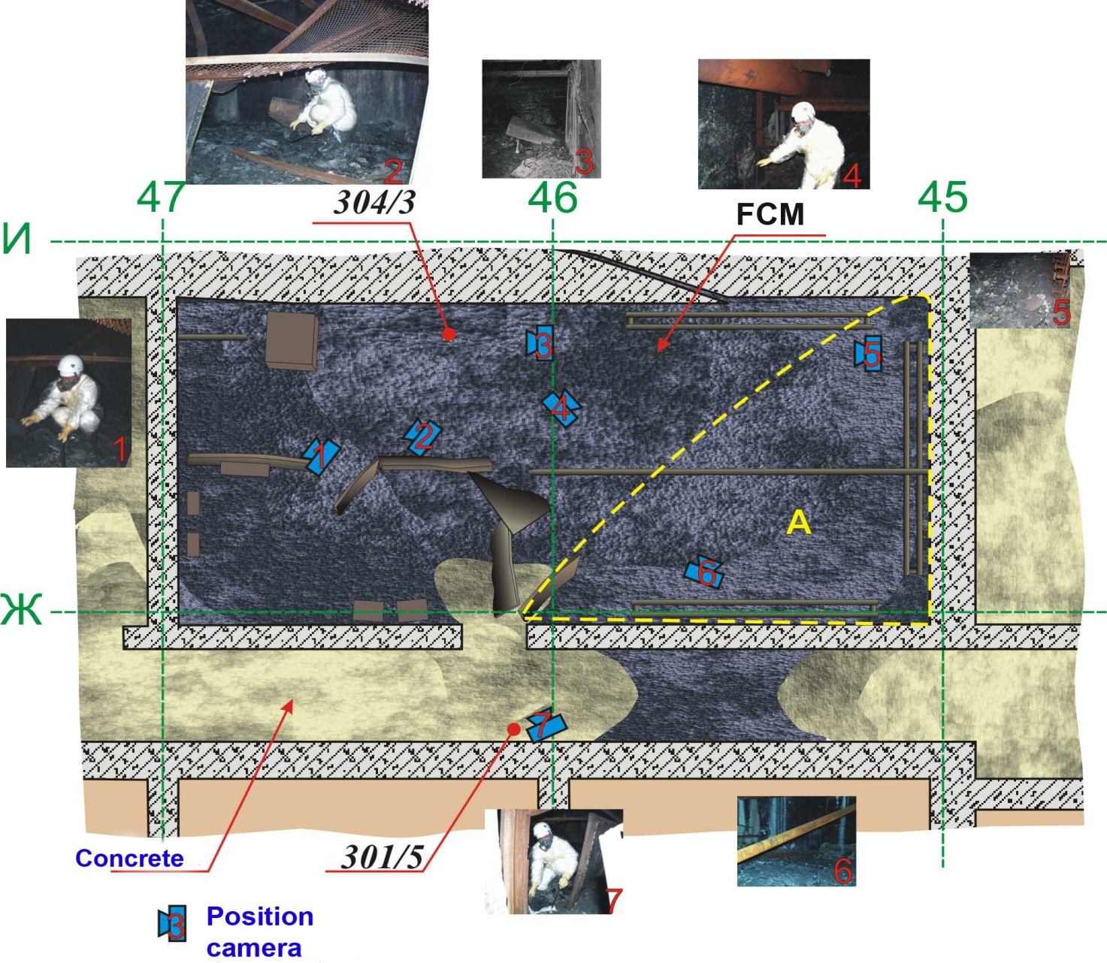
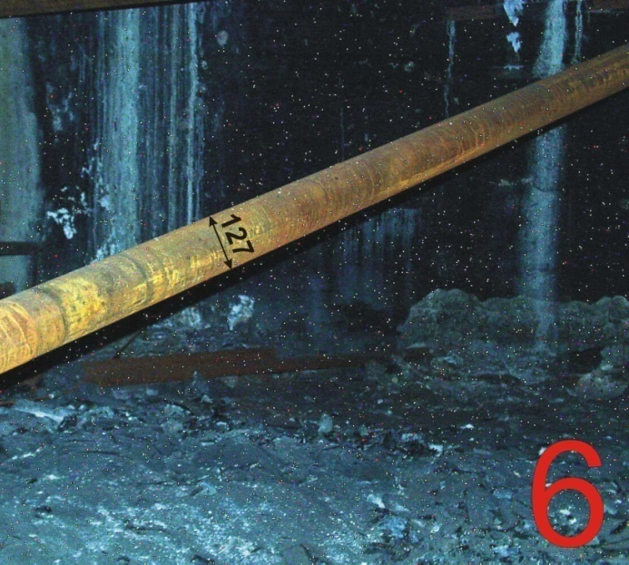
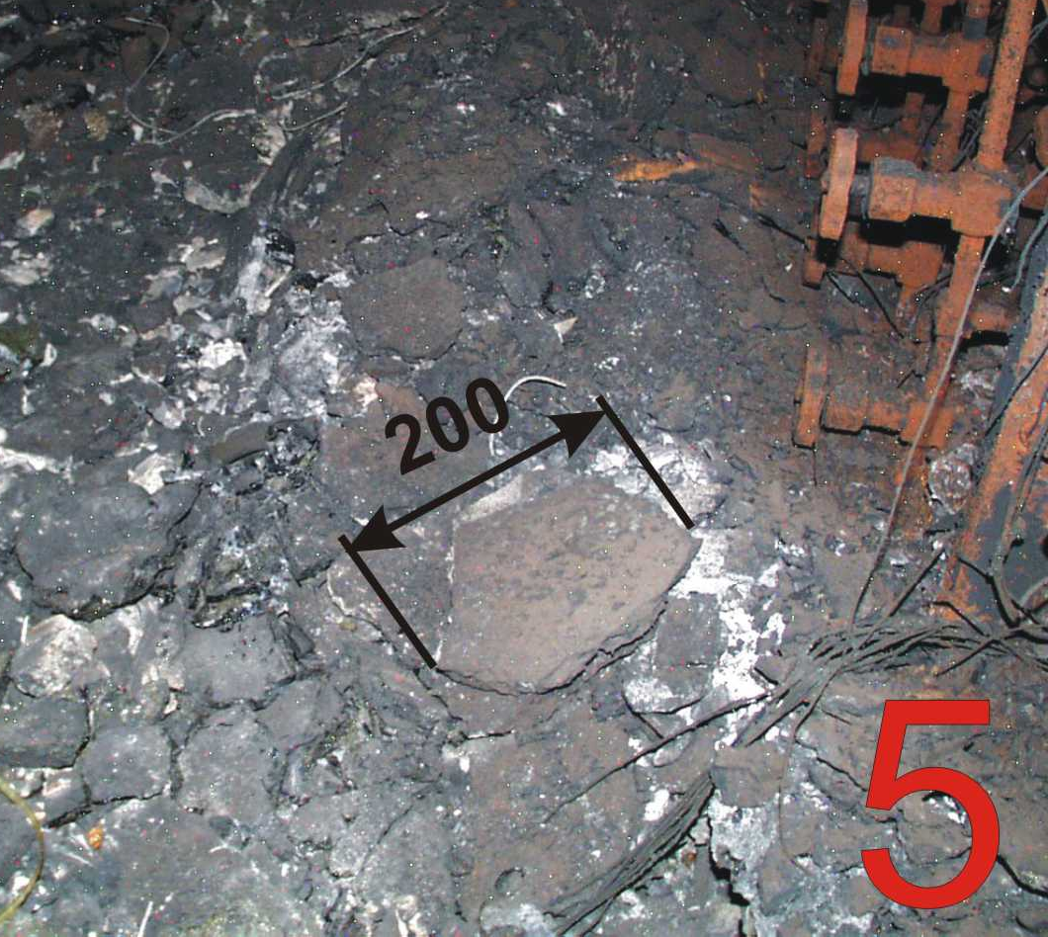
Assessment of the LFCM surface area in the room 304/3
LFCM volume = 60-65 m³
Room area = 63 m²
LFCM surface area = 1327 m²
17th CEG-SAM Meeting by CIEMAT, Madrid, 29-31 March, 2010

Slide 14
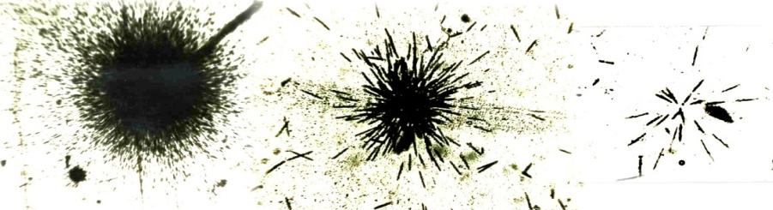
Assessment of the aerosols generation by the LFCM surface
LFCM sample
Air
Valve
Chamber
Impactor
Air from the chamber is periodically pumped through the impactor and filter
Filter
Air pump
Scheme of the experiment
Aerosol samples will be also analyzed by means of the neutron-activation methods coupled with the radiography of the fission fragments
17th CEG-SAM Meeting by CIEMAT, Madrid, 29-31 March, 2010

Slide 15
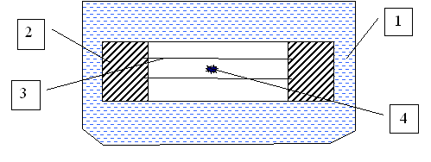
Assessment of destruction rates of the various FCM types in the simulated Shelter water
As the simulated water we prepared the water solution containing carbonate, hydro-carbonate and hydro-phosphate ions. The ions concentrations correspond to those average values in the water volumes in Shelter. рН of the solution is 9.3.
Reagent | Concentration mg/L
Na₂CO₃ | 100
NaHCO₃ | 500
Na₂HPO₄ | 3,0
Cassette for the RN leaching in the static conditions: 1- vessel with the leaching solution, 2- cassette body , 3- membrane filters (0.2 μm), 4- LFCM fragments
17th CEG-SAM Meeting by CIEMAT, Madrid, 29-31 March, 2010

Slide 16
Conclusions
The available information has been analyzed and classified.
The draft version of the project database has been created (room’s number → FCM
presence and parameters → presence of water → FCM destruction model). Present stage
of the DB – input of the information.
The method for estimation of the effective surface area of the FCM aggregations has been
developed. Now we estimate the areas of the main FCM aggregations.
Water and aerosols are periodically sampled in the Shelter rooms for establishing the links
to certain FCM aggregations.
Destruction rates of the main FCM types in the model fluids are studied.
The radioactive aerosols generation by the LFСМ surface is studied.
17th CEG-SAM Meeting by CIEMAT, Madrid, 29-31 March, 2010

Slide 17
Thank you very much for attention!
17th CEG-SAM Meeting by CIEMAT, Madrid, 29-31 March, 2010

