Slide 1
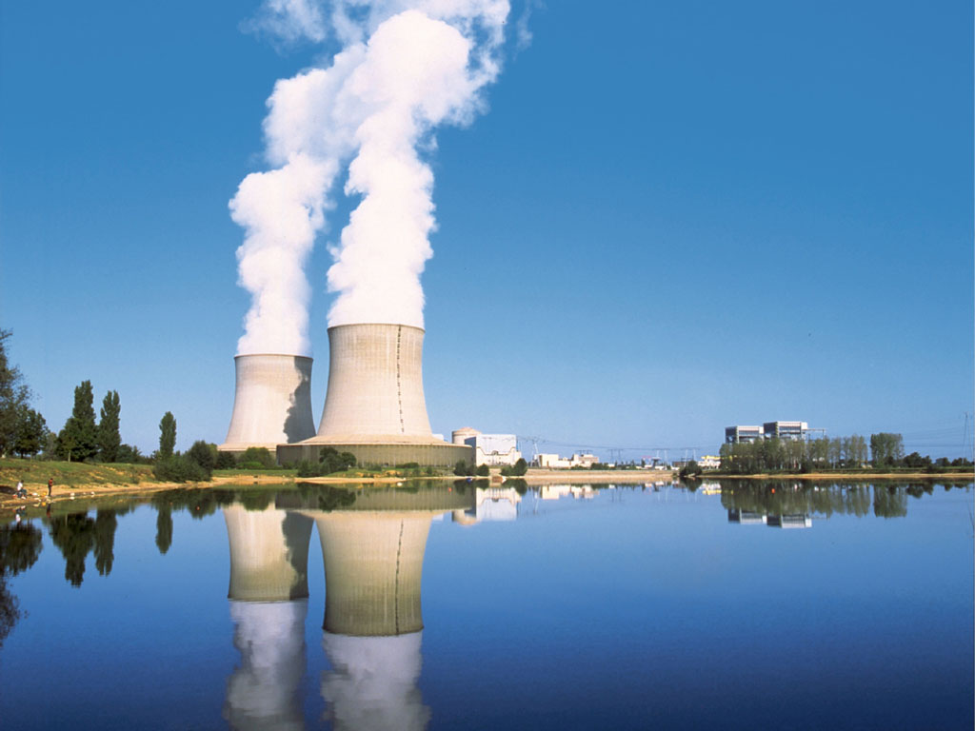



PARAMETER-SF4 post-test calculation with MAAP4.07
Andreas SCHUMM, Emilie BEUZET
March 2011
September 2010

Slide 2
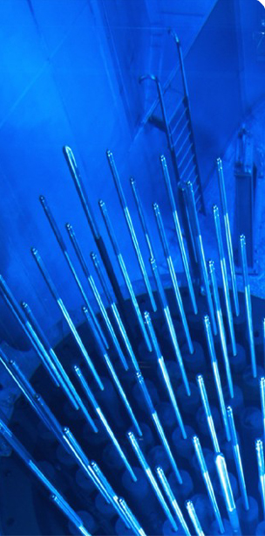
Sommaire
1. PARAMETER-SF4 test section
2. Specification of PARAMETER-SF4 test
3. Model parameters used in MAAP
4. Comparison with the previous post-calculations
5. Results of PARAMETER-SF4 post-test calculation
➔ Temperatures at different elevations (pre-ox)
➔ Hydrogen production
➔ Temperatures at different elevations (air)
➔ O₂ flow rates
6. Conclusions

Slide 3
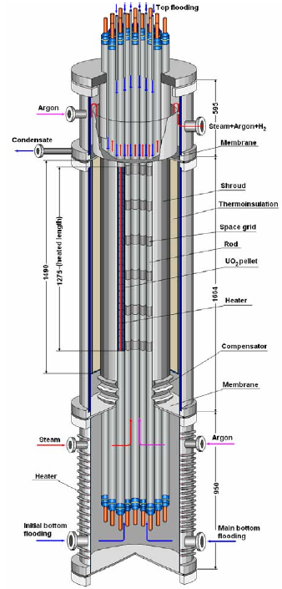
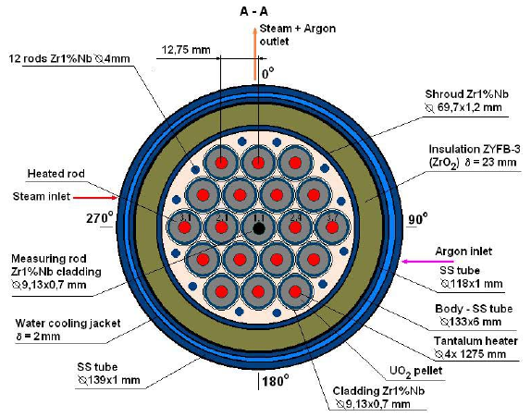
PARAMETER-SF4 test section
PARAMETER cross section
PARAMETER test facility

Slide 4
Specification of PARAMETER-SF4 test (1/2)
Pre-test and post-test calculations for PARAMETER SF4 have been carried out with a local version of MAAP4.07, containing extensions developed by EDF, specifically :
- Zr oxidation by air,
- introduction of material properties of the heater element materials (tantalum and molybdenum) used in PARAMETER.
Pre-test calculations in collaboration lead to the establishment of the PARAMETER SF4 sequence.
The simulation covers :
- establishment of a stable pre-oxidation plateau,
- power reduction,
- air ingress phase,
- bottom reflood.
➔t_{0MAAP}=t_{SF4}-1452 (the simulation begins with steam injection)

Slide 5
Specification of PARAMETER-SF4 test (2/2)
~2020 K
Argon 2g/s
Air 0.5g/s
Steam 3.5g/s
~1470 K
~1170 K
~770 K
Bottom reflood 80g/s
1452 s
16000 s

Slide 6
Model parameters used in MAAP (1/2)
Steam pre-oxidation = Cathcart + Urbanic correlation
Air oxidation = NUREG correlation
External resistance : 8.5mΩ / rod (established on the other PARAMETER experiments)

Slide 7
Model parameters used in MAAP (2/2)
First calculation (CEG-SAM of March 2010)
- 3 rows : 1 unheated rod / 6 rods / 12 rods + 12 peripheral rods
- 58 axial meshes : 5 for the lower plenum, 48 for the core and 5 for the upper plenum.
Second calculation (CEG-SAM of September 2010)
- 4 rows : 1 unheated rod / 6 rods / 12 rods / 12 peripheral rods,
(peripheral rods represented seperately)
- 58 axial meshes
‘New’ calculation
- 4 rows : 1 unheated rod / 6 rods / 12 rods / 12 peripheral rods added in all the geometrical characteristics (lower and upper plenums, rods number …),
-> full length rods extend through plenums
- 58 axial meshes

Slide 8
Comparison with the previous post-calculations
(at 200 mm )
simu1 = 3 rows simu2 = 4 rows
new = 4 rows + peripheral rods completly included in the geometry

Slide 9
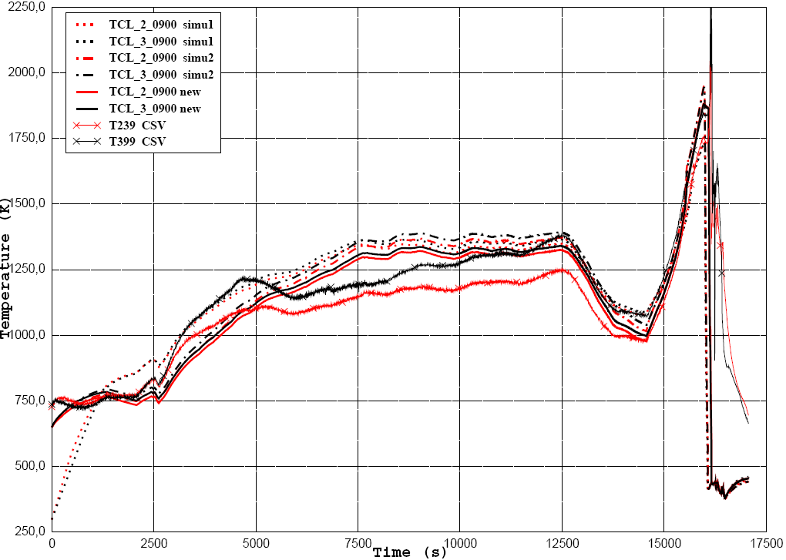
Comparison with the previous post-calculations
(at 900 mm)

Slide 10
Comparison with the previous post-calculations
(at 1300 mm)

Slide 11
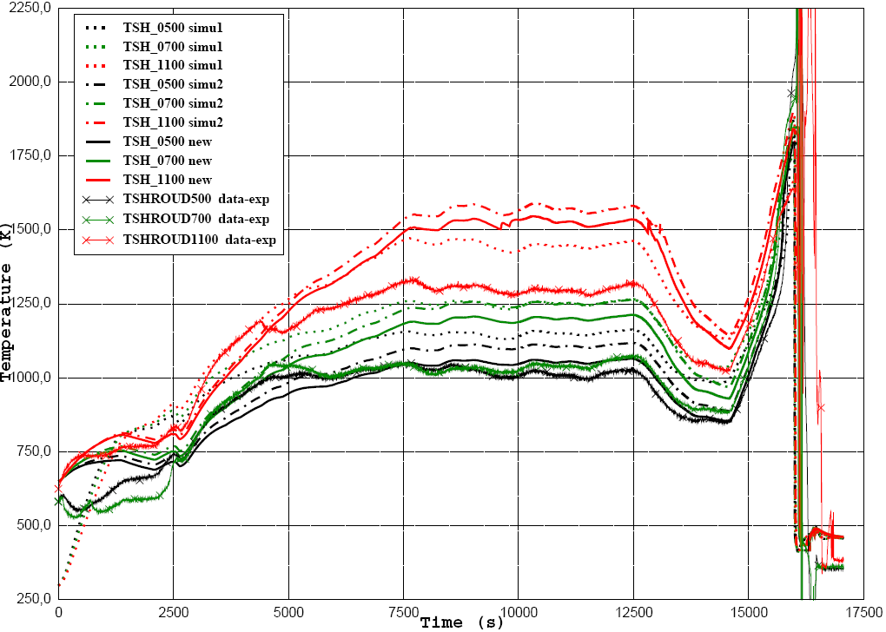
Comparison with the previous post-calculations
(shroud 500, 700 and 1100mm – bottom bundle improved)

Slide 12
Cladding temperatures at 500 mm high (pre-ox)

Slide 13
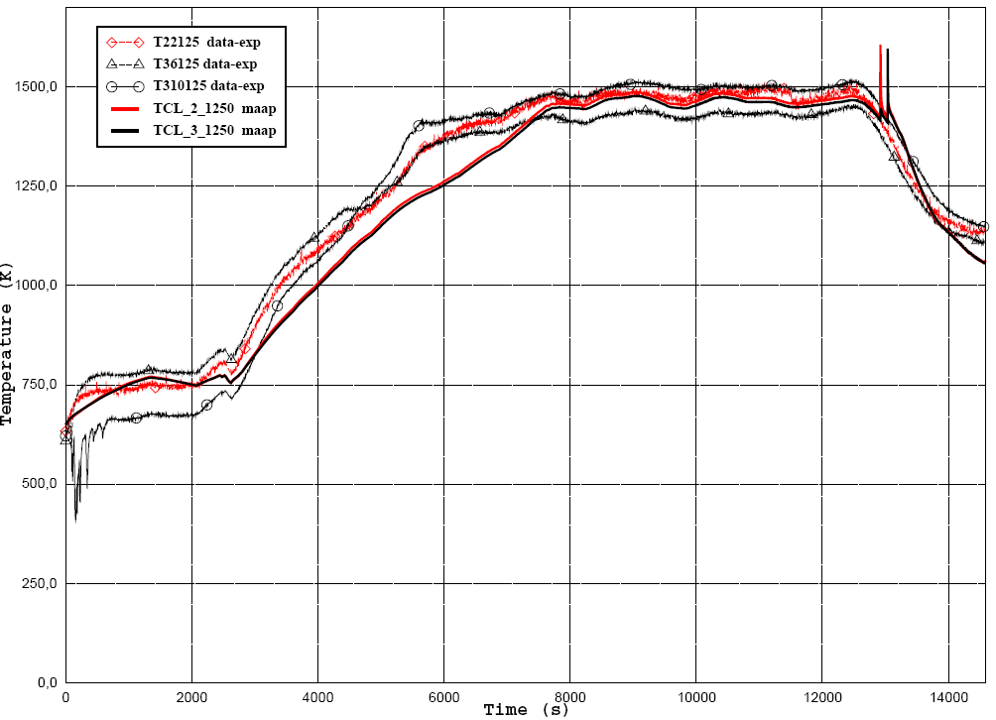
Cladding temperatures at 1250 mm high (pre-ox)
Tcl2 and tcl3 almost identical in simulation

Slide 14
Hydrogen production
rather good prediction of the hydrogen production during pre-oxidation phase
( 21.8g for the experiment and 19.7g for the simulation)

Slide 15
Cladding temperatures at 500 mm high (air)
Rapid drop after reflow in simulation

Slide 16
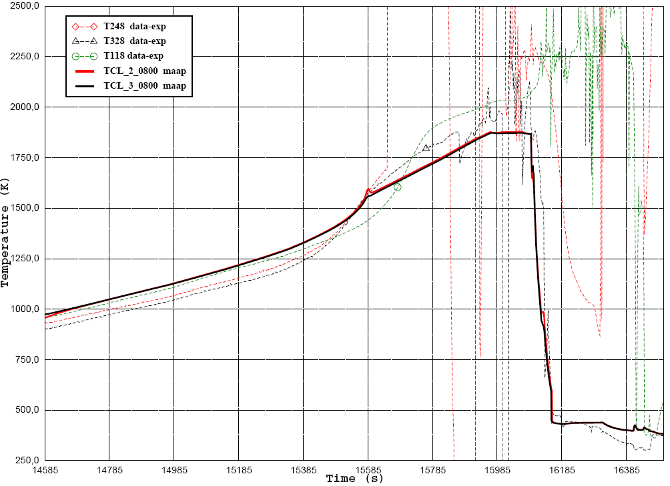
Cladding temperatures at 800 mm high (air)

Slide 17
Cladding temperatures at 1100 mm high (air)

Slide 18
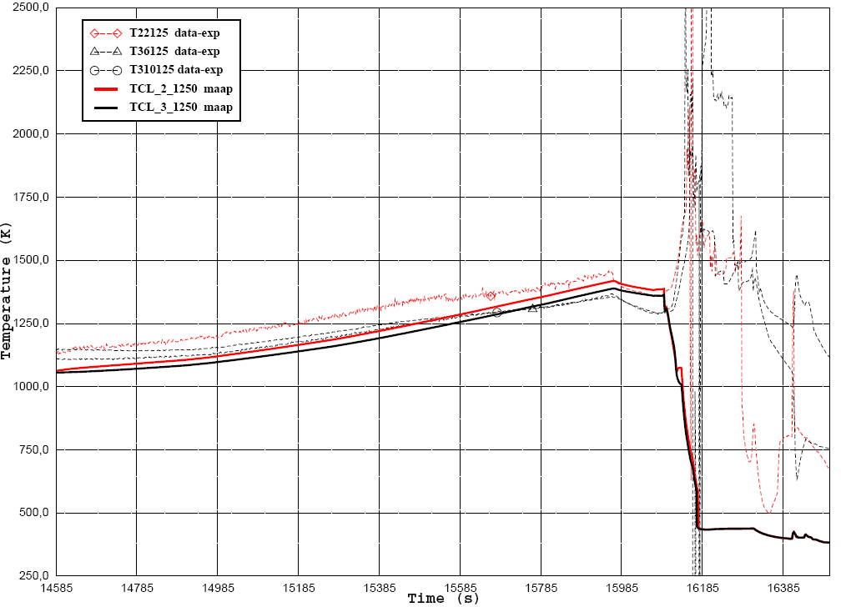
Cladding temperatures at 1250 mm high (air)

Slide 19
O₂ flow rates during air ingress
Modelling predicts O₂ starvation during air ingress at 17160 s (15710 s in MAAP time) and about 17100 s for the experiment.

Slide 20
Conclusions
Thermal behaviour :
- new modelling = better (for the overall bundle), slightly worse at 200mm
- good prediction during the steam phase
- good prediction during the air phase -- analysis is difficult for the upper part of the bundle due to thermocouples failure
- shroud : better behaviour in the lower part of the bundle
- flooding = T decrease too fast with the calculation
Hydrogen production :
- good prediction during pre-oxidation phase
- hydrogen production during the reflood not captured (< 1g) – Tantal oxydation and instant fill-up of lower plenum?
Modelling now predicts O₂ starvation with a quite good agreement against the experiment, as opposed to the initial simulation
Nitrate formation not simulated (no correlation available)

