Slide 1
Laser Heating Experiments with Different Corium Compositions:
Recent Results and Perspectives
M.Sheindlin
Joint Institute for High Temperatures, Moscow
sheindlin@yandex.ru

Slide 2
Short content of the presentation:
General presentation of the Joint Institute for High Temperatures (IVTAN);
The place of laser-heating experiments of IVTAN in the ISTC PRECOS project: the objectives and intermediate results;
Ongoing development of the laboratory and outlook.

Slide 3

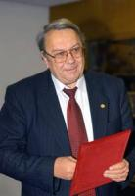
Joint Institute for High Temperatures of Russian Academy of Sciences (RAS) is a leading institute of RAS in the field of power generation and utilization of various types of energy, thermophysical properties of substances at extremely high temperatures, heat and mass transfer, materials science and extreme states of matter.
Director, member of RAS,
Prof. E.Fortov -
eminent expert in physics of extreme state of matter.
The Institute has 450 researchers, including 12 members of the Russian Academy of Sciences and about 300 researchers with PhD grade.

Slide 4
Basic activities of the Institute:
Development of effective, safe and reliable energy sources with low impact on environment;
Electrophysical, optical and mechanical properties of substances and low-temperature plasma in a wide range of parameters towards extremely high temperatures and pressures;
Heat and mass transfer, gas- and plasmadynamics;
Thermophysics and high-temperature materials science;
Development of new methods of generation of high energy density;
Energy saving problems, renewable energy, development of electrochemical power generators, increase of efficiency of natural fuel energy sources.

Slide 5
The main task of IVTAN laser-heating experiments in the PRECOS project is an issue of possible immiscibility of liquid in the U-Zr-O system.
The required set of samples have been prepared at NPO “LUCH” however the transfer of the samples to IVTAN is delayed due to the license required for experiments with natural uranium. Therefore it has been mutually agreed that in the mean time the experimental work is focused on systems not containing natural uranium. The first one is the Zr-ZrO₂ – the system, which can be considered as a good modeling substance for validation of the experimental technique to be used for investigation of the U- ZrO₂ system.

Slide 6
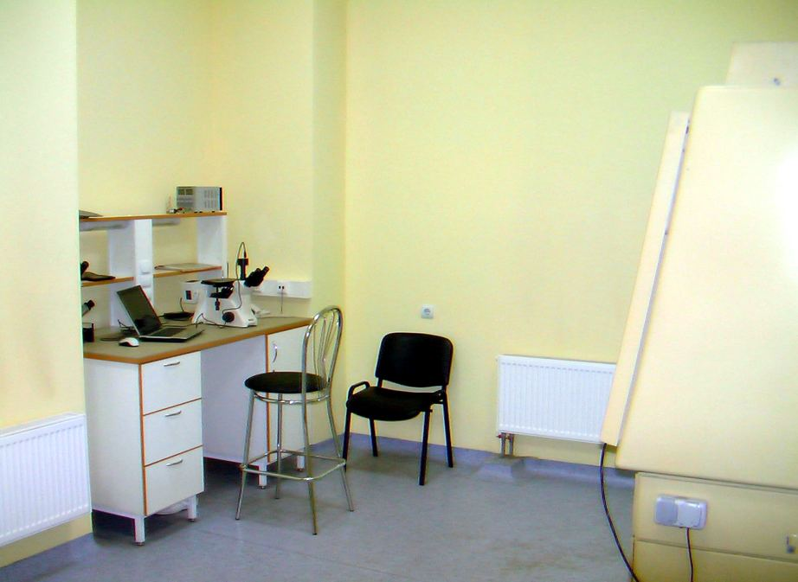
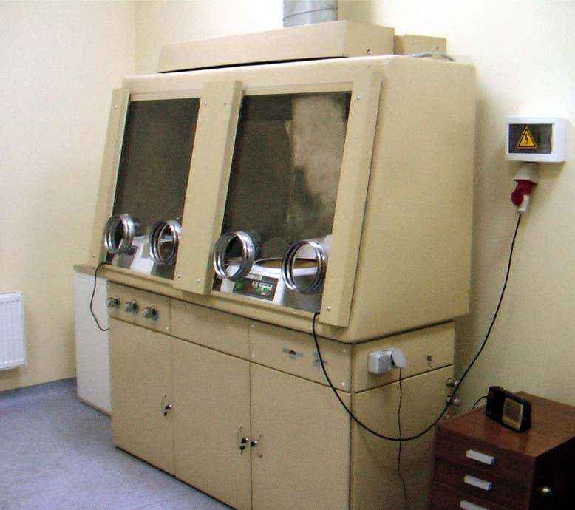
The work done so far for licensing:
1) Definition of main requirements for the laboratory room (contract work is paid by IVTAN)
2) The preliminary choice of suitable laboratory room is done
3) The specification requirements for the special laboratory are issued
4) The necessary agreement of Presidium of the Russian Academy of Sciences is received
5) The proper choice of a room for the special laboratory is officially confirmed by an authorized company (contract work is paid by IVTAN)
6) Training of laboratory personnel (contract work is paid by IVTAN)
7) Medical examination of personnel is completed
8) The project of the special laboratory is executed by an authorized company (contract work is paid by IVTAN)
9) Special additional maintenance work in the laboratory room according to recommendations of the licensing authorities is almost completed. The room is equipped with special power supplies, separate water supply and drain, ventilation with a special filtering. It has a metal door with two locks and alarm system, etc…. The separate room for storage of a radioactive waste is equipped
10) Necessary means for the individual control of contamination are leased
11) An authorized company having the right to perform an expertise of the project is defined
12) An expertise of the project of the lab is concluded
13) Decision about suitability of the laboratory to perform work with natural uranium is received
14) Remaining set of technical documentation is obtained
15) Certificate of compliance to the requirements for alfa-labs is received from Hygienic service authorities
Laboratory Room Dedicated for Handling of Natural Uranium Samples

Slide 7
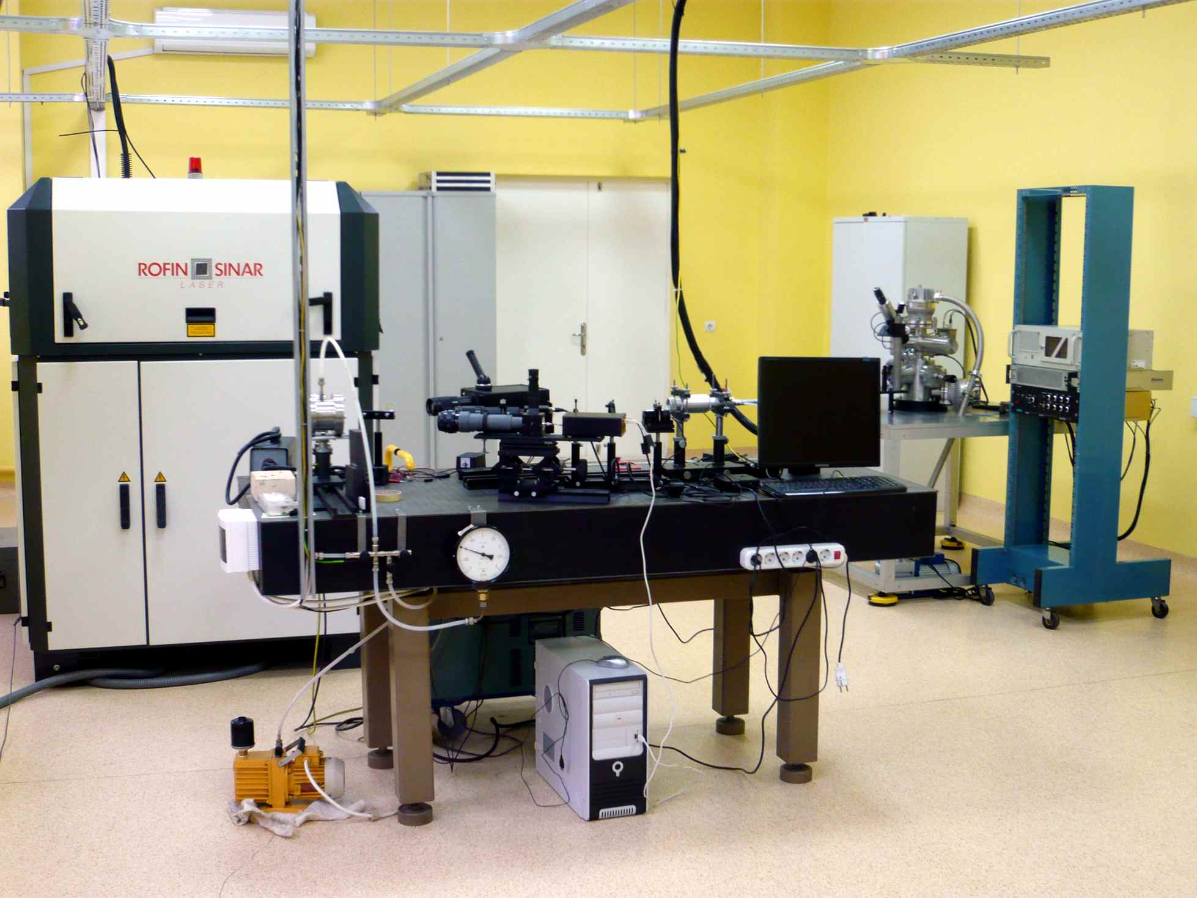
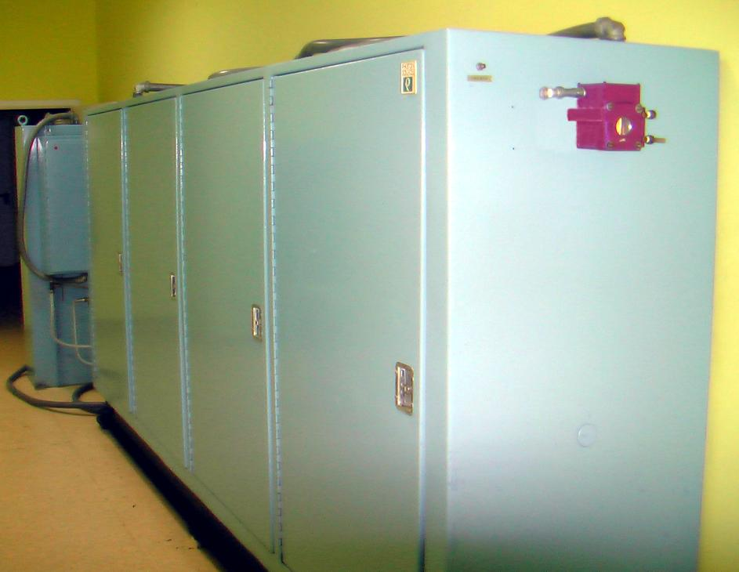
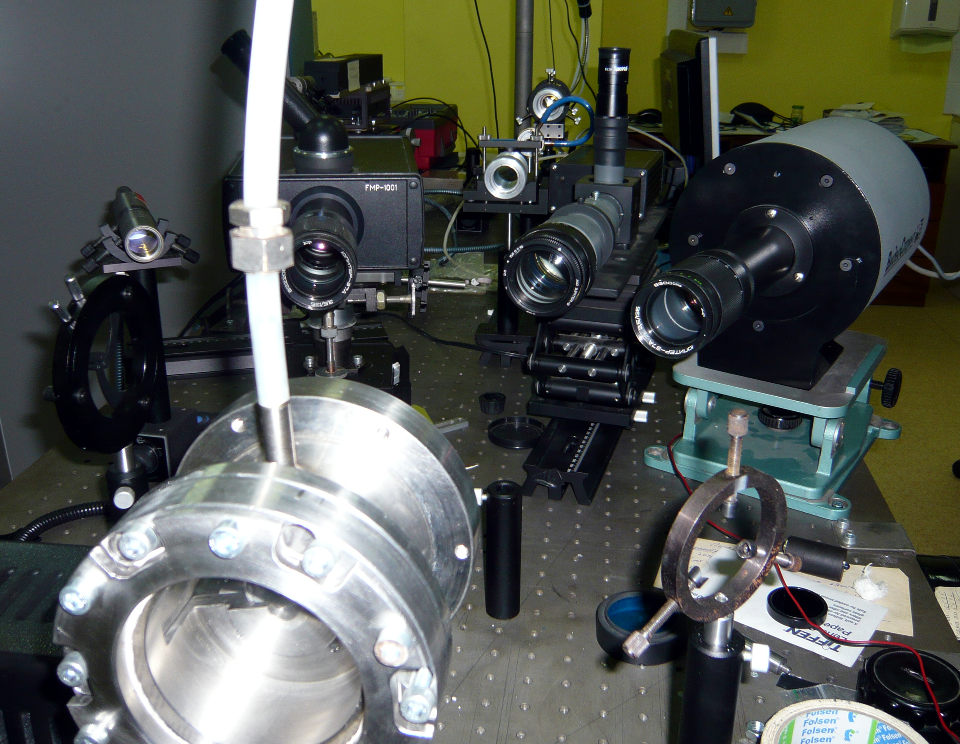
Present View of the Experimental Set-Up
Laser power regulation according to arbitrary function (time response of ca 1 ms)
Multichannel pyrometer, 1000 sp/s, wavelength range 450-900 nm
2 channel pyrometer, response time: 10 us
High-speed CMOS-camera: 1000 frames/s, max. resolution 1000x1000 pix.
Power CO₂-laser in the laboratory

Slide 8
Schematic of the Set-Up
Modification of laser-heating unit for low power experiments

Slide 9
Zr-O System: Experimental Results
It is assumed that emissivity is linear vs. atomic percent in the range between well adopted values for Zr and ZrO₂

Slide 10
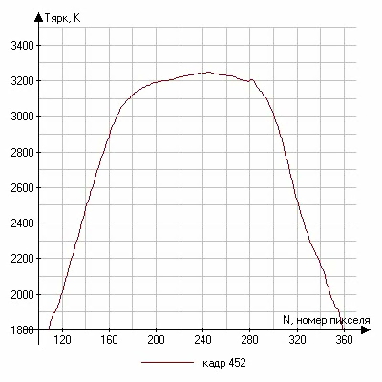
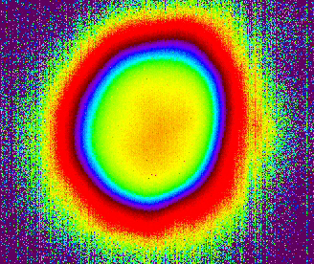
Temperature Field: Solidification Dynamics of Zirconia at 1000 frames/s

Slide 11
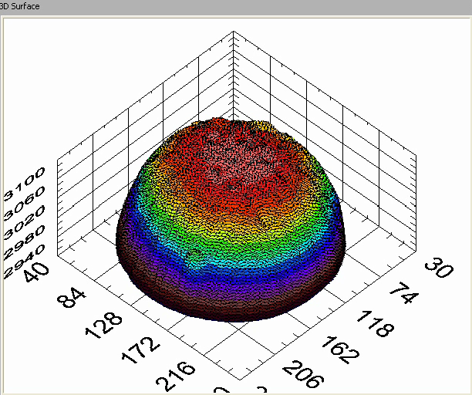
ZrO₂ Melting Test:
True Temperature Measurements by Polichromatic Pyrometer and Dynamics of 2D Temperature Distribution in the Vicinity of the Freezing Point

Slide 12
Some important tasks performed in course of the project:
New setup with power laser heating is constructed. The power of 3 kW YAG-laser can be controlled arbitrary with time resolution of 1 ms;
High-speed multichannel pyrometer is constructed, the required data evaluation software package is ready;
High-speed precise temperature field measurement system is put into operation;
Measurements of phase transitions of Zr-O system with emphasis on its metallic-rich and ZrO₂-rich domains are performed;
ZrO₂–FeO samples in the wide composition range from ZrO₂ to the eutectic point are manufactured by cold pressing of the powder mix;
Melting point measurements of CaO are performed;
Study of ZrO₂–FeO phase transition above eutectic temperature is being conducted;
Mathematical model of the noncongruent laser-melting and solidification of two component materials is further developed taking into consideration existence of two-phase zone.

Slide 13
Laser-Pulse Melting of CaO

Slide 14
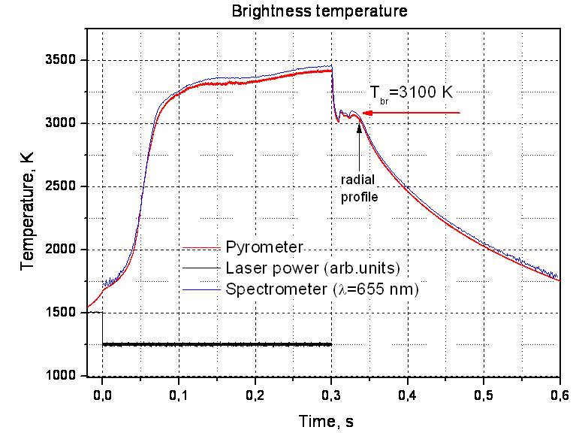
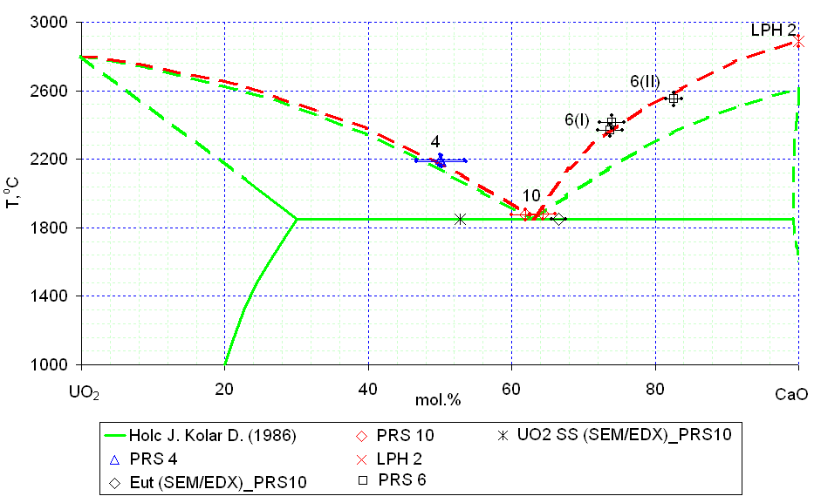
CaO Melting Point Measurements
Experimental Thermogram
Test results on UO₂ - CaO system
?
Peculiarities of CaO melting:
Very low absorption coefficient below 1500-2000K
The boiling temperature is less than 200 K higher than the melting temperature
Assuming that ε=0.85-0.9 →Tmelt= 3160 ± 30K
It is planned to make direct measurements of ε at the M.P. of CaO.

Slide 15
ZrO₂-FeO System
Verification of the laser-heating technique on relatively well studied binary system
Testing of applicability of the mixed oxide samples prepared by blending followed just by pressing without any heat treatment
Definition of number of the laser-melting cycles for complete homogenization of initially inhomogeneous low density samples
Example of the thermogram

Slide 16
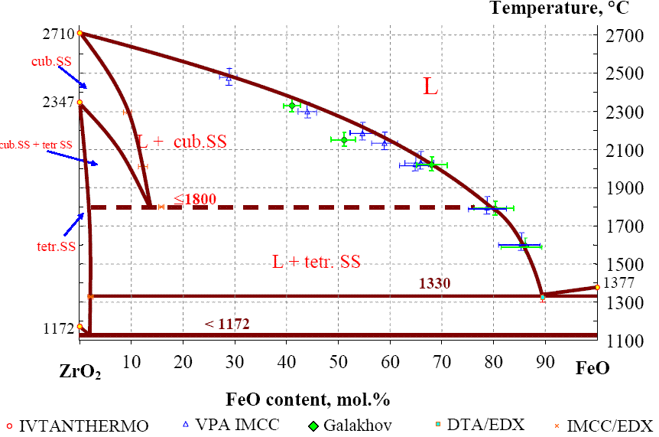
ZrO₂-FeO System: Laser-Heating Results
?
- IVTAN (2010), laser-heating
- IVTAN (2010), laser-heating
-March 2011

Slide 17
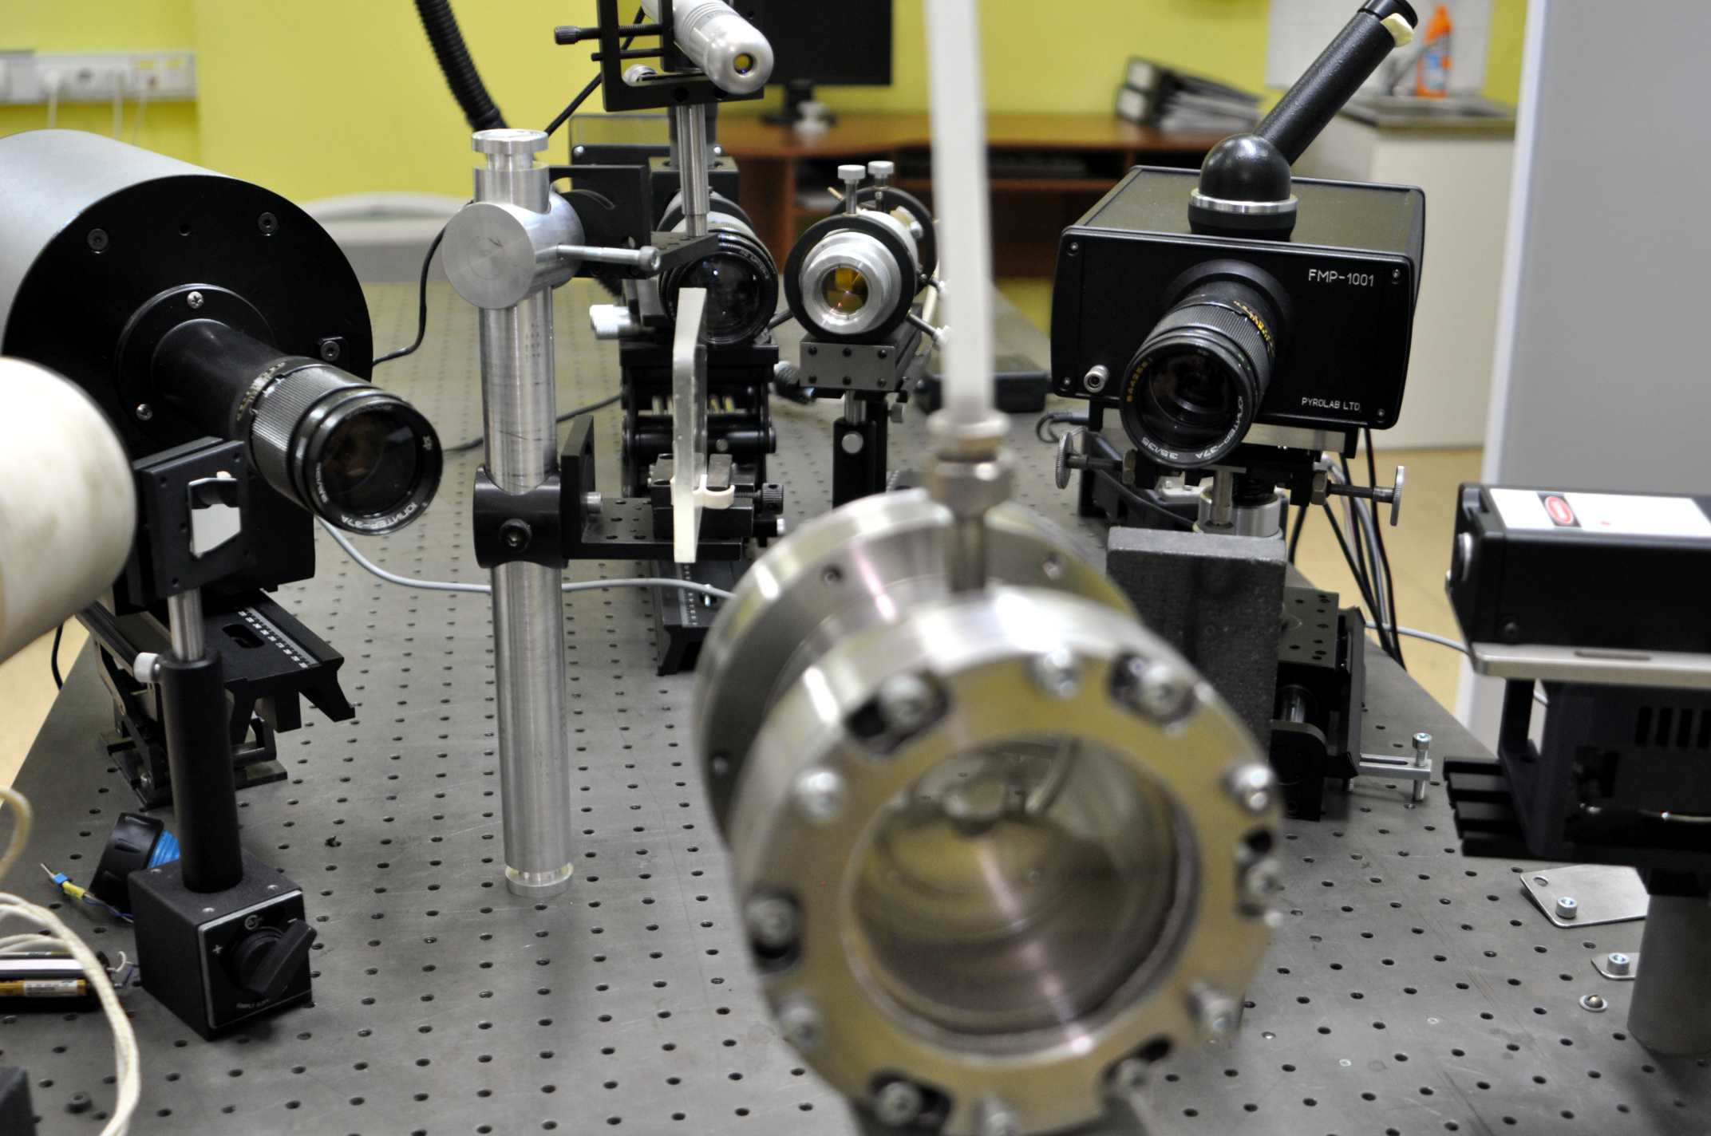
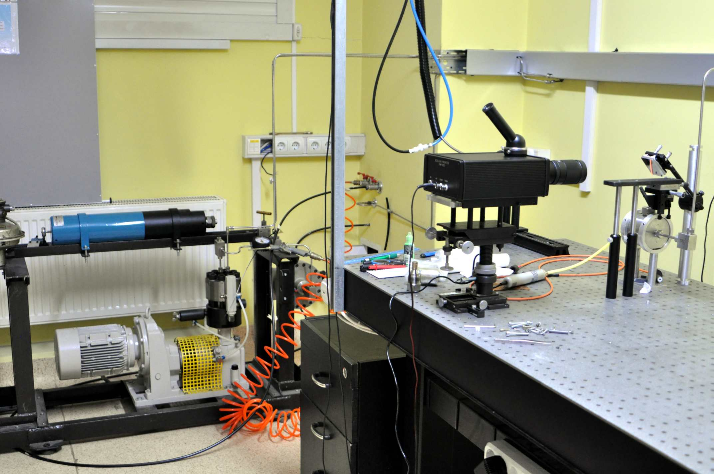
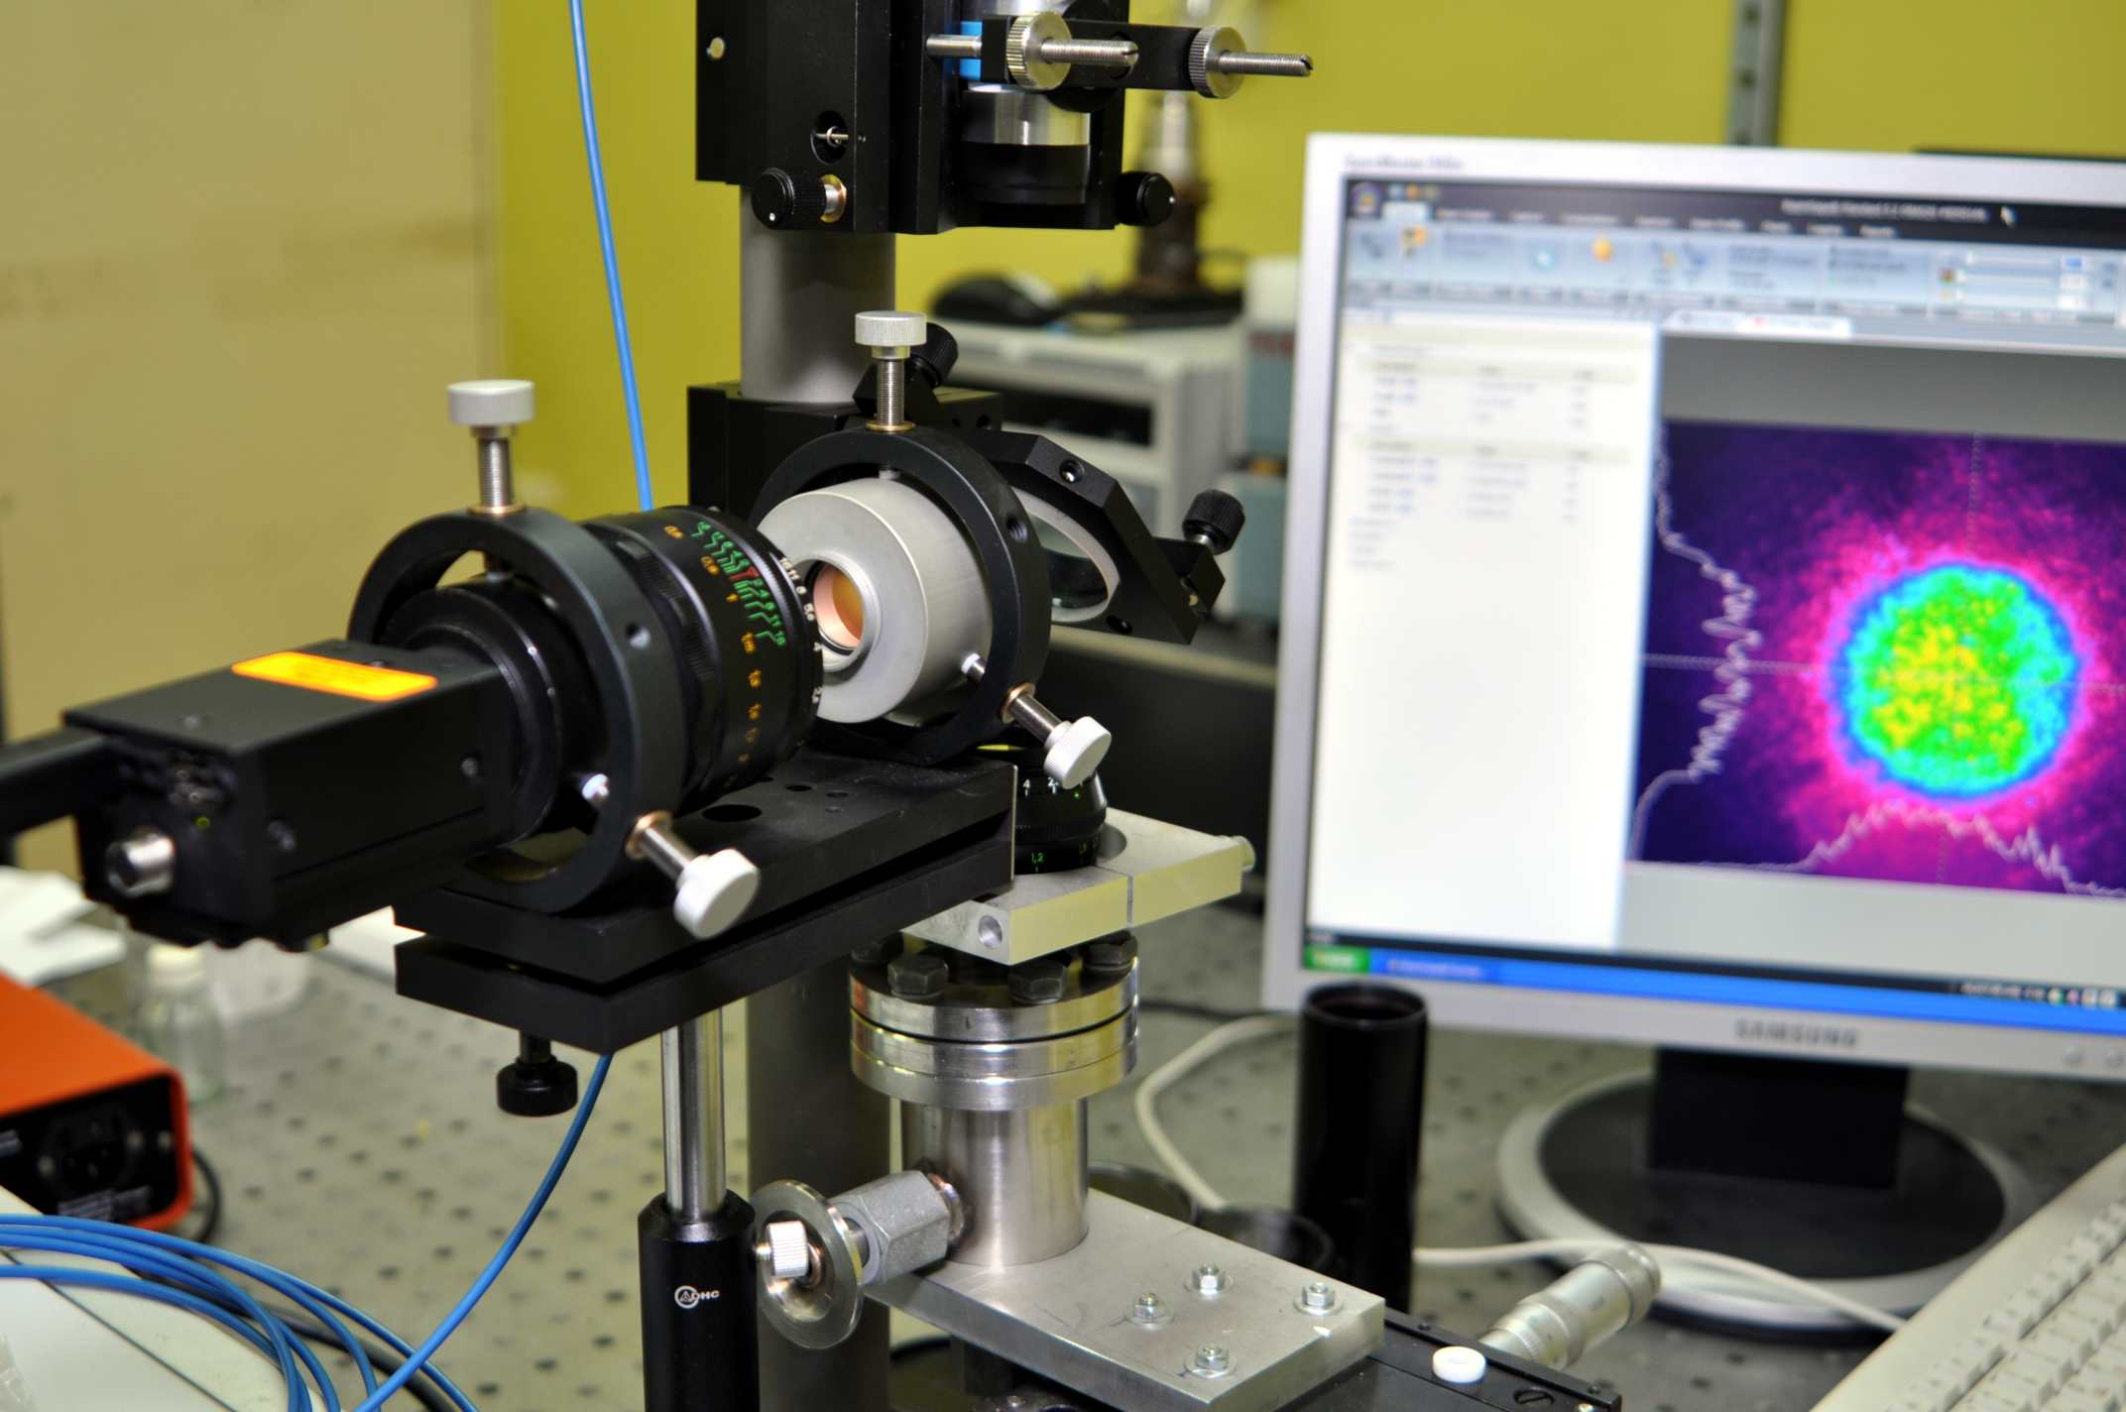
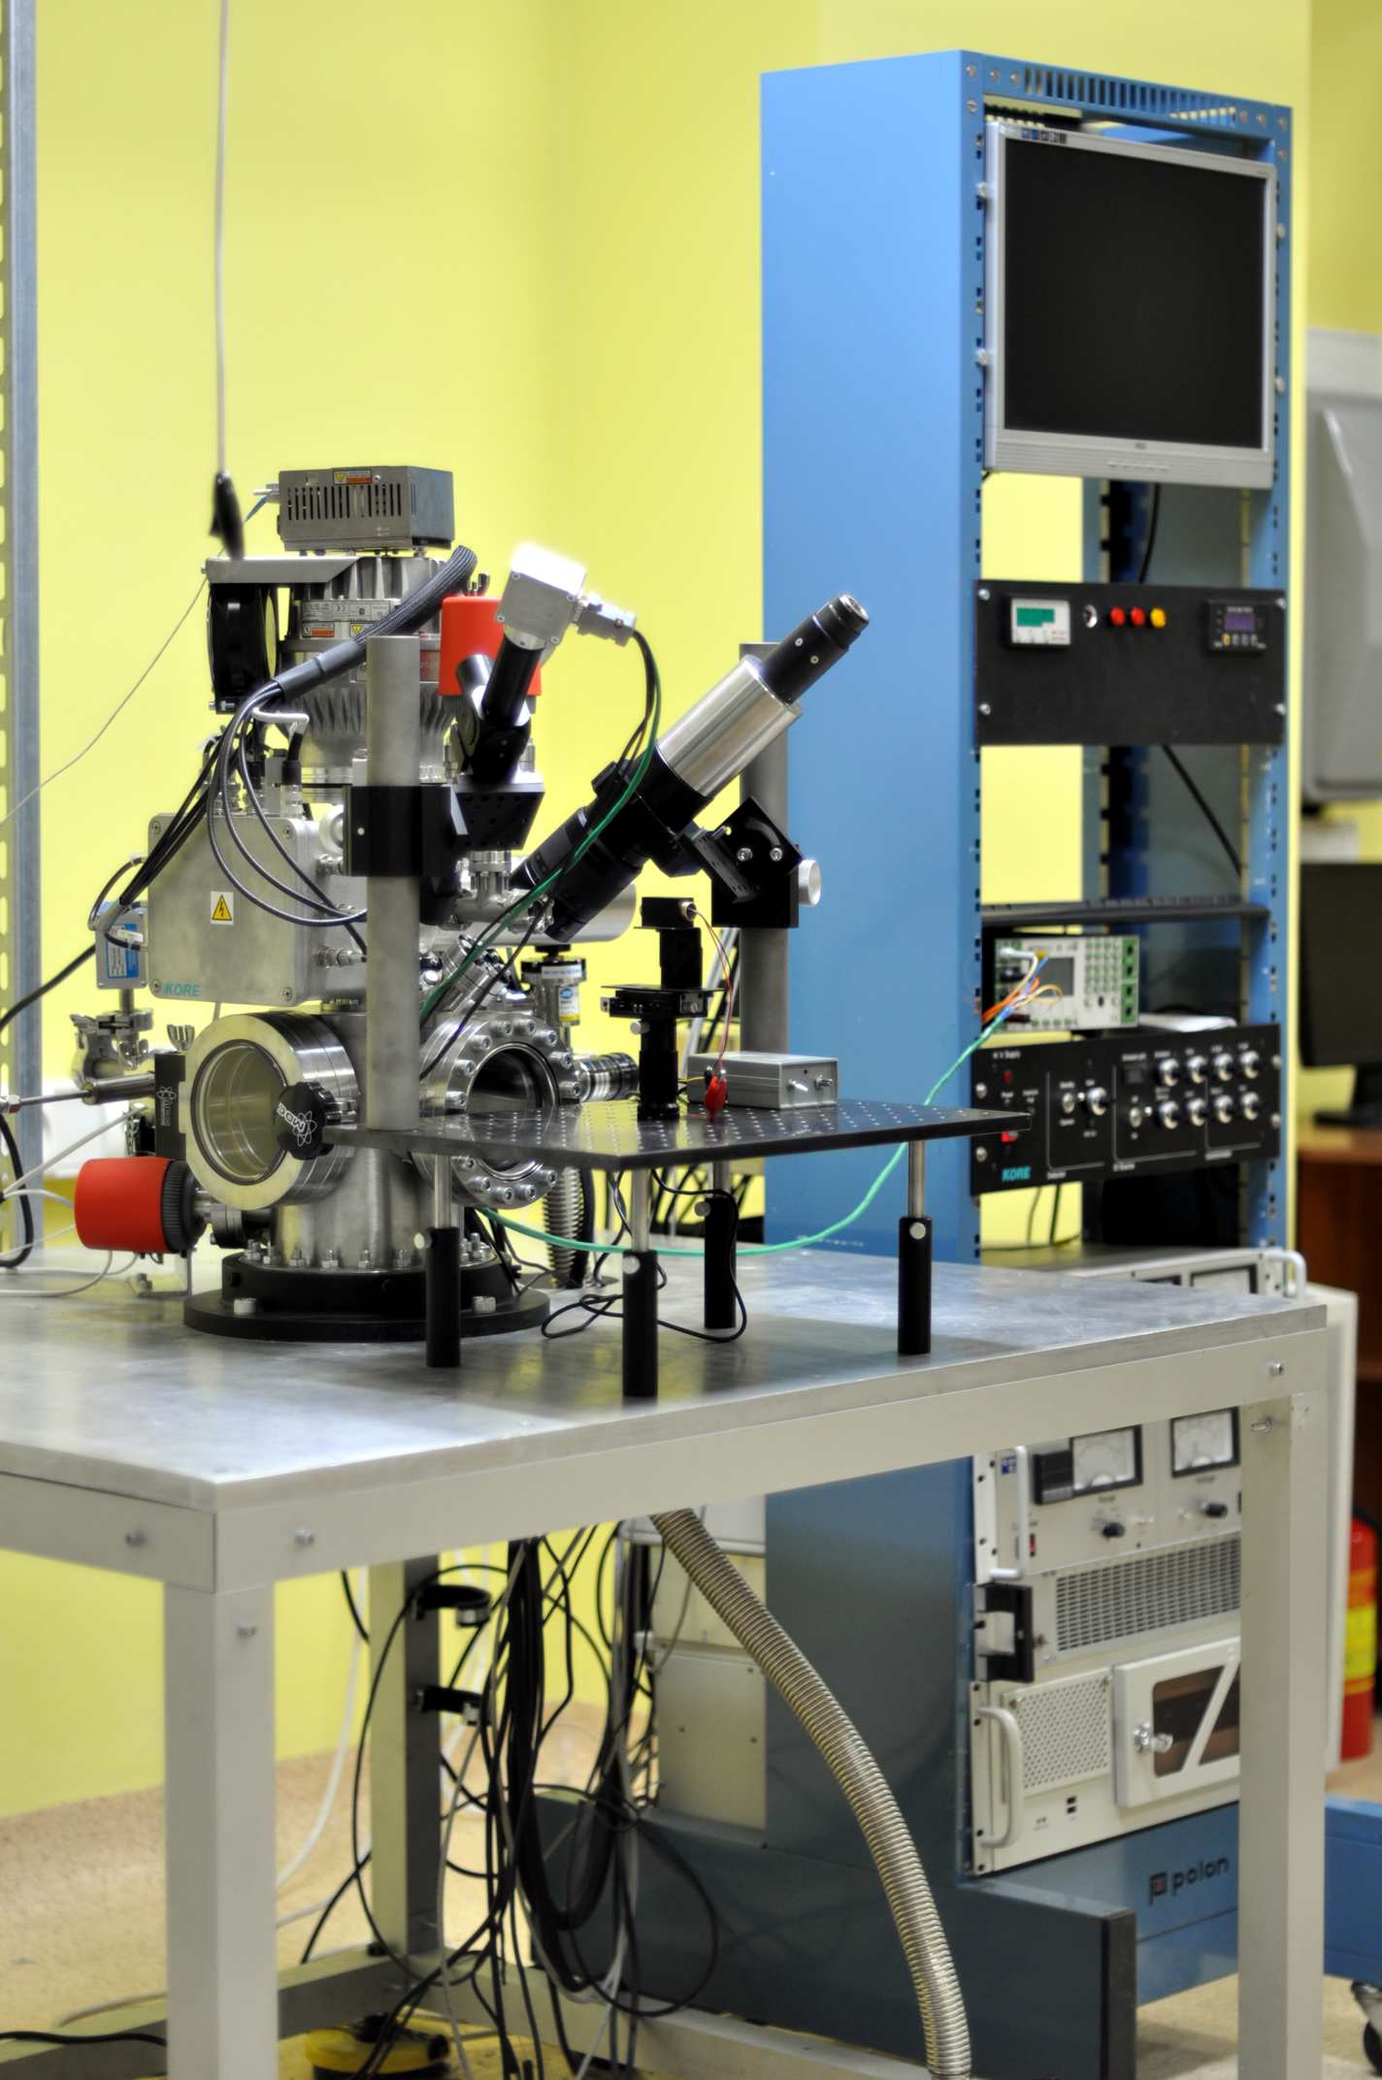
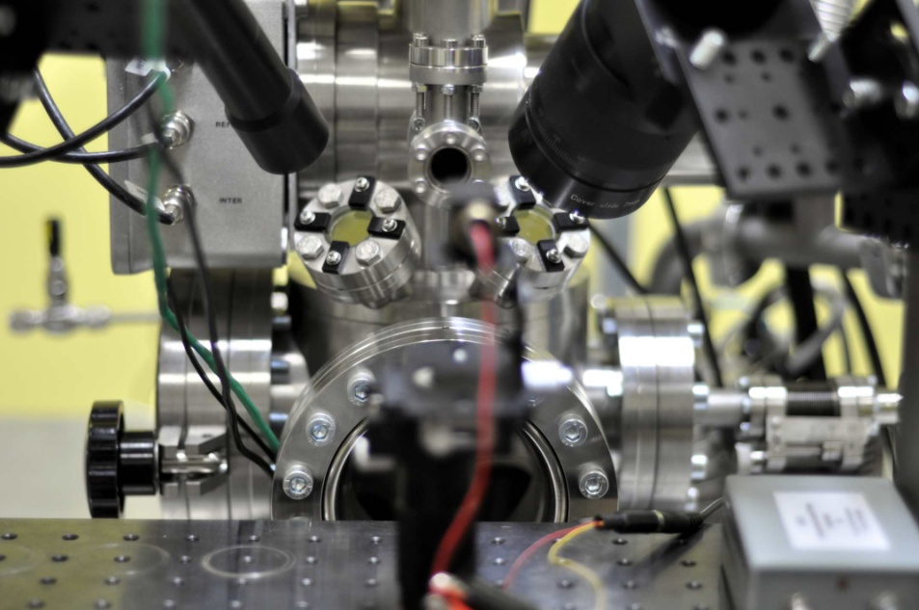
High-Temperature Thermopysical Laboratory Today

Slide 18
Conclusion and outlook
Concerning the PRECOS project the laser-melting experiments on ZrO₂ –FeO system will have continued until the U- ZrO₂ samples are transferred to IVTAN. It is planned that the most of experiments on U-Zr-O system will be performed during the agreed half-year extension period.
Some more measurements on CaO melting point are also planned with the emphasis to improve accuracy of true temperature measurements by polychromatic pyrometry.
It is planned to significantly improve accuracy of temperature field measurements and true temperature determination by using a very high-temperature (up to 3270 K) large area blackbody irradiator to be installed in the lab by June 2011. New ultra-high-speed camera featuring low noise and high, 12 bit, dynamic range will be installed to replace the 8 bit camera currently used in the experiments.
New set-ups like TOF mass-spectrometer with both laser-induced and Knudsen Cell evaporation, high-pressure multi-kilobar set-up etc., are now operational in the high-temperature thermophysical laboratory of IVTAN. These apparatus open new perspectives in the comprehensive study of corium and modern nuclear fuel compositions at extremely high temperatures.
An “exploding wire” apparatus with 10 μs high current density pulse heating are currently being constructed for investigation of thermodynamics of liquid uranium at extremely high temperatures and high pressures.

Slide 19
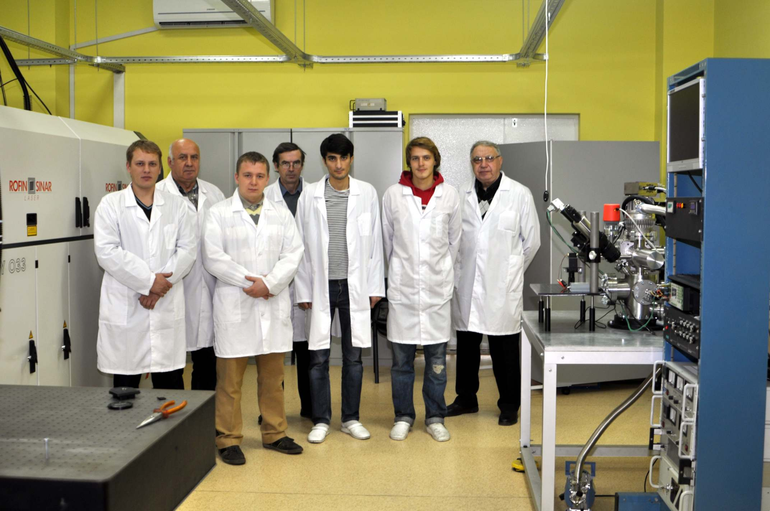
Thank you for your attention !

Slide 20
END

Slide 21
Licensing of the laboratory for performing tests with natural uranium
The work done so far:
1) Definition of main requirements for the laboratory room (contract work is paid by IVTAN)
2) The preliminary choice of suitable laboratory room is done
3) The specification requirements for the special laboratory are issued
4) The necessary agreement of Presidium of the Russian Academy of Sciences is received
5) The proper choice of a room for the special laboratory is officially confirmed by an authorized company (contract work is paid by IVTAN)
6) Training of laboratory personnel (contract work is paid by IVTAN)
7) Medical examination of personnel is almost completed
8) The project of the special laboratory is executed by an authorized company (contract work is paid by IVTAN)
9) Special additional maintenance work in the laboratory room according to recommendations of the licensing authorities is almost completed. The room is equipped with special power supplies, separate water supply and drain, ventilation with a special filtering. It has a metal door with two locks and alarm system, etc…. The separate room for storage of a radioactive waste is equipped
10) Necessary means for the individual control of contamination are leased
11) An authorized company having the right to perform an expertise of the project is defined
12) An expertise of the project of the lab is concluded
13) Decision about suitability of the laboratory to perform work with natural uranium is received
14) Remaining set of technical documentation is obtained
15) Certificate of compliance to the requirements for alfa-labs Hygienic service authorities

Slide 22
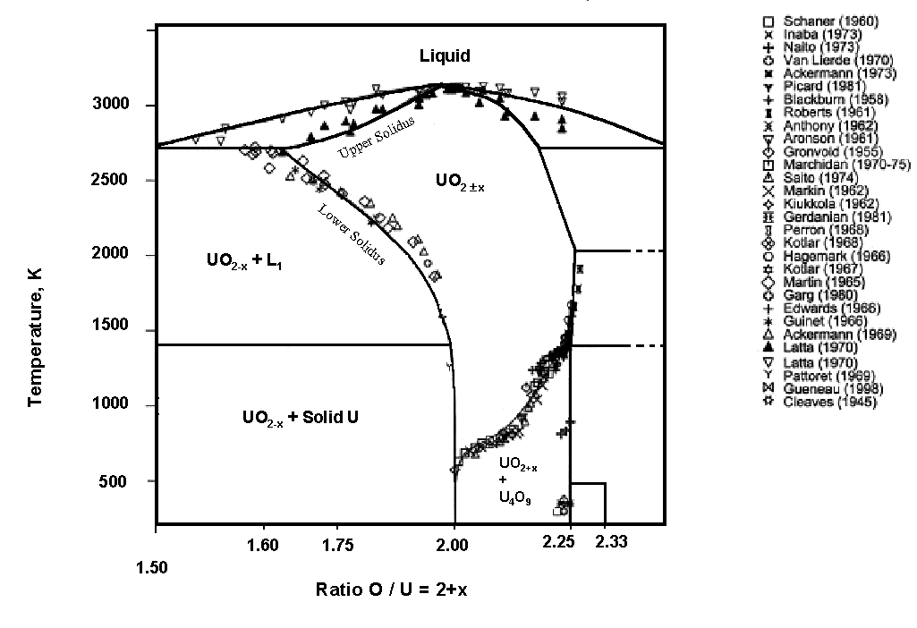
UO_{2±x} Phase Diagram
3500
Traditional Methods:
Problems in the hyperstoichiometric region:
- sample contamination from the crucible metal.
- important oxygen losses (strongly non congruent evaporation).
Liquidus and solidus lines are hard to measure in this domain.
?
3000
2500
UO_{2+x}
₊
O₂
Temperature, K
2000
UO_{2+x} + L₁
UO_{2 + x}
1500
UO_{2+x}
₊
U₃O_{8-y}
1000
UO_{2+x} + Solid U
500
U₃O₇
After: C. Guéneau et al., J. Nucl. Mater. 304 (2002), 161.
1.25
1.50
1.75
2.00
2.25
2.50
O/U ratio

Slide 23
Model of Melting of Uranium Dioxide on the Basis of its Crystalline Lattice Defects
The uranium dioxide crystal lattice defects are analyzed and the type and the number of these defects are defined. The latter makes it possible to find solidus temperatures of non-stoichiometric uranium dioxide in a wide range of its oxidation states and also to find the physical mechanisms defining area of existence of a cubic fluorite-type uranium dioxide phase.
Basic propositions and approaches:
1. Appearance-annihilation of defects in a crystal lattice of uranium dioxide is a result of its chemical interaction with surrounding oxygen;
2. The type of defects in the lattice is related to the experimentally defined dependence of sample stoichiometry on the partial pressure of oxygen at a given temperature;
3. When the number of the defects in a lattice interstitial cannot be increased any more the lattice collapses. In other words the lattice arrive to its melting point.
References:
Pakhomov E.P., High-Temperature Thermophysics 44, No 6, (2006) p. 861-867 (in Russian)
Pakhomov E.P., High-Temperature Thermophysics 47, No 6, (2009) p.1-15 (in Russian)

Slide 24
Calculated Solidus and Solid-Phase Transitions in UO_{2±x}
Latta&Frixel
Manara &
Sheindlin
calculated
Temperature, К
UO_{2 - x}
?
х = 2 – О/U

Slide 25
Numerical simulation of noncongruent melting and solidification of two component materials taking into account the existence of two phase region.
Main assumption: existence of the local thermodynamic equilibrium over all sample
Noncongruent phase transitions lead to redistribution of composition between phases in the vicinity of their moving boundaries.
Disturbance in initially homogeneous composition leads to diffusion assisted mass transfer
The basic equations are equations for heat transfer and for mass transfer. They define mass fraction C and temperature T
Numerical calculation is based on the through scheme without definition of the phase boundaries

Slide 26
Numerical Results
Laser pulse and surface thermograms
Peculiarities of the mass transfer model does not effect the theoretical thermogram (see comparison with x=constant model)
Surface stoichiometric parameter x versus time
Variation of phase state at surface leads to fast disturbance of starting stoichiometry.
However at melting and freezing deviations from starting stoichiometry are acceptable.

