Slide 1
R&D research priorities from SARNET-2 project SARP (Severe Accident Research Priorities)
M. Sonnenkalb (GRS)
on behalf of SARP Team
Contact Expert Group on Severe Accident Management (CEG-SAM)
20th Meeting, Moscow, 11. + 12.10.2011

Slide 2
Contents
  SARP work in past and recommendations
  Ongoing SARNET-2 activities -> see paper of B. Clement
  Ongoing OECD projects
  SARP-2 objectives in SARNET2
  SARP-2 status

Slide 3
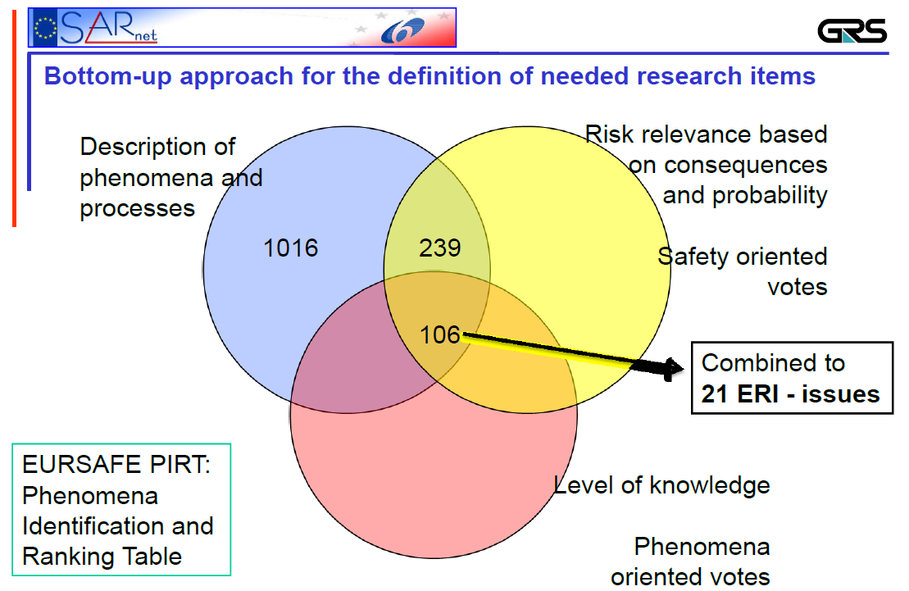

Slide 4

Remaining Severe Accident Research Issues – High Priority
SARP in SARNET identified 6 issues remain open with high priority
Issues are dealt within SARNET-2:
  ERI 1,2: Research on coolability of not totally degraded core during
  reflood and debris cooling
  ERI 2,1 & 2,2: Combined research on ex-vessel melt pool configuration during
  MCCI & ex-vessel corium coolability, also by top flooding
  ERI 3,1 & 3,2: Combined research on melt relocation into water & ex-vessel
  FCI
  ERI 3,4: Research on hydrogen mixing, combustion in containment
  (flame acceleration), H2 mitigation measures
  ERI 5,1: Research on oxidizing impact on source term (Ru oxidizing
  conditions or air ingress for HBU and MOX fuel elements)
  ERI 5,2 & 5,4: Combined research on iodine chemistry in RCS & in
  containment

Slide 5
Objectives of SARP-2 Working Package
Proposal of SARNET 2 Project
  Agree on updated assessment methodology
  Review issues resulting from SARNET SARP which are not appropriately covered by SARNET2
  Analyse R&D progresses and results from Level 2 PSA studies
  Reassess issues ranking and eventually reorient priorities
  Identify potential experimental and theoretical programmes to address these issues (including estimated costs and duration)
  Make recommendations for R&D programme revision
  Agree on further issues to be considered as closed

Slide 6
Objectives of SARP-2 Working Package
Proposal of SARNET 2 Project
  Agree on updated assessment methodology
  Review issues resulting from SARNET SARP which are not appropriately covered by SARNET2
  Analyse R&D progresses and results from Level 2 PSA studies
  Reassess issues ranking and eventually reorient priorities
  Identify potential experimental and theoretical programmes to address these issues (including estimated costs and duration)
  Make recommendations for R&D programme revision
  Agree on further issues to be considered as closed

Slide 7
Information on major OECD projects related to R&D topics
-> SARNET-2 Status reported by B. Clement
-> some OECD projects important for future R&D needs
(priority containment phenomena)

Slide 8
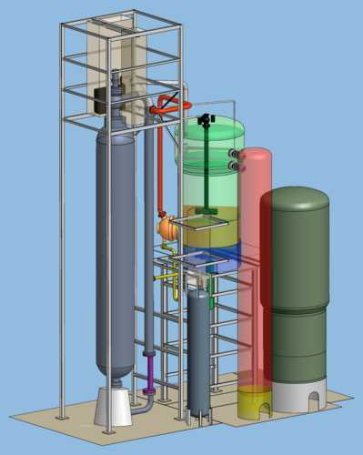
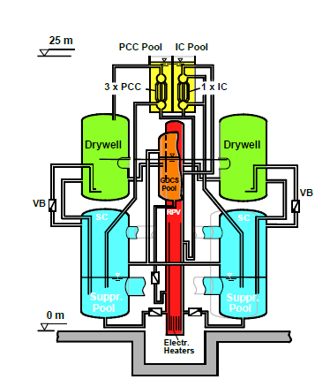
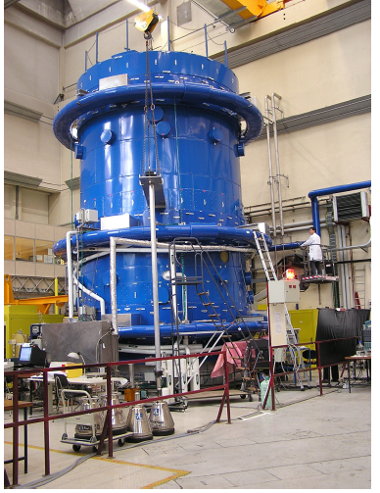
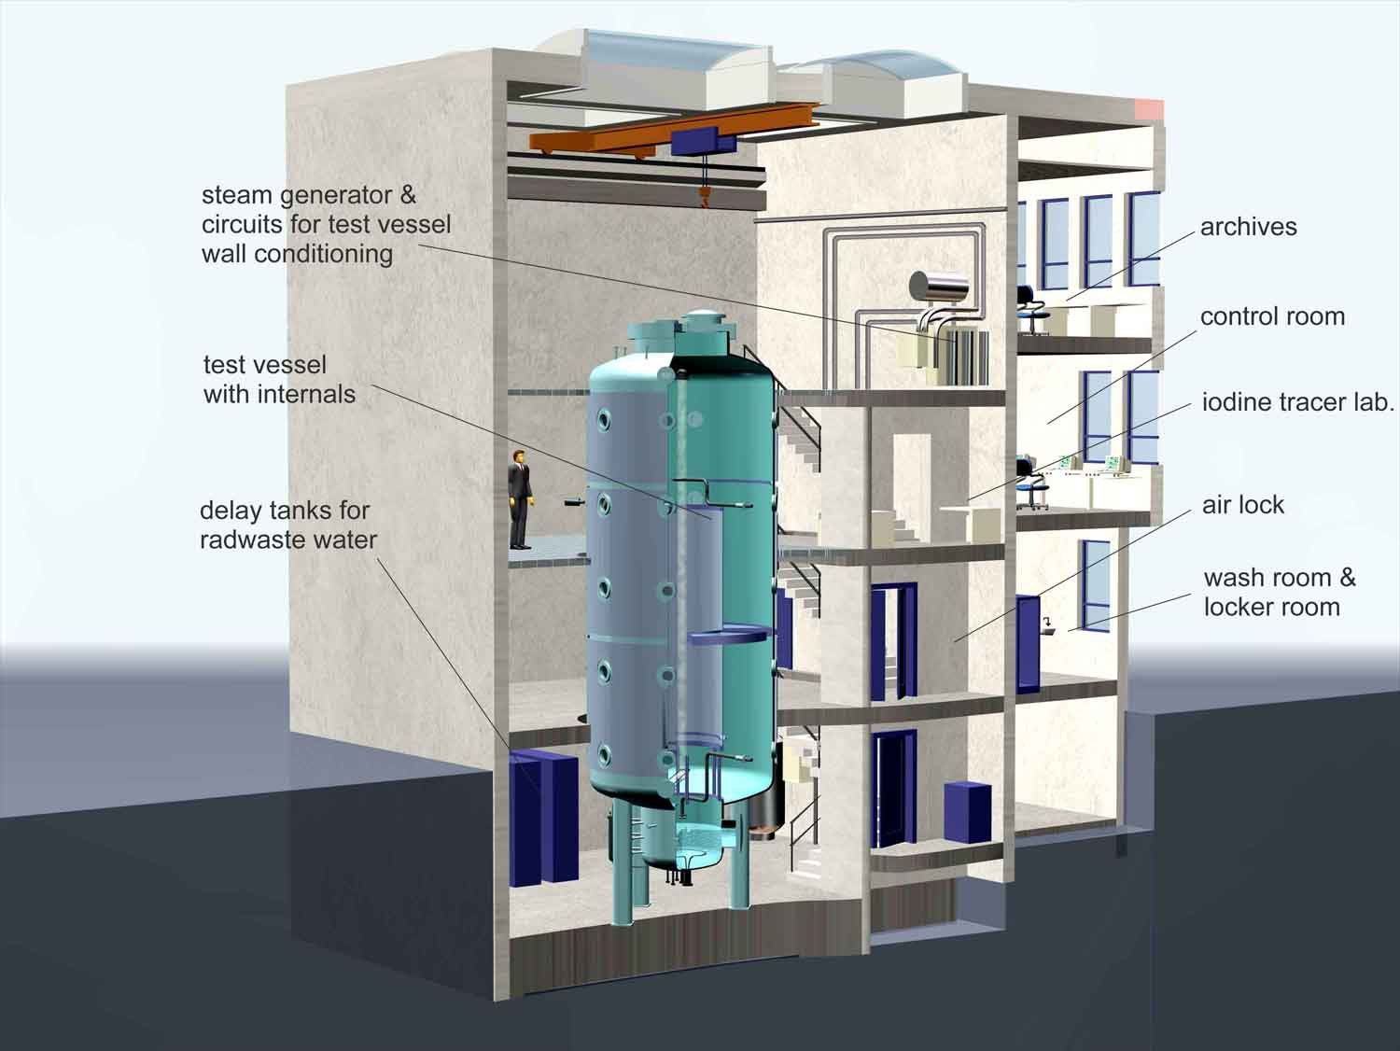
“Containment Test Facilities” in Europe
 | INKA (AREVA) | PANDA (PSI) | MISTRA (CEA) | THAI (BT)
Reactor type / test specifics | BWR Integral | BWR Integral & SET | PWR SET, CET | Generic SET, CET
Phenomena | Component testing Generation III+ | Thermal hydr. & AM measures | Thermal hydr. & AM measures | Thermal hydr. & Severe accidents
Total volume | 830 m³ | 460 m³ | 100 m³ | 60 m³
Fluid / medium | Air, Water, Steam, (He) | He, Air, Water, Steam | He, Air, Steam | He, Air, Wtr., Stm. H₂, Aerosol, I-123
Controlled walls | No | No | Yes | Yes

Slide 9
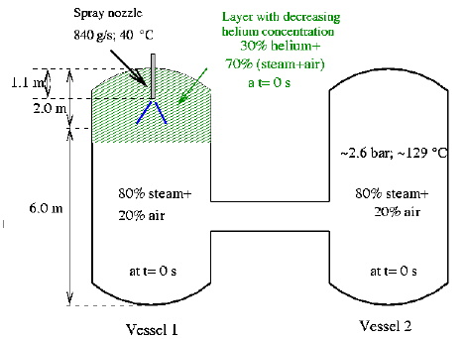
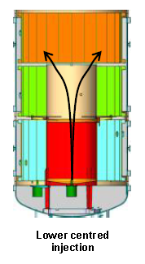
SETH-2 – SESAR Thermal-hydraulics
Objectives/Test series (2007 – 2010):
PANDA test series included:
• Low momentum vertical fluid release test s. (ST1)
• Low momentum horizontal fluid release test s. (ST2)
• Containment spray test series (ST3)
• Containment cooler test series (ST4)
• Recombiner test series (ST5)
• Rupture disk test series (ST6)
MISTRA test series included
• Establishment of initial gas stratification series (INITIALS)
• Natural circulation induced by wall condensation series (NATHCO)
• Steam jet impingement on walls series (IMPING)
• Low momentum air or steam injection series (LOWMA & LOWMS)
• Spray effect on stratification series (SPRAY)
• scaling effects - studied in LOWMA3, LOWMA4 and ST1
Operating Agent: PSI & CEA
Facility: PANDA & MISTRA

Slide 10
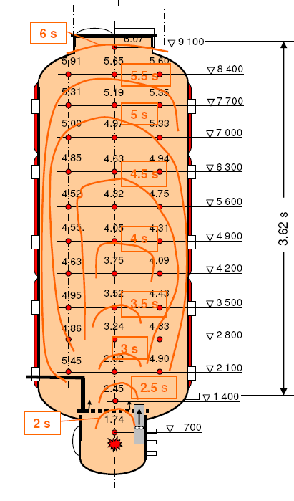
THAI-1 – Thermal-Hydraulics, Hydrogen, Aerosols, Iodine
Objectives/Test series (2007 – 2010):
  Helium/Hydrogen Material scaling (HM)
  Slow Hydrogen Deflagration (HD)
  Hydrogen Recombiner performance (HR)
  Interaction of Metal Iodines with Passive Autocatalytic Recombiners
  Passive Autocatalytic Recombiner Poisoning
  Aerosol Wash-Down (Scoping Test)
70 tests have been performed, to be used for LP and CFD code validation
some have been selected for blind and open post-test calculations,
some of them for ISP-47 and -49
an analytical workgroup was established aimed at the evaluation of the test results
Operating Agent:
Becker Technologies (Germany)
Facility: THAI
(HD)
  (HR)

Slide 11
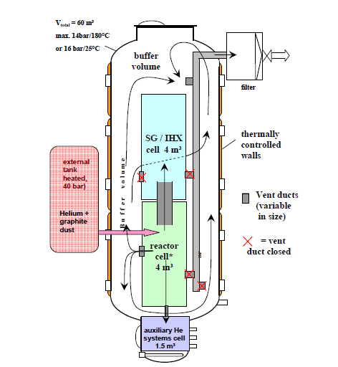
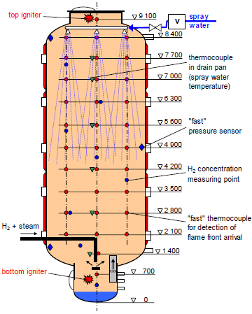
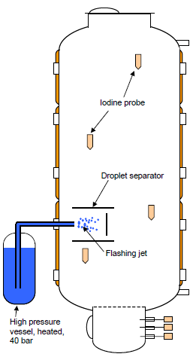
THAI-2 – Thermal-Hydraulics, Hydrogen, Aerosols, Iodine
a)
Objectives (2011 – 2015):
To investigate HTGR graphite dust transport issues, specific Water Cooled Reactors aerosol and iodine issues and hydrogen mitigation under accidental conditions.
Some topics are follow-up actions from THAI-1.
Technical Issues:
Atmospheric Flow and Graphite Dust Transport in Multi-Compartment Geometry
Hydrogen Combustion during Spray Operation
Onset of PAR Operation in Case of Extremely Low Oxygen Concentration
Release of Gaseous Iodine from a Flashing Jet
Deposition of Molecular Iodine on Aerosol Particles
Operating Agent: Becker Technologies (Germany)
Facility: THAI
b)
d)

Slide 12
Behavior of Iodine Projects (BIP and BIP-2)
Objective:
Provide separate effects and modeling studies of iodine behavior in a nuclear reactor containment building following a severe accident
Technical Issues Addressed in BIP (2007-2011):
  Relative contributions of homogeneous aqueous phase processes in the bulk and in paint pores, and heterogeneous processes on surfaces to organic iodine formation
  Adsorption/desorption rates on containment surfaces
Technical Issues Addressed in BIP-2 (2011-2014):
  More detailed and mechanistic understanding of
    Iodine adsorption/desorption on paints
    Organic iodine formation by experiments with well
    characterized paints and paint constituents
  Common understanding on how to extrapolate from
  small scale to reactor scale conditions.
Operating Agent: AECL (Canada)
Facility: Radioiodine Test Facility (RTF)
RTF Facility

Slide 13
Source Term Evaluation and Mitigation Project (STEM)
Objectives: Contribute to the ultimate goal of
  Allowing a better a-priori evaluation of the source term under severe accidents,
  Supporting a better prognosis of releases during emergency situations.
Technical Issues Addressed (2011 – 2015):
  Radioactive release in mid and long term
    Stability of aerosol particles under radiation
    Long term gas/deposits equilibrium in a
    containment
  Ruthenium chemistry
    Ruthenium transport
  Paint ageing and interaction with Iodine
Operating Agent: IRSN (France)
Facilities: EPICUR et al.
EPICUR Facility

Slide 14
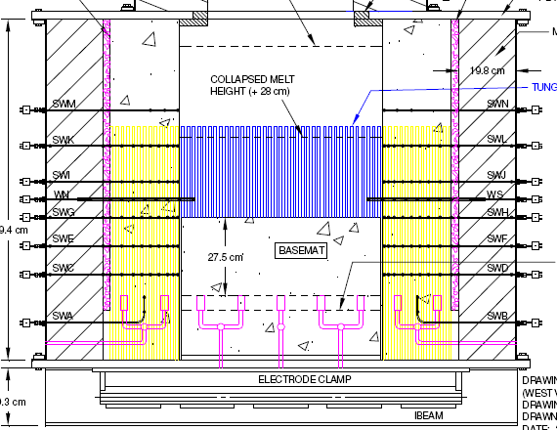
Molten Core Concrete Interaction – OECD MCCI-1 und -2
MCCI-1 (2002-2006)
    Melt coolability in reactor cavity
    long term 2-D erosion
MCCI-2 (2006-2010)
    “Combined effect tests” on melt coolability in reactor cavity
    “new design features” to enhance melt coolability in reactor cavity
    Tests of 2D erosion with different conrete types (LCS, SIC)
    Integral tests
  Tests with real Materials
  Data used for model development / validation: MEDICIS in ASTEC CPA and COCOSYS
Experiments at ANL, US

Slide 15
SARP-2 Status
  Kick-Off-Meeting was held at GRS, Cologne, November 17th, 2010
  2nd Meeting was held at GRS, Cologne, May 5th, 2011
  result of SARP-2 should be:
  “Updated version of SARNET SARP conclusions and proposals for future research in the severe accident domain”
  It is not intended to send requests or to distribute a questionnaire like in SARP-1.
  first steps: summary of ongoing activities in SARNET2 and other related OECD projects with regard to the 21 ERI topics
  -> prepared by SARP members an SARNET WP leaders
  -> discussed during 2nd meeting
  -> discussion started on “issues to be closed”
  -> discussion started on new/renewed topics based on Fukushima, like recriticality in core by flooding with water, influence of sea water injection, pool scrubbing in wetwell water pool, spent fuel pool accidents, …
  3rd Meeting is planned at GRS, Cologne, November 29th, 2011

