Slide 1
State Scientific Center of the Russian Federation –
Institute for Physics and Power Engineering named after A. I. Leypunsky
EXPERIMENTAL STUDY OF LIQUID METAL BOILING AS SIMULATION OF ACCIDENTS
IN FAST REACTOR CORE
A.P. Sorokin, A.D. Efanov, E.F. Ivanov,
G.P. Bogoslovskaya, I.R. Zueva, M.A. Fedosova

Slide 2
State Scientific Center of the Russian Federation –
Institute for Physics and Power Engineering named after A. I. Leypunsky
DESCRIPTION OF A PROBLEM
An analysis of the safety of fast rectors under conditions of severe accident with actuating the emergency protection and switching-off the circulation pumps has shown that, among others, we should solve the problem of fuel assemblies cooling under the regimes of sodium boiling
In this case, the core is heated at very low flow rates of the coolant circulation in a circuit

Slide 3
State Scientific Center of the Russian Federation –
Institute for Physics and Power Engineering named after A. I. Leypunsky
THE PURPOSE OF THE INVESTIGATIONS
To study the physics and characteristics of the hydraulic and thermal processes under liquid-metal boiling in a system of parallel assemblies in the natural circulation circuit
Theoretical models and computer codes for estimating the stability of operation of water-cooled facilities must be checked and modified to be applied to the case of liquid-metal low-velocity natural circulation

Slide 4
State Scientific Center of the Russian Federation –
Institute for Physics and Power Engineering named after A. I. Leypunsky
EXPERIMENTAL STUDY OF LIQUID METAL BOILING IN SINGLE FUEL-PIN ASSEMBLY UNDER NATURAL CIRCULATION CONDITIONS
Systematic investigations of eutectic alloy boiling of sodium-potassium under natural circulation conditions performed in the SSC RF IPPE in 90-th years XX-th of century enabled us to obtain a qualitative picture of the process and quantitative description of different phases of development of the two-phase liquid metal flow in a single fuel-pin assembly in a natural-circulation loop, i.e., the stable bubble flow, the unstable slug flow, which goes-over into the stable annular-disperse flow, and the heat transfer crisis with dry out of the heat transfer surface (the boiling crisis of the second type)

Slide 5
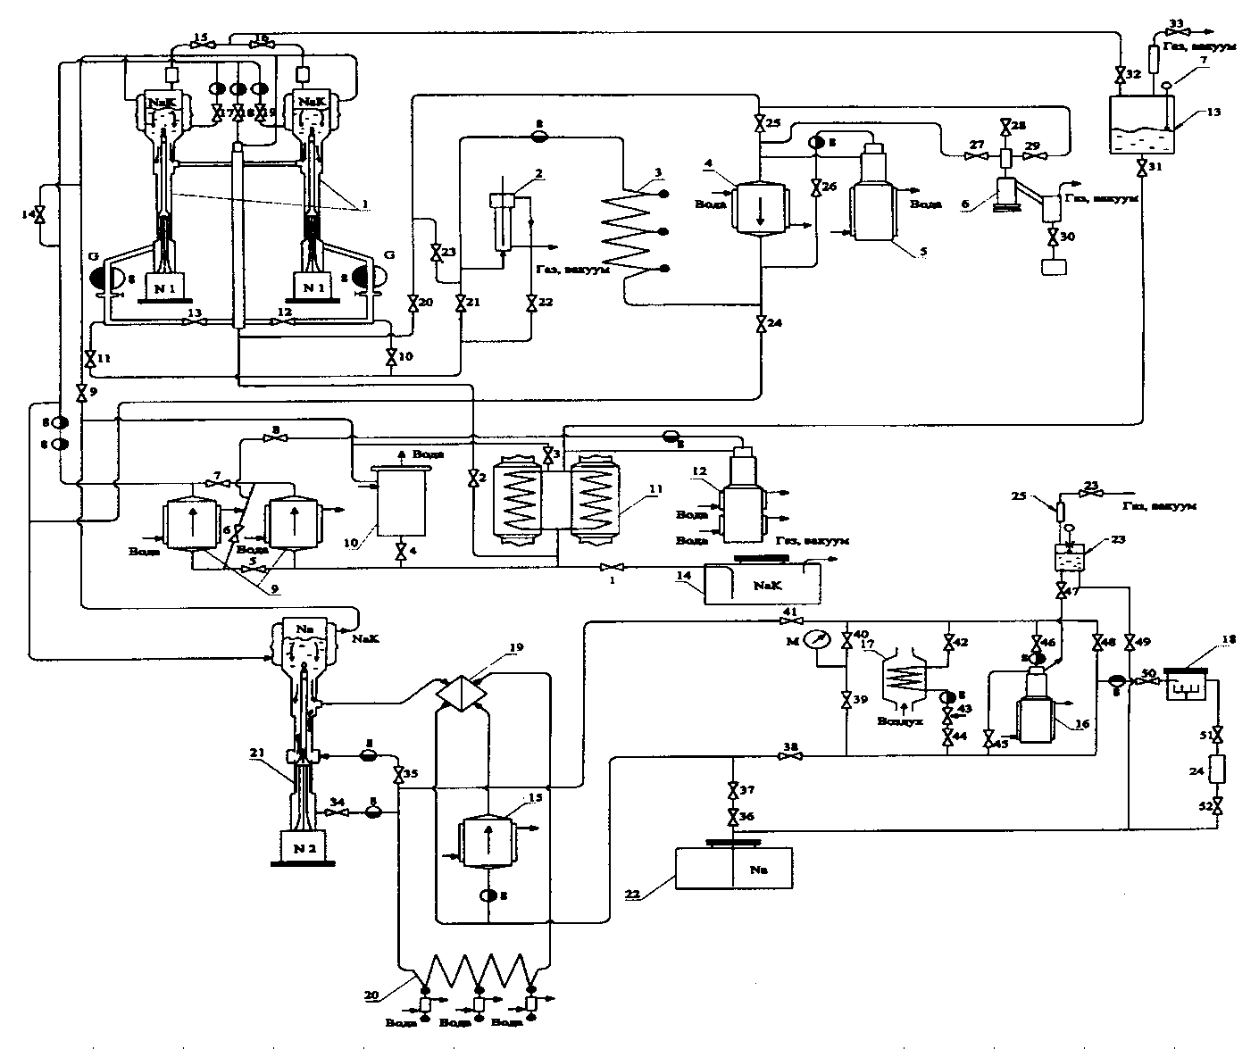
State Scientific Center of the Russian Federation –
Institute for Physics and Power Engineering named after A. I. Leypunsky
THE HIGH-TEMPERATURE LIQUID METAL FACILITY FOR INVESTIGATIONS OF FAST REACTOR ACCIDENT REGIMES

Slide 6
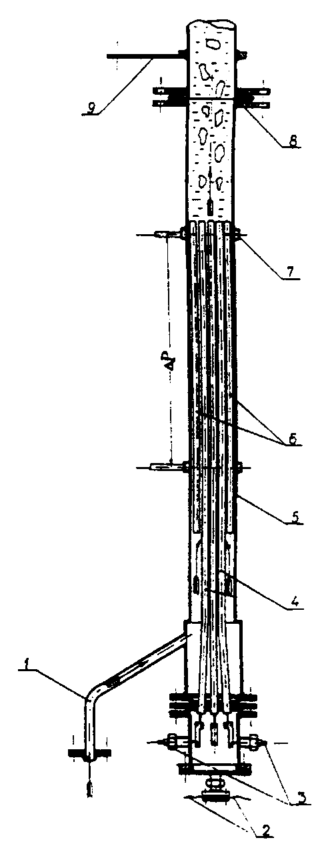
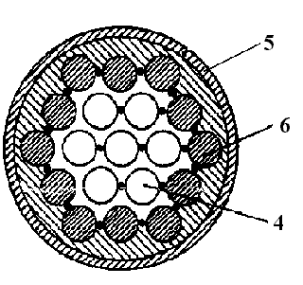
State Scientific Center of the Russian Federation –
Institute for Physics and Power Engineering named after A. I. Leypunsky
FUEL-PIN ASSEMBLY MODEL
1 – inlet of coolant
2 – thermocouples
3 – current leader to simulators
4 – fuel elements
5 – frame of model
6 – non-heating pins
7 – camber for takeoff of pressure
8 – unit for connection of model
9 – common current leader

Slide 7
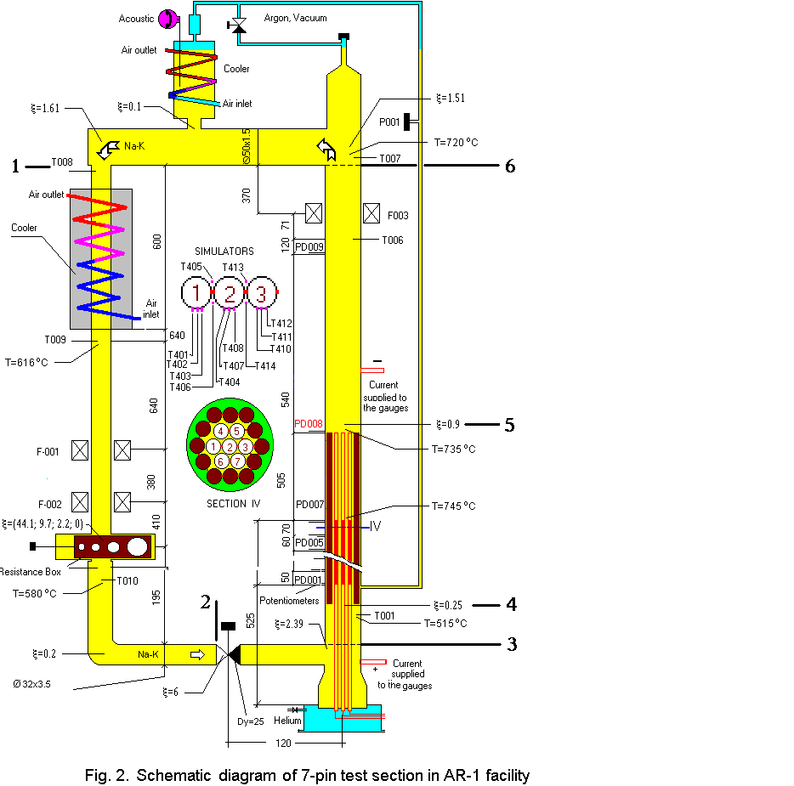
State Scientific Center of the Russian Federation –
Institute for Physics and Power Engineering named after A. I. Leypunsky
SCHEMATIC REPRESENTATION OF EXPERIMENTAL MODEL

Slide 8
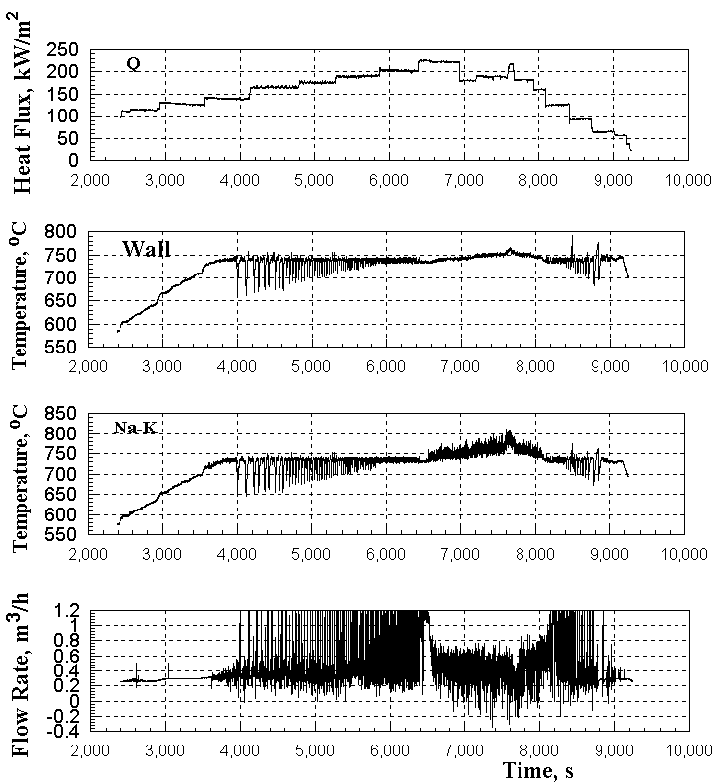
State Scientific Center of the Russian Federation –
Institute for Physics and Power Engineering named after A. I. Leypunsky
EXPERIMENTAL RESULTS
Heat flux, wall temperature, coolant temperature on an outlet from a zone of energy release, coolant flow rate in the experiment with the spacer d=20 mm

Slide 9
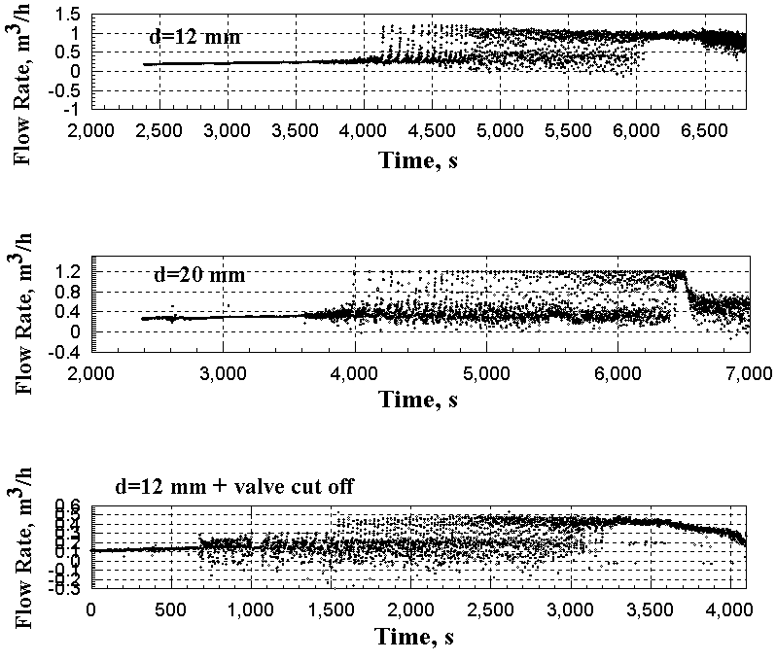
State Scientific Center of the Russian Federation –
Institute for Physics and Power Engineering named after A. I. Leypunsky
CHANGE OF THE COOLANT FLOW RATE

Slide 10
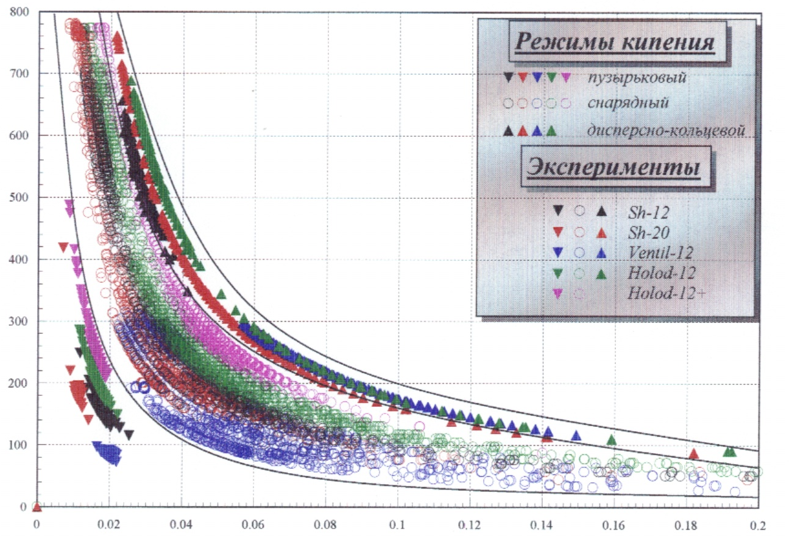




State Scientific Center of the Russian Federation –
Institute for Physics and Power Engineering named after A. I. Leypunsky
CARD OF REGIMES ON THE EXPERIMENTAL DATA
Boiling regimes:
- пузырьковый
- снарядный
- дисперсно- кольцевой
Experiments:
- Sh-12
- Sh-20
- Ventil-12
- Holod-12
- Holod-12+
Mass velocity of coolant, kg/m²
Quality, x

Slide 11
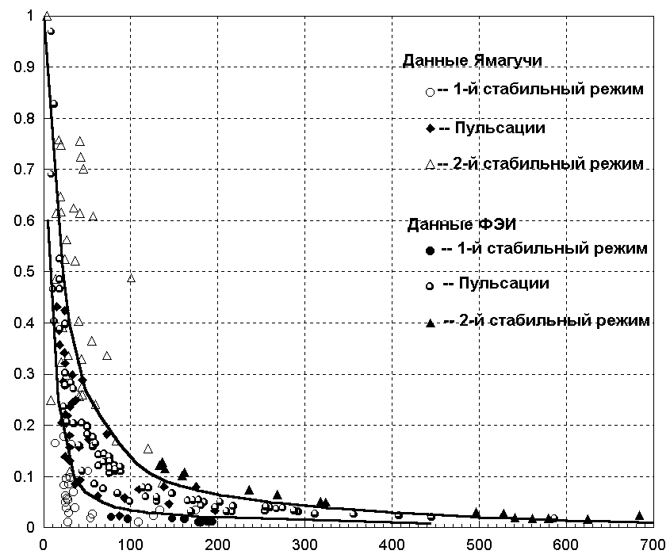
State Scientific Center of the Russian Federation –
Institute for Physics and Power Engineering named after A. I. Leypunsky
COMPARISON OF EXPERIMENTAL DATAS
ON FLOW REGIMES OF A TWO-PHASE FLOW OF LIQUID METAL
Data of Yamaguchi
Weight quality, x
1-th stable regime
pulsations
2-nd stable regime
Data of IPPE
1-th stable regime
pulsations
2-nd stable regime
Mass velocity of coolant, kg/m²

Slide 12
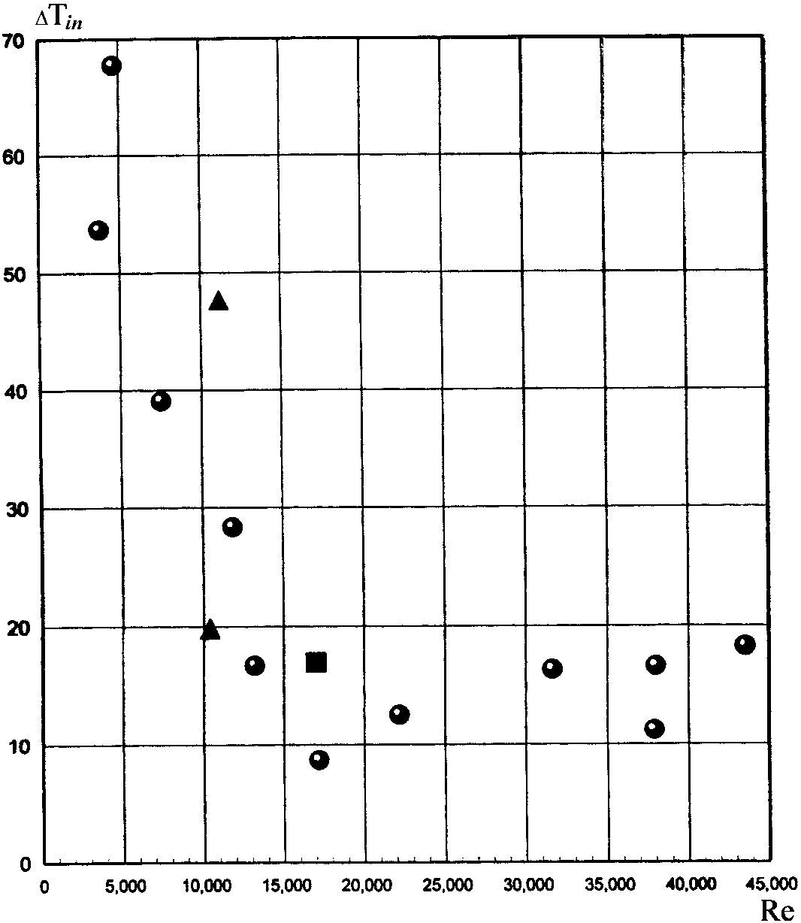

State Scientific Center of the Russian Federation –
Institute for Physics and Power Engineering named after A. I. Leypunsky
INITIAL OVERHEATING AT LIQUID METAL BOILING
- data of Kikuchi
❐ - data of IPPE
○ - data of IPPE

Slide 13
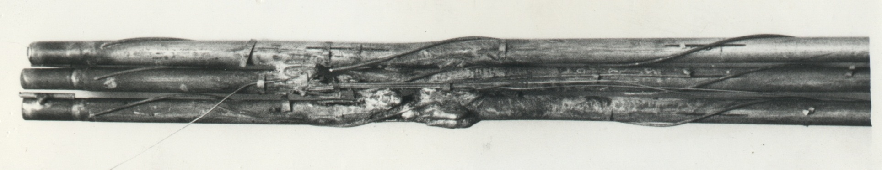
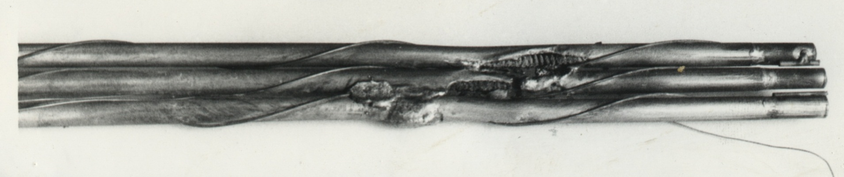
State Scientific Center of the Russian Federation –
Institute for Physics and Power Engineering named after A. I. Leypunsky
SEVERE ACCIDENT IN MODEL FUEL-PIN ASSEMBLY

Slide 14
State Scientific Center of the Russian Federation –
Institute for Physics and Power Engineering named after A. I. Leypunsky
COMPARISON OF EXPERIMENTAL DATAS ON LIQUID METAL BOILING HEAT TRANSFER
α/р^{0,15}, kW/m²К
Potassium:
1 – pool boiling
2 – tube D=10 mm (heat exchanger)
3 – tube D=6 mm (electrical heating)
4 – tube D=10 mm (electrical heating)
5 – tube D=22 mm (electrical heating)
6 – tube D=8.3 mm (electrical heating)
7 – tube D=4 mm (electrical heating)
Eutectic alloy Na-K (SSC RF-IIPE):
7-pin bundle D=35.2 mm (electrical heating)
IPPE
q, kW/m²

Slide 15
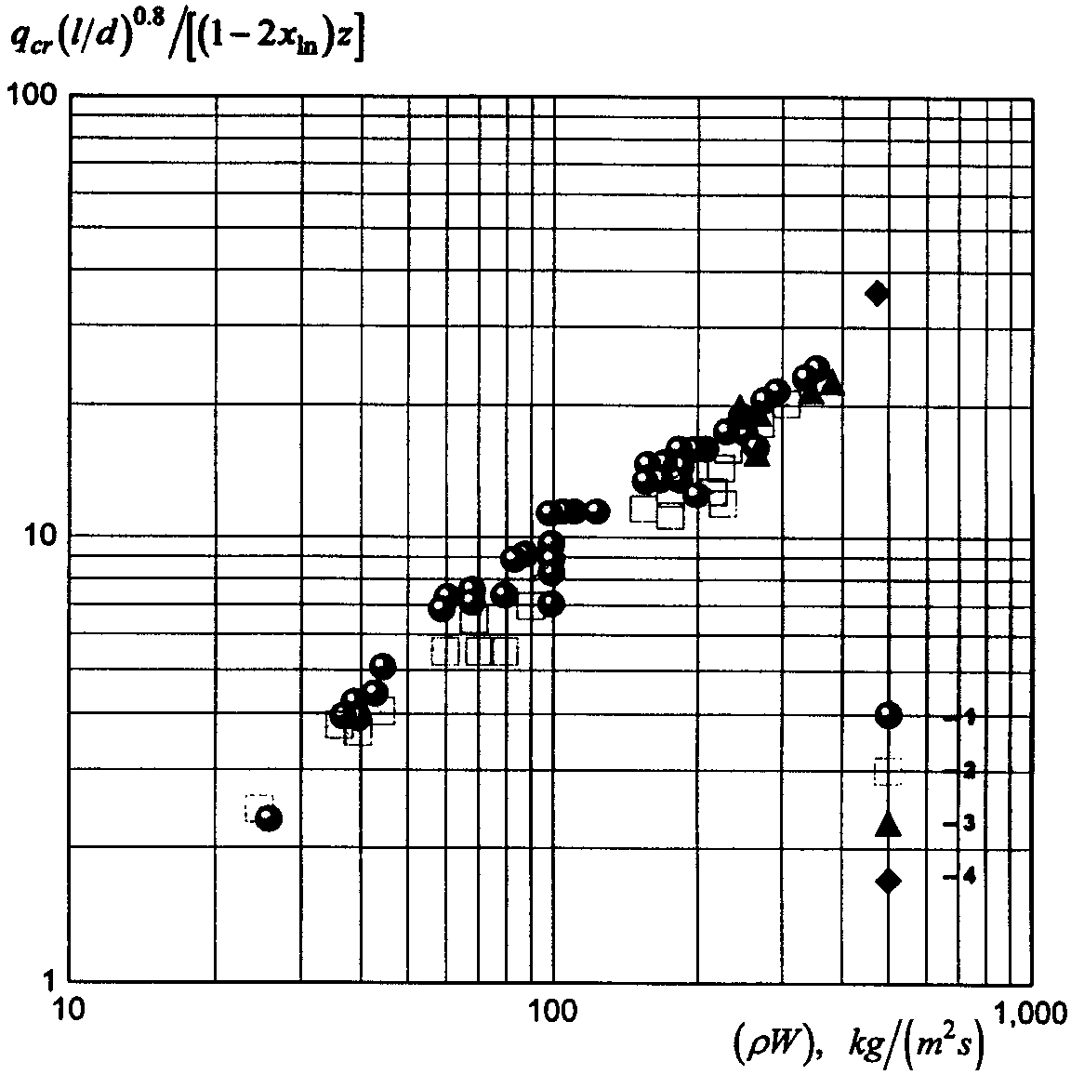
State Scientific Center of the Russian Federation –
Institute for Physics and Power Engineering named after A. I. Leypunsky
DEPENDENCE OF RELATIVE VALUE OF A CRITICAL THERMAL FLOW ON MASS VELOCITY OF THE COOLANT
1 – experimental data for tube (sodium)
2 – experimental date for tube (potassium)
3 – experimental data for ring gaps (sodium)
4 – experimental data of IPPE for 7-pin bundle of simulators (eutectic alloy of sodium-potassium)

Slide 16
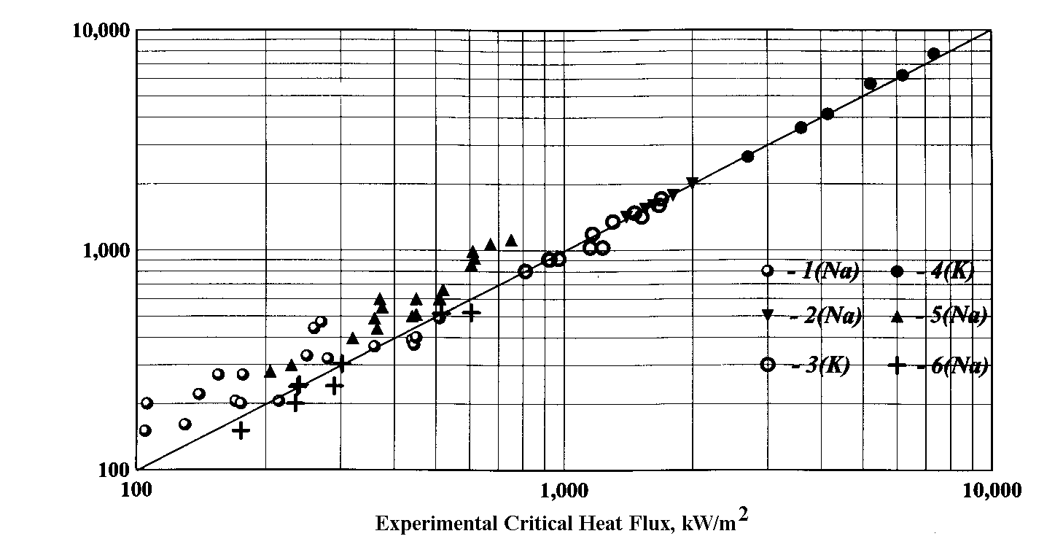
State Scientific Center of the Russian Federation –
Institute for Physics and Power Engineering named after A. I. Leypunsky
COMPARISON OF EXPERIMENTAL AND PREDICTED DATA ON SODIUM AND POTASSIUM CRITICAL HEAT FLUX AT THEIR BOILING
1 – Yamaguchi K.; 2, 3 – Chang S.H., Lee Y.-B.;
4, 5 – Kottowski H.M., Savatteri C.; 6 – Kaiser A.

Slide 17
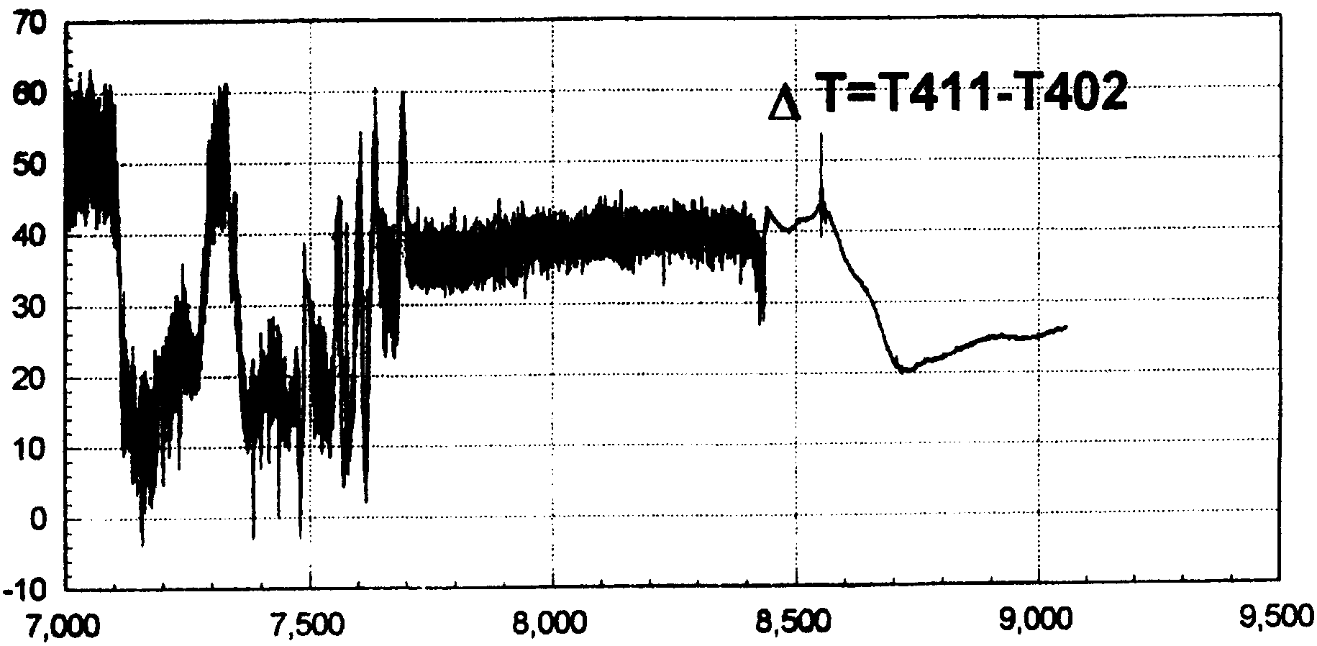
State Scientific Center of the Russian Federation –
Institute for Physics and Power Engineering named after A. I. Leypunsky
INFLUENCE OF A SURFACE ROUGHNESS OF PIN SIMULATORS ON THEIR TEMPERATURE REGIME
T, °C
Time, sec
Roughness simulator №1 → thermocouple Т402
Roughness simulator №3 → thermocouple Т411

Slide 18
State Scientific Center of the Russian Federation –
Institute for Physics and Power Engineering named after A. I. Leypunsky
EXPERIMENTAL INVESTIGATIONS OF LIQUID METAL BOILING IN A SYSTEM OF PARALLEL CHANNELS
The experimental facility for studying the liquid-metal boiling in a system of parallel assemblies is mounted in the sodium-potassium loop of the AR-1 installation in SSC RF-IPPE
The facility consists of two natural circulation loops; each containing an electrically heated pin-bundle simulator
Two assemblies with seven fuel elements are integrated in every circulation circuit
The tanks located above the assemblies are also connected to each other
Each the assembly (loop) can operate independently through own circulation circuit

Slide 19
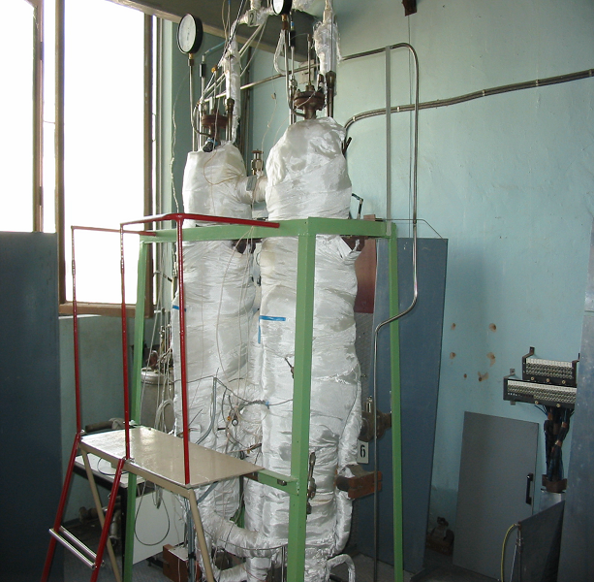
State Scientific Center of the Russian Federation –
Institute for Physics and Power Engineering named after A. I. Leypunsky
PART OF TEST FACILITY FOR EXPERIMENTS ON LIQUID METAL BOILING IN A SYSTEM OF PARALLEL ASSEMBLIES
The geometry of the pin-assembly model simulated typical assemblies of the BN-600 and BN-800 fast reactors

Slide 20
State Scientific Center of the Russian Federation –
Institute for Physics and Power Engineering named after A. I. Leypunsky
SYSTEM OF MEASUREMENT
The measurement system enabled us to monitor the following parameters
the electric power supplied to the pin-simulators and auxiliary electric heaters of the installation
the coolant flowrate
the static pressure and the pressure oscillations in the boiling zone
the pressure drop at the pin assembly models over the heating section
the pin-simulator surface temperature in three cross sections along the heating section height
the coolant temperature in three cross sections along the heating section height and at different points of the circulation circuit
the flowrate of the cooling water

Slide 21
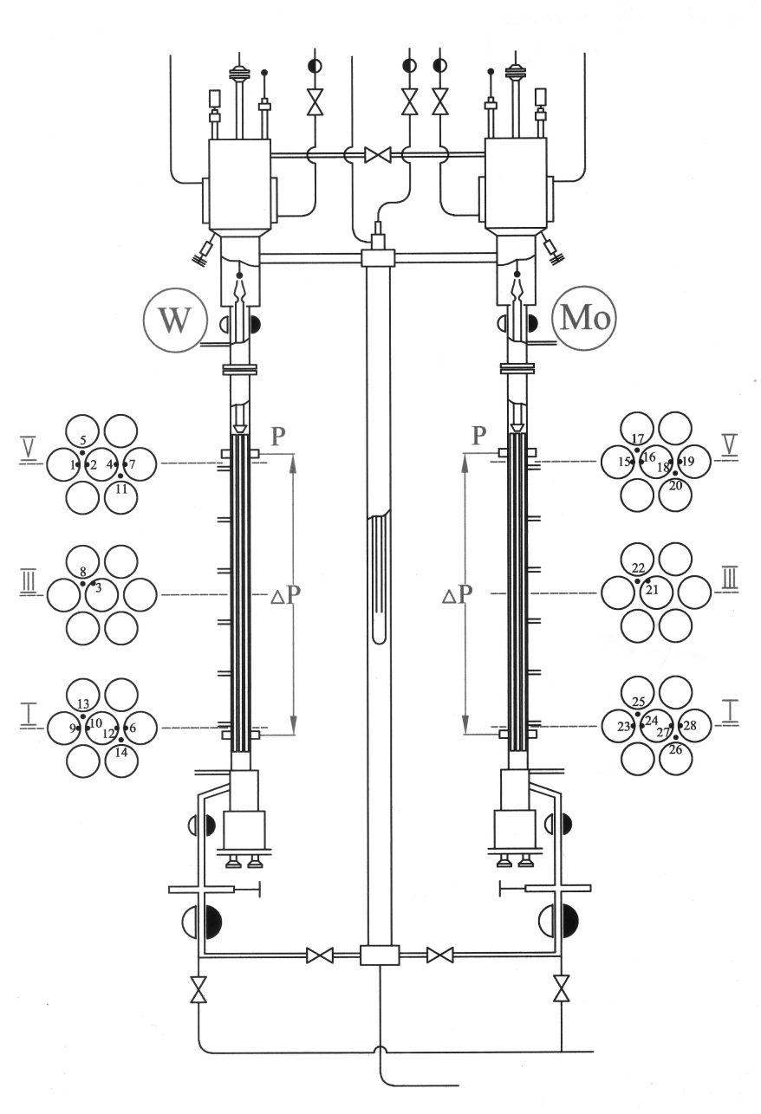
State Scientific Center of the Russian Federation –
Institute for Physics and Power Engineering named after A. I. Leypunsky
SCHEMATIC DIAGRAM OF TEST FACILITY AND POSITION OF SENSORS FOR MEASUREMENT OF TEMPERATURE, PRESSURE, COOLANT FLOW
tout L
tout Rр
t₁ L
t₁ R
tcom
L – left bundle, R – right bundle
indexes in, out and com indicate inlet, outlet and common temperature
tin L
tin R
Gin L
Gin R

Slide 22
State Scientific Center of the Russian Federation –
Institute for Physics and Power Engineering named after A. I. Leypunsky
TECHNIQUE OF EXPERIMENT
The experiments were conducted with a stepwise increase in power supplied to the pin simulator
The increment in the heat flux at the pin surface was not more than 10 – 20 kW/m²
After each step of the power increase, a certain time lag was provided to allow the parameters being measured to stabilize
The experiments were performed at a lowered pressure
The pressure in the breather spaces was approximately 0.4 bar which corresponded to a level of pressure in the upper part of the heat-release section of the assembly models of 0.49-0.52 bar

Slide 23
State Scientific Center of the Russian Federation –
Institute for Physics and Power Engineering named after A. I. Leypunsky
EXPERIMENTAL RESULTS
q, kW/m²
T_{Na-K}, °C
Time, sec
- t₁₇
- t₂₂
- t₂₅
G, m³/h
T_{w}, °C
- t₁₆
- t₂₁
- t₂₄
Time, sec
Changes in the flow parameters under independent operation of the right assembly:
heat flux, pin surface temperature, coolant temperature, inlet flowrate during experiment performed only on right bundle

Slide 24
State Scientific Center of the Russian Federation –
Institute for Physics and Power Engineering named after A. I. Leypunsky
THERMOHYDRAULIC PARAMETERS
UNDER INDEPENDENT OPERATION OF THE RIGHT ASSEMBLY
T_{w}, °C
Initially, oscillations of a small amplitude with a period of 3 to 5 s were observed, which reflected the generation, growth, and entrainment of the vapor bubbles by the coolant flow
Then, oscillating process with the greater amplitudes and the period of oscillations of from 20 to 40 s took place. When this occurred, the oscillations of all parameters appeared to be synchronized in time. Their amplitude and period gradually increased with time
- t₁₅
- t₁₉
T_{Na-K}, °C
- t₁₇
- t₂₀
G, m³/h
Time, sec

Slide 25
State Scientific Center of the Russian Federation –
Institute for Physics and Power Engineering named after A. I. Leypunsky
PARALLEL OPERATION OF THE ASSEMBLIES
WITH SIMILAR HEATING CONDITIONS
T_{w left}, °C
T_{w right}, °C
- t₂
- t₃
- t₁₀
- t₁₆
- t₂₁
- t₂₃
T_{Na-K left}, °C
T_{Na-K right}, °C
- t₅
- t₈
- t₁₃
Time, sec
- t₁₇
- t₂₂
- t₂₅
Time, sec

Slide 26
State Scientific Center of the Russian Federation –
Institute for Physics and Power Engineering named after A. I. Leypunsky
CHANGES IN THE FLOW PARAMETERS UNDER PARALLEL OPERATION
OF THE ASSEMBLIES WITH THE SAME POWER INPUT
q, kW/m²
- q_{left}
- q_{right}
G, m³/h
- G_{in left}
- G_{in right}
Time, sec
An amplitude of the flowrate oscillations in the system of parallel interacting assemblies grew up to approximately 0.5 m³/h, which is much more than that in the circuit with a single assembly, where the amplitude was about 0.05 m³/h
This attests for the enhancement of the pulsations due to hydraulic interaction of parallel channels, i.e., for the existence of the interchannel instability

Slide 27
State Scientific Center of the Russian Federation –
Institute for Physics and Power Engineering named after A. I. Leypunsky
CHANGES IN THE FLOW PARAMETERS UNDER PARALLEL OPERATION
OF THE ASSEMBLIES WITH THE SAME POWER INPUT WITH 4 HEATED ELEMENTS IN LEFT AND WITH 7 HEATED ELEMENTS IN RIGHT ASSEMBLY
T_{w left}, °C
T_{w right}, °C
- t₂
- t₃
- t₁₀
- t₁₆
- t₂₁
- t₂₄
T_{Na-K left}, °C
T_{Na-K right}, °C
- t₅
- t₈
- t₁₂
Time, sec
- t₁₇
- t₂₂
- t₂₅
Time, sec
The appearance of slugs caused the flow reversal in the assembly with boiling

Slide 28
State Scientific Center of the Russian Federation –
Institute for Physics and Power Engineering named after A. I. Leypunsky
CHANGES IN THE FLOW PARAMETERS UNDER PARALLEL OPERATION
OF THE ASSEMBLIES WITH THE SAME POWER INPUT WITH 4 HEATED ELEMENTS IN LEFT AND WITH 7 HEATED ELEMENTS IN RIGHT ASSEMBLY
q, kW/m²
- q _{left}
- q _{right}
G, m³/h
- G _{in left}
- G _{in right}
Time, sec

Slide 29

State Scientific Center of the Russian Federation –
Institute for Physics and Power Engineering named after A. I. Leypunsky
FLOW RATE PARAMETERS FOR RIGHT AND LEFT BUNDLES
G, m³/h
q, kW/m²
 and  - independently operation of fuel-pin assemblies
□ and ■, ∆ and ▲- parallel operation of fuel-pin assemblies

Slide 30
State Scientific Center of the Russian Federation –
Institute for Physics and Power Engineering named after A. I. Leypunsky
AMPLITUDES AND PERIOD OF OSCILLATION FOR FLOW PARAMETERS
ΔT_{w}, °C
ΔG, m³/h
ΔT_{Na-K}, °C
Δτ, s
Time, sec
Time, sec
- separate operation of right bundle
parallel operation of the assemblies with the same power input:
- left bundle
- right bundle
parallel operation of the assemblies with different number of heating pins:
- left bundle
- right bundle
In the slug-flow regime, the period of oscillation of the thermohydraulic parameters is from 20 to 40 s
In this case, a peak-to-peak value of the coolant flowrate oscillations in the system of parallel channels (assemblies) is essentially ten times greater than that under independent operation of each the channel

Slide 31
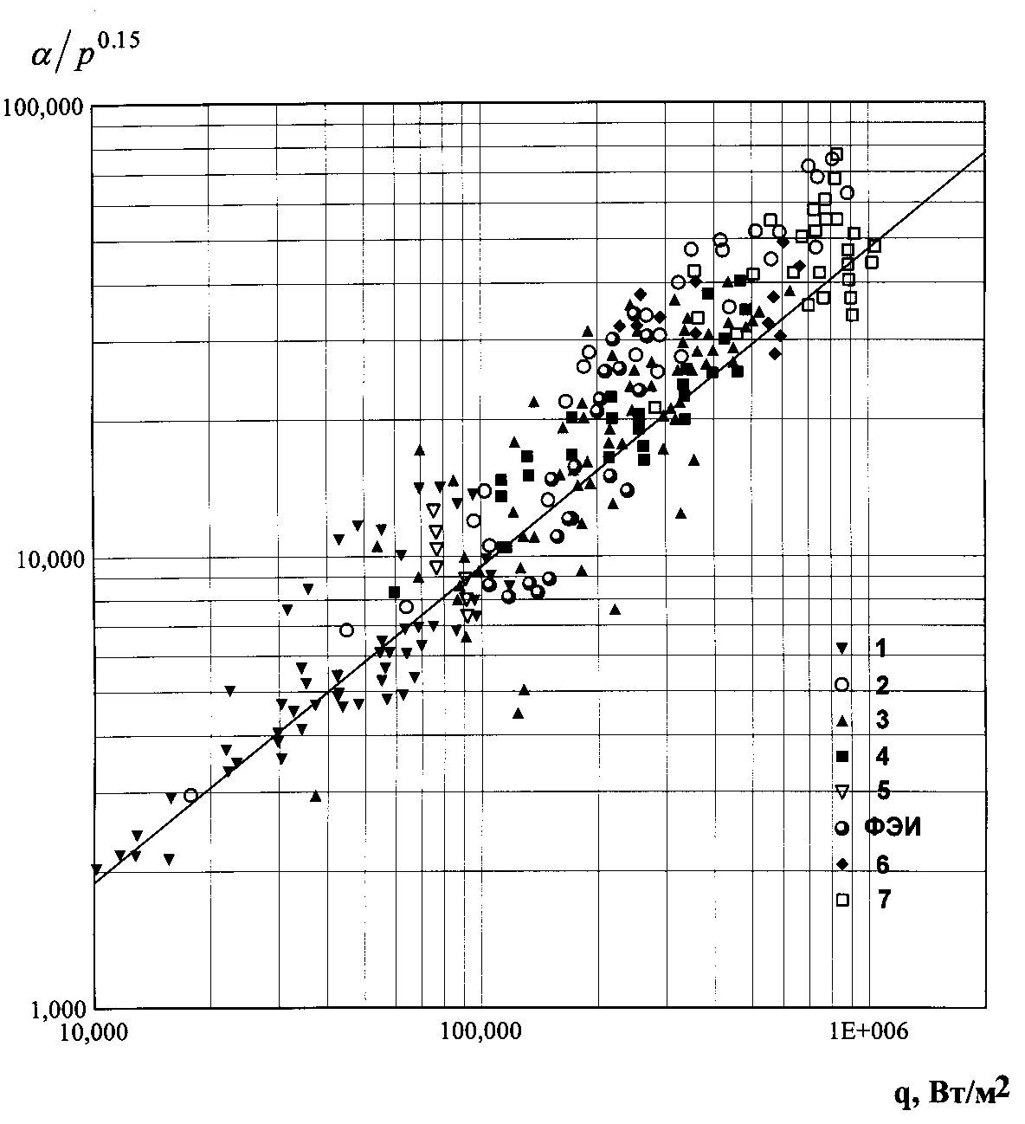

State Scientific Center of the Russian Federation –
Institute for Physics and Power Engineering named after A. I. Leypunsky
COMPARISON OF HEAT TRANSFER DATA
UNDER LIQUID METAL BOILING
α/р^{0,15}, kW/m²К
100 000
– calculation by formula
Experimental data:
Potassium:
▼ – pool boiling
 – pipe D=10 mm (heat exchanger) )
❐ – pipe D= 6 mm (electrical heating)
○ – pipe D=10 mm (electrical heating)
⬧ – pipe D=22 mm (electrical heating)
 – pipe D=8.3 mm (electrical heating)
– pipe D=4 mm (electrical heating)
10 000
Na-K eutectic (SSC RF IPPE):
– separate 7-pin bundle l=420 mm
7-pin bundle l=840 mm
– separate (right) bundle
– parallel bundles under the same power
– parallel bundles, when one bundle has four, but another bundle has seven heated pins
– parallel bundles, when q_{right}=0.8 q_{left}
1 000
50
100
q, kW/m²
500

Slide 32
State Scientific Center of the Russian Federation –
Institute for Physics and Power Engineering named after A. I. Leypunsky
THE CONCLUSION BY RESULTS OF INVESTIGATIONS OF LIQUID METAL BOILING IN A SYSTEM OF PARALLEL FUEL-PIN ASSEMBLIES
The experimental study in IPPE of the eutectic sodium-potassium alloy boiling under conditions of natural circulation in the system of two parallel assemblies simulating those of fast reactors are shown
At a heat flux of approximately 130 kW/m², the bubble flow regime changes over to the developed slug flow with strong oscillations of the coolant flowrate and the other parameters
The onset of the oscillating process during coolant boiling in one of the assemblies arranged in parallel provides antiphase oscillations in the second assembly
These oscillation of the thermohydraulic parameters in different loops proceed in the antiphase mode

Slide 33
State Scientific Center of the Russian Federation –
Institute for Physics and Power Engineering named after A. I. Leypunsky
Hydrodynamic interaction between the loops is the cause of a significant growth in the flowrate amplitude (“resonance” of flowrate oscillation) and of a possible “lock” of the flowrate or a flow reversal in the loops. It may also result in an increase in the temperatures of the coolant and the claddings of pins (the effect of interchannel instability) and in the incipience of the heat transfer crisis
The difference in the heat fluxs on the surfaces of heat-generating pins in parallel assemblies provides the enhancement of the “resonance” of the oscillating process
Heat transfer coefficients under liquid-metal boiling in a single assembly or in assemblies arranged in parallel agree with each other as well as with such a data for liquid-metal boiling in tubes

