Slide 1
Steam Oxidation Effect on Zone of Interaction of C-32 Corium with Vessel Steel: MCP-3 Test
A.P. Alexandrov Research Institute of Technology
ISTC METCOR-P Project
#3592
Presented by S. Bechta
2nd METCOR-P meeting
July 9, 2008, St. Petersburg

Slide 2
Contents
Objectives
Experimental setup and procedure
Experimental results
Post-test analysis
Ablation and steam absorption kinetics
Conclusions

Slide 3
Objectives
Qualification and quantification of steam oxidation effect on interaction zone

Slide 4
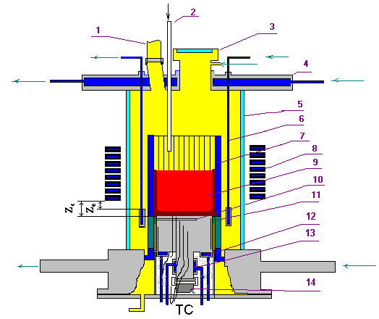
Experimental Setup
RASPLAV-3 Furnace
1 – steam vent from the furnace
2 – steam line
3 – lid
4 – water-cooled cover
5 – quartz tube
6– water-cooled electromagnetic screen
7 – crucible sections
8 – inductor
9 – melt
10 – acoustic defect
11 – thermal insulation of the specimen
12 – top specimen calorimeter
13 – bottom specimen calorimeter
14 – US sensor

Slide 5
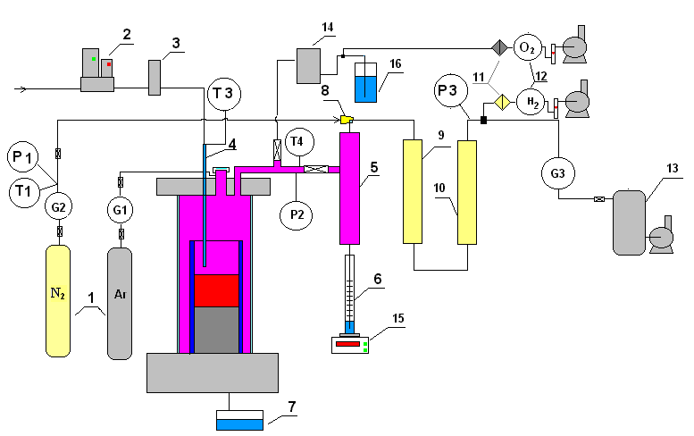
Experimental Setup (2)
Gas-Aerosol Sampling System
1 – tanks with N₂ and Ar
2 – water controller
3 – steam generator
4 – quartz tube for
steam supply into
the furnace
5 – steam condenser
6 – condensate
collector
7 – condensate drop
catcher
8 – ejector
9 – large-area filter
(LAF - steam)
10 – silica gel drier
11 – analytical filter
(AF)
12 – electrochemical
sensors of oxygen
and hydrogen
13 – vacuum receiver
14 – large-area filter
(LAF - Argon)
15 – weight sensor
16 – hydro lock

Slide 6
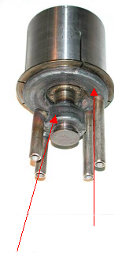
Experimental Setup (3)
Specimen of Vessel Steel
TC Localization
TC # | α, º (azimuth angle) | r, mm (distance from specimen axis to TC) | h, mm (distance from specimen hot top to TC)
TC01 TC02 TC03 TC04 TC05 TC06 TC07 TC08 TC09 TC10 TC11 TC12 TC13 | 180 90 135 45 270 0 225 180 90 45 225 315 – | 10 10 10 10 10 10 10 29 29 29 29 29 7.5 | 1 2 3 4 6 8 20 1 2 4 8 20 104
Upper
calorimeter
Lower
calorimeter

Slide 7
Experimental Setup (4)
Furnace Charge
Component | Mass, g
UO₂ | 1385.7
ZrO₂ | 164.1
Zr | 272.5
Total | 1822.3
C_{n} = 30.8
U/Zr = 1.188 at.

Slide 8
Experimental Procedure
Stage | Time interval, s | Description
A | 0…38300 (≈ 11 h) | Molten pool and interaction zone formation
B | 38300…42500 | Temperature of the vessel steel temperature is decreased, crust above the interaction zone is formed
C | 42500…44300 | Molten pool is oxidized by steam
D | 44300…49200 | Specimen temperature is increased, crust above the interaction zone dissolves
E | 49200…50490 | Interaction zone and specimen are oxidized

Slide 9
Experimental Results
Thermocouple Readings and Anode Voltage
During all experiment
Fragment: Oxidation period
A B C D E
A B C D E

Slide 10
Experimental Results (2)
Power into Cold Crucible and Upper Calorimeter
During all experiment
Fragment: Oxidation period
A B C D E
A B C D E

Slide 11
Experimental Results (3)
Nitrogen Flow Rate and Hydrogen Concentration
Steam Ingress
C
D
E
Blowing of furnace

Slide 12
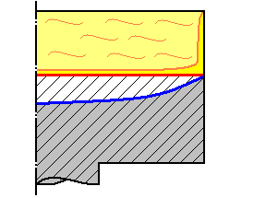
Experimental Results (4)
Corrosion kinetics
A
D
E
Melt
IZ
Specimen
References:
[1] S.V. Bechta, V.B. Khabensky,
V.S. Granovsky etc. EXPERIMENTAL
STUDY OF INTERACTIONS BETWEEN
SUBOXIDIZED CORIUM AND REACTOR VESSEL STEEL. Proc. of ICAPP’06, Reno, NV USA, June 4-8, 2006, Paper 6054

Slide 13
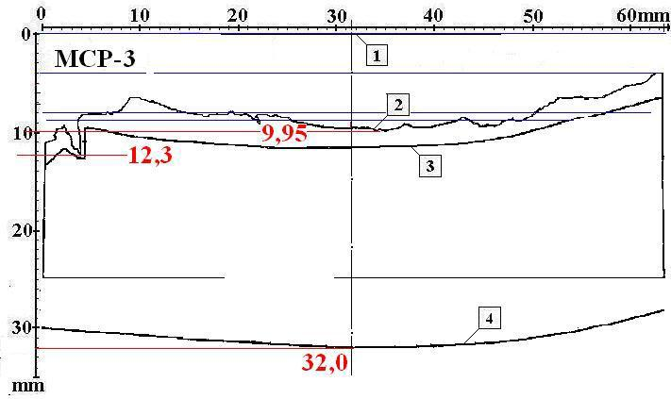
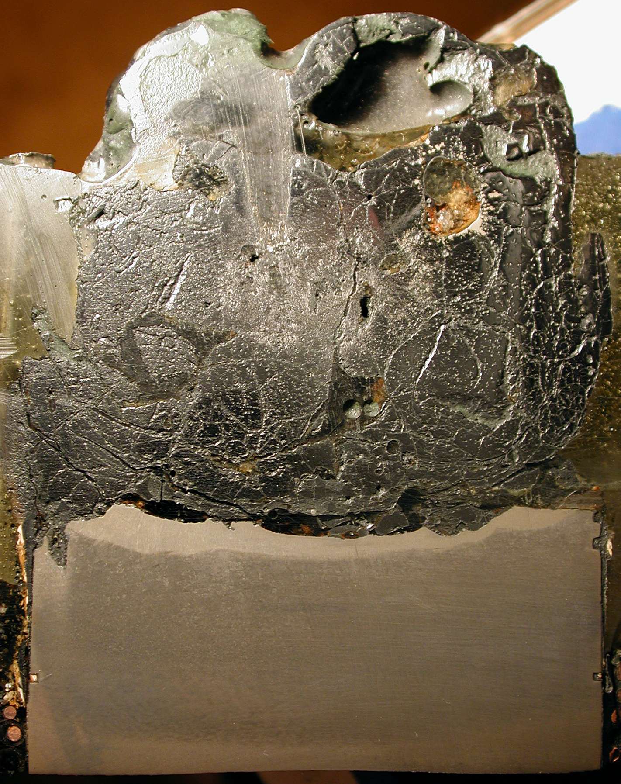
Post-Test Analysis
Ingot Section
Specimen Section Scheme
1 – undamaged specimen surface
2 – post-test specimen boundary
3 – boundary of the decarbonized steel zone
4 – zone of the melt thermal impact on the
macro- and micro-structure of steel
(boundary – isotherm 727ºС ?)
Mass of steel migrated into the melt ≈ 190 g

Slide 14
Post-Test Analysis (2)
Chemical Analysis of Samples
Sample | Concentration, mass.%
 | Fe⁰ | Fe²⁺ | Fe³⁺ | U⁴⁺ | U⁶⁺ | Zr⁴⁺
Ingot | 1.7 | 4.3 | 1.5 | 54.0 | 3.8 | 21.7
Crust above ingot | – | 3.0 | 1.2 | 59.6 | – | 20.0
Corium splashes | – | 3.5 | 1.7 | 56.6 | – | 23.0
Rod | – | 0.8 | – | 63.7 | – | 24.6
Aerosol on quartz tube | – | 8.4 | 1.3 | 53.0 | 4.8 | 17.3
Aerosol on crucible | – | 3.7 | 2.5 | 34.0 | 28.5 | 2.0
Aerosol in LAF (Ar) | 8.7 | 15.3 | 2.3 | 51.4 | 9.3 | –
Aerosol in LAF (steam) | 19.8 | 28.1 | 2.5 | 29.5 | 6.4 | –
Aerosol in condenser | – | 2.5 | 1.8 | 34.8 | 19.6 | 24.0
Total mass of aerosols – 88.9 g
Mass of evaporated iron – 3.2 g

Slide 15
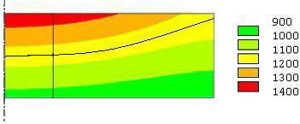
Ablation and steam absorption kinetics
Specimen temperatures during it interaction with suboxidized corium
1 cm
T, ºC
US sensor
sighting spot
Final position of the interaction
zone (IZ)
Comparison of MC6 and MCP-3 Test Results
Parameter | Test
 | MC6 | MCP-3
Final Corrosion Depth, mm | 6.2 | 7.6
Temperature of Lower Boundary of IZ at Final Position (T_{B}), ºC | 1180 | 1160

Slide 16

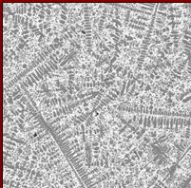
Ablation and steam absorption kinetics (2)
Steam absorption was calculated in the assumptions:
Interaction zone composition approximately corresponds to MC6
Steam absorption rate is proportional to the measured hydrogen content
in the furnace gas
Due to the losses of generated hydrogen its actual concentration
in the furnace gas is higher than measured, but proportional to it
Total volume of generated hydrogen depends on the mass balance
of components involved in the H₂O reactions
U
Zr
Fe
mass.%
27.6
5.2
67.2
mol.%
8.4
4.2
87.4
MC-6

Slide 17
Ablation and steam absorption kinetics (3)
Hydrogen Generation
Average rates of hydrogen liberation:
6.9 mg/s – at stage C
3.6 mg/s – at stage E
Hydrogen liberation rates at the steady regime:
9.7 mg/s – at stage C
5.0 mg/s – at stage E

Slide 18
Ablation and steam absorption kinetics (4)
Heat Generation at Corium Pool Oxidation Stage (Stage C)
Reactions on the melt/furnace atmosphere boundary:
Zr + 2H₂O = ZrO₂ + 2H₂ + 530 kJ/mol
UO₂ + H₂O = UO₃ + H₂ – 160 kJ/mol
Fe + H₂O = FeO + H₂ – 30 kJ/mol
2Fe + 3H₂O = Fe₂O₃ + 3H₂ – 120 kJ/mol
Heat of chemical reactions generated at stage C:
≈ 1370 kJ
Corresponding average heat power:
≈ 0.759 kW

Slide 19
Ablation and steam absorption kinetics (5)
Heat Generation at Interaction Zone and Specimen Oxidation Stage (Stage E)
Reactions in the interaction zone:
Zr + O₂ = ZrO₂ + 1090 kJ/mol
U + O₂ = UO₂ + 1060 kJ/mol
2U + O₂ = 2UO₃ + 2360 kJ/mol
Fe + O₂ = FeO + 500 kJ/mol
4Fe + 3O₂ = 2Fe₂O₃ +1440 kJ/mol
Heat of chemical reactions generated at stage E:
≈ 888 kJ
Corresponding average power of heat release:
≈ 0.505 kW
Estimation of heat power to the specimen surface both from the melt and generated by chemical reactions ≈ 2.5 kW
( 2 kW – from the melt, 0.5 kW – chemical reactions)

Slide 20
Conclusions
Posttest analysis is still in progress, but the following can be noted:
Before the oxidation start, in the conditions close to MC6 interaction
between the С-30 corium melt with steel, the MCP-3 interaction zone
depth in the USS sighting spot was deeper by approx. 1.4 mm, and the
incubation period – shorter by approx. 6000 s
The oxidation rate and hydrogen generation rate measured during the
pool oxidation regime were close to MA-9 test. The oxidation is
controlled by the steam supply to the molten pool surface
The most conservative regime was realized in the test, i.e. the IZ was
oxidized by corium melt, which have been oxidized in advance
A partial melting of the steel surface layer took place in the end of
oxidation regime. This was caused by uncontrolled increase of heat
transferred from the melt (setup-specific factor) and/or additional heat
generated by chemical reactions. The mentioned heat powers have been
evaluated as 2 and 0.5 kW respectively

