Slide 1
Code development activities in the area of nuclear safety
Valery Strizhov

Slide 2
Content
Status of Safety Codes for water cooled reactors
Safety Codes for liquid metal reactors
Advanced multiphysics three dimensional codes
Containment codes

Slide 3
Development of SOCRAT Code
SOCRAT/V1 has been developed for simulation of in-vessel phase of accident progression
  Assessments of the hydrogen release during in-vessel stage of accident progression
  Assessments of the mass and energy release from the reactor vessel to molten core localization device
SOCRAT/V2 designed for verification of accident management procedures
SOCRAT/V3 will be completed for assessments of radiological consequences of accidents

Slide 4
Components of SOCRAT code
Major Components
  Thermal hydraulics module (RATEG) VNIIEF
  Cladding behavior (SVECHA/QUENCH) IBRAE-FZK
  FP inventories and decay heat (BONUS) IBRAE
  Fission product release (MFPR) IBRAE-IRSN
  FP behavior in the primary circuit (PROFIT) IBRAE
  Containment phenomena (KUPOL) IPPE
  Late phase of core degradation (HEFEST) IBRAE
Complimentary components
  Steam explosion (VAPEX) EREC
  Natural circulation (CONV) IBRAE
  MCCI: (RASPLAV+SPREAD) IBRAE
  Containment mechanics (CONT) IBRAE
  Environment and risk (NOSTRADAMUS) IBRAE
Material properties database

Slide 5
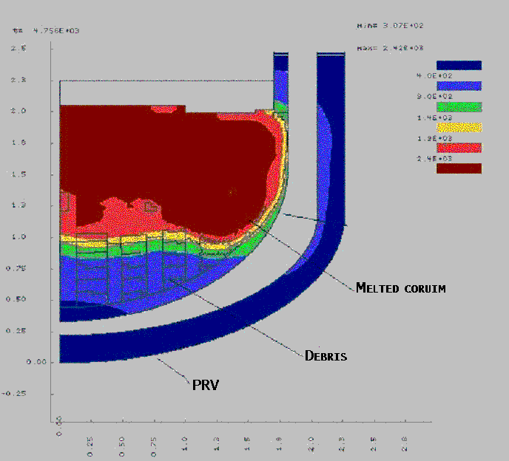
Applications
VVER-440, VVER-1000, VVER-1500, AES-2006,
Hydrogen source term evaluation:
  SFD core degradation sequences (SBO, ECCS, LOCA);
Mass and energy release:
  containment
  core catcher/concrete basement.
Analysis of effectiveness of safety systems for LAES-2 and NVAES-2
Justification of initial data for designing of hydrogen systems (VVER-440, VVER-1000)
Analysis of experimental facilities for justification of passive safety systems LAES-2

Slide 6
Summary
The SOCRAT system of codes is built using the state of the art models for best estimate simulation of key severe accident phenomena
  The code is extensively used for assessments of accident progression scenarios at NPP with VVERs
  After completion the code will allow modeling of accident phenomena from the initiating event to radiological consequences.

Slide 7
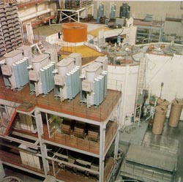
LMR in Russia
BN-600
  Fuel UO₂+MOX
  FA with MOX – 91 of 400
BN-800
  Fuel UO₂+PuO₂
BN-1200 (?) Gen III+ NPP
R&D up to TD GenIV commercial sodium and lead cooled fast reactors (2015)
Dense fuel, closed cycle (2015)
BN-600 reactor

Slide 8
BN-600 model for neutron physiscs
(Joker code)
Precise code for analysis of reactor core
  Neutron constants
  FP inventories
  Optimization of the fuel cycle
  Detailed space and temporal characteristics of core
Detailed assemblies characteristics
  Initial characteristics;
  Irradiation characteristics in the reactor
  Fuel burn-up

Slide 9
Model for LM thermal hydraulics
(joint IBRAE-IPPE code : GRIF-SM-COREMELT modules + software shell)
Multicomponent multiphase hydrodynamics
Sodium boiling
Heat exchange in boiling sodium
Steel and fuel melting and relocation
Reactivity effects

Slide 10
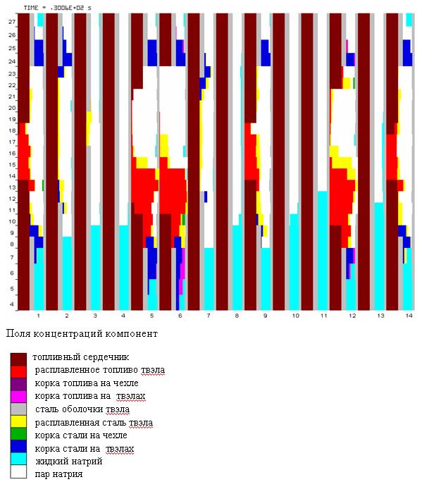
Modeling of hypothetical severe accident with core melting in BN-600 reactor

Slide 11
Advanced simulation tools
Realization of multi-dimensional physical and numerical models including single and multi-phase CFD methods
State-of-the-art level of numerical solvers and constitutional models, modern computational architecture: clusters, multiprocessor computations
Development of experimental database for verification of codes

Slide 12
Experience
The CFD code developments has been started about 15 year ago realized first as the CONV code
The main focus was simulation of natural circulation phenomena
Application to the experimental facilities in the frames of OECD RASPLAV-MASCA Projects
Application to the in-vessel retention problem to simulate heat distribution

Slide 13
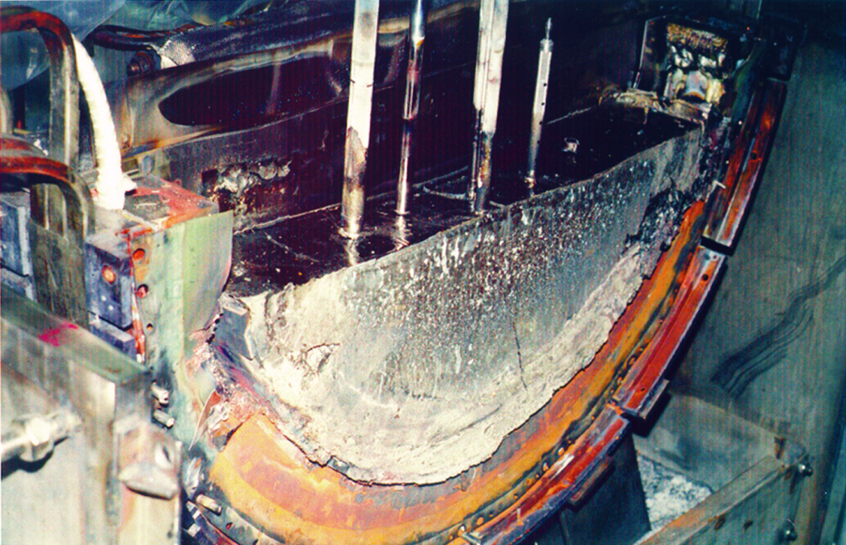
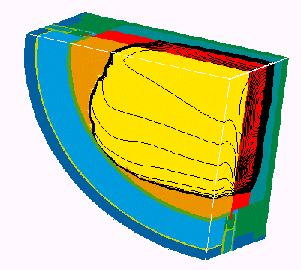
Simulation of «RASPLAV» AW-4 Test
RSC
«Kurcatov
Institute»
Comparison of the calculated and experimental scenarios for power input (left) and molten corium temperature (right)
The computational model of the AW facility

Slide 14
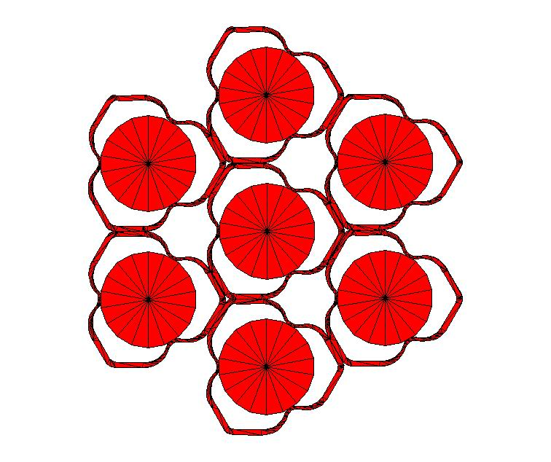
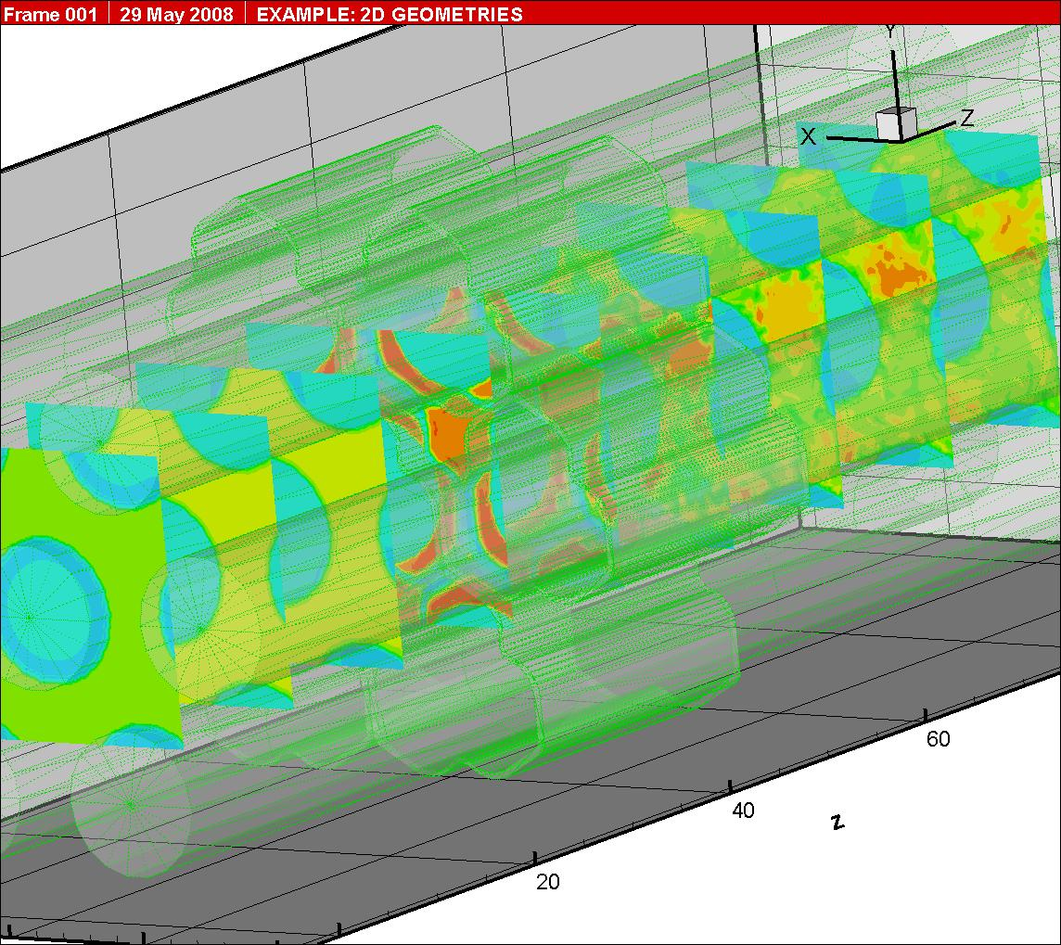
Applications of CFD codes (2)
Calculations of the coefficients of hydraulic resistance of spacer grid
Spacer grids and fuel elements
3D distribution of longitude velocity

Slide 15
Program of code developments for LMR
It should be new generation code
3-D CFD modeling of multiphase multicomponent flows in reactor elements
Intellectual program shell to integrate dissimilar modules
Parallel calculations
Notes:
15

Slide 16
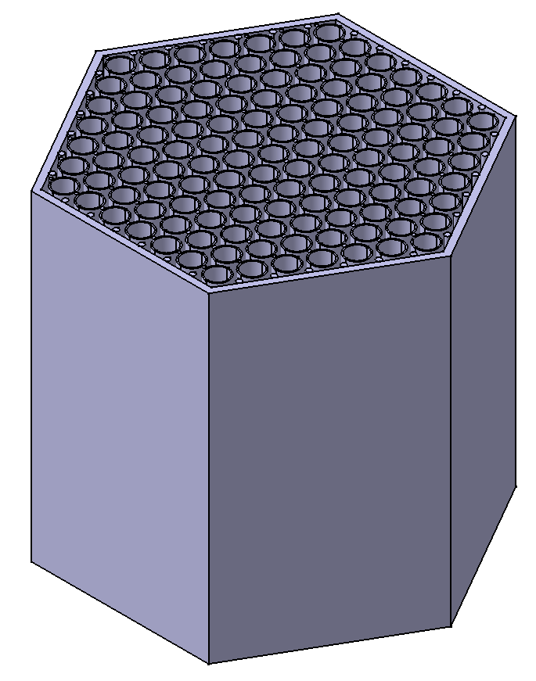
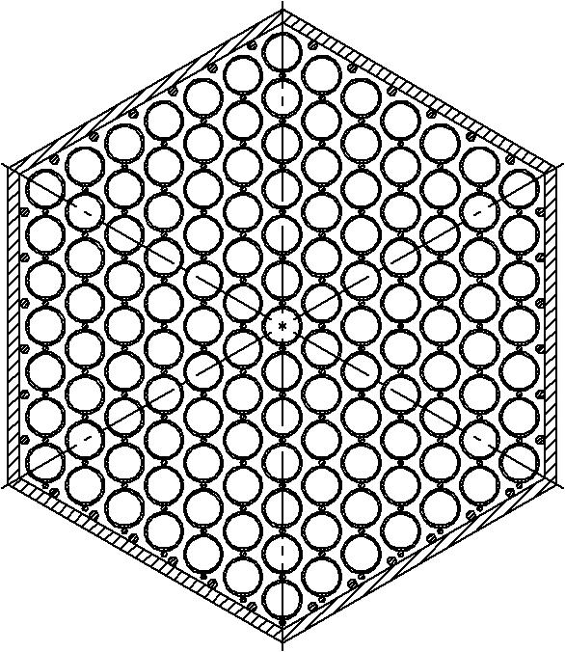
3-D CFD modeling
of LMFR fuel assembly. Geometry model
wire
cladding
wire
displacers
Fuel rods
structure

Slide 17
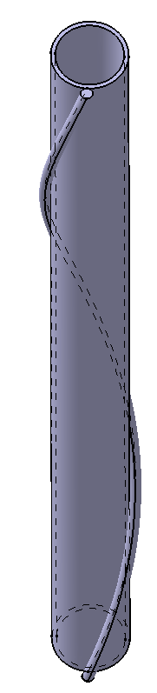
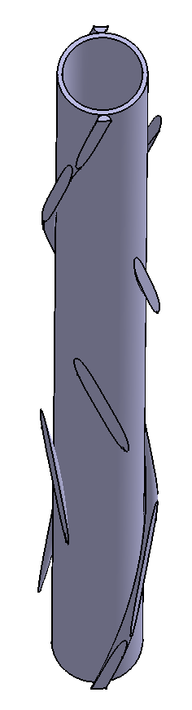
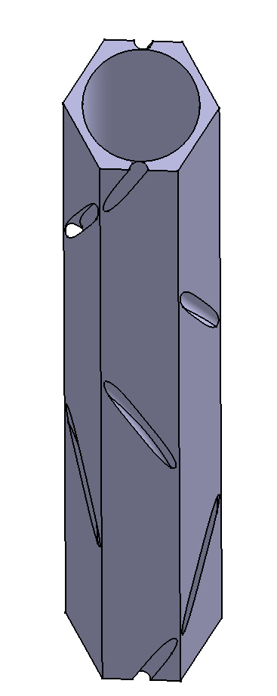
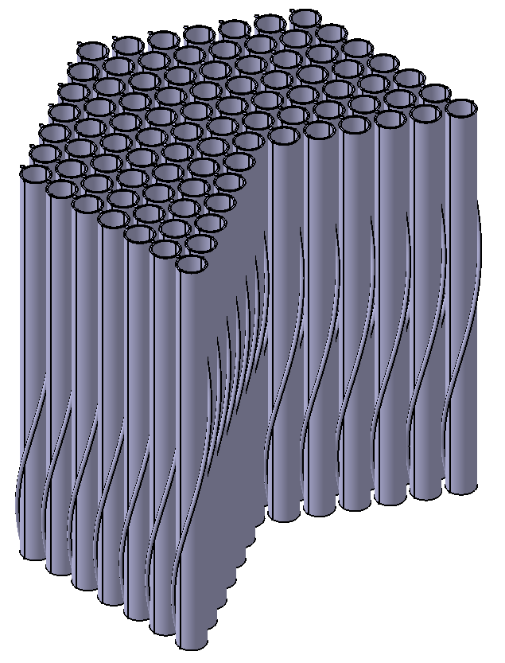
Geometry model of fuel assembly
Cell model
Modeling domain
Rod bundle
Single rod

Slide 18


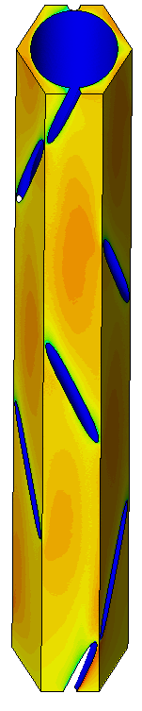

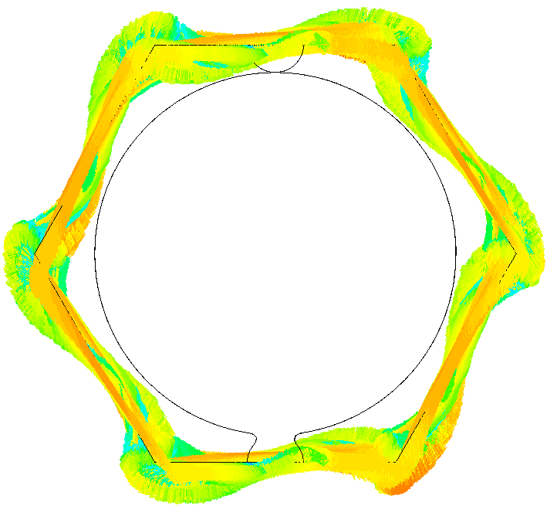
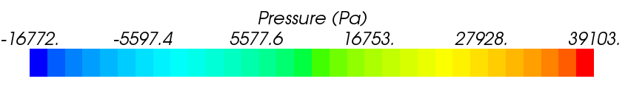
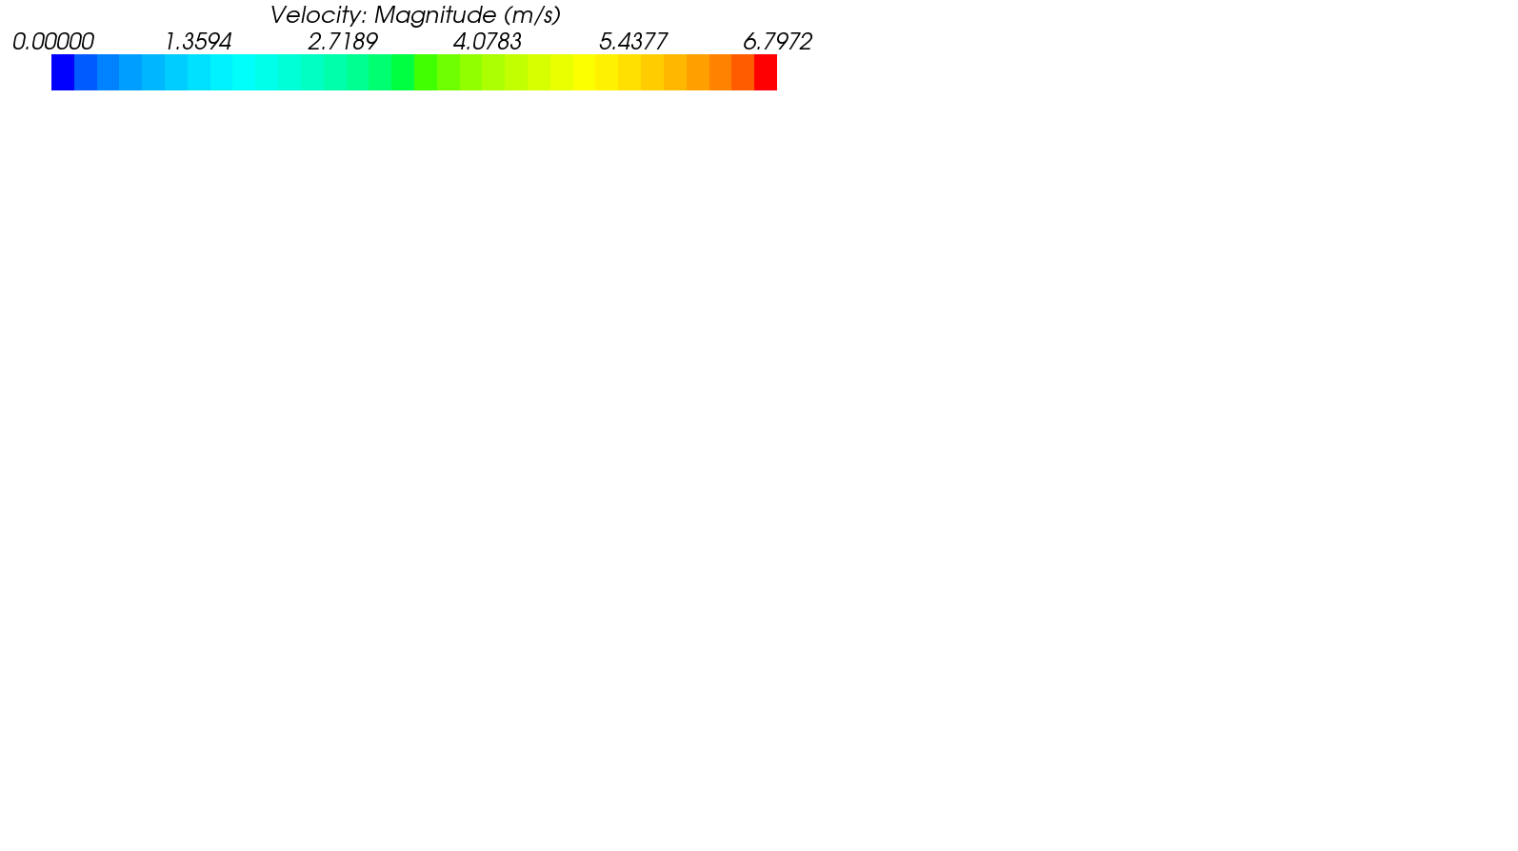
Model results
Coolant velocity field
Computational grid

Slide 19
Multiphase CFD
The following methods are developing for solving MCFD problems
  Multiphase model with the turbulence models and closing equations;
  Direct numeric simulation methods with the explicit interphase boundaries (to account for the surface tension and mass transfer through boudaries)
Development of experimental techniques for MCFD flows

Slide 20
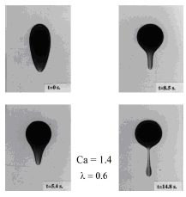
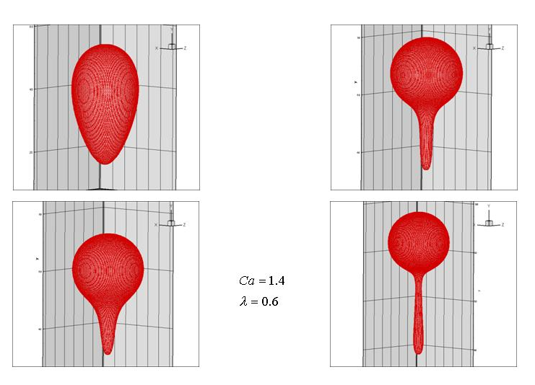
Bubble movement to the surface
Experiment
Calculation

Slide 21
Multiphase CFD development
Modeling of disperse flows (droplets and bubbles)
Modeling of gas and fluids with interphase boundary
Two phase flows

Slide 22
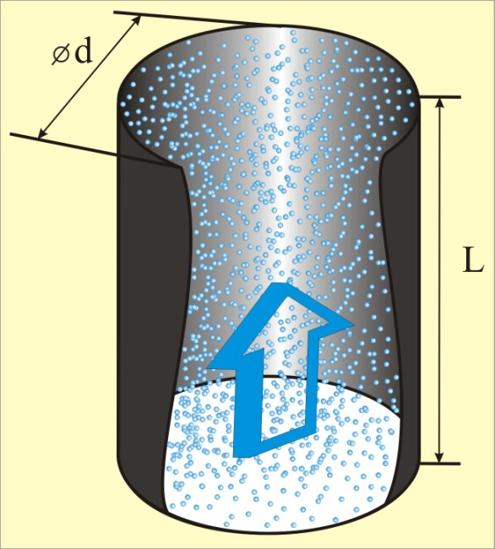
Deposition of droplets from turbulent flow in a pipe
расчет ИБРАЭ
расчет FLUENT

Slide 23
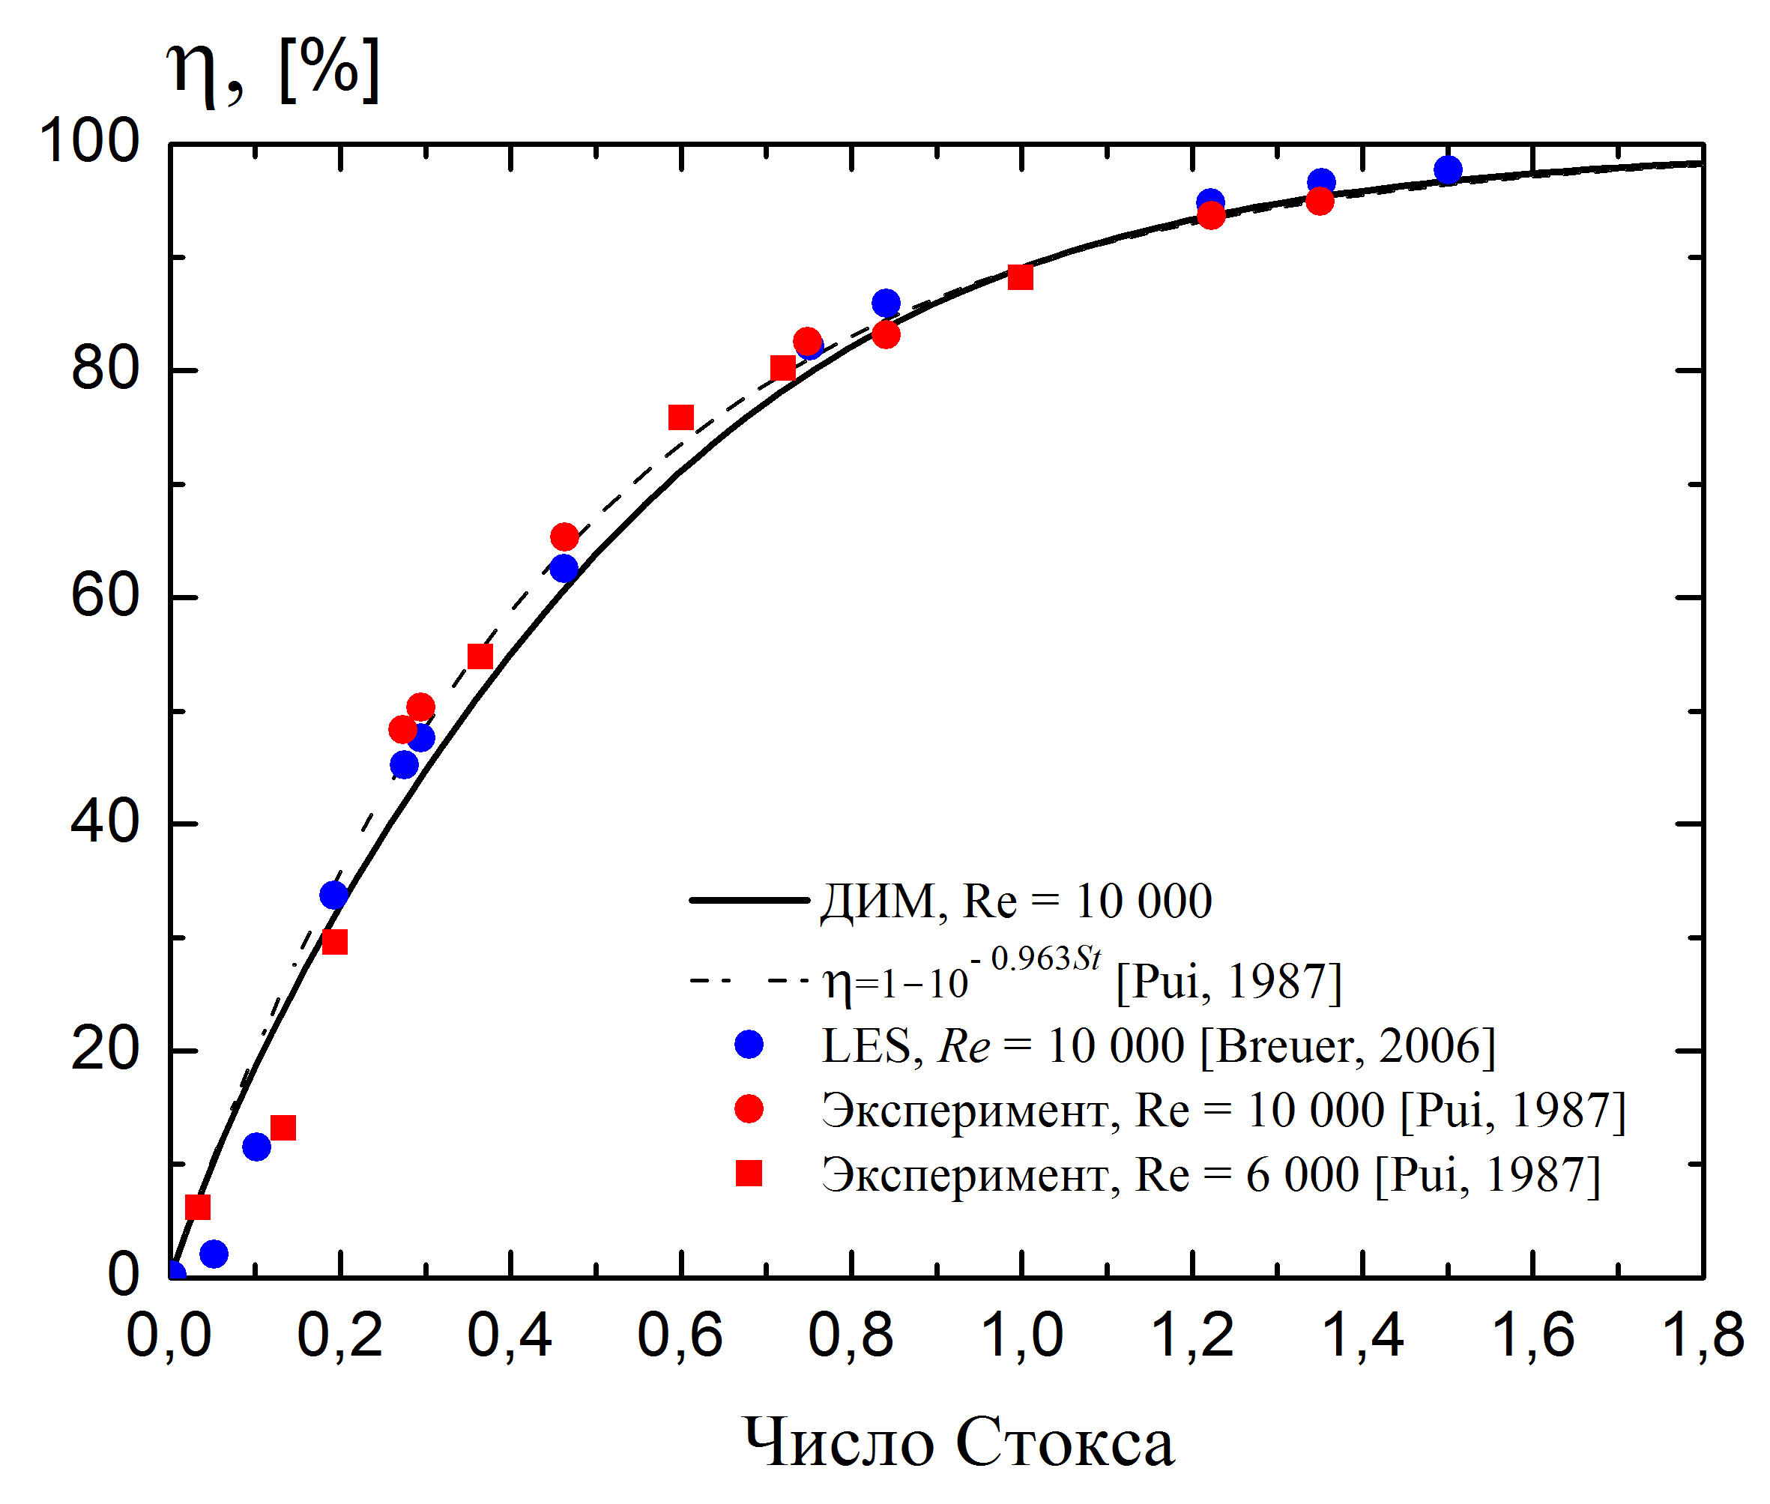
Deposition in a curved pipe
- эффективность осаждения

Slide 24
Development of the CONT computer code for prestressed concrete containment
Project goals:
  Enhancement of the operational safety of containments
  Decrease of the cost of the maintenance of the concrete prestressing system
Verification of the code
  Validation against SANDIA 1:6 scale test
  Validation against SANDIA 1:4 scale test
The code is licensed in the Rostekhnadsor of RF
Code applications:
  Safety assessments of prestressed concrete containments
  Optimization of the maintenance procedures
  Assessment of concrete containment aging accounting for rheological properties of concrete
  Implementation of containment monitoring system at Kalinin NPP

Slide 25
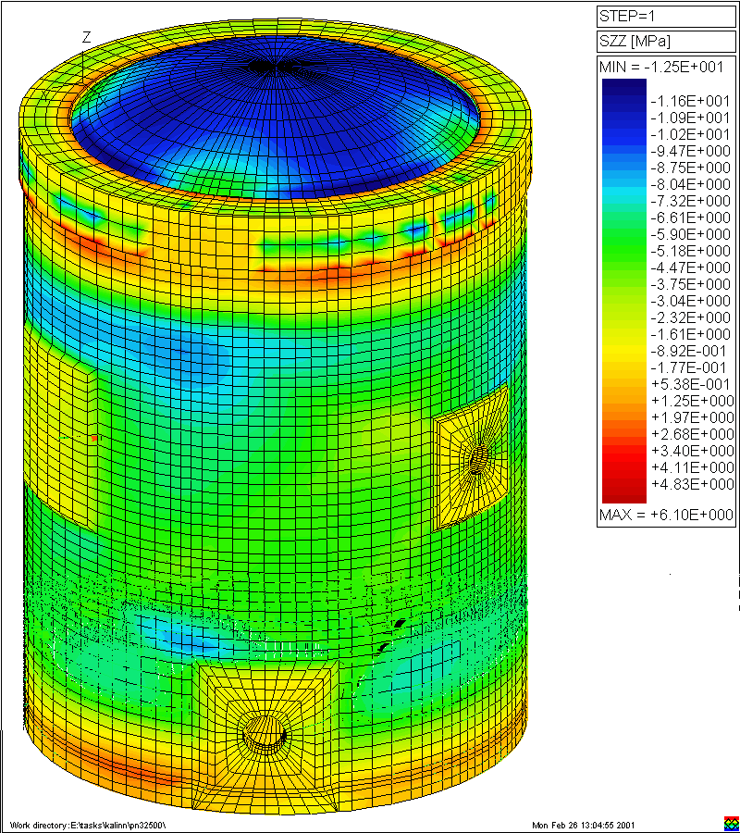
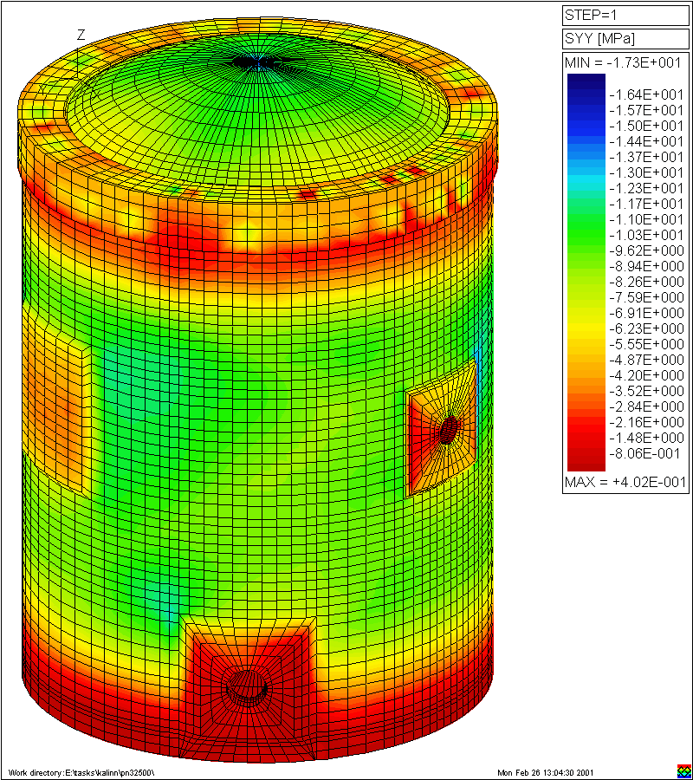
Stress distribution for Kalinin NPP
Меридиональные
Круговые

Slide 26
MELCOR Modernization project
MELCOR code has been developing since 1982
Since that time
  The computer techniques has been developing
  New programming technologies have been developed and realized in new compilers. The most important was object oriented approach to the development of large computer codes
  The understanding of physical phenomena has been significantly improved
Further development and maintenance of the code required significant efforts

Slide 27
Major objectives of the project
Develop modern approach to code organization including new memory management scheme based on the principles of object oriented programming;
Convert MELCOR code to FORTARAN 95 using advantages of the compiler such as
  Dynamic memory allocation;
  New possibilities of work with arrays;
  User defined types of data;
  Pointers for direct access to data.
Remove dated programming structures which are not recommended for use;

