Slide 1
International Science and Technology Center
Project Proposal
Thermal Hydraulics of U-Zr-O molten pool under oxidising conditions in multi-scale approach (crucible - bundle - reactor scales)
Short title: THOMAS
(Thermal Hydraulics of Oxidising Melt in Severe (↔) Accidents)
Presented by
M.S. Veshchunov (IBRAE)
Project Manager
ISTC-SAM Workshop
ISTC, Moscow
July 14, 2008

Slide 2
General Information
Leading Institution: | IBRAE, Moscow (Nuclear Safety Institute of Russian Academy of Sciences)
Duration: Commencement: | 3 years
Total cost: | $ 310 000

Slide 3
Non-CIS Collaborators
FZK | Forschungszentrum Karlsruhe GmbH | Germany Karlsruhe
ITU | European Commission Joint Research Centre Institut für Transurane | Germany Karlsruhe
IRSN | Institut de Radioprotection et de Sûreté Nucléaire | France Cadarache
CEA | Commisariat à l’Energie Atomique | France Cadarache
IVS Trnava | Inžinierska výpočtová spoločnosť Trnava, s.r.o., | Slovak Republic

Slide 4
Project Objectives
On the base of analysis of available test data from small - and large - scale experiments, to develop a mechanistic description of U-Zr-O molten pool behaviour in oxidising conditions.
For this purpose, to carry out a tight coupling of the two advanced numerical tools developed within the previous Project #2936: the SVECHA physico-chemical (molten pool oxidation) model and the 3D thermo-hydraulic code CONV.
This will allow extension of thermal hydraulic consideration of oxidised melt from small scales (crucible tests) up to a large scale (reactor pressure vessel), including an intermediate scale corresponding to molten pools in bundle tests.
As a result, improved interpretation of the Phebus FP bundle tests observations of corium melt oxidation, as well as transposition of thermal hydraulic consideration from test to reactor scale, are foreseen.

Slide 5
Project Priorities
In accordance with SARNET Evaluation of Severe Accident Research Priorities:
The core and debris coolability (rod failure, molten pool formation, molten pool and debris cooling, crust failure) and thermal-hydraulics within particulate debris during reflood (which can potentially terminate the core degradation and stop the accident), is ranked as high priority
The details of in-vessel melt pool behaviour are preconditions for possible in-vessel melt retention considerations. The in-vessel melt retention aspects and the improvement of the predictability of the thermal loading are a matter of high priority and special interest for BWR and reactors with low power density (e.g. VVER-440), and of medium priority for large PWR and VVER reactors.

Slide 6
Interconnection of the Project with the other Projects
EC Projects
ISTC Project
“THOMAS”
SARNET (6th FP)
SARNET-II (7th FP)
SVECHA code
Physico-chemical model for molten pool oxidation (small scale)
PHEBUS FP
CONV code
Thermo-hydraulics of molten pool
in the lower head
of the RPV
RASPLAV
MASCA
LIVE (FZK)

Slide 7
Experimental observations
Non-destructive and destructive post-test examinations of bundles in various tests showed formation of molten pools of different scales at various stages of core degradation:
  small local pools in CORA and QUENCH test bundles.
  extended molten pool in a central zone of the Phebus FP test bundles (similar to TMI-2).
In the late stage of a severe accident, melt relocates into the lower head of the reactor pressure vessel and forms a large molten pool.
Oxidation kinetics of melts can be significantly higher in comparison with that of solid materials, therefore, it strongly determines heat and hydrogen source terms during severe accidents (QUENCH tests). On the other hand, the oxidation kinetics strongly depends on thermal hydraulic behaviour of oxidised melt.
Therefore, investigation of in-vessel molten pool behaviour under oxidation conditions is still an important issue with respect to core degradation and reactor pressure vessel coolability and failure analysis.

Slide 8
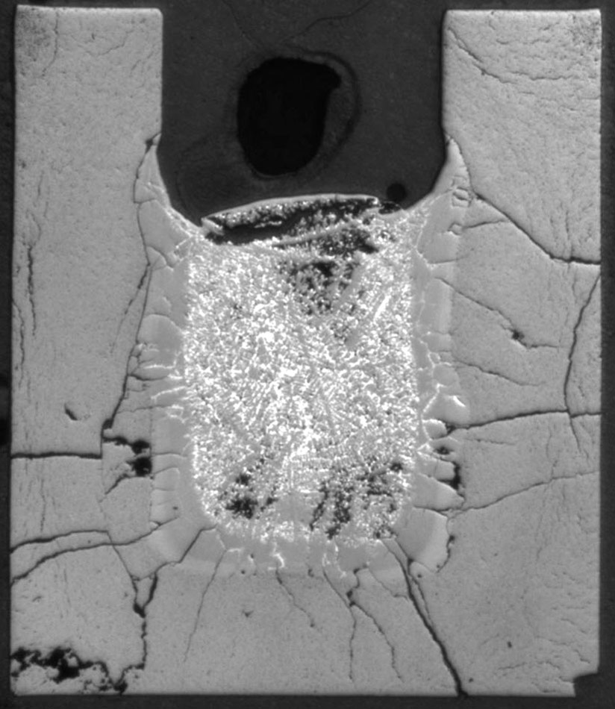
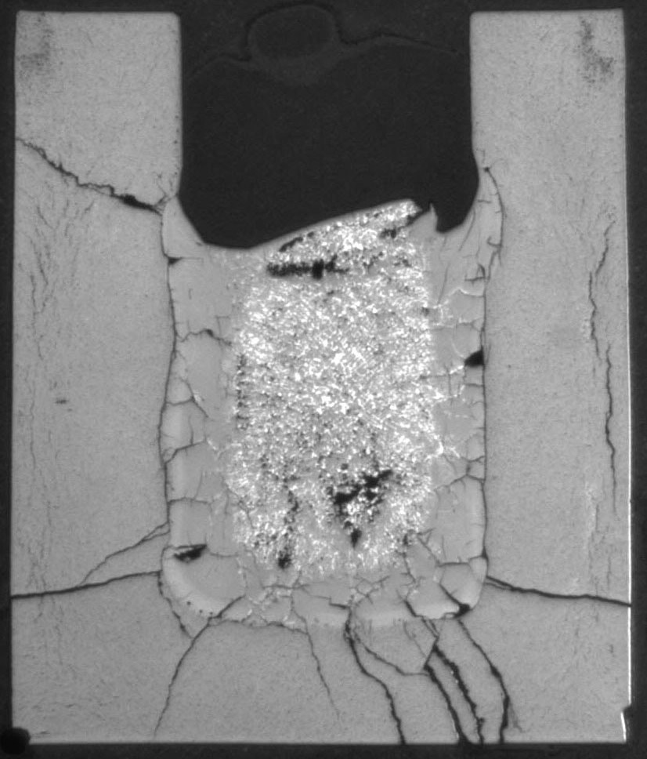
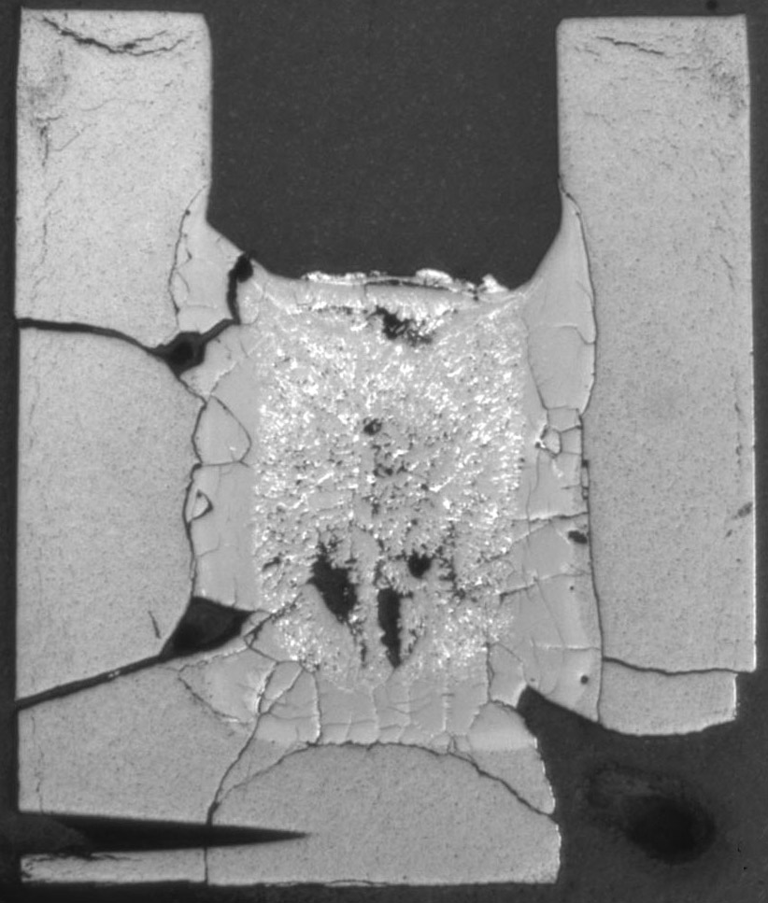
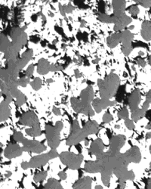
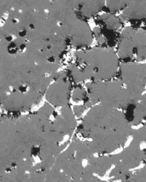
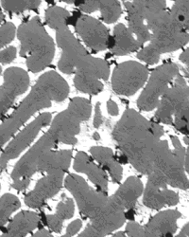
FZK short-term crucible tests (1/2)
Zr melt interactions with ZrO₂ crucible walls (J.Stuckert)
T=2200ºC
.
t =10 min.
t =15 min.
t =25 min.
Zr:O= 42:58
Zr:O= 39:61
Zr:O= 37:63

Slide 9
FZK short-term crucible tests (2/2)
t =10 min.
t =15 min.
t =25 min.
Zr:O= 42:58
Zr:O= 39:61
Zr:O= 37:63
T=2200ºC

Slide 10
SVECHA model for U-Zr-O melt non-equilibrium oxidation / dissolution
.
Melt saturation under isothermal conditions
Section of quasi-binary phase diagram
Spatial distribution of temperature and oxygen concentration

Slide 11
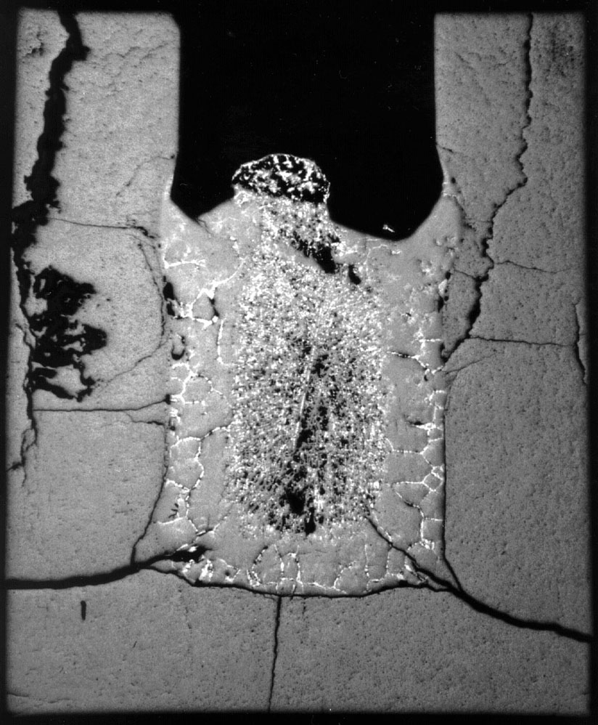
Simulation of short-term FZK crucible tests
10 min.
20 min.

Slide 12
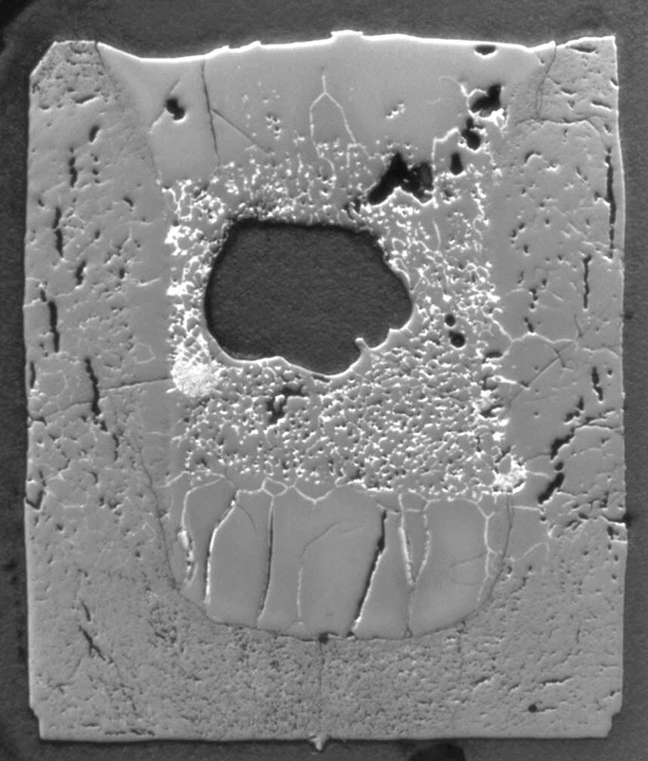
FZK long-term crucible tests
Oxide crust
Ar
Zr-O
ZrO₂
20 min.
<<
290 min.
Main observations
Dissolution of ZrO₂ walls in the initial stage of interactions (erosion)
Subsequent growth of oxide crust at the melt-walls interface (corrosion)
Secondary dissolution of oxide crust on the walls in the late stage
Heavy precipitation of the ceramic phase in the oxidised melt
Growth of oxide layer on the free (non-oxidised) surface of melt (!)

Slide 13
2-dimensional model for melt oxidation / dissolution
“Hot” vertical and “cold” horizontal surfaces:
ΔT^{(r)} > 0 and ΔT^{(a)} < 0
Temperature and concentration distribution at hot and cold surfaces in saturated melt
Heat and diffusion fluxes at hot and cold surfaces in saturated melt
For consideration of various temperature conditions at different interfaces of melt, an extension of the previously developed 1-d model by coupling of flux matches at various interfaces and total mass balance has been carried out.

Slide 14
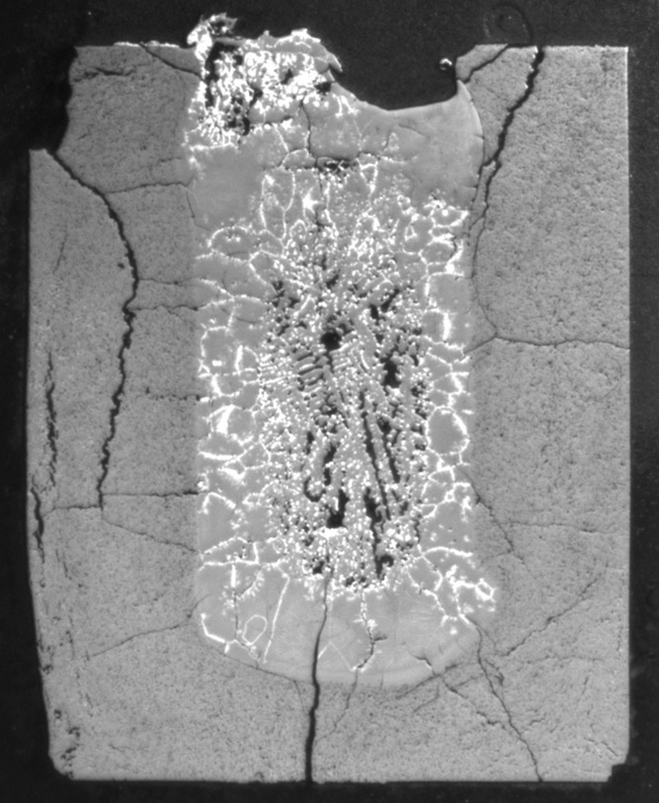
Simulation of long-term FZK crucible tests
200 min.
290 min.

Slide 15
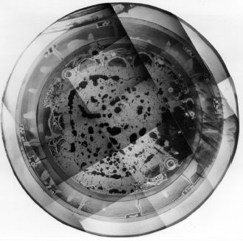
Interpretation of melt oxidation in Phebus FP tests with 2-d model
Quick dissolution of fuel rods and oxidation of molten pool, ≈ complete conversion into ceramic phase (crust + precipitates) on cool-down
Ceramic crust
Ceramic phase precipitation (up to 100%)
Post-test macrograph of (U,Zr)O₂ ceramic corium (molten pool)
Evolution of molten pool layers during transient

Slide 16
Simulation of molten pool oxidation in new (proposed) crucible tests (1/3)
Proposed crucible isothermal tests with “cold” ceramic walls and “hot” free oxidizing surface with inductive heating of metallic melt should model molten pool (MP) oxidation in the lower head of the (cooled) reactor vessel
tests at the LAVA facility (FZK) is under preparation
Oxide crust
Steam
Steam
Oxide crust
Zr-O
ZrO₂
Molten corium
Lower head

Slide 17
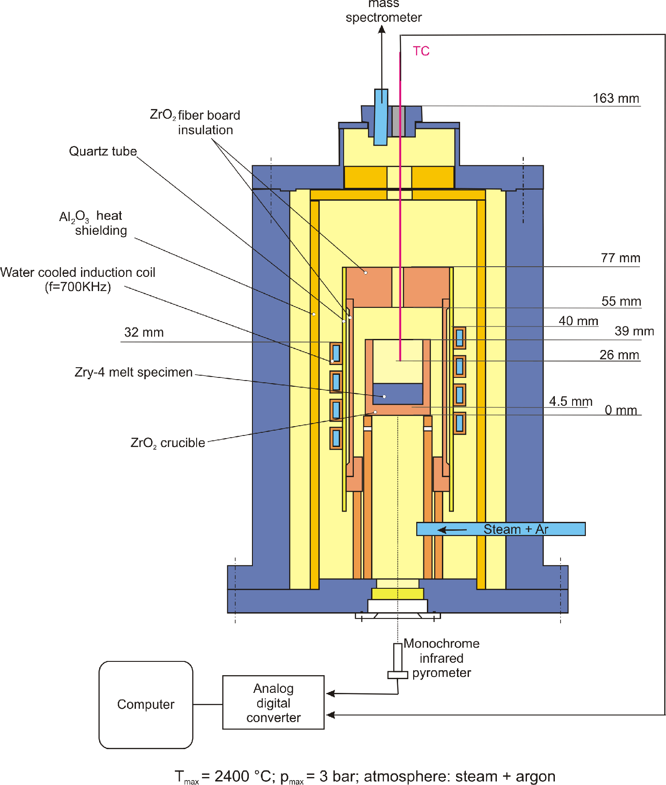
LAVA Test Apparatus at FZK

Slide 18
Simulation of molten pool oxidation in crucible tests (2/3)
.
2-d model predictions for “cold” ceramic walls (ΔT_{w} < 0) and “hot” free surface (ΔT_{up} ≥ 0) at the MP temperature 2540K
ZrO₂ crucible parameters: R = 36.5 mm, h = 10 mm, wall thickness 7 mm.
Charge is produced from the mixture of metallic Zr and ceramic ZrO₂ phases with the average atomic composition Zr:O = 2.7:1.

Slide 19
Simulation of molten pool oxidation in crucible tests (3/3)
.
Large crucible
High temperature (2770K)
ΔT_{up} = 0
Large crucible
U-Zr-O melt
ΔT_{up} = 0
Complete oxidation: ≈ 4000 s
Complete oxidation: ≈ 8000 s
Conclusion: owing to quick stabilisation of oxide crust thickness at the melt/steam interface, the total kinetics of melt oxidation obeys (close to) linear (rather than parabolic) time law

Slide 20
Main results of the 2-d melt oxidation model validation
The model correctly describes the main observations of the FZK crucible tests:
Dissolution of ZrO₂ walls in the initial stage of interactions
Growth of oxide crust at the melt / walls interface
Secondary dissolution of oxide crust in the late stage
Growth of oxide layer on the free (non-oxidised) surface of melt
Heavy precipitation of the ceramic phase in the oxidised melt
The model predicts:
Growth of oxide crust on “cold” non-oxidized free surface of melt in new crucible tests.
The total kinetics of melt oxidation obeys a (close to) linear (rather than parabolic) time law, owing to quick stabilisation of oxide crust thickness at the melt/steam interface.
This prediction about growth of ceramic crust on cold walls can be (qualitatively) extended to molten pool oxidation in RPV.

Slide 21
Molten pool oxidation in lower head of reactor vessel (1/2)

Slide 22
Molten pool oxidation in lower head of reactor vessel (2/2)
Model predictions
On the base of the 2-d MP oxidation model simulations of melt oxidation in simplified crucible tests, the following conclusions can be derived:
In oxidizing atmosphere the oxide crust growth will take place on internal side of the walls accompanied with (possible) precipitation of ceramic phase in the melt bulk.
After relatively quick attainment of steady-state conditions with oxide crust thickness of several mm (≈ 0.1 d_{wall}):
  cooling of the MP through walls can be significantly suppressed;
  the MP temperature will further increase;
  possible corrosion (oxidation) and/or melting of a thin metal layer at the interface between the oxide crust and the wall can occur.
In the lack of detailed thermal hydraulic consideration, the main model predictions can be extended to large scales (RPV) only qualitatively.
For quantitative predictions the model should be coupled with the thermal-hydraulic code CONV

Slide 23
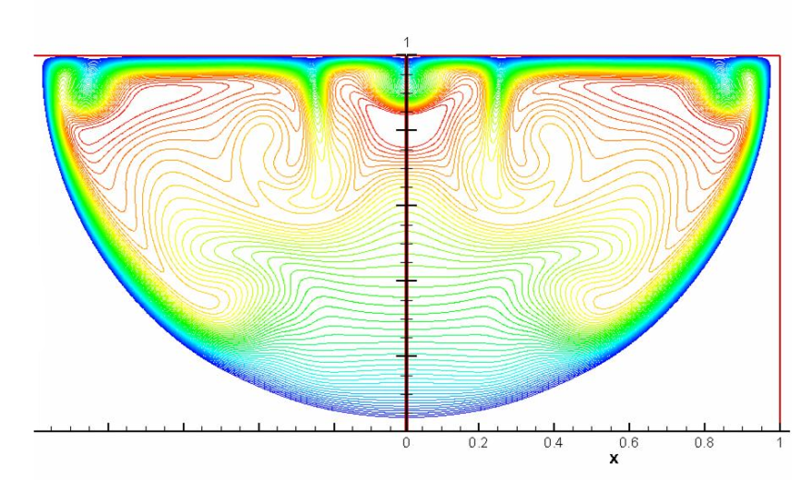
CONV Code
Main results from ISTC Project #2936
2D and 3D unified thermal hydraulic technique for simulation of multiphase processes in complex domains of convectively stirred melt in a wide range of parameters (Ra < 10¹⁶ and Re ≈10³-10⁴)
DNS (Direct Numerical Simulation) and LES (Large Eddy Simulation) modelling approach to turbulent flows in the large-scale thermal hydraulic problems
Simulation of phase changes in pure materials and binary alloys validated against tests on pure gallium melting
Extensive validation against experimental data, including experiments with a heat generating fluid such as LIVE, COPO, SIMECO
Numerical predictions
Isotherms
Temperature profile. Ra=10¹⁰

Slide 24
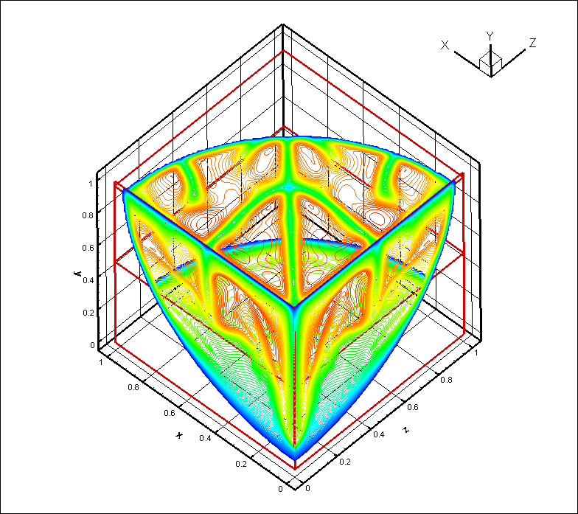
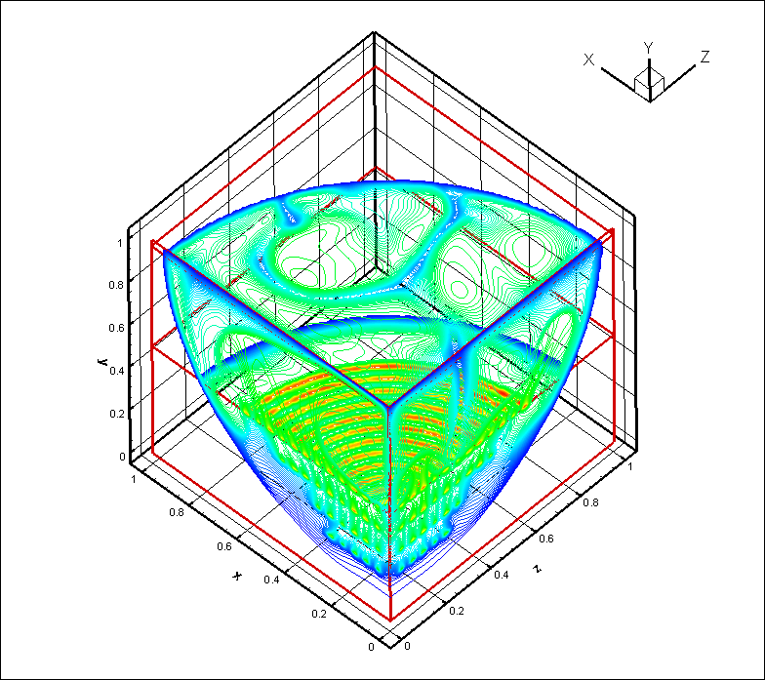
Analysis of LIVE Tests Conditions
Comparison of uniform and circular heating
Uniform heat: Ra=10⁹
^{3d temperature field}
Nu vs Ra at different heating conditions
Comparison with correlations of M. Sonnenkalb (Proc. of Workshop on Large molten pool heat transfer, Grenoble, France, 1994)
Circular heat: Ra=10⁹

Slide 25
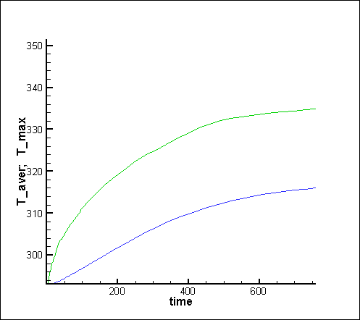
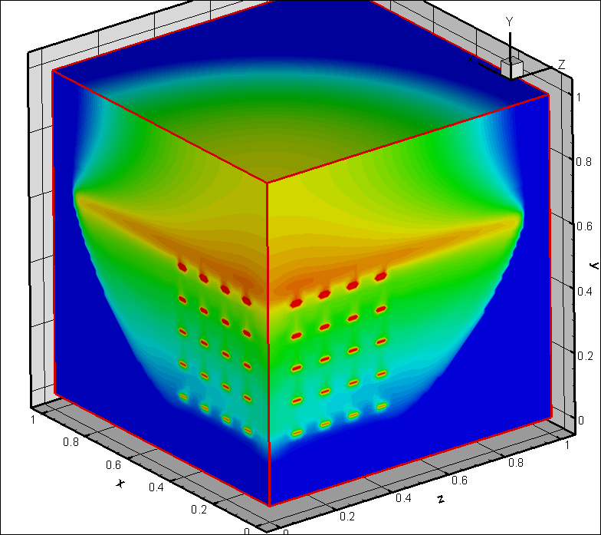
Preliminary LIVE calculations
Adiabatic top boundary,
Isothermal side boundary, 273 K
Circular heating –– 3 kW (in ¼ domain)
Average and maximal temperatures
Melt level =0.7
Air level = 0.7÷1
3d hemispherical domain
Isotherms

Slide 26
Conclusions (1/2)
The advanced physico-chemical model for molten pool oxidation (coupled with the fuel pellet dissolution model) under non-equilibrium conditions of SA was developed in the SVECHA code within the ISTC Project #2936 in collaboration with European partners of the SARNET Project (JRC/IE, FZK).
Further improvement of the molten pool oxidation model on the base of new crucible tests (e.g. at PLINIUS Corium Platform) is foreseen in the new ISTC Project THOMAS in close collaboration with SARNET participants (FZK, CEA, ITU).
The main deficiency of the SVECHA approach is oversimplification of the thermal-hydraulic description of the convectively stirred melt (reasonable for crucible tests): the main thermal hydraulic characteristics of the convectively stirred melt are taken into consideration using simple correlations for the mass transfer coefficients at the oxide/melt interface.
For large scales this deficiency can be overcome by tight coupling of the new molten pool oxidation model with the thermal hydraulic code CONV.

Slide 27
Conclusions (2/2)
The thermo-hydraulic code CONV initially designed in the frameworks of RASPLAV and MASCA Projects was strongly advanced in the ISTC Project #2936 for simulation of multiphase processes in complex domains of convectively stirred melt. The code already includes simplified models for simulation of phase changes and micro-segregation in binary alloys and is ready for implementation of the more advanced physico-chemical model.
The modified code will be verified against available experimental data (e.g. molten pool in Phebus FP tests) and applied to the analysis of the physico-chemical behaviour of molten pool in the reactor pressure vessel. The solution of this task will be complementary to the LIVE project in FZK, and thus will provide analytical support to the LIVE tests.
The developed and verified models will be further used for benchmarking and improvement of simplified models of various system codes such as ICARE/CATHARE, ASTEC in collaboration with SARNET participants (e.g. IRSN) and Russian severe accident code SOCRAT.

