Slide 1

NITI Proposals for
Task 2 tests of the EVAN Project
A.P. Alexandrov Research Institute of Technology
Presented by S. Bechta
1st EVAN Meeting

Slide 2
Task 2. Study FP release from a molten pool
Objectives
Determine rates of low-volatile fission products release (FPR) from
molten pool of prototypic corium
Quantify the sensitivity of release rates to the oxygen potential of the
above-melt atmosphere
Determine aerosols’ characteristics
Simulants of radiologically relevant fission products for a late phase of the severe accident: stable Sr, Ba, Ce, La, Mo, Ru
Experimental data application
Verification of models describing FPR into the atmosphere
of the primary circuit/containment
Analysis of phenomena, which set conditions for source term

Slide 3
Methodology
Main tests:
- medium-scale tests with chemically prototypic molten corium (~2 kg),
- power deposited in the melt is simulated by the melt induction heating in a cold crucible (IMCC),
- flow method for release rate determination
Illustration of an analytical system used in the LPP project
1. Shielded box. 2. Metallic bottom.
3. Molten corium. 4. Inductor. 5. Cold crucible. 6. Quartz tube. 7. Cooled cover.
8. Start-up medium area filter (MAF).
9. Side port of the cover. 10. Vacuum pump.
11, 19, 20, 37. Regulating valves.
13. Analytical line rotameter.
12,25. Roll-blade flow meter.
14. Pressurized gas tanks (air, nitrogen). 15,16,24,34. Pressure sensors.
17,26,27,31,35. L thermocouples.
21. Analytical filters F1 (AFA).
22. Medium-area filters F2 (MAF).
23. Three-way cock. 28. Vibrator.
29. Analytical line. 30. Main line. 32. Cyclone. 33. Large-area filter F3 (LAF).
38. Disposable specimen holder.
39. Disposable module.

Slide 4
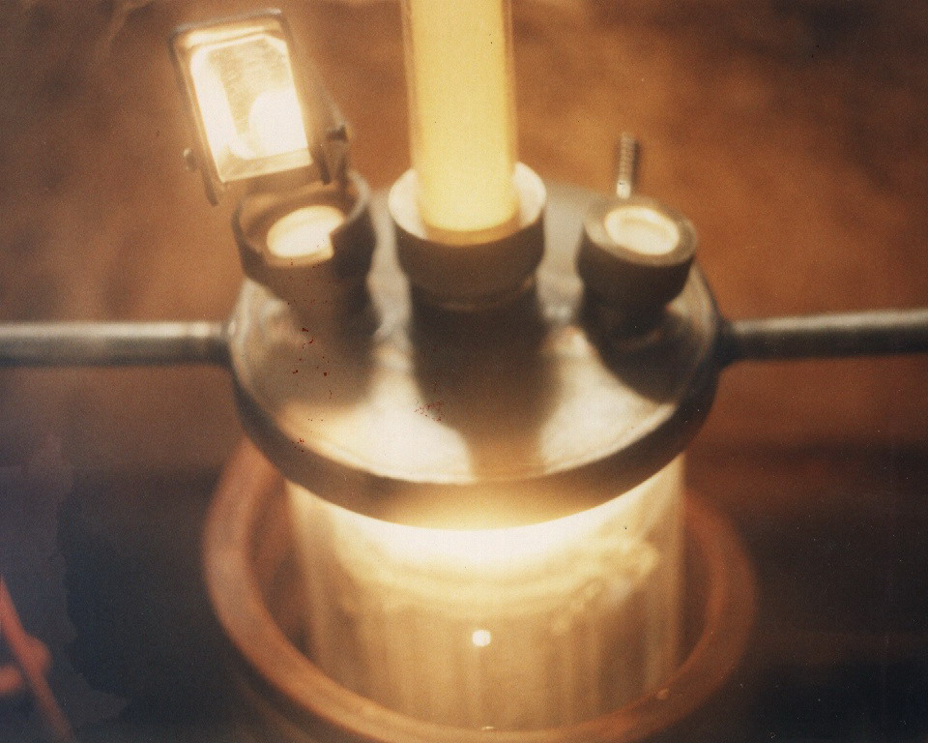
View of IMCC furnace with connected sampling line

Slide 5
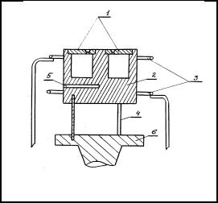
Methodology (2)
Supportive analytical tests performed at the ISC RAS:
Determination of the FP partial pressures above the corium microspecimens in vacuum
Differential mass-spectrometry – a version of the Knudsen method
Coupled Knudsen chamber of isothermal effusion
1 - covers with effusion ports
2 - molybdenum crucible
3 - cathodes
4 - holders
5 - pyrometric port
6 - plate

Slide 6
Methodology (3)
Methods of aerosol posttest analysis:
Weight analysis is used for determining the mass of aerosols
collected on the analytical filters installed in the gas-aerosol
sampling system, and aerosol transport losses in furnace
components and lines
Elemental and phase composition of aerosols is determined by
the ICP MS, XRF, SEM/EDX, XRD and various methods of
chemical analysis
Particle size distrtibution is measured using the method of the
small-angle light scattering, optical and electron microscopy of
filters and substrates

Slide 7
Experimental matrix for Task 2 of EVAN Project (Phase 1)
Test procedure
Start-up mode – melting and homogenization of C-32 molten corium pool in
argon, with the surface temperature T_{liq}+(50÷100)C. Melt sampling
Switching from the start-up aerosol line to the one of working regime
Aerosol sampling mode for 30 min during evaporation of molten C-32
Feeding of the argon-oxygen mixture into the furnace at a constant flow rate.
Sampling regime for approximately 60 min during the melt C-32 to C-100
transition
Melt sampling
Aerosol sampling mode for 30 min during evaporation of molten C-100
HF heating disconnection
Installation disassembly, preparation of aerosol and ingot samples for
analytical tests and posttest analysis

Slide 8
Questions for discussion
Content of FPS in the charge
It is proposed to use the same content as in MASCA (mass %: La₂O₃ - 0.59, CeO₂ - 0.61, BaO - 0.56, SrO - 0.59, Mo - 0.5, Ru - 0.5) for the comparison of the results
Forms of the FPS put in the charge
It is proposed to introduce Mo and Ru in the form of metals, and other FP as oxides (SrO and BaO will be sintered with ZrO₂ )

