Slide 1
FSUE SRI SIA “LUCH”
IBRAE RAS
FSUE EDO “GIDROPRESS”
ISTC project #3690: Results of PARAMETER–SF3/SF4 pre- and post-test numerical modelling
Presented by D.Tomashchik
IBRAE RAS
16th CEG-SAM Meeting, Moscow, Russian Federation
IBRAE, Nuclear Safety Institute of Russian Academy of Science
September 8-9, 2009
Notes:
1

Slide 2
Used Codes and Participants
SOCRAT – IBRAE
ICARE/CATHARE – NSI RRC KI-IRSN
ATHLET-CD – GRS
RELAP/SCDAPSIM MOD3.2 (RELAP) – FSUE EDO “GIDROPRESS”
MAAP4 – EdF
SCDAP/RELAP/IRS (RELAP/IRS) – PSI
PARAM-TG – FSUE SRI SIA “LUCH”
Notes:
2
2

Slide 3
Codes Capability
Code | Oxidation in Air
 | Heat of reaction | Kinetic
SOCRAT | √ | as in steam
ICARE/CATHARE | √ | √
ATHLET-CD | √ | √
MAAP4 | √ | √
RELAP/SCDAPSIM | - | -
SCDAP/RELAP/IRS | √ | √
Notes:
3

Slide 4
Objectives and Tasks (1)
Agreed at PARAMETER meeting in July 2008 SF4 considers as approximate counterpart of QUENCH-10
Stages:
Pre-oxidation
Cool-down
Air ingress
Bottom quench

Slide 5
Objectives and Tasks (2) Key states
Proposed by J.Birchley, Approved at FZK Meeting on 1 September 2008
Pre-oxidation in steam at ~1200ºC → oxide layer 300(…400) μm
Decrease power → reduce temperature from 1200ºC to 900ºC
Switch from steam to air
Target temperature before flooding onset ~1750ºC

Slide 6
Objectives and Tasks (3) Requirements
Long period of oxygen starvation
Oxygen Measurement System Performance Capability of the PARAMETER Test Facility determines additional requirements to SF4 scenario:
↕
Low (<1 K/c) heat up rate
Notes:
6

Slide 7
PARAMETER SF4 test scenario (Summary)
Air flow rate: to be defined
Total Power: to be defined
Quench flow rate: to be defined
Pre-oxidation
phase duration: to be defined

Slide 8
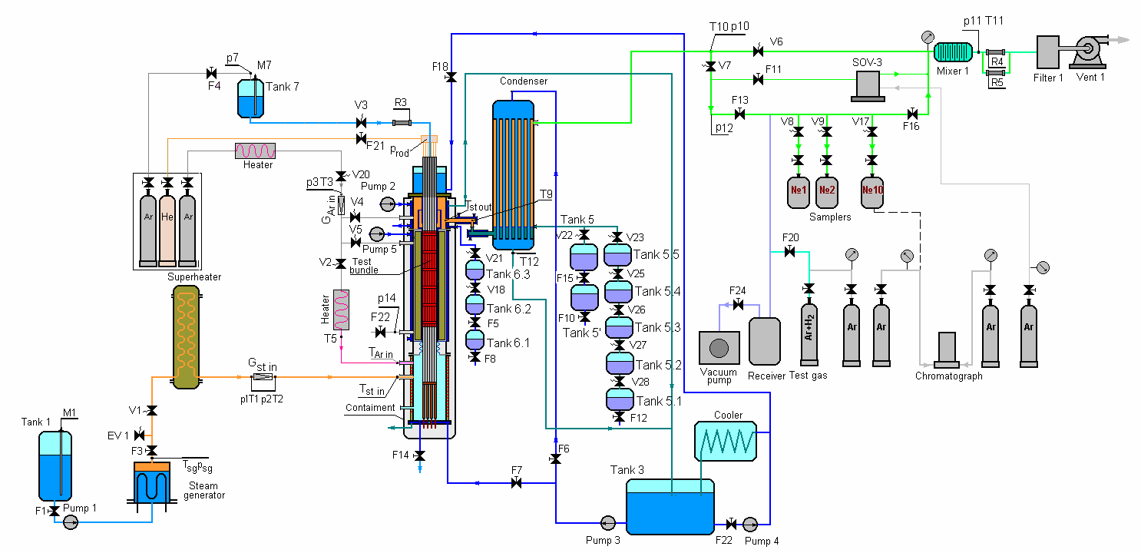
Modeling & Knowledge Problems
Lack of knowledge about air oxidation kinetic
Air-Argon Mixing in Test Section
(low flow rates ↔ technique of air injection)
Difficulty of pressure calculations at air ingress phase and during flooding
(system pressure ↔ quench flow rate)
Outlet coolant path

Slide 9
“Roadmap”
Step 1: Determination of required time period and power level for pre-oxidation phase, required power level for cool-down phase (Air flow rate = 0.8 g/s)
Analyze of acceptability the “step1” scenario
Step 2: Decreasing hot spot shift
Step 3: Heat balance analysis at air ingress phase
Step 4: Choose air flow rate (0.25…1.0 g/s)
Step 5: Estimation of heat up rate and starvation conditions at air ingress phase

Slide 10
Step 1. Boundary conditions for pre-oxidation phase
Steam flow rate 3.5 g/s
Argon flow rate 2.0 g/s
System pressure 0.35 MPa
Pre-oxidation at 1200^{O}C
Air flow rate (suggested) 0.8 g/s
Codes: RELAP/IRS,
ATHLET-CD,
SOCRAT
Starvation
60-250 s
Heat up rate
claddings >5 K/s
shroud ~30*K/s
*melting before
flooding onset
Notes:
10
10

Slide 11
Step 1. Hot spot location
RELAP/IRS 500mm
ATHLET-CD 700mm
SOCRAT 1000mm
Notes:
11

Slide 12
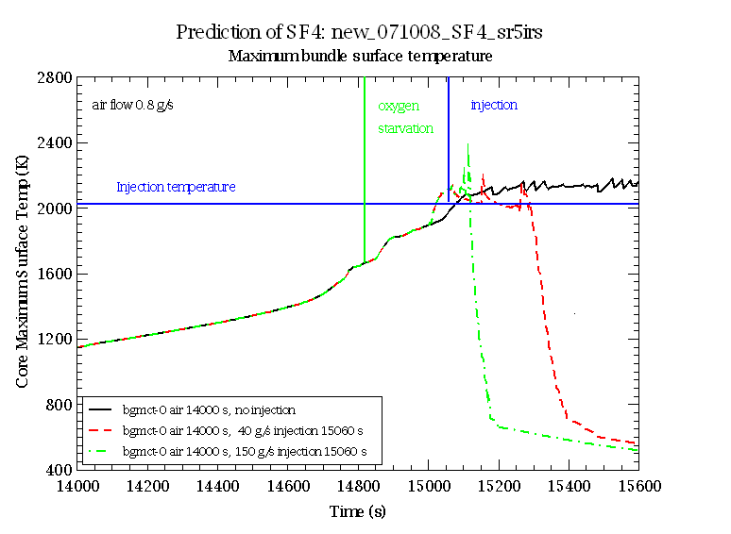
Step 1. Scenario weaknesses
Short starvation conditions (60 s –ATHLET-CD, 250 s – RELAP/IRS, 200 s- SOCRAT)
Too high heat up rate
( 30 К/s for shroud in ATHLET-CD run,
10 К/s for RELAP/IRS, SOCRAT run )
Melting : shroud at 700 mm in ATHLET runs.
Quench: Melting at 150 g/s
variation runs – 40 &150 g/s
RELAP/IRS run
Notes:
12

Slide 13
Step 2. Hot Spot Shift: How to…(SOCRAT data)
Decrease hot spot shift ↔ Redistribute axial bundle oxide thickness
No influence of reduced steam flow rate on ZrO2 axial profile at 1200^{O}C
Notes:
13

Slide 14
Step 2. Hot Spot Shift (ATHLET-CD,SOCRAT)
Decreasing steam flow rate
↕
bundle temperature instability
at pre-oxidation
(uncontrolled escalation)
Notes:
14

Slide 15
Step 3: Prolongate starvation period: How to…
Can we obtain heat balance in bundle?
Qchem+Qelectric≤Qcoolant+Qloss
Qchem=6.9kW per 1g air /Christine Bals/
Qcoolant=Σ Cp*G*ΔT≈400*Gar+650*Gair
Qloss ~1…1.5 kW
1.Increase Argon flow rate
2.Decrease Air flow rate
6.9*0.33+0=2.3 < 2.8=400*4+650*0.33+1.0 (0.33 g/s Air)
6.9*0.5+0=3.5 ~ 3.5=400*4+650*0.5+1.5 (0.5 g/s Air)
produced removed
Notes:
15
15

Slide 16
Step 3. Heat Balance on Air (SOCRAT)
Steam flow rate 3.50 g/s
Argon flow rate 4.00 g/s
Air flow rate 0.33 g/s
Pre-oxidation V1/V2
at different temperature
Starvation >1000 s
BUT! Ar flow rate of 4 g/s can’t be realized for technical reasons

Slide 17
Step 4. Choose air flow rate (SOCRAT data)
GRS, PSI, IBRAE:
Acceptable air flow rate =0.5 g/s

Slide 18
Proposed PARAMETER-SF4 test scenario for final calculations
No. | Stage | Main Parameters
 |  | FA temperature, C | Medium | Heating rate, K/s | Time, s
1 | Joule heating up of FA in argon flow | ∼30-400 | Argon flow rate 2 g/s at temperature 400 C |  | 0-1500
2 | FA stabilization in the flow of steam-argon mixture | 400→500 | Argon/steam flow rate 2/3.5 g/s temperature 400/500 C |  | 1500-3500
3 | FA pre-heating (transient phase I) | 500→1200 |  | 0.3 (initial), 0.1 (final) | 3500-8000
4 | FA pre-oxidation | ~1200 |  |  | 8000-14000
5 | FA cooling down (transient phase II) | 1200→900 |  |  | 14000-16000
6 | Air ingress phase | 900→1750 | Argon/air flow rate at inlet 2/0.5 g/s temperature 400/30 C |  | 16000 -
7 | Bottom flooding of the assembly (as soon as FA will reach Tmax=1750 C) | Up to saturation | Water (flow rate -80 g/s, temperature ~30 C) |  | As soon as saturation temperature will be reached

Slide 19
Final PARAMETER SF4 pretest calculations
Boundary condition

Slide 20
Final SF4 pretest calculations (1)
Notes:
20

Slide 21
Final SF4 pretest calculations (2)
Notes:
21

Slide 22
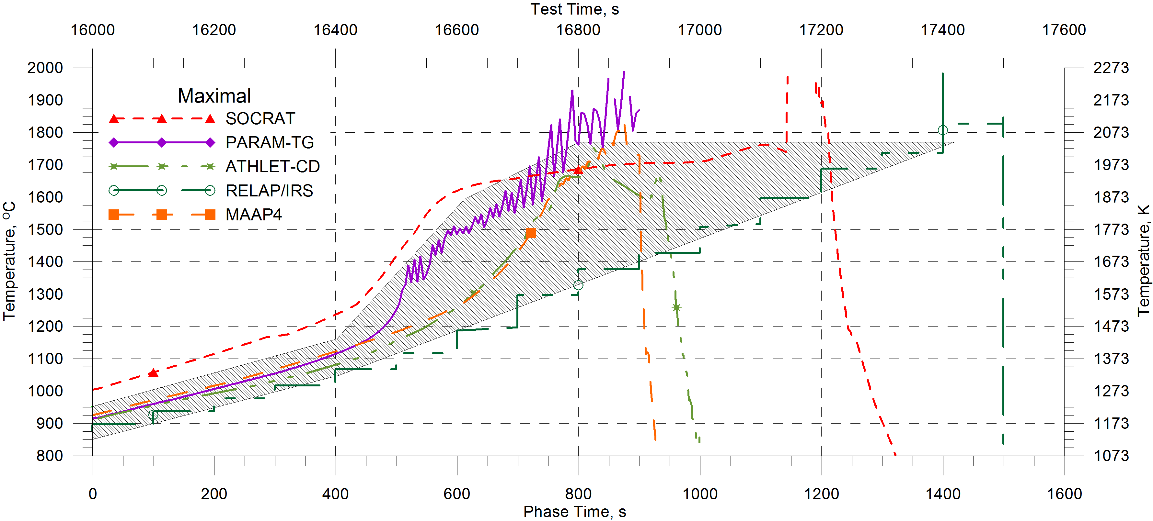
Temperature Evolution at Air Ingress Phase
T<1200^{O}C → predicted heat up rates
T>1200^{O}C → heat up rates 0.5…2K/s
Code | Starvation onset, s / Temperature, C | Starvation duration, s
ATHLET | 16640 / 1350 | 200
MAAP | 16721 / 1500 | 160
RELAP/IRS | 16750 / 1550 | 600
SOCRAT | 16560 / 1600 | 600
PARAM-TG | 16560 / 1450 | 110
Scenario seems to be acceptable
Notes:
22

Slide 23
Final SF4 pretest calculations (3)
Cladding 2 Ring Shroud Internal
Temperature profile at the end of air ingress phase /Tmax≈Ttarget-20K/
Notes:
23

Slide 24
Final SF4 pretest calculations (4)
Short term temperature increase at flooding stage
No bundle melting
Notes:
24

Slide 25
Final SF4 pretest calculations (5)

Slide 26
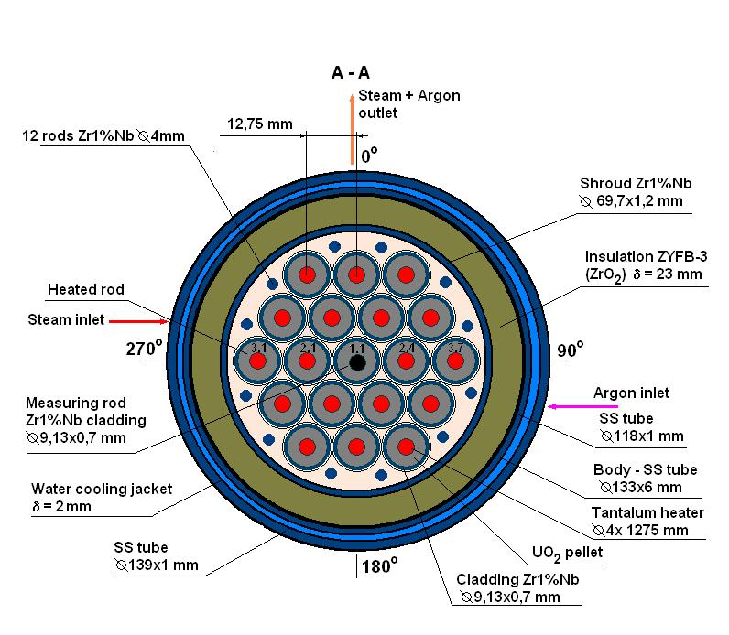
Final SF4 pretest calculations (6)
Oxygen limitation for peripheral rods & shroud
Peripheral rods melting may occur
Notes:
26

Slide 27
Hydrogen generation

Slide 28
Conclusion
A lot of runs were done to determine SF4 scenario
Pretest SF4 calculations demonstrated that both air flow rate to be 0.5 g/s at air ingress phase and electrical power to be 5.5 kW at air ingress phases are acceptable (heat up rate, starvation conditions durations, no cladding melting)
Most SFD codes predict hot spot shift to 700-500 mm.
Some codes with air oxidation models predict short term cladding escalation up to 2000C at flooding stage.
SOCRAT code predicts peripheral rods to achieve zirconium melting point at 500-900 mm at quenching stage due to oxide scale dissolution under oxygen starvation conditions. It might be connected with too lower oxidation kinetic applied, but this effect can not be excluded.
Hydrogen production at flood stage is about 5 g, but may be higher (30-60g) if bundle temperature achieves zirconium melting point

Slide 29
Acknowledgement
J. Burchley- SCDAP/RELAP/IRS (RELAP/IRS) -PSI
Ch. Bals (GRS)
E. Beuzet, J.-S. Lamy (EdF)
Notes:
29
29

