Slide 1
PARAMETER SF4 pre-test calculation with ATHLET-CD
Ch. Bals, K. Trambauer
Gesellschaft für Anlagen- und Reaktorsicherheit (GRS), Germany

Slide 2
Content
PARAMETER test facility
Rerun of PARAMETER SF2 post-test calculation as a reference for SF4 pre-test calculation (new ATHLET-CD version 2.2a)
Specification of the PARAMETER SF4 experiment and simulation with ATHLET-CD
Model parameters of ATHLET-CD
Results of PARAMETER SF4 pre-test calculation:
  Temperatures
  Quench fronts
  Hydrogen generation
  Oxide layer thickness
Conclusion

Slide 3
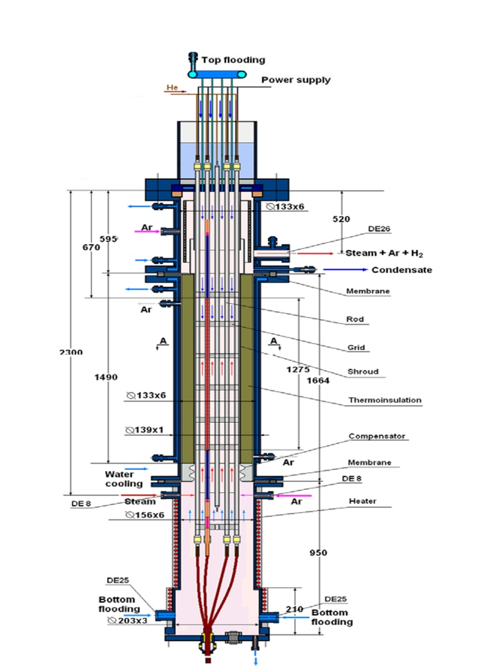
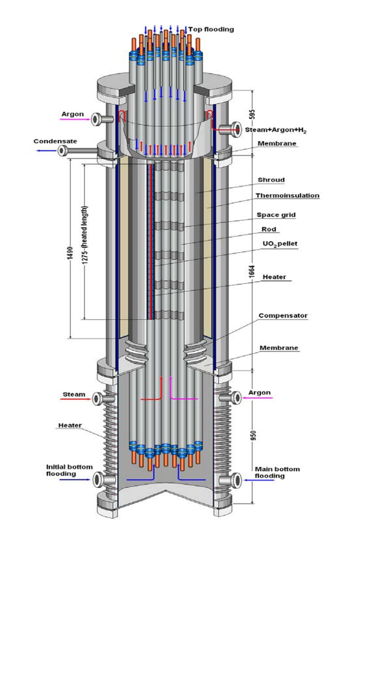
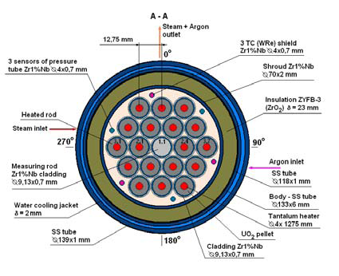
PARAMETER test facility
Layout
General View

Slide 4
Input model for PARAMETER calculations with ATHLET-CD
Flow Channels
  Central Bundle 85.7 %
  Outer Bypass 14.3 %
  Cooling Jacket
  Separate pipes for Ar and steam inlet pipes
Structures
  Rods:
  ROD1 ( 1)
  ROD2 ( 6)
  ROD3 (12)
  Grids (6)
  Shroud / Insulation
  Cooling Jacket Walls
Changes compared to previous calculations:
  Ar fill at top to switch Ar injection from bottom to top after start of reflood
  Additional structures at top of bundle (upper plate, separation sheet)

Slide 5
Rerun of SF2 post-test calculation as a validation basis for
SF4 pre-test calculation (1)
Repetition of SF2 post-test calculation
due to the use of the new ATHLET version 2.2a for calculation of SF4
Small changes in modelling have to be verified:
  additional structures at top of bundle
  switch of Argon injection to top of bundle after start of flooding
  heat transfer between shroud / insulation and jacket tube calculated by the code (previously a constant value was used)
Small differences in results compared to previous calculation
(maximum temperatures slightly reduced,
integral hydrogen production slightly lower)

Slide 6
Rerun of SF2 post-test calculation as a validation basis for
SF4 pre-test calculation (2)
Time of final quench 8s delayed compared to experiment (16628 s);
height of last quench in agreement with test data at 1250 mm;
The water discharge during quench is determined as previously
- entrained liquid at 16628 s: 4.3 kg
- totally evaporated liquid: 2.3 kg
and agrees well with discharged and condensed liquid in test of 6.5 kg
(collected in tank 5)
collected mass in tank 5

Slide 7
PARAMETER SF4 Specification and Simulation with ATHLET-CD (1)
Specification according to Jon Birchley,
(e-mail, 11.11.2008)
Power supply – temperature behavior:
- cold bundle at start of test:
25 °C at 0 s
- power initially based on SF3 specification;
adjusted to achieve max. plateau temperature
of ~1200 °C with given time function
- at 12000 s (oxide scale thickness of 300 µm
is assumed to be reached) power reduction
to 5.5 kW to reduce T_{max} to ~ 900 °C before
air injection is started at t=14000s
- constant power of 5.5 kW during air injection
phase
is switched off when max. temperature
of 1750 °C is reached;
at same time bottom injection of water is
started

Slide 8
PARAMETER SF4 Specification and Simulation with ATHLET-CD (2)
Argon inlet flow :
- constant rate of 2.0 g/s
- until start of reflood from bottom,
- then switch to upper injection
- T= 450°C
Steam inlet flow:
- 0.0 g/s until 1500 s
- 3.5 g/s until 14000s,
when air injection is started,
- T=500°C
Air inlet flow:
- 0.8 g/s (0.16 g/s O₂, 0.64 g/s N₂)
- air injection starts at 14000s
- air injection is switched off when
bottom water injection is started

Slide 9
PARAMETER SF4 Specification and Simulation with ATHLET-CD (3)
Bottom flooding is initiated as soon as T_{max}=1750 °C is reached
(together with power shut off)
Water flow rate: 80 g/s (base case)
comparison with SF2:
- top flooding: 41 g/s
- bottom flooding: 130 g/s
Variation (second case):
water flow rate: 40 g/s
Water temperature: 25 °C
Injection is finished when
T_{max} < 200°C
Bundle pressure: 3 bar
- constant boundary condition of
3 bar until end of calculation
(no realistic simulation of
condenser in ATHLET-CD calc.)

Slide 10
Model parameters of ATHLET-CD for post-test calculation of SF2 and pre-test calculation of SF4 (1)
Cladding oxidation model:
Leistikow / Prater-Courtright
correlation was used
(IOXMOD = 19)
instead of recommended Sokolov
correlation (WWER: Zr1%Nb)
(IOXMOD = 18)
Default values for interfacial friction parameters are used
1600°C
1200°C

Slide 11
Model parameters of ATHLET-CD for post-test calculation of SF2 and pre-test calculation of SF4 (2)
Electrical resistance of electrodes defined corresponding to given temperature dependency of
Mo, Ta;
Brass not considered in calculations
(below / above simulated core region)
External resistance 1 mΩ/rod
Hydraulic diameter in core region:
D_{H}=3.8·10⁻³ m (=D_{H} at grid positions)

Slide 12
Results of PARAMETER SF4 pre-test calculation
Temperatures in pre-oxidation period
(before air oxidation):
- maximum temperature is calculated
at 1250 mm elevation
- given time function for power leads to a
maximum plateau temperature of
T_{max} = 1281 °C
(expected T_{max} ~ 1200 °C);
- Temperature decrease between
12000 s and 14000 s to ~ 900 °C is
achieved as desired

Slide 13
Results of PARAMETER SF4 pre-test calculation
Temperatures (air ingress period):
- after a time period of ~ 600 s following
the start of air injection (t=14000s)
oxygen starvation can be observed at
the elevations above ~ 1000 mm
- due to oxygen starvation in the upper
bundle region the higher air oxidation
and therefore the stronger tempe-
rature excursion moves to lower
elevations;
- maximum temperature of 1750 °C
is reached at t=14666 s
at bundle elevation 700 mm

Slide 14
Results of PARAMETER SF4 pre-test calculation
Temperatures (quenching period):
- bottom flooding is initiated at 14666s
when T_{max} = 1750 °C is reached
- after start of flooding only small
temperature increase of ~ 100°C is
calculated for both flooding rates
(80 g/s and 40 g/s) when liquid enters
the heated bundle (steam oxidation)
- due to cooling only from the bottom
last quench is calculated at the upper
bundle elevations

Slide 15
Results of PARAMETER SF4 pre-test calculation
Quench fronts:
- quenching of bundle within
time period of 212 s after start of
bottom flooding for base case (80 g/s),
injected liquid until end of
quenching: 17.0 kg
- second case (40 g/s) : 367 s needed
for quenching of the bundle;
injected liquid 14,7 kg
(for comparison SF2:
top / bottom quenching within 112 s,
injected liquid until end of
quenching: 16.7 kg)
- last quench at ~ 1500 mm bundle
elevation (nearly no progress of
upper quench front)

Slide 16
Results of PARAMETER SF4 pre-test calculation
Hydrogen generation:
- Total mass of hydrogen generated:
29.4 g,
(20.2 g in bundle region)
calculated with
Leistikow / Prater-Courtright
correlation as for SF2
- Hydrogen generated during quench:
2.96 g at 80 g/s,
2.81 g at 40 g/s.

Slide 17
Results of PARAMETER SF4 pre-test calculation
Oxide layer thickness:
- oxide layer at the end of the
pre-oxidation phase has a
maximum value of ~ 450 µm
(intended oxide scale thickness
is ~ 300 µm)
- max. increase of oxide scale
during air oxidation phase ~ 110 µm
at 800 mm elevation
- a max. layer thickness of 465 µm
is reached at the end of the
calculation (1250 mm elevation)

Slide 18
Conclusions
ATHLET-CD calculates slightly higher maximal temperatures within the pre-oxidation phase than expected with the given time function for power (calculated: ~1280°C, expected: 1200°C);
the temperature decrease to 900°C within 2000 s before the start of air injection is in agreement with the desired value; the maximal temperature within the air ingress phase of 1750°C as the start point for bottom water injection is reached earlier than expected (calculated: 14666 s, expected: 15060 s)
Air injection with a rate of 0.8 g/s leads to a oxygen starvation at the positions above
1000 mm after a time period of ~ 600 s (at ~14600s, start of air injection at 14000s);
therefore the elevation of the maximum temperature moves to lower positions;
Time needed for bottom quenching: 212 s for calculation with injection rate 80 g/s, 367 s for case with 40 g/s injection rate
Total hydrogen generation is 29.4 g, about 3 g during quench
(Leistikow / Prater-Courtright correlation was used as for SF2 post-test calculation)
Oxide layer thickness at the end of the pre-oxidation phase is calculated higher than expected with the given power curve (450 µm instead of 300 µm);
oxide layer at the end of the calculation is 465 µm

