Slide 1
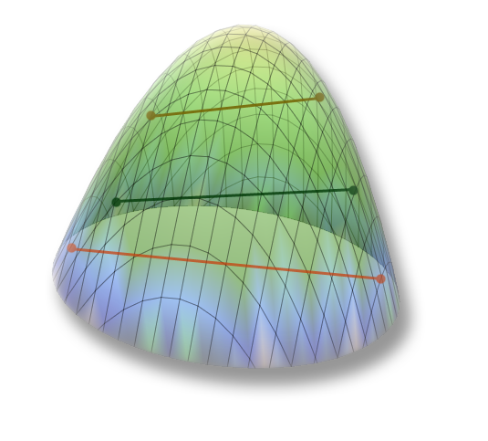

Miscibility gap in the
UO₂-FeO-SiO₂ system
A.P. Alexandrov
Research Institute of Technology
ISTC PRECOS
Project #3813
Presented by Svetlana Kirillova
5th PRECOS Meeting
ETU
Saint-Petersburg

Slide 2
Research objectives
  Miscibility gap boundaries determination
Experimental technique
  Galakhov microfurnace
  (melting, annealing, quenching)
UO₂ of >99.0 % purity, SiO₂ of 99.99% purity, FeO of >99.0 % purity,
charge mass – 150 mg
molybdenum crucibles ∅ 6 mm
2

Slide 3
First experimental series (GPRS 33-35)
Test | Content, mol.% |  |  | T, °C | Exp. time, min | Note
 | UO₂ | SiO₂ | FeO
GPRS33 | 5.0 | 70.0 | 25.0 | 1100 | 60 | Annealing
 |  |  |  | 2100 | 5 | Melting and quenching
GPRS34 | 10.0 | 80.0 | 10.0 | 1100 | 60 | Annealing
 |  |  |  | 1850 | 5 | Melting and quenching
GPRS35 | 20.0 | 73.0 | 7.0 | 1100 | 60 | Annealing
 |  |  |  | 1950 | 5 | Melting and quenching
UO₂
CORPHAD+PRECOS
CORPHAD
T_{m}=2080 °C
35
34
33
SiO₂
T_{m}=1700 °C
Fe₂SiO₄
FeO
3

Slide 4
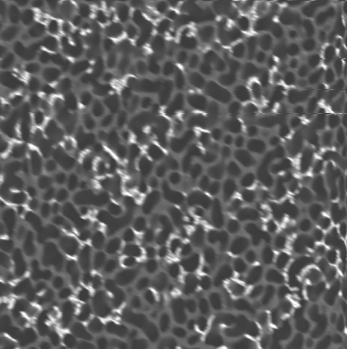
First experimental series (GPRS 33 results)
T_{m}=2080 °C
0.8
SiO₂
33
10 μm
1
2100
T_{m}=1700 °C
FeO
0
0.2
0.4
MG not detected (Above the MG)
4

Slide 5
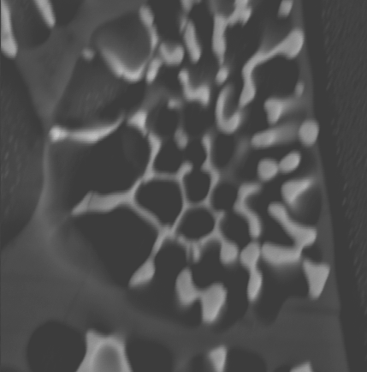
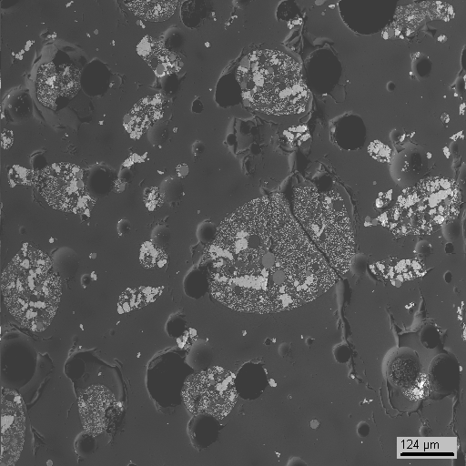
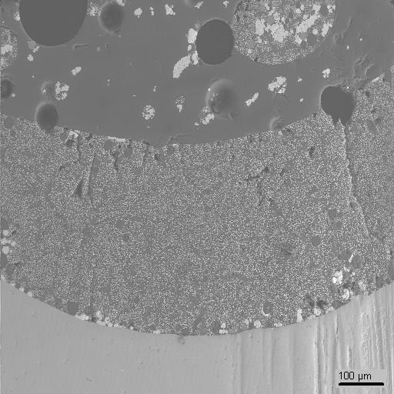
First experimental series (GPRS 34 results)
300 μm
Area 1
0.8
T_{m}=2080 °C
5 μm
34
1850
SiO₂
T_{m} < 1850 - ?
250 μm
T_{m}=1700 °C
T, °C | Type | UO₂ | FeO | SiO₂
1850 | Heavy liquid | 11.8±1.2 | 20.9±1.9 | 67.3±1.7
 | Light liquid | 4.0±0.3 | 6.6±1.3 | 89.4±1.6
T_{m} | Heavy liquid | 12.2±1.5 | 23.4±3.6 | 64.4±4.4
 | Light liquid | 1.7±0.1 | 2.8±0.3 | 95.5±0.4
<T_{m} | Area 1 | 21.3±0.7 | 10.0±0.3 | 68.8±0.4
FeO
0.2
MG detected
(macro and micro segregation)
5

Slide 6
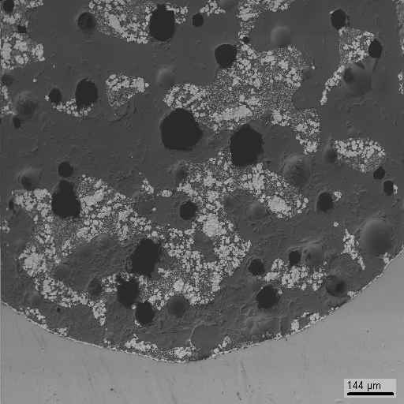
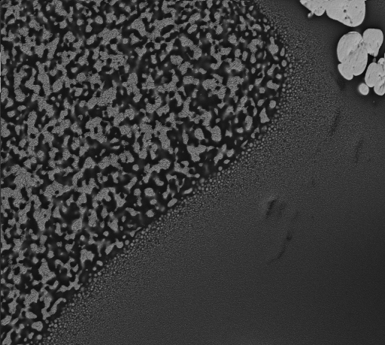
First experimental series (GPRS 35 results)
30 μm
0.8
T_{m}=2080 °C
35
< T_{m} - ?
1950
SiO₂
250 μm
T_{m}=1700 °C
FeO
T, °C | Type | UO₂ | FeO | SiO₂
<T_{m} | Heavy liquid | 20.1±8.6 | 15.0±1.8 | 64.9±6.8
 | Light liquid | 3.3±0.5 | 3.3±0.5 | 93.5±1.0
1950 | Homogeneous | 12.2±0.5 | 7.2±0.6 | 80.5±0.6
<1950 | Unhomogeneous | 8.7±1.3 | 7.3±0.9 | 84.1±1.9
0.2
MG detected
(micro segregation only)
6

Slide 7
Second experimental series (GPRS 59-64)
Test | Content, mol.% |  |  | T, °C | Exp. time, min | Note
 | UO₂ | SiO₂ | FeO
GPRS59 | 18.0 | 77.0 | 5.0 | 1100 | 60 | Annealing
 |  |  |  | 1750 | 10 | Melting and quenching
GPRS60 | 18.0 | 77.0 | 5.0 | 1100 | 60 | Annealing
 |  |  |  | 1850 | 10 | Melting and quenching
GPRS61 | 12.0 | 78.0 | 10.0 | 1100 | 60 | Annealing
 |  |  |  | 1750 | 10 | Melting and quenching
GPRS62 | 12.0 | 78.0 | 10.0 | 1100 | 60 | Annealing
 |  |  |  | 1850 | 10 | Melting and quenching
GPRS63 | 6.0 | 79.0 | 15.0 | 1100 | 60 | Annealing
 |  |  |  | 1750 | 10 | Melting and quenching
GPRS64 | 6.0 | 79.0 | 15.0 | 1100 | 60 | Annealing
 |  |  |  | 1850 | 10 | Melting and quenching
0.8
T_{m}=2080 °C
59-60
61-62
SiO₂
63-64
T_{m}=1700 °C
FeO
0.2
Research objectives: T_{m} determination, exposure answers solving,
tie lines near T_{m} determination
7

Slide 8
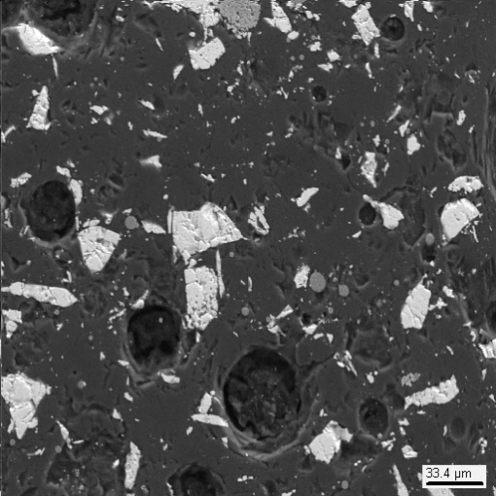
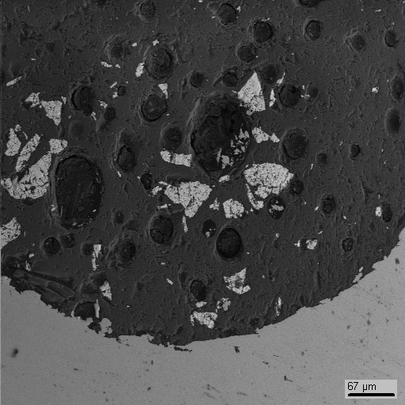
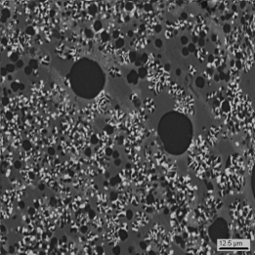
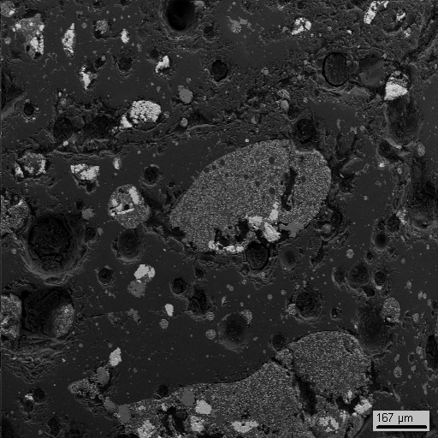
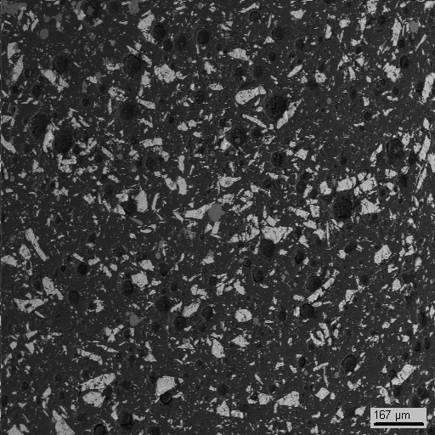
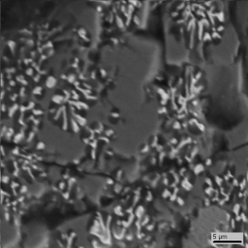
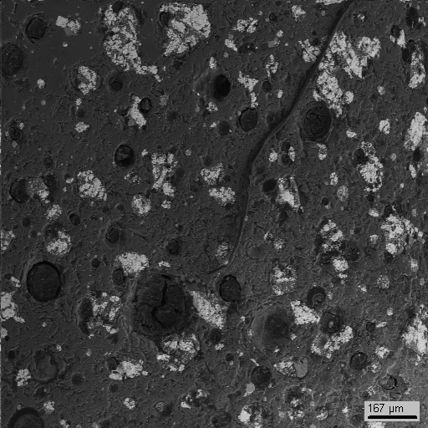
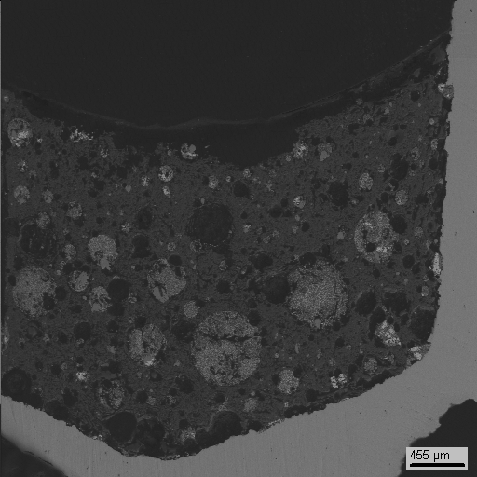
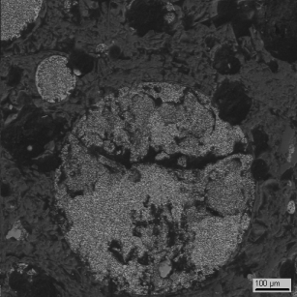
Second experimental series (GPRS 59-64)
Peculiarities: 10 min. exposure, quenching
T= 1750°С
59
70 μm
61
150 μm
63
200 μm
T= 1850°С
60
200 μm
62
200 μm
64
700 μm
8

Slide 9
Second experimental series (GPRS 59-61 results)
MG not detected
for GPRS 59-61
0.8
T_{m}=2080 °C
T_{m} > 1850
1850 > T_{m} > 1750
SiO₂
T_{m}=1700 °C
70 μm
FeO
0.2
9

Slide 10
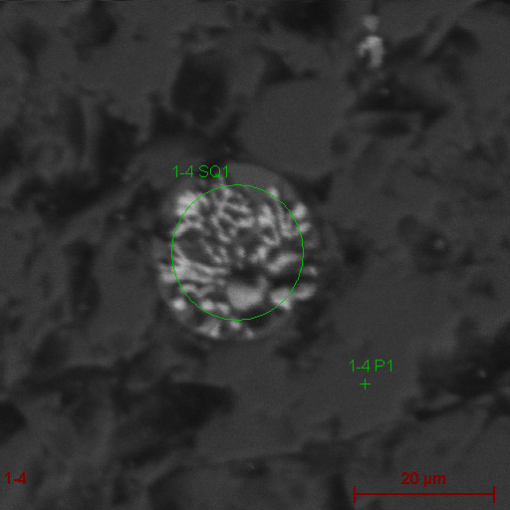
Second experimental series (GPRS 62 results)
20 μm
0.8
T_{m}=2080 °C
1850 > T_{m} > 1750
1850
SiO₂
200 μm
T_{m}=1700 °C
FeO
0.2
T, °C | Type | UO₂ | FeO | SiO₂
1850 | Heavy liquid | 19.2±2.6 | 22.1±11.7 | 58.7±13.3
 | Light liquid | 2.5±0.7 | 5.3±1.2 | 92.2±1.8
MG detected for GPRS 62
(micro segregation only)
10

Slide 11
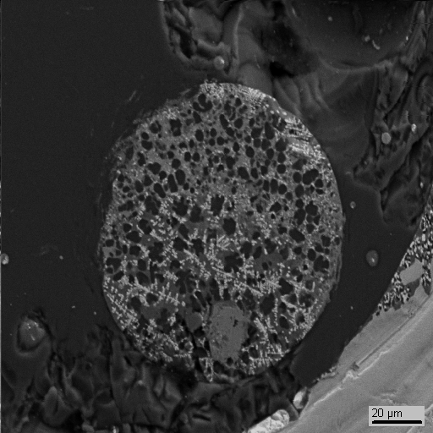
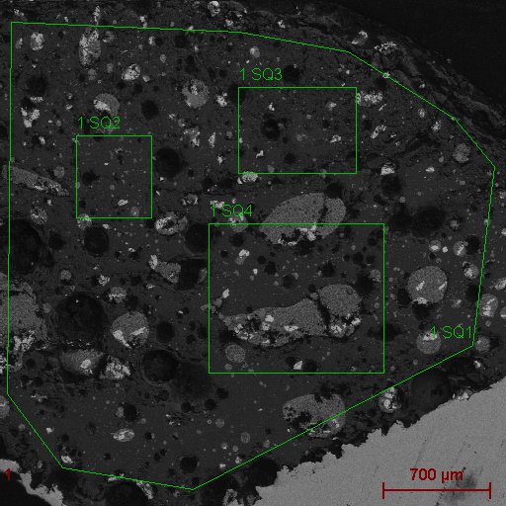
Second experimental series (GPRS 63 results)
0.8
T_{m}=2080 °C
30 μm
700 μm
SiO₂
1750 > T_{m}
T_{m}=1700 °C
FeO
0.2
T, °C | Type | UO₂ | FeO | SiO₂
1750 | Heavy liquid | 11.9±2.4 | 34.7±3.4 | 53.4±4.2
 | Light liquid | 1.8±0.5 | 6.6±1.4 | 91.6±1.9
MG detected for GPRS 63
(micro segregation only)
11

Slide 12
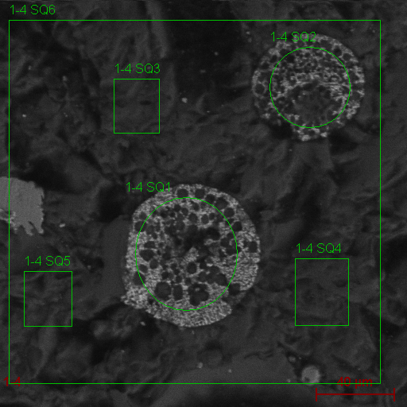
Second experimental series (GPRS 64 results)
0.8
T_{m}=2080 °C
40 μm
1850
700 μm
SiO₂
1750
T_{m}=1700 °C
FeO
0.2
T, °C | Type | UO₂ | FeO | SiO₂
1850 | Heavy liquid | 13.0±1.2 | 26.7±4.2 | 60.3±4.8
 | Light liquid | 2.9±0.5 | 7.2±1.1 | 90.0±1.4
MG detected for GPRS 64
(micro segregation)
12

Slide 13
Third experimental series (GPRS 67-72)
Test | Content, mol.% |  |  | T, °C | Exp. time, min | Note
 | UO₂ | SiO₂ | FeO
GPRS67 | 18.0 | 77.0 | 5.0 | 1100 | 60 | Annealing
 |  |  |  | 1950 | 10 | Melting and quenching
GPRS68 | 18.0 | 77.0 | 5.0 | 1100 | 60 | Annealing
 |  |  |  | 2050 | 10 | Melting and quenching
GPRS69 | 12.0 | 78.0 | 10.0 | 1100 | 60 | Annealing
 |  |  |  | 1900 | 10 | Melting and quenching
GPRS70 | 12.0 | 78.0 | 10.0 | 1100 | 60 | Annealing
 |  |  |  | 1950 | 10 | Melting and quenching
GPRS71 | 6.0 | 79.0 | 15.0 | 1100 | 60 | Annealing
 |  |  |  | 1700 | 10 | Melting and quenching
GPRS72 | 6.0 | 79.0 | 15.0 | 1100 | 60 | Annealing
 |  |  |  | 1950 | 10 | Melting and quenching
0.8
T_{m}=2080 °C
67-68
69-70
SiO₂
71-72
T_{m}=1700 °C
FeO
0.2
Research objectives: T_{m} determination, tie lines determination
13

Slide 14
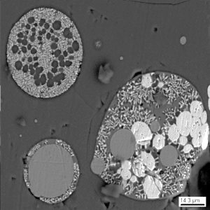
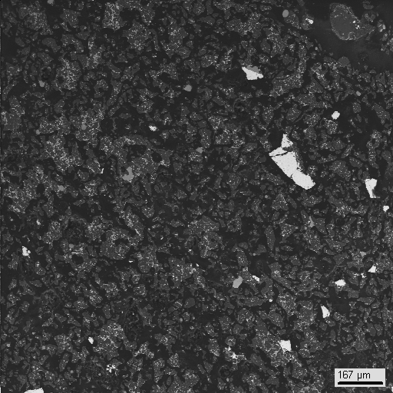
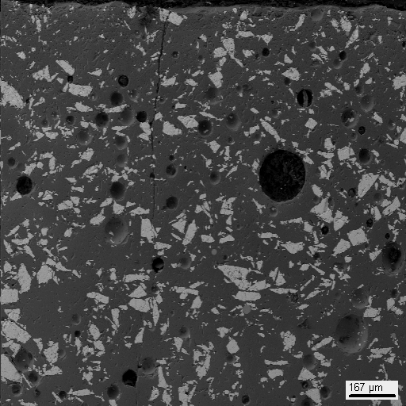
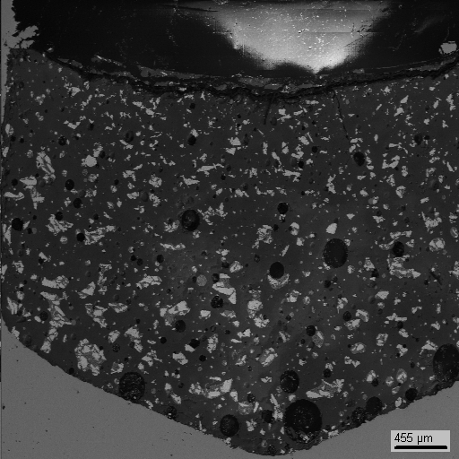
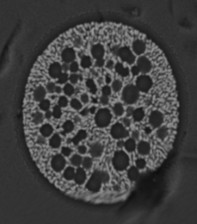
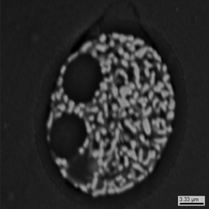
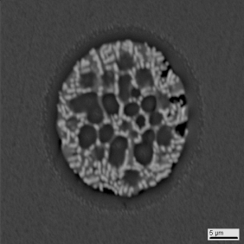
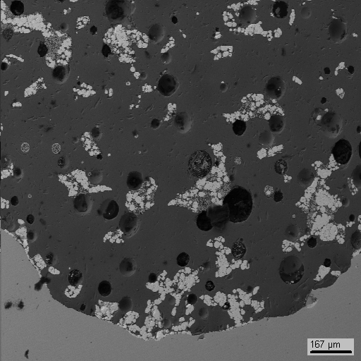
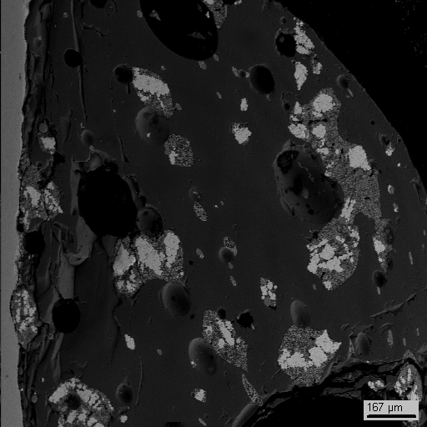
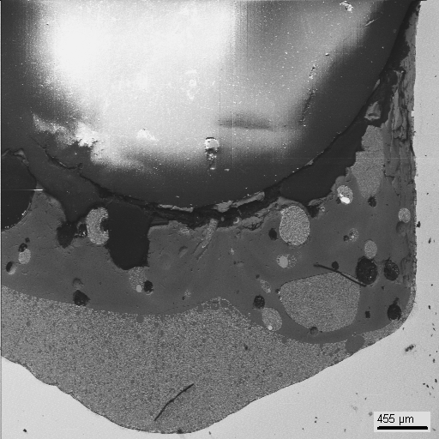
Third experimental series (GPRS 67-72)
Peculiarities: 10 min. exposure, quenching
T= 1950°С
T= 1900°С
T= 1700°С
67
300 μm
69
900 μm
71
300 μm
T= 2050°С
T= 1950°С
T= 1950°С
68
300 μm
70
300 μm
72
900 μm
14

Slide 15
Third experimental series (GPRS 67 and 71 results)
MG not detected
for GPRS 67 and 71
0.8
T_{m}=2080 °C
2050 > T_{m} > 1950
1850 > T_{m} > 1750
SiO₂
1750 > T_{m} > 1700
T_{m}=1700 °C
300 μm
FeO
0.2
15

Slide 16
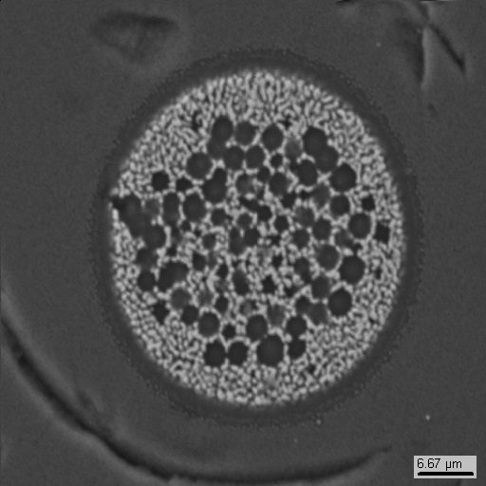
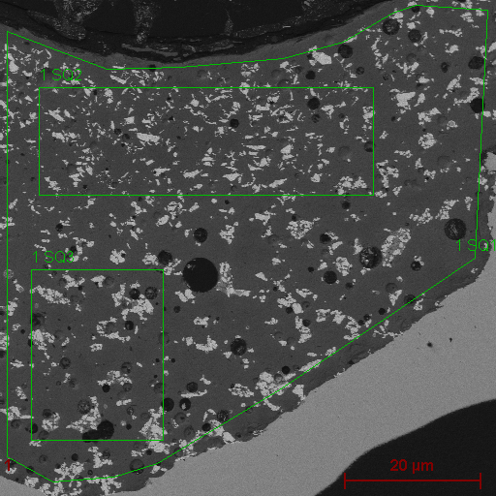
Third experimental series (GPRS 68 results)
0.8
T_{m}=2080 °C
2050
7 μm
SiO₂
700 μm
T_{m}=1700 °C
FeO
0.2
T, °C | Type | UO₂ | FeO | SiO₂
2050 | Heavy liquid | 26.0±10.8 | 12.2±8.9 | 61.8±11.9
 | Light liquid | 6.3±0.7 | 3.2±0.4 | 90.5±1.0
MG detected for GPRS 68
(micro segregation only)
16

Slide 17
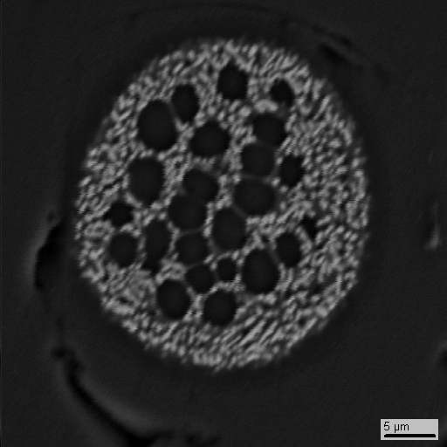
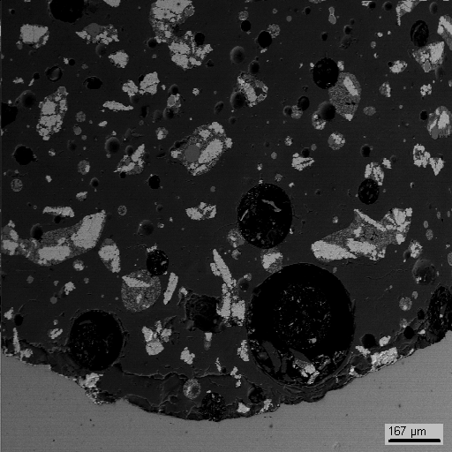
Third experimental series (GPRS 69 results)
0.8
T_{m}=2080 °C
6 μm
1900
SiO₂
200 μm
T_{m}=1700 °C
FeO
0.2
T, °C | Type | UO₂ | FeO | SiO₂
1900 | Heavy liquid | 15.0±2.7 | 22.8±4.5 | 62.2±6.6
 | Light liquid | 3.0±0.8 | 5.2±1.3 | 91.9±2.0
MG detected for GPRS 69
(micro segregation only)
17

Slide 18
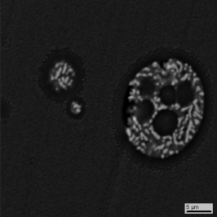
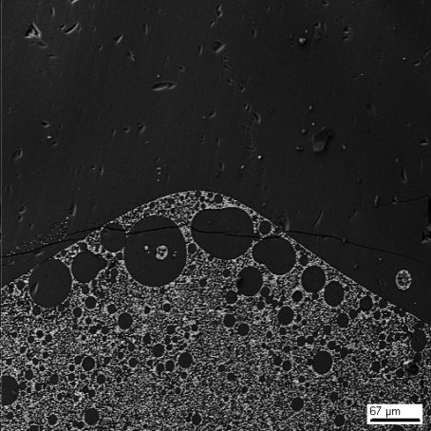
SEM/EDX for GPRS 72
0.8
T_{m}=2080 °C
600 μm
SiO₂
1950
T_{m}=1700 °C
FeO
0.2
T, °C | Type | UO₂ | FeO | SiO₂
1950 | Heavy liquid | 10.0±0.8 | 19.0±1.0 | 71.0±1.6
 | Light liquid | 3.5±0.1 | 7.6±1.0 | 88.9±1.1
T_{m} | Heavy liquid | 15.7±1.5 | 20.5±5.6 | 64.2±7.4
 | Light liquid | 2.6±0.6 | 4.5±0.9 | 92.8±1.2
18

Slide 19
Forth experimental series (GPRS 79-81, 84)
Test | Content, mol.% |  |  | T, °C | Exp. time, min | Note
 | UO₂ | SiO₂ | FeO
GPRS79 | 18.0 | 77.0 | 5.0 | 1100 | 60 | Annealing
 |  |  |  | 2150 | 10 | Melting and slow cooling down
 |  |  |  | 2000 | 10 | Annealing and quenching
GPRS80 | 12.0 | 78.0 | 10.0 | 1100 | 60 | Annealing
 |  |  |  | 2000 | 10 | Melting and slow cooling down
 |  |  |  | 1800 | 10 | Annealing and quenching
GPRS81 | 6.0 | 79.0 | 15.0 | 1100 | 60 | Annealing
 |  |  |  | 2000 | 10 | Melting and slow cooling down
 |  |  |  | 1725 | 10 | Annealing and quenching
GPRS84 | - | 80.0 | 20.0 | 1100 | 60 | Annealing
 |  |  |  | 2100 | 10 | Melting and slow cooling down
 |  |  |  | 1700 | 10 | Annealing and quenching
0.8
T_{m}=2080 °C
79
80
SiO₂
81
T_{m}=1700 °C
84
FeO
0.2
Research objectives: T_{m} determination, tie lines determination
19

Slide 20
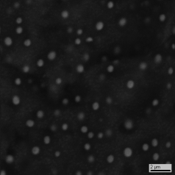
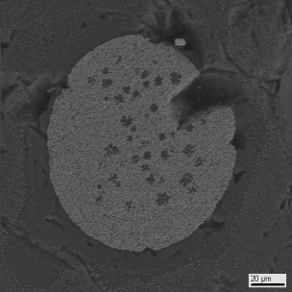
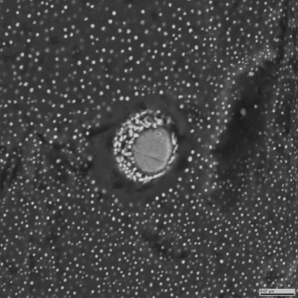
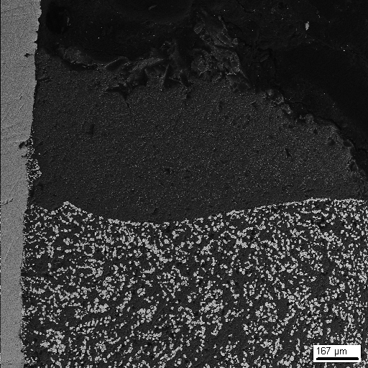
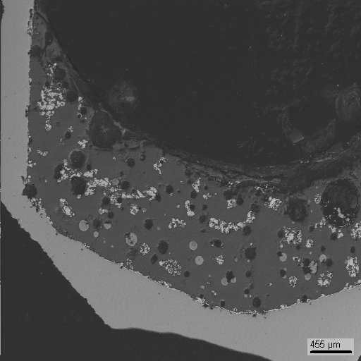
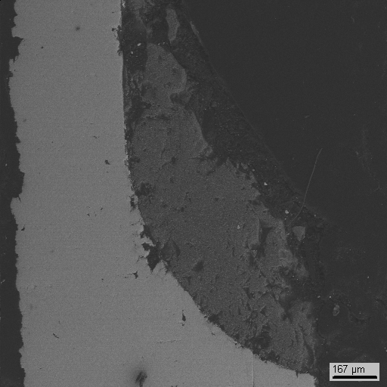
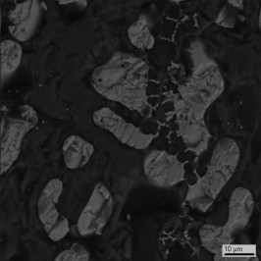
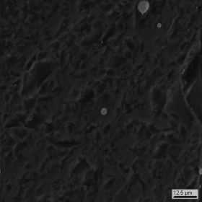
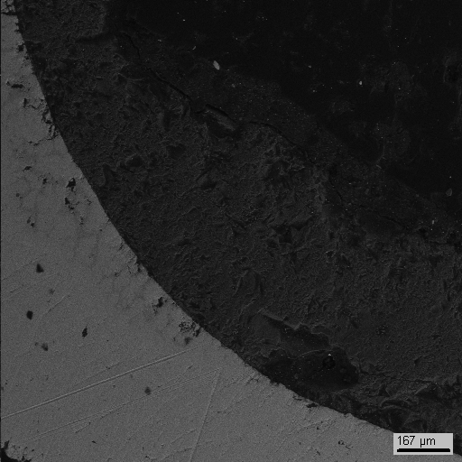
Forth experimental series (GPRS 79-81, 84)
Peculiarities: overheating, slow cooling down, 10 min. exposure, quenching
T= 2000°С
T= 1800°С
T= 1725°С
79
80
900 μm
300 μm
81
300 μm
T= 2050°С
84
300 μm
20

Slide 21
SEM/EDX for GPRS 79
0.8
T_{m}=2080 °C
2000
< T_{m}
SiO₂
200 μm
MG detected
for GPRS 79
(nonequilibrium)
T_{m}=1700 °C
FeO
0.2
T, °C | Type | UO₂ | FeO | SiO₂
2000 | Recrystallization | 14.7±1.3 | 5.5±0.6 | 79.8±1.9
 | Light liquid | 6.6±0.7 | 2.4±0.6 | 91.1±1.0
21

Slide 22

SEM/EDX for GPRS 80
0.8
T_{m}=2080 °C
< T_{m}
600 μm
MG detected
for GPRS 80
(micro segregation only)
SiO₂
T_{m}=1700 °C
FeO
0.2
T, °C | Type | UO₂ | FeO | SiO₂
1800 | Heavy liquid | 39.3±1.9 | 17.4±2.5 | 43.2±3.5
 | Light liquid | 3.9±0.4 | 3.1±0.7 | 93.0±0.7
 | Total | 6.2±0.6 | 6.0±0.6 | 87.8±1.2
22

Slide 23
MG in the UO₂-SiO₂-FeO System
0.8
2050 > T_{m} > 1950
T_{m}=2080 °C
2050
~ T_{m}
~ T_{m}
1850 > T_{m} > 1750
~ T_{m}
2000
1900
1850
1750 > T_{m} > 1700
SiO₂
1950
1750 > T_{m}
T_{m}=1700 °C
FeO
0.2
23

Slide 24
Scheme of spinodal decomposition
binodal
spinodal
T, °C
1
2
3
2
1
2
3
3
A
B
B

Slide 25
Conclusions
The miscibility gap in the UO₂-FeO-SiO₂ system was observed
Monotectic plate is outlined (with accuracy about 100°C)
Ten tie lines was constructed
Ten points were settled to be done (three points for MG region)
Twenty experiments have been made in only MG region
There is many uncertainties and incomprehensibilities which distort MG observations in this ternary system
25

