Slide 1

Results on the UO2 – SiO2 system
A.P. Alexandrov Research Institute of Technology
ISTC PRECOS Project
#3813
1st PRECOS Meeting
Presented by Larisa Mezentseva
ISC RAS
Saint-Petersburg

Slide 2
Previously obtained data on the system
Phase diagrams available in literature
T, °C
2200
UO₂–SiO₂ phase diagram with a eutectic by S.M. Lang et al., Nat. Bur. Stand., Circular 568. 1956
Eutectic composition
(15-10) UO₂ – (85-90) SiO₂, mol %
Eutectic temperature 1650±10 °С
L
2000
UO₂ + L
SiO₂
+
L
1800
1650±10
1600
UO₂ + SiO₂
1400
UO₂
20
40
60
80
SiO₂
mol % SiO₂

Slide 3
Previously obtained data on the system
Phase diagram available in literature
T, °C
Fusion diagram with the miscibility gap by S. Lungu, Romanian J. of Physics. 1962. V. 7. N 4. P. 419
Eutectics composition:
2 UO₂ – 98 SiO₂, mol %
Eutectic temperature 1719±10 °С
Monotectic temperature 2070±10 °С
2800
L
2600
2400
2200
L₁ + L₂
2000
2070±10
UO₂ + L
1800
1719±10
UO₂ + SiO₂
1600
UO₂
20
40
60
80
SiO₂
mol % SiO₂

Slide 4
Experimental CORPHAD results
Red lines – Lungu’ diagram
Blue lines and blue points –
results of our previous work
within the CORPHAD project
The miscibility gap was found to exist
The miscibility region position was roughly outlined
The monotectic temperature was determine to be in the temperature range of 2000–2080°C

Slide 5
Research objectives of PRECOS project
  To define the monotectic temperature and the boundary curve of the miscibility gap in vicinity of the monotectic temperature
  To determine the critical point of the boundary curve
  To determine eutectic, solidus and liquidus temperatures, tie-lines in the miscibility gap

Slide 6
Methods of analysis
Solidus – liquidus temperatures determination by
visual polythermal analysis (Galakhov microfurnace and IMCC)
Heat treatment, exposure and quenching
SEM/EDX analysis

Slide 7
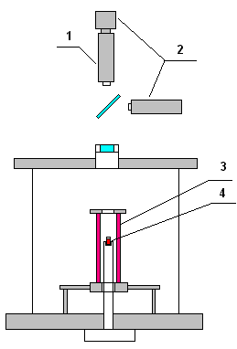
Experiment technique
Scheme of the modernized Galakhov microfurnace:
  1 – pyrometer;
  2 – video cameras;
  3 – W heating tube;
  4 – Mo crucible
  Atmosphere – Ar + H₂(4 vol. %)
  Total gas pressure – 3 atm
  Mass of the samples – 50–150 mg
  Stepwise heating
  Heating rate – 1–8°C/min
  Exposure time – 5 and 10 min
  Quenching
The error of pyrometer temperature
measurements is ±1 relative %

Slide 8
Characteristics of the tests on the UO₂–SiO₂ system
UO₂ of >99.0 % purity
SiO₂ of 99.99% purity
Total mass of the charge – 150 mg (Galakhov microfurnace)
– about 1 kg (IMCC)

Slide 9
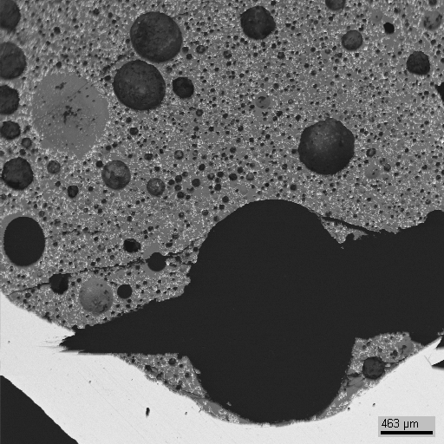
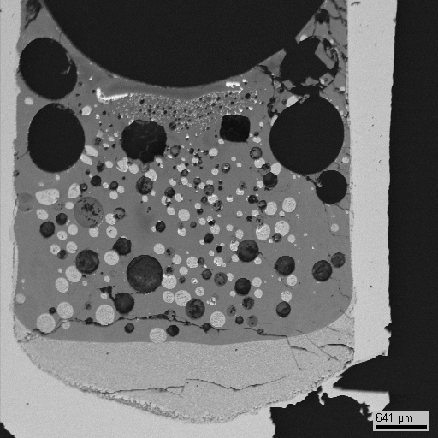
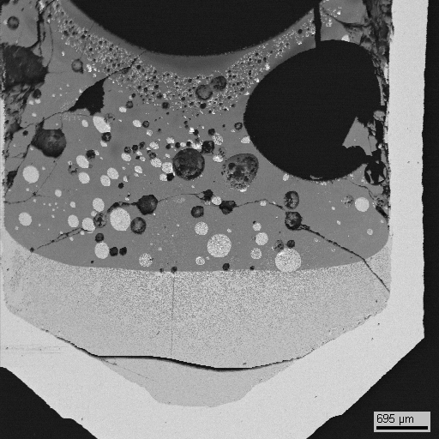
Experimental results of Galakhov microfurnace
Longitudinal sections of the crucibles
Light liquid
Light liquid
Heavy liquid
Heavy liquid
GPRS 1
2050°C 5 min.
below monotectic
GPRS 2
2080°C 5 min.
GPRS 3
2080°C 10 min.
0.5 mm
0.7 mm
0.8 mm
just above monotectic
Mo crucible

Slide 10
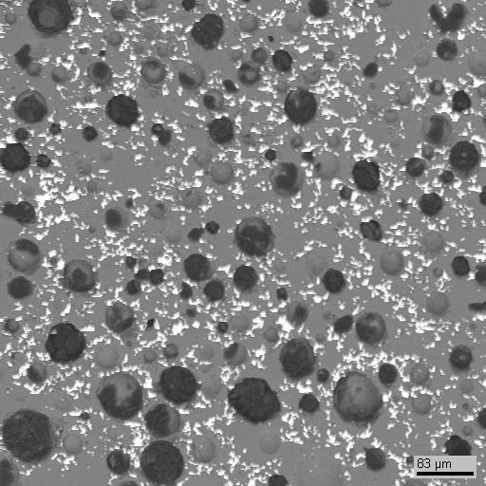
Experimental results of Galakhov microfurnace
Longitudinal section
of the crucible
Fragment of the cooled specimen
0.5 mm
GPRS 1
2050°C 5 min.
below monotectic
80 μm
Bright UO₂ unfused crystals are observed

Slide 11
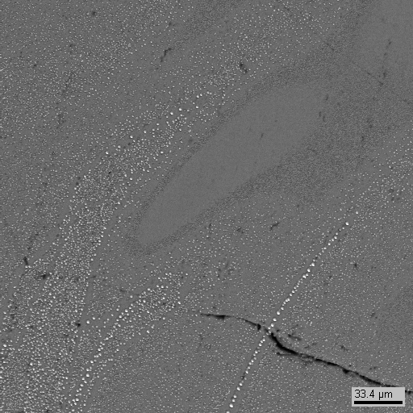
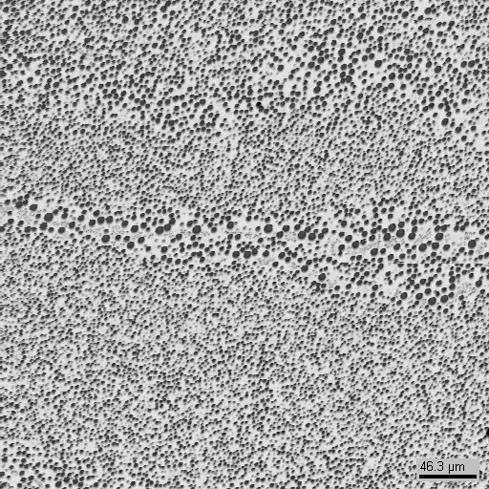
Experimental results of Galakhov microfurnace
Longitudinal section
of the crucible
Fragment of the cooled specimen
Cooled light liquid
50 μm
0.7 mm
Mo crucible
GPRS 2
2080°C 5 min
just above monotectic
Cooled heavy liquid
60 μm

Slide 12
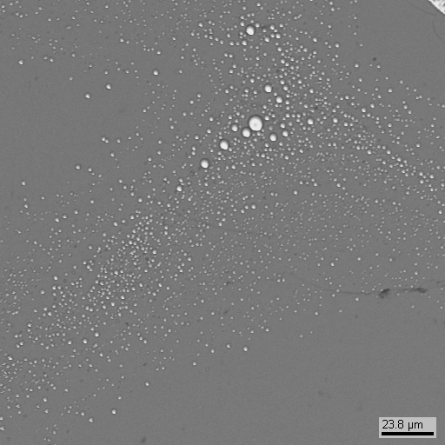
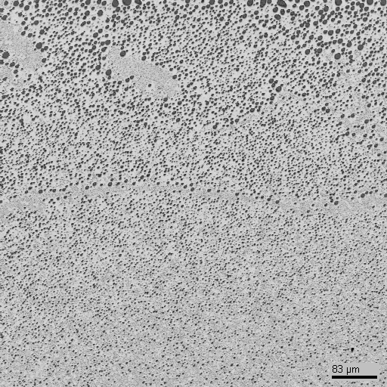
Experimental results of Galakhov microfurnace
Longitudinal section
of the crucible
Fragment of the cooled specimen
Cooled light liquid
30 μm
0.8 mm
Mo crucible
GPRS 3
2080°C 10 min
just above monotectic
Cooled heavy liquid
100 μm

Slide 13
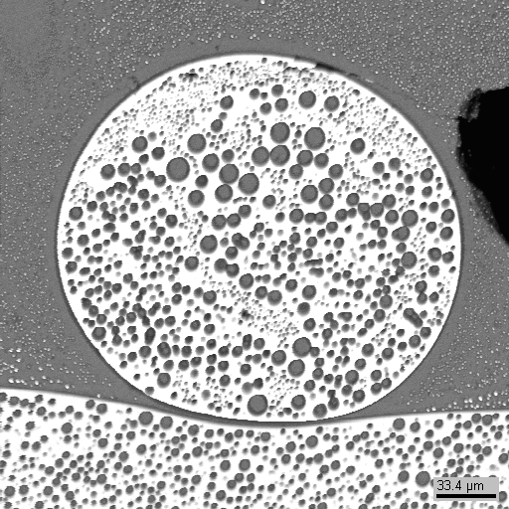
Experimental results of Galakhov microfurnace
A drop of heavy liquid in light liquid near the phase boundary after cooling
GPRS 2
2080°C 5 min
30 μm

Slide 14
Experimental results
GPRS 2 and 3
EDX analysis of the domains in heavy liquid layer
2080°C 5 min
2080°C 10 min
Examined region | Composition, mol %
 | UO₂ | SiO₂
SQ1 | 26.7 | 73.3
SQ2 | 27.34 | 72.66
SQ3 | 27.96 | 72.04
SQ4 | 30.28 | 69.72
Overage value | 28.07±1.56 | 71.93±1.56
Examined region | Composition, mol %
 | UO₂ | SiO₂
SQ1 | 28.09 | 71.91
SQ2 | 31.78 | 68.22
SQ3 | 29.97 | 70.03
SQ4 | 28.26 | 71.74
Overage value | 29.53±1.73 | 70.47±1.73

Slide 15
Experimental results
GPRS 2 and 3
EDX analysis of the domains in light liquid layer
2080°C 5 min
2080°C 10 min
Examined region | Composition, mol %
 | UO₂ | SiO₂
SQ1 | 12.64 | 87.36
SQ2 | 11.69 | 88.31
SQ3 | 11.66 | 88.34
Overage value | 12.00±0.56 | 88.00±0.56
Examined region | Composition, mol %
 | UO₂ | SiO₂
SQ1 | 11.51 | 88.49
SQ2 | 11.62 | 88.38
SQ3 | 12.74 | 87.26
Overage value | 11.96±0.68 | 88.04±0.68

Slide 16
Experimental results of IMCC
The thermogram of PRS1 test
sampling 1 2 3
T_{liq} measurement

Slide 17
Experimental results of IMCC
Fragment of thermogram of PRS1 test
T_{liq} measurement

Slide 18
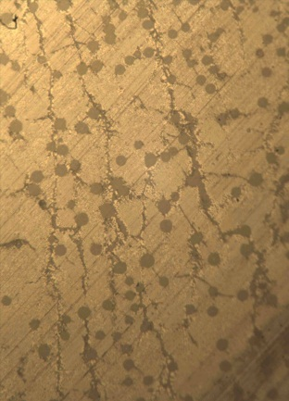
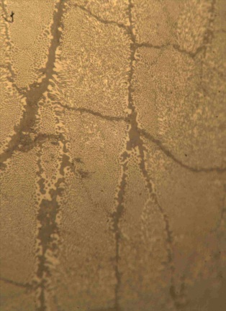
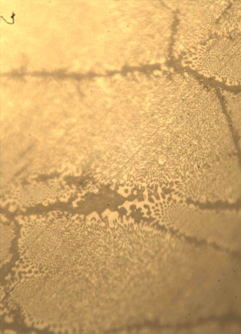
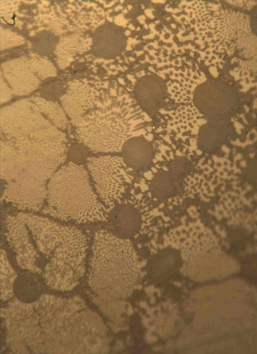
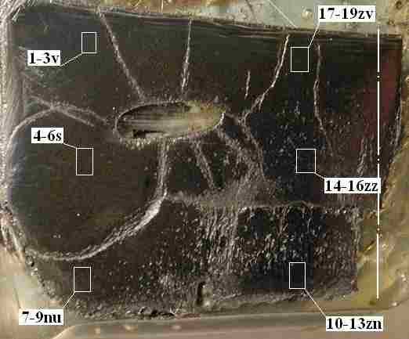
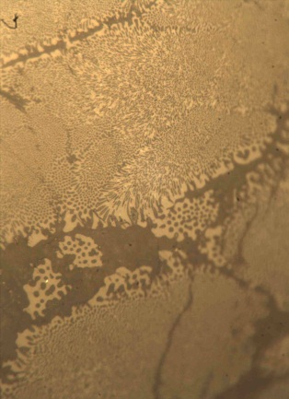
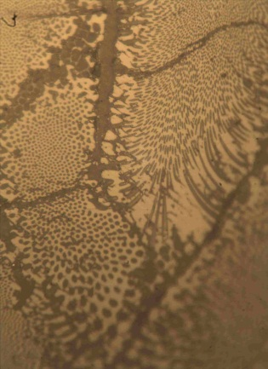
Experimental results of IMCC
Optical microscopy
Longitudinal section
of the crystallized melt
(PRS1 test)

Slide 19
Experimental results
PRS 1
Chemical analysis of the sampling
Sampling number | Composition, mol %
 | UO₂ | SiO₂
1 | 37.68 | 62.32
2 | 47.40 | 52.60
3 | 48.36 | 51.64
Overage value | 44.48±5.91 | 55.52±5.91
T_{liq} measurement
Measure number | T_{liq}, °C
1 | 2444
2 | 2404
3 | 2427
Overage value | 2425±20

Slide 20
Experimental PRECOS results
Red lines – Lungu’ diagram
Blue lines and blue points –
results of our previous work
within the CORPHAD project
Yellow points – results of the
present work

Slide 21
Summary
The monotectic temperature was determine to be in vicinity of 2080°C
The liquidus temperature of the 44.5 UO₂ – 55.5 SiO₂ mol% composition is 2425±20°C

Slide 22
Conclusions
5- and 10 minute exposure at high temperatures is enough to determine correctly a composition of the coexisting liquid phases in the system under investigation, but it is difficult to get reliable results due to the SiO release
To prevent a composition changing during heat treatment use of cover in Galakhov microfurnace could be possibly helpful

Slide 23
Conclusions
Further experiments required:
To define miscibility gap region
T=2450°C, 30 sec exposure (with cover)
T=2500°C, 30 sec exposure (with cover)
To define the eutectic temperature
DTA analysis of a series of compositions (mol%)
05UO₂ – 95SiO₂
04UO₂ – 96SiO₂
03UO₂ – 97SiO₂
02UO₂ – 98SiO₂

