Slide 1


Final report of the
UO₂-SiO₂ system
A.P. Alexandrov
Research Institute of Technology
ISTC PRECOS
Project #3813
Presented by Vyacheslav Almjashev
5th PRECOS Meeting
ETU
Saint-Petersburg

Slide 2
Lungu’s data
T, °C
2800
T, °C
Lungu, 1973
L
2800
2600
L
2600
2400
L₁ + L₂
2200
2400
2000
UO₂ + L
L₁ + L₂
1800
1719±10
2200
1600
1400
UO₂ + SiO₂
2000
2070±10
UO₂ + L
1200
1800
1000
UO₂
SiO₂
1719±10
20
40
60
80
mol.% SiO₂
UO₂ + SiO₂
To spinodal decomposition
in the UO₂-SiO₂ system
1600
UO₂
20
40
60
80
SiO₂
mol.% SiO₂
2

Slide 3
Research objectives
  Miscibility gap – binodal curve
  and critical point determination
  Liquidus curve from the UO₂ side
3

Slide 4
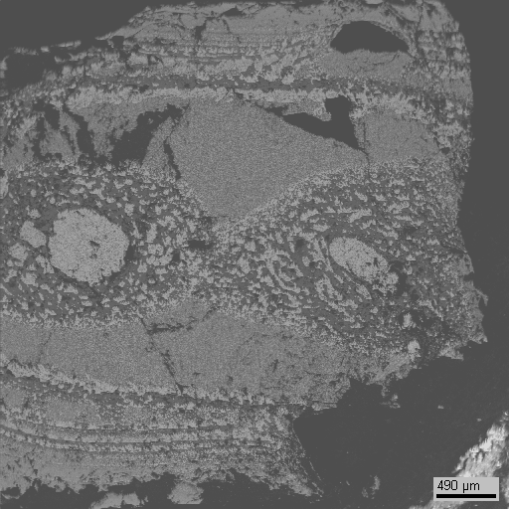
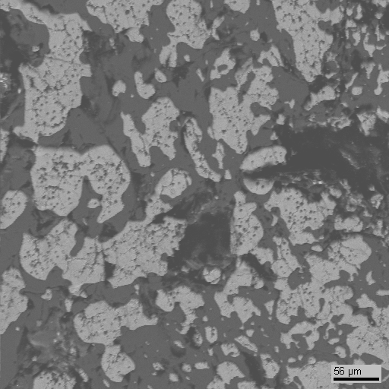
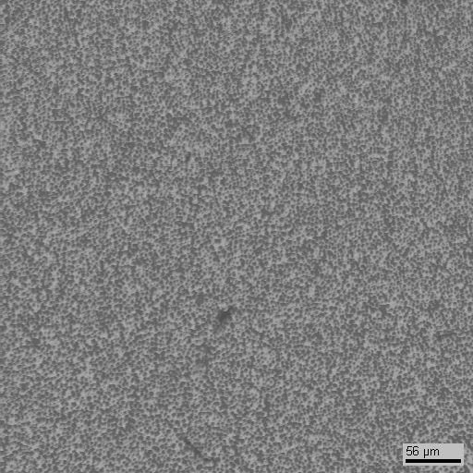
Fourth experiment done by IMCC (PRS 8)
81.4 mol.% SiO₂
by synthesis
100 μm
(sample of melt)
81.0±3.0 mol.% SiO₂
100 μm
80.4 mol.% SiO₂
1 mm
84.0 mol.% SiO₂

Slide 5
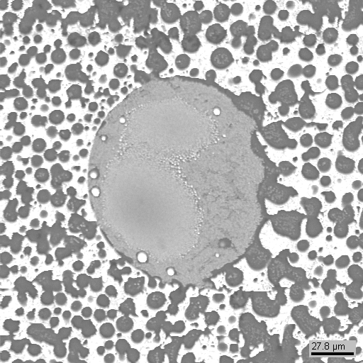
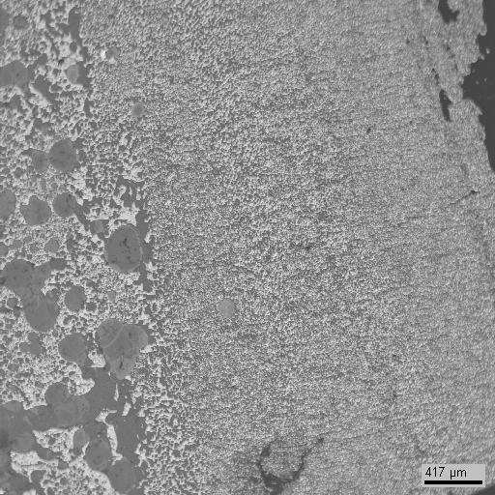

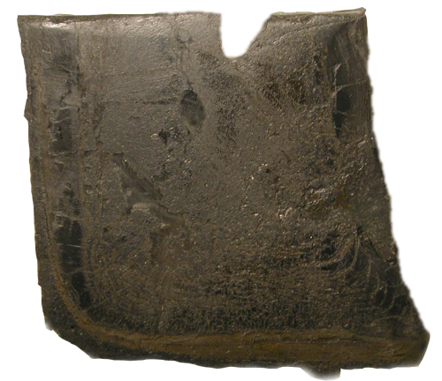
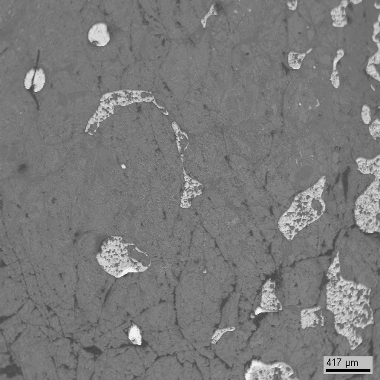
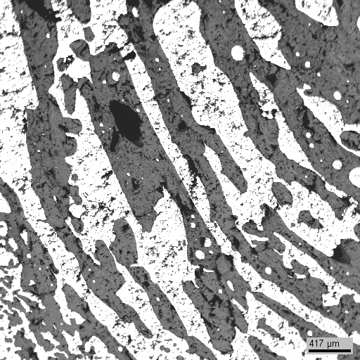
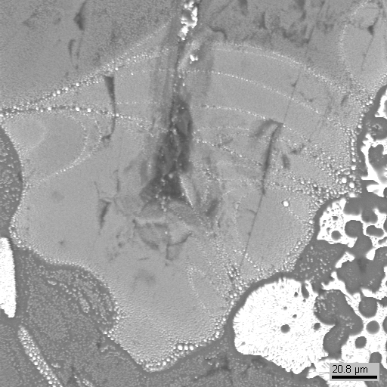
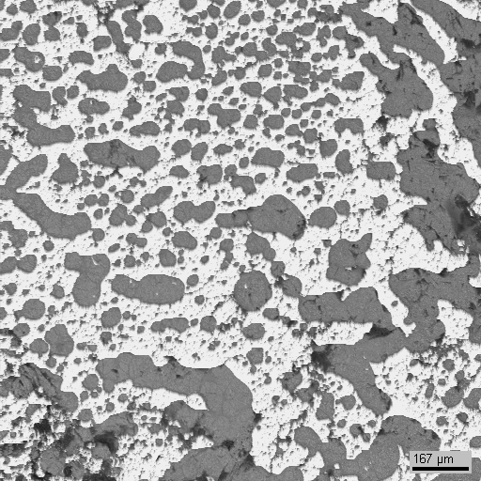
Fourth experiment done by IMCC (PRS 8)
ameboid microstructure
has the dynamic nature
81.4 mol.% SiO₂
by synthesis
Instability
edge
∇T
1 mm
83.5 mol.% SiO₂
ingot
The new type of instability
90.7 mol.% SiO₂
1 mm
1 sm
84.8 mol.% SiO₂
83.9 mol.% SiO₂
200 μm
1 mm

Slide 6
Fifth experiment done by IMCC (PRS 9)
Experimental objectives
Determine liquidus temperature at high UO₂ content
Charge composition
mol.%: 75.0 UO₂ + 25.0 SiO₂
VPA IMCC: Fragment of the experimental thermogram showing melt surface
    T_{liq} was measured three times: 2560ºC, 2563ºC and 2550ºC ⇨ T_{liq}=2558±40ºC
6

Slide 7
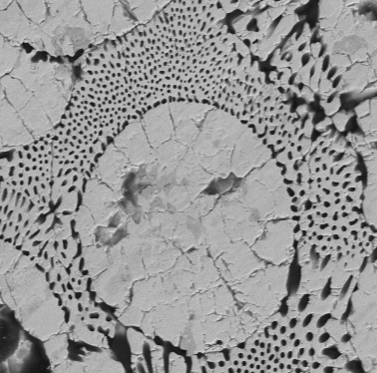
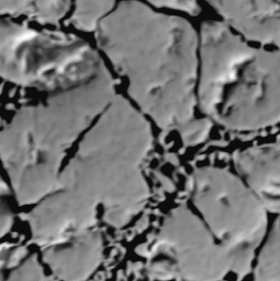
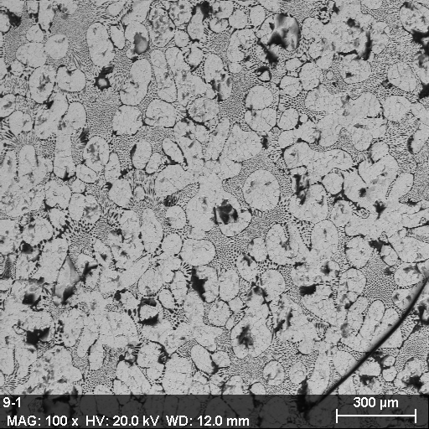
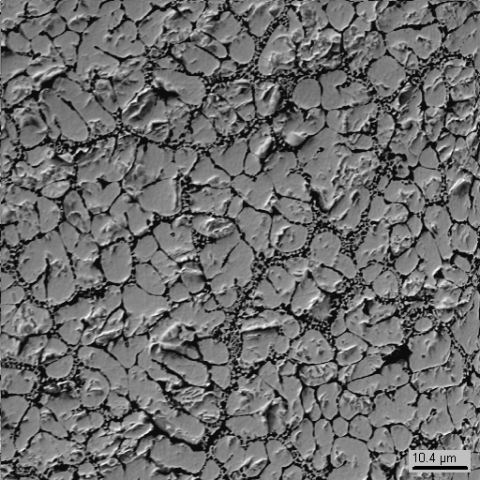
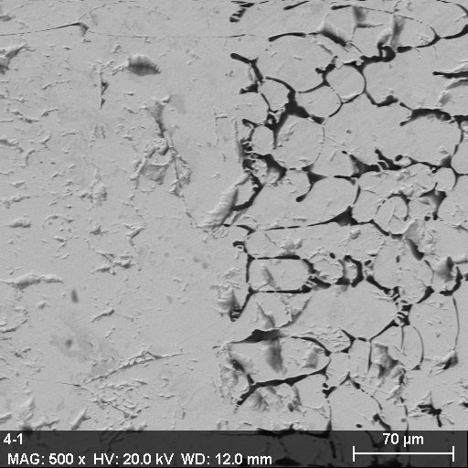
Fifth experiment done by IMCC (PRS 9)
25 mol.% SiO₂
by synthesis
37.1±0.8 mol.% SiO₂
6.9 mol.% SiO₂
80 μm
350 μm
15 μm
~2560 °С
(sample of melt)
20.5±3.3 mol.% SiO₂
(central zone of ingot)
30.2±0.6 mol.% SiO₂
(ingot nearby crucible)
26.9 mol.% SiO₂
7

Slide 8
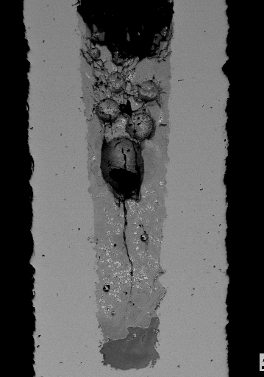
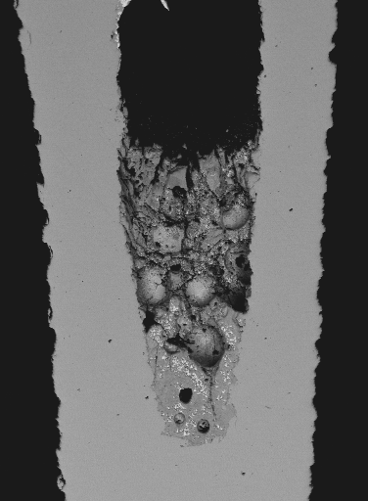
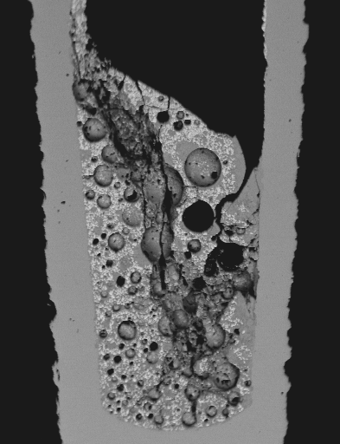
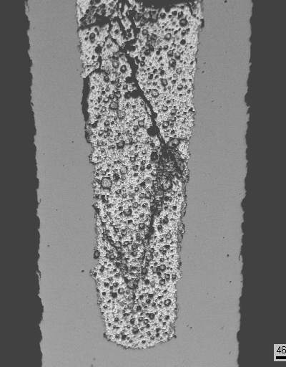
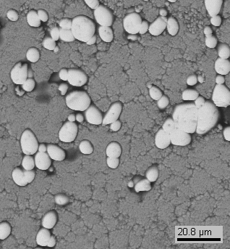
Fourth experimental series (GPRS 14-17)
Peculiarities: 10 min. exposure, quenching, T= 2125±25 °С
1 mm
60 mol.% SiO₂
by synthesis
(55.9 by analysis)
50 mol.% SiO₂
by synthesis
(48.3 by analysis)
50 mol.% SiO₂
by synthesis
(47.7 by analysis)
40 mol.% SiO₂
by synthesis
(34.6 by analysis)
Liquid phase composition measurements
65.0±1.6 mol.% SiO₂
63.2 ±2.9 mol.% SiO₂
68.0±2.0 mol.% SiO₂
62.8±1.4 mol.% SiO₂
the solid phase in all samples at the isotherm 2125°C has been found
average liquid phase composition is 64.8±4.4 mol.% SiO₂
8

Slide 9
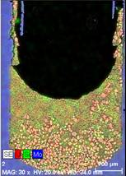
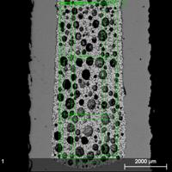
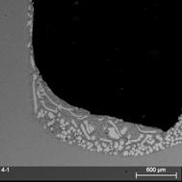
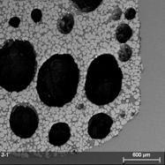
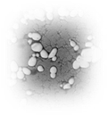
Fifth experimental series (GPRS 19-22)
Peculiarities: 10 min. exposure, quenching, T= 2200°С
60 mol.% SiO₂
by synthesis
(58.7±1.5 by analysis)
50 mol.% SiO₂
by synthesis
(50.2±1.3 by analysis)
50 mol.% SiO₂
by synthesis
(50.2±1.9 by analysis)
40 mol.% SiO₂
by synthesis
(42.9±0.9 by analysis)
Liquid phase composition measurements
61.1±0.4 mol.% SiO₂
67.6±1.2 mol.% SiO₂
63.0±1.9 mol.% SiO₂
64.4 mol.% SiO₂
the solid phase in all samples at the isotherm 2200°C has been found
liquid phase composition is 64.0±3.9 mol.% SiO₂
9

Slide 10
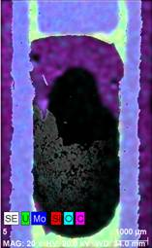
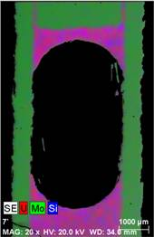
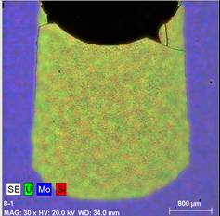
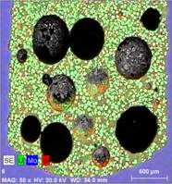
Sixth experimental series (GPRS 23, 24, 26, 28)
Peculiarities: 10 min. exposure, quenching, T= 2300°С
60 mol.% SiO₂
by synthesis
(59.7±0.1 by analysis)
60 mol.% SiO₂
by synthesis
(59.9±0.5 by analysis)
60 mol.% SiO₂
by synthesis
(55.0±0.5 by analysis)
50 mol.% SiO₂
by synthesis
(49.0±2.2 by analysis)
Liquid phase composition measurements
Fully melted
62.8±2.2 mol.% SiO₂
Fully melted
Fully melted
10

Slide 11
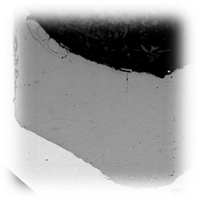
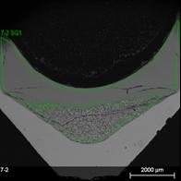
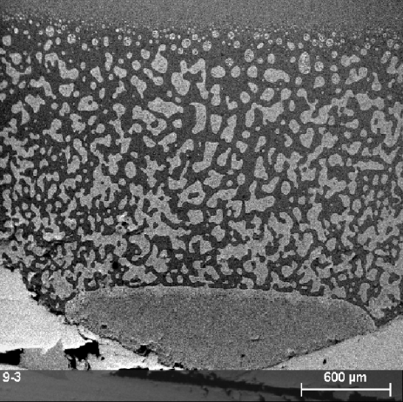
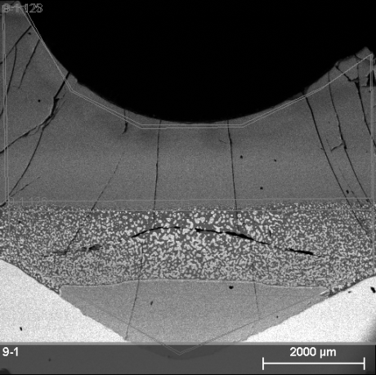
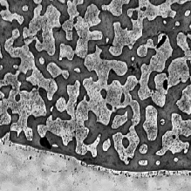

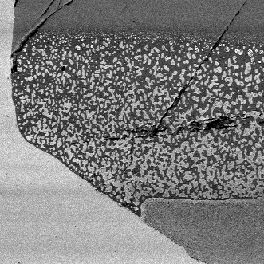
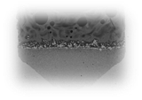

Seventh experimental series (GPRS 18, 25, 27, 32)
Peculiarities: 10 min. exposure, quenching
81.4 mol.% SiO₂ by synthesis
GPRS18
GPRS25
GPRS27
GPRS32
(80.3±0.3 by analysis)
(80.8 by analysis)
(80.8 by analysis)
2200 °С
Above critical point
2175 °С
2160 °С
2130 °С
Above critical point
Below critical point
level | mol.% SiO₂
top | 82.2±2.9
ameboid | 79.1±0.5
bottom | -
level | mol.% SiO₂
top | 79.2
ameboid | 78.6
bottom | 74.0
level | mol.% SiO₂
top | 82.2±0.6
ameboid | 79.5±0.7
bottom | 72.7±0.4
GCORD4, 81.4 mol.% SiO₂
1 min., 2200 °С
11

Slide 12
UO₂-SiO₂ phase diagram
T, °C
ChA
2400
SEM/EDX
2800
Galakhov
L
L₁ + L₂
PRS9 nearby crucible
2600
PRS3
5-S
GPRS-18
2200
2400
PRS1
4-S
GPRS-25
L₁ + L₂
GPRS-27
GPRS-32
2200
5-S
GPRS-18
2080
4-S
GPRS-25
2070±10
2080
GPRS-27
GPRS-32
2000
2000
2070±10
UO₂ + L
1800
1719±10
60
80
UO₂ + SiO₂
1600
UO₂
20
40
60
80
SiO₂
mol.% SiO₂
12

Slide 13
Conclusions
The miscibility gap limits are re-examined. With the accuracy of 15°C the miscibility gap critical point was pointed out
The liquidus curve in the observed system was
constructed from the UO₂ side
Seven points were settled to be done
Forty experiments have been made
13

