Slide 1
International Science and Technology Center
INVESTIGATION OF FISSION PRODUCT RELEASE FROM HIGH BURN-UP FUEL ANNEALED UNDER OXIDIZING AND REDUCTION CONDITION
VERONIKA
(VVER Experiments on Release due to Over-heating: Normalization and Knowledge Augmentation).
Project Proposal
RIAR (Dimitrovgrad), IBRAE (Moscow)
12th CEG-SAM Meeting
Saint Petersburg, Russia
SPAEP (Atomenergoproekt)
September 11-13, 2007

Slide 2
Objectives of VERONIKA Project
Receiving the experimental data on fission products release from highly irradiated VVER fuel along with fuel microstructure evolution under severe accident conditions
Physical fission products release models and numerical codes development on the base of results obtained

Slide 3
MFPR Basic Models
Intragranular gas atoms
Grain
-
diffusion towards grain boundary (
С
concentration)
-
growth & boundary sweeping
-
bubble nucleation & capture by bubbles
-
capture by dislocations
-
directio
nal diffusion by
С
T
-
grain
-
boundary sweeping, dislocation creep
Intragranular bubbles
Intragranular
-
nucleation and coalescence
zone
-
capture of gas atoms
-
loss of gas atoms by re
-
solution (thermal & recoil)
-
di
ffusion towards grain boundaries (face bubbles):
directional diffusion by
С
T, grain
-
boundary sweeping,
dislocation creep, vacancy gradient.
-
Face bubbles
-
fed by gas atoms, intragranular bubbles
& vaporizati
on of condensed
-
phase species
-
growth & interconnection leading to release
into edge bubbles
Edge bubbles
Intergranular
-
supplied by face bubbles
zone
-
swelling until a critical threshold
-
release into open porosities
Precipitates
Dislo
cations
-
fed by intragranular diffusion of non
-
gas FPs
-
creep towards grain boundaries
-
formation of 3 condensed phases at grain boundary:
-
trapping of intragranular gases
ternary (e.g.
Cs
2
MoO
4
),
CsI
& metallic (
Ru
,
Mo, Sb
)
(atoms & bubbles)
-
equilibrium between precipitates, face bubbles,
UO
2+x

Slide 4
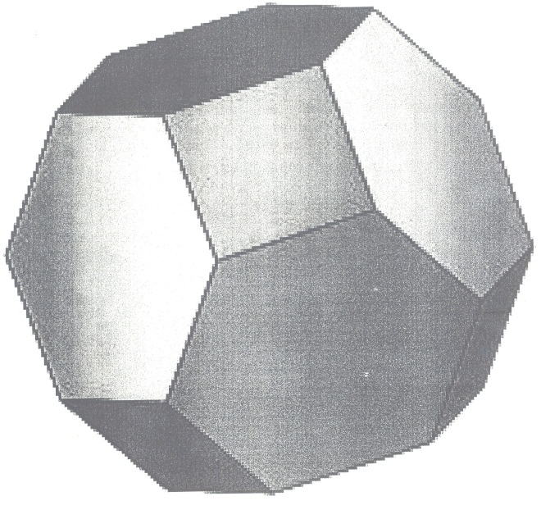
Transport of Fission Gases
System of equations:
X = {C_{g}, C_{b}, V_{b}, ρ_{d}, C_{d}, V_{p}, C_{p}, C_{v}, C_{i}}
Diffusion of gas atoms (C_{g})
Intragranular bubbles (C_{b}, N_{b}) nucleation, growth and resolution
(thermal and irradiation-induced)
Intragranular bubbles diffusion (also biased in temperature gradient)
and coalescence
Interactions with dislocations (ρ_{d}), sintering pores (C_{p}), vacancies (C_{v})
and interstitials (C_{i})
Intergranular bubbles formation, coalescence and interconnection...

Slide 5
Scope of VERONIKA Project Tests
Investigation of fission products release from fuel with burnup of 60 MW*d/kgU in oxidizing and reducing environments in the temperature range of 1400 - 2300ºC
Investigation of the release of a wide list of fission products including short living isotopes: ⁸⁵Kr, ¹³³Xe, ¹³¹I, ¹³⁷Cs, ¹³⁴Cs, ¹⁰⁶Ru, ¹⁰³Ru, ¹⁴⁴Ce, ⁹⁹Mo, ¹⁴⁰Ba, ⁹⁵Zr and other. That will be provided by pre-irradiation of the specimens in the research reactor

Slide 6
Revised test matrix part 1
(a): the samples are fuel fragments and the test consists of simple ramp (1K/s) up to 1400°C
maintained one hour.
(b): the test consists of the test (a) followed by a ramp (1K/s) up to 1700°C maintained 30 minutes.
(c): the same as (b) but the second ramp ends at T3>2000°C maintained 30 minutes.
(d): in this case samples are fuel pellets in their original cladding ant the test is identical to (b)
(d’): idem (d) but with air.

Slide 7
Revised test matrix part 2
(a1, b1, c1) : the scenario of tests is identical to a, b and c respectively but in this case the gas phase composition is mixed, for example 25mg/s for H₂O and 0,3 mg/s for H₂)
(a2, b2): idem than tests a1, b1 but with bare fuel
(e): idem (a) but with fuel rod segments
(f): idem ( c) but with fuel rod segments
(e’): idem (e) but with air
(f’): idem (f) but with air

Slide 8
Main Test Procedures
Manufacturing of the experimental rig
Initial fuel rod examinations
Refabricated fuel rods manufacturing
Refabricated fuel rods irradiation
Preparation and certification of fuel specimens (fuel pellets and fragments of fuel rods)
FP release tests
Post-test examination of fuel specimens

Slide 9
Initial fuel rod examination
Objectives:
Selection of the typical spent fuel rod
Avoid the cladding defects – debris, nodules etc
Initial fuel and cladding certification
Test procedures
Eddy-current defectoscopy
Y-scanning
Profilometry
Plenum gas analysis
Fuel and cladding structure characterization
Metallography – Pellet crack pattern, fuel-cladding interaction/gap, fuel porosity, fuel grain size measurement.
SEM - (polished surface and fractography) porosity, intra- and intergranular bubbles pattern.
EPMA – Fission product distribution, precipitates composition.

Slide 10
Refabricated fuel rods manufacturing
Manufacturing of the short fuel rods (200 mm long) sealed by the welded end plugs and filled with He at 2-2.5 MPa from the fragments of initial fuel rod.
Refabricated fuel rods irradiation
Low power (30-50 Wt/cm)
Low temperature (to be defined)
Objective: accumulation of the short-lived isotopes in the solid solution; prevent any fuel structure transformation

Slide 11
The main irradiation test parameters of fuel samples

Slide 12
The interesting fission products

Slide 13
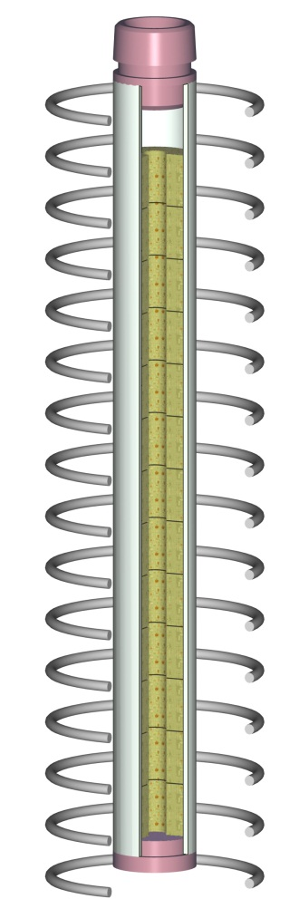
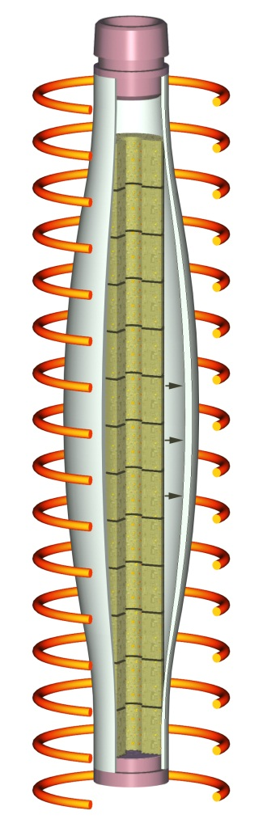
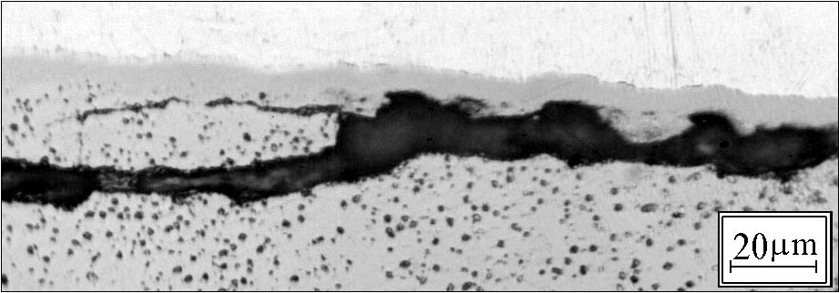
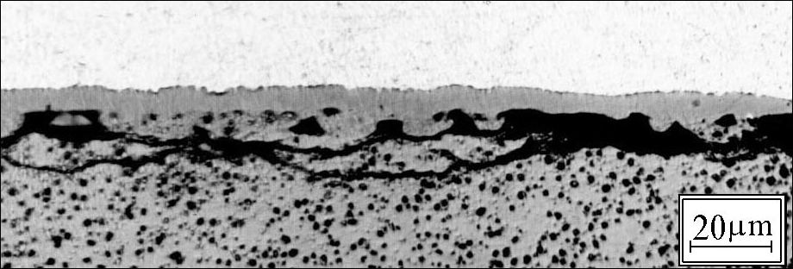
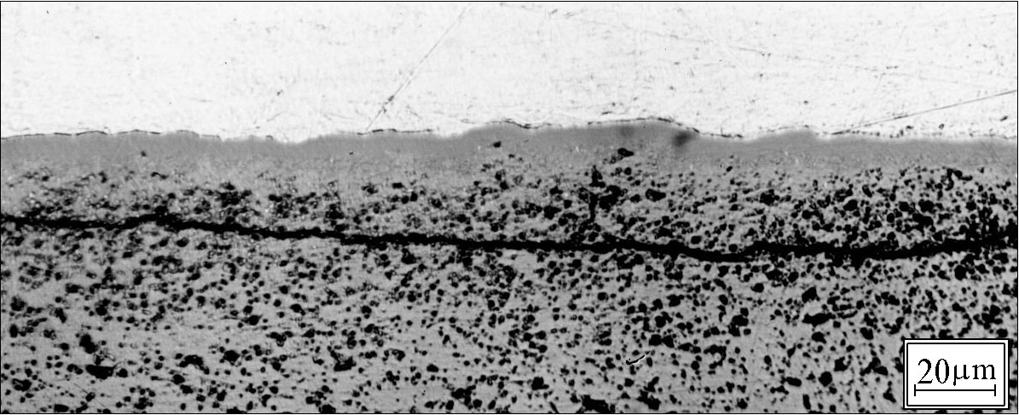
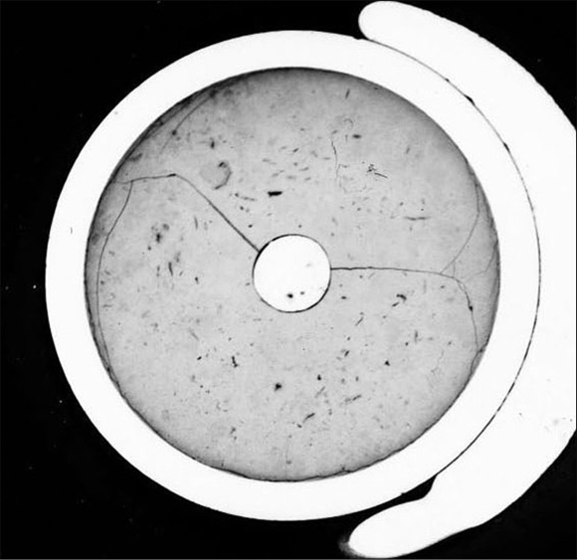
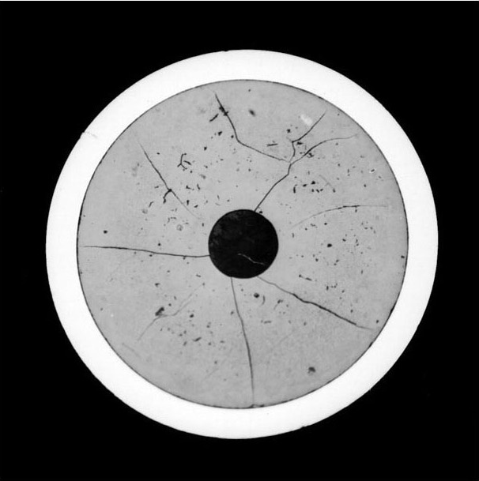
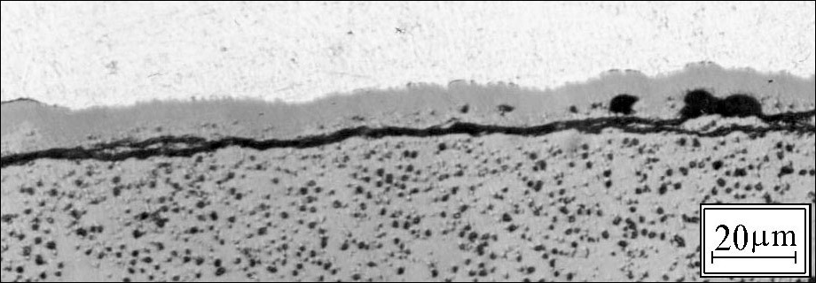
Specimen preparation
Bare fuel pellet extraction
Radial and contraction cracks in the fuel
Pellet-clad separation by heating
the pressurised rods up to 700ºC

Slide 14
Test Rig
Hot cell
Filter-
dehydrator
Condenser
Carrier gas line
(in the case
of pure steam
environment)
Additional filter
Main filter
Water collector
Pressure
transducer
Gamma-spectrometer
(FP measurement
in the filter)
Specimen
Ceramic tubes
(ZrO₂, Al₂O₃, Al₂O₃)
Flow meter
Gamma-spectrometer
(GFP measurement)
Gamma-spectrometer
(FP measurement
in the specimen)
HF coil
Main channel
(ZrO₂)
Steam overheater
(800°С)
Mass spectrometer
Specimen
holder
Protective gas line
Heater(150°С)
Intel steam line
H₂
Inlet gas line
Pyrometer
He

Slide 15
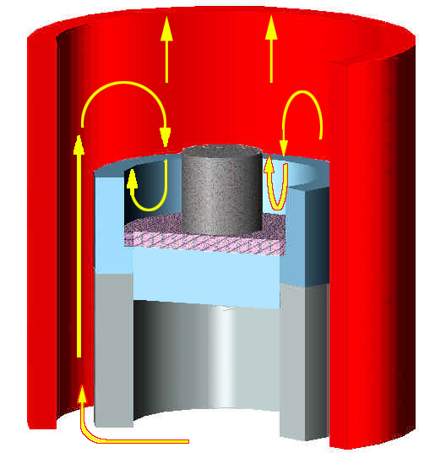
Crucible materials
Specimen UO₂(Zr-UO₂ )
Channel tube (ZrO₂ )
Crucible ZrO₂
Insulating plate (Y₂O₃ )

Slide 16
Test Regime
Test temperature
heating in the inert atmosphere up to the temperature of 600 °C
heating from 600 up to 1400 °C with a rate of 1 K/s
annealing at 1400 °C during 1 hour
heating with a rate of ~ 1 K/s up to the specified temperature (1700 or 2300 °C)
annealing during 30 minutes
end of heating

Slide 17
Test Performance
Parameters to be measured during the test
  intensity of GFP in the delay coil
  intensity of FP in a fuel specimen
  intensity of FP on the main filter
  hydrogen concentration in the carrier-gas after passing through the heater
Results to be obtained
  relative FP release
  hydrogen generation

Slide 18
Post-Test Examinations
Optical metallography
  grain size
  porosity
  gas swelling
EPMA and SEM analysis
  local content and radial distribution of fission products
  composition of precipitates in the fuel

Slide 19
MFPR Tasks in VERONIKA Project
Pre-test calculations for determination of the test parameters and conditions
Processing and analysis of the test results
Development and improvement of the physical models on fission products release and high burnup VVER fuel behaviour under severe accident conditions
Implementation of the developed and improved models to the MFPR code
Verification of the MFPR code against the new experimental database and other new available data at the end or during the program

Slide 20
Project Costs
The first stage
(3 years duration, 800 000 $) :
Т₁0 – beginning of the work under the project;
Т₁0+1 year – manufacturing and testing of the experimental rig
Т₁0+1 year - adaptation of the MFPR code to the new experimental rig, pre-test calculations
Т₁0+2,5 years – first series of tests (10 tests)
Т₁0+3,0 years – theoretical analysis of the obtained experimental data, development of models and codes
The second stage
(2.5 years duration, 500 000 $):
  Т₂0 – beginning of the second stage work;
  Т₂0+1 year – second series of tests (10 tests)
  Т₂0+2.5 years –post-test specimen examinations; theoretical analysis of the obtained experimental data, development of models and codes
The estimated total cost of the Project (2 stages) – 1 300 000 $

