Slide 1
International Science and Technology Center
Progress Report on the Project # 3876
Thermal Hydraulics of U-Zr-O molten pool under oxidising conditions in multi-scale approach (crucible - bundle - reactor scales)
Short title: THOMAS
(Thermal Hydraulics of Oxidising Melt in Severe (↔) Accidents)
Presented by
M.S. Veshchunov (IBRAE)
Project Manager
15th Meeting CEG-CM
Villigen, Switzerland
Paul Scherrer Institut (PSI),Labor für Thermohydraulik
March 10-12, 2009

Slide 2
General Information
Leading Institution: | IBRAE, Moscow (Nuclear Safety Institute of Russian Academy of Sciences)
Duration: Approved for funding: | 3 years July 2008
Total cost: | $ 305 000

Slide 3
Non-CIS Collaborators
FZK | Forschungszentrum Karlsruhe GmbH | Germany Karlsruhe
ITU | European Commission Joint Research Centre Institut für Transurane | Germany Karlsruhe
IRSN | Institut de Radioprotection et de Sûreté Nucléaire | France Cadarache
CEA | Commisariat à l’Energie Atomique | France Cadarache
IVS Trnava | Inžinierska výpočtová spoločnosť Trnava, s.r.o., | Slovak Republic

Slide 4
Project Objectives
On the base of analysis of available test data from small - and large - scale experiments, to develop a mechanistic description of U-Zr-O molten pool behaviour in oxidising conditions.
For this purpose, to carry out a tight coupling of the two advanced numerical tools developed within the previous Project #2936: the SVECHA physico-chemical (molten pool oxidation) model and the 3D thermo-hydraulic code CONV.
This will allow extension of thermal hydraulic consideration of oxidised melt from small scales (crucible tests) up to a large scale (reactor pressure vessel), including an intermediate scale corresponding to molten pools in bundle tests.
As a result, improved interpretation of the Phebus FP bundle tests observations of corium melt oxidation, as well as transposition of thermal hydraulic consideration from test to reactor scale, are foreseen.
The developed and verified models will be further used for benchmarking and improvement of simplified models of various system codes such as ICARE/CATHARE, ASTEC or Russian severe accident code SOCRAT.

Slide 5
Technical Schedule
Task 1. Development and Improvement of the Physico-Chemical Model for the U-Zr-O Melt Oxidation on the Base of New Crucible Tests (1-6 QUATERS)
Task 2. Development and Improvement of the Unified Thermal Hydraulic Technique (CONV Code) for Simulation of Multiphase Processes in Complex Domains of Convectively Stirred Melt (1-6 QUATERS)
Task 3. Tight Coupling of the Two Advanced Tools: the Physico-Chemical (Molten Pool Oxidation) Model and the Thermo-Hydraulic Code CONV, for Realistic Mechanistic Description of U-Zr-O Molten Pool Behaviour in Oxidising Test Conditions (7-10 QUATERS)
Task 4. Extension of the Thermal Hydraulic Consideration of Oxidised Melt from Small Scale (Crucible Tests) up to a Large Scale (Reactor Pressure Vessel), Including an Intermediate Scale Corresponding to Molten Pools in the Bundle Tests (11-12 QUATERS)

Slide 6
Task 1. New (proposed) crucible tests for simulation of molten pool oxidation
Proposed crucible isothermal tests with “cold” ceramic walls and “hot” free oxidizing melt surface with inductive heating of metallic melt should model molten pool (MP) oxidation in the lower head of the (cooled) reactor vessel
tests at the LAVA facility (FZK) is under preparation
Oxide crust
Steam
Steam
Oxide crust
Zr-O
ZrO₂
Molten corium
Lower head

Slide 7
Pre-test simulation of melt oxidation
(previous Project #2936)
2-d model predictions for “cold” ceramic walls (ΔT_{w} < 0) and “hot” free surface (ΔT_{up} ≥ 0) at the MP temperature 2540K
ZrO₂ crucible parameters: R = 36.5 mm, h = 10 mm, wall thickness 7 mm.
Charge is produced from the mixture of metallic Zr and ceramic ZrO₂ phases with the average atomic composition Zr:O = 2.7:1.

Slide 8
Main predictions of the 2-d melt oxidation model
On the base of the 2-d MP oxidation model simulations of melt oxidation in simplified crucible tests, the following qualitative conclusions can be derived:
In oxidizing atmosphere the oxide crust growth will take place on internal side of the walls accompanied with (possible) precipitation of ceramic phase in the melt bulk
The total kinetics of melt oxidation obeys a (close to) linear (rather than parabolic) time law, owing to quick stabilisation of oxide crust thickness at the melt/steam interface.
After relatively quick attainment of steady-state conditions with oxide crust thickness of several mm (≈ 0.1 d_{wall}):
  cooling of the MP through walls can be significantly suppressed;
  the MP temperature will further increase;
  corrosion (oxidation) at the interface between the oxide crust and the wall will occur (METCOR Project).
For quantitative predictions to large scales (RPV) the model should be coupled with the thermal-hydraulic code CONV

Slide 9
Main stages of corium/SS walls interactions
Transient stage: rapid ablation of SS and formation of solid (or mushy) crust controlled by (rapid) heat exchange processes (+ possible mixing) neglecting (slow) diffusional redistribution of components (CONV code)
Steady state stage: self-consistent consideration of heat- and mass exchange processes in steep temperature gradient and oxidation from melt :
  Conversion from mushy to solid crust (a new model is developed)
  Crust growth (simultaneous; available model is adapted to 2-d geometry)
  Corrosion (oxidation) of SS walls, in two stages:
    Initial (reduction of “excessive” oxygen in the crust): ~ few hours (~ d²/D_{ox} )
    Late (oxygen diffusion in concentration gradient of (U,Zr)O_{2-x} [x_{min}(T₊), x_{min}(T₋)])

Slide 10
Oxygen diffusion through the solid crust
Initial stage
T
T₊
c_{O}
T₋
c_{min}(T₊)
c_{min}(T₋)
J_{ox}
U-Zr-O melt
(U,Zr)O₂
x
SS
T
Solution of diffusion equation ⇒
T₊
c_{O}
T₋
c_{min}(T₊)
Late stage
J_{ox}
c_{min}(T₋)
U-Zr-O melt
(U,Zr)O₂
x
SS

Slide 11
Oxygen diffusion through the mushy crust
Brody-Flemings approximation (local equilibrium between solid and liquid phases in two-phase zone):
  Justified and simplified for a relatively thin mushy zone
  Supplied with flux matches at mushy zone interfaces
  Solution:
  corresponds to the Mullins-Sekerka criterion for plane front instability (i.e. completely self-consistent consideration)
  Accepted for publication: Journal of Eng. Thermophysics (2009)

Slide 12
Corrosion of SS walls
Available SVECHA model
Parabolic correlation from KI tests (06Х18Н10Т steel)
To be modified using METCOR data for 15 Kh2NMFA steel
“Oxygen starvation” regime: oxygen flux J_{ox} through the crust (above calculated) is rate controlling during relatively long period of interactions

Slide 13
Conclusions
Task 1 of ISTC Project #3876 is under development in accordance with the Project Technical Schedule:
  The existing model for U-Zr-O melt oxidation was updated to the 2-d case corresponding to a more realistic geometry of molten pool in crucible tests;
  Main stages of corium/SS walls interactions were analysed, and new models of heat- and mass-exchange processes in steep temperature gradient and oxidation from melt were developed, including:
    Crust growth and conversion from mushy to solid crust;
    Corrosion (oxidation) of SS owing to interaction with the crust, using METCOR data.
  The foreseen by the Project schedule FZK new crucible tests are under preparation

Slide 14
Task 2. Scope of Current Activities
Task 2.1 (1 and 2 quarters)
Modernization of the existing code CONV, including into the code of:
  a new procedure for solving elliptical equations with boundary conditions of Neumann for the correction of pressure, and
  new developed computing scheme of the highest order accuracy for solving of equations system of Navier-Stokes
    Preliminary results by parallelization of CONV code.

Slide 15
Modernization of CONV code
Preprocessing
  Connection with modern CAD systems
  Immersed boundaries methods
Methods
  A new procedure for solving elliptical equations for pressure correction:
    New iterative FFT solver for solving of the selfadjoint and self-consistent grid elliptic problem for pressure
    The Richardson iterative method with Chebyshev’s set of parameters using preconditioner FFT solver for Laplace’s operator
  A new developed numerical scheme of the highest order of accuracy for solving of Navier-Stokes equations
  Algorithms with small scheme diffusion
  Non-dissipative conditionally monotonic difference scheme for solving of an advection equation
Postprocessing
  temporary characteristics and multidimensional fields for velocity, pressure, temperature in format (*.dat) for TECHPLOT
  Calculation of heat flux fields at the curvilinear surfaces

Slide 16
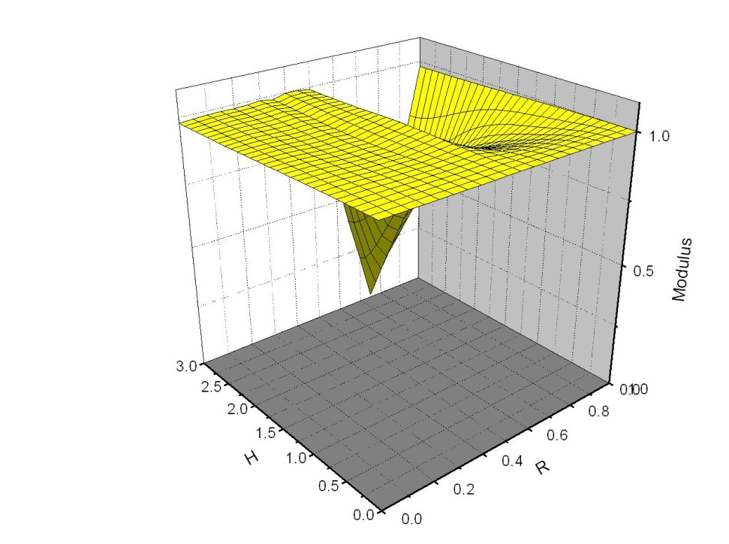
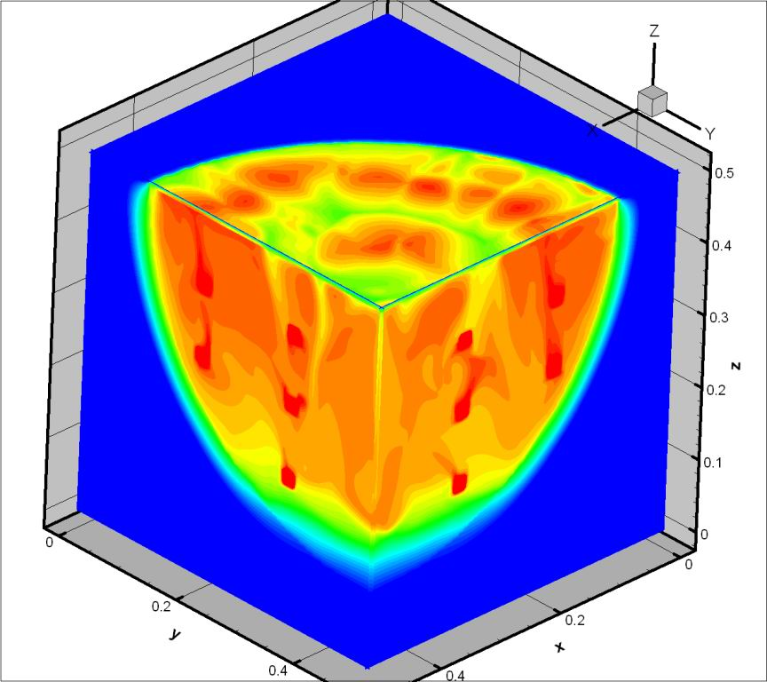
Non-dissipative conditionally monotonic difference scheme for solving of advection equation
Natural convection Ra=10¹²
Algorithms with small scheme diffusion
Non-dissipative conditionally monotonic difference scheme for solving of advection problem near upper boundary with high accuracy
Dissipative surface
R- Courant number; H- wave number;

Slide 17
Choice of Optimum
Turbulence Model
Quasi DNS approach
Approximating turbulence model
k-e model
Large Eddy Simulation with explicit filtration
  ν^{T}- turbulence viscosity
  Reloc -local Reynolds number
  Recrit- critical Reynolds number
  Ra- Rayleigh number
  PrT- turbulent Prandtl number
  f(Ra) - function of Rayleigh number, calibrated by numerical calculations of natural convection in а cavity with walls of different temperature.
  Ri -Richardson number, estimated by Prof. Kondratenko (IBRAE) 0.1÷1.
In implementation process

Slide 18
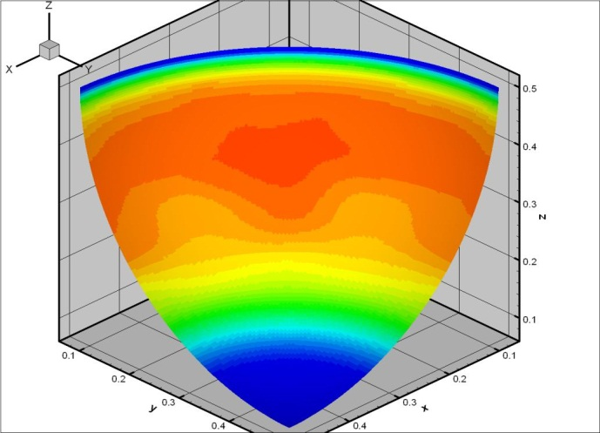
New Analysis of Tests Performed under
Similar to LIVE Conditions
Comparison of uniform and circular heating
Circular heat: Ra=10¹²
Nu vs Ra at different heating conditions:
Comparison with correlations (Proc. of Workshop on Large molten pool heat transfer, Grenoble, France, 1994)
Calculations were expanded up to 10¹³

Slide 19
Preliminary results by parallelization of CFD code CONV
MPI technology with distributed memory
Open MP technology with shared memory
Explicit approximation convective and diffusion operators in Navier-Stockes and energy equations
N processors | Speedup
1 | 1
2 | 1.7
8 | 4.9
16 | 8.4
Explicit approximation convective and diffusion operators in Navier-Stockes and energy equations
N processors | Speedup
1 | 1
2 | 1.6
4 | 2.6
8 | 4.1
Speedup equals 5х10⁻⁶ second for 1 time step per 1 mesh node (1proc.)
OpenMP (Intel Xeon 5300 Shared Memory):
  Calc. 1 time step on the grid 100**3 nodes occupies 5 seconds (1proc.)
  Calc. 1 time step on the grid 200**3 nodes occupies approx. 10 sec. (8 proc.)
MPI (Intel Xeon 5300 Distributed Memory) :
  Calc. 1 time step on the grid 200**3 nodes occupies approx. 3 sec. (32 proc.)
Calculation by means of QDNS for Ra <=10¹² may be conducted in real time

Slide 20
Conclusions
Task 2 of ISTC Project #3876 is under development in accordance with the Project Technical Schedule:
  The code CONV was modernized by including a new procedure for solving elliptical equations for the correction of pressure and new developed numerical scheme of the highest order of accuracy for solving of Navier-Stokes equations.
  For simulation of turbulence flows the quasi direct numerical simulation (QDNS) approach and improved algebraic turbulence model were implemented in the CONV code. The applicability of the developed turbulence approach was proved by the extensive validation against the 2D and 3D experiments.
  The preliminary parallel multiprocessor version of CONV code was developed for multidimensional modeling of thermal hydraulics processes. The outcomes demonstrate increasing of speedup for the parallel version CONV code in comparison with its PC analog.

