Slide 1
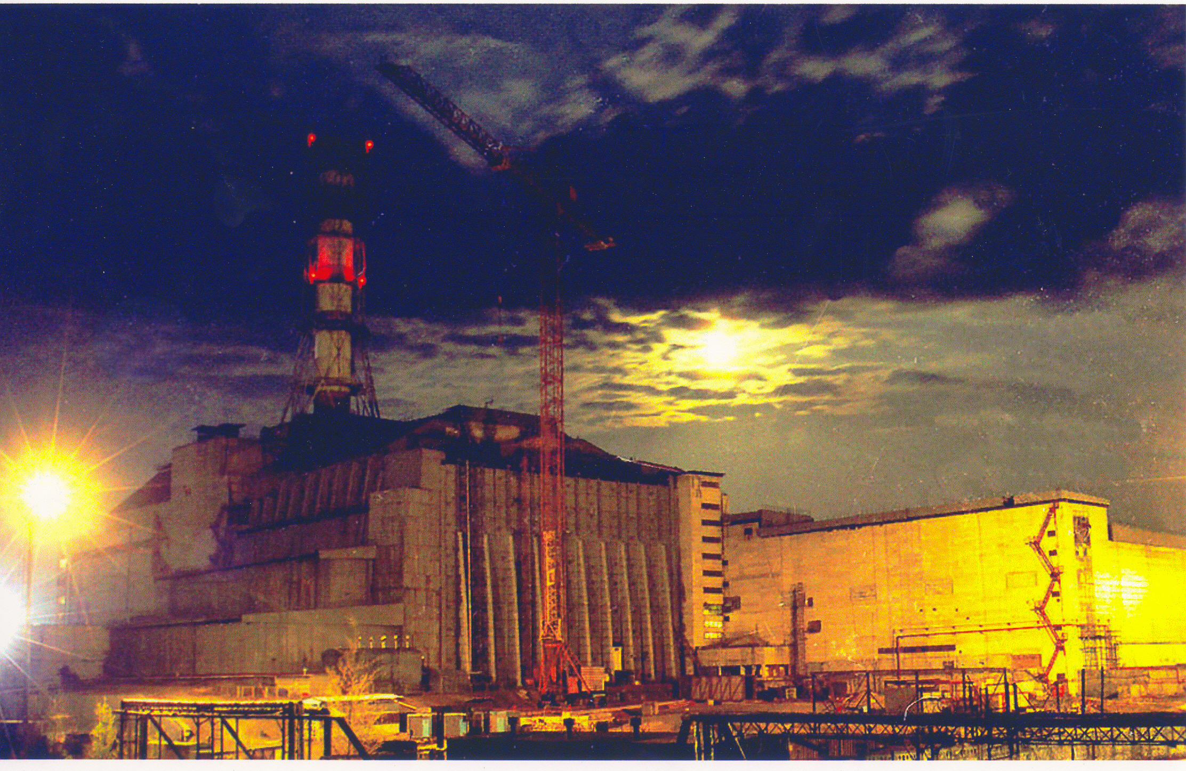
ESTIMATED EXPERIMENTAL RESEARCHES
TO CHARACTERIZE HIDDEN NUCLEARLY HAZARDOUS
CLUSTERS OF FUEL CONTAINING MATERIALS
IN DESTROYED ChNPP UNIT 4
UNAS Cor. Memb. TSD Klyuchnykov O.O., TSC – Vysotskiy E.D. PMSC- Shostak V.B.
Institute for safety problems of NPPs
National Academy of sciences of Ukraine
Chernobyl, 2008
Notes:
1

Slide 2
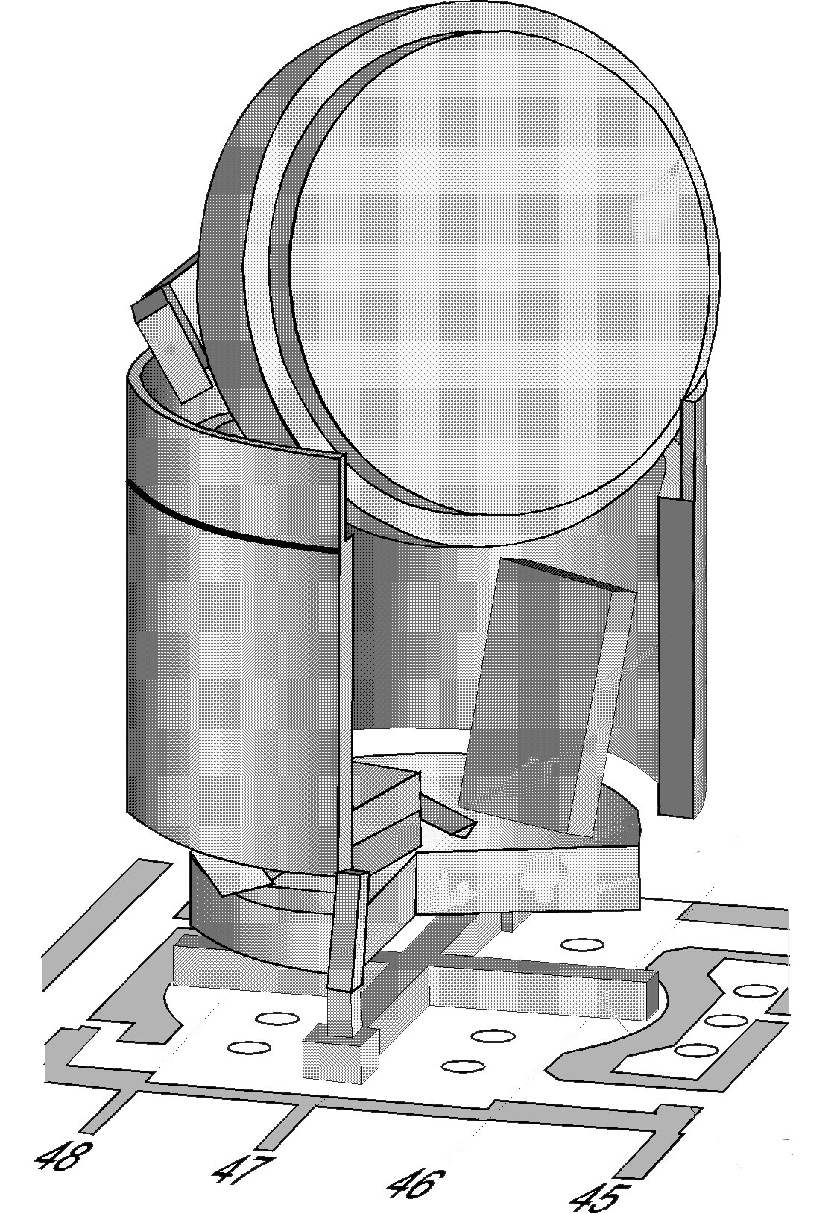
Fig. 1. Reactor vault and under reactor room 305/2 after accident (reconstruction)
Reactor basis (RB)
South-east quadrant of under reactor room. Lava fuel containing materials (LFCM) formation and outcome place
Reactor foundation plate – 2 meters of monolith concrete
Room 304/3

Slide 3
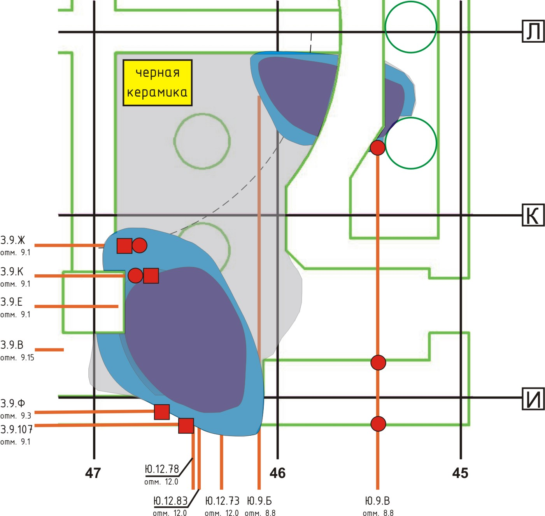
Fig. 2. Boreholes in foundation plate
Drilling boreholes in direction to premises 305/2 were carried out in 1987-1990 with the aim to identify LTCN layout boundaries.
Drilling process was stopped, when the activity of withdrawn cores testified the fact, that drilling tool entered a LTCM cluster with high fuel content.
Considering the above, one should assume that bottom holes of such boreholes, which were not drilled to the end (З.9.Ф, З.9.Ж, З.9К, З.9.Е, Ю.9.Б, Ю.9.В), reached the boundaries of LTCM clusters with high fuel content hidden under the concrete.
Black ceramics
З.9.Л
Melting-through areas
Drill boreholes

Slide 4
Fig. 3. Temperature measurements
Temperature fields indicated the presence of heat emanation sources in separate parts of subreactor plate.
Measurements of heat flows enabled making approximate evaluation of fuel amount within the area of clusters (around 50 tons uranium).
Currently, temperature within the area of cluster located in south-east part of premises 305/ 2 exceeds the temperature on subreactor plate peripheria at more than 20 °С (Fig. 4). Outflow of warm water is periodically observed within the cluster area
Temperature fields in FP room 305/2 (October, 1988)

Slide 5
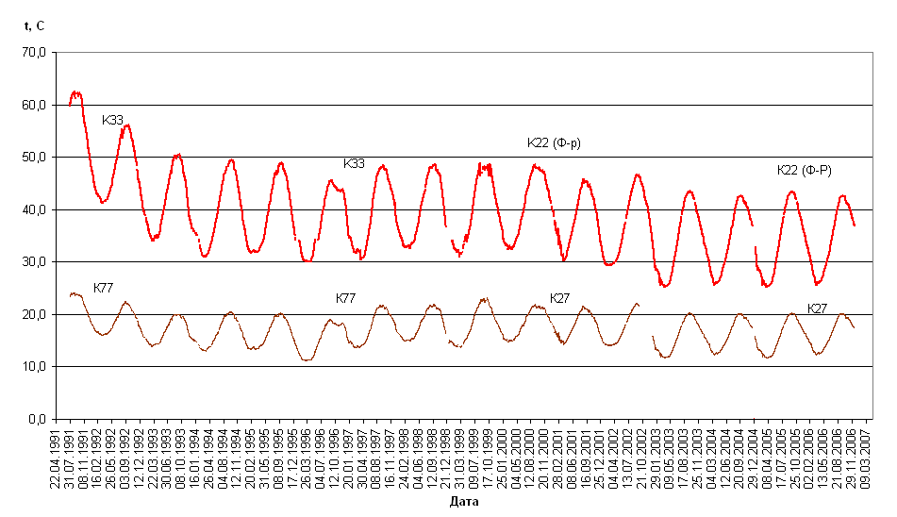
Fig. 4. Dynamics of temperature changes on melting area periphery and foundation plate

Slide 6
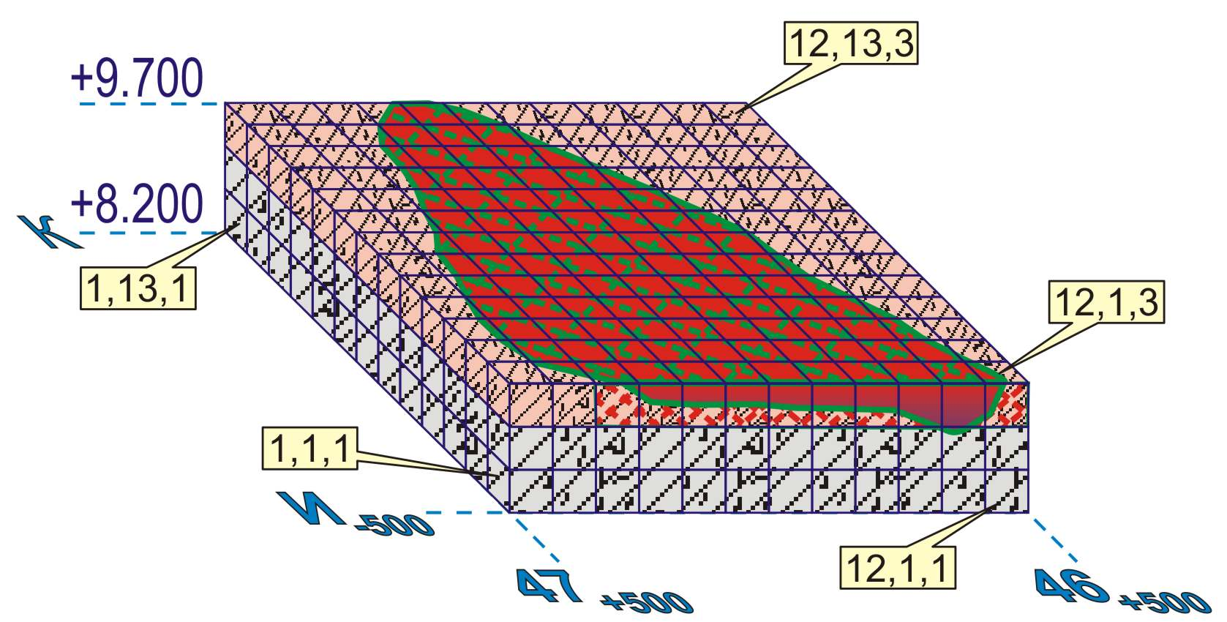
UO₂ (maximum) = 30 %
Fig. 5. Model &
neutron-flux density distribution

Slide 7
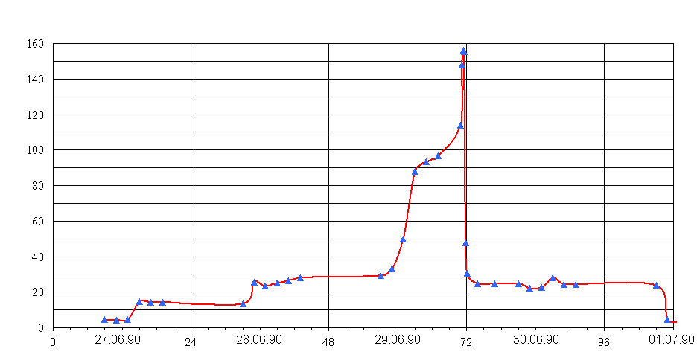
Fig. 6. Neutron incident in room 305/2, June, 1990. Neutron detector reading in room 304/3
b) Filling of neutron absorber -gadolinium led to sensors blocking
- control points
Channel count speed, imp/sec.
c) Self-dumping of incident occurred after 36 hours as result of probable over-wetting of multiplying medium of clusters.
Currently, clusters are permanently located in water, whose level does not drop below building mark + 9.10 m.
а) Neutron sensors located in neighboring premises 304/3, fixed consequent increase in flux density of neutron leak (via 1-m concrete wall) from premises 305/2 in more than 60 times (1-4*10⁻³ β)

Slide 8
Fig. 7. Temperature in foundation plate, 1988-1991
A version of incident reasons was water penetration within clusters area.
Period of intensive precipitation in 1990
Release of energy
(relative units)
а) In early 1990, clusters temperature dropped below 100 °С
b) Water coming via roofing cracks into «Shelter» object during March – April 1990 and intensive precipitation in June resulted in impregnation of LFCM clusters with water.

Slide 9
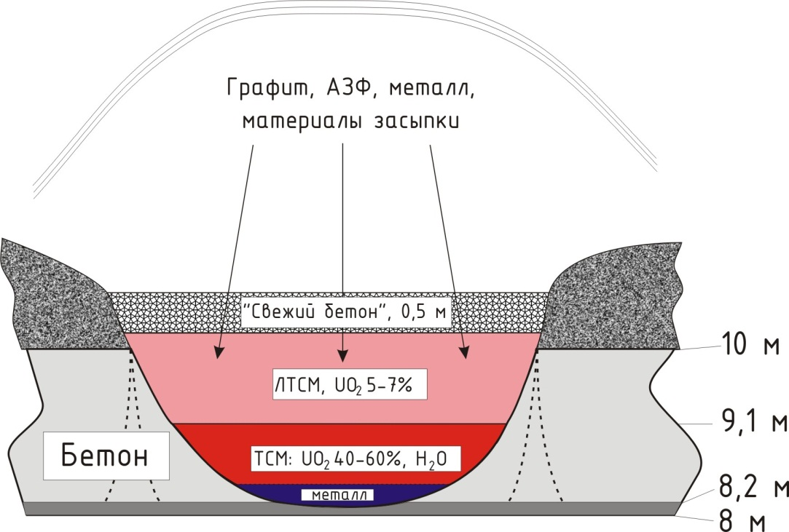
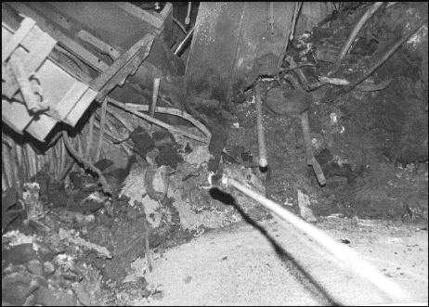
Fig. 8. FCM organization process and cluster structure
Graphite, active zone fragments, metal, filling up materials
“fresh” concrete, 0,5 m
Concrete
Southern melted-through area surrounded by “charge”, which is formed in result of explosion and destruction of active zone (AZ). “Charge” around concrete area fully melted and burned out. Fuel is sinked in melted-through area.
LFCM cluster, covered by “fresh” concrete layer

Slide 10
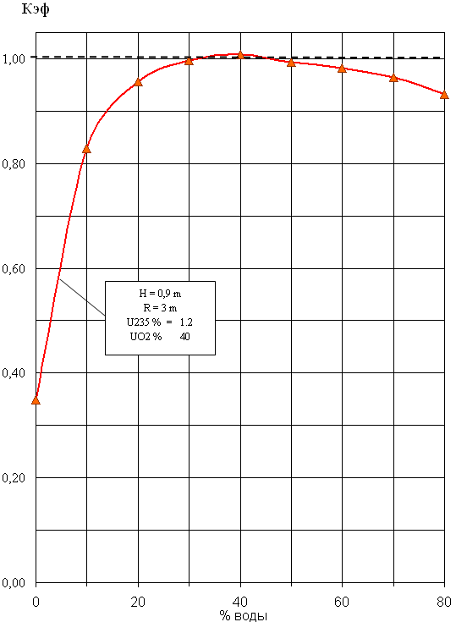
Fig. 9. Dependence of binary system (UO₂+SiO₂)Kef with total concrete reflector under concentration of UO₂ – 40%, U²³⁵ – 1,2%
Multiplying system is modelled in geometry written in size of southern meling area. Binary system has homogenous structure with porosity from 40 to 60%. U235 concentration to 1,0-1,2% corresponds to burnup of 11-13 MW*day/kg (U). Model height is restricted by water level in melting area. Calculations was made in MCNP-4 software complex.
Today, foundation plate LFCM are located in water in subcritical state.
b) At the beginning of the 1990, temperature in clusters dropped below 100°C and LFCM appears in water. In June, 29 1990 was peak of neutron incident.
а) In 1988, temperature in LFCM clusters was above 200°C.
water volume, %

Slide 11
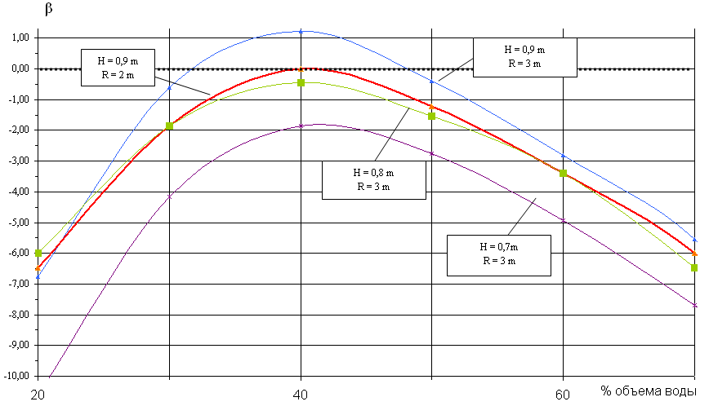
Fig. 10. Multiplying system reactivity within optimal damping area
(UO2 – 40%, U235 – 1,2%)
Minimal geometry of cylinder

Slide 12
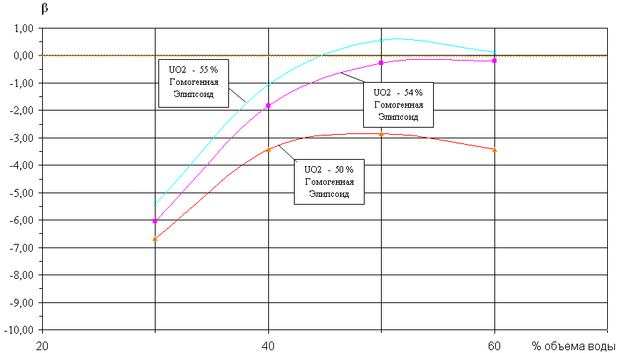
Fig. 11. System reactivity in optimal damping area
(UO2 - 50-55%; U235 - 1%)
Burning increase ubder tge same system volume leads to offset of higher fuel concentration, as well as to increase in needed volumes of moderator.

Slide 13
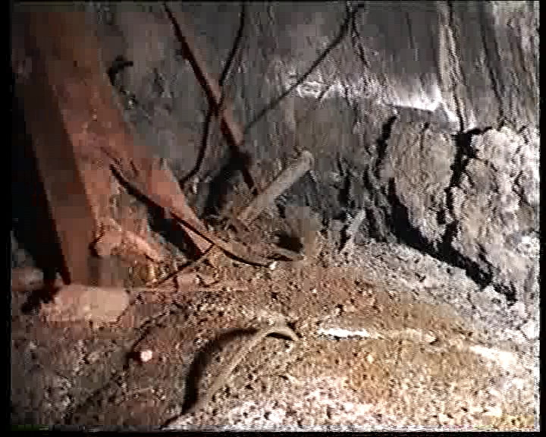
Fig. 12. Northern melted-through area
Concrete pedestal
“grotto”
Melted-through area
“fresh” concrete

