Slide 1
ISTC project K-1265:
Experimental study of core melt in-vessel retention
IN-VEssel COrium Retention (INVECOR)
Presented by Vladimir Zhdanov
IAE NNC RK
CEG-SAM 16th Meeting,
September, 08 – 09, 2009
Moscow, Russia

Slide 2
Presentation contents
Introduction
Main directions of work and results
  Preparation and results of large-scale calibration tests in LAVA-B facility
  Preparation and results of 1st integral large-scale test
  Proposals for the 2nd and 3rd INVECOR tests
Summary

Slide 3
Introduction
Project K-1265 has been started from May 1, 2006. It is 14th quarter of Project performance. Planned date of project finishing is October 31, 2009
Technical report on 3 years of Project performance is available in CEG-SAM web-site
Operations are fulfilled according to the Work Plan.
Ongoing tasks are:
Large scale tests for research of corium pool behavior during IVR with imitation of decay heat
Post-test analysis after INVECOR experiments.

Slide 4
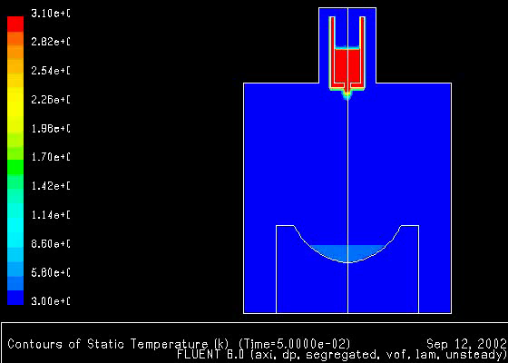
Corium melt preparation
Pyrometer
Heat exchanger
Water cooled housing
Graphite crucible
Thermal insulation
Inductor
Scenario of corium melt discharging
Bottom supporting sleeve
Device for plug splitting
Electric melting furnace (EMF)

Slide 5
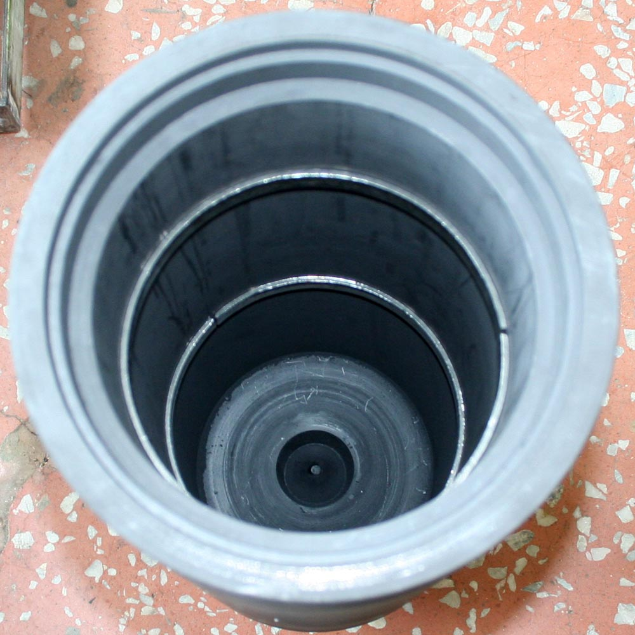
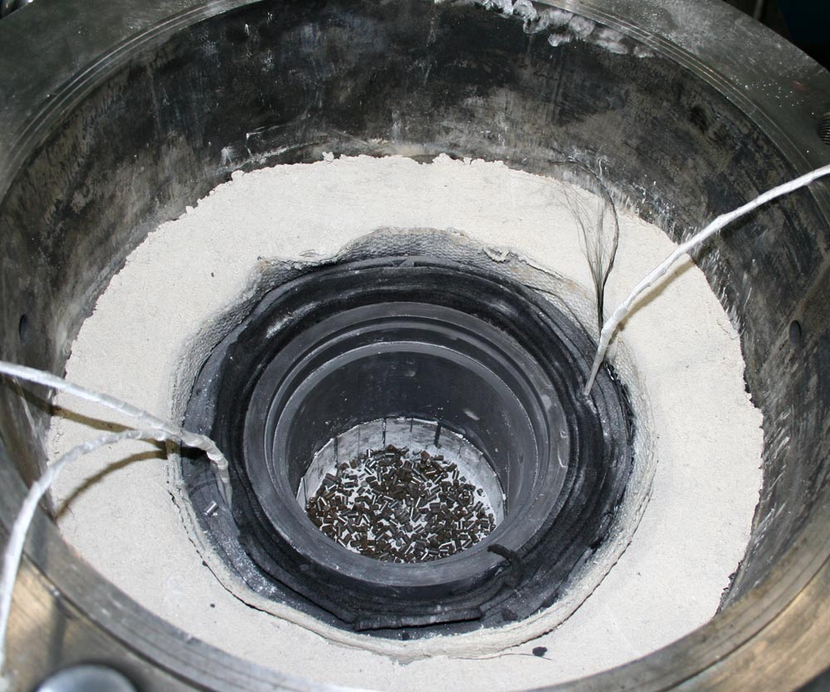
Preparation of EMF for test
For protective coating application
For corium components melting

Slide 6
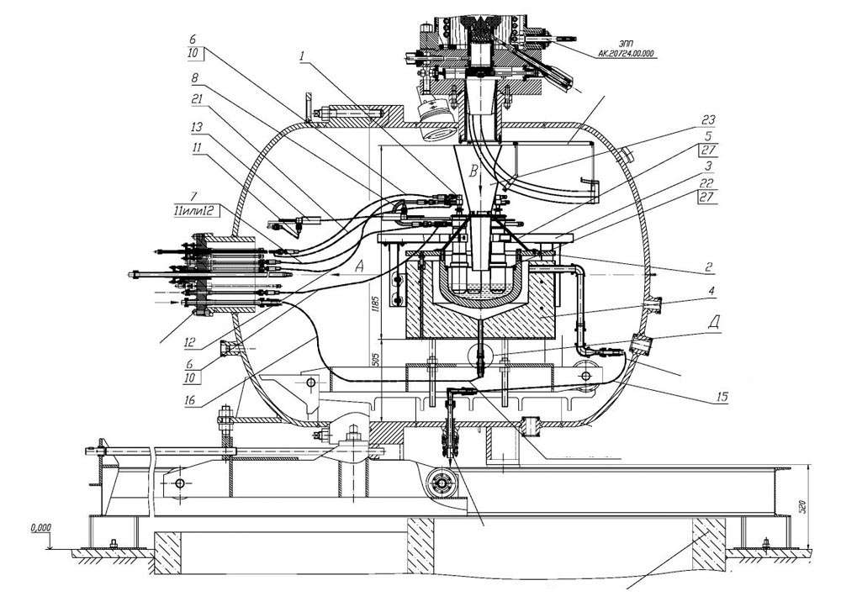
Preparation of test section (1)
Test section in the pressure vessel of LAVA-B facility

Slide 7
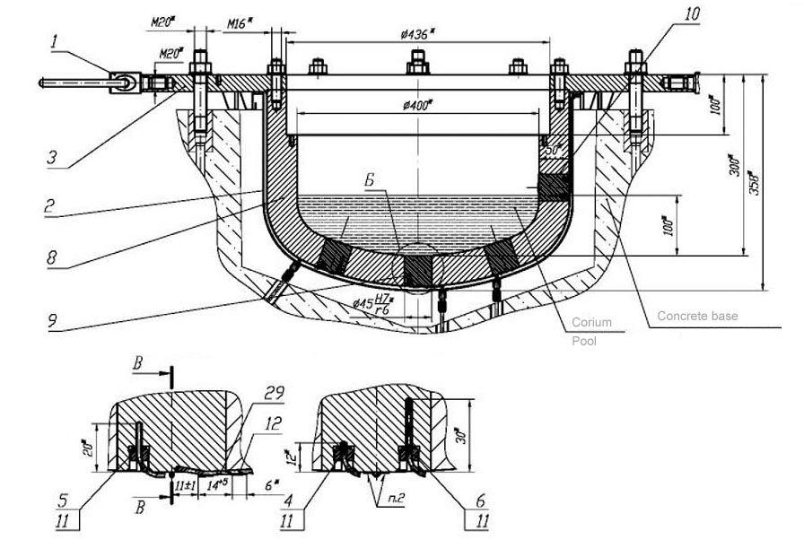
Preparation of experimental section (2)
Thermocouples location in RPV model

Slide 8
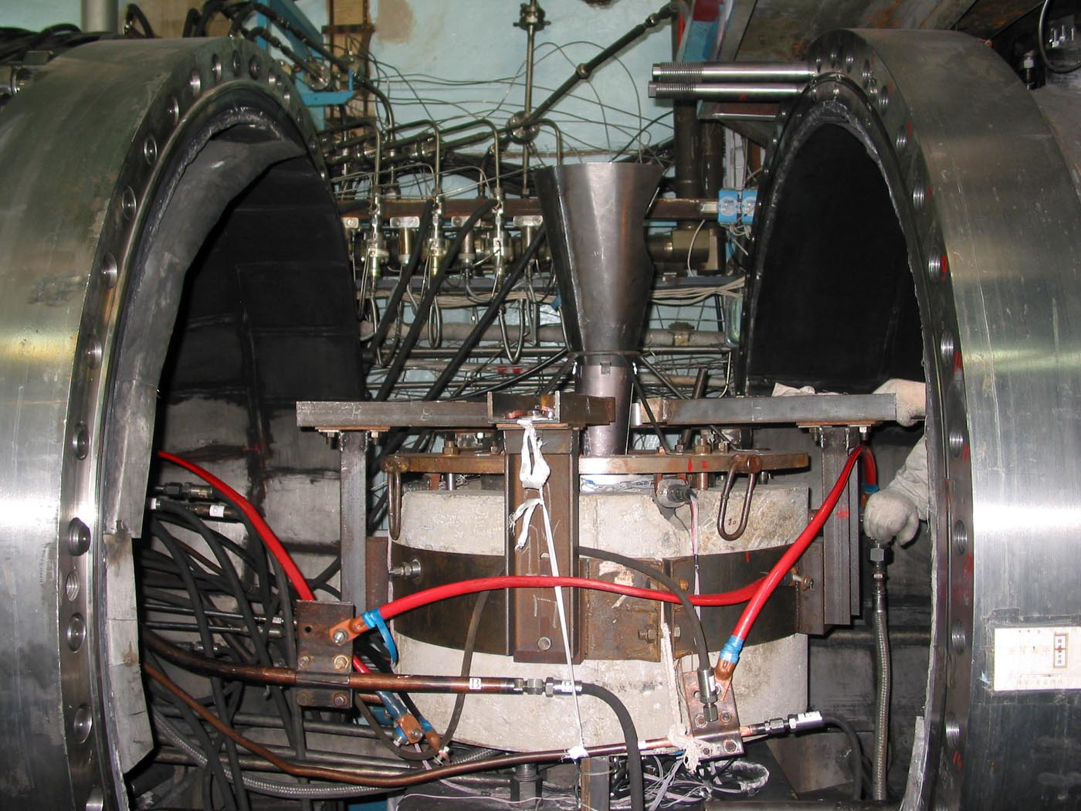
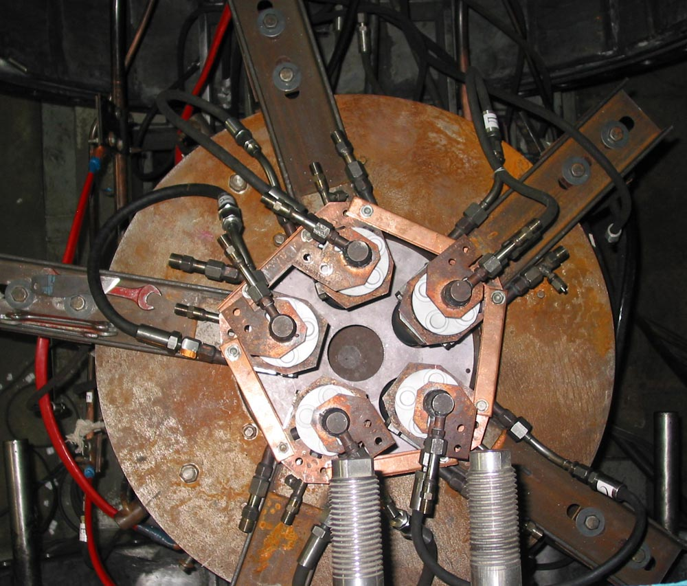
Preparation of experimental section (3)
Test section top view
Test section in LAVA-B facility

Slide 9
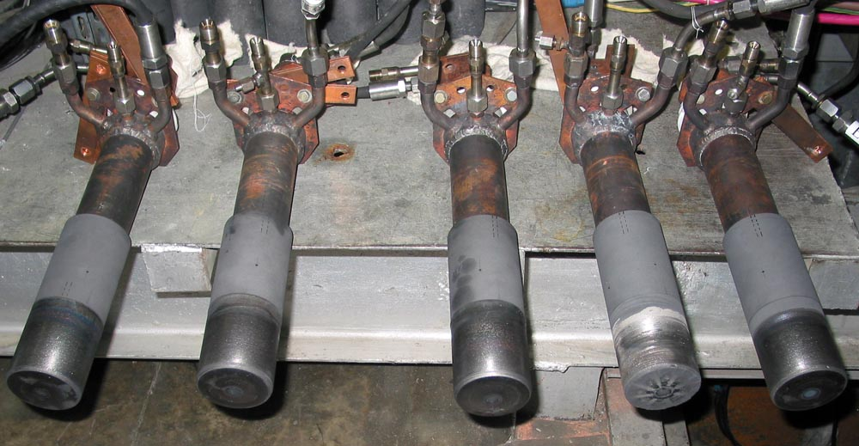
Preparation of experimental section (4)
Coaxial plasmatrons before test

Slide 10
First calibration test (1)
Diagram of corium heat-up
Test was interrupted due to an accident in electric power supply substation

Slide 11
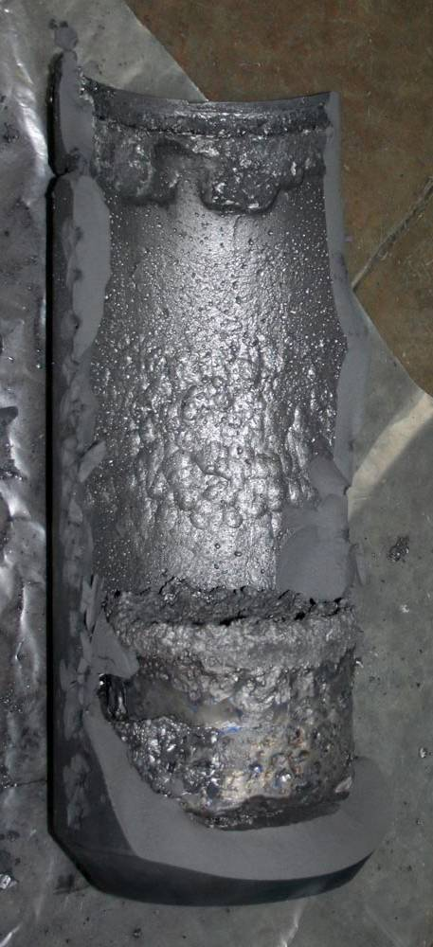
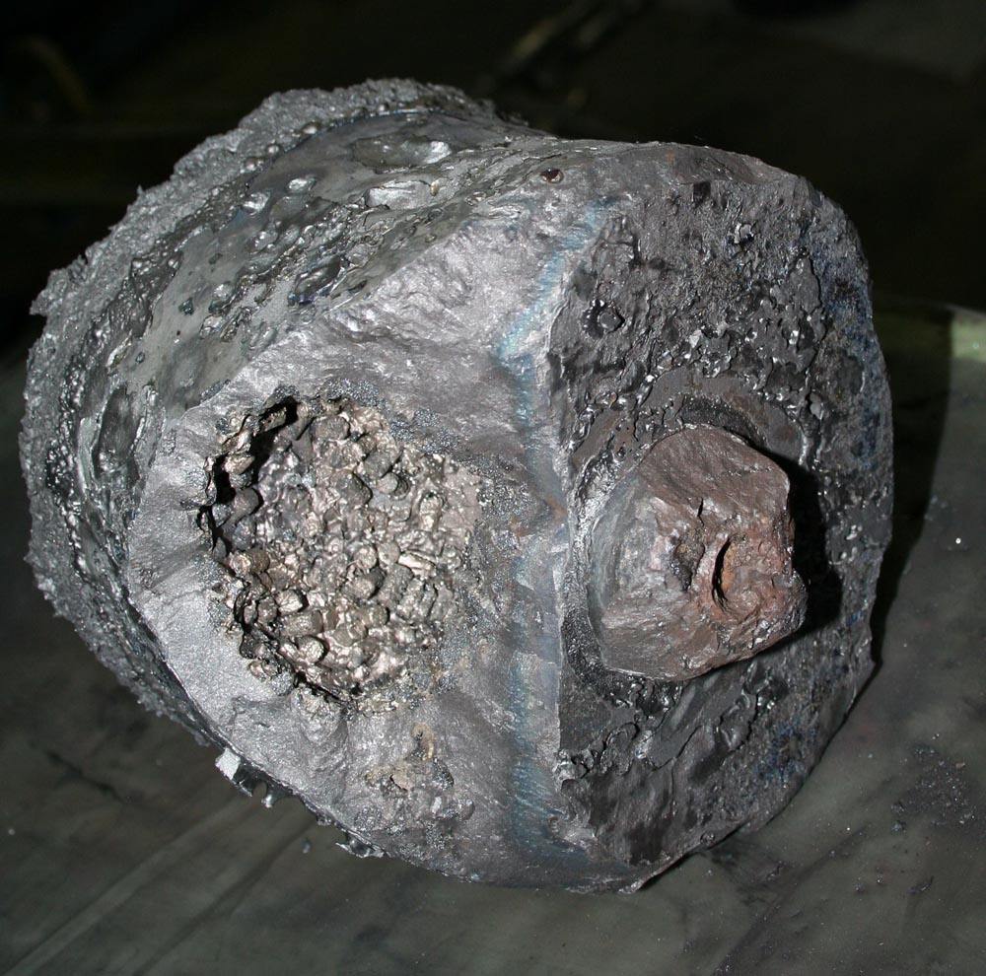
First calibration test (2)
Crucible with remained corium

Slide 12
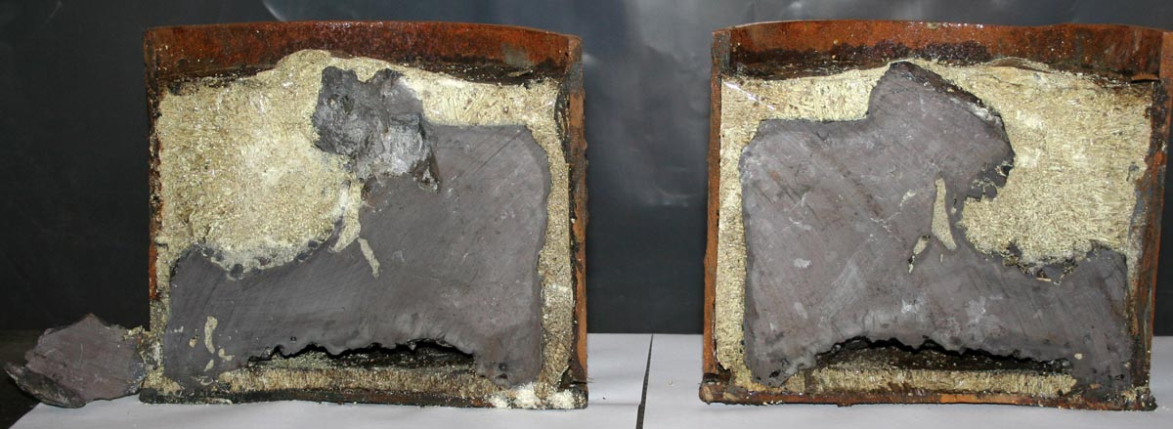
First calibration test (3)
Cross section of corium ingot
Corium composition: U_{0.95}Zr_{0.05}O₂ ÷ U_{0.8}Zr_{0,2}O₂
Fragments of this ingot were used in the subsequent test for addition into RPV model

Slide 13
Second calibration test (1)
Diagram of corium heat-up

Slide 14
Second calibration test (2)
Temperature of RPV model wall

Slide 15
First integral test (1)
Diagram of corium heat-up
10 kg of once molten corium (after 1st calibration test) was added into RPV model before start of test

Slide 16
First integral test (2)
Temperature history in the RPV model after corium melt discharging

Slide 17
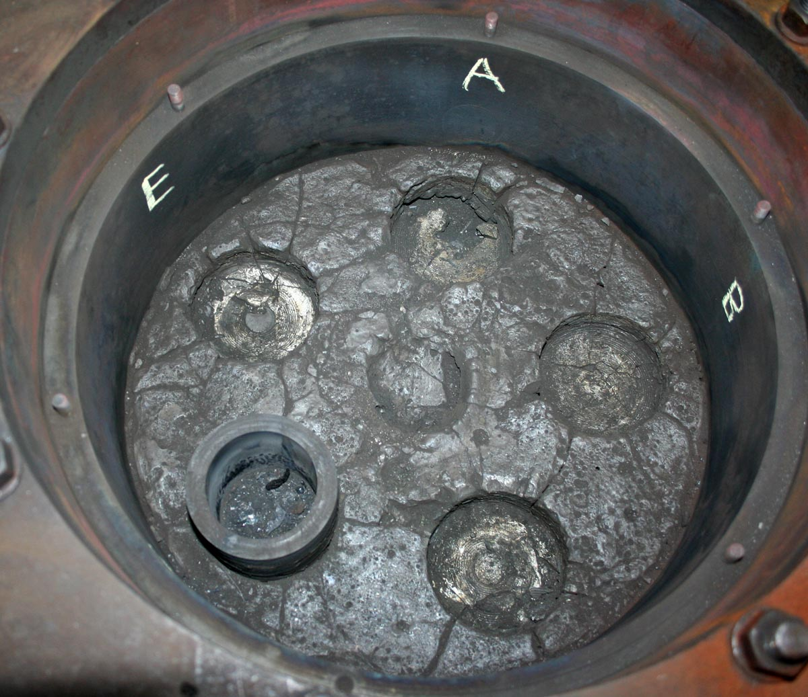
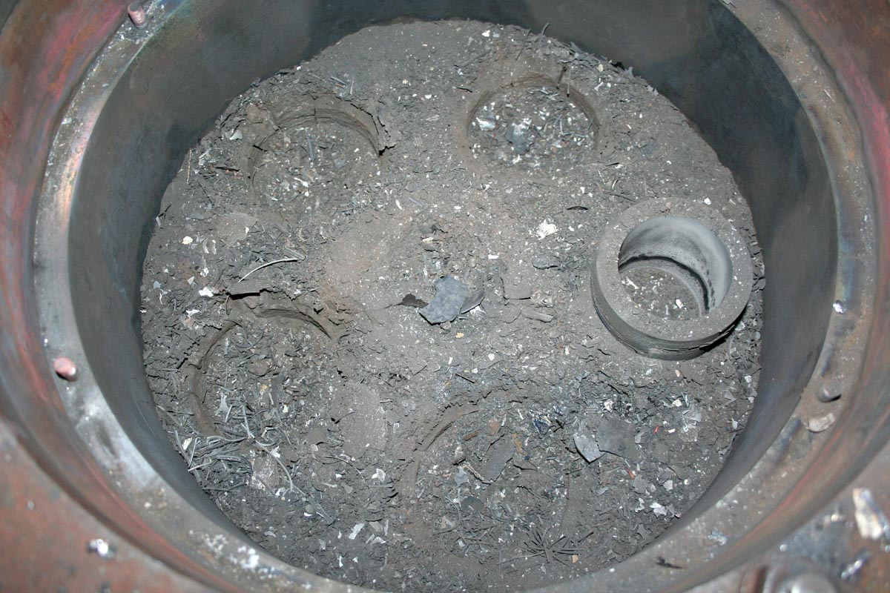
First integral test (3)
Total
(∼50 Kg)
After friable debris removal
(∼45 Kg)
View of solidified corium in RPV model

Slide 18
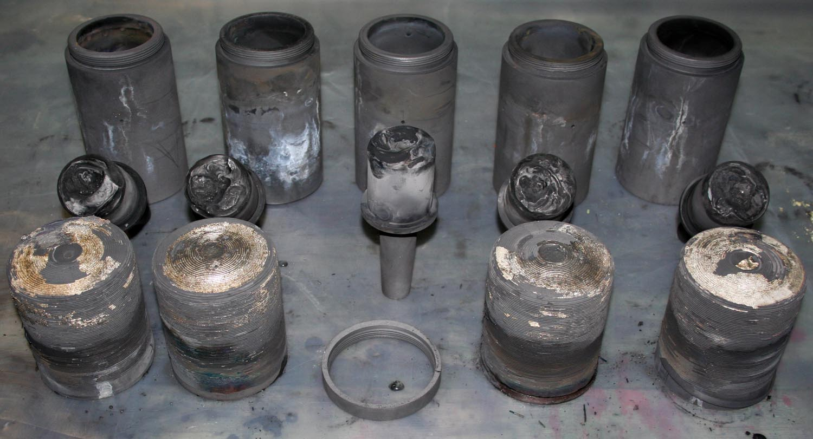
First integral test (4)
State of plasmatrons nozzles after test

Slide 19
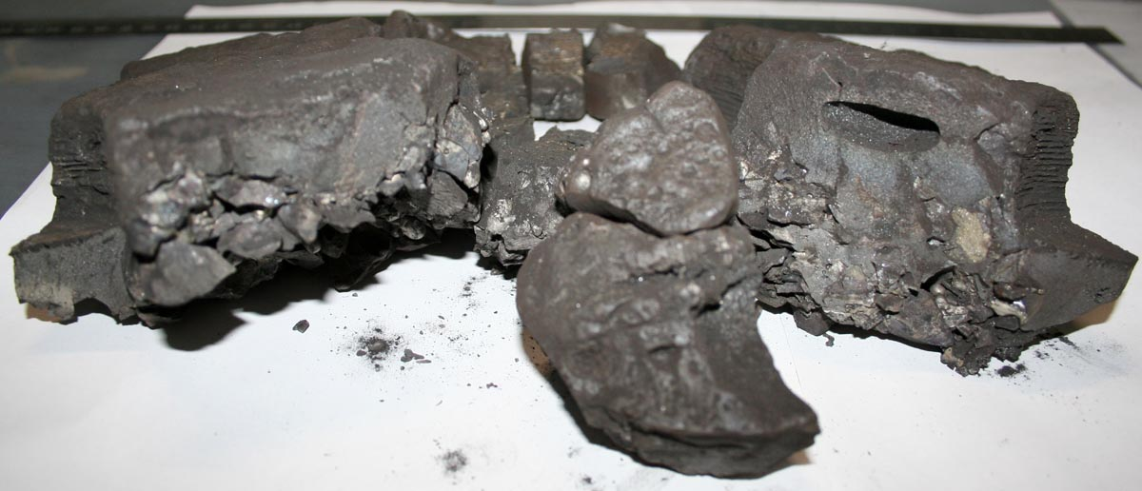
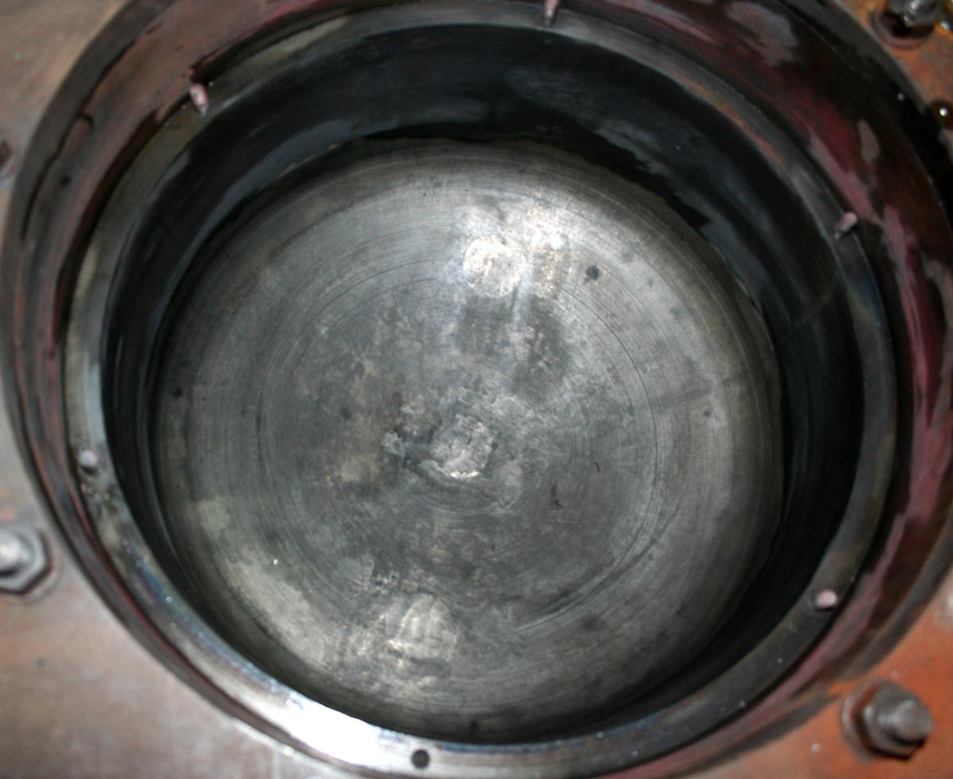
First integral test (5)
Fragments of corium ingot
(maximum thickness is 8,8 cm)
State of RPV model after
solidified corium removal

Slide 20
Condition for 2nd integral test (1)
To improve the plug split mechanism operation;
To increase the thickness of thermal insulation in the bottom part of RPV model for obtaining of uniform heating of vessel wall;
To switch on the plasmatrons earlier before corium melt discharge to heat up the RPV model up to 800 °C at least;
To place the stainless sheet on the bottom of RPV model to imitate the VVER vessel design;
To install the thermocouple in the upper thermal screen;
To increase the total power of plasmatrons during the test;
Duration of experiment should be not less than 2,5 hours.
Planned date of test conduction – September, 29

Slide 21
Condition for 2nd integral test (1)
Plasmatrons
RPV model
Ta - screen
SS - sheet
Corium pool
Concept of stainless steel displacement in RPV model

Slide 22
Condition for 3rd integral test
(for discussion)
Plasmatrons
RPV model
Ta - screen
SS - sheet
Corium pool
To place the stainless sheet between upper tantalum screen and top of debris bed in the RPV model to imitate the “focus-effect”;
Planned date of test conduction – October, 15

Slide 23
Summary
Main results of large scale tests are:
Corium component heat-up mode in electric melting furnace has been specified during the performed large scale tests.
Condition of the 2nd and 3rd integral tests have been developed considering the defects observed in the performed tests.
Two different ways of stainless steel addition in the debris bed have been proposed.
Protective coating has been resisted against corium attack both in the melting crucible and in the RPV model.
Post – test research of corium composition is under way. Results will be placed in CEG web-site.

