Slide 1
ISTC project K-1265:
Experimental study of core melt in-vessel retention
IN-VEssel COrium Retention (INVECOR)
Presented by Vladimir Zhdanov
IAE NNC RK
CEG-SAM 14th Meeting,
September, 09 – 11, 2008
Kiev, Ukraine

Slide 2
Presentation contents
Introduction
Main directions of work and results
  Results of additional testing of plasmatrons
  Testing of device for decay heat modeling in prototypic corium (TOP-4…TOP-7 tests)
  Comparative analysis
  Summary on TOP tests results
Conclusions

Slide 3
Introduction
Project K-1265 has been started from May 1, 2006. It is 10th quarter of Project performance (12 quarters by Work plan)
Technical report on 2 years of Project performance is available in CEG-SAM web-site
Operations are fulfilled according to the confirmed Working Plan.
Ongoing task are:
Post-test analysis after TOP experiments.
Problem of major task performance (large scale tests) are still continuing because to materials delivery delay.

Slide 4
Testing of device for decay heat modeling (1)
Testing of plasmatrons modes
Increase of plasmatrons power is possible using nitrogen as a work medium in inter-electrode space, but arc burning stability strongly depended on gas pressure in the facility pressure vessel;
Plasmatrons power is lower at usage of argon gas as a work medium, but arc burning is more stable and weakly depends on gas pressure in the facility pressure vessel;
Current in the electric arc is higher at usage of argon gas what leads to intense erosion of inner electrode nozzle (plasmatrons life-time is short)

Slide 5
Testing of device for decay heat modeling (2)
Objectives
To find the optimal gas composition and pressure in the coaxial plasmatrons and in the pressure vessel of experimental facility.
To increase the average electric power of plasmatrons.
Varied parameters
Gas composition
Ratio between pressure inside coaxial plasmatrons and pressure vessel volume
Changes of electrical circuit components

Slide 6
Testing of device for decay heat modeling (3)
Testing mode of plasmatrons
(5th experiment)
Influence of the nitrogen concentration in a mix of gases
on plasmatrons power
Experimental data show, that starting from at ~13 % the nitrogen maintenance in a mix of gases plasmatrons power becomes practically constant.
It is enough to add to the argon flow the nitrogen equal to ~15 % of the argon flow rate and plasmatrons power increase from 11…12 kW to 17…20 kW.

Slide 7
Tests with one plasmatrons (TOP)
Preparation of experimental cell (1)
1 – glass fabric; 2 – centering Zr-rings; 3 – outer electrode nozzle with protective coating; 4 – corium (UO2 (pellets) ZrO2 (powder) + Zr (granules); 5 – inner vessel; 6 – outer case of cell.
Scheme of loading (corium C-30; loaded mass 12,1 kg)

Slide 8
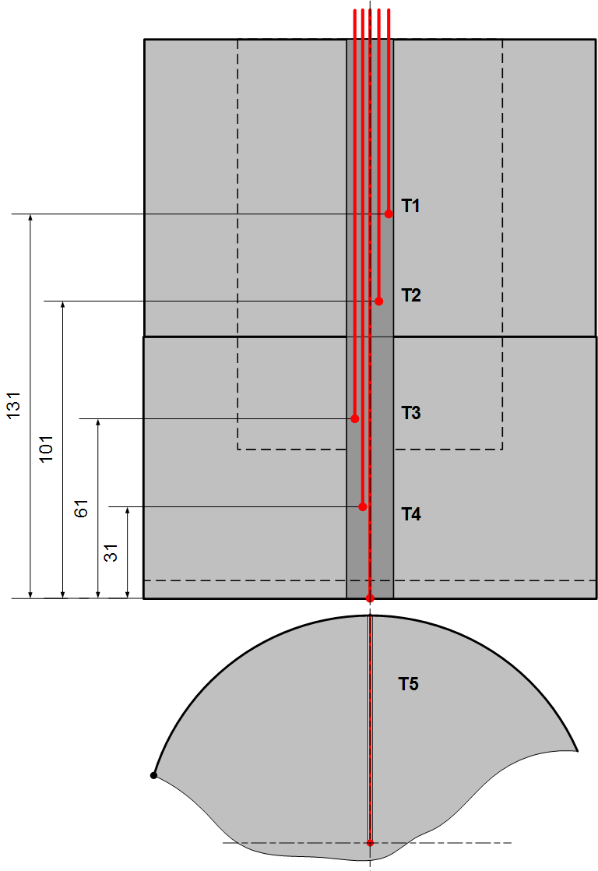
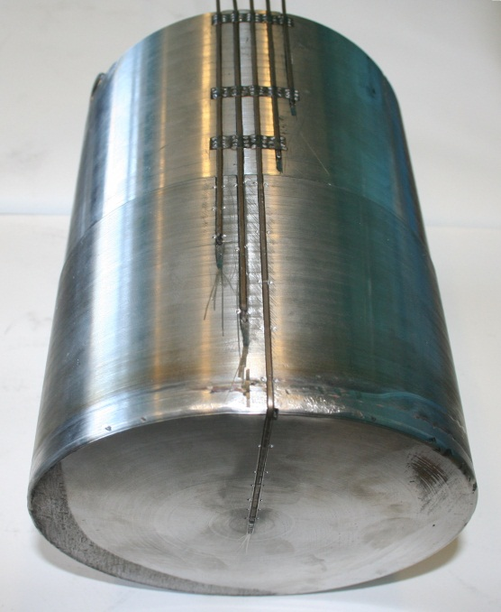
Tests with one plasmatrons (TOP)
Preparation of experimental cell (2)
Corium
Т1- MTD.04, Т2- MTD.14,
Т3- MTD.31, Т4- MTD.103
Inner vessel wall
Т1- L.Т.31, Т2- MDT.44, Т3- MDT.02, Т4- MDT.22, Т5- MDT.11
Thermocouples layout

Slide 9
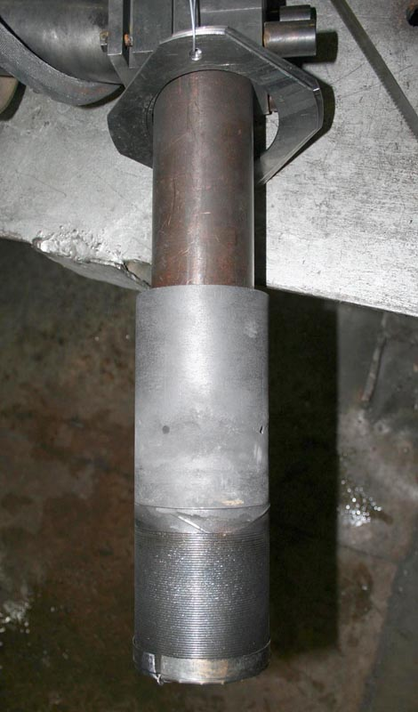
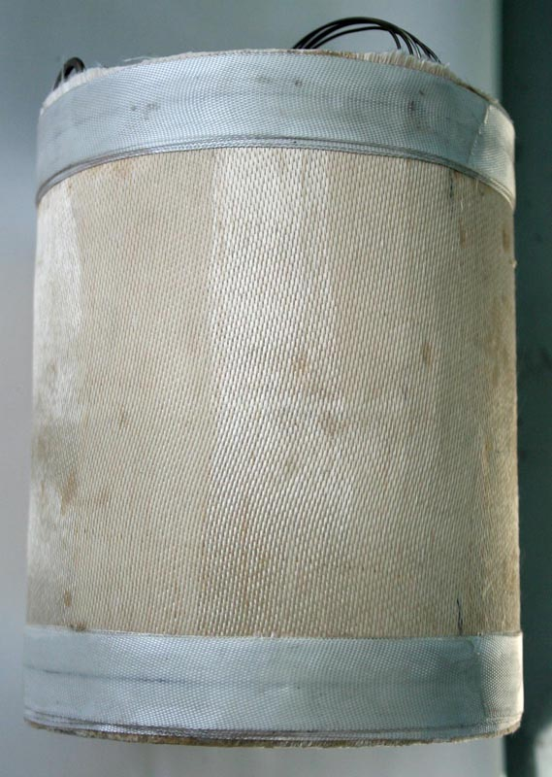
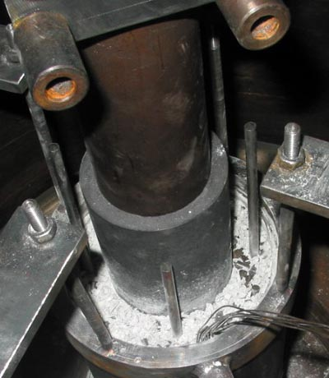
Tests with one plasmatrons (TOP)
Preparation of experimental cell (3)
Assemblied plasmatrons
Thermal insulation on the surface of inner vessel
Test cell in the experimental facility LAVA-B
Test cell assembling

Slide 10
Testing of device for decay heat modeling test TOP-4 (1)
Objectives of test
To found the ways of plasmatrons power increase;
To imitate the condition of the electric arc interruption; and restore the condition of arc re-ignition;
To train the methods of plasmatrons device operation;

Slide 11
Testing of device for decay heat modeling test TOP-4 (2)
Temperature
of inner vessel wall
Temperature of corium
11 start-ups of plasmatrons have been performed during the test caused by test condition variation

Slide 12
Testing of device for decay heat modeling test TOP-4 (3)
Summary on the test regimes
Most stable arc burning has been observed at argon supplied in an inter-electrode space, but power of a plasmatrons drops on 20 … 25 % in comparison with operation using nitrogen.
Most energetic favorable working medium given to an inter-electrode space of a plasmatrons - a nitrogen and argon mixture in the ratio 9:1.
Repeated arc ignition in a plasmatrons happens easier at a high temperature of electrode nozzles.
It is necessary to keep the low pressure in a facility vessel for prevention of the spontaneous interruption of electric arc (less than 0,15 MPa).
The cut-off of additional inductivity in a plasmatrons feed circuit has not affected stability of arc burning, but has allowed to increase the electrical power of plasmatrons by approximately 0,9 kW.
Decrease of aperture diameter for a gas discharge from an inter-electrode space has led to plasmatrons unstable operation as a whole.
Notes:
Plasmatrons switching on the backup power supply does not yield appreciable effect on stability of its operation.

Slide 13
Testing of device for decay heat modeling test TOP-4 (4)
Results of post test research

Slide 14
Testing of device for decay heat modeling test TOP-5 (1)
Test TOP-5 has been prepared considering the TOP-4 results analysis, namely:
Diameter of apertures for a gas discharge from an inter-electrode space has been increased up to 3 mm;
It has been solved to supply a nitrogen/argon mixture in the ratio 9:1 to an inter-electrode space (but really it was pure N₂);
Pressure of gas in a pressure vessel of LAVA-B facility should not exceed 0,15 MPa;
Inductivity was deleted from a plasmatrons feed circuit;
Duration of experiment should be prolonged up to 2,5 hours.

Slide 15
Testing of device for decay heat modeling test TOP-5 (2)
Temperature of inner vessel wall
Temperature of corium
Spontaneous interruption of an electric arch took place. Arch burning has renewed without special ignition due to high temperature of electrode nozzles after pressure decrease in the LAVA-B facility pressure vessel from 0,15 to 0,14 MPa.
The maximum measured temperature of a vessel wall was 960 °С, corium temperature was 2000 °С. Electric power of plasmatrons was about 19 kW.

Slide 16
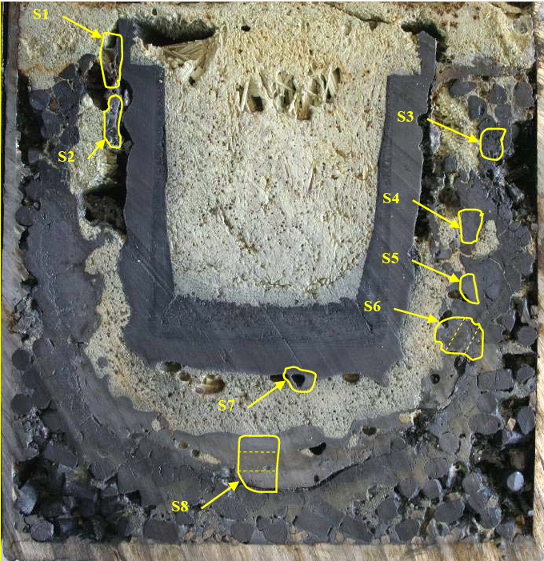
Testing of device for decay heat modeling test TOP-5 (3)
Main phases are solid solutions:
(U, Zr)O₂ with FCC lattice of UO2 and phases of variable composition: Zr(U)(C, O, N)
S1: U_{0.2}Zr_{0.8}O₂
S4: U_{0.75}Zr_{0,25}O₂
S6.1: U(Zr)(C,O,N)
S6.2: UO₂÷U_{0.6}Zr_{0.4}O₂
S6.3: U_{0.6}Zr_{0.4}O₂
Scheme of corium sampling
Notes:
It is visible in figure that around an electrode nozzle of plasmatrons the large gas cavity has been generated. Melting zone of corium is appreciable larger than in previous tests TOP.
It is necessary to label to the negative phenomena erosion presence on an external surface of an electrode and sedimentation of a layer of soot on its internal surface. The most probable reason of that is poor quality of the graphite used for manufacturing of electrode nozzles. These details have been made of one blank for tests TOP-4 and TOP-5. Probably, in these two experiments the similar phenomena have been found in this connection, despite distinction in modes of tests.

Slide 17
Testing of device for decay heat modeling test TOP-6 (1)
R4340 graphite was used for electrode nozzles fabrication
Test duration was 140 minutes
Argon has been supplied in the inter-electrode space due to trouble in nitrogen input system
Temperature of inner vessel wall
Temperature of corium
Notes:
In spite of relatively low plasmatrons power the value of electric current in arc was 340 A, - greatest value in all TOP tests.
Current in the arc is most responsible for erosion of inner electrode nozzle.

Slide 18
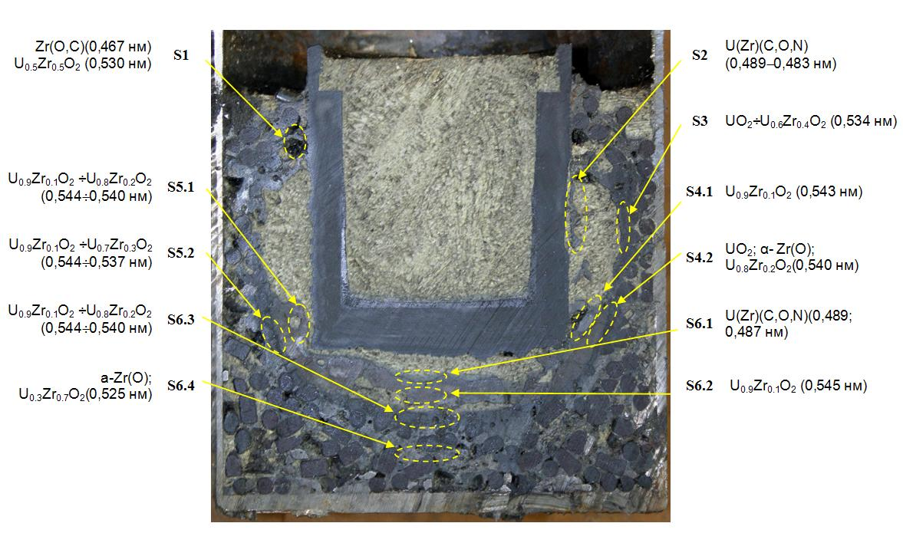
Testing of device for decay heat modeling test TOP-6 (2)
Results of post test research

Slide 19
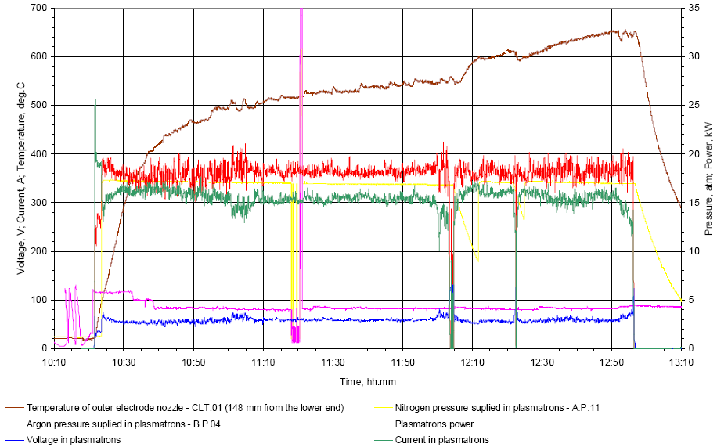
Testing of device for decay heat modeling test TOP-7 (1)
R4340 graphite was used for electrode nozzles fabrication
Test duration was 154 minutes
Mix of argon and nitrogen has been supplied in the inter-electrode space
Temperature of inner vessel wall
Gas pressure in plasmatrons and
temperature of top part of outer electrode

Slide 20
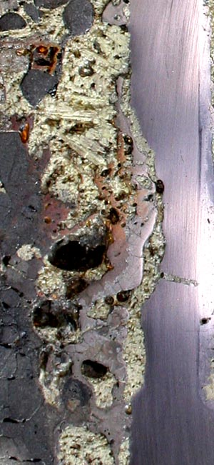
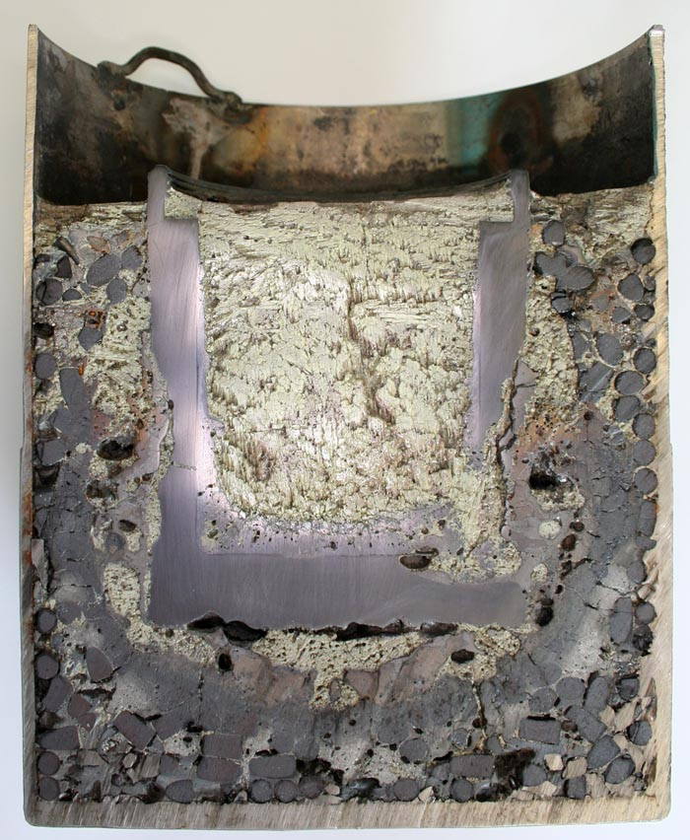
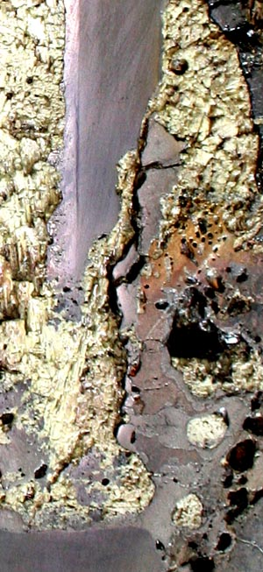
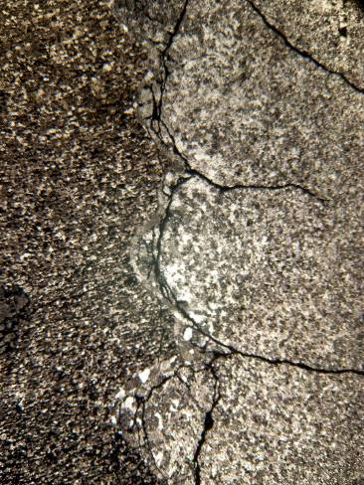
Testing of device for decay heat modeling test TOP-7 (2)
Outer electrode nozzle was cracked during the test due to presence of defects in the graphite blank

Slide 21
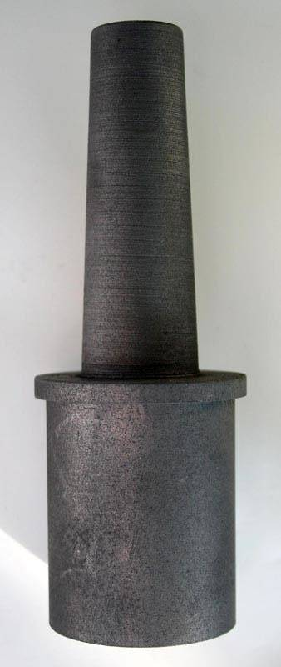
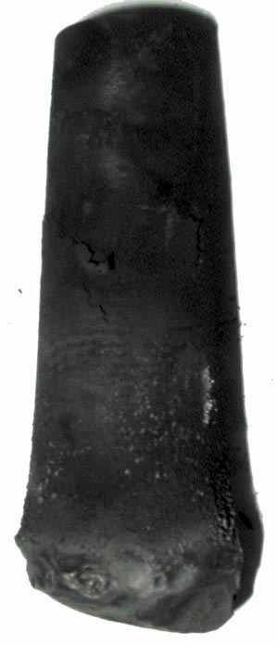
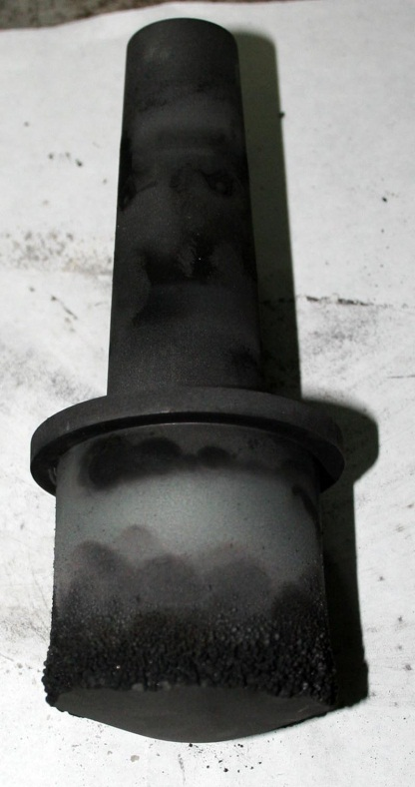
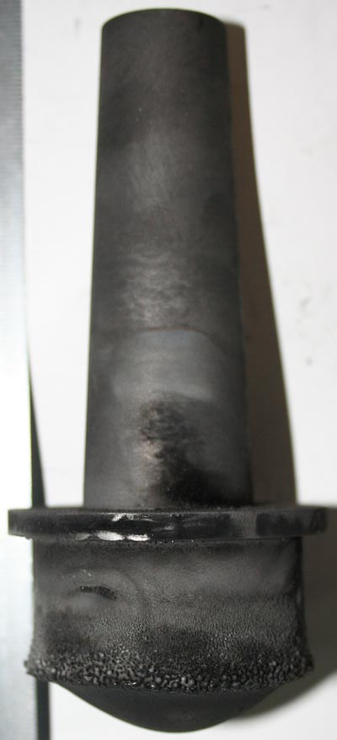
Testing of device for decay heat modeling
Comparative analysis (1)
After test TOP-4
After test TOP-5
After test TOP-6
After test TOP-7
Initial
Erosion rate of inner electrode nozzle limited the plasmatrons life-time

Slide 22
Testing of device for decay heat modeling
Comparative analysis (2)
16
Erosion rate/energy input, g/(GJ⋅min)
ARV-1
14
R4340
12
10
8
6
4
2
0
0,215
0,235
0,255
0,275
0,295
0,315
0,335
Electric current in the arc, kA
Relative erosion rate of inner electrode depending on current in the arc
(Test TOP-2 has been excluded from consideration due to small part of energy supplied to corium)

Slide 23
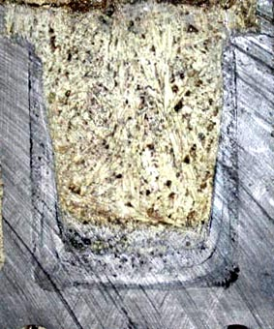
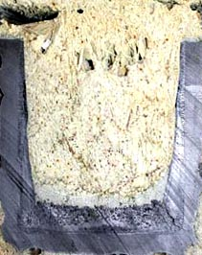
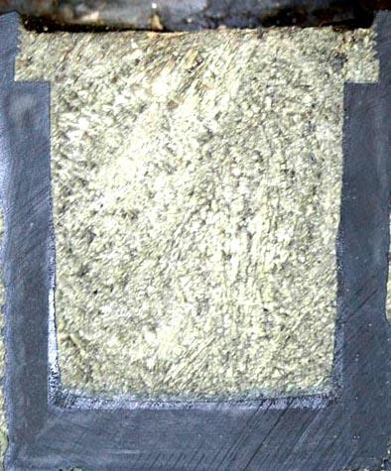
Testing of device for decay heat modeling
Comparative analysis (3)
TOP-4
ARV graphite
Soot deposit
TOP-6
R4340 graphite
TOP-5
ARV graphite
About 70% of arc energy is released in the inner electrode nozzle;
Presence of dust in the inter-electrode space makes arc burning more stable, but create some resistance for heat transfer from inner electrode to outer; one
Soot deposit on the inner surface of outer electrode decreases the effective thermal conductivity of nozzle wall
Notes:
Thus, there occurs pollution of internal surfaces of plasmatrons with graphite dust as the by-effect at plasmatrons operation. And that can lead to arc formation in any part of plasmatrons and to its failure.
Presence of soot in inter-electrode space can reduce the radiant heat flux from inner electrode of plasmatrons to outer electrode

Slide 24
Testing of device for decay heat modeling
Comparative analysis (4)
Parameter | TOP-1 | TOP-2 | TOP-3 | TOP-4 | TOP-5 | TOP-6 | TOP-7
Time of operation, hh:mm | 1 : 00 | 2 : 00 | 2 : 00 | 1 : 53 | 2 : 30 | 2 : 20 | 2 : 34
Gas composition in the inter-electrode space | N₂ | N₂ | N₂ | N₂; 36%N₂+64%Ar | N₂ | 15%N₂+85%Ar | N₂+Ar
Gas pressure in the inter-electrode space, atm | n.d. | n.d. | n.d. | 1,5-1,8 | 1,35 | 2,6 | 1,5
Average pressure of gas in facility vessel, atm. | 1,3 | 1,2 | 1,4 | 1,1-1,0 | 1,2 | 2,4 | 1,2
Average voltage value of electric arc, V | 62 | 60 | 75 | 60,5 | 65 | 52 | 59
Average current value of electric arc, A | 270 | 272 | 220 | 312 | 290,6 | 318 | 307
Average plasmatrons power, kW | 16,8 | 16,3 | 16,5 | 18,3 | 18,7 | 15,9 | 18,1
Power input, MJ | 60,7 | 119,2 | 119,0 | 125,3 | 170,7 | 138,4 | 167,0
Maximum temperature of outer electrode nozzle (148 mm from the bottom end face) | 387 | 594 | 511 | 767 | 828 | 590 | 656
Max. temperature of gas exhausted from the melt, deg.C | 352 | 483 | 381 | 818 | 859 | 683 | 547
Maximum temperature of inner vessel wall, deg.C ‑ 2 mm from the bottom ‑ 30 mm from the bottom ‑ 60 mm from the bottom ‑ 90 mm from the bottom - on the bottom | 673 1107 1149 880 n.d. | 623 693 980 951 287 | 527 764 846 844 235 | 413 856 929 861 345 | 605 777 936 842 625 | 384 869 964 774 229 | 471 755 877 742 203
Maximum temperature of corium, deg.C ‑ 30 mm from the bottom ‑ 55 mm from the bottom ‑ 80 mm from the bottom ‑ 105 mm from the bottom | 1319* 2133* 2230* 1429 | 2002* 1985* 2190 2034 | 1843* 2215 1949 1576 | 1920* 1997* 2176* 2264 | 1921* 2245* 2469* 2113 | 1970* 2402* 2573 1979 | 2418 2090 2682 1975
Rate of graphite erosion, g/min | 0,26 | 0,23 | 0,464 | 1,89 | 1,16 | 0,29 | 0,607
Graphite type | ARV | ARV | ARV | ARV | ARV | R4340 | R4340
Note. *) – Temperature at the moment of thermocouple damage.

Slide 25
Summary on TOP tests results
Main results of TOP tests are:
Application of thermal insulation on the outer surface of RPV model allows the temperature increase up to level of physico-chemical interaction “corium-steel”;
Protective coating on graphite electrodes showed its reliability against molten corium attack;
Design of plasmatrons ensures the operation of device for decay heat modeling during 2 hours and more;
Usage of R4340 graphite for electrode nozzle making could allow to prolong the plasmatrons operation up to 3 hours (to be specified);
Increase of plasmatrons power up to 18…19 kW could allow to increase of corium mass in integral test via preliminary approx. 10 kg loading of corium into test section.

Slide 26
Conclusions
Basic works of project Working Plan have been performed concerning to facility modernization and experiment technique improvement.
Technique of Zr- coating application on electrode nozzles was worked out.
Testing of plasmatrons in “free” condition have been performed.
Seven tests with one plasmatrons in prototypic corium have been conducted. Post-test research are almost finished.
Problem of graphite materials delivery necessary for large scale is not solved yet.

