Slide 1
Experimental studying of LIMITATION technique of corium Components interaction with carbon
Presented by V. Zhdanov
Institute of atomic energy of National nuclear center of Kazakhstan Republic

Slide 2
The following variants of protection against undesirable interaction are possible:
1 Use of coverings from refractory materials on the graphite crucible surface;
2 Use of internal inserts from refractory metals in graphite crucible;
3 Choice of variants of burden loading at which during the heating process protective barriers from carbides of some burden components are formed;
4 Use of combinations of above methods.

Slide 3
Experimental stand VCG-135
Stand parameters:
Maximum electrical power: 60 kW
Generator frequency: 66 kHz
Working chamber volume: 120 l
Maximum burden loading: 150 g
Maximum gas pressure in the chamber: 0,2 MPa
Maximum heating temperature: up to 3500 K
Temperature sensor: bychromatic pyrometer

Slide 4
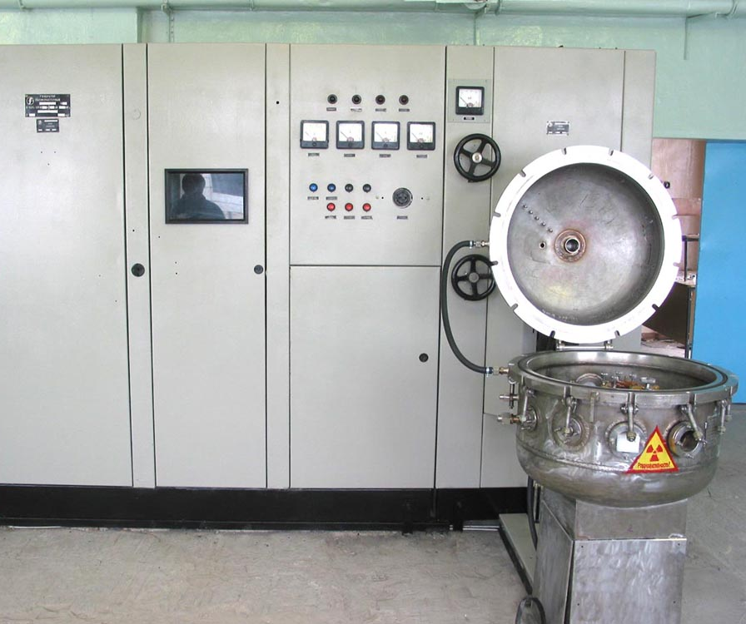
Experimental stand VCG-135 (after modernization)
Modernization objectives
To increase working chamber volume
To increase gas pressure in the working chamber
To increase operation depth of heating power
To apply modern measurement system

Slide 5
Experiments with refractory carbides coating
Carbide coating on the graphite crucibles
Tantalum carbide (TaC)
Niobium carbide (NbC)
Combined coating:
NbC (intermediate layer)+ ТаС (outer layer)

Slide 6
Experimental assembly

Slide 7
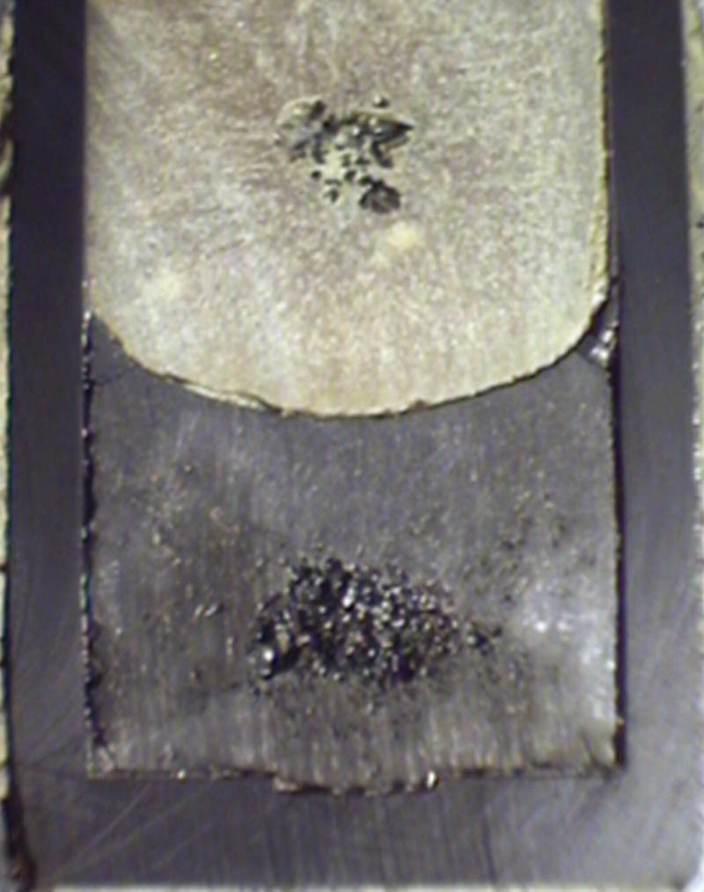
Results of corium obtaining using crucibles with carbide coatings
а) TaC coating б) NbC coating в) NbC+TaC coating

Slide 8
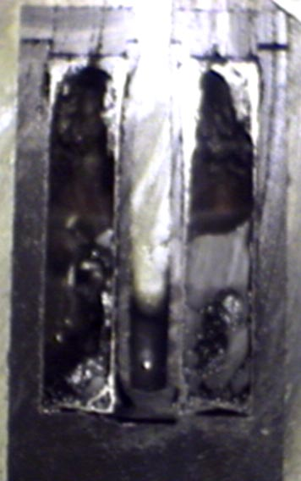
Experiments using metallic tantalum inserts
With preliminary tantalum carbiding | Without preliminary tantalum carbiding

Slide 9
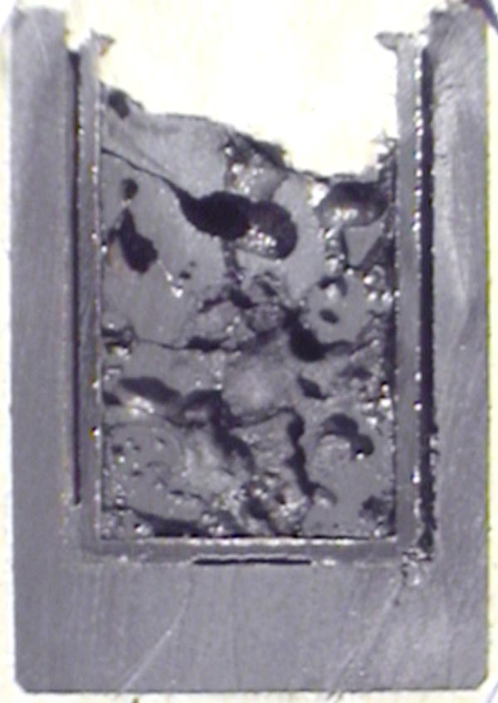
Experiments using tungsten inserts
Variation of intermediate layers
Та – insert ТаС – coating Zr - coating

Slide 10
Result of UO2 melting in the crucible with tungsten protective insert

Slide 11
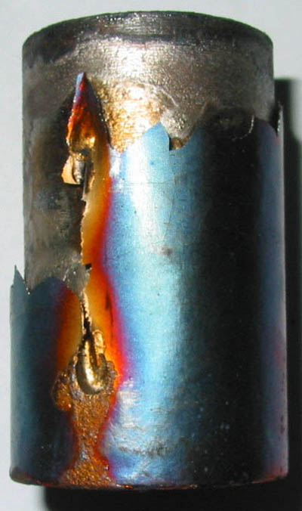
Result of burden melting with subsequent keeping at high temperature
Melt ingot insert surface tantalum sub-layer

Slide 12
Research of zirconium containing on experimental assembly statement
Methods of zirconium loading

Slide 13
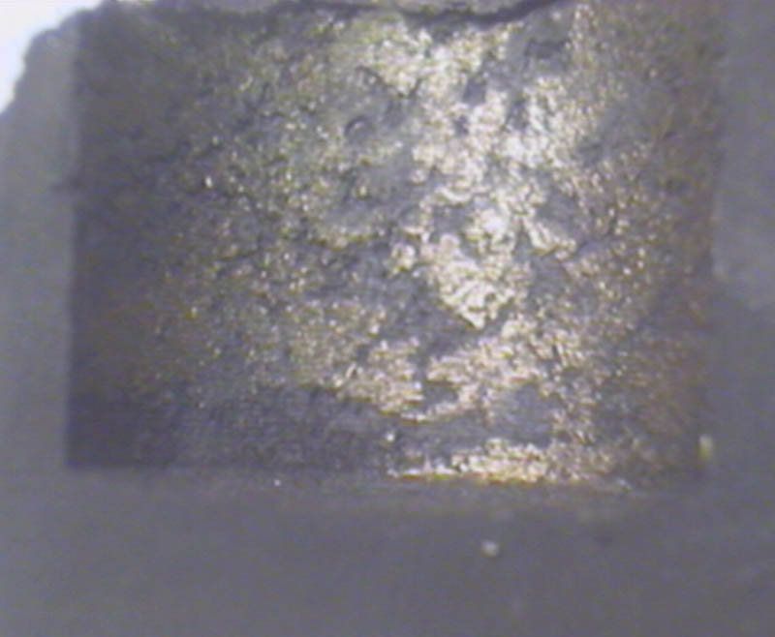
Результат плавления шихты с повышенным содержанием циркония
17 wt% 20 wt% Crucible inner surface

Slide 14
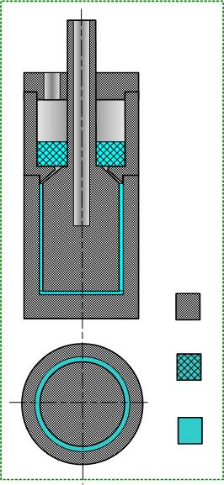
Techniques of inner crucible surface zirconium coating
Experimental assemblies for Zr coating
Zr chips in the clearance Zr plate in clearance with additional feeding

Slide 15
Techniques of inner crucible surface zirconium coating
Scheme of crucible loading for Zr coating Crucible longitudinal section

Slide 16
Experiment on Zr coating reliability estimation
Test parameters
Loading, g
UO2 – 78 g
ZrO2 – 22 g
Maximum temperature 2650 deg. C
Keeping at Tmax – 5 minutes

Slide 17
Summary
Protection effect of reflective carbides coating depends strongly from coating quality
Metallic tantalum inserts show low reliability due to inserts deformation
Tungsten insert applying needs protection of tungsten itself from interaction with carbon. Maximum heating temperature is limited due to tungsten deformation at high temperature
Effect of self-limitation of burden – carbon interaction was found in the case of BWR – type mixture melting (with high metallic zirconium content)
Technique of Zr coating on graphite crucible inner surface was developed.

