Slide 1
O-U-Zr phase diagram : state of the art after the CORPHAD project
M. Barrachin
11th July 2008 St Petersburg, ISTC PRECOS Kick-off Meeting

Slide 2
Outline
CORPHAD objectives
Past data on the miscibility gap in the U-O-Zr phase diagram
NUCLEA actual modelling
Experimental data (CORPHAD)
Possible revision of the U-O-Zr phase diagram modelling
ITU experimental data
Conclusions

Slide 3
CORPHAD objectives related to the U-O-Zr phase diagram investigation
To determine more accurately the shape of the miscibility gap (MG) in the U-O-Zr phase diagram (hypostoichiometric region)
The shape of the miscibility gap as well as the orientation of the tie lines inside this MG have an impact on the composition of the non miscible phases in the bottom of the RPV at high temperature (stratification process).
Few quantitative thermodynamic experimental data related to the MG before the CORPHAD Project :
  at very high temperature : Guéneau et al. (1998), tie-line in the liquid state, measured at 3223 ±100 K
  at lower temperature : apparently contradictory and imprecise data

Slide 4
Past data on the MG in U-O-Zr (1)

Slide 5
Past data on the MG in U-O-Zr (2)

Slide 6
Past data on the MG in U-O-Zr (3)

Slide 7
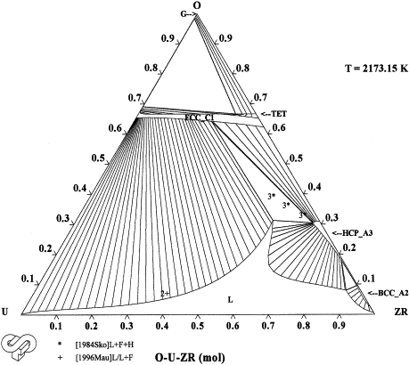
NUCLEA actual modelling: 2173 K (1)
Reproduces the small oxygen solubility in U-Zr alloys measured by Maurizi (1996)
Maurizi’s data consistent with a small oxygen solubility in U (Guéneau 1998, CORPHAD 2006)
Leads to a rather large MG at higher temperature

Slide 8
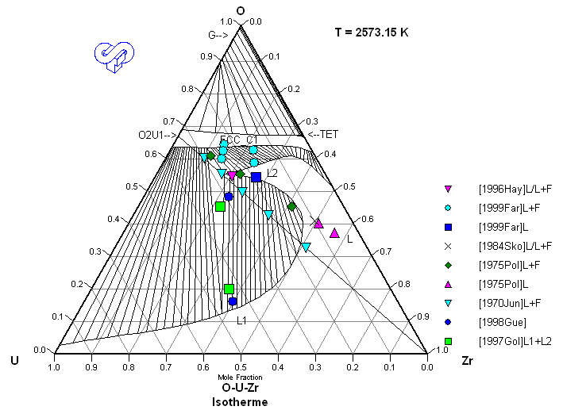
NUCLEA actual modelling : 2573 K (2)
Allows to reconcile the different data apparently contradictory about the existence of a large miscibility gap

Slide 9
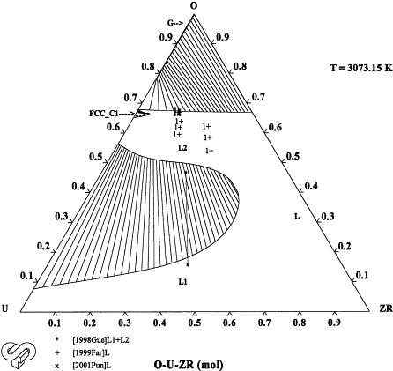
NUCLEA actual modelling 3073 K (3)
Reproduces Guéneau’s data at very high temperature
Large MG

Slide 10
NUCLEA actual modelling (4)
Comparison with experimental liquidus for (U,Zr)O_{2+x}

Slide 11
NUCLEA actual modelling (5)
Main conclusions and main uncertainties (as stated in 2003)
Below 2073 K, good agreement between NUCLEA and the available experimental data
At T > 2073 K and high zirconium content, it seems that the extent of the miscibility gap is limited by the UO₂-Zr_{0.7}O_{0.3} line (to be confirmed in CORPHAD)
UO₂-Zr_{0.7}O_{0.3}

Slide 12
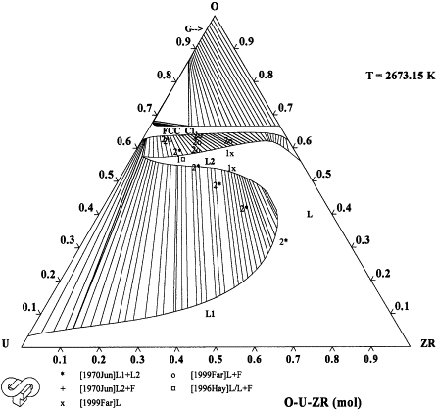
NUCLEA actual modelling (6)
Main conclusions and main uncertainties (as stated in 2003)
The diphasic field L + (U,Zr)O_{2-x} is not precisely determined between 2273 and 2573 K (to be determined in CORPHAD)
Orientation of the tie lines in the diphasic field L1 + L2 at a temperature lower than that of the Guéneau’s test (to be determined in CORPHAD)
L + (U,Zr)O_{2-x}
L1 + L2

Slide 13
CORPHAD experimental data
3 « types »
Liquidus and solidus temperatures in the UO₂-ZrO₂-Zr region in order to determine the limits of the diphasic field L + (U,Zr)O_{2-x}
For compositions for which liquidus and solidus are determined, detection of MG
Experimental data related to the extent of the miscibility gap and measurement of the tie lines

Slide 14



CORPHAD experimental data (2)
Test | U | Zr | O | Tliq (K) | Calculation | Δ
CORD 28-I | 7.7 | 53.7 | 38.6 | 2358 | 2238 | -120
CD4 | 8.0 | 52.0 | 40.0 | 2373 | 2231 | -142
CORD 28-II | 12.9 | 43.9 | 43.2 | 2443 | 2357 | -86
CD3 | 13.0 | 43.0 | 44.0 | 2408 | 2362 | -46
CD5 | 16.0 | 36.0 | 48.0 | 2498 | 2426 | -72
CORD 34 | 21.5 | 34.7 | 43.8 | 2578 | 2470 | -92
ITU | 22.0 | 33.0 | 44.0 | 2550 | 2486 | -64
CORD 37 | 32.5 | 29.2 | 38.3 | 2601 | 2570 | -31
CORD 42 | 40.5 | 27.0 | 32.5 | 2663 | 2595 | -68
CORD 41 | 56.0 | 3.1 | 40.9 | 2788 | 2690 | -98
CORD 29 | 19.8 | 17.2 | 63.0 | 2734 | 2803 | +69
Significant disagreement at low liquidus temperatures (i.e high Zr content) up to 2573 K
Consistent disagreement : calculated liquidus temperatures too low

Slide 15
CORPHAD experimental data (3)
(??) at this temperature, no MG in O-U
CORPHAD tests (42, 37) in agreement with NUCLEA
CORPHAD test (34) in disagreement with NUCLEA

Slide 16
CORPHAD experimental data (4)
Tie lines in the miscibility gap
 |  | U_{0.325}Zr_{0.292} O_{0.383} (2643 K) | U_{0.405}Zr_{0.270}O_{0.325} (2753 K) | U_{0.560}Zr_{0.031}O_{0.409} (2948 K)
L2 (oxide) | U | 25.2 | 27.7 | 43.7
 | Zr | 26.7 | 23.2 | 1.4
 | O | 48.2 | 49.2 | 54.9
L1 (metal) | U | 40.8 | 53.2 | 88.8
 | Zr | 32.2 | 29.3 | 2.7
 | O | 27.2 | 17.6 | 8.5

Slide 17
CORPHAD experimental data (5)
U_{0.325}Zr_{0.292} O_{0.383} (2643 K)
Not compatible with the Guéneau’s data

Slide 18
CORPHAD experimental data (6)
U_{0.405}Zr_{0.270} O_{0.325} (2753 K)

Slide 19
CORPHAD experimental data (7)
U_{0.560}Zr_{0.031} O_{0.409} (2958 K)

Slide 20
CORPHAD experimental data (8)
Main conclusions
Significant disagreement at low liquidus temperatures (i.e high Zr content) up to 2573 K
Experimental data related to the extent of the miscibility gap and measurement of the tie lines indicate that MG does not reach the UO₂-Zr section

Slide 21
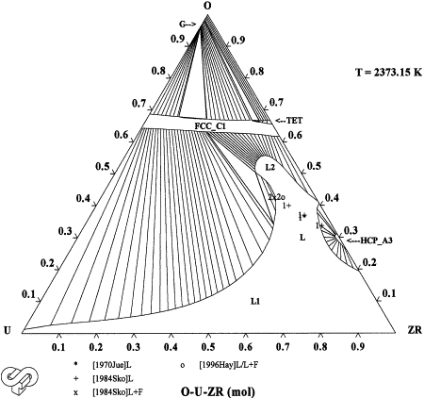
Possible revision of the O-U-Zr phase diagram (1)
2373 K
NUCLEA
Revised

Slide 22
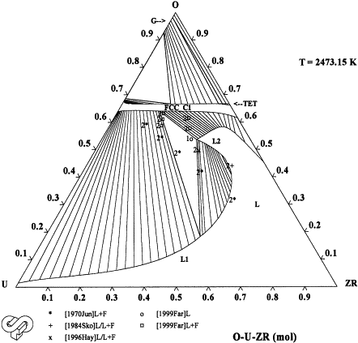
Possible revision of the O-U-Zr phase diagram (2)
2473 K
NUCLEA
Revised

Slide 23
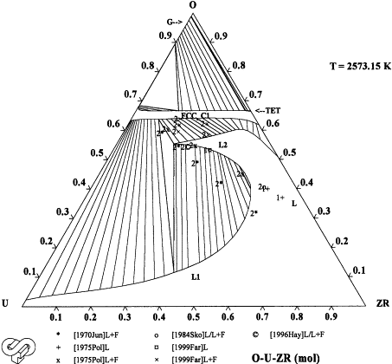
Possible revision of the O-U-Zr phase diagram (3)
2573 K
NUCLEA
Revised
Miscibility gap at 2573 K
At temperature slightly higher than in NUCLEA

Slide 24
Possible revision of the O-U-Zr phase diagram (4)
Comparison with the detections of the MG for the CORPHAD compositions in the U-O-Zr
2573 K (revised)
Global agreement with the CORPHAD observations about presence of MG

Slide 25
ITU experimental data (1)
From M. Sheindlin et al. (2006)

Slide 26
ITU experimental data (2)
CORPHAD liq (no MG)
ITU sol
ITU liq
→ Seems to confirm the presence of MG on the UO₂-Zr section.

Slide 27
Conclusions
At T > 2073 K and high zirconium content, it seems that the extent of the miscibility gap is limited by the UO₂-Zr_{0.7}O_{0.3} line (to be confirmed in CORPHAD)
→ it is confirmed by the CORPHAD results
The diphasic field L + (U,Zr)O_{2-x} was not precisely determined between 2273 and 2573 K (to be determined in CORPHAD)
→ the CORPHAD results confirm that the liquidus line modelling should be revised
Orientation of the tie lines in the diphasic field L1 + L2 at a temperature lower than that of the Guéneau’s test (to be determined in CORPHAD)
    → the CORPHAD results indicate a smaller MG than that determined by Guéneau et al. (disagreement with ITU results)

Slide 28
CORPHAD results
ITU results
NUCLEA
PRECOS matrix ?
Thank you for your attention

