Slide 1

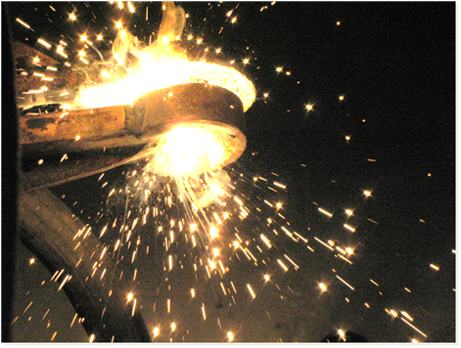
Development and testing of melts levitation installation
A.P. Martynov
St. Petersburg June 2011 года

Slide 2
Advantages and limitations of electromagnetic levitation melting
There is no contact between the melt and crucible material
Combination of methods of heating and lifting
Use of any atmosphere and pressure
Unlimited time of melting
High power density
Unlimited superheating
The overheat is limited only by generator power
No temperature gradient
Small amount of material required
Impossibility to heat materials with high resistivity
Impossibility to cool the levitated material
St. Petersburg June 2011 года

Slide 3
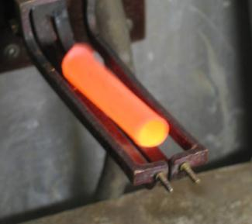
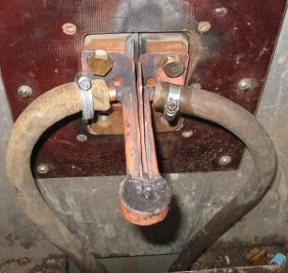
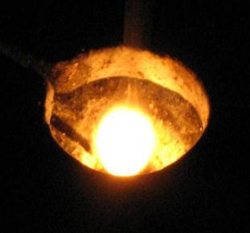
Melts levitation tested versions
Inductor type «boat»
One turn inductor
Two turn inductor
St. Petersburg June 2011 года

Slide 4
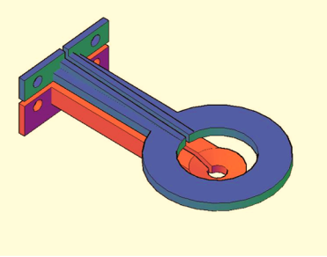
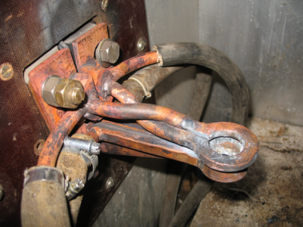
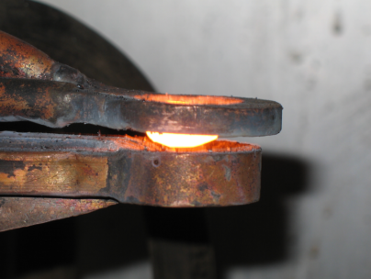
    Development of two coil inductor
The top coil provides horizontal stabilization and induction heating of melting drop
The bottom coil current provides induction heating and support of the melting drop
St. Petersburg June 2011 года

Slide 5
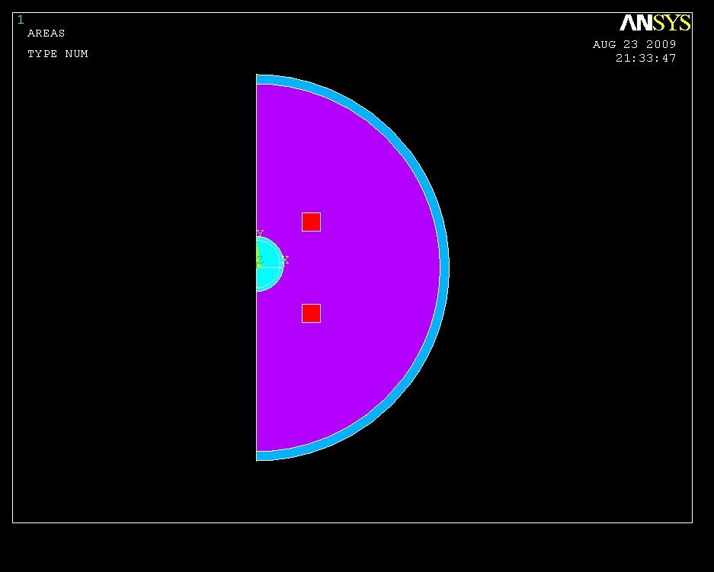
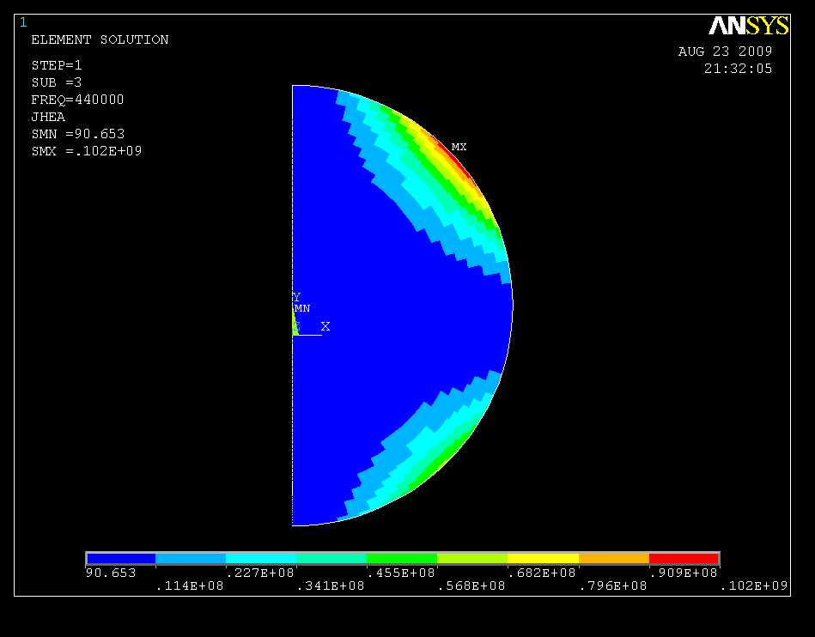
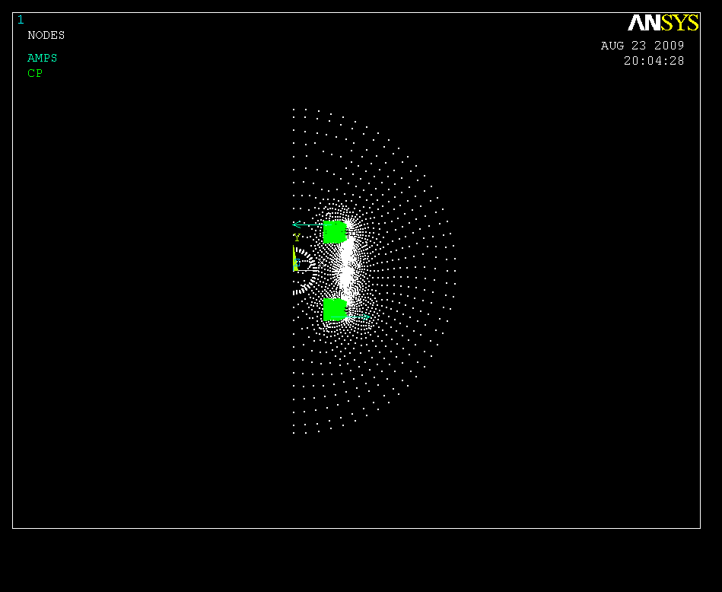
    Mathematics modeling of levitation heating
Mathematics model include the two coil inductor with horizontal stabilization and induction heating of melting drop
St. Petersburg June 2011 года

Slide 6
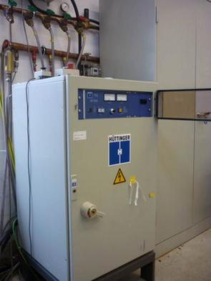
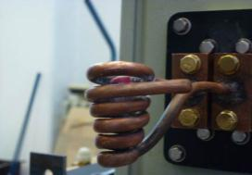
Tests on transistor generators
Models TIG | 20/300 | 4/300
Output power
Nominal power | 20 kW | 4 kW
Power range | 0…100% | 0…100%
Frequency
Frequency range | 30…300 kHz |  | 30…300 kHz
Output voltage
Voltage range | 0…400 V | 0…400 V
Current (120%) | 120 A | 24 A
Not stability of work on dynamic loading
Impossibility of coils currents regulation
High inductor voltage
St. Petersburg June 2011 года

Slide 7
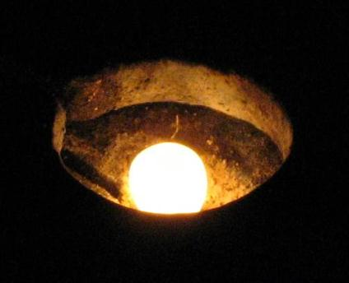

Tests on lamp generator in ETU «LETI»
Installation characteristics:
Output power – 25 kW;
Current frequency – 0,44 MHz
Steel melt with a small overheat
Steel melt with a high overheat
Stable levitation at various currents
Possibility of the high overheat
St. Petersburg June 2011 года

Slide 8
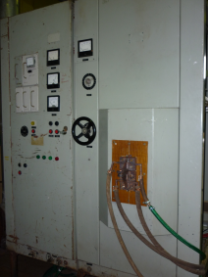
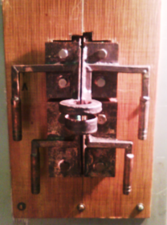
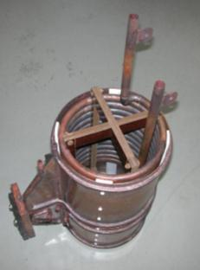
NITI installation development
Development and manufacturing of output transformer with regulation possibility of each inductor coils voltage
Development and manufacturing of two inductors system
Installation characteristics:
Output power – 60 kW;
Current frequency – 0,44 MHz
Transformer with two separate outputs
St. Petersburg June 2011 года

Slide 9
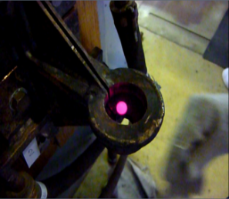
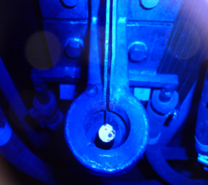
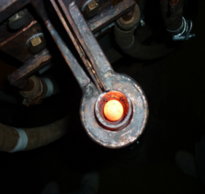
NITI installation tests
Definition of melting process parametres of steel balls with various diameters
Steel -7 mm
Steel - 8 mm
Steel - 14 mm
Stability of work
Regulation possibility of inductors currents
St. Petersburg June 2011 года

Slide 10
The future works
Melting in protective atmosphere
Heavy metals melting – W, U….
Melting of metallic-oxide corium composition
Application of additional gas support
Application of laser or other kind of heating for additional heating of the melt
Definition of melt properties.
St. Petersburg June 2011 года

Slide 11
Conclusion
New installation for melting metal and metallic-oxide alloys levitation is developed
Experimental researches have shown levitation possibility of steel balls with diameter of 7-14 mm
Mathematics model is worked
The future works are defined.
St. Petersburg June 2011 года

