Slide 1
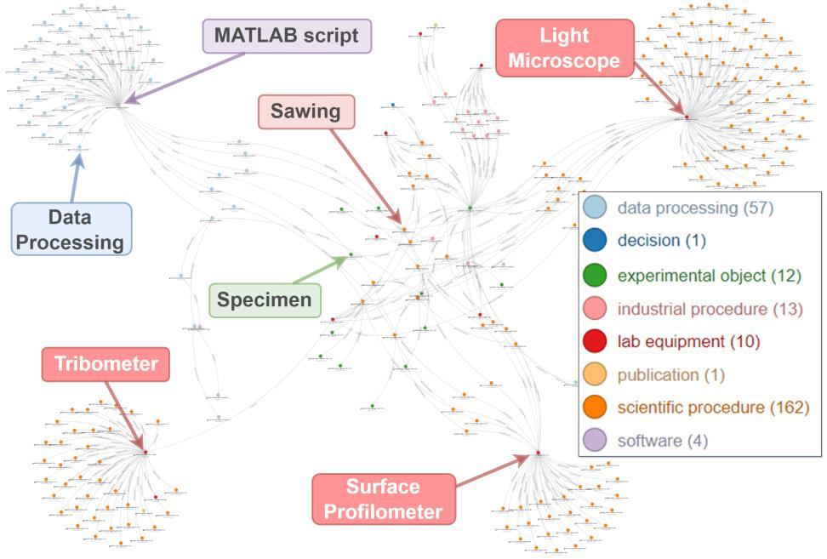
HiWi-Job
Web Developer
Data Science in Materials Science
Background
The digital transformation of experimental labs is an indispensable steppingstone in the broader application of machine-learning-based methods which tackle longstanding scientific challenges. One of the potential routes for converting data into knowledge is through the application of the FAIR (findable, accessible, interoperable, reusable) data principles. Fully applying these principles, however, requires a gentle balance of utilizing solutions like ontologies and virtual research environments, which need to be provided with user-friendly interfaces, thus lowering the barrier to entry for domain experts.
Illustration of the process of harmonizing data objects, through a domain ontology, into a knowledge graph.
Objectives
The specific objective of this project is to engineer and further improve the front- and back-end infrastructure for effective communication between lab scientists, ontologies, and Kadi4Mat. Proof-of-concept work in that respect has already been performed and published (Garabedian et al., 2022, www.nature.com/articles/s41597-022-01429-9). Additionally, software solutions which facilitate the use and generation of FAIR data in practice have already been implemented at s prototypical level. Thus, this project will step on existing expertise, and the outcomes will be immediately applied in an experimental lab.
Requirements
Students who have experience in Python programming, espcially web development. Prior experience using the following tools and frameworks is a plus: Flask, Neo4J, Svelte. The applicant will be part of an active and diverse team of data scientists, experimental scientists, and mechanical engineers.
Possible start: as soon as possible
Contact
Nick Garabedian, Ph.D.
Linked Tribological Data Group Leader
E-Mail: nikolay.garabedian@kit.edu
Ilia Bagov, M.Sc.
Research Associate, Linked Tribological Data
E-Mail: ilia.bagov@kit.edu
06.09.2023

